Slide 1
Educational system in Brasil -First: age of students -Then: study years -After that: stages of education -Finally: mark system and exams
Student of thr 15th group
Mcs, fcs,
The voronezh state university
Velikodnyij vladimir
+7 –903-864-96-63(sber,tinkoff,gazprombank,sbp,qiwi) for donation sto poor student

Slide 2
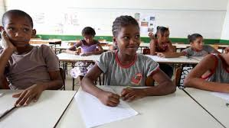
Age
Students age: from 6 to 16
(8 forms of compulsory)

Slide 3
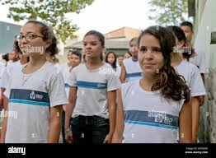
Study year
Study year: from february to december
Study week:6 days, 3 shifts

Slide 4


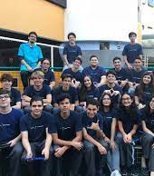
Stages of education
-Primary school
-Secondary school =HIGH SCHOOL
All in all: 11 forms

Slide 5

Mark system & exams
-mark system depends on school
-EXAMS IN THE END OF SECONDARY SCHOOL

Slide 6

Now let's consider the main pointS
-students from 6 to 16 years old
-6 days per week with 3 shifts,
From february to deember
-2 school stages(-11forms)
AND HIGH SCHOOL
-no universal mark system

Slide 7

Thank you for your attention!!!
Presentation made by student of 15 group
Mcs, fcs,
The voronezh state university
Velikodnyij vladimir +7-903-864-96-63
(for donations on sber,tinkoff,gazprom,qiwi)* "SBP" IS AVAILABLE

Slide 8
