Slide 1
rootJS - Design
PSE – Software Engineering Practice
J. Schwabe, T. Beffart, M. Früh, S. Rajgopal, C. Wolff, C. Haas

Slide 2
Recap
Create node.js bindings for ROOT
Make all ROOT functions avaiable through node.js

Slide 3
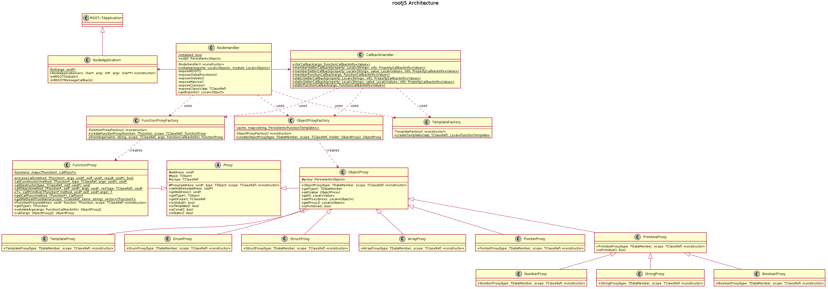
Introduction
Notes:
When using node moldues to extend the basic node api, one uses the require statement, providing the
name of the module. require returns a JavaScript object wich is called exports, containing everyting the
node modules decides to include.
In our case require will run the initilize method which will crawl trough ROOT to find all gloablly
accessible variables, functions and classes.
For all these items a property or function is being added to the exports object. These properties are
bound to a callback function which is equipped with meta data, refereing to the property or function in
ROOT. With this information the callback function is able to call the actual ROOT functionality.
To send the results to node we need to convert the resulting objects or values. In order to convert
the data we will use proxys for the different datatypes that will be returned by a factory.

Slide 4
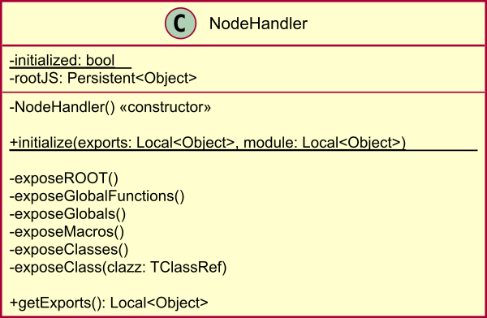
NodeHandler
Entry point for node.js App
Exposes ROOT to node.js
Using V8‘s export functionality
//in node.js
var root = require(rootJS.node)
//in C++
NODE_MODULE(rootJS, initialize)
Notes:
ode handler class acts as the main entry point for a node application that incorporates our bindings. It uses the V8 export functunality to expose ROOT functions to nodejs. In node js you would write this. This would trigger the init sequence to make ROOT functions available in that node object through –in that case- root.dosth(). Lets have a look at this init sequence

Slide 5
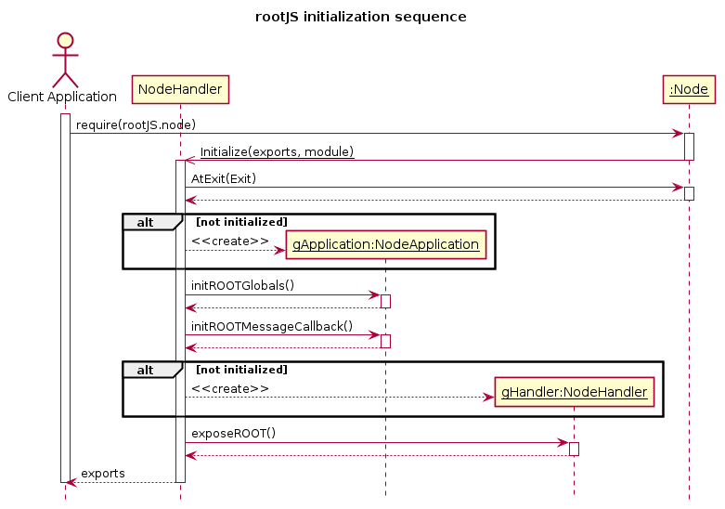
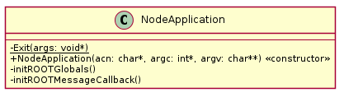
Initialization sequence
Notes:
The client node app requires our node module. V8 then executes the init method we stated in the Macro showed before. Atexit sets an exit hook so we can react to the client being closed.
We then use an instance of the nodeapplication class to set some of ROOT‘s environment variables. Lets have quick look on that class. The node application class inherits from TRootApplication. Its purpose is to handle event processing.
Then a new node handler is created if necessary and its expose root function is called. The root objects are then exported to the node.js object created in the client app.

Slide 6
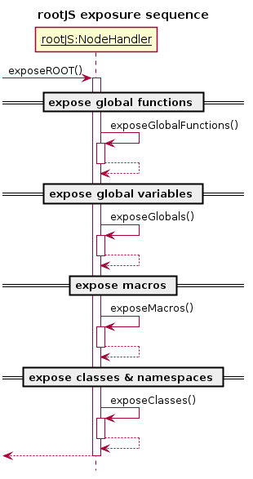
Exposure Sequence
Notes:
The expose root method iterates over the root objects it aims to export and uses our factory methods to create proxies of root objects. For example the creation of a class would lool like this

Slide 7
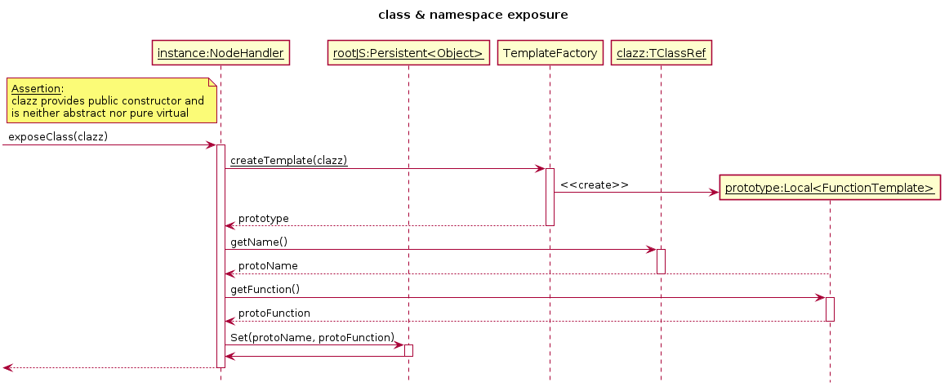
Class Exposure Sequence
Notes:
First a protoype is created by the template factory (how will be discussed later). Then the class name is retrieved from the TClassRef class. Then we set the newly created function in the export object and it is ready to be exposed to node.js

Slide 8
NodeHandler
Entry point for node.js App
Exposes ROOT to node.js
Using V8‘s export functionality
After Initialization sequence
Static variables available
Static methods callable
Constructors ready to initialize classes
Notes:
After init sequence has completed all static variables and methods are available in the node.js object. All constructors are ready to initialize classes by calling them through node.js. The exporting required wrapping root objects in appropriate proxy objects. This is achieved by the proxy factory classes →

Slide 9
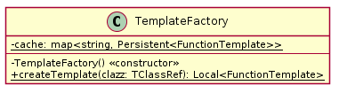
TemplateFactory
Creates template from reflection of a ROOT class
Iterates over the class to
Create proxies of all static members
Create proxies of all methods
Uses the proxy factories to create those
Used to export the constructor and the static methods
Notes:
The template factory class is used in init to create accessable protoypes of the root classes. It uses roots TClassRef reflection class to get the necessary information. Then proxies of all static members and all methods are created using the other two factories.

Slide 10
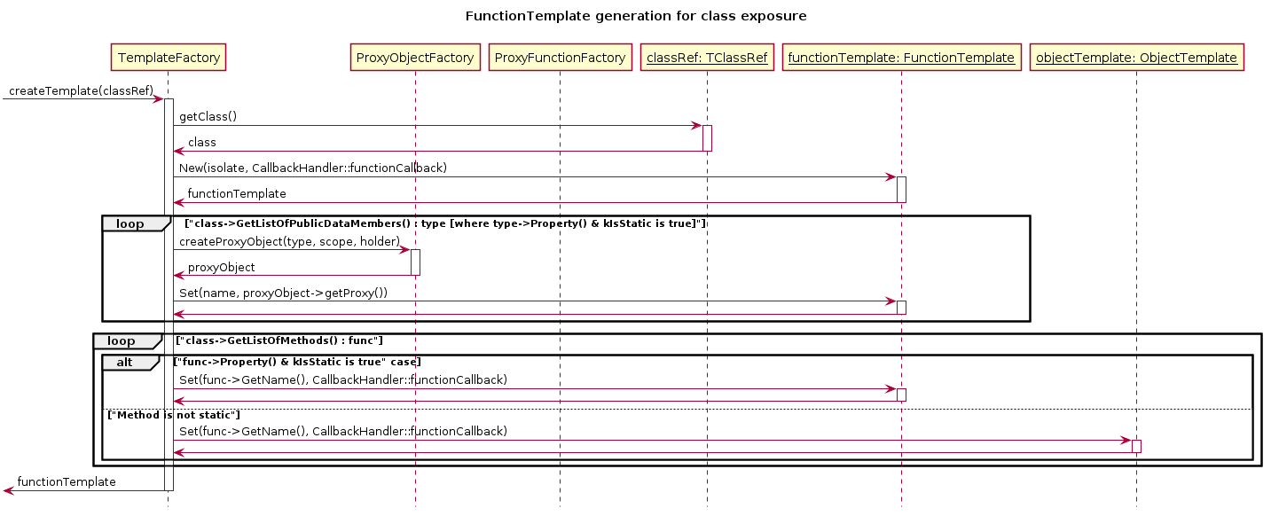
Template creation sequence
Notes:
First the class meta data is retrieved from the reflection. A loop then iterates over all public data members and creates proxies from them by invoking the appropriate factories. Then they are added to the function template. Another loop iterates through the methods of the class and also adds them to the template. The template is then returned to be exported to node.js and the class‘ constructor can now be called through node to instanciate the class.

Slide 11
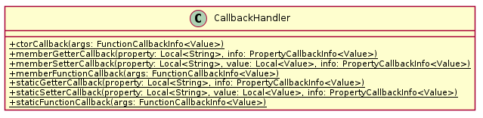

CallbackHandler
The CallbackHandler class gets invoked whenever an encapsulated ROOT function or object is accessed.
Based on the provided callback information ROOT objects may be manipulated and function calls may be delegated properly .
ROOT objects <-> Javascript objects
ROOT functions <-> Javascript functions

Slide 12
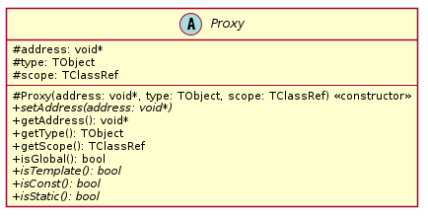
ROOT Proxy
Unified interface to encapsulate both ROOT objects and functions
C++ <-> Javascript
Stored data
Memory address
Data type
Data scope
Notes:
Our encapsulation concept relies on an abstract base class called Proxy.
Proxy class provides an unified interface for realization of both ROOT object and function encapsulation.
Thanks to ROOT‘s build in Reflection API we are able to identify any known ROOT object by just three data members.
At first a Proxy instance stores the address to the actual object in memory
It also stores a Tobject reference providing meta information meaning data type in case of objects
Then it holds a reference to enclosing scope which may be a class namespace or even c sruct

Slide 13
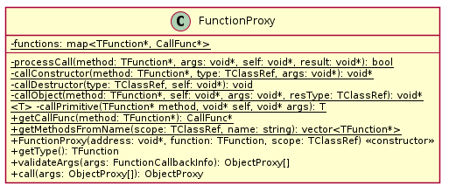
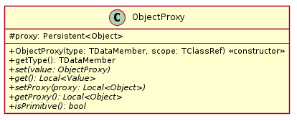
ROOT Proxy
Notes:
There are two specialized classes inheriting from the Proxy base class.
The FunctionProxy encapsulates a ROOT function and will be described in more detail in a minute
As the name suggests the ObjectProxy class encapsualtes ROOT objects and primitives

Slide 14
ObjectProxy
Direct access to C++ object in memory
set(value: ObjectProxy)
get() : Local<Value>
Hold reference to encapsulating Javascript proxy object via internal field
Differentiate between primitive and non-primitive proxy types
Notes:
Representing ROOT objects basically means to be able to read and write data or rather manipulate data
That is exactly what an ObjectPoxy does by providing a getter Method to retrive the encapsulated data by reading it from the stored memory location
The setter method allows us to write object data -> Of course we need to differentiate between primitive and non-primitive types as the next slide will show

Slide 15




Encapsulating primitives
Generically cast types using specialized inner classes
Notes:
Since Javascript basically only knows three primitive types namely the
String type
- Number type
Boolean type
Casting in inner classes ensures that a long long and a double will be equally cast to a number

Slide 16




Encapsulating non-primitives
Notes:
To encapsulate ROOT non-primitives we create specializations of ObjectProxy

Slide 17

ObjectProxyFactory
Generate ProxyObject‘s for exposed JavaScript objects
Recursively process TDataMembers until primitive data is reached (depth first search)
Use proxied holder for offset calculation of base address
Caching mechanisms are used to speed up the generation during run time
Also resolves cyclic dependencies
Notes:
Generating ObjectProxies is done within a Factory class, so if the CallbackHandler mentioned earlier needs to create an object it commands the factory to do so

Slide 18
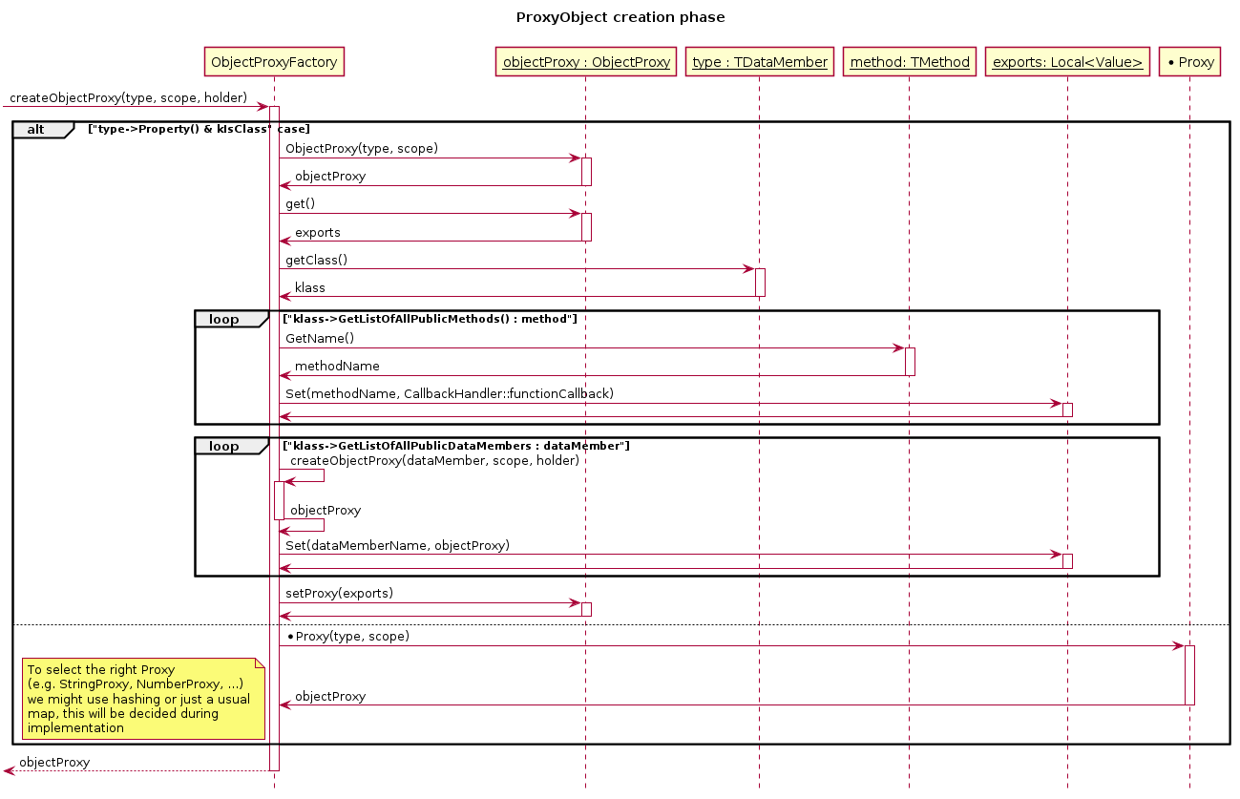

Slide 19
FunctionProxy
Makes ROOT callables accessible
CallFunc* points to the wrapped function in storage
Is provided by Cling
validateArgs checks arguments passed by V8 in the FunctionCallbackInfo and converts them to ObjectProxies
Notes:
The function proxy wraps root callables and enables them to be called from node.js
It holds a CallFunc* pointer provided by cling which points to the method in memory and meta information about the method provided by roots reflections
It also provides functionality to validate parameters and encapsulate them within ObjectProxy instances. Likewise any return values are also encapsulated.
As JavaScript does not support overloading, but C++ does, the FunctionProxy can be used to statically
get all methods with a specified name.The FunctionProxy also maintains a static cache which maps
callables to their memory location.
Once created the proxied function can be called by call or through validate args if the parameters aren’t proxied yet

Slide 20
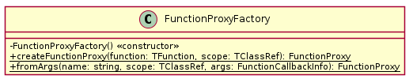
FunctionProxyFactory
Creates function proxies
fromArgs to find the correct method in case of overloading
Notes:
Creates function proxies using the meta information provided by roots reflection Tfunction and tclassref classes. From args can be used to find the correct method by name and argument in case of overloading

Slide 21
Notes:
To conclude, everything boils down to providing an adapter between the node and the c++ version of objects and our proxies do that exact thing by providing references to the underlying root objects and functionality to translate those into java script objects.
Thats it from us, thank you for your attention. Now if you have any question be they of conceptual nature or concerning a single class or method feel free to ask them

Slide 22


Non-Blocking
Implementation Detail

