Slide 1
rootJS – Node.js bindings for ROOT 6
PSE – Software Engineering Practice
J. Schwabe, C. Haas, T. Beffart, M. Früh, S. Rajgopal, C. Wolff

Slide 2
Introduction – the team
Computer Science students 3rd semester
Supervisor: Dr. Szuba
Team members
Christoph Haas
Jonas Schwabe
Theo Beffart
Maximilian Früh
Christoph Wolff
Sachin Rajgopal

Slide 3
Introduction – ROOT
Process and visualize large amounts of scientific data (CERN)
Features a C++ interpreter (CLING) - i.e. used for rapid and efficient prototyping
Persistency mechanism for C++ objects

Slide 4

Introduction - Node.js
Open source runtime environment
Develop server side web applications
Act as a stand alone web server
Google V8 engine to execute JavaScript code
rootJS bindings realized as native Node.js module written in C++

Slide 5
Introduction - rootJS
Node.js bindings for ROOT
Be able to write ROOT code in Node.js programs
Integrate ROOT into Node.js based web applications
System Requirements
Mac OS X and Linux
ROOT 6
Node.js versions
Stable on Node.js 4.4 (LTS)

Slide 6
Introduction – What is PSE?
Praxis der Softwareentwicklung(PSE)
Create software in a team in 5 months using object oriented software engineering
Design: UML
The final software: Maximum of 10k LOC, 250 hours/person
Weekly meetings
Development phases - waterfall model
Analysis
Requirement Elicitation
System Design
Implementation
Testing & Integration
Operation & Maintenance

Slide 7
Analysis
Requirement Elicitation
System Design
Implementation
Testing & Integration
Operation & Maintenance

Slide 8
Phase Recap – Requirement Elicitation
Required criteria
Work on Linux
Accept C++ code for JIT compilation
Dynamically update C++ internals on changes
Asynchronous wrappers for common I/O operations
Limiting criteria
Do not extend existing ROOT functionality
Do not necessarily support future ROOT versions

Slide 9
Phase Recap – Requirement Elicitation
Language bindings
Use ROOT functions
Use ROOT objects
Use JIT compiler
Focus on benefits provided by JavaScript
Asynchronous calls
Use in web applications

Slide 10
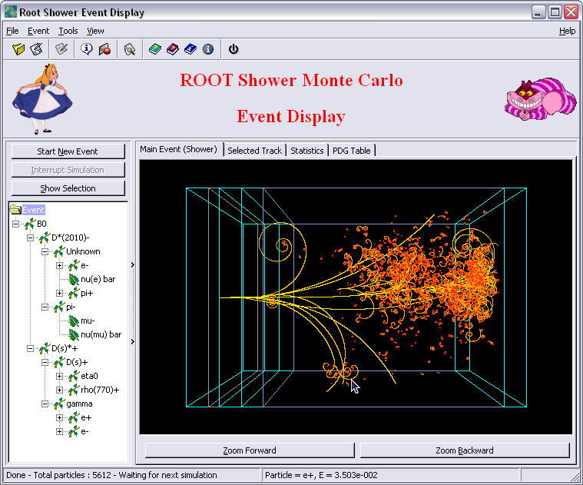
Phase Recap – Requirement Elicitation
Usage scenario: event viewer
Visualizes experimental data
Standalone ROOT application
Needs ROOT and dependencies installed
Needs access to data sources
→ Limited portability

Slide 11



Phase Recap – Requirement Elicitation
Client / Server approach using rootJS
Server runs ROOT and dependencies, rootJS
Client only needs modern web browser
No heavy work load on client
Data sources
ROOT + dependencies,
rootJS
Clients

Slide 12
Analysis
Requirement Elicitation
System Design
Implementation
Testing & Integration
Operation & Maintenance

Slide 13

Phase Recap – Design
Basic architecture requirements:
dynamic object creation and encapsulation
non-blocking function calls via callbacks
fundamental language differences
different type systems (dynamic vs. static)
prototype functions instead of classes
multithreading support?
Task: „write an adapter“
software design pattern
help incompatible interfaces to work together
Environment:
v8 API:
object exposure and callback handling
ROOT RTTI-interface
class, namespace, global and member variable information
JavaScript
↑
rootJS
↓
C++
RTTI
CLING | CINT
Notes:
Basic architecture requirements:
dynamic object creation and encapsulation
non-blocking function calls via callbacks
fundamental language differences
different type systems (dynamic vs. static)
prototype functions instead of classes
multithreading support?
Task: „write an adapter“
software design pattern
help incompatible interfaces to work together
Environment:
v8 API: object exposure and callback handling
ROOT RTTI-interface: class, namespace, global and member variable information

Slide 14

Design – Requirements Realization
init
callback
handling
entry point for client interactions with ROOT
recursively seek & expose classes and namespaces
JavaScript object
Proxy object
C++ object
function calls
object access
object creation
provide async call context before forwarding to RTTI API
direct access to C++ objects in memory via corresponding proxy object
forward constructor calls
encapsulate construced objects for exposure
Notes:
init phase
recursively seek & expose classes and namespaces
callback handling
entry point for client interactions with ROOT
basic requirements -> core features
function calls
provide async call context before forwarding to RTTI API
object access
direct access to C++ objects in memory via corresponding proxy object
object creation
forward constructor calls
encapsulate construced objects for exposure
Proxy encapsulation concept

Slide 15
Design – Architecture Concept
init
callback
handling
function calls
object access
object creation
FunctionProxyFactory
ObjectProxy
ObjectProxyFactory
TemplateFactory
+ fromArgs()
+ readValue()
+ writeValue()
+ createCapsule()
+ createTmplt()
FunctionProxy
ObjectProxy
+ call()
- address
Notes:
Function calls:
FunctionProxyFactory
-> find overloaded / overwritten method from arguments
-> create a Function Proxy -> call it (async)
object access:
Object Proxy
-> read and write directly to memory
object creation:
ObjectProxyFactory
-> encapsualte recursively -> rely on cache
-> return object proxy

Slide 16
Design – Core Architecture
NodeHandler
CallbackHandler
+ exposeROOT()
+ onAccess()
FunctionProxyFactory
ObjectProxyFactory
TemplateFactory
+ fromArgs()
+ createCapsule()
+ createTmplt()
Proxy
- address
FunctionProxy
ObjectProxy
PrimitiveProxy
+ call()
+ read() / write()

Slide 17
Analysis
Requirement Elicitation
System Design
Implementation
Testing & Integration
Operation & Maintenance

Slide 18
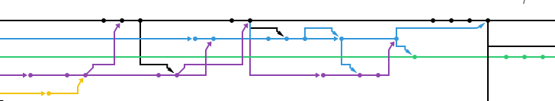
Implementation – Principles
Test driven development
Tests for features
Test for encountered bugs
Tests rely on ROOT behaviour
Stable master branch
Features / bug fixes on separate branches

Slide 19
Implementation – Our Setup
Code & bug tracker hosted by GitHub
https://github.com/rootjs
Continuous integration via Jenkins http://jnugh.de:8080/
Integration tests
Code coverage
Doxygen documentation on http://rootjsdocs.jnugh.de/annotated.html

Slide 20

Implementation – Our Setup
Why GitHub?
Open source
Everyone knows how to use it
Always available

Slide 21

Implementation – Our Setup
Why Jenkins?
Originally wanted TravisCI
Building ROOT times out
On our own system timeouts don‘t matter
Jenkins also gets the job done

Slide 22
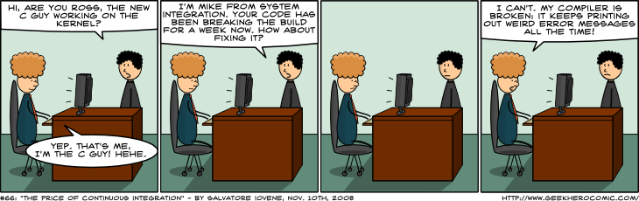
Implementation – Our Workflow
New features are developed in separate branches
Pull requests are only merged if all tests pass
Pull requests tagged “help wanted“ are discussed during weekly meeting
Easch bug in the issue tracker is assigned a new branch containing a test for that bug
Bug is fixed in that branch
When all tests pass it can be merged

Slide 23
Implementation – Testing
~4000 lines of code with 77% line coverage
Missing lines are error handling or seldom used argument types (eg. ushort)
89 tests used in continous integration at the end of implementation

Slide 24
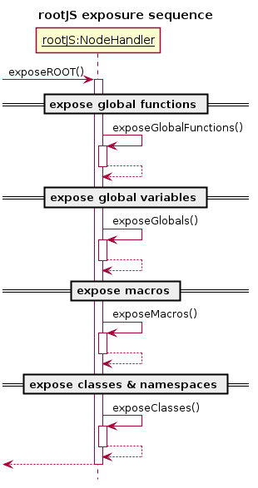
Implementation – Talking to Node: NodeHandler
V8 provides an exports
Expose everything using Set on that object
Use ROOT‘s GetListofGLobals, gClassTable etc.
Iterate those lists and create Templates/Proxies
Set them as properties in the exports object
How do we make sure ROOT‘s namepaces are preserved?
Each namespace gets a template which is Set to the export object
Classes are Set in their respective namespace‘s object
export
ROOT
Math
exposeNamespaces()
Fit
Math

Slide 25
Implementation – Talking to Node: Callbacks
Each exposed function is associated with a static method in the CallbackHandler
Functions “know“ whether they are static, a constructor...
Can handle them accordingly

Slide 26
Implementation – Factories
Factories create wrapper proxies for ROOT objects, primitive data and functions
Invoked whenever a constructor is called
Invoked whenever a function is called for the first time
Template factory creates function templates for classes and namespaces
Iterates the class/namespace‘s ListOfPublicDataMembers etc.
Creates proxies for those and Sets them as properties in the v8 template it is creating

Slide 27
Implementation – Proxies
Correct proxy to be used is selected using cling
Read/Writes happen in ROOT memory space
Everything is in sync all the time
Memory addresses come from our MetaInfo implementation
What about pointers?
Or pointer pointers?
Or pointer pointer pointers?
→ Normalize memory address by referencing/derefencing until it is a void**
...

Slide 28
Implementation – FunctionProxy
Use cling to get function pointers based on call signatures
gInterpreter->CallFunc_SetFuncProto
Parameters are passed using a buffer
Scalar values are copied into the buffer (converted from v8 objects)
Objects are always passed by address
Creation of buffer and call of function are separated to support async calling

Slide 29
Implementation – FunctionProxy
What was hard:
Very little documentation for cling API
Had to guess how to use some of the functionality
PyROOT was a helpful reference
What we didn‘t think of:
Overloaded methods that support different types of floating point numbers
If number fits into type, overloaded version is selected
Problem because for example
First variant uses float
We have a small number
Number has many decimal places

Slide 30
Implementation – Asynchronous Calls
During design we were uncertain how async calling would work
Planned to use ROOT‘s TThread
V8 does not work in a multithreaded environment
Interactions with node need to be done from main thread

Slide 31

Implementation – Asynchronous Calls → libuv
Libuv‘s message passing between async workers and v8
We use libuv because it integrates great with node
No need to wait for threads actively
Handled by signals → non-blocking & no waste of CPU time

Slide 32
Implementation – ObjectProxyBuilder
V8 does not work with libuv workers
ObjectProxy makes heavy use of v8
When running a constructor ObjectProxy uses a v8 FunctionTemplate
Can not create ObjectProxies in worker threads
→ ObjectProxyBuilder contains meta data to be used in the main thread

Slide 33
Implementation – Differences between Proxies
Interfaces of ROOT classes we have to wrap in a proxy are incosistent
Want to have unified interface for all Proxies
Another layer of indirection saves the day:
MetaInfo encapsulates differences
Each Proxy instance has a MetaInfo object associated that contains the needed implementations
MetaInfo
PointerInfo
MemberInfo
GlobalInfo
EnumInfo
FunctionInfo

Slide 34
Implementation – Want more Libraries?
gSystem can load additional shared libraries
We have to updae our bindings whenever new classes are added
Provide an additional function loadlibrary() and refreshExports()
Loads a library and updates or just updates repsectively
Simply reexecutes exposure process
Traverses gClassTable etc and adds any new classes, globals ..
Fast because v8 properties are stored in a hashtable
Allows for library loading during runtime and even creation of new global variables

Slide 35
LIVE DEMONSTRATION

Slide 36
Project Review
Features
Fulfills all required criteria
Runs on Linux and Mac OS X
Supports asynchronous execution for all functions
Supports C++ operators
Supports loading ROOT libraries
Open issues
Use function pointer as return value
Encapsulation of anonymous types

Slide 37
Project Review
Team performance
It went really well
Especially considering it was the first collaborated software project for most of us
Especially considering most of us didn't know any or very little C++ or JavaScript
What could be improved?
Time management
Often difficult because of university/work commitments
Task management
Difficult at first to coordinate who does what
Got better towards the end with Github issues

Slide 38
Project Review
What we learned
Git is awesome!
LaTeX has a steep learning curve
Testing is effective!
A lot about the Google v8 engine
Old projects may have a somewhat chaotic code base

Slide 39
Questions?
Find rootJS on github: https://github.com/rootjs
?

Slide 40
Sources
Danilo Piparo and Olivier Couet. ROOT Tutorial for Summer Students
https://indico.cern.ch/event/395198/attachments/791523/1084984/ROOT_Summer_Student_Tutorial_2015.pdf
CERN. ROOT application domains
https://root.cern.ch/application-domains
Wiki. Node.js logo
https://upload.wikimedia.org/wikipedia/commons/d/d9/Node.js_logo.svg
exortech. v8 logo
https://github.com/exortech/presentations/blob/master/promise_of_node/img/v8.png
CERN. ROOT Shower Event Display
https://root.cern.ch/rootshower00png
http://uxrepo.com/icon/database-by-linecons
http://www.iconarchive.com/show/outline-icons-by-iconsmind/Server-icon.html
http://jestingstock.com/image-computer-icon.html
Axel Naumann. ROOT logo
http://axel.web.cern.ch/axel/images/portfolio/modals/logo_full-plus-text-hor.png

Slide 41
Sources
Octodex Github. logo
https://octodex.github.com/images/octobiwan.jpg
Jenkins-CI. jenkins logo
https://wiki.jenkins-ci.org/display/JENKINS/Logo
geekherocomic. The Price Of Continuous Integration
http://www.geekherocomic.com/2008/11/10/the-price-of-continuous-integration/
libuv. libuv logo
http://docs.libuv.org/en/v1.x/_static/logo.png

