Slide 1
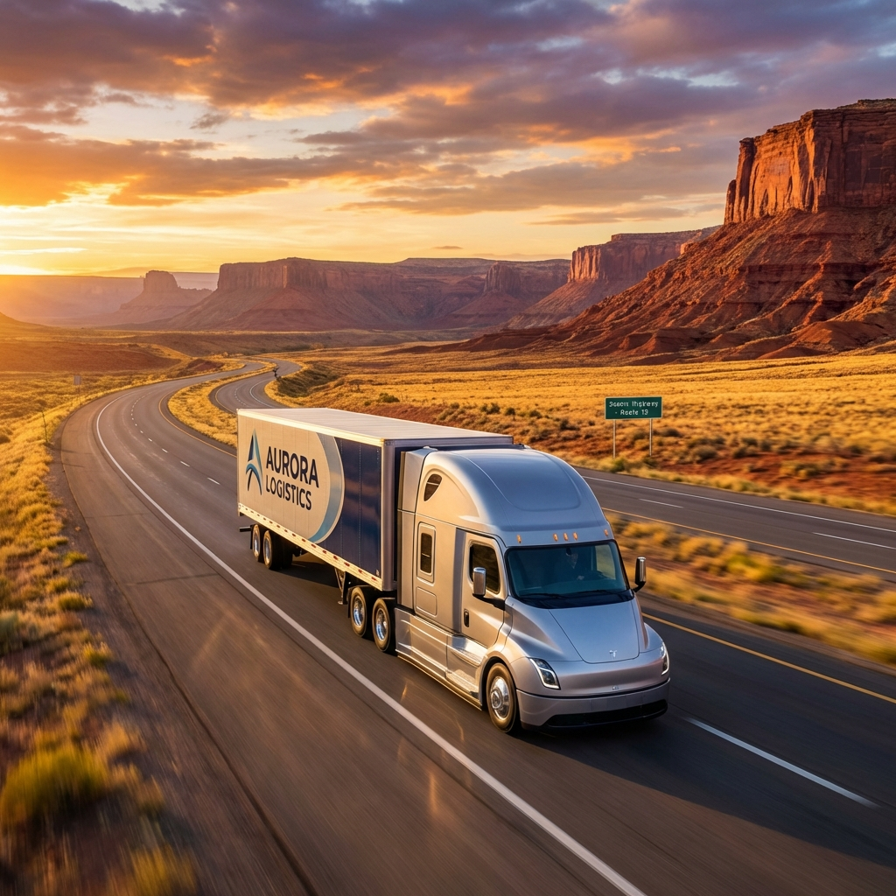
PARTNERSHIP OPPORTUNITY
Partnership Opportunity:
Revolutionizing Trucking Compliance
Unlocking High-Intent Markets with QuickTruckTax.com
Presented by: [Your Name] | Founder, Vendax Systems LLC

Slide 2
The Opportunity – Market Demand
3.5 Million+ truck drivers in the US.
The Legal Mandate: Every heavy vehicle (55,000+ lbs) must file IRS Form 2290 annually.
The Momentum: 170+ high-intent US visitors per month (Organic).
Engagement: Users spend 20+ mins on our site.
Conversion: AI-driven tools (Calculators, Calendars) are ready for launch.

Slide 3
Business Model – Scaling Through Automation
The Product: A seamless, agentic e-filing platform that turns complex tax laws into simple, 5-minute workflows.
Revenue Streams: Filing Fees ($45 flat fee) + Compliance Retainers (Monthly recurring).
The Edge: Zero advertising spend. Growth driven by SEO and AI referrals (ChatGPT/Copilot).

Slide 4
Your Role – The Responsible Official (RO)
The Core Focus: Your primary responsibility is to serve as the US-resident "Responsible Official" to secure the EFIN license for the firm.
No Expertise Required: You do not need to be a compliance expert. Your role is primarily administrative and oversight-based.
In-House Support: We have an in-house PTIN holder who manages all technical compliance challenges and trucking-specific tax issues.

Slide 5
Risk Management – Your Protection First
Risk: Financial Liability?
Reality: No. You are not liable for individual trucker taxes. Operational integrity is managed by our PTIN expert.
Risk: Compliance Errors?
Reality: Our in-house PTIN holder anchors the technical filing. You act as the "Gatekeeper" with power to pause operations.
Risk: Software Errors?
Reality: Signed Indemnification Agreement. Vendax LLC assumes all technical and software liability.

Slide 6
Effort vs. Reward – A Passive Partnership
Your Time Investment:
Setup (2 hours) + Ongoing (1 hour/month log review).
The Reward:
30% of every filing fee revenue share.
Potential:
At 500 filings/season = $6,750+ for roughly 10 hours of work per year.

Slide 7
Step-by-Step – The Path to Launch
1. Identity Verification: Create account on IRS e-Services (via ID.me).
2. Application Link: I list Vendax LLC; you accept the invite as the RO.
3. Suitability: IRS conducts a background check (~45 days).
4. EFIN Issuance: IRS grants the license to the firm.
5. Launch: We flip the switch on QuickTruckTax.com and start generating revenue.

Slide 8
Conclusion – Shared Success
"Your Compliance + Our Technology = Market Dominance."
Let's build the future of trucking compliance together.
Contact Info: [Your Email/WhatsApp]

