Slide 1
Big Data For Warranty Assessment
By
N S Pramod Krishna

Slide 2
What is Big Data?
Extremely large data sets that may be analyzed computationally to reveal patterns, trends, and associations, especially relating to human behavior and interactions.

Slide 3
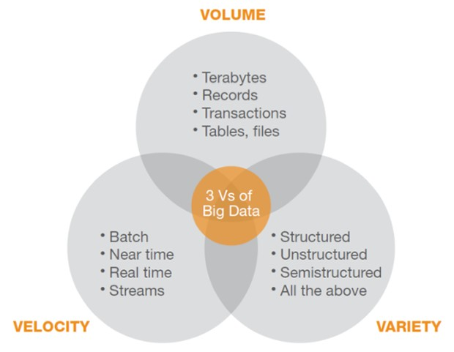
Three V’s of Big Data

Slide 4
Traditional Algorithms
Main Memory
CPU
Includes:
Program
Input Data
Scratch Data
Output Data

Slide 5
Modern Algorithms
Input Data is too large to fit in the main memory
Distributed across many servers in a large data centre.
Processed in one (or a few) processes.

Slide 6
Why do we need the “Data driven” approach?
Primordially, it is essential for one to find hidden correlations among our data and to derive some causation, if any.
Expectation of Output is not as strict.
Sufficient if “most of the time”* the output is “good enough”**
* Probability theory
** Approximation

Slide 7
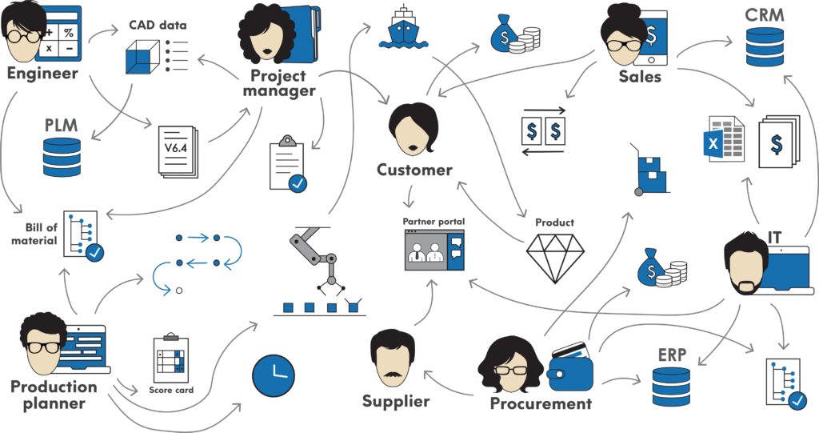
Data in Manufacturing

Slide 8
What exactly is Warranty Management?
Warranty Management is not just solely a component of field service but also is a standalone or integrated activity for product and services organizations alike.
Be it manufacturers, dealers, or third-party users, a robust warranty management system is necessary for critical aspects of the warranty management process, which entails monitoring of policies, flat rates, fault codes, rules management, registration and claims processing

Slide 9
Functionalities in warranty management
• Call Handling, Scheduling and Dispatch On-Demand
• Service Call / Work Order Management
• Mobile Workforce Management (MWM)
• Customer Relationship Management (CRM)
• Service Performance Analytics and Reporting
• Customer Billing and Invoicing
• Parts / Inventory Management
• Call Tracking and Performance Management
• Time and Attendance Management
• Solution Implementation / Installation

Slide 10
Product
Final Product
Sub-Assembly
Sub-Assembly
Sub-Assembly
Sub-Assembly
Sub-Assembly

Slide 11
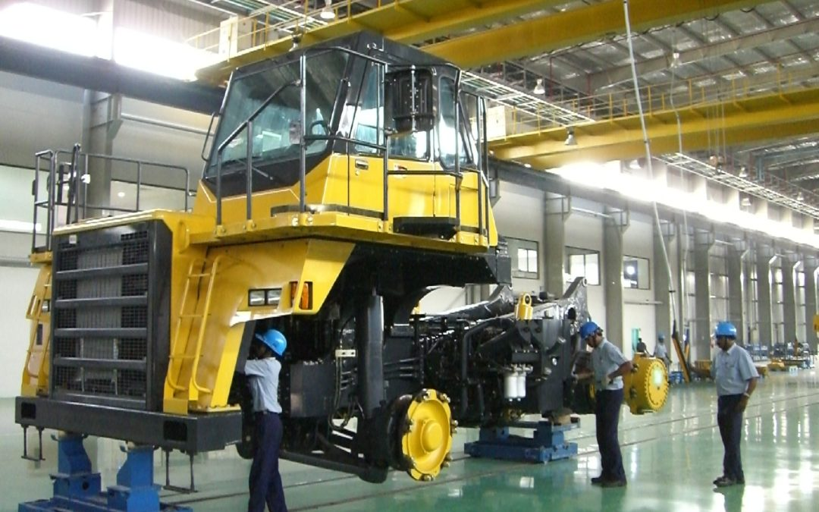
Typical Assembly Line

Slide 12
Warranty Issues
The warranty business has been centered around one value proposition: What are the odds of a product needing a repair, and what is the average cost likely to be?
How can we estimate the break-even price of an extended warranty for both the consumer and the provider?
If a repair is eventually needed, who bears the charges for the scenario?
Note: News of poor service reaches more than twice as many people as praise for a good experience.

Slide 13
The Data way
Synthesize field product performance:
By synthesizing field product performance, service and customer data from multiple sources, companies will be able to detect potential problems earlier, optimize spare-parts planning and improve forecasting accuracy.
When flaws are caught early enough, companies can make faster incremental changes to their product pipelines. Field product performance in the moment expedites information transmission through a big-data feedback loop.
Over time, this process will become faster and more efficient.

Slide 14
The Data way contd…
Optimize price and duration
There is a tipping point where warranties stop being cost effective, and where expenses outweigh sales revenue. Determining an ideal time limit and coverage scope can feel like a game of darts in the dark. Over time, though, companies improve their precision.
Big data improves the prediction process, by evaluating multiple variables such as optimal price and warranty length, analysts can estimate the overall maximum profit for a particular product. From there, organizations can build models to optimize warranty price points and durations.

Slide 15
The Data way contd…
Understanding the value of a consumer:
The most important metrics for any manufacturer is a quantitative index of the value of any consumer, which is essentially a collective outcome of all brand loyalty, marketing and buyer satisfaction initiatives. And to gauge this value, one has to concentrate on each customer individually. This is where Big Data comes in.
Companies can use big data to connect the dots between warranties, consumer growth and retention. Warranty providers can position their fragmented, transitional data points into a comprehensive consumer relationship story. This data offers more than just a product-centric view.

Slide 16
Conclusion
Big data's applications in consumer products warranties are limitless. Organizations can start by identifying historical pain points to highlight suspected areas of failure. The next step, through big data analytics, is to speed up the analysis process through new machine learning models and tools.

Slide 17
References
Image reference: Kobelco Crane
https://cranemarket.com/blog/japan-excavator-manufacturers-ramping-up-indian-output/
Warrantyweek Newsletter
https://www.warrantyweek.com/archive/ww20150212.html
IBM Big Data Hub
https://www.ibmbigdatahub.com/blog/consumer-product-warranties-3-ways-big-data-can-optimize-value
Algorithms for Big Data, Prof John Augustine, IITM,NPTEL
https://nptel.ac.in/courses/106/106/106106142/

Slide 18
THANK YOU

