Slide 1
Information Visualization Final project MLB visualization
徐瑄甫、陳俊瑋、曾筱筑

Slide 2
outline
Introduction
Heat map showing the locations of all hit ball
radar chart
game viewer

Slide 3
Introduction
Focus on specific player
Mike Trout .LAA
Albert Pujols .LAA
Kris Bryant .CHC
Anthony Rizzo .CHC
Mookie Betts .BOS
David Ortiz .BOS
Time : 2016/4 - 2016/10
Present information about the player or his team

Slide 4
Heat map showing the locations of all hit ball
Reference paper
Baseball4D: A Tool for Baseball Game Reconstruction & Visualization
Authors : Carlos Dietrich, David Koop, Huy T. Vo, and Claudio T. Silva, IEEE Fellow
Visual Analytics Science and Technology (VAST), 2014 IEEE

Slide 5
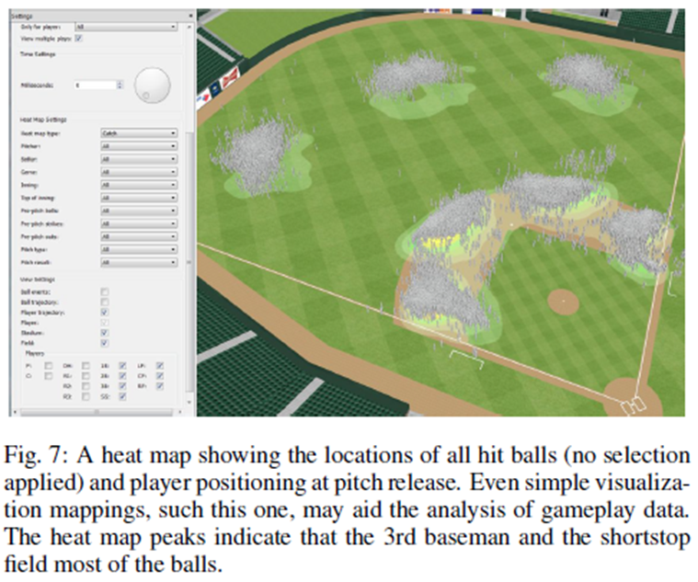
Heat map showing the locations of all hit ball
GOAL
Heat map
Showing the locations of all hit ball
Specific Player Switchable
Reference Graph

Slide 6
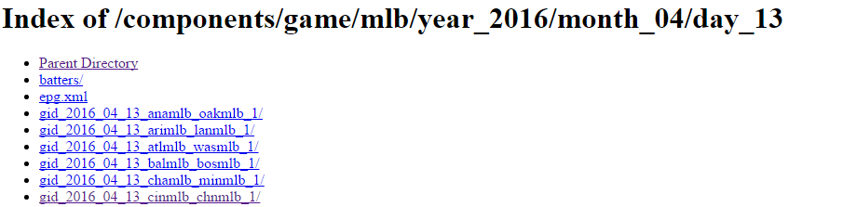
Heat map showing the locations of all hit ball
Data collection
Parser the website : http://gd2.mlb.com/components/game/mlb/
Get all specific team gameplay data

Slide 7
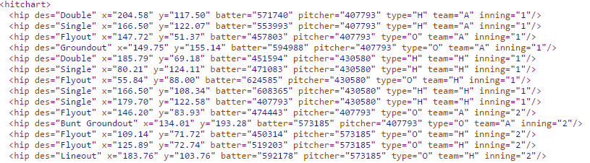
Heat map showing the locations of all hit ball
Data collection
Get all specific player hit data
des x y ( condition : type=“H” )

Slide 8
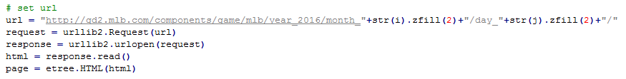
Heat map showing the locations of all hit ball
Data collection
Using Python
import urllib2
from lxml import etree
取得html全部內文 (page)
月份 ( 例 : 05 )
日期 ( 例 : 04 )

Slide 9
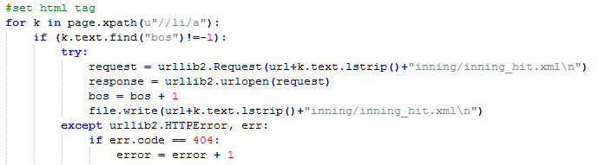
Heat map showing the locations of all hit ball
Data collection
Using Python
找到我們需要的球隊的比賽的inning_hit.xml
例外處理 : 若該場比賽不存在inning_hit.xml檔案，則跳過不處理

Slide 10
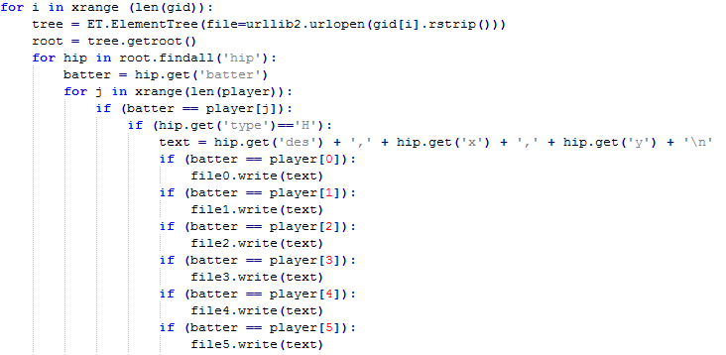
Heat map showing the locations of all hit ball
Data collection
Using Python
將每個球員的打擊資料
以 des , x , y 格式記錄成 .CSV檔
des : 該打擊敘述 ( 例 : single )
x: 該球落點x座標
y: 該球落點y座標
取得batter ID
若為我們指定的球員則記錄下來

Slide 11
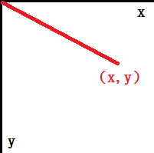
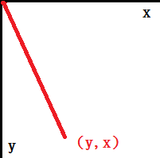
Heat map showing the locations of all hit ball
Data preprocessing
官方資料中的x,y座標需轉換成符合我們球場圖的x,y座標
x = float(row[2])*math.cos(2*math.pi/360*-135) - (float(row[1]))*math.sin(2*math.pi/360*-135)
y = float(row[2])*math.sin(2*math.pi/360*-135) + (float(row[1]))*math.cos(2*math.pi/360*-135)
x = x + 177
y = y + 250
Rotate -135 degree
Then Translate

Slide 12
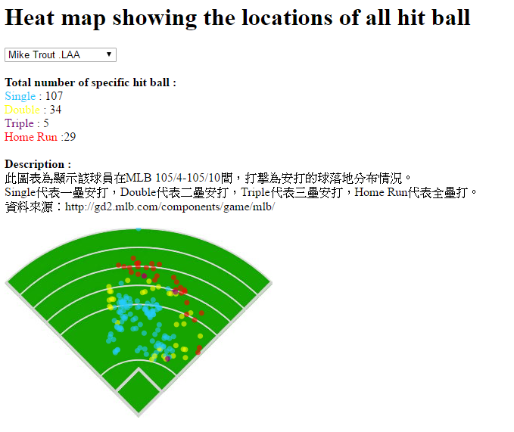
Heat map showing the locations of all hit ball
圖名
初步成果說明
球員選單切換
圖例說明
簡要說明
圖
http://cs.nccu.edu.tw/~g10510/vis17/hittrack_dot.html

Slide 13
Heat map showing the locations of all hit ball
對於視覺化結果進行分析和驗證
呈現方式
一開始是用線來表示hit track，但期末報告的時候發現效果不佳 (線太密集，會重疊，看不出落點效果)，所以改為Heat map (用dot來表示) 。
落點位置的疑惑
發現落點位置都沒有在內場（下方方格範圍），查看yahoo運動MLB資料發現落在內場的球通常為出局，所以我們資料沒有納入。
結論
實作過程中發現沒有官方x,y座標實際圖或講解，結果呈現的正確性有待商榷，若想更進一步提高正確性，可能要參考有提供作法的相關研究。

Slide 14
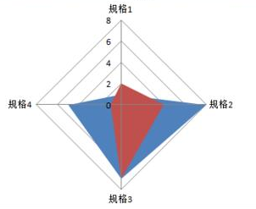
radar chart
Goal
Each corner is the ball style
Show the statistics for each players hitting on each ball style

Slide 15
April
May
June
July
August
Sept
Oct
1
2
3
4
5
6
7
8
9
…...
inning

Slide 16
April
May
June
July
August
Sept
Oct
date
1
2
3
opponent
@CHC
@CHC
@CHC
1
2
3
4
5
6
7
8
9
…...
inning

