Slide 1
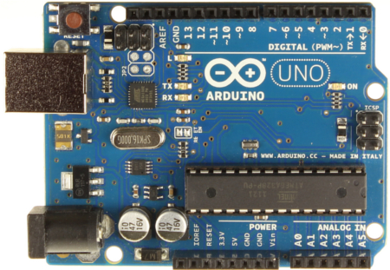
6V Battery
TOSHIBA
TA7291P
-
Motor
1
2
3
4
5
6
7
8
9
10

