Slide 1

A Machine Learning Approach To Web-Page Content Extraction
PRESENTED BY: SUMIT KUMAR TIWARY , RISHIKESH MAURYA , AWANISH KUMAR GUPTA (131/11) (260/11) (272/11)
NATIONAL INSTITUTE OF TECHNOLOGY
JAMSHEDPUR, INDIA – 831014

Slide 2
INTRODUCTION
Software Applications targeting at extracting information from web sources .
Large amount of information produced , shared and consumed online. Making this information available for use by computer programs
Removal of noisy elements from information rich documents .
Conversion of web pages from raw or semi-structured text to meaningful components with limited human effort.

Slide 3
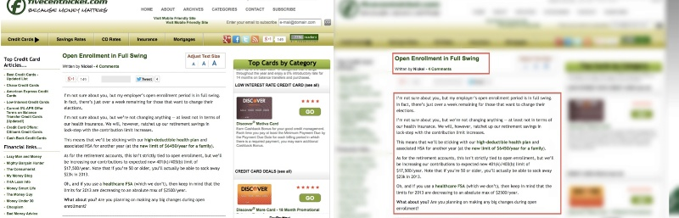
Fig. 1: Example webpage: original on the left, annotated main content on the right

Slide 4
NEED FOR WEB PAGE CONTENT EXTRACTION
Enhance online reading experience of users .
Increase efficiency of search engines.
Optimize web sites for hand-held devices.
Extracting structured data that appears multiple times on a single web page.
Classifying text blocks using a mixture of visual and language independent feature.

Slide 5
CURRENT SCENARIO
Early efforts rely on heuristics about web pages with main content such as text-density etc.
Existing algorithms are based on the observation that non-content fragments are highly formatted with more tags.
Some approaches like template detection algorithm classify identical parts found in all web pages as noisy components.

Slide 6
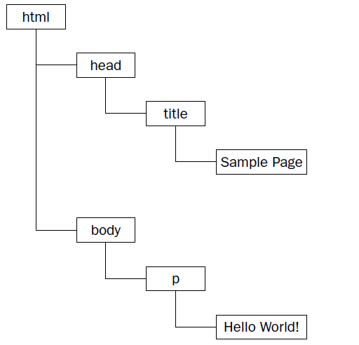
PROPOSED ALGORITHM
Web page is divided into a tree whose nodes are visually grouped blocks.
Blockify training documents and train a SVM qualifier based on features extracted from blocks.
For test documents, same blockify algorithm is applied and blocks classified as contents are extracted to construct the main content.

Slide 7
INSIGHT TO ALGORITHM
BLOCKIFYING
Use HTML parser to traverse the HTML DOM tree and accumulate relevant information such as text and links as traversing
When the beginning or end of a block-level element is reached, we output the accumulated text as a text block.
FEATURE EXTRACTION
Use features that are strongly indicative whether a text block is content or not.
In our approach, we select three types of features: text features, relative position, and id & class token feature.
The first type is called text features, which are extracted based on text properties inside a text block.

Slide 8
SVM Training and Classification
For each block we have selected the following most relevant features:
number of words in this block and the quotient to its previous block
average sentence length in this block and the quotient to its previous block
text density in this block and the quotient to its previous block
link density in this block
After feature extraction, we label each block as content or non-content
7

Slide 9


Information Extraction from The Web
STRUCTURED DATA
tom | 664 | blue | BSc
bill | 345 | grey | PhD
dave | 123 | red | MSc
sue | 555 | red | BA
WRAPPERS
WEB PAGES

Slide 10
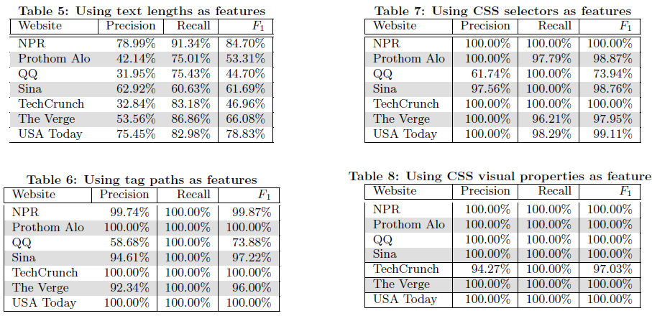
Data Set collected from various web sites

Slide 11
CONCLUSION
We have developed a language independent pipeline to extract web content.
Our learning algorithm can achieve perfect labeling when trained on a single website.
We have found that some of our features|tag path, CSS selectors|contributed to the near perfect classication results in many websites, but they also fail in some cases.
CSS visual properties work particularly well across most websites.

Slide 12
RELATED WORK
For instance, the Opera browser uses the handheld CSS media type
One method is to transform a web page into a hierarchy of individual content units called Semantic Textual Units, or STUs. First, STUs are built by analyzing syntactic features of an HTML document
By parsing a webpage into a DOM tree, we have found that one not only gets better results but has more control over the exact pieces of information that can be manipulated while extracting content

Slide 13
OUR APPROACH
the page is first passed through an HTML parser that corrects HTML errors and then creates a DOM tree representation of the web page
Once parsed, the resulting DOM document can be seamlessly shown as a webpage to the end-user by flattening the tree and producing back the HTML
DOM tree is hierarchically arranged and can be analyzed in sections or as a whole, providing a wide range of flexibility for our extraction algorithm, our content extractor navigates the DOM tree recursively, using a series of different filtering techniques to remove and adjust specific nodes and leave only the content behind

Slide 14
IMPLEMENTATION

Slide 15
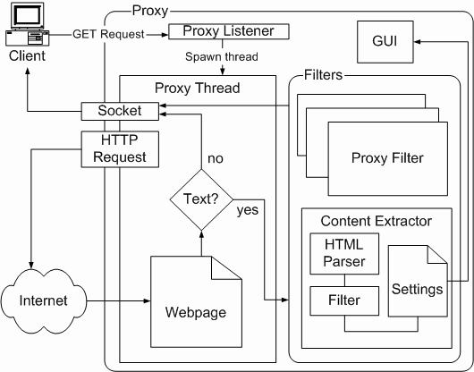

Slide 16
FIRST FILTER
The first set of filters simply ignores tags or specific attributes within tags.
With these filters, images, links, scripts, styles, and many other elements can be quickly removed from the web page

Slide 17
SECOND FILTER
the second set of filters is more complex and algorithmic, providing a higher level of content extraction. This set, which can be extended, currently consists of the advertisement remover, the link list remover, the removed link retainer and the empty table remover.
the DOM tree is parsed, the values of the “src” and “href” attributes throughout the page are surveyed to determine the servers to which the links refer

Slide 18
IMPORTANT LINKS
After the DOM tree is completely parsed, the list of removed links is added to the bottom of the page. In this way, any important navigational links that were previously removed remain accessible, and since the parser had parsed them initially as separate units,

Slide 19
OUTPUT
After the entire page is parsed and modified appropriately, it can be output in either HTML or as plain text .

Slide 20
LIMITATIONS

Slide 21
FUTURE DIRECTIONS
It may be possible to implement artificially intelligent heuristic algorithms, such as Bayesian learning or Markov Model creation
With the addition of trainable filtering, it could adapt to a particular user's or group’s preferences
one of our main goals was to expose a simple API for programmers to extend, so that current and future natural language processing and information retrieval algorithms can easily be added.

Slide 22
REFERENCES
YaoZuo- A Machine Learning Approach To Webpage Content Extraction
ZhouMashuq- Web Content Extraction Through Machine Learning
Artificial Intelligence By Rich and Knight-3rd edition
Building Machine Learning Systems with Python - Richert, Coelho
Web Data Extraction, Applications and Techniques: A Survey
Emilio Ferraraa, Center for Complex Networks and Systems Research, Indiana University, Bloomington, IN 47408, USA.

Slide 23
THANK YOU

