Slide 1
Machine Learning
Lectures 13 – Neural Networks

Slide 2
Neural Networks
An artificial network consists of a pool of simple processing units which communicate by sending signals to each other over a large number of weighted connections.
NN, a beautiful biologically-inspired programming paradigm which enables a computer systems to learn from observational data
Deep learning, a powerful set of techniques for learning in neural networks
http://neuralnetworksanddeeplearning.com/

Slide 3
1943
FIRST PASS
Probabilistic interpretations, Bayesian and spiking networks
McCulloch–Pitts “neuron”
Started the field
1962
LEARNING IMPROVEMENT
02
04
Rosenblatt’s perceptron
Learned its own weight values; convergence proof
1969
HOW ABOUT LAYERS?
Minsky & Papert Proved limitations of single-layer perceptron networks
01
03
05
1982
ENERGY FUNCTION
Hopfield and convergence in symmetric networks
1986
MORE TUNNING
Backpropagation of errors
Method for training multilayer networks
NN Evolution

Slide 4
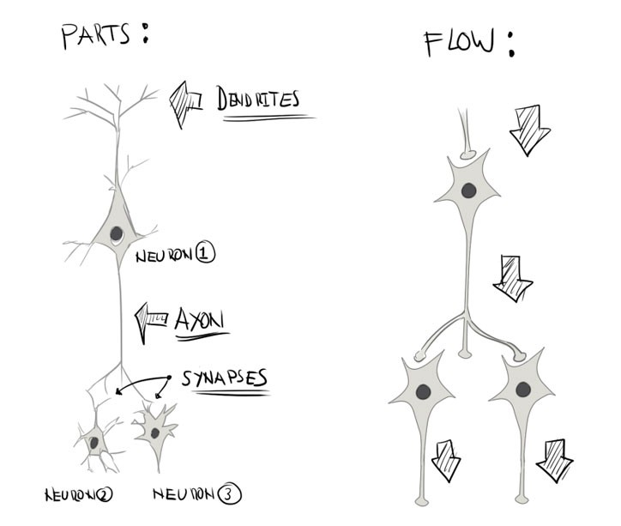
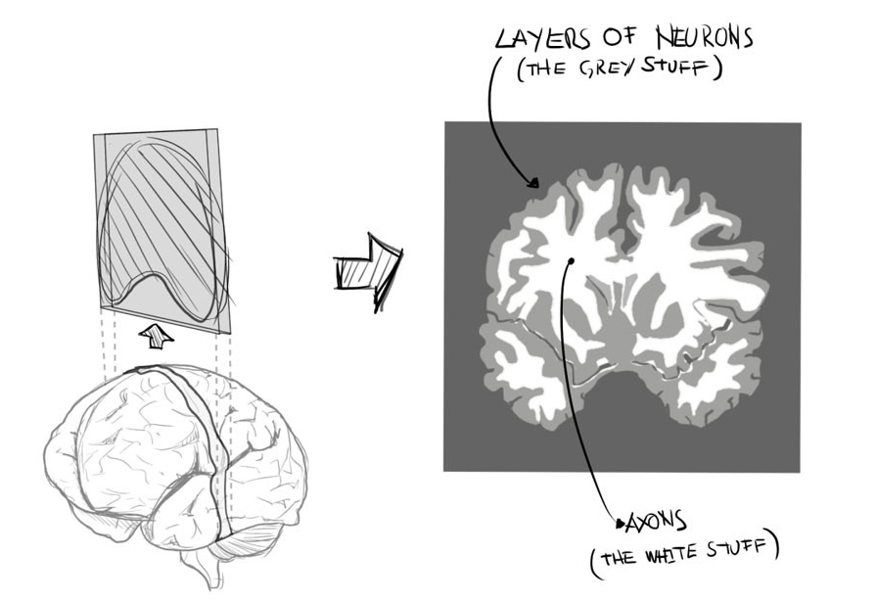
How does human brain work?
In the human brain, a typical neuron collects signals from others through a host of fine structures called dendrites.
The neuron sends out spikes of electrical activity through a long, thin stand known as an axon, which splits into thousands of branches.
At the end of each branch, a structure called a synapse converts the activity from the axon into electrical effects that inhibit or excite activity in the connected neurons.
When a neuron receives excitatory input that is sufficiently large compared with its inhibitory input, it sends a spike of electrical activity down its axon.
Learning occurs by changing the effectiveness of the synapses so that the influence of one neuron on another changes.
https://becominghuman.ai/making-a-simple-neural-network-2ea1de81ec20

Slide 5
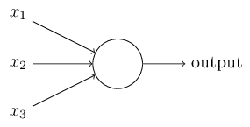
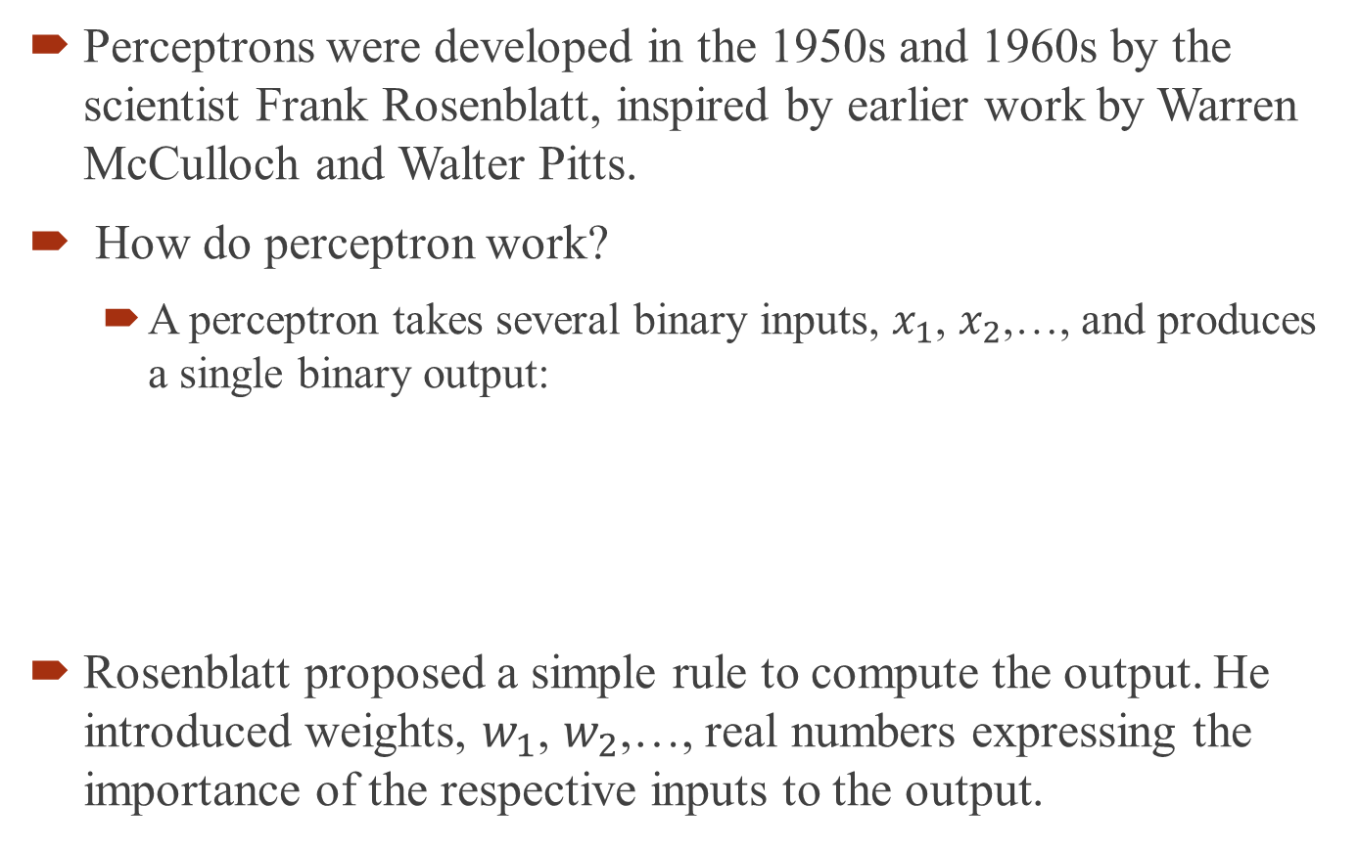
Perceptron
Perceptrons were developed in the 1950s and 1960s by the scientist Frank Rosenblatt, inspired by earlier work by Warren McCulloch and Walter Pitts.
How do perceptron work?
A perceptron takes several binary inputs, $x_{1}$, $x_{2}$,…, and produces a single binary output:
Rosenblatt proposed a simple rule to compute the output. He introduced weights, $w_{1}$, $w_{2}$,…, real numbers expressing the importance of the respective inputs to the output.

Slide 6

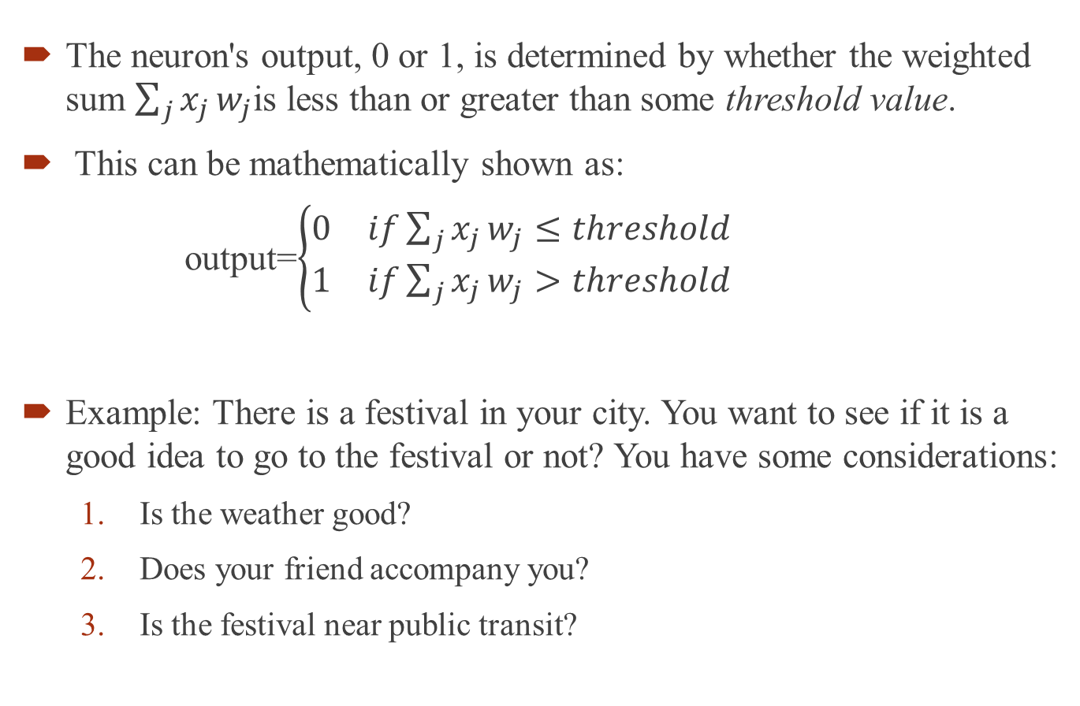



Perceptron
The neuron's output, 0 or 1, is determined by whether the weighted sum $\sum_{j}{x_{j}}w_{j}$is less than or greater than some threshold value.
This can be mathematically shown as:
output=$\left\{\begin{matrix}\begin{matrix}0 & if\sum_{j}{x_{j}}w_{j}≤threshold\end{matrix} \\ \begin{matrix}1 & if\sum_{j}{x_{j}}w_{j}>threshold\end{matrix}\end{matrix}\right.$
Example: There is a festival in your city. You want to see if it is a good idea to go to the festival or not? You have some considerations:
Is the weather good?
Does your friend accompany you?
Is the festival near public transit?
$$x_{1}$$
$$1 or 0$$
$$x_{2}$$
$$x_{3}$$

Slide 7
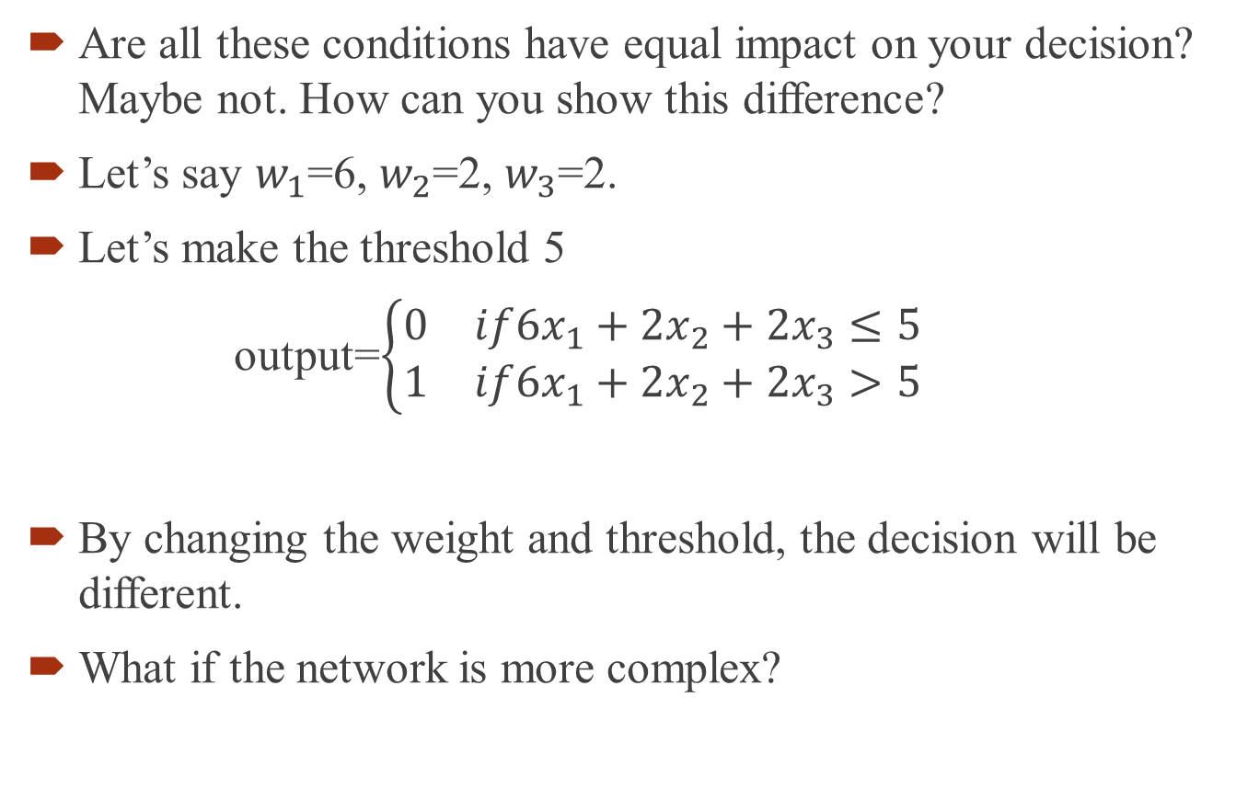
Perceptron- Example
Are all these conditions have equal impact on your decision? Maybe not. How can you show this difference?
Let’s say $w_{1}$=6, $w_{2}$=2, $w_{3}$=2.
Let’s make the threshold 5
output=$\left\{\begin{matrix}\begin{matrix}0 & if{6x}_{1}+{2x}_{2}+{2x}_{3}≤5\end{matrix} \\ \begin{matrix}1 & if{6x}_{1}+{2x}_{2}+{2x}_{3}>5\end{matrix}\end{matrix}\right.$
By changing the weight and threshold, the decision will be different.
What if the network is more complex?

Slide 8
Example
Price of the house
Size of the house
Price of the house
f(x)
neuron
Activation function
f(x) can be SVR, linear regression, decision tree, ….
Size of the house

Slide 9
More layers
What if more parameters are involved in price of the house?
Size
Family size
No. of bedrooms
Price
Walkability
Address
School quality
Wealth
Output Layer
Input Layer
Hidden Layer
Deep learning by Andrew NG

Slide 10
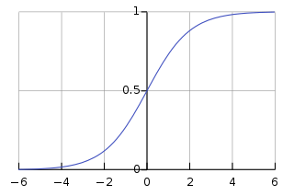

How does it work?
We still have input and output here
There are several types of activation function. Let us for now focus on one type of it called Sigmoid.
When we have multiple layers, the output of each layer will be the input of the next layer
For training the model, we use back propagation method (more in Deep learning course)
$$\hat{y}=σ(wx+b)$$

Slide 11









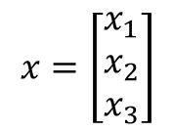



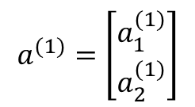
Sample NN
$$x=\left[\begin{matrix}x_{1} \\ x_{2} \\ x_{3}\end{matrix}\right]$$
$$a^{(1)}=\left[\begin{matrix}a_{1}^{(1)} \\ a_{2}^{(1)}\end{matrix}\right]$$
$$\underset{z_{1}^{(1)}}{\underbrace{w_{1}^{\left(1\right)T}x+b_{1}^{(1)} }}$$
$$\underset{a_{1}^{(1)}}{\underbrace{σ(z_{1}^{(1)})}}$$
$$x_{1}$$
$$a_{1}^{(1)}$$
$$\underset{a^{(2)}}{\underbrace{σ(z^{(2)})}}$$
$${y= a}^{(2)}$$
$$\underset{z^{(2)}}{\underbrace{w^{\left(2\right)T}a^{(1)}+b^{(2)}}}$$
$$x_{2}$$
$$\underset{a_{2}^{(1)}}{\underbrace{σ(z_{2}^{(1)})}}$$
$$a_{2}^{(1)}$$
$$\underset{z_{2}^{(1)}}{\underbrace{w_{2}^{\left(1\right)T}x+b_{2}^{(1)} }}$$
$$x_{3}$$
Concepts: Neuron(node), Activation function, weight, bias

Slide 12
Advantages
Flexibility and Versatility: Neural networks can learn and adapt to a wide range of tasks, making them versatile for various applications such as image recognition, natural language processing, and time series forecasting.
High Accuracy: With deep architectures and large datasets, neural networks can achieve high accuracy in complex pattern recognition tasks, often outperforming traditional machine learning algorithms.
Feature Learning: Neural networks can automatically learn relevant features from raw data, reducing the need for manual feature engineering and making them suitable for tasks with unstructured data.
Parallel Processing: Neural networks can be implemented to take advantage of parallel processing on GPUs and specialized hardware, leading to faster training and inference times for large-scale datasets.
Generalization: When properly trained and regularized, neural networks can generalize well to new, unseen data, reducing overfitting and improving performance on real-world applications.

Slide 13
Disadvantages
Data Requirements: Neural networks require a significant amount of data for effective training, and performance may suffer if the dataset is small or biased.
Computationally Intensive: Training deep neural networks can be computationally intensive, especially for complex models and large datasets. This can lead to long training times and high hardware requirements.
Black Box Nature: Neural networks are often seen as black boxes, making it challenging to interpret and understand their internal decision-making processes, especially in complex deep architectures.
Overfitting: Without proper regularization and validation techniques, neural networks are prone to overfitting, leading to poor generalization and performance on unseen data.
to their complex nature, neural networks lack interpretability, which may be a critical factor in some applications, such as healthcare or legal domains.

Slide 14
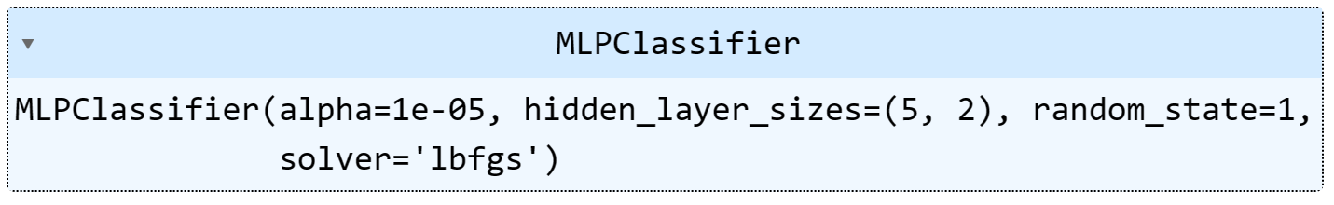

Coding Python
import pandas as pd
from sklearn.model_selection import train_test_split
from sklearn.neural_network import MLPClassifier
from sklearn.metrics import classification_report
from sklearn.metrics import confusion_matrix
from sklearn.preprocessing import normalize
X = [[0., 0.], [1., 1.]]
y = [0, 1]
clf = MLPClassifier(solver='lbfgs', alpha=1e-5, hidden_layer_sizes=(5, 2), random_state=1)
clf.fit(X, y)
clf.predict([[2., 2.], [-1., -2.]])

Slide 15
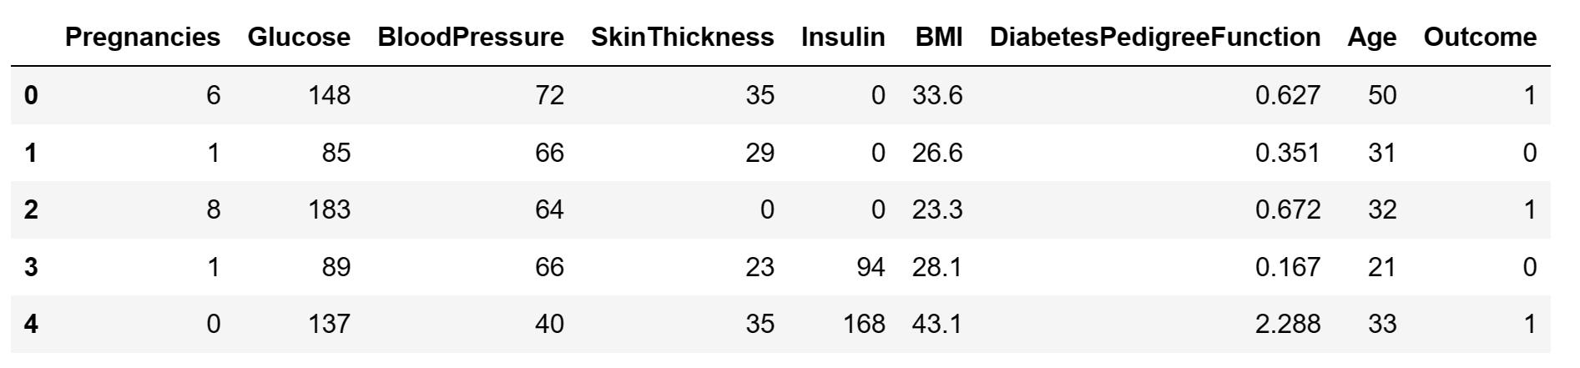
Coding Python
df = pd.read_csv(diabetes.csv’)
df.head()
X = df.drop(columns=['Outcome']).values
y = df['Outcome'].values
X= normalize(X)

Slide 16
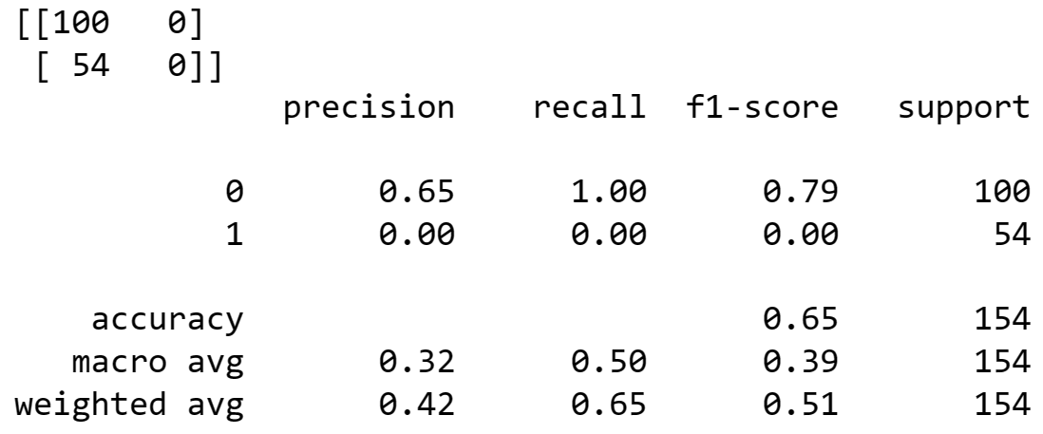
Coding Python
X_train, X_test, y_train, y_test = train_test_split(X, y, test_size=0.20, random_state=43)
clf = MLPClassifier(hidden_layer_sizes=(10), activation='logistic', solver='adam', max_iter=500)
clf.fit(X_train, y_train)
y_predict= clf.predict(X_test)
print(confusion_matrix(y_test,y_predict))
print(classification_report(y_test,y_predict))

Slide 17
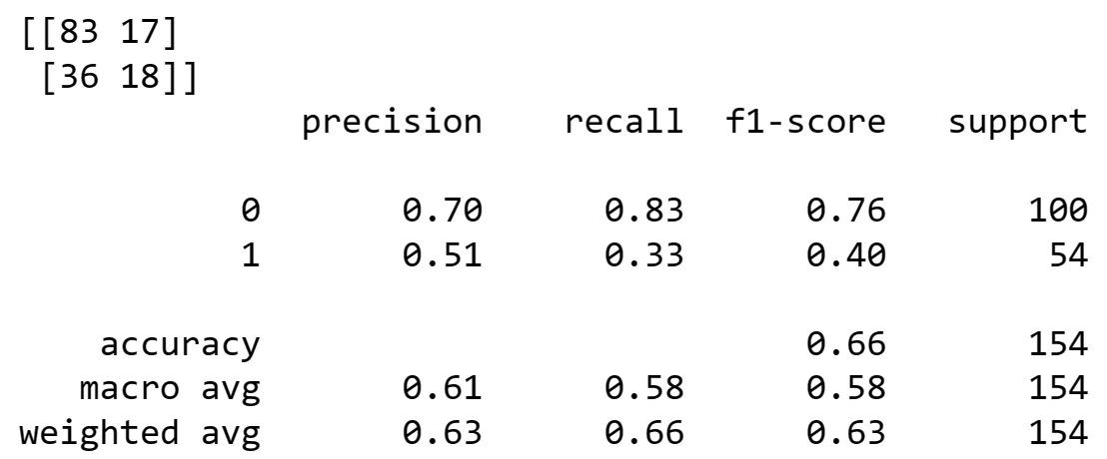
Coding Python
clf = MLPClassifier(hidden_layer_sizes=(10,8), activation='relu', solver='adam', max_iter=500)
y_predict= clf.predict(X_test)
print(confusion_matrix(y_test,y_predict)) print(classification_report(y_test,y_predict))

Slide 18
Coding R
ibrary(neuralnet)
library(dplyr)
iris <- iris %>% mutate_if(is.character, as.factor)
set.seed(245)
data_rows <- floor(0.80 * nrow(iris))
train_indices <- sample(c(1:nrow(iris)), data_rows)
train_data <- iris[train_indices,]
test_data <- iris[-train_indices,]
model = neuralnet( Species~Sepal.Length+Sepal.Width+Petal.Length+Petal.Width, data=train_data, hidden=c(4,2), linear.output = FALSE )
plot(model,rep = "best")

Slide 19
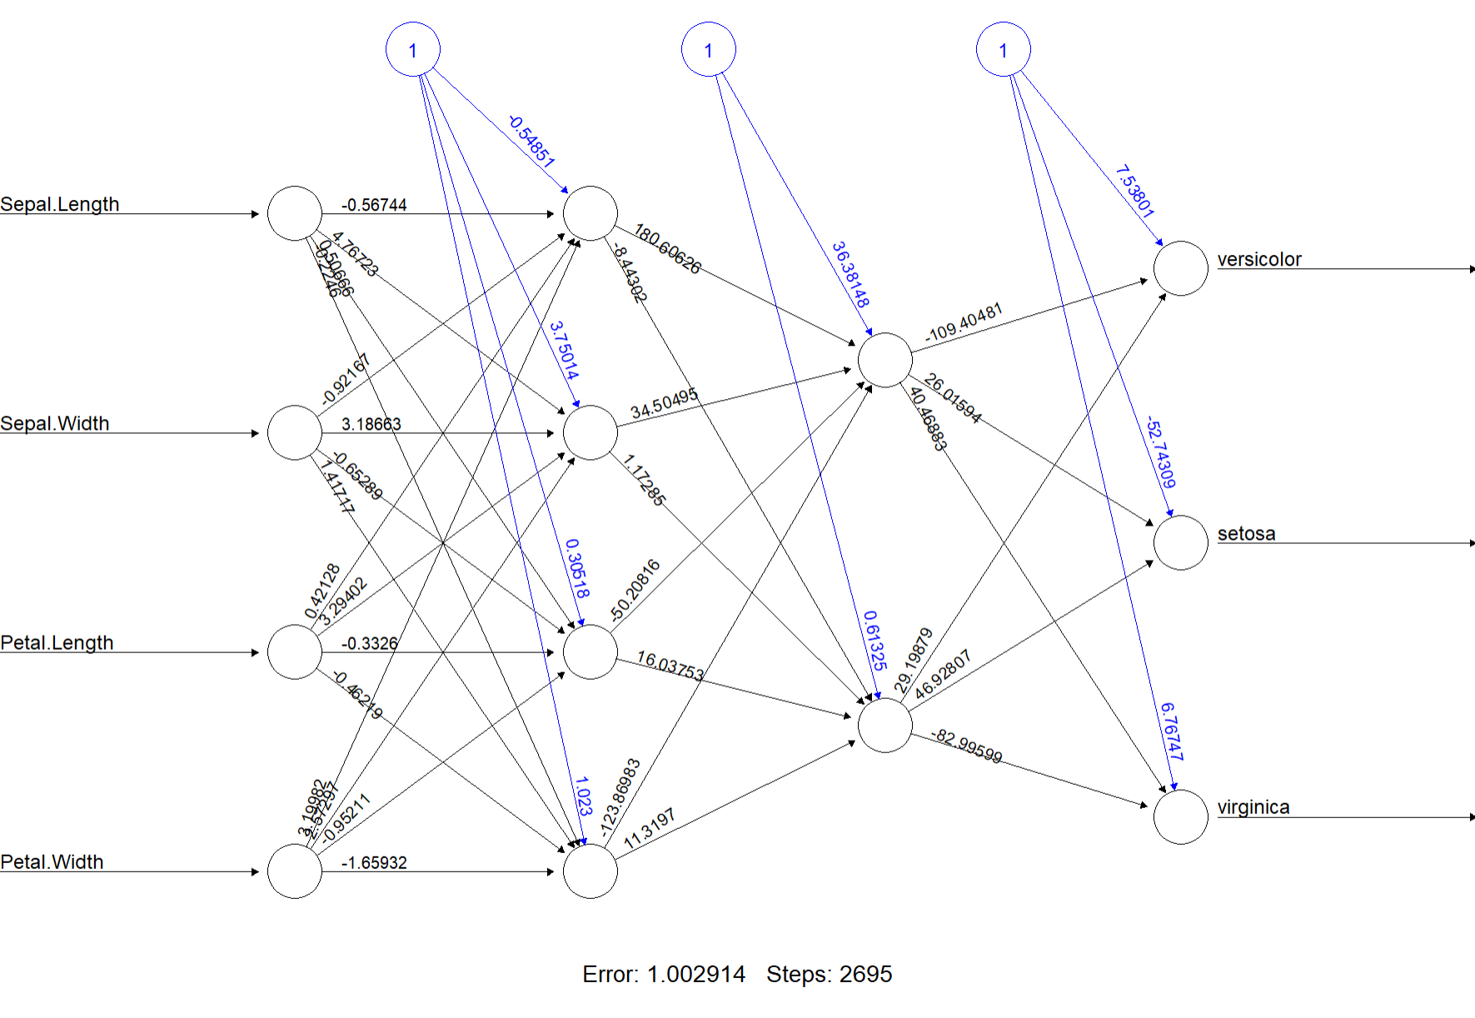
Coding R

Slide 20
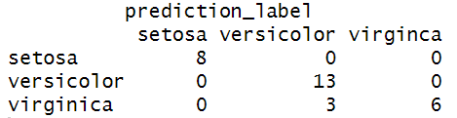
Coding R
pred <- predict(model, test_data)
labels <- c("setosa", "versicolor", "virginca")
prediction_label <- data.frame(max.col(pred)) %>% mutate(pred=labels[max.col.pred.]) %>% select(2) %>% unlist()
table(test_data$Species, prediction_label)
check = as.numeric(test_data$Species) == max.col(pred)
accuracy = (sum(check)/nrow(test_data))*100
print(accuracy)
Accuracy: 90%

