Slide 1
Machine Learning
Lecture 1- Introduction to machine learning

Slide 2
What is learning?
One Definition: Learning is optimizing performance (based on some criterion) using example data or past experience. Then, the goal of machine learning is to build algorithms enabled by constraints exposed by representations that support models targeted at: thinking, perception, and/or action.
Another Definition: Statistical learning refers to a vast set of tools for understanding data. These tools can be classified as supervised or unsupervised. Broadly speaking, supervised statistical learning involves building a statistical model for predicting, or estimating, an output based on one or more inputs. With unsupervised statistical learning, there are inputs but no supervising output; nevertheless we can learn relationships and structure from such data.

Slide 3
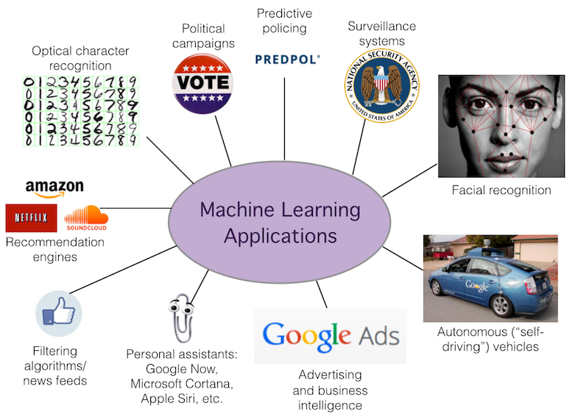
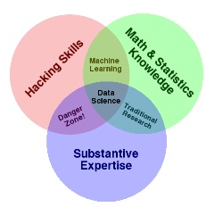
Machine learning
What is Machine learning?
“Field of study that gives computers the ability to learn without being explicitly programmed” – Arthur Samuel 1959
“How to construct programs that automatically learn from experience” – Mitchell 1997

Slide 4
Different types of ML
Supervised Learning:
Usually means you have access to a training set that includes both input and output data. The goal is to find that algorithm with which you can infer the given output from the given input. We’ll talk about supervised learning more than unsupervised learning. The methods we’ll cover include: classification, decision-trees, Bayesian methods, neural networks and multi-agent based models.
Unsupervised learning
Usually means finding an algorithm that can be used to produce output given some un-described input. For example, given some data we might try to find a way to cluster it in order to formulate an algorithm that describes the data in terms of that clustering.

Slide 5
Other ML perspectives
Information-based Learning:
We use information to guide or inform our decisions or lead us to the next question. When we automate this we will optimize this by minimizing errors or entropy or some parameter. Example: decision tree
Similarity-based Learning:
What we are doing is putting together things that are similar. Example: Regression
Probability-based Learning
Find the probability of belonging to different classes rather than exactly identifying the class. Example: Naïve Bayes
Error-based Learning:
What we’re doing is developing a model, running it and checking our output against something then tweaking the model to reduce the error we find when we run our check. Example: KNN

Slide 6

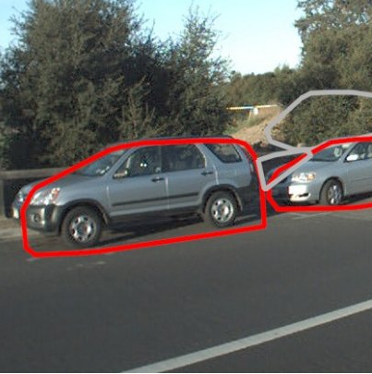




What is the supervised learning?
“Supervised learning is the machine learning task of inferring a function from labeled training data.” - Mohri 2012
The training data consist of a set of training examples. In supervised learning, each example is a pair consisting of an input object (typically a vector) and a desired output value (also called the supervisory signal).
Notes:
A supervised learning algorithm analyzes the training data and produces an inferred function, which can be used for mapping new examples. An optimal scenario will allow for the algorithm to correctly determine the class labels for unseen instances. This requires the learning algorithm to generalize from the training data to unseen situations in a "reasonable" way.

Slide 7

How many targets do you see here?

Slide 8
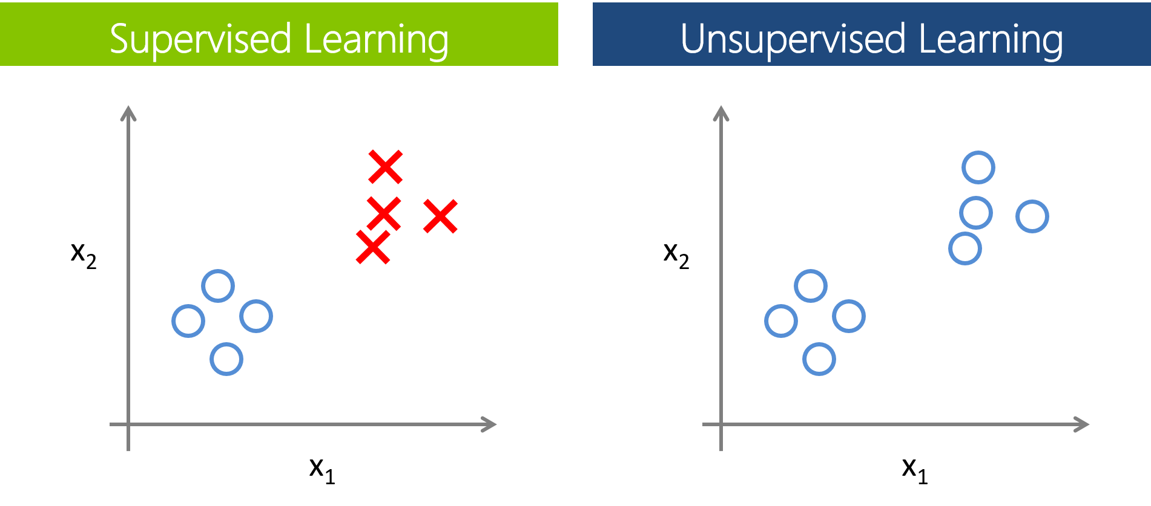
Unsupervised Learning
In unsupervised learning, we are encountering data which is not labeled like it was in supervised learning.

Slide 9
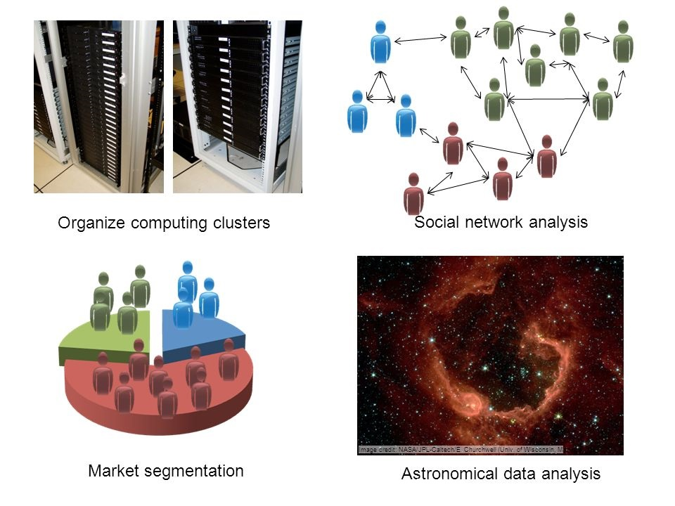
Unsupervised Learning

Slide 10
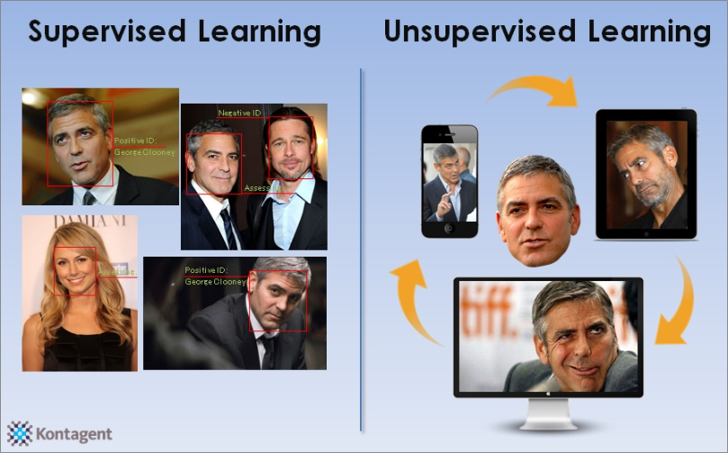
To recap…
Supervised learning is about approximation while unsupervised learning is about description
In supervised learning, the output datasets are provided which are used to train the machine and get the desired outputs whereas in unsupervised learning no output datasets are provided, instead the data is clustered into different classes .
Notes:
A supervised learning algorithm analyzes the training data and produces an inferred function, which can be used for mapping new examples. An optimal scenario will allow for the algorithm to correctly determine the class labels for unseen instances. This requires the learning algorithm to generalize from the training data to unseen situations in a "reasonable" way.

Slide 11
Machine Learning from Problem Perspective
Classification
Functions as its name suggests, by classifying data in order to then make predictions.
Is one of the supervised learning techniques.
Regression
It consists of mathematical methods that allow data scientists to predict a continuous outcome (y) based on the value of one or more predictor variables (x).
Time Series
A time series is a sequence of observations taken sequentially in time.
Time series forecasting involves taking models then fit them on historical data then using them to predict future observations.
Clustering
An unsupervised process to find meaningful structure, explanatory underlying processes, generative features, and groupings inherent in a set of examples.

Slide 12
Linear Algebra
Linear Algebra is very useful in ML so we are going to have a brief overview on ML
Use the posted book on Canvas for more information
Notes:
There is a strong relationship between algebra, geometry and statistical concepts. So, one of the things we’ll try to accomplish is a reading knowledge of matrix expressions to aid in understanding statistical concepts.
Consider the vector $a= \left[\begin{matrix}2 \\ 1 \\ 3\end{matrix}\right]$

Slide 13

Vectors and Vector Spaces
What’s a vector?
A column or row of numbers, that’s all.
$a= \left[\begin{matrix}2 \\ 1 \\ 3\end{matrix}\right]$ or $b= \left(2, 1, 3\right)$
But be careful! $\left(2, 1, 3\right)≠(1, 2, 3)$
By convention, all vectors are column vectors unless otherwise specified!
Transpose of a vector
${\left[\begin{matrix}2 \\ 1 \\ 3\end{matrix}\right]}^{T}= \left[2, 1, 3\right]$
Notes:
There is a strong relationship between algebra, geometry and statistical concepts. So, one of the things we’ll try to accomplish is a reading knowledge of matrix expressions to aid in understanding statistical concepts.
Consider the vector $a= \left[\begin{matrix}2 \\ 1 \\ 3\end{matrix}\right]$

Slide 14
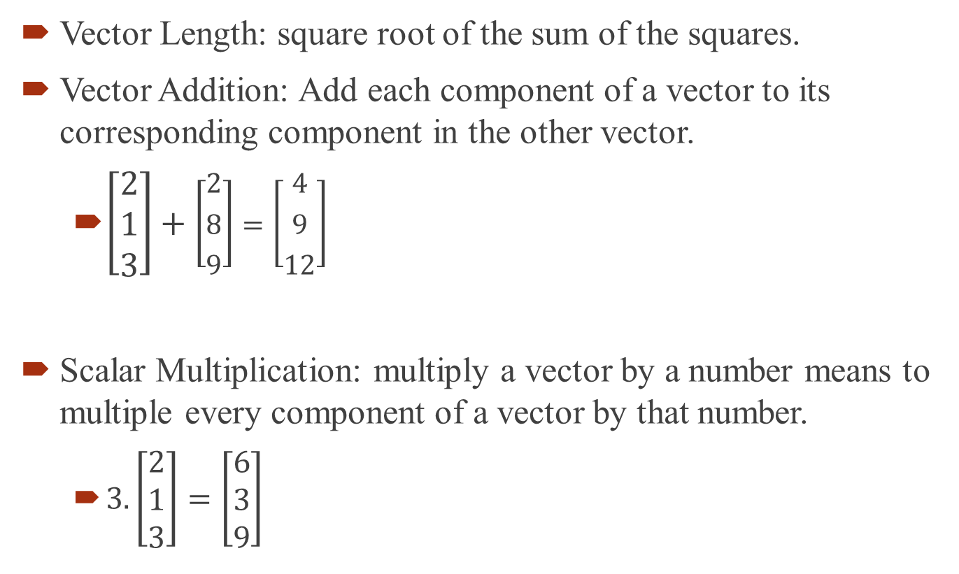
Vector Terminology
Vector Length: square root of the sum of the squares.
Vector Addition: Add each component of a vector to its corresponding component in the other vector.
$\left[\begin{matrix}2 \\ 1 \\ 3\end{matrix}\right]+\left[\begin{matrix}2 \\ 8 \\ 9\end{matrix}\right]=\left[\begin{matrix}4 \\ 9 \\ 12\end{matrix}\right]$
Scalar Multiplication: multiply a vector by a number means to multiple every component of a vector by that number.
$3.\left[\begin{matrix}2 \\ 1 \\ 3\end{matrix}\right]=\left[\begin{matrix}6 \\ 3 \\ 9\end{matrix}\right]$

Slide 15
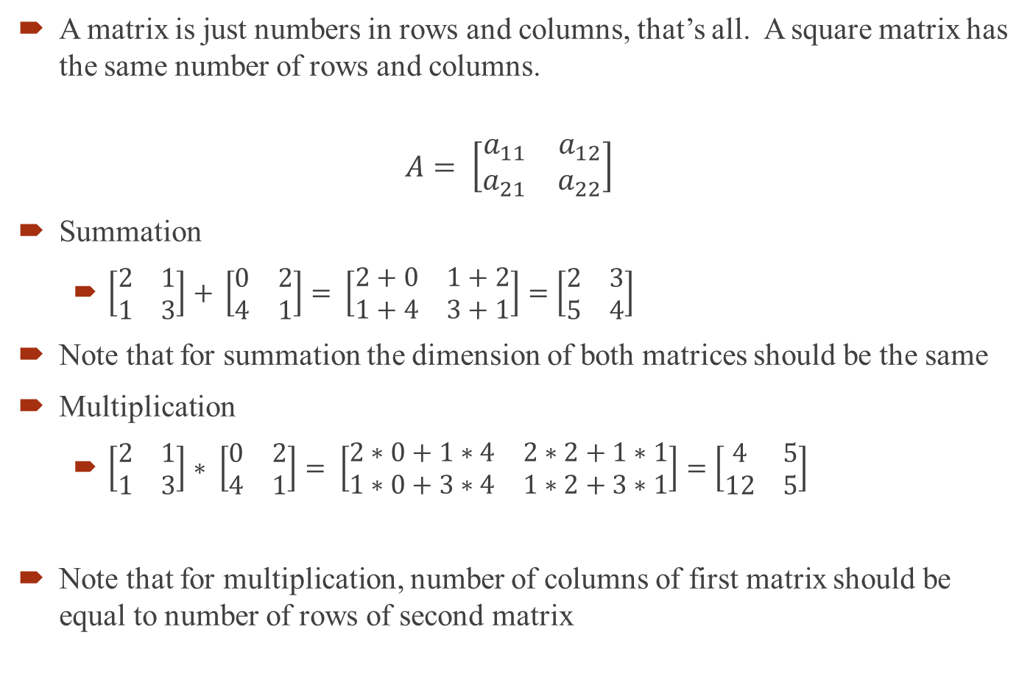
Matrices
A matrix is just numbers in rows and columns, that’s all. A square matrix has the same number of rows and columns.
$$A= \left[\begin{matrix}a_{11} & a_{12} \\ a_{21} & a_{22}\end{matrix}\right]$$
Summation
$\left[\begin{matrix}2 & 1 \\ 1 & 3\end{matrix}\right]$ $+ \left[\begin{matrix}0 & 2 \\ 4 & 1\end{matrix}\right]= \left[\begin{matrix}2+0 & 1+2 \\ 1+4 & 3+1\end{matrix}\right]=\left[\begin{matrix}2 & 3 \\ 5 & 4\end{matrix}\right]$
Note that for summation the dimension of both matrices should be the same
Multiplication
$\left[\begin{matrix}2 & 1 \\ 1 & 3\end{matrix}\right]$ $∗ \left[\begin{matrix}0 & 2 \\ 4 & 1\end{matrix}\right]= \left[\begin{matrix}2∗0+1∗4 & 2∗2+1∗1 \\ 1∗0+3∗4 & 1∗2+3∗1\end{matrix}\right]=\left[\begin{matrix}4 & 5 \\ 12 & 5\end{matrix}\right]$
Note that for multiplication, number of columns of first matrix should be equal to number of rows of second matrix
Notes:
Now let’s start looking at matrices and arrays. Slide 5 has a simple 2x2 matrix and shows how one is constructed in R. Note that in R when you construct a matrix using a list of numbers the numbers are read into the matrix column-by-column.

Slide 16

Matrices
Question: Which multiplication is NOT correct?
$\left[\begin{matrix}2 & 1 \\ 1 & 3\end{matrix}\right]$ $∗ \left[\begin{matrix}0 & 2 \\ 4 & 1\end{matrix}\right]$
$\left[\begin{matrix}2 & 1 \\ \begin{matrix}2 \\ 1 \\ 4\end{matrix} & \begin{matrix}2 \\ 0 \\ 4\end{matrix}\end{matrix}\right]$ $∗ \left[\begin{matrix}0 & 2 \\ 4 & 1\end{matrix}\right]$
$\left[\begin{matrix}0 & 2 \\ 4 & 1\end{matrix}\right]∗\left[\begin{matrix}2 & 1 \\ \begin{matrix}2 \\ 1 \\ 4\end{matrix} & \begin{matrix}2 \\ 0 \\ 4\end{matrix}\end{matrix}\right]$
Notes:
Now let’s start looking at matrices and arrays. Slide 5 has a simple 2x2 matrix and shows how one is constructed in R. Note that in R when you construct a matrix using a list of numbers the numbers are read into the matrix column-by-column.

Slide 17
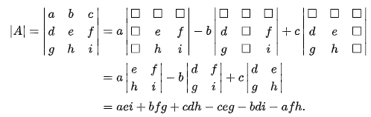

Matrix determinant
$\det\left(A\right)or |A|$ is a scalar value
If $A= \left[\begin{matrix}a & b \\ c & d\end{matrix}\right]$ then $\left|A\right|=ad −bc$
Similarly, for a 3 × 3 matrix A, its determinant is:
Identity matrix
$I= \left[\begin{matrix}1 & 0 & 0 \\ 0 & 1 & 0 \\ 0 & 0 & 1\end{matrix}\right]$

Slide 18




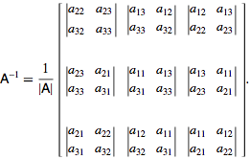

Matrix inverse
For
For 3x3
$$AA^{−1}=I$$

Slide 19
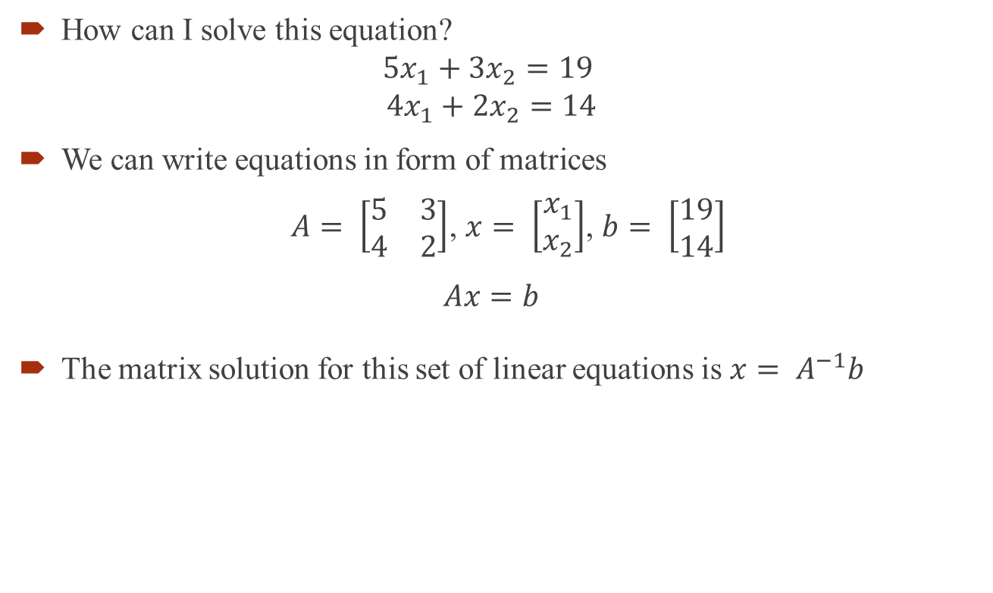



Solving a set of Linear Equations
How can I solve this equation?
$$5x_{1}+3x_{2}=19$$
$$4x_{1}+2x_{2}=14$$
We can write equations in form of matrices
$A= \left[\begin{matrix}5 & 3 \\ 4 & 2\end{matrix}\right]$, $x= \left[\begin{matrix}x_{1} \\ x_{2}\end{matrix}\right]$, $b= \left[\begin{matrix}19 \\ 14\end{matrix}\right]$
$$Ax=b$$
The matrix solution for this set of linear equations is $x= A^{−1}b$
$$A^{−1}=\frac{1}{ad−bc}\left[\begin{matrix}d & −b \\ −c & a\end{matrix}\right]$$
$A^{−1}=\frac{1}{10−12}\left[\begin{matrix}2 & −3 \\ −4 & 5\end{matrix}\right]$=$\left[\begin{matrix}−1 & 1.5 \\ 2 & −2.5\end{matrix}\right]$
${x=A}^{−1}b=\left[\begin{matrix}−1 & 1.5 \\ 2 & −2.5\end{matrix}\right]\left[\begin{matrix}19 \\ 14\end{matrix}\right]$=$\left[\begin{matrix}2 \\ 3\end{matrix}\right]$

Slide 20
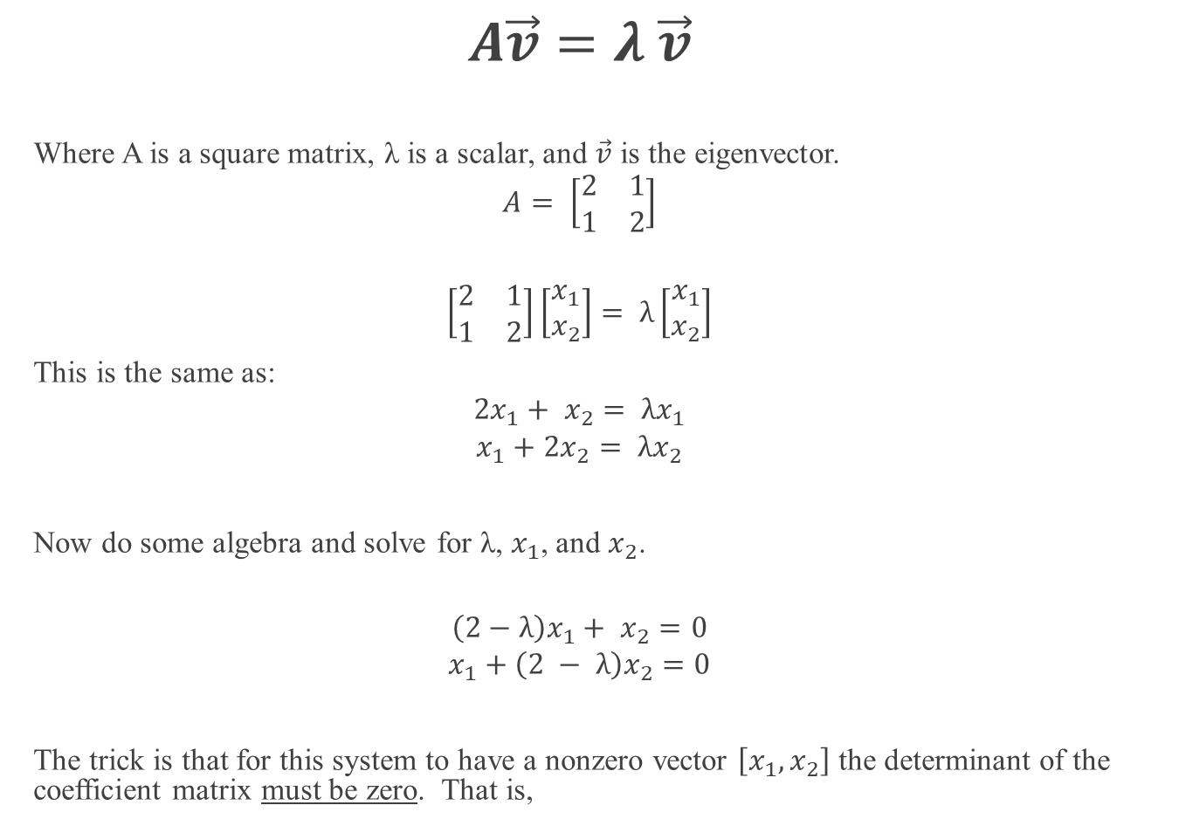
Eigenvectors and Eigenvalues
$$A\vec{v}=λ \vec{v}$$
Where A is a square matrix, λ is a scalar, and $\vec{v}$ is the eigenvector.
$$A= \left[\begin{matrix}2 & 1 \\ 1 & 2\end{matrix}\right]$$
$$\left[\begin{matrix}2 & 1 \\ 1 & 2\end{matrix}\right]\left[\begin{matrix}x_{1} \\ x_{2}\end{matrix}\right]= λ\left[\begin{matrix}x_{1} \\ x_{2}\end{matrix}\right]$$
This is the same as:
$$2x_{1}+ x_{2}= λx_{1}$$
$$x_{1}+2x_{2}= λx_{2}$$
Now do some algebra and solve for λ, $x_{1}$, and $x_{2}$.
$$\left(2−λ\right)x_{1}+ x_{2}=0$$
$$x_{1}+\left(2 − λ\right)x_{2}=0$$
The trick is that for this system to have a nonzero vector $\left[x_{1}, x_{2}\right]$ the determinant of the coefficient matrix must be zero. That is,

Slide 21
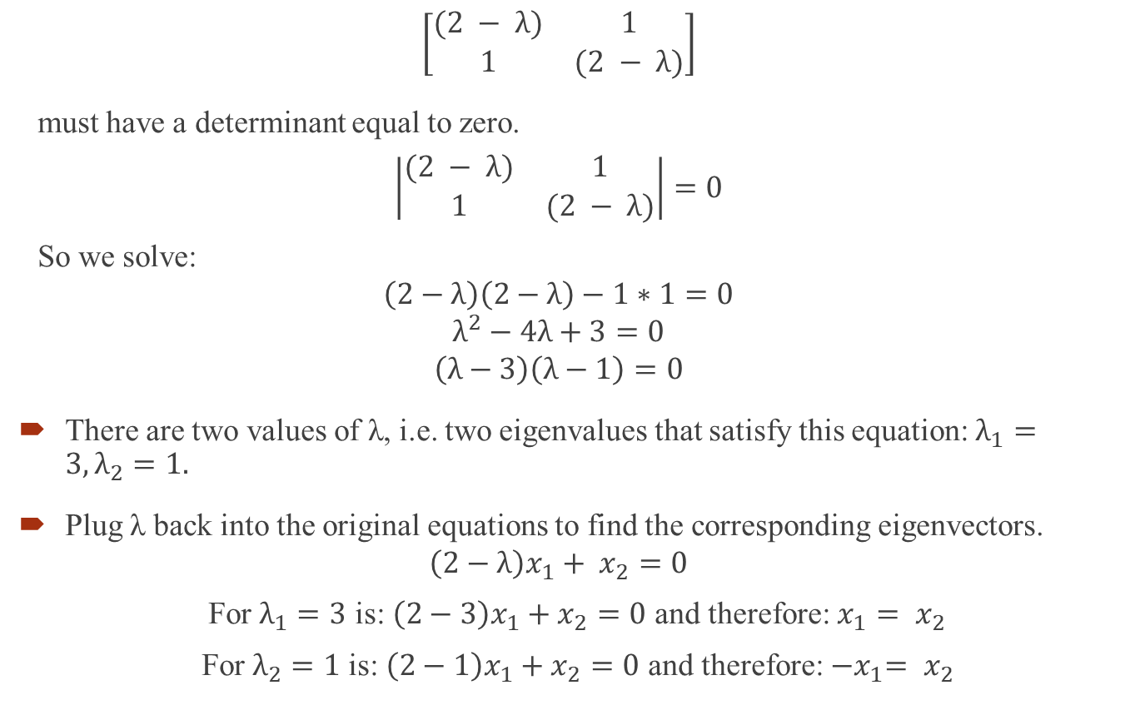
Eigenvectors and Eigenvalues Cont’d. 2
$$\left[\begin{matrix}(2 − λ) & 1 \\ 1 & (2 − λ)\end{matrix}\right]$$
must have a determinant equal to zero.
$$\left|\begin{matrix}(2 − λ) & 1 \\ 1 & (2 − λ)\end{matrix}\right|=0$$
So we solve:
$$\left(2−λ\right)\left(2−λ\right)−1∗1=0$$
$$λ^{2}−4λ+3=0$$
$$\left(λ−3\right)\left(λ−1\right)=0$$
There are two values of λ, i.e. two eigenvalues that satisfy this equation: $λ_{1}=3, λ_{2}=1.$
Plug λ back into the original equations to find the corresponding eigenvectors.
$$\left(2−λ\right)x_{1}+ x_{2}=0$$
For $λ_{1}=3$ is: $\left(2−3\right)x_{1}+x_{2}=0$ and therefore: $x_{1}= x_{2}$
For $λ_{2}=1$ is: $\left(2−1\right)x_{1}+x_{2}=0$ and therefore: ${−x}_{1}= x_{2}$

Slide 22

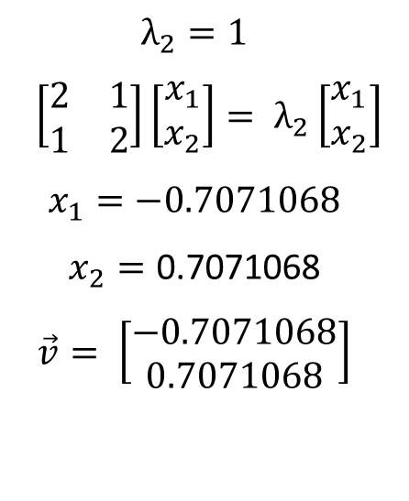
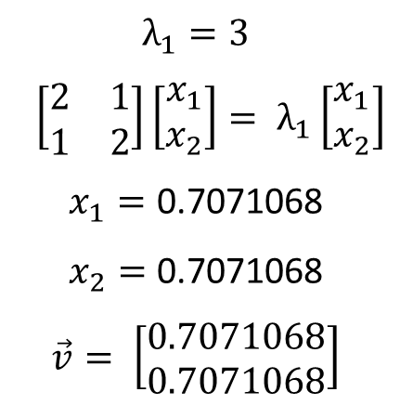
Two Solutions
$$A= \left[\begin{matrix}2 & 1 \\ 1 & 2\end{matrix}\right]$$
$$A\vec{v}=λ \vec{v}$$
$$\left[\begin{matrix}2 & 1 \\ 1 & 2\end{matrix}\right]\left[\begin{matrix}x_{1} \\ x_{2}\end{matrix}\right]= λ\left[\begin{matrix}x_{1} \\ x_{2}\end{matrix}\right]$$
$$λ_{1}=3$$
$$\left[\begin{matrix}2 & 1 \\ 1 & 2\end{matrix}\right]\left[\begin{matrix}x_{1} \\ x_{2}\end{matrix}\right]= λ_{1}\left[\begin{matrix}x_{1} \\ x_{2}\end{matrix}\right]$$
$$x_{1}=\text{0.7071068}$$
$$x_{2}=\text{0.7071068}$$
$$\vec{v}= \left[\begin{matrix}0.7071068 \\ 0.7071068\end{matrix}\right]$$
$$λ_{2}=1$$
$$\left[\begin{matrix}2 & 1 \\ 1 & 2\end{matrix}\right]\left[\begin{matrix}x_{1} \\ x_{2}\end{matrix}\right]= λ_{2}\left[\begin{matrix}x_{1} \\ x_{2}\end{matrix}\right]$$
$$x_{1}=−0.7071068$$
$$x_{2}=\text{0.7071068}$$
$$\vec{v}= \left[\begin{matrix}−0.7071068 \\ 0.7071068\end{matrix}\right]$$

Slide 23


Eigenvalues and Eigenvectors
Python
R
import numpy as np
A=np.matrix('2 1;1 2')
A
eigen = np.linalg.eig(A)
eigen[0]
eigen[1]
> A=matrix(c(2,1,1,2),ncol=2)
> A
[,1] [,2]
[1,] 2 1
[2,] 1 2
> ea=eigen(A)
> G=ea$vectors
> G
[,1] [,2]
[1,] 0.7071068 -0.7071068
[2,] 0.7071068 0.7071068

