Slide 1
Decision Tree
Lecture 3
Machine Learning

Slide 2
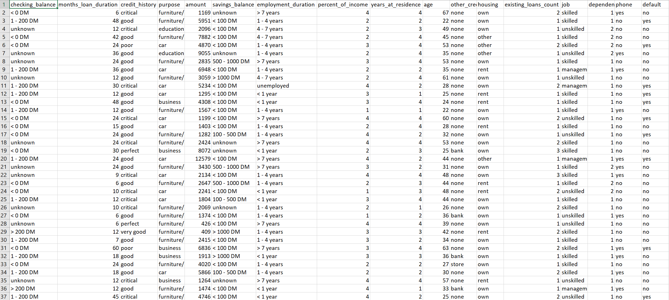
Dataset
Target/ label
Input features/ attributes
Dependent/ Output/ response variable
Independent/ input/ predictor variable
Observations
Instances

Slide 3
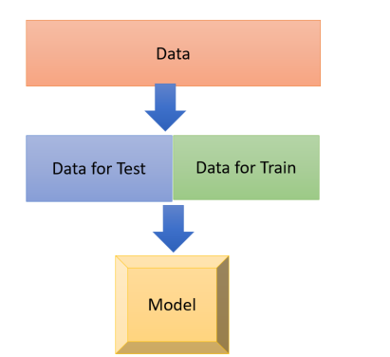
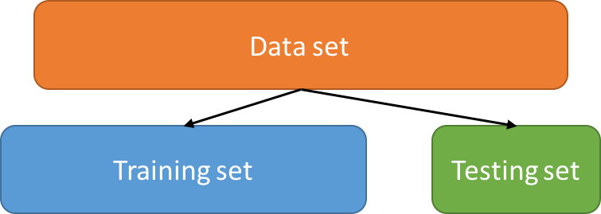
Data preparation
Given a data set, e.g. a collection of observations, find a model for the class attribute as a function of the other attributes in the data set
A training set of observations is used for supervised learning
A test set of observations is used to determine the accuracy of the model

Slide 4
Classification
Functions as its name suggests, by classifying data in order to then make predictions
Is one of the supervised learning techniques
Used for predictive modeling
Uses a classification model via a learning algorithm
Goal: Categorization- Categorical output
Given an event, predict is category. Examples:
Is there any fraud in credit report?
How should we file a given email?
Event = list of features. Examples:
Credit: What are the transactions?
Email: Who sent the email?

Slide 5
Decision Trees
A decision tree consists of:
Root node (or starting node)
Interior nodes
Leaf nodes (or terminating nodes)

Slide 6
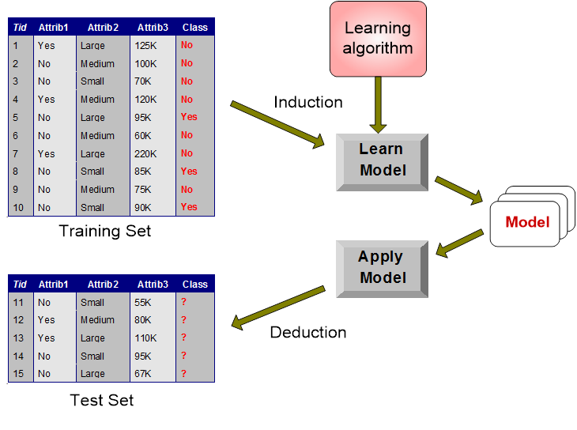
Illustrating Classification (from Tan, Steinbach and Kumar)

Slide 7
Algorithm
Tid | Refund | Marital Status | Taxable Income | Cheat
1 | Yes | Single | 125K | No
2 | No | Married | 100K | No
3 | No | Single | 70K | No
4 | Yes | Married | 120K | No
5 | No | Divorced | 95K | Yes
6 | No | Married | 60K | No
7 | Yes | Divorced | 220K | No
8 | No | Single | 85K | Yes
9 | No | Married | 75K | No
10 | No | Single | 90K | Yes
Refund
Don’t
Cheat
Yes
No
Don’t
Cheat
Don’t
Cheat
Refund
Refund
Yes
No
Yes
No
Don’t
Cheat
Marital
Status
Don’t
Cheat
Marital
Status
Single,
Divorced
Single,
Divorced
Married
Married
Cheat
Don’t
Cheat
Taxable
Income
Don’t
Cheat
< 80K
>= 80K
Don’t
Cheat
Cheat

Slide 8
Specifying Splits
Depends on the type of Attribute
Nominal
Ordinal
Continuous
Depends on the number of ways to split
2-way split
Multi-way split

Slide 9
Greedy Strategies
What is a greedy strategy?
A greedy algorithm is an algorithmic paradigm that follows the problem solving heuristic of making the locally optimal choice at each stage with the intent of finding a global optimum. (Wikipedia)
Advantages – simpler
Disadvantages – may only find local optimum
Notes:
Virtually all algorithms iterate to a solution or to some predefined convergence criteria. Otherwise why would we need to use an algorithm? As an algorithm proceeds step-by-step, a greedy strategy is one that seeks the best solution, according to a predefined criteria, at that point in the algorithm. That’s all it does; it seeks the current, best solution. For example, if a greedy strategy is used to develop a rule-based classifier it might try to find the best rule at each stage and add that rule to the rule set. However, when there is more than one rule involved the rule set that is developed this way might not be collectively the best , or best performing. Or, when building a decision tree a decision to split early might not result in the best tree when the overall tree’s performance is considered. The decision to split early may hinder the performance of later splits.
So, the advantages of a greedy strategy is that it is simpler and often faster. But, this comes with the disadvantage that the overall algorithm may produce a solution that is only locally optimum and not globally optimum.

Slide 10
Splitting on Nominal Attributes
Multi-way split: Use as many partitions as distinct values.
Binary split: Divides values into two subsets. Need to find optimal partitioning.
CarType
Family
Luxury
Sports
CarType
CarType
{Sports, Luxury}
OR
{Family, Luxury}
{Family}
{Sports}
© Tan,Steinbach, Kumar Introduction to Data Mining 4/18/2004 10
Notes:
We’ll start with the simplest case, i.e. that of nominal attributes. If a nominal attribute has two levels it is binary, e.g. true or false, etc. as mentioned before. Then, the split is straight forward. However, if a nominal attribute has multiple levels then it can be more difficult to decide how to make the split. Sometimes the algorithm will require or just work better with 2-way splits. So, some grouping of levels is required. Even if it isn’t necessary to reduce from many to 2 levels it is probably not a good idea in terms of processing to keep too many levels. A multi, 3-way split is illustrated at the top of Slide 9.
In general, splitting starts from a root or parent node. Nodes downstream are considered child nodes. We’ll see later several ways to evaluate splits but will use a split to try to reduce the impurity of the remaining data.

Slide 11
Splitting on Ordinal Attributes
Multi-way split: Use as many partitions as distinct values.
Binary split: Divides values into two subsets. Need to find optimal partitioning.
What about this split?
Size
Small
Large
Medium
Size
Size
{Small, Medium}
OR
{Medium, Large}
{Large}
{Small}
Size
{Small, Large}
{Medium}
© Tan,Steinbach, Kumar Introduction to Data Mining 4/18/2004 11
Notes:
Splitting on ordinal attributes is very similar to splitting on nominal attributes but with the added benefit or disadvantage, depending on your perspective, of the levels of the attribute being ordered. If you are required to group levels this can be an advantage or disadvantage. You might not want to have one very large group of two levels if you are only left with a very few instances in a group comprised of the remaining third level of the attribute.
Slide 10 illustrates multi, 3-way splits and 2-way splits as before. Slide 10 also poses an interesting question at the bottom. What about creating a 2-way split, i.e. 2 groups, where one of the groups comprises small and large and the other group only has medium. Does this make sense in any context?

Slide 12
Splitting on Continuous Attributes
Different ways of handling
Discretization to form an ordinal categorical attribute
Static – discretize once at the beginning
Dynamic – ranges can be found by equal interval bucketing, equal frequency bucketing (percentiles), or clustering.
Binary Decision: (A < v) or (A ≥ v)
consider all possible splits and finds the best cut
can be more compute intensive
© Tan,Steinbach, Kumar Introduction to Data Mining 4/18/2004 12
Notes:
Splitting on continuous attributes can be more difficult. Because of the nature of decision trees, and if you want to use them as a basis for formulating rules, continuous attributes must be split up some way. The exact way will depend on the discipline you are working in and the type of analysis you will perform. One way is not always best.
Slide 11 illustrates a few ways of splitting continuous attributes. For example, if you are doing an analysis that requires comparison of different quantiles you might be able to set those up at the beginning and during implementation have the algorithm sort the records in the training set into the appropriate bins representing the quantiles. If you are doing other types of analysis, e.g. considering the impact of something on aging, you might want to have a number of bins established by age groups as determined by other medical data, or you might want a binary situation where you are looking at people over or under 65 years of age. Setting up appropriate splits on continuous data requires some intelligent consideration.

Slide 13
Splitting on Continuous Attributes (2)
© Tan,Steinbach, Kumar Introduction to Data Mining 4/18/2004 13
Notes:
Slide 12 illustrates the splitting of the attribute taxable income in two ways:
As a binary split with taxable income greater or less than 80k.
Or, with bins that include predefined ranges of taxable income. This is the first multi-way split we’ve seen in this presentation that was greater than a 3-way split.

Slide 14
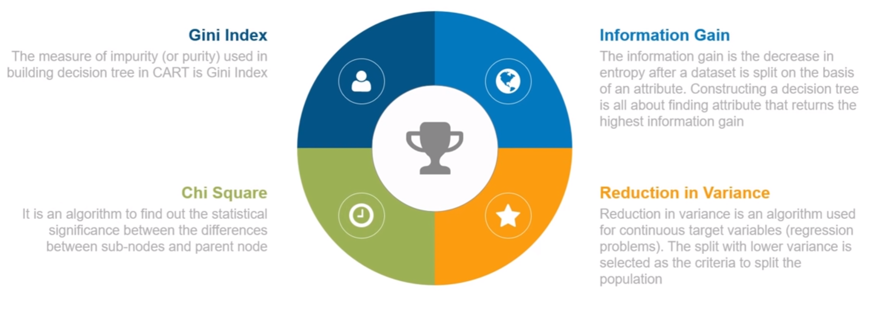
How to make the splits?

Slide 15
Determining the Best Split
Three measures of node impurity
Gini Index
Entropy
Misclassification Error
Notes:
) How do we determine what the best split is? At the end of the day we’ll see that this depends largely on the class distribution before and after splitting. For example, when we think about the class distribution think about the binary case and its 2 extremes, i.e. in the binary case as shown in Figure 4.13 on page 159 in the textbook, the extremes are the class is uniformly distributed or the records all belong to the same class 0 or 1. When the records all belong to 1 class there is no “impurity”. When the records are evenly distributed the impurity is maximized.
Measures of impurity include: entropy; Gini; and, classification error. Determining what the best split is will be based on determining the degree of impurity of the parent node (before splitting) versus the degree of impurity of the child node (after splitting) and minimizing the “weighted average impurity measures of the child nodes”. That is, the gain, as discussed in the textbook on page 160, is the difference between the impurity of the parent node and the weighted average impurity measures of the child nodes. Note that when entropy is used as the measure of impurity as shown in equation 4.6 this is called information gain.

Slide 16
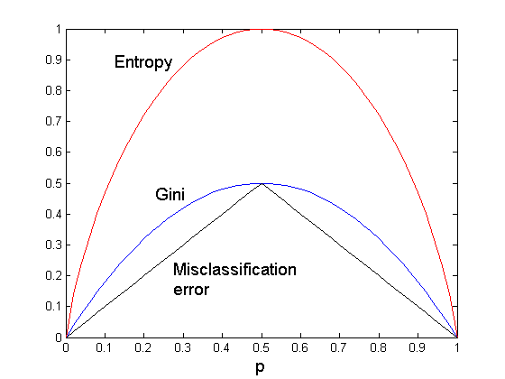
Comparison of Splitting Criteria
For a 2-class problem:
© Tan,Steinbach, Kumar Introduction to Data Mining 4/18/2004 16
Notes:
Slide 28 shows the differences that result between using the splitting criteria we’ve discussed: entropy versus the Gini Index versus classification error. As you can see, the maximum occurs when there is the greatest entropy or the most heterogeneity. The minimum occurs when there is the least entropy or the most homogeneity.

Slide 17
Decision tree- Advantage and disadvantage
Advantages:
Simple to understand and interpret
Little data preparation
Useful for both numerical and categorical data
Able to handle multi-targets
Disadvantages:
Can create over-complex trees (overfitting)
Unstable to small variations
Create biased trees if some classes dominate
Notes:
Strictly speaking data and attribute types are not the same thing and there is an enormous amount of gray area. An attribute has been defined by Witten et al in their book “Data Mining: Practical Machine Learning Tools and Techniques” as
Each instance that provides input to machine learning is characterized by its values on a fixed, predefined set of features or attributes. The instances are the rows of tables that we… (have compiled as datasets) and the attributes are the columns.
But, Witten et al are only considering one part of machine learning that deals with datasets that are in the format of spreadsheets. We know that there are many other types of data and it is important to include all types when we draw conclusions about attributes in the context of data types.
If we come at this from a different direction, the perspective of different data types in R, we find we have:
R assignment operators
Numeric data
Integers
Complex numbers
Logicals
Characters and Lists
Factors
Vectors
Data frames

Slide 18
Stopping Criteria for Tree Induction
Stop expanding a node when all the records belong to the same class
Stop expanding a node when all the records have similar attribute values
Early termination (to be discussed later)
Notes:
As mentioned briefly before, there are a number of criteria for stopping tree induction including; stopping an expanding node when all records belong to the same class, stopping an expanding node when all records have “similar” attribute values, or executing an early termination.

Slide 19
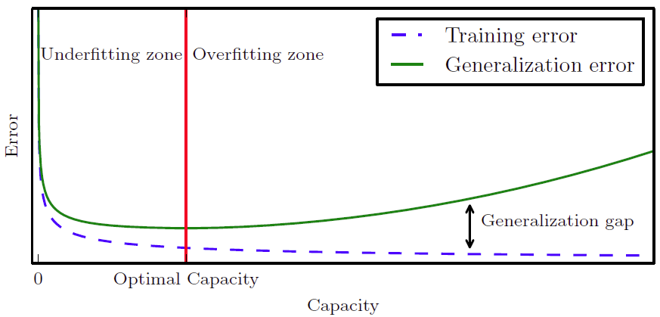
Overfitting
Many reasons overfitting can occur
Noise, Insufficient instances
Overfitting results in decision trees that are more complex than necessary
Training error no longer provides a good estimate of how well the tree will perform on previously unseen records
Need new ways for estimating errors
Goodfellow, Bengio& Courville. 2016. Deep Learning. MIT Press: Cambridge, MA.
Notes:
We could spend an entire lecture on overfitting. I don’t want to do that. But, I don’t want to give you an impression that this isn’t an important topic by just skipping it altogether. Overfitting is one of the most common challenges with decision tree induction. There are many reason overfitting can occur including noise and an insufficient number of instances resulting in insufficient training.
Overfitting will result in decision trees that are more complex than necessary.
The training error measured no longer provides a good estimate of how well the tree will perform.
When overfitting is present a new way for estimating errors will be needed.

Slide 20
Addressing Overfitting
Pre-Pruning (Early Stopping Rule)
Stop the algorithm before it becomes a fully-grown tree
Typical stopping conditions for a node:
Stop if all instances belong to the same class
Stop if all the attribute values are the same
More restrictive conditions:
Stop if number of instances is less than some user-specified threshold
Stop if class distribution of instances are independent of the available features (e.g., using χ ² test)
Stop if expanding the current node does not improve impurity measures (e.g., Gini or information gain).
© Tan,Steinbach, Kumar Introduction to Data Mining 4/18/2004 20

Slide 21
Addressing Overfitting (2)
Post-pruning
Grow decision tree to its entirety
Trim the nodes of the decision tree in a bottom-up fashion
If generalization error improves after trimming, replace sub-tree by a leaf node.
Class label of leaf node is determined from majority class of instances in the sub-tree
© Tan,Steinbach, Kumar Introduction to Data Mining 4/18/2004 21

Slide 22
Model Evaluation
Metrics for Performance Evaluation
How to evaluate the performance of a model?
Methods for Performance Evaluation
How to obtain reliable estimates?
Methods for Model Comparison
How to compare the relative performance among competing models?
© Tan,Steinbach, Kumar Introduction to Data Mining 4/18/2004 22

Slide 23
Metrics for Performance Evaluation
Focus on the predictive capability of a model
Rather than how fast it takes to classify or build models, scalability, etc.
Confusion Matrix:
 | PREDICTED CLASS
ACTUAL CLASS |  | Class=Yes | Class=No
 | Class=Yes | a | b
 | Class=No | c | d
Consistent with Statistical Tests:
a: TP (true positive)
b: FN (false negative)
c: FP (false positive)
d: TN (true negative)
© Tan,Steinbach, Kumar Introduction to Data Mining 4/18/2004 23

Slide 24
Metrics for Performance Evaluation (2)
Most widely-used metric:
 | PREDICTED CLASS
ACTUAL CLASS |  | Class=Yes | Class=No
 | Class=Yes | a (TP) | b (FN)
 | Class=No | c (FP) | d (TN)
© Tan,Steinbach, Kumar Introduction to Data Mining 4/18/2004 24

Slide 25
Example 1- Iris Dataset
This data sets consists of 3 different types of irises’ (Setosa, Versicolor, and Virginica) petal and sepal length, stored in a 150x4
We want to make a model that predicts the type of Iris based on given physical information
Code is provided on Canvas
Petal length | Sepal length | Petal width | Sepal width | Type of iris
5.1 | 3.5 | 1.2 | 0.2 | Setosa
4.9 | 3.0 | 1.4 | 0.2 | Versicolor
4.7 | 3.6 | 1.3 | 0.3 | Versicolor
3.2 | 2.8 | 1.2 | 0.2 | Virginica
3.8 | 3.7 | 1.5 | 0.1 | Versicolor
Notes:
Let’s look at algorithms for decision tree induction in R. First, let’s look at the rpart package. It is one of the most popular so well used and documented. Again, let’s use the Titanic dataset. The commands are shown here on Slide 39.

Slide 26
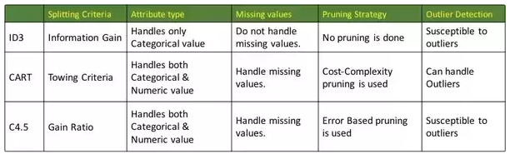
Induction Algorithms

Slide 27
More About Math
Optional

Slide 28
Node Impurity
Define node impurity: nodes with homogeneous class distribution are preferred.
Non-homogeneous,
High degree of impurity
Homogeneous,
Low degree of impurity
© Tan,Steinbach, Kumar Introduction to Data Mining 4/18/2004 28
Notes:
Slide 14 illustrates the 2 extremes of node impurity, the evenly distributed case and the case where all (or in the case nearly all) records belong to the same class. For the non-homogeneous case, Class 0 has 5 records and Class 1 has 5 records, i.e. the records are evenly distributed among the classes. For the homogeneous case, Class 0 has 9 out of 10 records. Class 1 only has 1 record. So, in this case nearly all records belong to the same class.

Slide 29
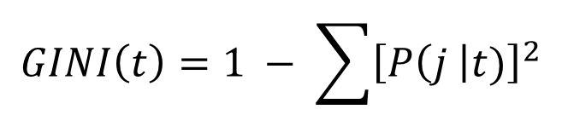
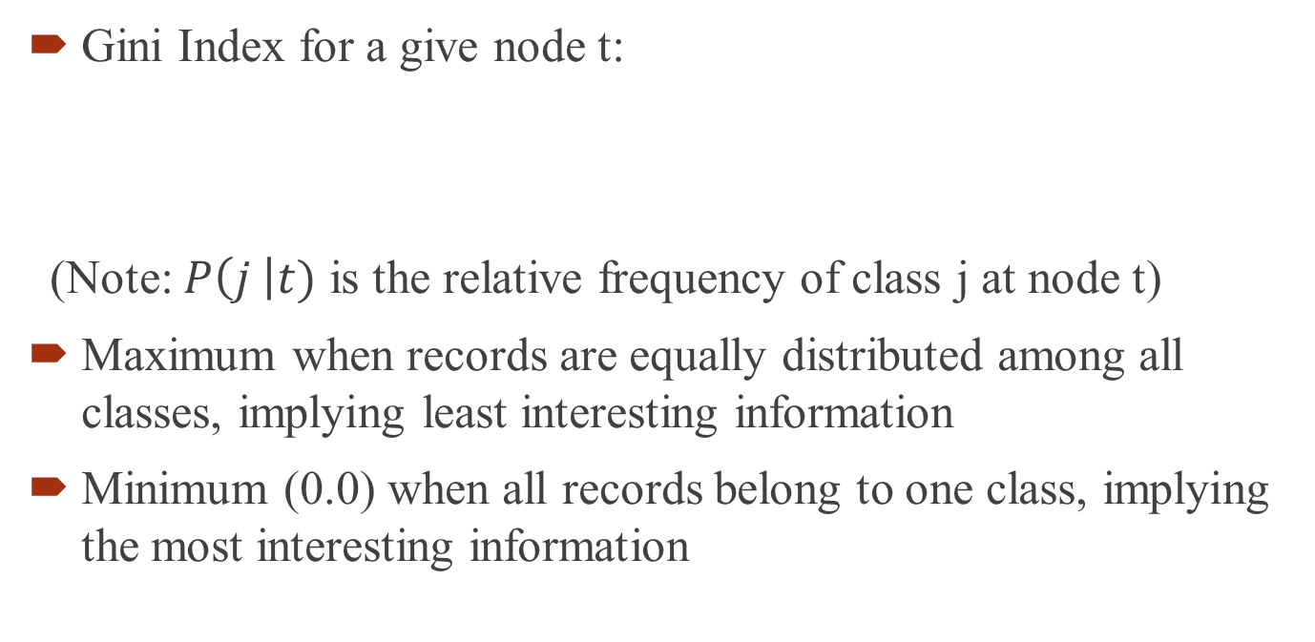
The Gini Index
Gini Index for a give node t:
(Note: $P\left(j \right|t)$ is the relative frequency of class j at node t)
Maximum when records are equally distributed among all classes, implying least interesting information
Minimum (0.0) when all records belong to one class, implying the most interesting information
$$GINI\left(t\right)=1 − \sum{{\left[P\left(j \right|t)\right]}^{2}}$$
© Tan,Steinbach, Kumar Introduction to Data Mining 4/18/2004 29
Notes:
Let’s consider the Gini Index first. The Gini Index as originally developed by the Italian statistician Corrado Gini in 1912 was used to rate countries by income distribution. A maximum Gini Index equal to 1 would mean that all the income belonged to one country. A minimum Gini Index equal to 0 would mean that income was evenly distributed among all countries. In essence, this Index measures the degree of unevenness in the spread of values over the range of a variable.
Slide 15 shows the equation for calculating the Gini Index. Note that the matrices at the bottom of the slide illustrate the effect of the degree of unevenness in the calculated Gini Index where the minimum occurs when all records are in one class C2 and the maximum occurs when records are evenly spread between classes C1 and C2.

Slide 30
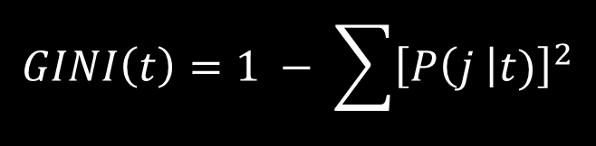
Examples for Computing Gini
$$GINI\left(t\right)=1 − \sum{{\left[P\left(j \right|t)\right]}^{2}}$$
P(C1) = 0/6 = 0 P(C2) = 6/6 = 1
Gini = 1 – P(C1)² – P(C2)² = 1 – 0 – 1 = 0
P(C1) = 1/6 P(C2) = 5/6
Gini = 1 – (1/6)² – (5/6)² = 0.278
P(C1) = 2/6 P(C2) = 4/6
Gini = 1 – (2/6)² – (4/6)² = 0.444
© Tan,Steinbach, Kumar Introduction to Data Mining 4/18/2004 30
Notes:
Slide 16 shows the step-by-step calculations for the Gini Index.

Slide 31
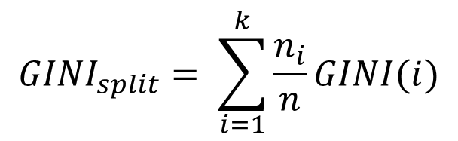
Splitting Base on GINI
When a node p is split into k partitions (children), the quality of split is computed as,
where, n_{i} = number of records at child i,
n = number of records at node p.
$${GINI}_{split}= \sum_{i=1}^{k}{\frac{n_{i}}{n}GINI(i)}$$
© Tan,Steinbach, Kumar Introduction to Data Mining 4/18/2004 31
Notes:
The Gini Index is used to determine splitting in CART, SLIQ and SPRINT. Slide 17 gives the equation for calculating the “quality of split” based on the Gini Index.

Slide 32
Computing the GINI for Categorical (Nominal) Attributes
For each distinct value, gather counts for each class in the dataset
Use the count matrix to make decisions
Multi-way split
Two-way split
(find best partition of values)
© Tan,Steinbach, Kumar Introduction to Data Mining 4/18/2004 32
Notes:
The Gini Index can be used to evaluate splitting categorical attributes too. In this case, a count is made of each distinct value and then the Gini Index is calculated. Again, the Gini Index with the smallest value is preferred. However, even though the multiway split shown on Slide 19 results in the smallest Gini Index remember that some induction algorithms only allow a binary split and so the multiway split shown would not be allowed.

Slide 33
Computing the GINI for Continuous Attributes
Use Binary Decisions based on one value
Several Choices for the splitting value
Number of possible splitting values = Number of distinct values
Each splitting value has a count matrix associated with it
Class counts in each of the partitions, A < v and A ≥ v
Simple method to choose best v
For each v, scan the database to gather count matrix and compute its Gini index
Computationally Inefficient! Repetition of work.
© Tan,Steinbach, Kumar Introduction to Data Mining 4/18/2004 33
Notes:
The Gini Index can also be used to evaluate splitting for continuous attributes. There are a number of ways to proceed, e.g. by brute force consideration of value of an attribute as a candidate split position.

Slide 34
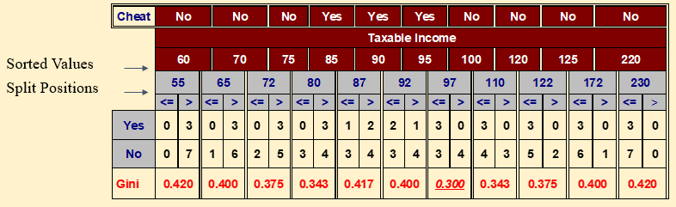
More Computing the GINI for Continuous Attributes
For efficient computation: for each attribute,
Sort the attribute on values
Linearly scan these values, each time updating the count matrix and computing gini index
Choose the split position that has the least gini index
© Tan,Steinbach, Kumar Introduction to Data Mining 4/18/2004 34
Notes:
However, it is more efficient to first sort a continuous attribute on its values, scan these values for candidate split positions, and then find the position that yields the least Gini Index. Even more efficient is to sort the continuous attribute and then use adjacent records with different class labels as candidate split positions. At these locations, adjacent records with different class labels, compute the Gini Index and select the location with the least value of the Index.

Slide 35
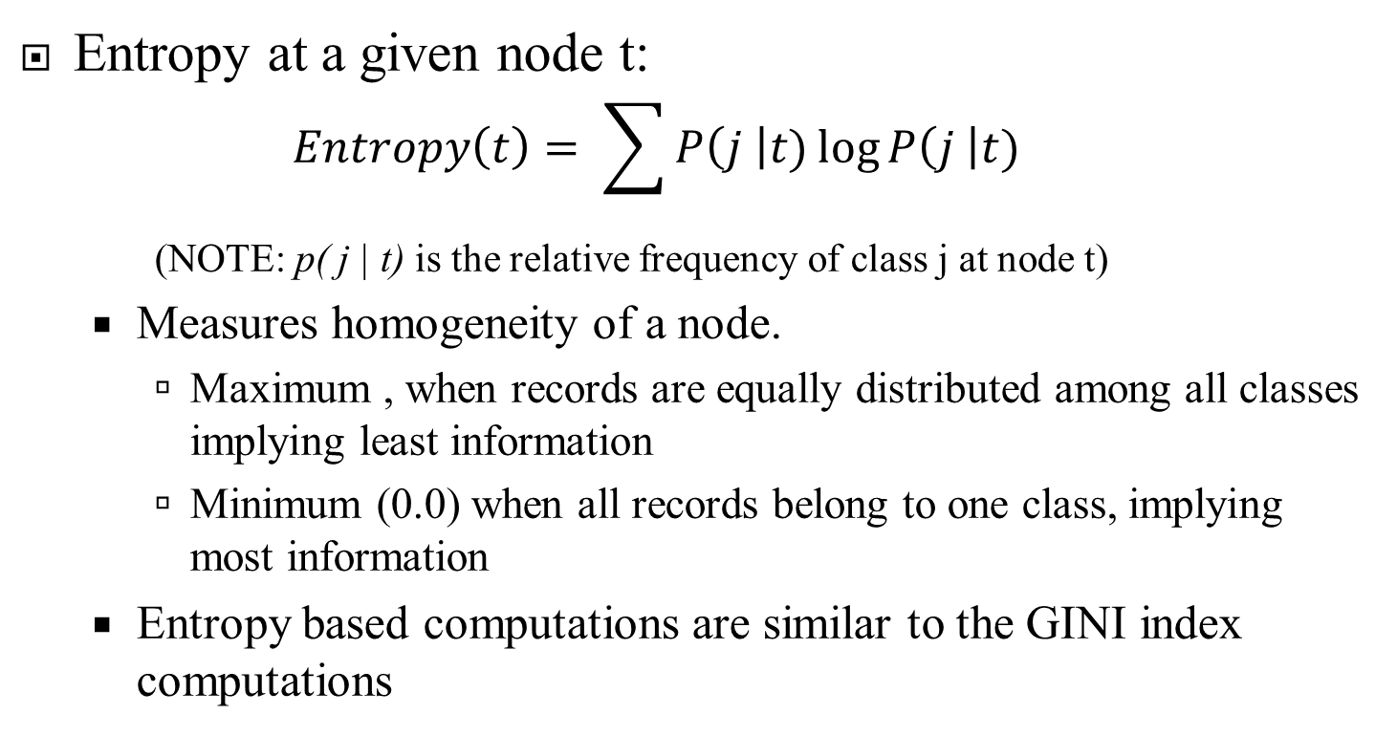
Splitting Criteria based on Information Gain
Entropy at a given node t:
$$Entropy\left(t\right)= \sum{P\left(j \right|t)\log{P\left(j \right|t)}}$$
(NOTE: p( j | t) is the relative frequency of class j at node t)
Measures homogeneity of a node.
Maximum , when records are equally distributed among all classes implying least information
Minimum (0.0) when all records belong to one class, implying most information
Entropy based computations are similar to the GINI index computations
© Tan,Steinbach, Kumar Introduction to Data Mining 4/18/2004 35
Notes:
Now let’s consider the use of entropy as a splitting criterion. This use of entropy is based on pioneering work by Claude Shannon on information theory.
One of the most common method to evaluate candidate splitting positions is the use of entropy; however, in the form of information gain. For now, we’ll leave the discussion in the form of entropy. Slide 22 shows the equation to calculate entropy at a given node. P is the non-zero probability for the “j” number of records of a class divided by the “t” total number of records and log base 2 is used because information is/was encoded in bits.
The same as the Gini Index, entropy is a measure of the homogeneity of a node, or the values of an attribute. Entropy reaches a maximum when all records are equally distributed and a minimum when all records belong to one class. More information is in your ISL textbook on page 312.

Slide 36
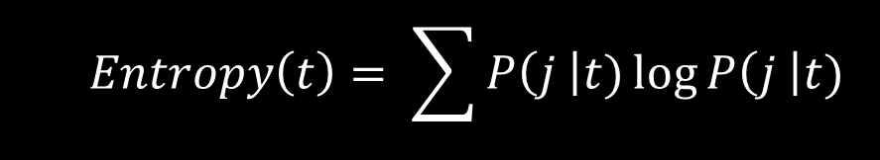
Examples for Computing Entropy
$$Entropy\left(t\right)= \sum{P\left(j \right|t)\log{P\left(j \right|t)}}$$
P(C1) = 0/6 = 0 P(C2) = 6/6 = 1
Entropy = – 0 log 0 – 1 log 1 = – 0 – 0 = 0
P(C1) = 1/6 P(C2) = 5/6
Entropy = – (1/6) log₂ (1/6) – (5/6) log₂ (5/6) = 0.65
P(C1) = 2/6 P(C2) = 4/6
Entropy = – (2/6) log₂ (2/6) – (4/6) log₂ (4/6) = 0.92
© Tan,Steinbach, Kumar Introduction to Data Mining 4/18/2004 36
Notes:
Slide 23 steps through 3 examples for calculating entropy. As we have said many times now, the preferred split is when all records are of one class, i.e. the first example with entropy equal to 1. When the distribution of records among classes is more even, as in example 3, the entropy approaches a maximum value.
Impurity measures such as the Gini Index and entropy favor attributes that have a large number of distinct values. However, this is not the entire argument. For example, a database with a customer id number will provide the largest number of distinct values for an attribute since each customer has a unique id number. This example illustrates that even though an attribute may have a very large number of distinct values it may not be a predictive attribute, e.g. customer ID number has no ability to predict car type, or as another example student id number has no value to predict a student’s major in school.

Slide 37
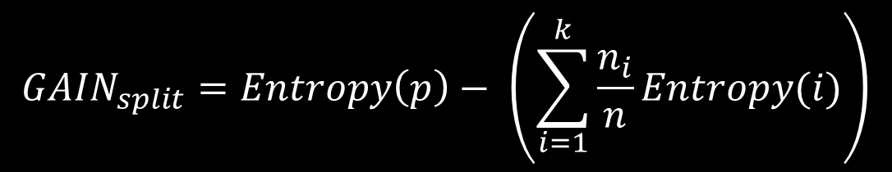
Splitting on Information Gain
Information Gain:
Parent Node, p is split into k partitions;
n_{i} is number of records in partition i
Measures Reduction in Entropy achieved because of the split. Choose the split that achieves most reduction (maximizes GAIN)
Disadvantage: Tends to prefer splits that result in large number of partitions, each being small but pure.
$${GAIN}_{split}=Entropy\left(p\right)− \left(\sum_{i=1}^{k}{\frac{n_{i}}{n}Entropy(i)}\right)$$
© Tan,Steinbach, Kumar Introduction to Data Mining 4/18/2004 37
Notes:
There are 2 strategies for overcoming this challenge. First, you could restrict test conditions to binary splits only. CART is a decision tree algorithm that implements this strategy. But, we’ve already discussed some of the issues when we make this restriction.
The other strategy is to modify the splitting criterion to take into account the number of outcomes produced by the attribute test condition. From entropy we can derive the concept of Information Gain. Note that in this equation for Gain, P refers to the parent node rather than the probability as was the case in the equation for entropy itself. C4.5 is a decision tree algorithm that implements this criterion known as gain ratio.

Slide 38
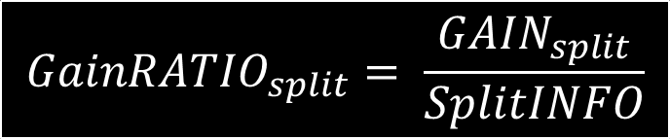
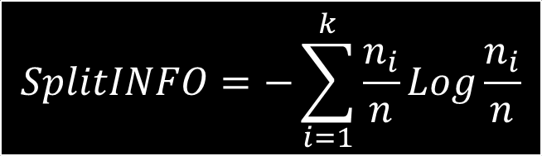
Splitting on Information Gain (2)
Gain Ratio:
Parent Node, p is split into k partitions
n_{i} is the number of records in partition i
Adjusts Information Gain by the entropy of the partitioning (SplitINFO). Higher entropy partitioning (large number of small partitions) is penalized!
Used in C4.5
Designed to overcome the disadvantage of Information Gain
$$SplitINFO=−\sum_{i=1}^{k}{\frac{n_{i}}{n}Log\frac{n_{i}}{n}}$$
$${GainRATIO}_{split}= \frac{{GAIN}_{split}}{SplitINFO}$$
© Tan,Steinbach, Kumar Introduction to Data Mining 4/18/2004 38
Notes:
Gain ratio is given on Slide 25 and in the ISL textbook on page 311.
So, if we partition, or split, the tuples or records in the data set on some attribute have distinct values then these partitions correspond to the branches grown from the parent or root node N. Ideally we want these partitions to produce an exact classification of these tuples, i.e. we want each partition to be pure. But, in reality some impurities exist. How much more information we need to arrive at an exact classification, or to remove any remaining impurities can be measured. Information gain is derived to take into consideration information gain relative to the total intrinsic information and reduce the bias towards attributes with extremely large numbers of distinct values.

Slide 39

Splitting on Classification Error
Classification error at a node t :
Measures misclassification error made by a node.
Maximum , when records are equally distributed among all classes, implying least interesting information
Minimum (0.0) when all records belong to one class, implying most interesting information
$$Error\left(t\right)=1−\max{P\left(i \right|}t)$$
© Tan,Steinbach, Kumar Introduction to Data Mining 4/18/2004 39
Notes:
There are additional criteria for splitting to consider, e.g. classification error. Classification error is typically associated with training or as a training error, which is typically associated with Model Overfitting. There is a trade-off between developing a model with a very low training error and one with a low generalization error. That is, when the model developed fits the training data too well it might be subject to “overfitting” and less able to make accurate predictions than one with a higher training error.

Slide 40

Examples for Computing Error
$$Error\left(t\right)=1−\max{P\left(i \right|}t)$$
P(C1) = 0/6 = 0 P(C2) = 6/6 = 1
Error = 1 – max (0, 1) = 1 – 1 = 0
P(C1) = 1/6 P(C2) = 5/6
Error = 1 – max (1/6, 5/6) = 1 – 5/6 = 1/6
P(C1) = 2/6 P(C2) = 4/6
Error = 1 – max (2/6, 4/6) = 1 – 4/6 = 1/3
© Tan,Steinbach, Kumar Introduction to Data Mining 4/18/2004 40
Notes:
Slide 27 walks step-by-step through the process of calculating the value for classification error.

