Slide 1
Machine Learnin
Lecture 4
Supervised Learning Techniques and Algorithms – Random Forest

Slide 2
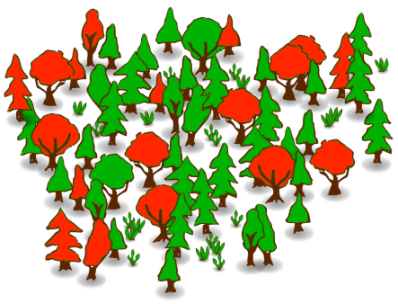
What is Random forest?
Random forests or random decision forests are an ensemble learning method for classification, regression and other tasks that operates by constructing a multitude of decision trees at training time and outputting the class that is the mode of the classes (classification) or mean prediction (regression) of the individual trees.
Wikipedia

Slide 3



Applications
Banking system
Finding loyal costumers and for credit default
Healthcare
Find combination of components to validate the correct medicine
Identifying the disease by analyzing patient medical records
Stock market
Predicting Market behavior
Predicting loss and gain
Fun and easy machine learning

Slide 4



Applications
Ecommerce
Recommendation system by looking at a small portion of data
Computer vision
Image classification
Microsoft used this algorithm for XBOX Kinect
Fun and easy machine learning

Slide 5

Some definitions…
Before we start to analyze how RF works, we need to know some terms:
Ensemble model:
Ensemble is a Machine Learning concept in which the idea is to train multiple models using the same learning algorithm.
Bagging:
The models are built in parallel on various samples and then the various models vote to give the final model and prediction.
Improves stability and handles overfitting

Slide 6


Some definitions…
Before we start to analyze how RF works, we need to know some terms:
Boosting:
Models are designed in series. In each successive model, the parameters are adjusted based on the learning of previous model
Handles overfitting and underfitting
Bootstrapping:
In statistics, bootstrapping is any test or metric that relies on random sampling with replacement.

Slide 7
Algorithm
Suppose we have N number of instances in training data. We start with taking random samples with replacement- Bootstrapped
If we have M features, a number m<M is specified such that at each node, m variables are selected at random out of M. The best split on these m is used to split the node. The value of m is held constant while the forest is grown.
Each tree is grown to the largest extent possible and there is no pruning.
Predict new data by aggregating the predictions of the n tree trees (i.e. majority votes for classification, or average for regression)
Fun and easy machine learning

Slide 8
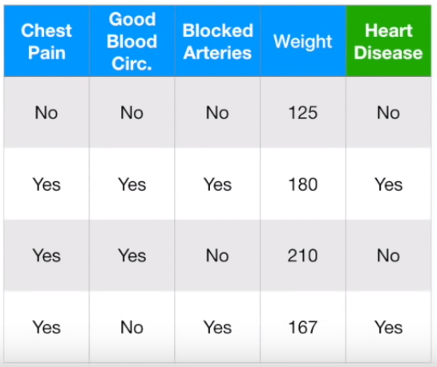
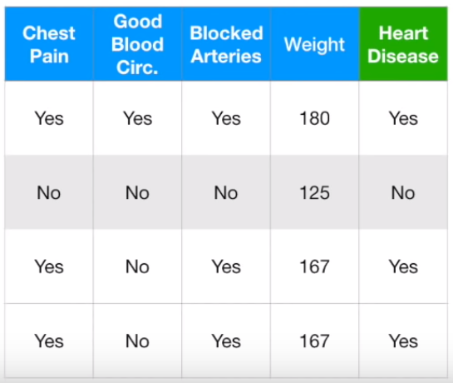

Example
We have a healthcare dataset and we want to predict the heart disease using this dataset (obviously not a real world example. Why?)
Step 1- Creating the bootstrapped dataset
Original dataset
Bootstrapped dataset
StatQuest with Josh Starmer

Slide 9
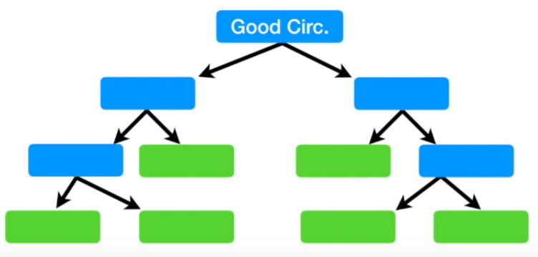

Example
Step 2- Creating the decision tree on a subset of variables.
Let’s randomly choose two variables and see which one can be the candidate for root node
StatQuest with Josh Starmer

Slide 10
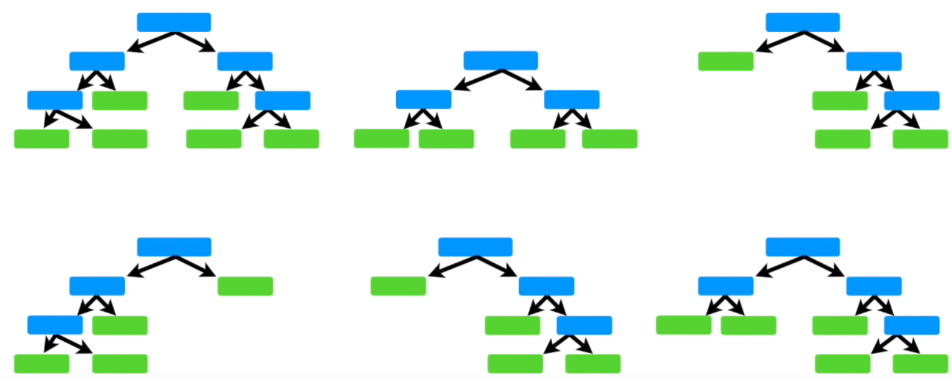

Example
Step 3- Go back to step one, make new boot strapped model and new decision tree
StatQuest with Josh Starmer

Slide 11
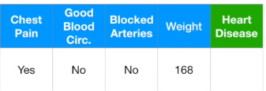
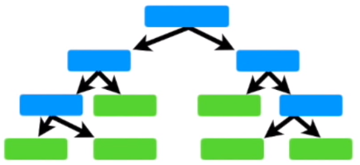

Example
Now let’s test the model on an unseen data
StatQuest with Josh Starmer

Slide 12
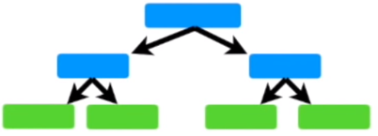

Example
See what the second tree says
StatQuest with Josh Starmer

Slide 13
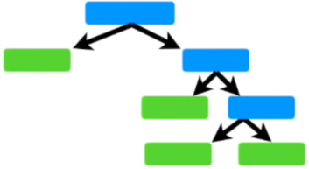

Example
How about third tree?
StatQuest with Josh Starmer

Slide 14

Example
After trying for all the trees. We may end up with following table:
The majority vote is YES so the prediction will be YES
Based on what we said, do you see this as a bagging problem or boosting?
Bagging
Out-of-Bag is equivalent to validation or test data.
YES
StatQuest with Josh Starmer

Slide 15
Why Random forest?
Pros:
It handles both classification and regression problems.
Handles the missing values and maintains accuracy for missing data
Won’t overfit the model
Handles large dataset with higher dimensionality
Cons:
The performance on regression is not as good as classification
Very little control on what the model does (black box)
Fun and easy machine learning

Slide 16
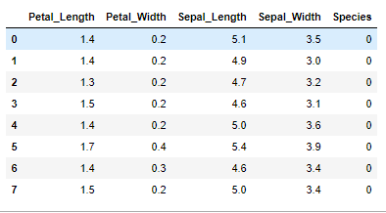
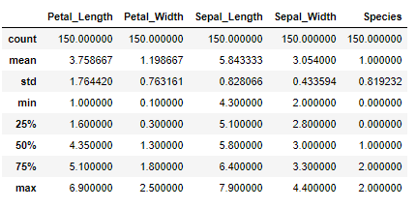
Iris- Example
For this part, let’s load the Iris dataset
from sklearn import datasets
import numpy as np
iris = datasets.load_iris()
X = iris.data
# Sepal and pedal negth and width
y = iris.target
IRIS = pd.DataFrame({'Sepal_Length':X[:,0], 'Sepal_Width':X[:,1], 'Petal_Length':X[:,2], 'Petal_Width':X[:,3], 'Species':y})

Slide 17

Coding
Data split
Training
Testing
from sklearn.model_selection import train_test_split
X_train, X_test, y_train, y_test = train_test_split(X, y, test_size=0.30, random_state=52)
from sklearn.ensemble import RandomForestClassifier
clf = RandomForestClassifier()
clf.fit(X_train, y_train)
from sklearn.metrics import confusion_matrix
# Test result
y_predict = clf.predict(X_test)
confusion_matrix(y_test, y_predict)
from sklearn.metrics import accuracy_score
accuracy_score(y_test, y_predict)*100

Slide 18
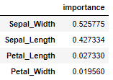
What are the most important features?
One of the interesting properties of Random forest algorithm is that it lets you see the importance of features.
import pandas as pd
cols = ['Sepal_Length', 'Sepal_Width', 'Petal_Length', 'Petal_Width']
feature_importances = pd.DataFrame(clf.feature_importances_, index = cols[0:4], columns=['importance']).sort_values('importance', ascending=False)
feature_importances

Slide 19
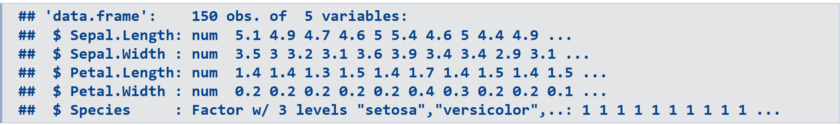
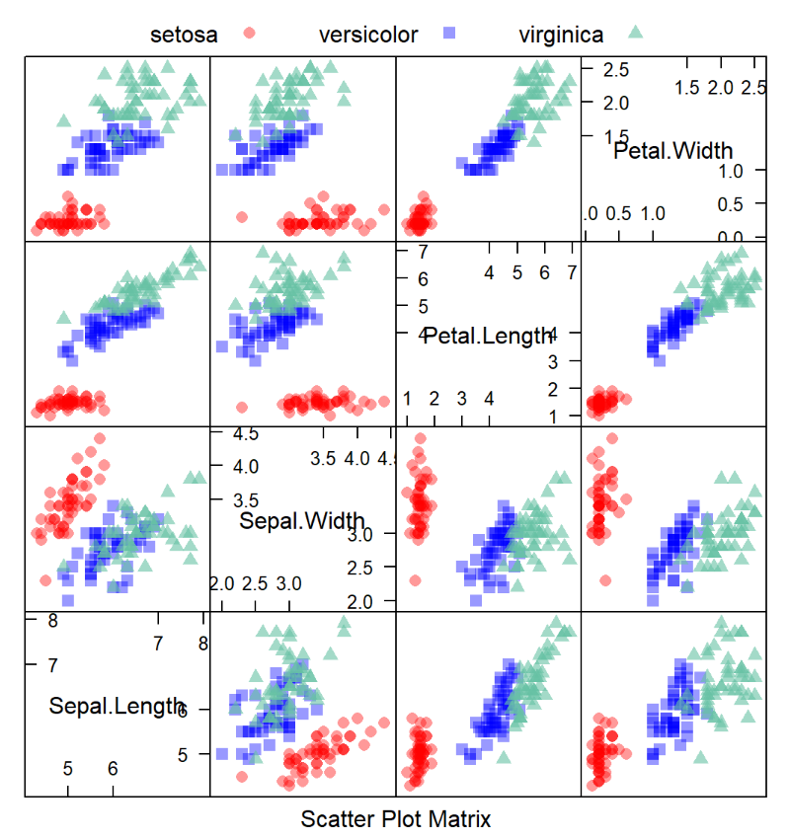
Coding with R- Scatter Plot
library ("caret")
data("iris")
iris = iris
str(iris)
library(AppliedPredictiveModeling)
transparentTheme(trans = .4)
featurePlot(x = iris[, 1:4],
y = iris$Species,
plot = "pairs",
## Add a key at the top
auto.key = list(columns = 3))

Slide 20
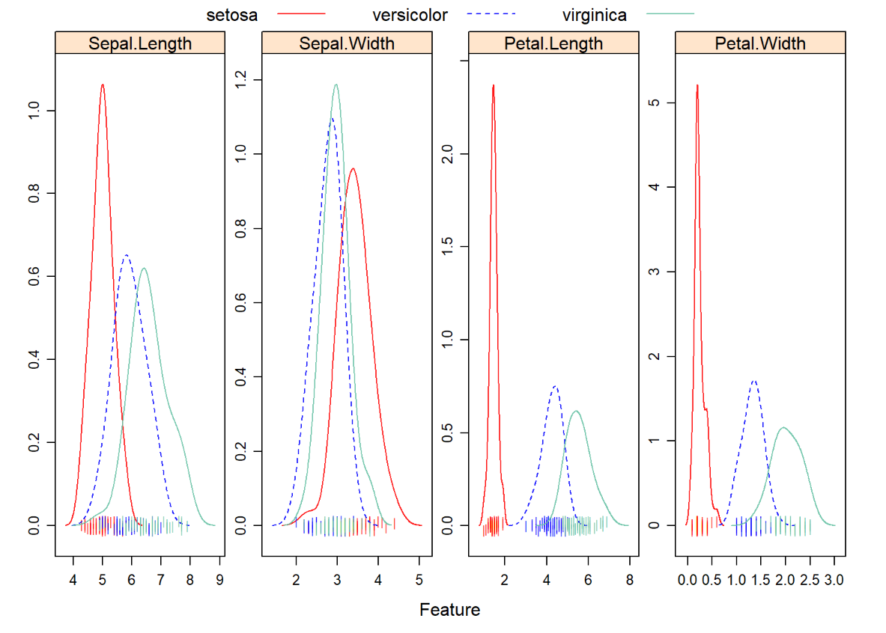
Visualization- Overlayed Destiney Plots
transparentTheme(trans = .9)
featurePlot(x = iris[, 1:4],
y = iris$Species,
plot = "density",
## Pass in options to xyplot() to
## make it prettier
scales = list(x = list(relation="free"),
y = list(relation="free")),
adjust = 1.5,
pch = "|",
layout = c(4, 1),
auto.key = list(columns = 3))

Slide 21

Modeling
Data split
Training
Testing
index = createDataPartition(iris[,1], p =0.80, list = FALSE)
trainData = iris[index,]
testData = iris[-index,]
testData$Species <- as.factor(testData$Species)
trainData$Species <- as.factor(trainData$Species)
library(randomForest)
iris_rf <- randomForest(Species~.,data=trainData)
iris_pred <- predict(iris_rf, testData)
Tb<- table(iris_pred, testData$Species)
Tb
sum(diag(Tb))/sum(Tb)*100
importance(iris_rf)

