Slide 1
Machine Learning
Lecture 6
Supervised Learning Techniques and Algorithms: Support Vector Machines
The majority of this content is taken from Alice Zhao lectures: https://github.com/adashofdata

Slide 2
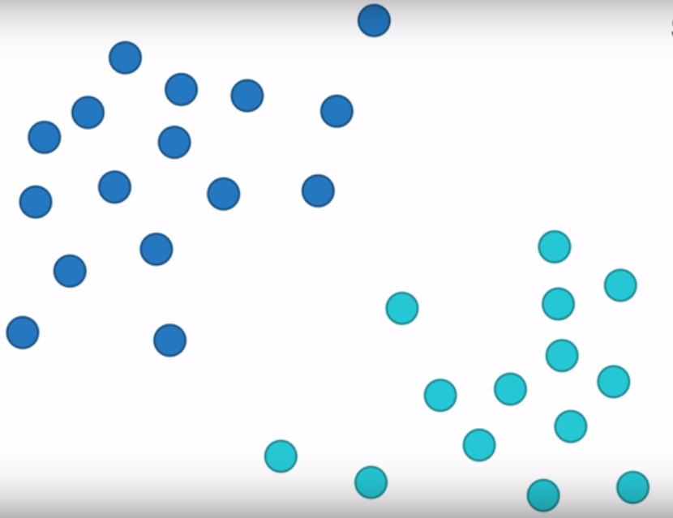
What is SVM
What is SVM?
It is a classification method.
What does it mean?
I have two sets of data (blow dots and cyan dots) and I want to classify them (split them into two sets)

Slide 3
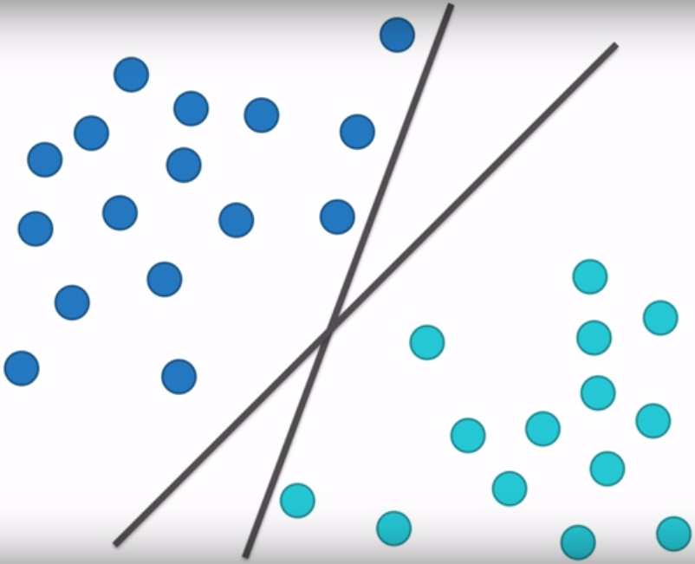
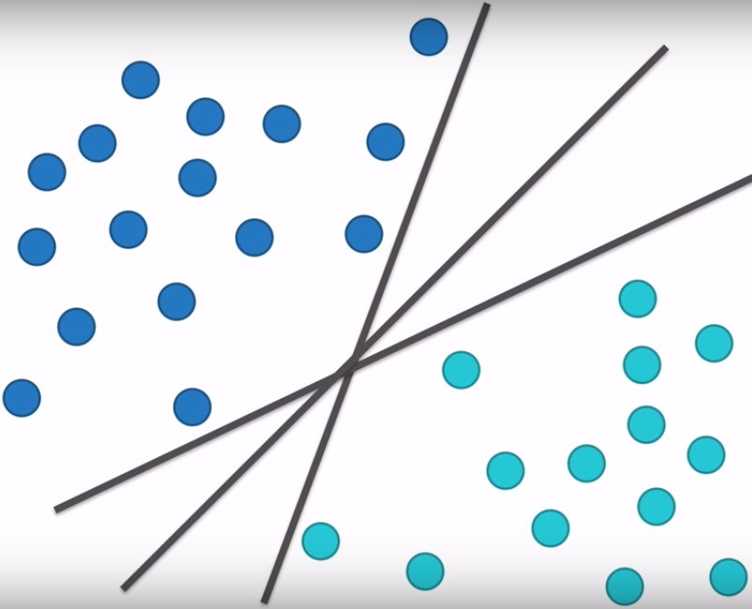
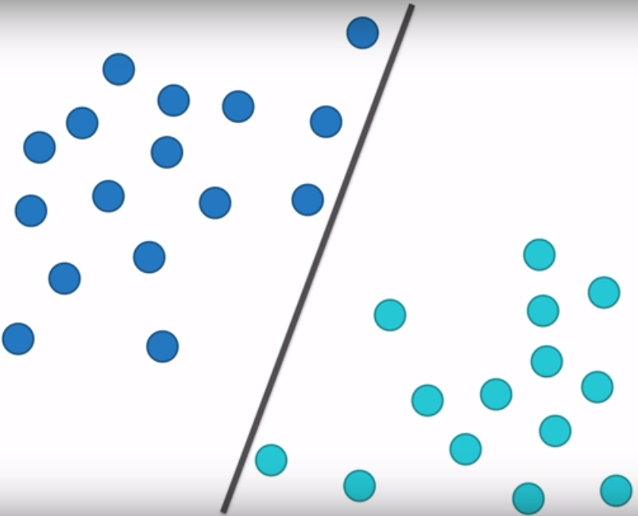
What is SVM
Which one is the best way to split the data?
All of these splitting are fine but what if we seek the best split?

Slide 4
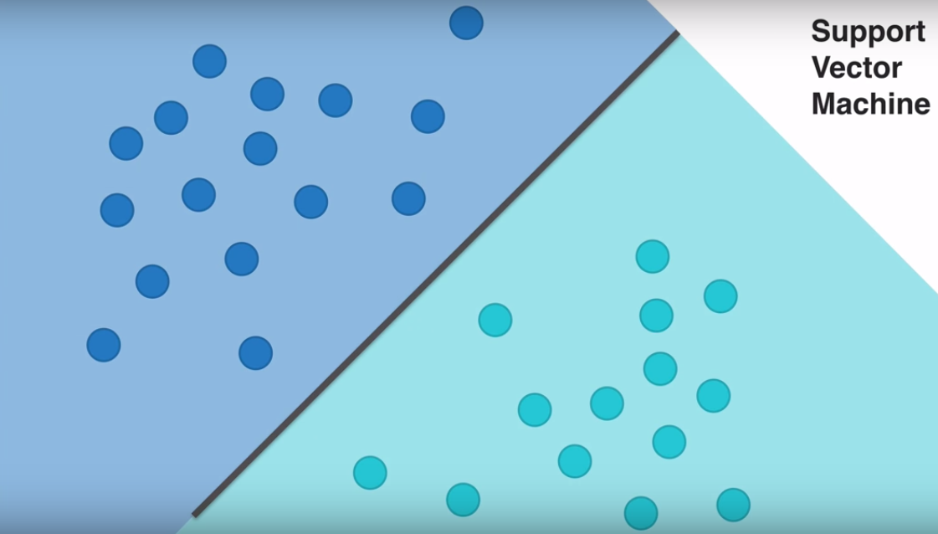
What is SVM
I claim this is the best line (SVM)

Slide 5
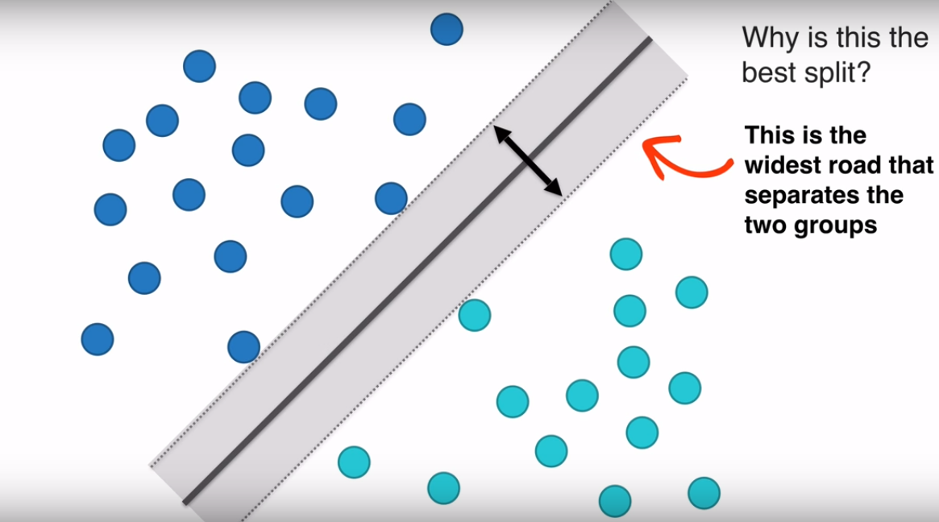
Why is this the best?

Slide 6
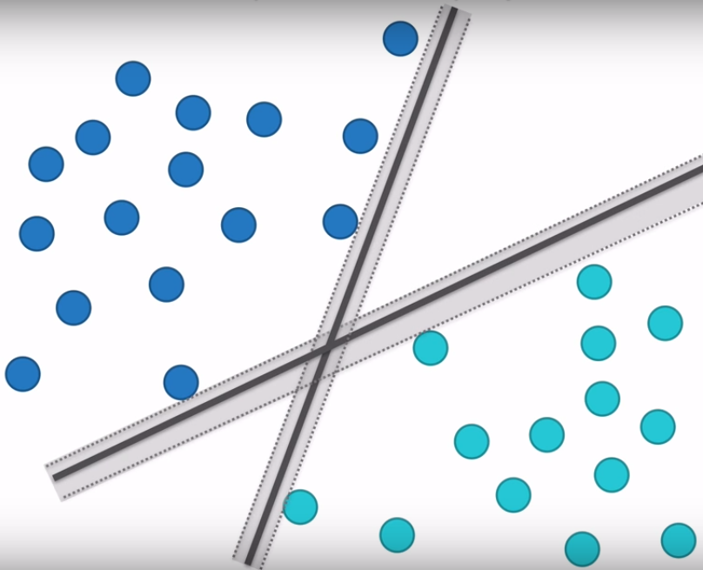
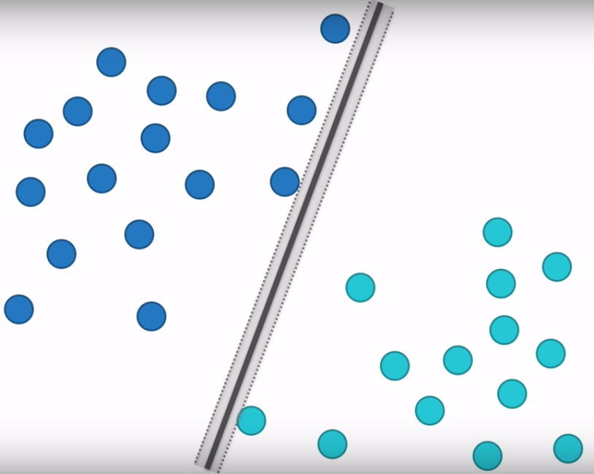
How about other ones?
They both have narrower roads

Slide 7
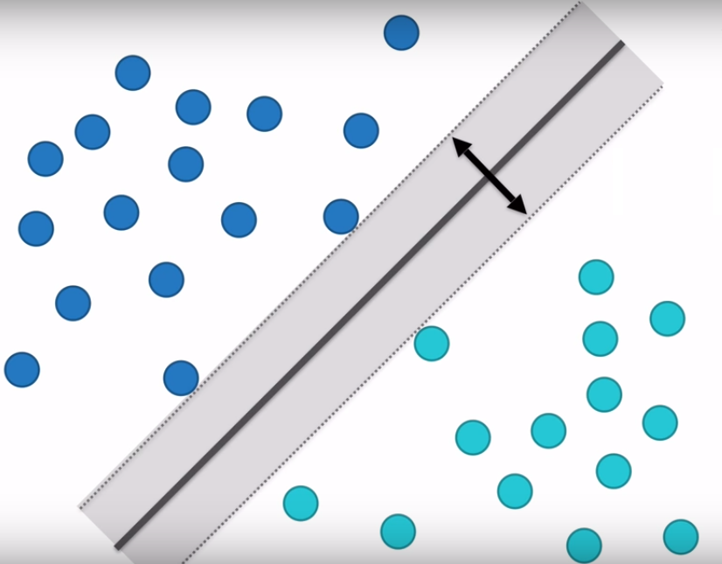
Technical terms
This is the widest road that separates two groups
Margin

Slide 8
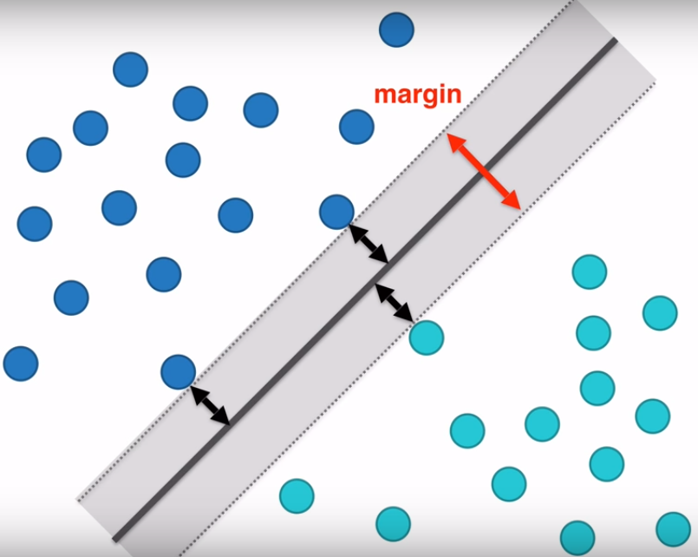
Technical terms
The distance between the points and the line are as far as possible
The distance between the support vectors and the line are as far as possible
The distance between the support vectors and the hyperplane are as far as possible

Slide 9
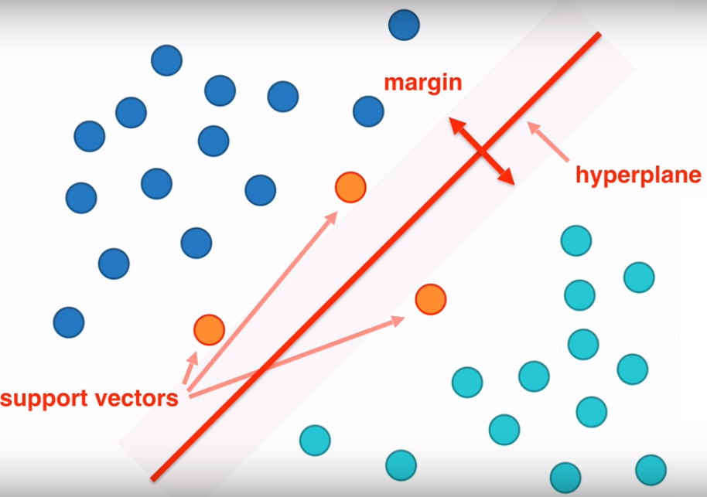
In conclusion
I found a hyperplane that best splits the data
It is as far as possible from vector machines
Or I can say I maximized the margins

Slide 10
Linear Optimization
Let’s have a review on optimization
Identify the decision variables
Identify the objective function
Identify all appropriate constraints
Write the objective function and constraints as mathematical expressions

Slide 11
Get back to our problem
This is an optimization problem because I want to maximize the margins
Constraints: The observations cannot be on the margins

Slide 12
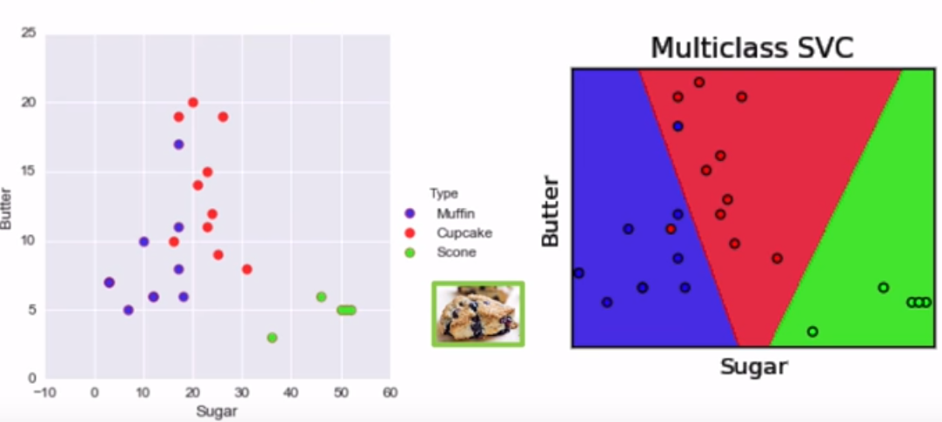
Does it work for more than two classes?
Yes! Just we have to use more hyperplanes
We can also penalize our model using C parameter (next week)

Slide 13
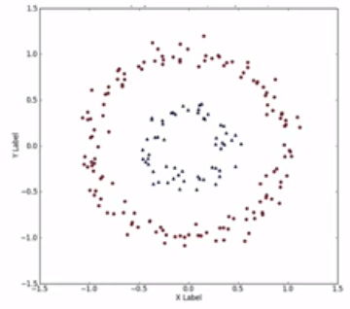
The Kernel Trick
What if our observation data is nonlinear?
Suppose I want to find hyperplane for this data

Slide 14
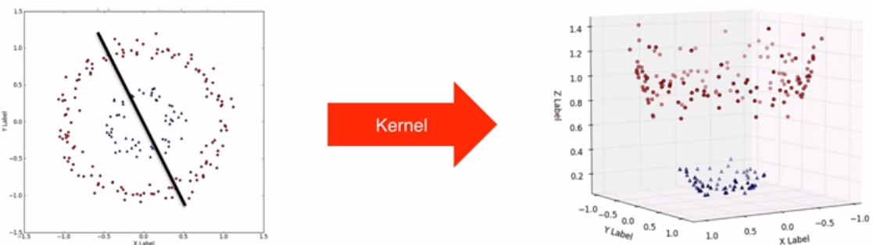
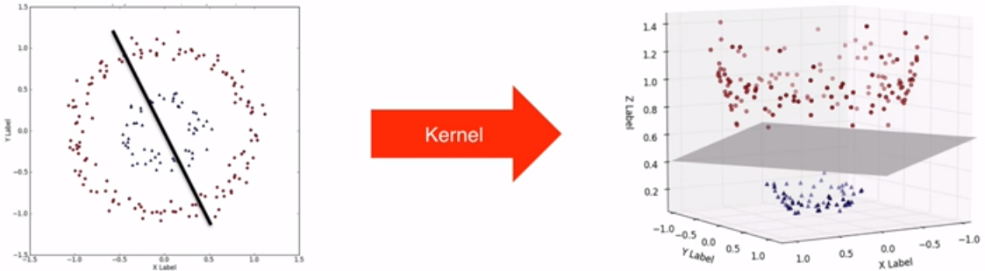
The Kernel Trick
What Kernel trick does is adding a new dimension to our data
Now you can linearly separate the data

Slide 15
The Kernel Trick
How to split these point?
y
z
See it in a 3d space
y
Same!!
x
x
A Friendly Introduction to Machine Learning. By: Luis Serrano

Slide 16
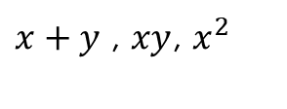
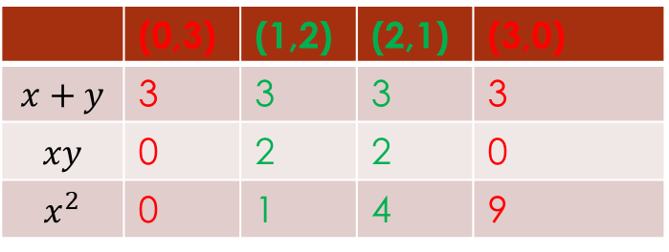
The Kernel Trick
Question: How can we split red and green?
y
Possible solution: Find an equation that has one output for red and different output for green
(0,3)
Good approach but how? Let’s try some equations…
(1,2)
$x+y$ , $xy$, $x^{2}$
(2,1)
(3,0)
 | (0,3) | (1,2) | (2,1) | (3,0)
$$x+y$$ | 3 | 3 | 3 | 3
$$xy$$ | 0 | 2 | 2 | 0
$$x^{2}$$ | 0 | 1 | 4 | 9
x
A Friendly Introduction to Machine Learning. By: Luis Serrano

Slide 17








The Kernel Trick
Question: How can we split red and green?
y
(0,3)
$$xy=0$$
What separates 0 and 2?
$$xy=2$$
0$×$3=0
$$xy=1$$
(1,2)
1$×$2=2
(2,1)
$$y=\frac{1}{x}$$
2$×$1=2
(3,0)
3$×$0=0
x
A Friendly Introduction to Machine Learning. By: Luis Serrano

Slide 18
The Kernel Trick
(x,y)
(x,y,xy)
(0,3)
(0,3,0)
(1,2)
(1,2,2)
z
(2,1)
(2,1,2)
(3,0)
(3,0,0)
y
(0,3)
(1,2)
(2,1)
(3,0)
x
A Friendly Introduction to Machine Learning. By: Luis Serrano

Slide 19
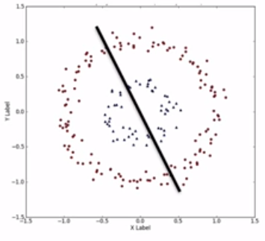
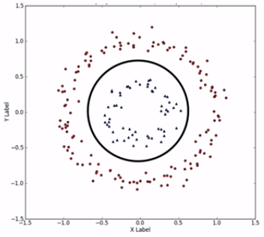
Different Kernels
Linear
Radial basis function
Other methods: Polynomial, sigmoid

Slide 20
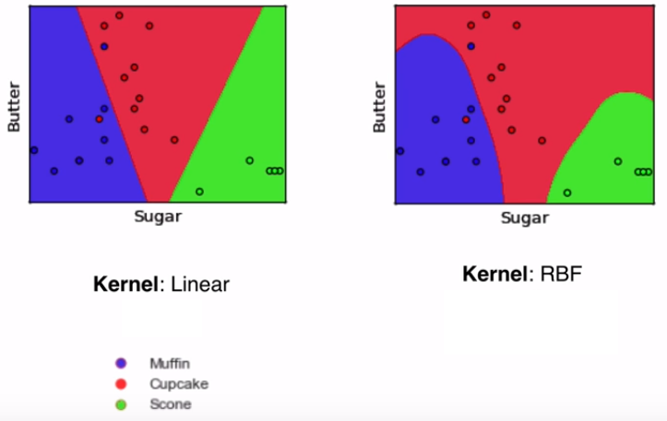
Different Kernels

Slide 21
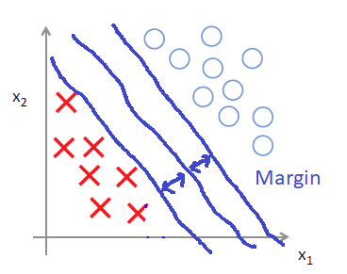
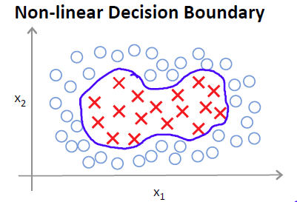






The Kernel Trick
Originally from Support Vector Machines
$$Predict y=1 if$$
$$θ_{0}+ θ_{1}x_{1}+ θ_{2}x_{2}+ θ_{3}x_{1}x_{2}+ θ_{3}x_{1}^{2}+ θ_{4}x_{2}^{2}+… ≥0$$
$$h_{θ}\left(x\right)= \left\{\begin{matrix}1 if θ_{0}+ θ_{1}x_{1}+… ≥0 \\ 0 otherwise \end{matrix}\right.$$
$$f_{1}$$
$$f_{2}$$
$$f_{3}$$
$$f_{4}$$
$$f_{5}$$

Slide 22


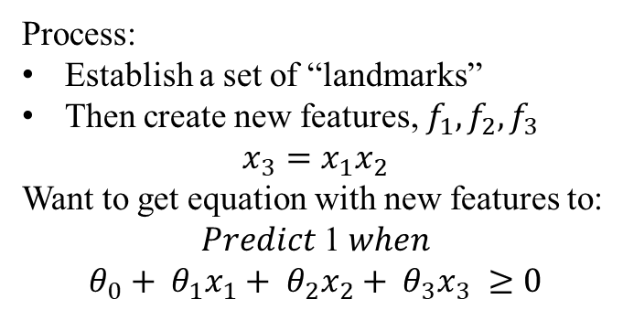
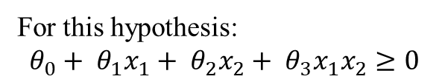







Define New Features
For this hypothesis:
$$θ_{0}+ θ_{1}x_{1}+ θ_{2}x_{2}+ θ_{3}x_{1}x_{2}≥0$$
Process:
Establish a set of “landmarks”
Then create new features, $f_{1}, f_{2}, f_{3}$
$$x_{3}={x_{1}x}_{2}$$
Want to get equation with new features to:
$$Predict \text{1} when$$
$$θ_{0}+ θ_{1}x_{1}+ θ_{2}x_{2}+ θ_{3}x_{3} ≥0$$
$$l^{(1)}$$
$$l^{(2)}$$
$$x_{1}$$
$$l^{(3)}$$
$$\left\|x− l^{\left(1\right)}\right\|$$
$$Given x: f_{1}=similarity\left(x, l^{\left(1\right)}\right)=\exp\left(−\frac{{\left\|x− l^{\left(1\right)}\right\|}^{2}}{2σ^{2}}\right)$$
$$x_{2}$$
$$Given x: f_{2}=similarity\left(x, l^{\left(2\right)}\right)=\exp\left(−\frac{{\left\|x− l^{\left(2\right)}\right\|}^{2}}{2σ^{2}}\right)$$
$$Given x: f_{3}=similarity\left(x, l^{\left(3\right)}\right)=\exp\left(−\frac{{\left\|x− l^{\left(3\right)}\right\|}^{2}}{2σ^{2}}\right)$$

Slide 23


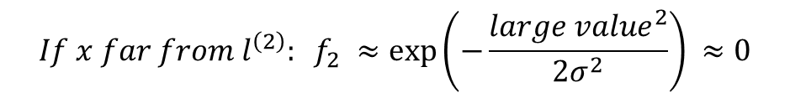

Compute Feature Values
$$Given x: f_{1}=similarity\left(x, l^{\left(1\right)}\right)=\exp\left(−\frac{{\left\|x− l^{\left(1\right)}\right\|}^{2}}{2σ^{2}}\right)$$
$$x=(x_{0}, x_{1}, x_{2}, …, x_{n})$$
$$Given x: f_{1}=similarity\left(x, l^{\left(1\right)}\right)=\exp\left(−\frac{{\left\|x− l^{\left(1\right)}\right\|}^{2}}{2σ^{2}}\right)=\exp\left(− \frac{\sum_{j=1}^{n}{({x_{j}−l_{j}^{1})}^{2}}}{2σ^{2}}\right)$$
$$If x ≈ l^{\left(1\right)}: f_{1} ≈\exp\left(−\frac{0^{2}}{2σ^{2}}\right) ≈1$$
$$If x far from l^{\left(2\right)}: f_{2} ≈\exp\left(−\frac{{large value}^{2}}{2σ^{2}}\right) ≈0$$

Slide 24
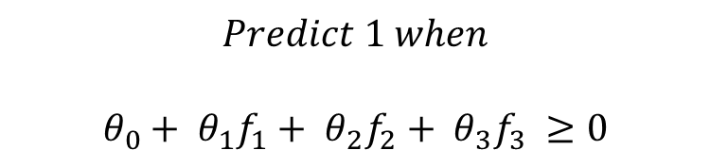



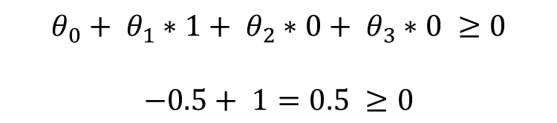




Generate the Decision Boundary
$$Predict \text{1} when$$
$$θ_{0}+ θ_{1}f_{1}+ θ_{2}f_{2}+ θ_{3}f_{3} ≥0$$
$$x$$
$$l^{(1)}$$
$$y=1$$
$$θ_{0}= −0.5, θ_{1}=1, θ_{2}=1, θ_{3}=0$$
$$l^{(2)}$$
For x close to
$${f1: f}_{1} ≈1, f_{2} ≈0, f_{3} ≈0$$
$$x_{1}$$
$$l^{(3)}$$
$$y = 0$$
$$θ_{0}+ θ_{1}∗1+ θ_{2}∗0+ θ_{3}∗0 ≥0$$
$$−0.5+ 1=0.5 ≥0$$
$$x$$
$$x_{2}$$
$$y=1$$

Slide 25
Pros and cons
Pros:
Method works very well for large data sets
Method works well for small data sets too
Cons:
Picking the right kernel is challenging

Slide 26
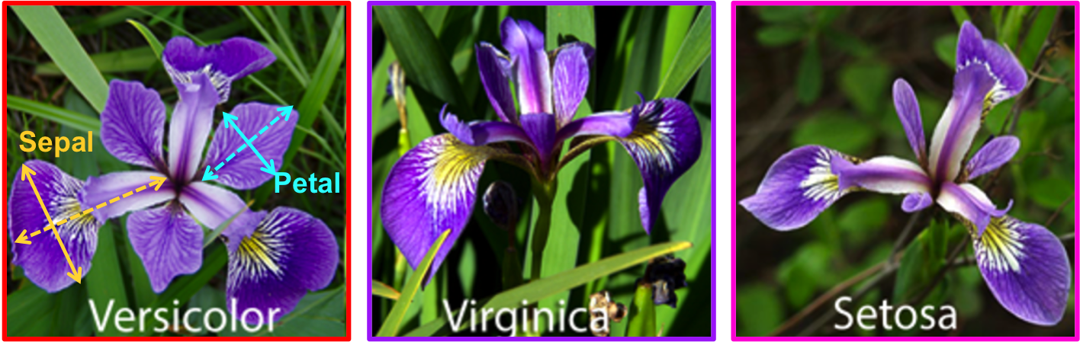
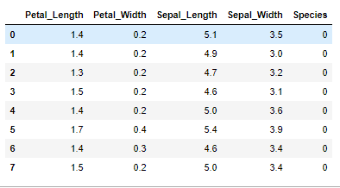
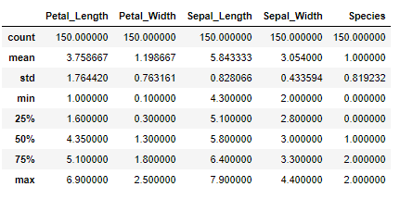
Multiple classes example
For this part, let’s load the Iris dataset
from sklearn import datasets
import numpy as np
iris = datasets.load_iris()
X = iris.data
# Sepal and pedal negth and width
y = iris.target
IRIS = pd.DataFrame({'Sepal_Length':X[:,0], 'Sepal_Width':X[:,1], 'Petal_Length':X[:,2], 'Petal_Width':X[:,3], 'Species':y})

Slide 27
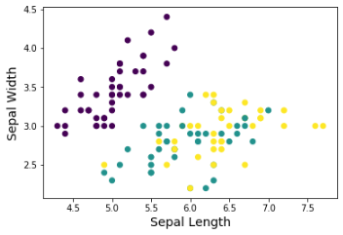
Split data to train and test
Use same methodology as before to split data to train and test
Now we have 70% of data for training and the rest for testing
from sklearn.model_selection import train_test_split
X_train, X_test, y_train, y_test = train_test_split(X, y, test_size=0.30, random_state=52)

Slide 28

Linear model
Let’s start with a very simple SVM model with no kernel (linear)
You can see the number of support vectors and their values
# Linear model
clf = svm.SVC(kernel='linear')
clf.fit(X_train, y_train)
# Test result
y_predict = clf.predict(X_test)
confusion_matrix(y_test, y_predict)
accuracy_score(y_test, y_predict)*100
# get number of support vectors for each class
clf.n_support_
# get indices of support vectors clf.support_

Slide 29

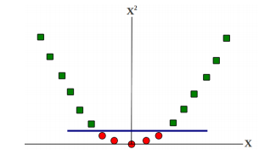
Nonlinear models- Review
Consider this binary classification problem
Each example represented by a single feature x
No linear separator exists for this data
Now map each example as x → {x, x 2}
Each example now has two features (“derived” from the old representation)
Data now becomes linearly separable in the new representation

Slide 30

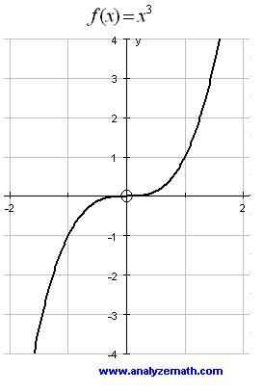
Polynomial kernel
Next, is the polynomial kernel
# Polynomial model
clf = svm.SVC(kernel='poly', degree=3)
clf.fit(X_train, y_train)
# Test result
y_predict = clf.predict(X_test)
confusion_matrix(y_test, y_predict)
accuracy_score(y_test, y_predict)*100

Slide 31

Radial Base Function kernel
RBF is one the most famous kernels
Change gamma to 0.3 and see the result
# Polynomial model
clf = svm.SVC(kernel='rbf', gamma=0.7)
clf.fit(X_train, y_train)
# Test result
y_predict = clf.predict(X_test)
confusion_matrix(y_test, y_predict)
accuracy_score(y_test, y_predict)*100

Slide 32
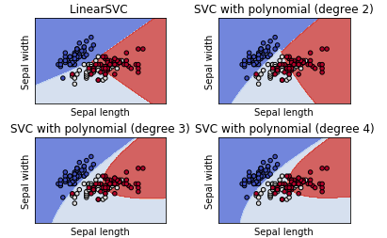
Tuning parameters
There are two methods to find the best parameters of the model
Method 1: Writing loop
Code is provided on Canvas

Slide 33
Tuning parameters
Method 2: Grid search
from sklearn.model_selection import GridSearchCV
parameters = {'kernel':('linear', 'rbf', 'poly'), 'C':[0.1, 0.5, 1, 10], 'degree':[2,3,4]}
svc = svm.SVC()
clf = GridSearchCV(svc, parameters, cv=5)
clf.fit(iris.data, iris.target)
clf.best_params_

Slide 34
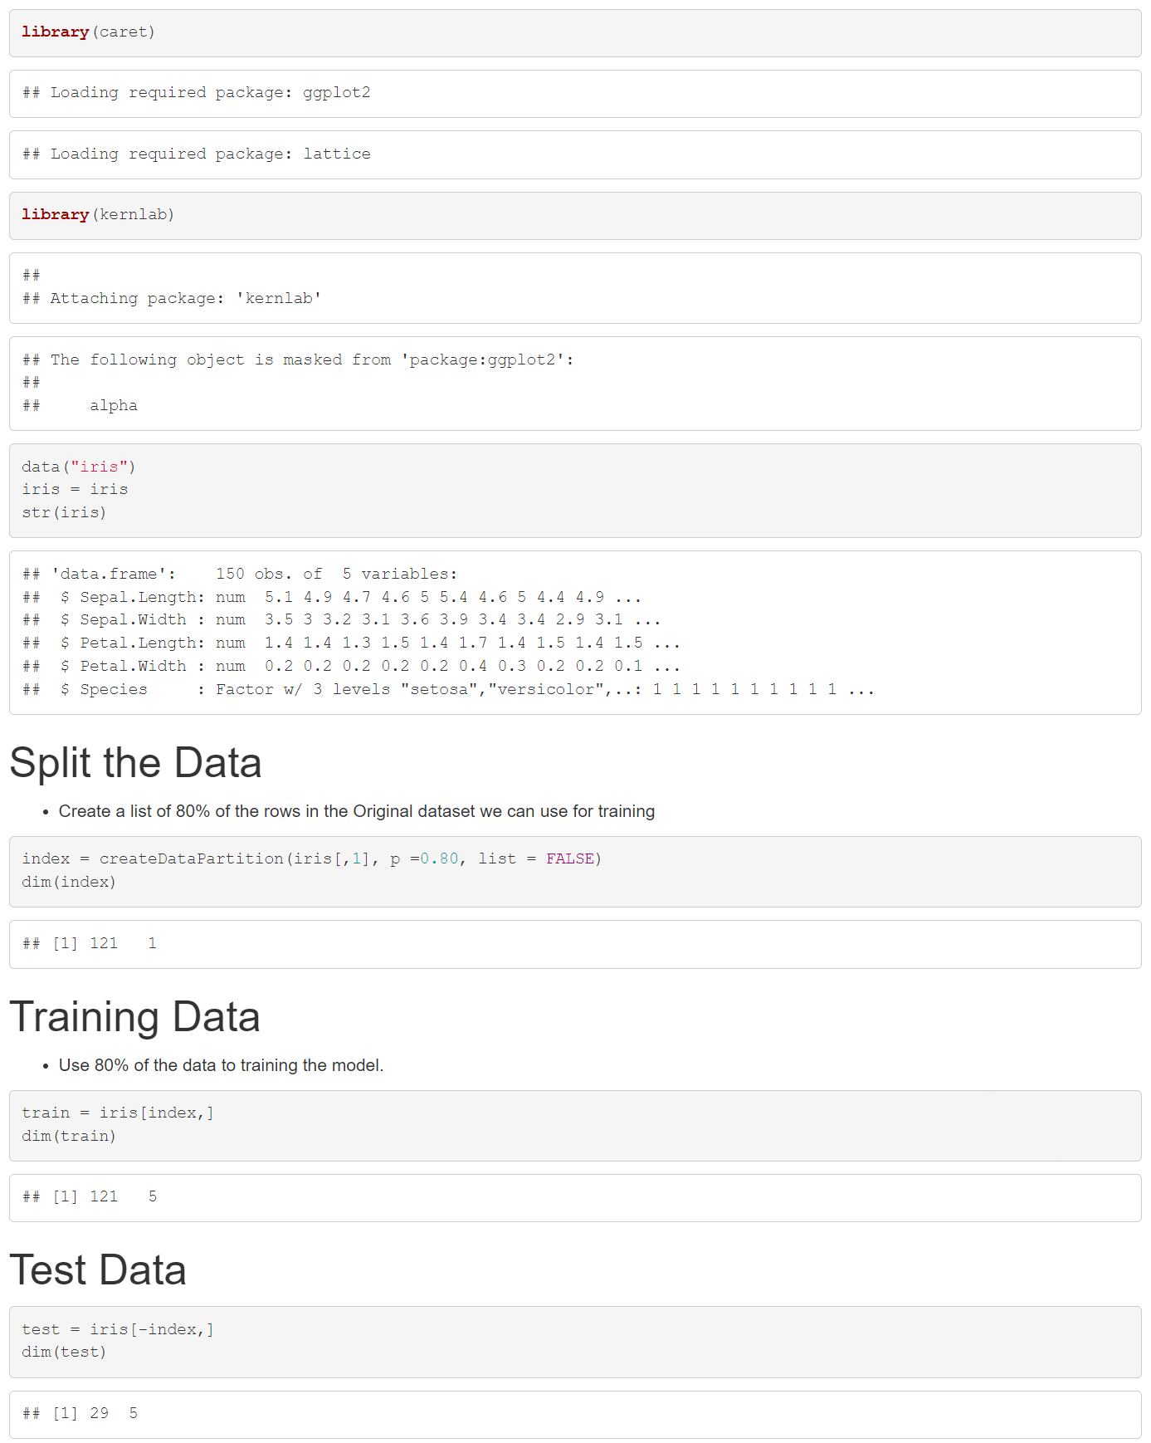
R

Slide 35
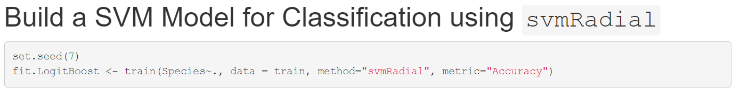
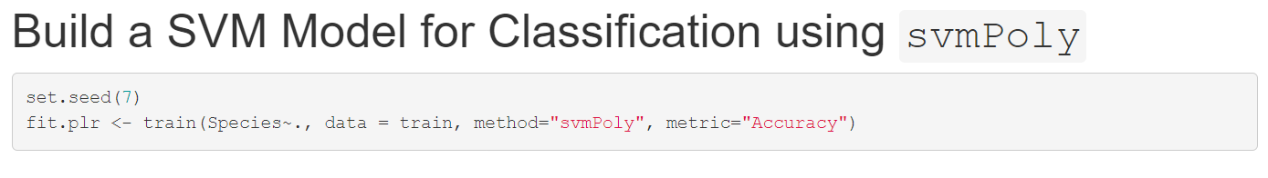
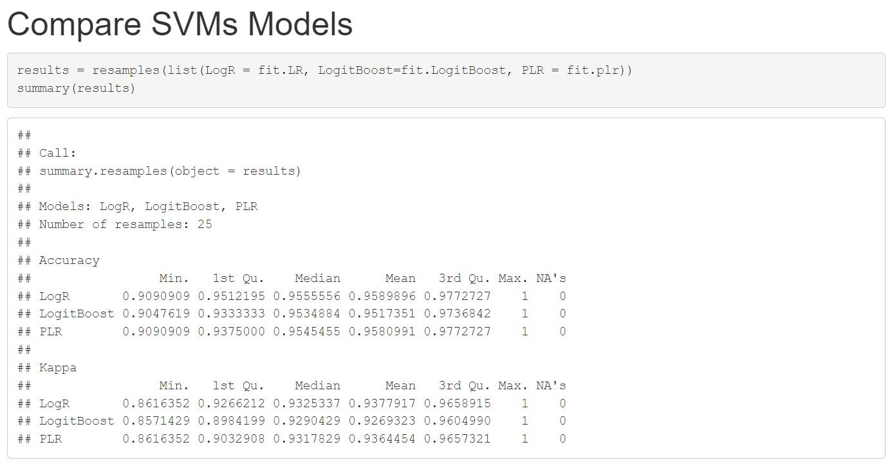
R

Slide 36
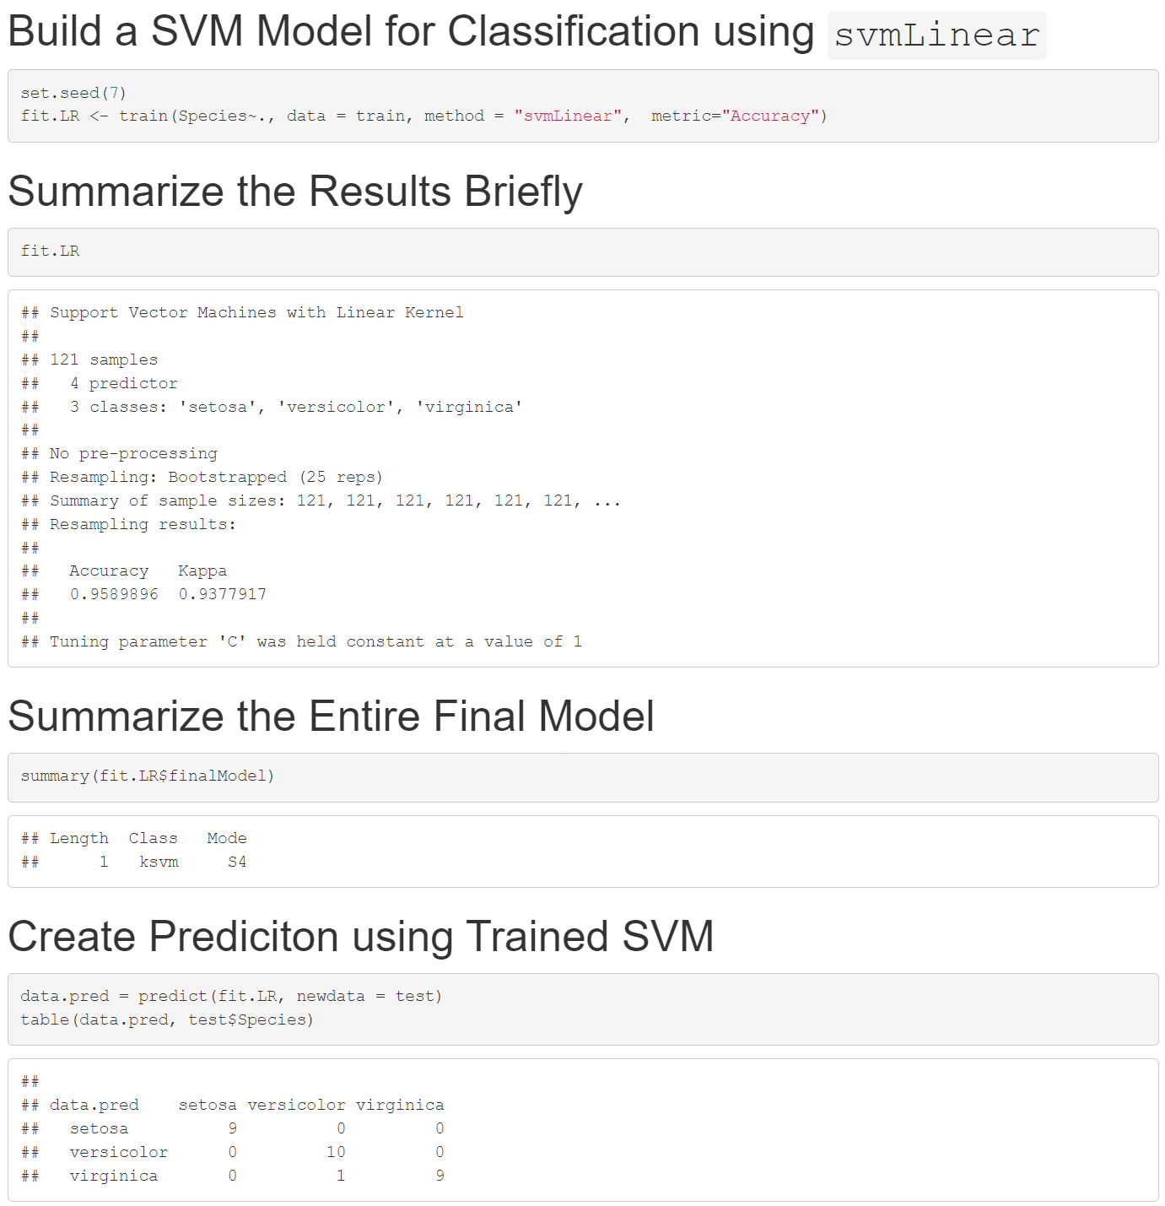
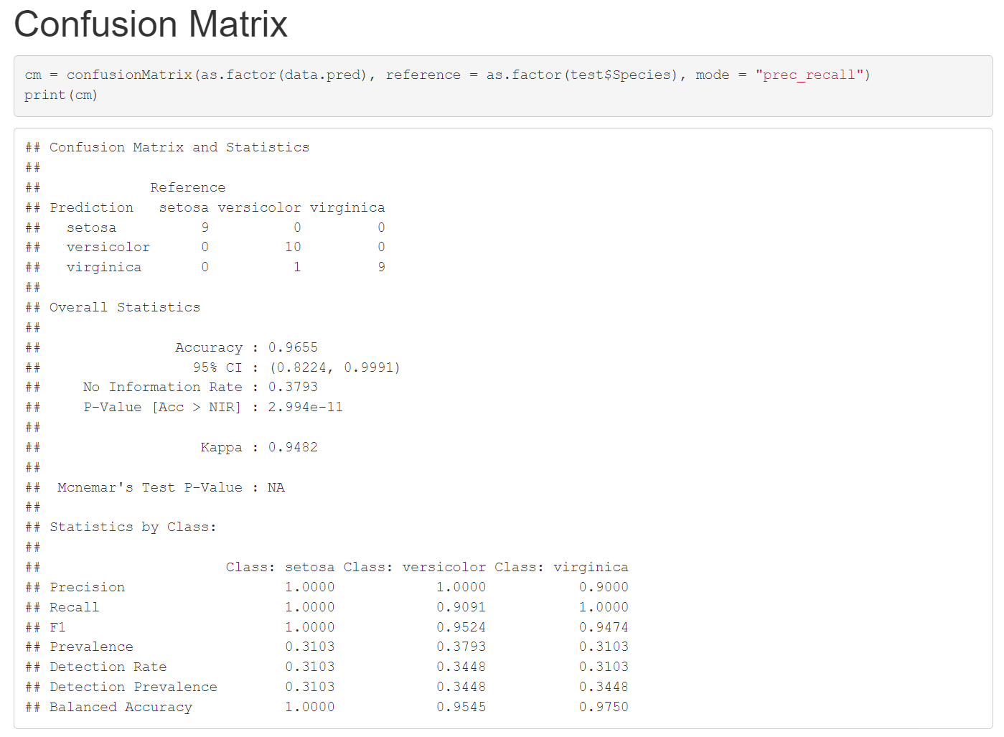
R

