Slide 1
Machine Learning
Lecture 8
Unsupervised Learning

Slide 2
Lesson Outline
Background and Introduction
What is Unsupervised Learning? Supervised versus Unsupervised Learning
Approaches to Unsupervised Learning
In general, how do we conduct unsupervised learning?
Unsupervised Learning Analyses and Algorithms
Notes:
This lecture begins the discussion about unsupervised learning. We’ve discussed supervised learning a lot. Supervised learning involves some data, typically called a training set that can be used to develop a model that can be used for a variety of reasons, e.g. predicting future events. The model can be as simple as an equation that represents the functional relationship between an independent, predictor variable and a dependent, response variable. Or, the model can be considerably more complicated, e.g. involving a cost function used to minimize the loss or error between predicted values of dependent or response variables and the one or many features, i.e. independent variables that impact a response. In using a training set to develop a model we are essentially training a model or engaging in supervised machine learning. Now, we are going to start discussing unsupervised learning.
Unsupervised learning involves developing a model, or engaging in machine learning, by looking for the relationship or relationships between predictor and response variables without the advantage of having data available in a form that allows us to supervise learning. This includes knowledge discovery in databases or KDD. We will still have data. But this data is often referred to as “unlabeled” data. Meaning that we do not know what the features are or have any way of determining what, if any, relationship or relationships may exist or form between the data we have. In other words, in unsupervised learning the model is not provided with the correct results as part of training.

Slide 3
Conducting Unsupervised Learning
Start with exploratory data analysis
Determine data requirements
Find and retrieve data
Explore and pre-process data
Develop summary and/or descriptive statistics and associated plots for the data
Initiate unsupervised learning analyses
Notes:
I want to take a minute to put in a plug for ANLY 506 Exploratory Data Analysis again. That is an entire course devoted to getting the data required for a specific analysis, taking a preliminary look at the data, cleaning up the data or pre-processing it as required. In general, it goes from the requirements for an analysis up to the point of actually conducting the analysis and reporting the results. I cannot overstate the importance of paying attention to the data. Data characteristics are important for many reasons but particularly for determining which technique to use in specific situations. For example if an algorithm has a time or space complexity of what we call in computer science O(m²) where m is the number of objects it will not be suitable for large data sets.
For right now I’ll give a very abbreviated version of Exploratory Data Analysis or EDA, just the basic steps and what they entail.
The first step is to determine what data is required to conduct a desired analysis. We typically do not just get handed a data set and asked what this data means, although that can happen. There is a process that has been developed over millennia that is used to design and conduct experiments of all kinds, including surveys. So, the first step is to determine for a specific analysis what data are required.
Then, the second step involves finding and retrieving the data in whatever format and state it might be in. Only rarely will you get data that is in a nice table format with no missing values, etc. Often data will be in binary format, blocked according to a data acquisition program, etc. To retrieve data can involve a wide variety of methods, e.g. if the analysis involves social media web-scraping might be needed.
Having retrieved the data, the next step is to take a preliminary look at the data and perform any pre-processing that is required. Pre-processing can involve everything or anything from dealing with missing values to feature scaling so that the final analysis is not biased do to different features being reported on very different scales, and so on.
Next, EDA will produce a variety of summary and/or descriptive statistics about the data and often associated plots of the data.

Slide 4
General Algorithms
Clustering
Hierarchical Clustering – clustering your data points into parent and child clusters. You might split your customers between younger and older ages, and then split each of those groups into their own individual clusters as well.
K-Means Clustering – clustering your data points into a number (K) of mutually exclusive clusters.
Probabilistic Clustering – clustering your data points into clusters on a probabilistic scale.
Data Compression
PCA, LDA and FA
Deep learning
Notes:
Often the way we start with such data sets falls in the realm of exploratory data analysis. The most common method of unsupervised learning is cluster analysis. Basically cluster analysis is used to find hidden patterns or groups in data. The most common clustering algorithms include:
• Hierarchical clustering
• k-Means clustering
• Gaussian mixture models
• Self-organizing maps
• and, hidden Markov models
Some of these, e.g. k-Means clustering consider “distances” such as the distance between the centroids of clusters to determine relationships. For example, clusters may be formed on categorical data such as gender and the distance between the centroids of male versus female cluster may represent the relationship between male and female purchases of a particular product or belief in some particular value. Self-organizing maps typically involve neural networks that form and learn a topology or distribution of the data. Or, knowledge discovery in databases, KDD, has been defined as “The non trivial process of identifying valid, novel, potentially useful, and ultimately understandable patterns in data” (Fayyad, et al, 1996)
Fayyad, U., Piatetsky-Shapiro, G & Smyth, P. (1996). “The KDD Process for Extracting Useful Knowledge from Volumes of Data”. Communications of the ACM, Vol 39: No 11.
Examples of the applications of unsupervised learning include:
• Bioinformatics, specifically sequence analysis and genetic clustering
• Data mining or more specifically pattern mining such as is used in medical imaging
• and, computer vision such as object or pattern recognition.
As we go through our discussion of unsupervised learning we will eventually cover all the types of algorithms mentioned and look at specific examples and how we can use R/RStudio to conduct unsupervised learning.

Slide 5
How to Define Inter-Intra Similarity
Similarity?
Intra-cluster distance: the sum of distances between objects in the same cluster
Inter-cluster distance: the distances between different clusters
Notes:
Just a few more points to mention so that you’ll have them in mind as we go through the various unsupervised learning techniques.
Similarity – Dissimilarity Inter-Cluster and Intra-Cluster similarity can be defined in a number of ways. Let’s look at Inter-cluster similarity from Tan’s Introduction to Data Mining. In his book, Tan defines Inter-cluster similarity using a “proximity matrix” as the
Minimum or the minimum distance between points in two clusters
Maximum or the maximum distance between points in two clusters
Group Average or the average distance between all points in two clusters
Distance between Centroids
Other Methods driven by an objective function, e.g. Ward’s Method using the squared error
This is illustrated on Slides 5 through 10.
Measures of distance include the Euclidean distance or sum of the squared Euclidean distance, Manhattan distance, correlation distance and many, many more. There are many sources that discuss the calculations for these measures of distance including our FML textbook beginning on page 183. Keep in mind that these calculations are of distances in “feature space”. For example, how similar are round shapes to each other than they are to square shapes. The more similar the closer data points should be together or the smaller the distance.
What you want to focus on is the type of analysis you are conducting and then pick the measure of distance appropriate for that type of analysis. For example, should the “distance” reflect an “absolute magnitude”? If so, either the Euclidean or Manhattan distance calculations should work. Or, does the analysis follow a response that will fluctuate over time? If so, calculating the correlation distance would probably be more appropriate.

Slide 6
How to Define Inter-Cluster Similarity
MIN
MAX
Group Average
Distance Between Centroids
Other methods driven by an objective function
Ward’s Method uses squared error
Notes:
One thing you might want to test. If the results of the analysis do not change for different appropriate measures of distance then you are at least on the right track. If your analysis changes drastically with different appropriate measures of distance then there is likely another inconsistency in the overall analysis that beyond this will cause additional problems in the results.

Slide 7
How to Define Inter-Cluster Similarity
MIN
MAX
Group Average
Distance Between Centroids
Other methods driven by an objective function
Ward’s Method uses squared error

Slide 8
How to Define Inter-Cluster Similarity
MIN
MAX
Group Average
Distance Between Centroids
Other methods driven by an objective function
Ward’s Method uses squared error

Slide 9
How to Define Inter-Cluster Similarity
×
×
MIN
MAX
Group Average
Distance Between Centroids
Other methods driven by an objective function
Ward’s Method uses squared error

Slide 10
Concepts in Clustering
“A good clustering is one where
(Intra-cluster distance) the sum of distances between objects in the same cluster are minimized,
(Inter-cluster distance) while the distances between different clusters are maximized

Slide 11
Hierarchical Clustering
Two methods: Top-down or Bottoms-up
Divisive hierarchical clustering works by recursively splitting the initial cluster into successive clusters moving down through a hierarchy.
Agglomerative clustering is the bottoms up approach that starts with a set of clusters then successively merges clusters until all are merged up through a hierarchy into one cluster.
One benefit of Hierarchical Clustering is that you don’t have to specify the number of clusters before you begin your analysis!
Notes:
In general, hierarchical clustering involves successively finding clusters using previously established clusters. There are two primary approaches to hierarchical clustering, top down or bottoms up. That is,
Divisive hierarchical clustering works by recursively splitting the initial cluster into successive clusters moving down through a hierarchy.
Agglomerative clustering is the bottoms up approach that starts with a set of clusters then successively merges clusters until all are merged up through a hierarchy into one cluster.
Hierarchical clustering can be hard to do even for simple cases. For example, we’ve looked at the Iris data set several times and used several machine learning techniques to look at that data set.

Slide 12
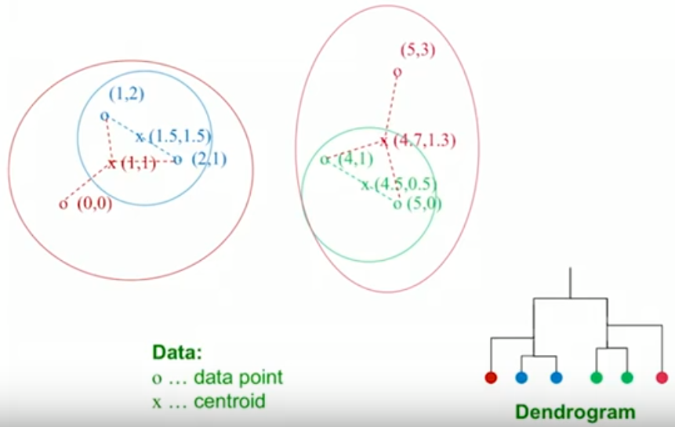
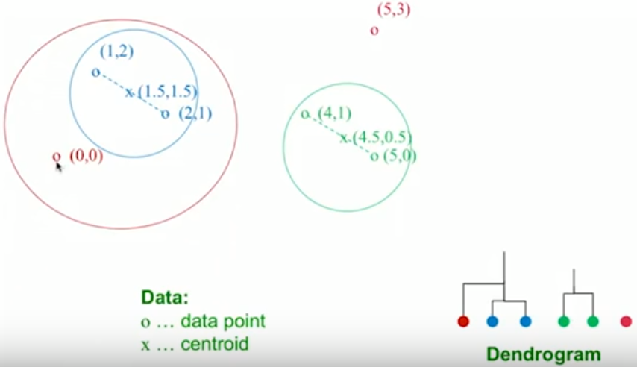
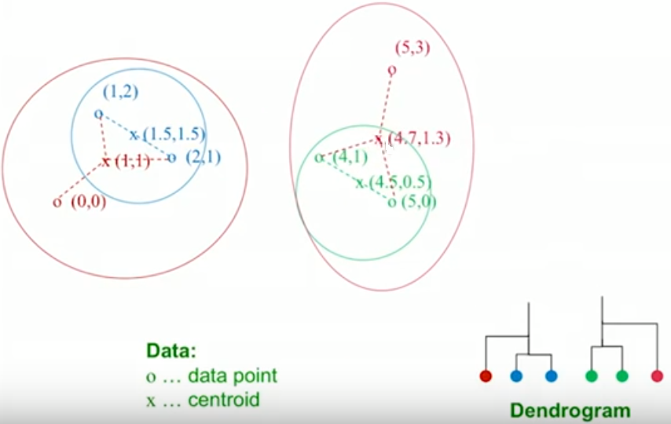
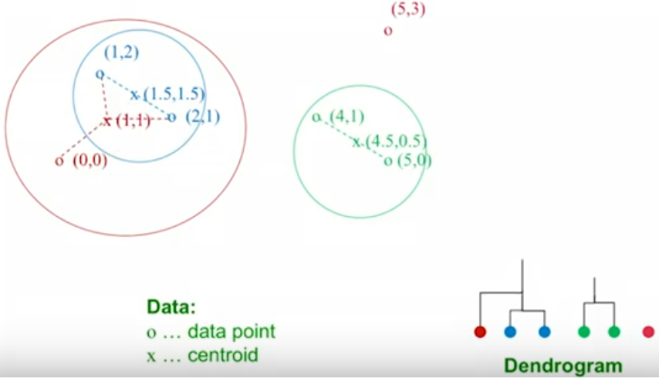
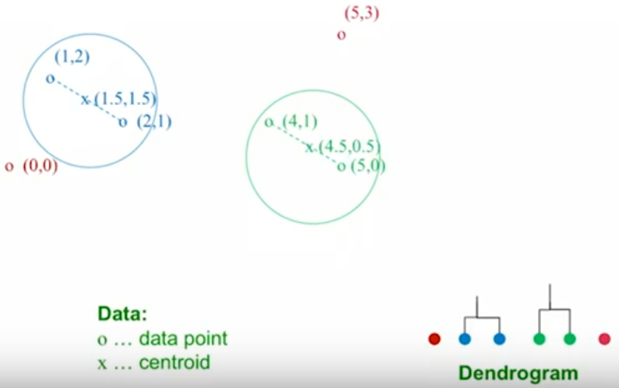
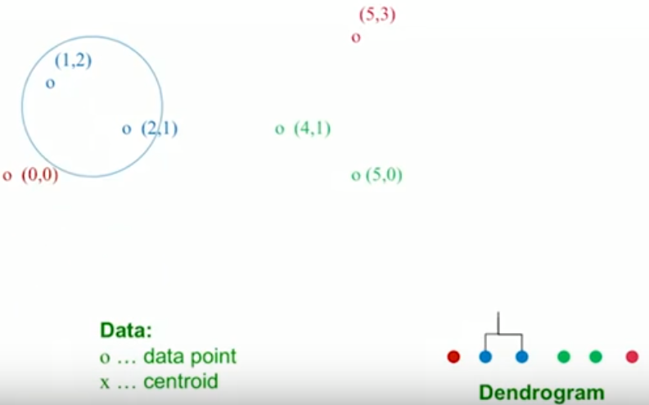
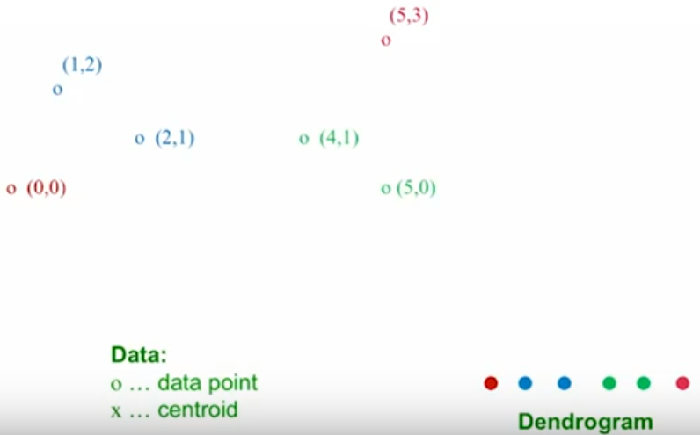
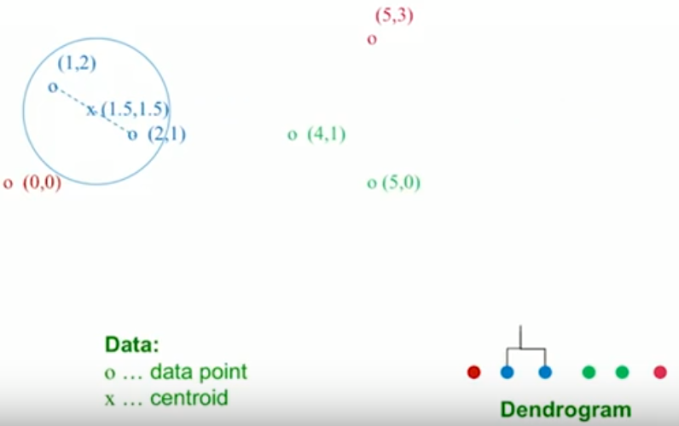

How does it work?
From- Artificial Intelligence - All in One

Slide 13
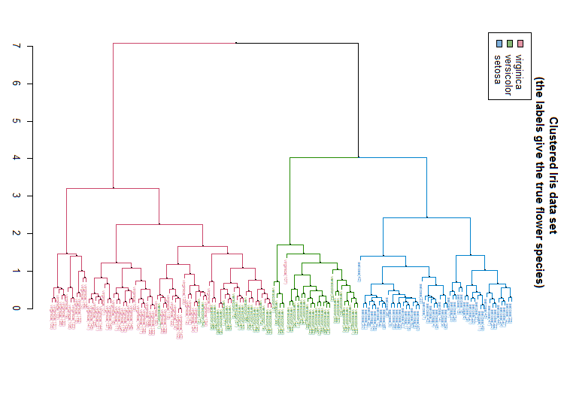
Notes:
Slide 14 illustrates the results of hierarchical clustering for the Iris data set. Here you see the effect of data points that are in the intersection of the two species, Virginica and Versicolor, i.e. the red and green branches formed from the divisive hierarchical clustering. This would be a problem, for example, if we wanted to use a support vector machine technique to separate the data in these species. We can talk about how to handle situations like this in the discussion about support vector machines. The figure shown on this slide is from the cran.r-project webpage: https://cran.r-project.org/web/packages/dendextend/vignettes/Cluster_Analysis.html

Slide 14
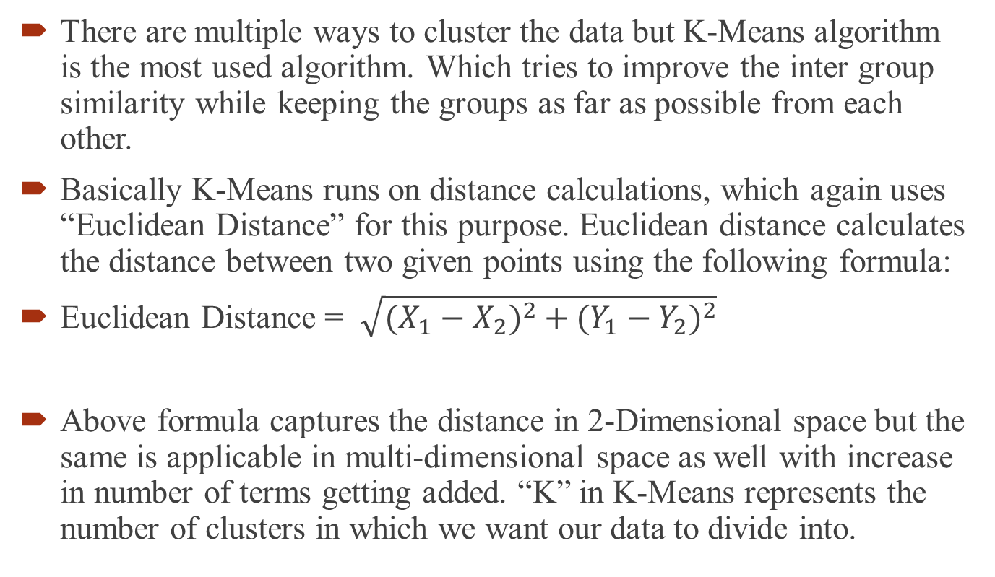
k-Means Clustering
There are multiple ways to cluster the data but K-Means algorithm is the most used algorithm. Which tries to improve the inter group similarity while keeping the groups as far as possible from each other.
Basically K-Means runs on distance calculations, which again uses “Euclidean Distance” for this purpose. Euclidean distance calculates the distance between two given points using the following formula:
Euclidean Distance = $\sqrt{(X_{1}−X_{2})^{2}+(Y_{1}−Y_{2})^{2}}$
Above formula captures the distance in 2-Dimensional space but the same is applicable in multi-dimensional space as well with increase in number of terms getting added. “K” in K-Means represents the number of clusters in which we want our data to divide into.
https://www.dezyre.com/data-science-in-r-programming-tutorial

Slide 15
k-Means Clustering
Divide or partition data into k clusters based on “features”
Define or initialize center points of clusters
Assign data points to clusters based on the closest center
Move centers to the centroid of each cluster formed
Move data points to the closest center
Repeat until no data points move
Notes:
Slide 15 begins our discussion about k-Means Clustering. K-Means clustering seeks to divide or partition data into k (a number of) clusters based on features. Each cluster is defined by its centroid. Each data point is assigned to a cluster based on the closest centroid. The goal for k-Means clustering is to minimize intra-cluster variance, e.g. minimize dissimilarities. Keep in mind that dissimilarities or distances are not necessarily measured numerically like we do geographically.
Using k-Means typically means using an iterative clustering algorithm with the following steps:
Initialize, i.e. pick k random points as cluster centers.
Assign data points to the closest center.
Change the cluster center to the average of its assigned points.
Repeat until no points change location during an iteration. The figure on this slide, Slide 15, illustrates the initial center points and their movement through the first iteration.

Slide 16
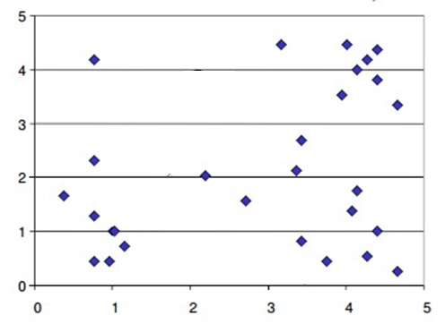
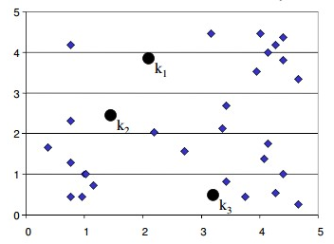
K-means Algorithm
Step 1 - Start with number of clusters (k) we want e.g., 3 in this case. K-Means algorithm start the process with random centers in data, and then tries to attach the nearest points to these centers.
https://www.dezyre.com/data-science-in-r-programming-tutorial

Slide 17
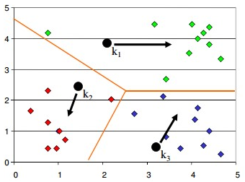
K-means Algorithm
Step 2 - Algorithm then moves the randomly allocated centers to the means of created groups.
https://www.dezyre.com/data-science-in-r-programming-tutorial

Slide 18
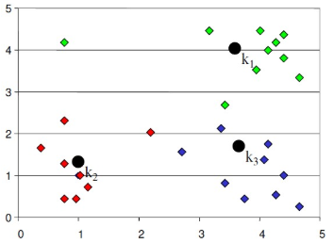
K-means Algorithm
Step 3 - In the next step, data points are again reassigned to these newly created centers
Step 4 - Steps 2 & 3 are repeated until no member changes their association/ groups
https://www.dezyre.com/data-science-in-r-programming-tutorial

Slide 19
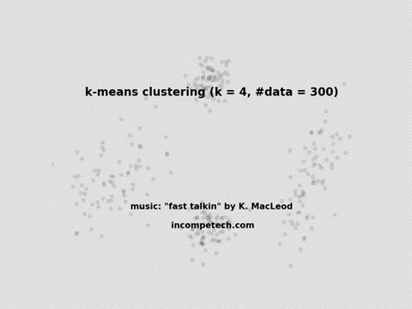
Initialize, i.e. pick k random points as cluster centers.
Assign data points to the closest center.
Change the cluster center to the average of its assigned points.
Notes:
The figure on Slide 16 illustrates setting up the k-Means clustering algorithm. In this figure k=5, i.e. 5 points are established as cluster centers. Next, data points are moved to the closest center. Then, the centers are moved to the centroids of the clusters formed. Notice that some of the cluster centers are moving to locations where many points will have to move considerable distance together to form a single cluster. This raises the question about how to determine k.

Slide 20
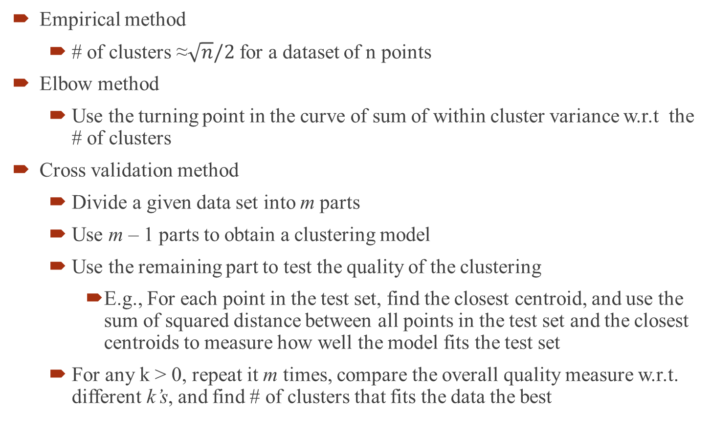
What is the best value of k?
Empirical method
# of clusters ≈$\sqrt{n}/2$ for a dataset of n points
Elbow method
Use the turning point in the curve of sum of within cluster variance w.r.t the # of clusters
Cross validation method
Divide a given data set into m parts
Use m – 1 parts to obtain a clustering model
Use the remaining part to test the quality of the clustering
E.g., For each point in the test set, find the closest centroid, and use the sum of squared distance between all points in the test set and the closest centroids to measure how well the model fits the test set
For any k > 0, repeat it m times, compare the overall quality measure w.r.t. different k’s, and find # of clusters that fits the data the best

Slide 21
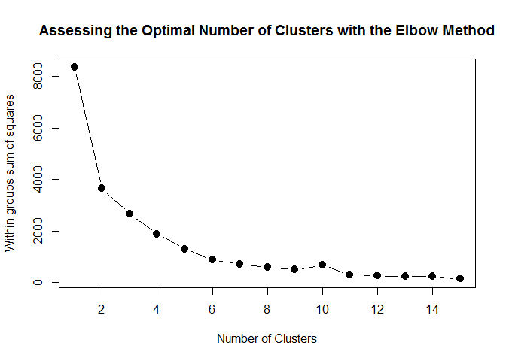
Elbow method
The Elbow method is a method of interpretation and validation of consistency within cluster analysis designed to help finding the appropriate number of clusters in a dataset.

Slide 22
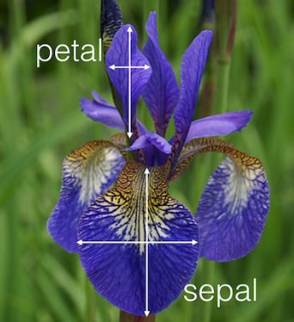
Iris dataset

Slide 23

Iris dataset
iris = datasets.load_iris()
X = iris.data # Sepal and pedal negth and width
y = iris.target
from sklearn.cluster import KMeans
km = KMeans(n_clusters = 3, n_jobs = 4, random_state=21)
km.fit(X)
We can see the centers
centers = km.cluster_centers_
print(centers)

Slide 24
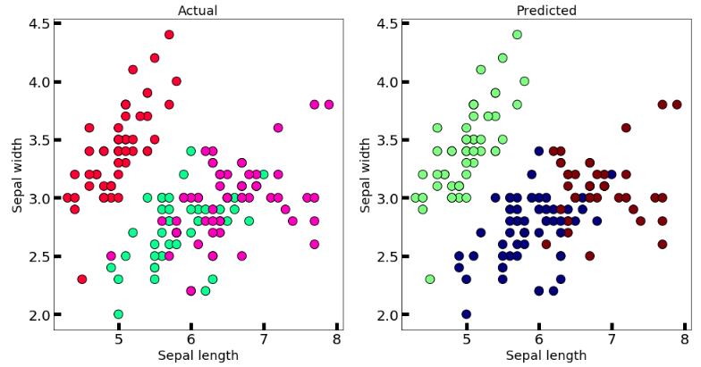
Graphical representation
Graphical interpretation
import matplotlib.pyplot as plt
new_labels = km.labels_
fig, axes = plt.subplots(1, 2, figsize=(16,8))
axes[0].scatter(X[:,0], X[:,1], c=y, cmap='gist_rainbow', edgecolor='k', s=150)
axes[1].scatter(X[:,0], X[:,1], c=new_labels, cmap='jet', edgecolor='k', s=150)
axes[0].set_xlabel('Sepal length', fontsize=18)
axes[0].set_ylabel('Sepal width', fontsize=18)
axes[1].set_xlabel('Sepal length', fontsize=18)
axes[1].set_ylabel('Sepal width', fontsize=18)
axes[0].tick_params(direction='in', length=10, width=5, colors='k', labelsize=20)
axes[1].tick_params(direction='in', length=10, width=5, colors='k', labelsize=20) axes[0].set_title('Actual', fontsize=18)
axes[1].set_title('Predicted', fontsize=18)
plt.show()
https://medium.com/@belen.sanchez27/

Slide 25
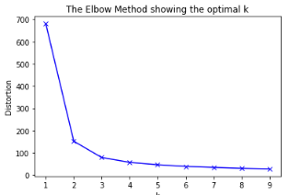
Elbow method
Using elbow method to find optimum k
distortions = []
K = range(1,10) for k in K:
kmeanModel = KMeans(n_clusters=k).fit(X)
kmeanModel.fit(X)
distortions.append(kmeanModel.inertia_)
# Plot the elbow
plt.plot(K, distortions, 'bx-')
plt.xlabel('k')
plt.ylabel('Distortion')
plt.title('The Elbow Method showing the optimal k')
plt.show()

Slide 26
Dendrogram example
# create dendrogram
dendrogram = sch.dendrogram(sch.linkage(points, method='ward'))
# create clusters
hc = AgglomerativeClustering(n_clusters=4, affinity = 'euclidean', linkage = 'ward')
# save clusters for chart
y_hc = hc.fit_predict(points)

Slide 27
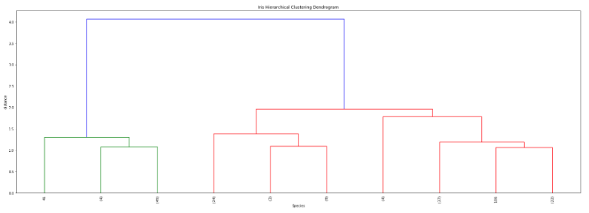
Dendrogram example
from scipy.cluster.hierarchy import dendrogram, linkage
# generate the linkage matrix
Z = linkage(X, 'average')
# set cut-off to 50
max_d = 7.08
# max_d as in max_distance
plt.figure(figsize=(25, 10))
plt.title('Iris Hierarchical Clustering Dendrogram')
plt.xlabel('Species') plt.ylabel('distance')
dendrogram( Z, truncate_mode='lastp',# show only the last p merged clusters p=10, # Try changing values of p leaf_rotation=90., # rotates the x axis labels leaf_font_size=8., # font size for the x axis labels)
plt.axhline(y=max_d, c='k')
plt.show()

Slide 28
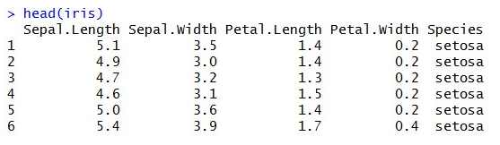
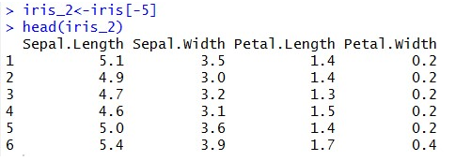
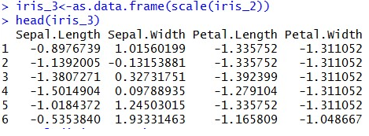
R code
R code for K means

Slide 29


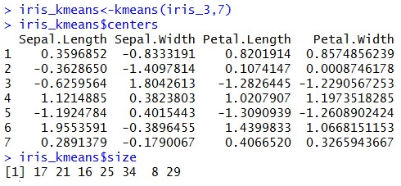
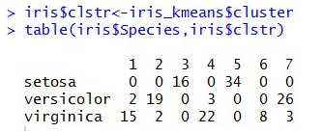
R code

Slide 30
Pros and cons
Pros:
Simple: It is easy to implement k-means and identify unknown groups of data from complex data sets. The results are presented in an easy and simple manner.
Flexible: K-means algorithm can easily adjust to the changes. If there are any problems, adjusting the cluster segment will allow changes to easily occur on the algorithm.
Suitable in a large dataset: K-means is suitable for a large number of datasets and it’s computed much faster than the smaller dataset. It can also produce higher clusters.
Efficient: The algorithm used is good at segmenting the large data set. Its efficiency depends on the shape of the clusters.
Time complexity: K-means segmentation is linear in the number of data objects thus increasing execution time. It doesn’t take more time in classifying similar characteristics in data like hierarchical algorithms.
https://www.prosancons.com/education/pros-and-cons-of-k-means-clustering/

Slide 31
Pros and cons
Cons:
Lacks consistency: K-means clustering gives varying results on different runs of an algorithm. A random choice of cluster patterns yields different clustering results resulting in inconsistency.
Sensitivity to scale: Changing or rescaling the dataset either through normalization or standardization will completely change the final results.
Handle numerical data: K-means algorithm can be performed in numerical data only.
Prediction issues: It is difficult to predict the k-values or the number of clusters. It is also difficult to compare the quality of the produced clusters.
https://www.prosancons.com/education/pros-and-cons-of-k-means-clustering/

Slide 32
k-Nearest Neighbors (k-NN) - Supervised
Measure the Euclidean distance between records in the training data set.
The nearest neighbor to a record in the training data set is the one that that has the smallest distance from it.
If k = 1, then the 1-NN rule classifies a record in the same category as its nearest neighbor.
k-NN rule finds the k-Nearest Neighbors in the training data set to each record we want to classify and then assigns the classification as the classification of majority of the k nearest neighbors
Typically, various values of k are used and then results inspected to determine which is best.

Slide 33
KNN Example
K=3
m
m
f
m
u
f
f
m
m
f
m
m
f
f
f
m
f

