Slide 1
Machine Learning
Lectures 10 – Feature Engineering 2

Slide 2
Lesson Outline
What is Principal Component Analysis (PCA)?
What is Factor Analysis?
What is Linear Discriminant Analysis (LDA)?
What is Feature Selection?
Examples

Slide 3
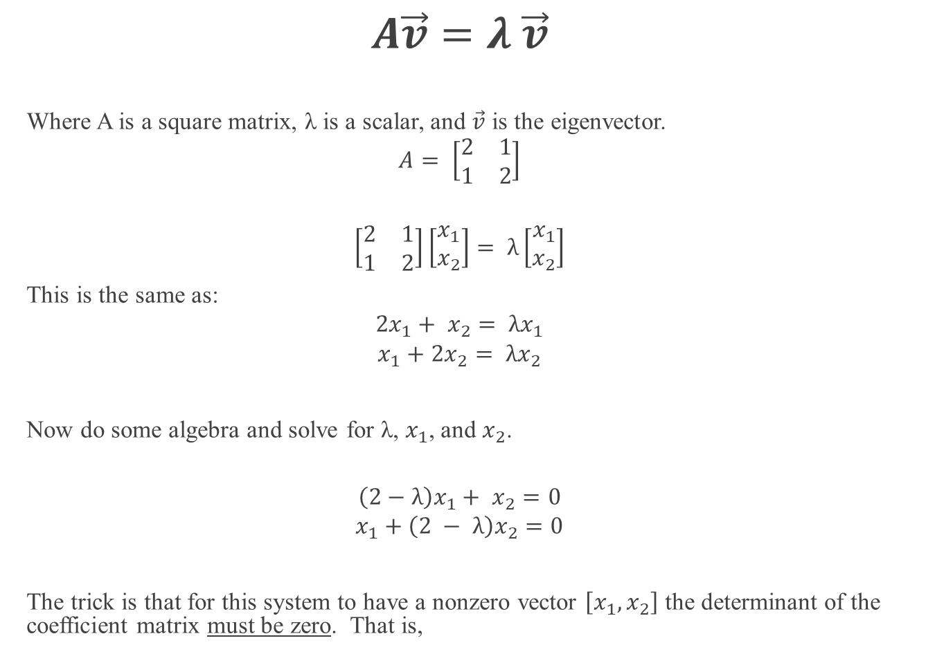
Eigenvectors and Eigenvalues
$$A\vec{v}=λ \vec{v}$$
Where A is a square matrix, λ is a scalar, and $\vec{v}$ is the eigenvector.
$$A= \left[\begin{matrix}2 & 1 \\ 1 & 2\end{matrix}\right]$$
$$\left[\begin{matrix}2 & 1 \\ 1 & 2\end{matrix}\right]\left[\begin{matrix}x_{1} \\ x_{2}\end{matrix}\right]= λ\left[\begin{matrix}x_{1} \\ x_{2}\end{matrix}\right]$$
This is the same as:
$$2x_{1}+ x_{2}= λx_{1}$$
$$x_{1}+2x_{2}= λx_{2}$$
Now do some algebra and solve for λ, $x_{1}$, and $x_{2}$.
$$\left(2−λ\right)x_{1}+ x_{2}=0$$
$$x_{1}+\left(2 − λ\right)x_{2}=0$$
The trick is that for this system to have a nonzero vector $\left[x_{1}, x_{2}\right]$ the determinant of the coefficient matrix must be zero. That is,

Slide 4
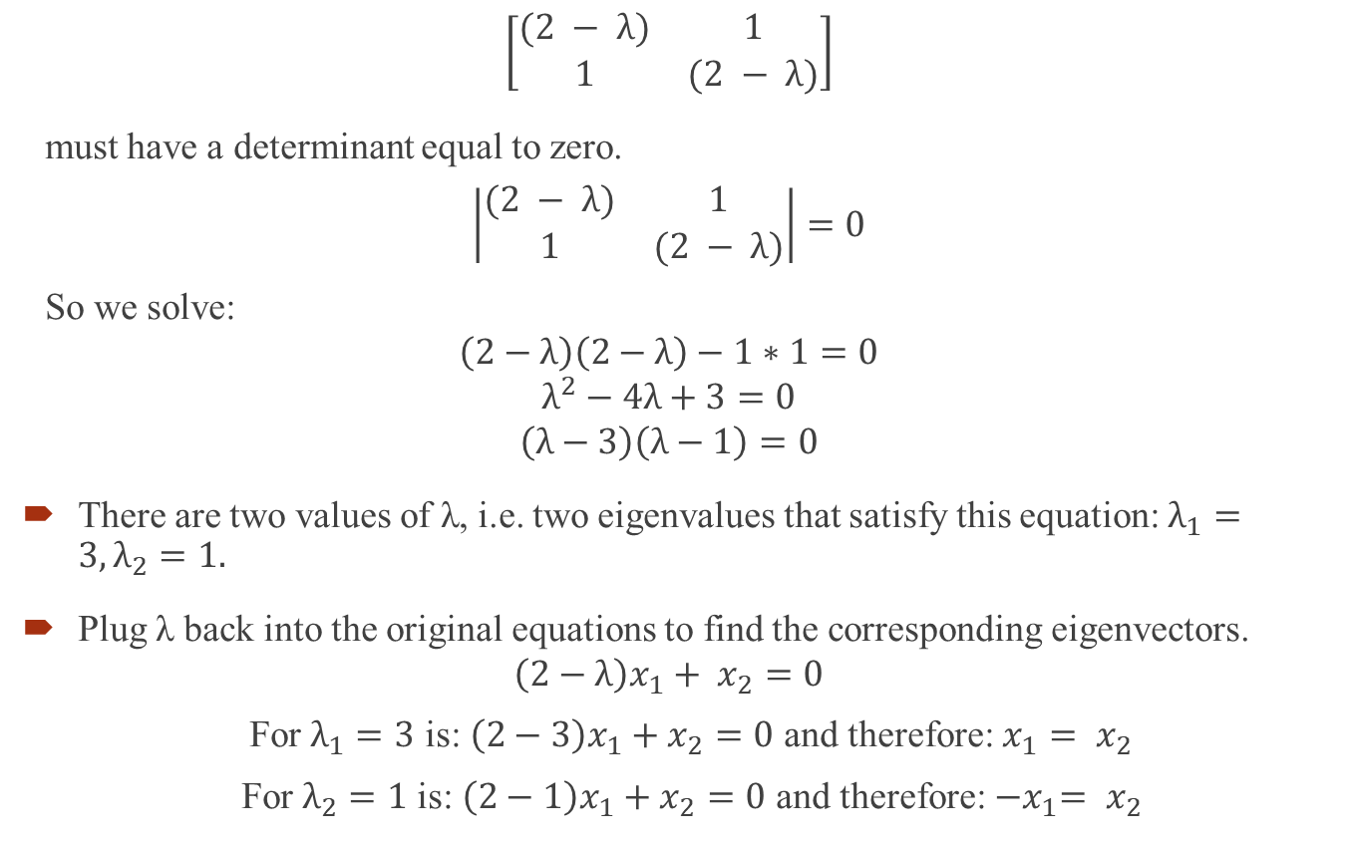
Eigenvectors and Eigenvalues Cont’d. 2
$$\left[\begin{matrix}(2 − λ) & 1 \\ 1 & (2 − λ)\end{matrix}\right]$$
must have a determinant equal to zero.
$$\left|\begin{matrix}(2 − λ) & 1 \\ 1 & (2 − λ)\end{matrix}\right|=0$$
So we solve:
$$\left(2−λ\right)\left(2−λ\right)−1∗1=0$$
$$λ^{2}−4λ+3=0$$
$$\left(λ−3\right)\left(λ−1\right)=0$$
There are two values of λ, i.e. two eigenvalues that satisfy this equation: $λ_{1}=3, λ_{2}=1.$
Plug λ back into the original equations to find the corresponding eigenvectors.
$$\left(2−λ\right)x_{1}+ x_{2}=0$$
For $λ_{1}=3$ is: $\left(2−3\right)x_{1}+x_{2}=0$ and therefore: $x_{1}= x_{2}$
For $λ_{2}=1$ is: $\left(2−1\right)x_{1}+x_{2}=0$ and therefore: ${−x}_{1}= x_{2}$

Slide 5

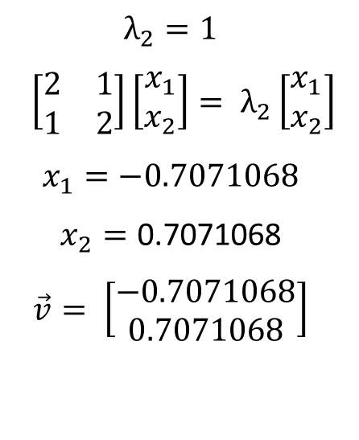
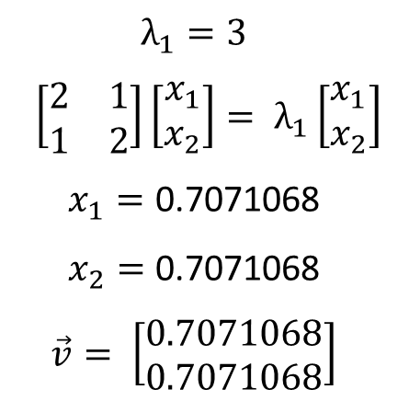
Two Solutions
$$A= \left[\begin{matrix}2 & 1 \\ 1 & 2\end{matrix}\right]$$
$$A\vec{v}=λ \vec{v}$$
$$\left[\begin{matrix}2 & 1 \\ 1 & 2\end{matrix}\right]\left[\begin{matrix}x_{1} \\ x_{2}\end{matrix}\right]= λ\left[\begin{matrix}x_{1} \\ x_{2}\end{matrix}\right]$$
$$λ_{1}=3$$
$$\left[\begin{matrix}2 & 1 \\ 1 & 2\end{matrix}\right]\left[\begin{matrix}x_{1} \\ x_{2}\end{matrix}\right]= λ_{1}\left[\begin{matrix}x_{1} \\ x_{2}\end{matrix}\right]$$
$$x_{1}=\text{0.7071068}$$
$$x_{2}=\text{0.7071068}$$
$$\vec{v}= \left[\begin{matrix}0.7071068 \\ 0.7071068\end{matrix}\right]$$
$$λ_{2}=1$$
$$\left[\begin{matrix}2 & 1 \\ 1 & 2\end{matrix}\right]\left[\begin{matrix}x_{1} \\ x_{2}\end{matrix}\right]= λ_{2}\left[\begin{matrix}x_{1} \\ x_{2}\end{matrix}\right]$$
$$x_{1}=−0.7071068$$
$$x_{2}=\text{0.7071068}$$
$$\vec{v}= \left[\begin{matrix}−0.7071068 \\ 0.7071068\end{matrix}\right]$$

Slide 6


Eigenvalues and Eigenvectors
Python
R
import numpy as np
A=np.matrix('2 1;1 2')
A
eigen = np.linalg.eig(A)
eigen[0]
eigen[1]
> A=matrix(c(2,1,1,2),ncol=2)
> A
[,1] [,2]
[1,] 2 1
[2,] 1 2
> ea=eigen(A)
> G=ea$vectors
> G
[,1] [,2]
[1,] 0.7071068 -0.7071068
[2,] 0.7071068 0.7071068

Slide 7
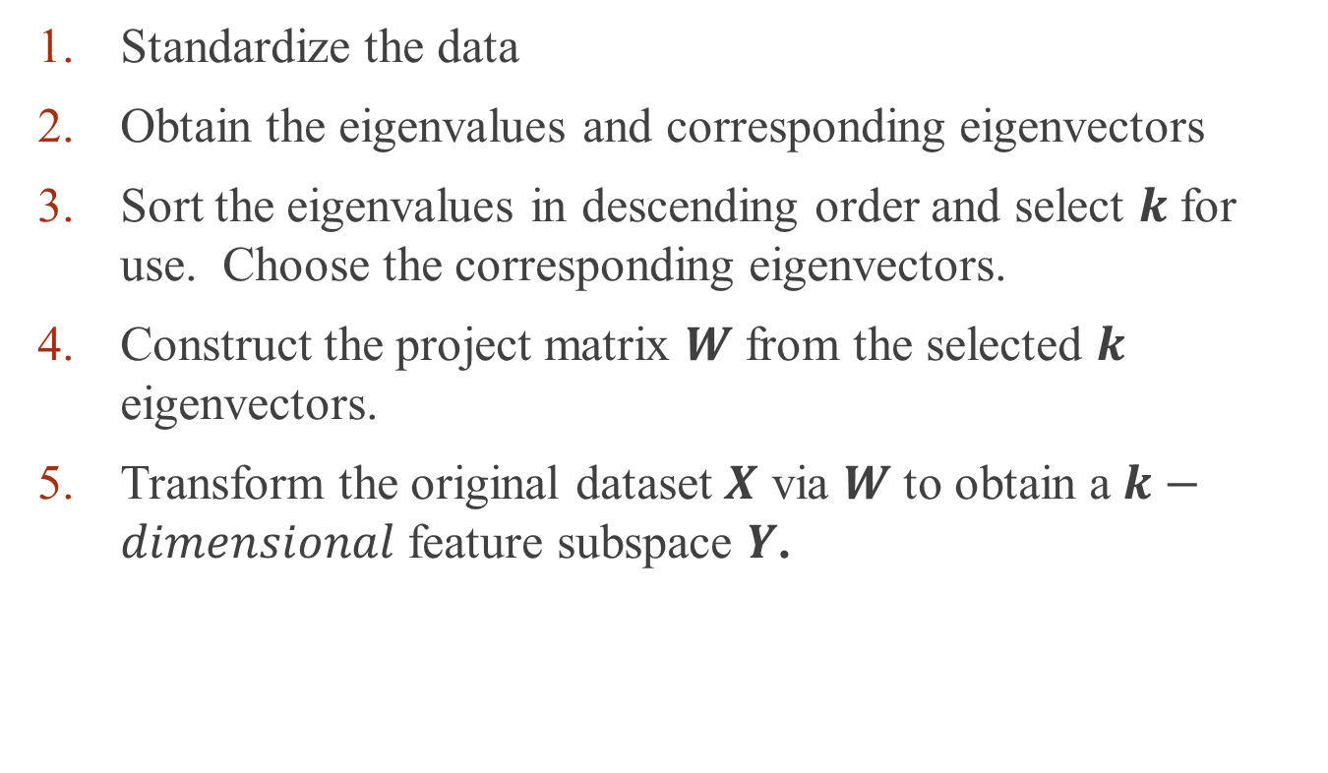
Conducting a PCA
Standardize the data
Obtain the eigenvalues and corresponding eigenvectors
Sort the eigenvalues in descending order and select $k$ for use. Choose the corresponding eigenvectors.
Construct the project matrix $W$ from the selected $k$ eigenvectors.
Transform the original dataset $X$ via $W$ to obtain a $k−dimensional$ feature subspace $Y$.

Slide 8
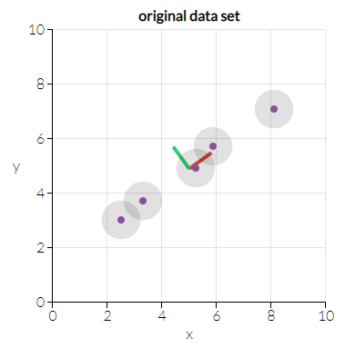
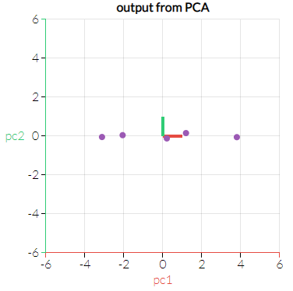


PCA Graphically
We don't lose much by dropping PC2 since it contributes the least to the variation in the data set.
http://setosa.io/ev/principal-component-analysis/

Slide 9
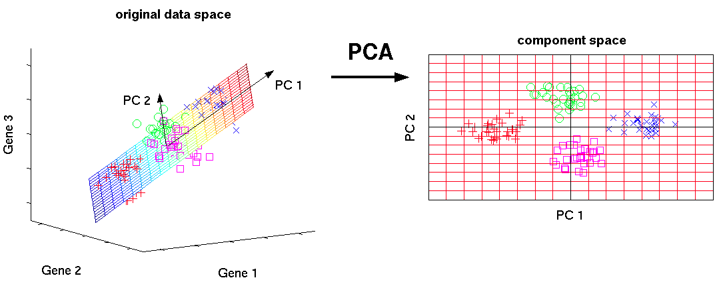
PCA
Dissects and ranks the correlational structure of multivariable data.
Can be used to reduce the dimensionality of a dataset while preserving all or most of the variance in the data.
The components derived are independent and orthogonal.

Slide 10
PCA in Python
import pandas as pd
from sklearn import datasets
import numpy as np
iris = datasets.load_iris()
X = iris.data # Sepal and pedal negth and width
Normalize data
from sklearn.preprocessing import scale
x = scale(X)
Implement PCA
from sklearn.decomposition import PCA
pca = PCA(n_components=2)
PC = pca.fit(x)

Slide 11
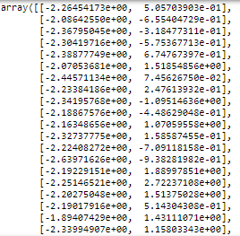
More information
PC Components
PC.components_
Variance in components
PC.explained_variance_ratio_
New features for all the instances
New_feats = pca.fit_transform(x)

Slide 12
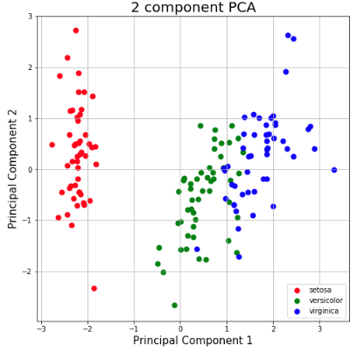
More information
import matplotlib.pyplot as plt
principalDf = pd.DataFrame(data = principalComponents , columns = ['principal component 1', 'principal component 2'])
finalDf = pd.concat([principalDf, IRIS[['Species']]], axis = 1)
fig = plt.figure(figsize = (8,8))
ax = fig.add_subplot(1,1,1)
ax.set_xlabel('Principal Component 1', fontsize = 15)
ax.set_ylabel('Principal Component 2', fontsize = 15)
ax.set_title('2 component PCA', fontsize = 20)
targets = [0,1,2]
colors = ['r', 'g', 'b']
for target, color in zip(targets,colors):
indicesToKeep = finalDf['Species'] == target
ax.scatter(finalDf.loc[indicesToKeep, 'principal component 1'] , finalDf.loc[indicesToKeep, 'principal component 2'] , c = color , s = 50)
ax.legend(['setosa', 'versicolor', 'virginica'])
ax.grid()
https://towardsdatascience.com/

Slide 13
PCA in R
#Load data
data(iris)
head(iris)
log.ir <- iris[,1:4] # All but target
ir.species <- iris[, 5] # target
#apply PCA - scale. = TRUE is highly
#advisable, but default is FALSE.
ir.pca <- prcomp(log.ir, center=TRUE, scale. = TRUE)
#print method
print(ir.pca)
#summary method
summary(ir.pca)
https://www.r-bloggers.com/computing-and-visualizing-pca-in-r/

Slide 14
PCA in R- Method 2
#Alternative - Use PCA on caret package
require(caret)
#use preProcess() to center, scale and transform data
trans = preProcess(iris[,1:4], method="pca")
PC = predict(trans, iris[,1:4])
#Retained PCs
head(PC)

Slide 15
Factor Analysis
Useful for examining the variable relationships within complex concepts or constructs
Collapses a number of variables down into interpretable, underlying factors, i.e. latent variables
Latent variables arise from multiple observed variables that have similar patterns of response because of their relationship through the latent variable
Factor analysis is a model of the measurement of a latent variable

Slide 16


















Factor Analysis
Four features are going to be represented by just two features:
$$y_{1}$$
$$y_{2}$$
$$y_{3}$$
$$y_{4}$$
Insomnia
Suicidal
Hypervent
Nausea
$$λ_{11}$$
$$λ_{12}$$
$$λ_{13}$$
$$λ_{22}$$
$$λ_{23}$$
$$λ_{24}$$
$$λ_{14}$$
$$λ_{21}$$
$$η_{1}$$
Depression
$$η_{2}$$
Anxiety
$y_{1}$=$λ_{11}η_{1}$+$λ_{12}η_{2}$+$ε_{1}$
$y_{2}$=$λ_{12}η_{1}$+$λ_{22}η_{1}$+$ε_{2}$
$y_{3}$=$λ_{13}η_{1}$+$λ_{23}η_{1}$+$ε_{3}$
$y_{4}$=$λ_{14}η_{1}$+$λ_{24}η_{1}$+$ε_{4}$

Slide 17
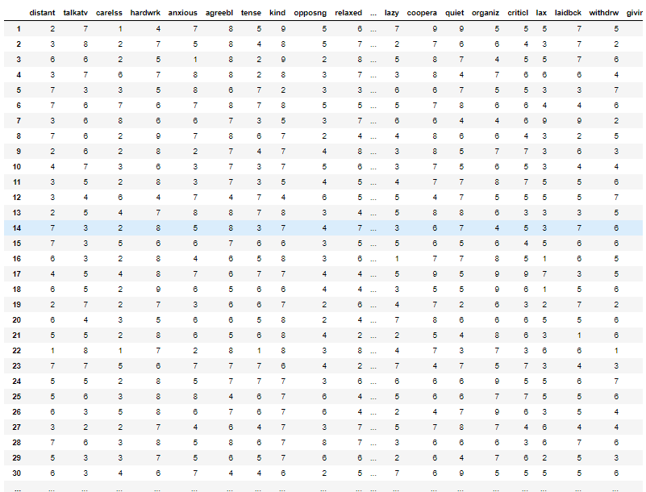
FA code in Python
dat = pd.read_csv('path/to/file/personality0.txt', sep=" ")
dat
240 rows × 32 columns

Slide 18
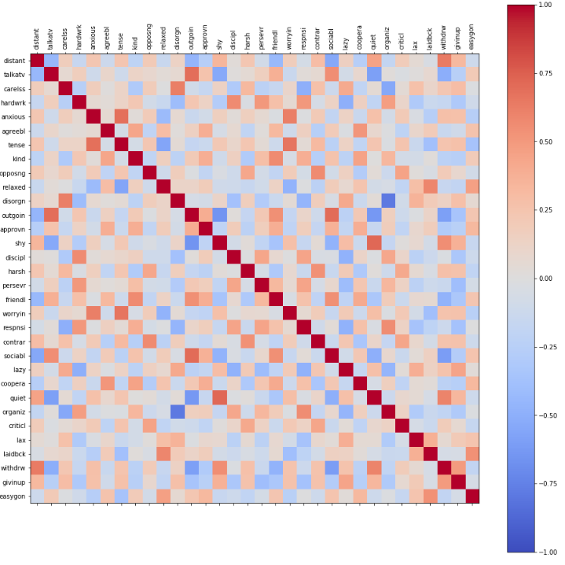
FA code in Python
corr = dat.corr()
fig = plt.figure()
ax = fig.add_subplot(111)
cax = ax.matshow(corr,cmap='coolwarm', vmin=-1, vmax=1)
fig.colorbar(cax)
fig.set_size_inches([16,16])
ticks = np.arange(0,len(dat.columns),1)
ax.set_xticks(ticks)
plt.xticks(rotation=90) ax.set_yticks(ticks)
ax.set_xticklabels(dat.columns)
ax.set_yticklabels(dat.columns)
plt.show()

Slide 19
FA code in Python
from sklearn.preprocessing import scale
from sklearn.decomposition import FactorAnalysis
data_normal = scale(dat)
fa = FactorAnalysis(n_components = 10)
fa = fa.fit(data_normal)
List of features and factors
feature_names = dat.columns
factor_names = ['Factor'+str(x) for x in range(1,11)]
pd.DataFrame(np.transpose(fa.components_), index=feature_names , columns=factor_names)

Slide 20
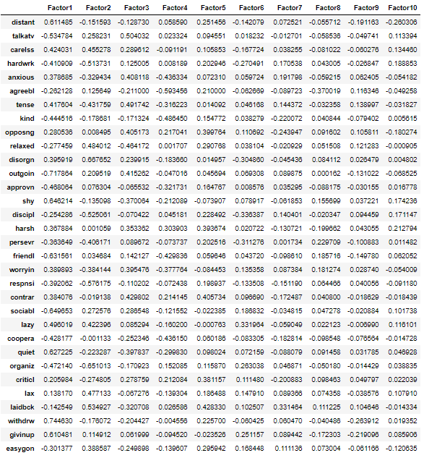
Factors and features

Slide 21
FA code in R
> dat <- read.table(personality0.txt')
> head(d)
distant talkatv carelss hardwrk anxious agreebl tense kind opposng relaxed disorgn outgoin approvn shy
1 2 7 1 4 7 8 5 9 5 6 3 2 7 9
2 3 8 2 7 5 8 4 8 5 7 5 8 7 6
3 6 6 2 5 1 8 2 9 2 8 7 6 7 5
4 3 7 6 7 8 8 2 8 3 7 2 5 6 4
5 7 3 3 5 8 6 7 2 3 3 5 2 5 8
6 7 6 7 6 7 8 7 8 5 5 6 5 6 8
discipl harsh persevr friendl worryin respnsi contrar sociabl lazy coopera quiet organiz criticl lax
1 5 5 8 9 9 9 5 9 7 9 9 5 5 5
2 7 3 7 7 5 7 5 8 2 7 6 6 4 3
3 5 2 5 8 3 9 2 8 5 8 7 4 5 5
4 6 2 8 8 3 8 2 6 3 8 4 7 6 6
5 7 5 6 2 8 7 3 2 6 6 7 5 5 3
6 5 3 6 7 7 7 5 4 5 7 8 6 6 4
laidbck withdrw givinup easygon
1 7 5 5 8
2 7 2 2 7
3 7 6 2 8
4 6 4 3 7
5 3 7 5 5
6 4 6 4 7
> str(d)
'data.frame': 240 obs. of 32 variables:
$ distant: int 2 3 6 3 7 7 3 7 2 4 ...
$ talkatv: int 7 8 6 7 3 6 6 6 6 7 ...
$ carelss: int 1 2 2 6 3 7 8 2 2 3 ...
$ hardwrk: int 4 7 5 7 5 6 6 9 8 6 ...
$ anxious: int 7 5 1 8 8 7 6 7 2 3 ...
$ respnsi: int 9 7 9 8 7 7 2 8 8 7 ...
$ contrar: int 5 5 2 2 3 5 2 5 3 4 ...
.

Slide 22
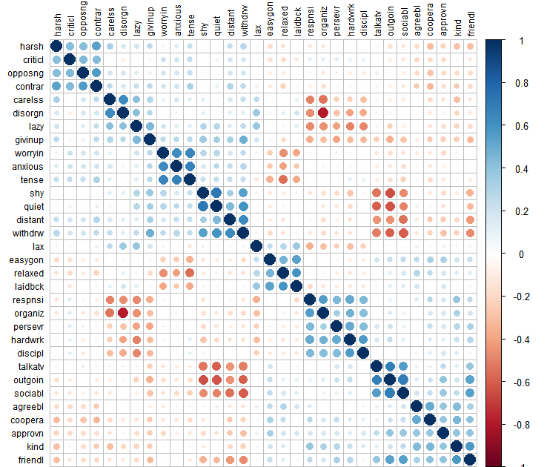
> #For dataframes with many columns, corrplot can be useful to get a sense of the
structure in the data (including larger scale organization)
> library(corrplot)
> corrplot(cor(d), order = "hclust", tl.col = 'black', tl.cex = .75)

Slide 23
> d_stan = as.data.frame(scale(d))
> ### Factor analysis with no rotation
> res1b = factanal(d_stan, factors = 10, rotation = "none", na.action = na.omit)
> res1b$loadings
Factor1 Factor2 Factor3 Factor4 Factor5 Factor6 Factor7 Factor8 Factor9 Factor10
SS loadings 6.706 3.071 2.554 2.283 1.979 1.105 0.867 0.689 0.393 0.382
Proportion Var 0.210 0.096 0.080 0.071 0.062 0.035 0.027 0.022 0.012 0.012
Cumulative Var 0.210 0.306 0.385 0.457 0.519 0.553 0.580 0.602 0.614 0.626
 | Factor1 | Factor2 | Factor3 | Factor4 | Factor5 | Factor6 | Factor7 | Factor8 | Factor9 | Factor10
distant | 0.593 | 0.269 |  |  |  | 0.207 | -0.101 |  | -0.221 | 0.214
talkatv | -0.505 | -0.513 |  | 0.270 | -0.114
carelss | 0.460 | -0.474 | 0.106 | 0.141 | 0.167 | 0.125 | -0.115 |  | 0.183
hardwrk | -0.457 | 0.326 | -0.136 | 0.348 | -0.166 |  | -0.315 |  | 0.170
anxious | 0.289 |  | -0.277 | 0.599 | 0.231 | -0.252 |  | -0.104
agreebl | -0.325 |  | 0.201 |  | 0.818 | 0.192 |  | -0.136
tense | 0.319 |  | -0.391 | 0.628 |  | -0.244 |  | -0.142
kind | -0.488 | 0.222 |  |  | 0.376 |  |  | 0.327
opposing | 0.290 | -0.168 |  | 0.404 | -0.217 | 0.330 | 0.189 | 0.194 | -0.230 | -0.166
relaxed | -0.177 |  | 0.602 | -0.311 | 0.155 | 0.187 |  | 0.176
disorgn | 0.462 | -0.640 | 0.199 |  | 0.251 |  | -0.302
outgoin | -0.690 | -0.435 | 0.128 | 0.233 | -0.104 |  |  |  |  | 0.194
approvn | -0.468 |  | 0.187 |  | 0.267 |  |  | 0.106 |  | 0.109
shy | 0.612 | 0.345 |  | -0.155 | 0.242 | -0.187 |  | 0.150 | 0.175
disciple | -0.303 | 0.451 | -0.127 | 0.214 | -0.100 | 0.185 | -0.329 |  | 0.148
harsh | 0.376 | -0.125 |  | 0.354 | -0.218 | 0.446 | 0.158 |  | 0.244
persevr | -0.398 | 0.250 | -0.115 | 0.277 | -0.106 |  | -0.371 | 0.187
friendl | -0.642 | -0.141 |  | 0.184 | 0.220 | -0.193 |  | 0.313
worryin | 0.296 | -0.401 | 0.484 | 0.123 | -0.376
respnsi | -0.463 | 0.478 | -0.209 | 0.172 |  | 0.146 | -0.140 | 0.172 | -0.121
contrar | 0.389 | -0.154 |  | 0.437 | -0.231 | 0.312 | 0.166 | 0.172
sociabl | -0.619 | -0.408 | 0.158 | 0.107 |  | -0.119 | 0.158
lazy | 0.529 | -0.318 | 0.135 |  | 0.195 | -0.141 | 0.323 | 0.122 | 0.120
coopera | -0.464 | 0.105 |  |  | 0.459 |  |  | 0.196
quiet | 0.574 | 0.461 |  |  | 0.346 |  |  | 0.187
organiz | -0.522 | 0.588 | -0.147 | 0.106 | -0.261 |  | 0.211
criticl | 0.186 | 0.112 | -0.142 | 0.400 | -0.257 | 0.276 | 0.154 | 0.185 |  | -0.147
lax | 0.210 | -0.242 | 0.383 | 0.165 | 0.104 | 0.166 | 0.124
laidbck |  |  | 0.997
withdrw | 0.726 | 0.344 |  |  |  | 0.138 |  |  |  | 0.306
givinup | 0.600 |  |  |  | 0.135 |  | 0.242 |  | 0.101 | 0.255
easygon | -0.220 |  | 0.542 |  | 0.143 |  | 0.104 | 0.208 | -0.105 | 0.117

Slide 24
Linear Discriminant Analysis (LDA)
LDA is used to find linear combinations of variables that characterize or separate classes of objects or events
LDA seeks to reduce dimensionality while preserving class discriminatory information
LDA is a generalization of Fisher’s linear discriminant
Maximizes the separability among classes

Slide 25
The Problem…
We’ve got a cancer drug
It works great for some people…
… but it makes other people feel worse. :(
How do we decide who to give the drug to?
Maybe gene expression can help us decide.

Slide 26
Using one gene to decide…
For the most part, the drug works in people with low transcription of gene X.
Transcription for Gene X
Fewer Transcripts
More transcripts
= The drug works!
= The drug does not work :(

Slide 27
Using one gene to decide…
For the most part, the drug works in people with low transcription of gene X.
However, there is overlap and no obvious “cutoff” for who to give the drug to.
And, for the most part, the drug does not work in people with high transcription of gene X.
Transcription for Gene X
Fewer Transcripts
More transcripts
= The drug works!
= The drug does not work :(

Slide 28
Using one gene to decide…
In summary, Gene X does an OK job at telling us who should take the drug (and who shouldn’t).
Can we do better? What if we used more than one gene?
Fewer Transcripts
More transcripts
= The drug works!
= The drug does not work :(

Slide 29
Using two genes to decide…
More Y transcripts
Two genes do a better job separating the two categories.
Would three genes be even better?
Gene Y
More X transcripts
Gene X
= The drug works!
= The drug does not work :(

Slide 30
Using three genes to decide…
With 3 dimensions, we use a plane to try and separate the two categories.
More Y transcripts
Gene Y
Gene Z
More X transcripts
Gene X
= The drug works!
= The drug does not work :(

Slide 31
Four or more genes…
We can’t draw a 4-D graph…. :(
Linear Discriminant Analsys (LDA) is like PCA, but it focuses on maximzing the seperatibility among known categories.

Slide 32
A super simple example
Reducing a 2-D graph to a 1-D graph
A 2-D graph (aka X/Y Graph)
A 1-D graph (aka number line)
Gene Y
LDA provides a way to do this.
Let’s see what it does, then we’ll go over the details.
Gene X

Slide 33
Reducing a 2-D graph to a 1-D graph with LDA
More Y transcripts
Gene Y
More X transcripts
Gene X
LDA uses both genes to create a new axis...

Slide 34
Reducing a 2-D graph to a 1-D graph with LDA
More Y transcripts
Gene Y
More X transcripts
Gene X
LDA uses both genes to create a new axis...
…and projects the data onto this new axis in a way to maximize the separation of the two categories.

Slide 35
Reducing a 2-D graph to a 1-D graph with LDA
More Y transcripts
Gene Y
More X transcripts
Gene X
LDA uses both genes to create a new axis...
…and projects the data onto this new axis in a way to maximize the separation of the two categories.

Slide 36
How LDA creates a new axis…
The new axis is created according to two criteria (considered simultaneously):
1) Maximize the distance between means.
Let’s call (μ – μ)
d for distance.
μ
μ
(μ – μ)²
Ideally large
s² + s²
Ideally small
s²
s²
2) Minimize the variation (which LDA calls “scatter” and is represented by s² ) within each category.

Slide 37
LDA and PCA comparison
from sklearn import datasets
from sklearn.discriminant_analysis import LinearDiscriminantAnalysis
import matplotlib.pyplot as plt
from sklearn.decomposition import PCA
iris = datasets.load_iris()
X = iris.data # Sepal and pedal negth and width
y = iris.target
target_names = iris.target_names
pca = PCA(n_components=2)
X_r = pca.fit(X).transform(X)
lda = LinearDiscriminantAnalysis(n_components=2)
X_r2 = lda.fit(X, y).transform(X) # Percentage of variance explained for each components
plt.figure()
colors = ['navy', 'turquoise', 'darkorange']
lw = 2
for color, i, target_name in zip(colors, [0, 1, 2], target_names):
plt.scatter(X_r[y == i, 0], X_r[y == i, 1], color=color, alpha=.8, lw=lw, label=target_name)
plt.legend(loc='best', shadow=False, scatterpoints=1)
plt.title('PCA of IRIS dataset')
plt.figure()
for color, i, target_name in zip(colors, [0, 1, 2], target_names):
plt.scatter(X_r2[y == i, 0], X_r2[y == i, 1], alpha=.8, color=color, label=target_name)
plt.legend(loc='best', shadow=False, scatterpoints=1)
plt.title('LDA of IRIS dataset')
plt.show()
https://scikit-learn.org/stable/auto_examples/decomposition/plot_pca_vs_lda.html

Slide 38
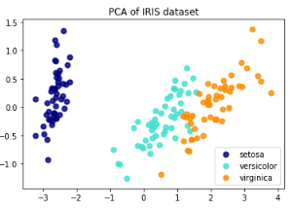
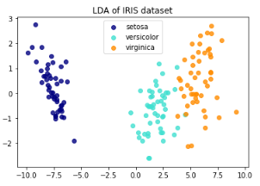
LDA and PCA comparison
https://scikit-learn.org/stable/auto_examples/decomposition/plot_pca_vs_lda.html

Slide 39
LDA with the Iris Dataset
> library(MASS)
> data("iris")
> r <- lda(formula = Species ~ ., data = iris, prior=c(1,1,1)/3)
> r$prior
setosa versicolor virginica
0.3333333 0.3333333 0.3333333
> r$counts
setosa versicolor virginica
50 50 50
> r$means
Sepal.Length Sepal.Width Petal.Length Petal.Width
setosa 5.006 3.428 1.462 0.246
versicolor 5.936 2.770 4.260 1.326
virginica 6.588 2.974 5.552 2.026
> r$scaling
LD1 LD2
Sepal.Length 0.8293776 0.02410215
Sepal.Width 1.5344731 2.16452123
Petal.Length -2.2012117 -0.93192121
Petal.Width -2.8104603 2.83918785
> r$svd
[1] 48.642644 4.579983
> prop = r$svd^2/sum(r$svd^2)
> prop
[1] 0.991212605 0.008787395
https://www.r-bloggers.com/computing-and-visualizing-lda-in-r/

Slide 40
> r2 <- lda(formula=Species ~ ., data=iris, prior=c(1,1,1)/3, CV=TRUE)
> head(r2$class)
[1] setosa setosa setosa setosa setosa setosa
Levels: setosa versicolor virginica
> head(r2$posterior, 3)
setosa versicolor virginica
1 1 5.087494e-22 4.385241e-42
2 1 9.588256e-18 8.888069e-37
3 1 1.983745e-19 8.606982e-39
> train <- sample(1:150, 75)
> r3 <- lda(Species ~ ., iris, prior = c(1,1,1)/3, subset=train)
> plda = predict(object=r, newdata=iris[-train, ])
> head(plda$class) #classification result
[1] setosa setosa setosa setosa setosa setosa
Levels: setosa versicolor virginica
> head(plda$posterior, 3) #posterior prob.
setosa versicolor virginica
1 1 3.896358e-22 2.611168e-42
2 1 7.217970e-18 5.042143e-37
3 1 1.463849e-19 4.675932e-39
> head(plda$x, 3) #LD projections
LD1 LD2
1 8.061800 0.3004206
2 7.128688 -0.7866604
3 7.489828 -0.2653845

Slide 41
> echa <- sample(1:150, 50)
> tabref <- iris[echa, 1:4]
> espref <- iris[echa, 5]
>
> tabsup <- iris[-echa, 1:4]
> espsup <- iris[-echa, 5]
>
> lda0 <- lda(tabref, espref)
> lda0
Call:
lda(tabref, espref)
Prior probabilities of groups:
setosa versicolor virginica
0.32 0.32 0.36
Group means:
Sepal.Length Sepal.Width Petal.Length Petal.Width
setosa 5.037500 3.431250 1.487500 0.256250
versicolor 6.125000 2.800000 4.375000 1.400000
virginica 6.622222 3.044444 5.477778 2.033333
Coefficients of linear discriminants:
LD1 LD2
Sepal.Length 1.633904 0.8667576
Sepal.Width 1.138961 -3.0680077
Petal.Length -3.307819 0.2157918
Petal.Width -1.393453 -2.1223230
Proportion of trace:
LD1 LD2
0.989 0.011
>
> espestim <- predict(lda0, tabsup)$class
> table(espestim, espsup)
espsup
espestim setosa versicolor virginica
setosa 34 0 0
versicolor 0 32 0
virginica 0 2 32
https://pbil.univ-lyon1.fr/R/pdf/course5.pdf

Slide 42
Shorter R code to conduct both PCA and LDA and generate comparison plots.
require(MASS)
require(ggplot2)
require(scales)
require(gridExtra)
pca <- prcomp(iris[,-5],
center = TRUE,
scale. = TRUE)
prop.pca = pca$sdev^2/sum(pca$sdev^2)
lda <- lda(Species ~ .,
iris,
prior = c(1,1,1)/3)
prop.lda = r$svd^2/sum(r$svd^2)
plda <- predict(object = lda,
newdata = iris)
dataset = data.frame(species = iris[,"Species"],
pca = pca$x, lda = plda$x)
p1 <- ggplot(dataset) + geom_point(aes(lda.LD1, lda.LD2, colour = species, shape = species), size = 2.5) +
labs(x = paste("LD1 (", percent(prop.lda[1]), ")", sep=""),
y = paste("LD2 (", percent(prop.lda[2]), ")", sep=""))
p2 <- ggplot(dataset) + geom_point(aes(pca.PC1, pca.PC2, colour = species, shape = species), size = 2.5) +
labs(x = paste("PC1 (", percent(prop.pca[1]), ")", sep=""),
y = paste("PC2 (", percent(prop.pca[2]), ")", sep=""))
grid.arrange(p1, p2)
https://gist.github.com/thigm85/8424654

Slide 43
Linear Discriminant Analysis
Attempts to express a categorical dependent variable as a linear combination of other independent variables.
Assumes the independent variables are normally distributed.
Can be used for dimensionality reduction before classification.

