Slide 1
Machine Learning
Lectures 11 – Model Evaluation

Slide 2
Model Evaluation
Test options refers to the technique used to evaluate the accuracy of a model on unseen data.
They are often referred to as resampling methods in statistics.
Test options that are generally recommend include:
Train/Test split: if you have a lot of data and determine you need a lot of data to build accurate models
Cross Validation: 5 folds or 10 folds provide a commonly used tradeoff of speed of compute time and generalize error estimate.
Repeated Cross Validation: 5- or 10-fold cross validation and 3 or more repeats to give a more robust estimate, only if you have a small dataset and can afford the time.
Note: We are staying away from time slice methods of sampling data because we are not getting into time series modeling.
Notes:
If you see the test set the model will be biased

Slide 3
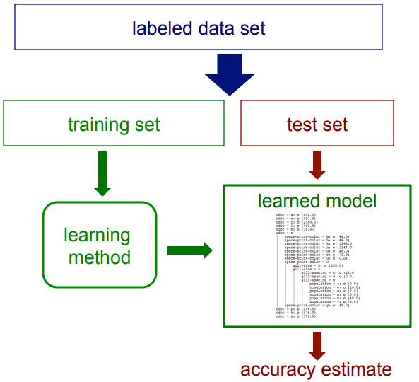
Review a General Model
Remember a Model diagram:
CS 760 (Machine learning)- University of Wisconsin, D. Page
Notes:
If you see the test set the model will be biased

Slide 4
Review a General Model
We use the training set to train the model
The test set will be used just ONE time to find the accuracy of the model
If the test-set labels influence the learned model in any way, accuracy estimates will be biased
The question is: how can we design an accurate model with less amount of data for training?

Slide 5
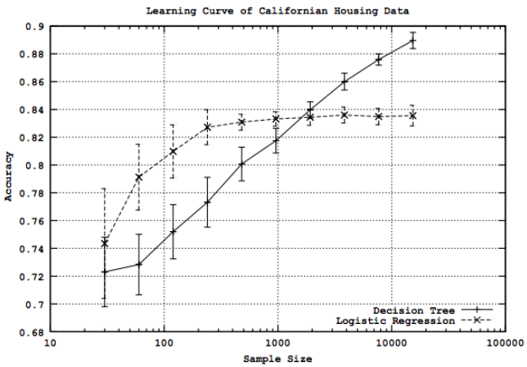
Learning Curves
We can see how the accuracy of a learning method change as a function of the training-set size through "learning curves"
CS 760 (Machine learning)- University of Wisconsin, D. Page

Slide 6
Learning Curves
How is it designed?
Given training/test set partition
for each sample size s on learning curve
(optionally) repeat n times
randomly select s instances from training set
learn model
evaluate model on test set to determine accuracy a
plot (s, a) or (s, avg. accuracy and error bars)
CS 760 (Machine learning)- University of Wisconsin, D. Page

Slide 7
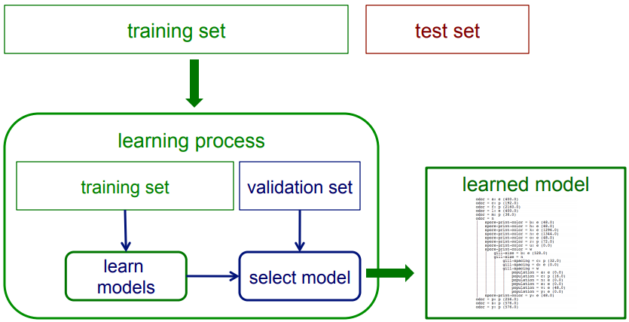
Validation Set
If we want unbiased estimates of accuracy during the learning process, we can use validation set
CS 760 (Machine learning)- University of Wisconsin, D. Page

Slide 8
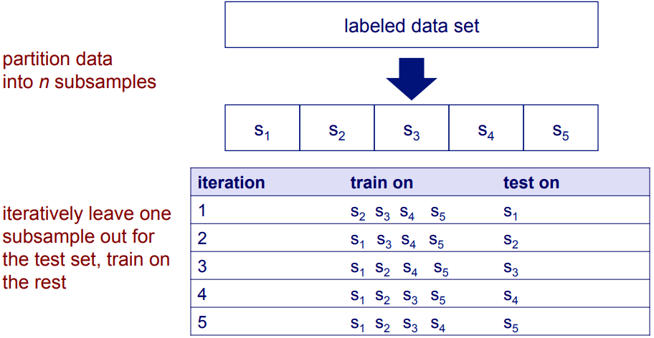
Cross validation
How can we use this validation set to be more beneficial?
CS 760 (Machine learning)- University of Wisconsin, D. Page

Slide 9
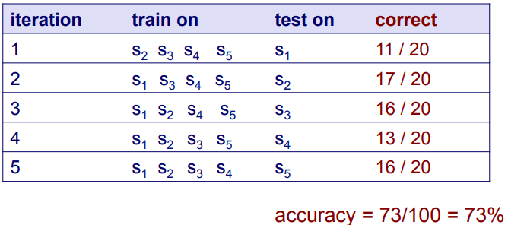
Cross validation
Suppose we have 100 instances, and we want to estimate accuracy with cross validation
CS 760 (Machine learning)- University of Wisconsin, D. Page

Slide 10
Cross validation
10-fold cross validation is common (n=10), but smaller values of n are often used when learning takes a lot of time.
In leave-one-out cross validation, n = # instances
CV makes efficient use of the available data for testing
Note that in CV, we are evaluating a learning method as opposed to an individual learned model
We can use CV to find the best degree of regression and classification
CS 760 (Machine learning)- University of Wisconsin, D. Page

Slide 11
Regression Metrics
For regression problems you should use:
Mean Absolute Error: is the average of the absolute differences between predictions and actual values. It gives an idea of how wrong the predictions were.
Mean Squared Error: is much like the mean absolute error in that it provides a gross idea of the magnitude of error. Taking the square root of the mean squared error converts the units back to the original units of the output variable and can be meaningful for description and presentation. This is called the Root Mean Squared Error (or RMSE).
RMSE: root mean squared error. Again, easy to understand and widely used.
R-squared: the goodness of fit or coefficient of determination.

Slide 12
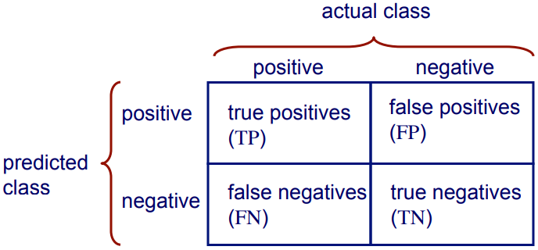

Confusion matrix for 2-class problems
We used confusion matrix to compute the accuracy
CS 760 (Machine learning)- University of Wisconsin, D. Page

Slide 13
Is accuracy an adequate measure of predictive performance?
Accuracy may not be useful measure in cases where
There is a large class skew
Is 98% accuracy good if 97% of the instances are negative?
There are differential misclassification costs – say, getting a positive wrong costs more than getting a negative wrong
Consider a medical domain in which a false positive results in an extraneous test but a false negative results in a failure to treat a disease
We are most interested in a subset of high-confidence predictions
CS 760 (Machine learning)- University of Wisconsin, D. Page

Slide 14
Example
What do you think about this confusion matrix? This is the confusion matrix of a machine learning model which diagnose cancer based on patients images
Accuracy = 83.33%
Accuracy looks good. Is it a good model?
 |  | Actual Target
 |  | Cancer = Yes | Cancer = NO
Predicted Target | Cancer = Yes | 5 | 5
 | Cancer = NO | 10 | 70
CS 760 (Machine learning)- University of Wisconsin, D. Page

Slide 15
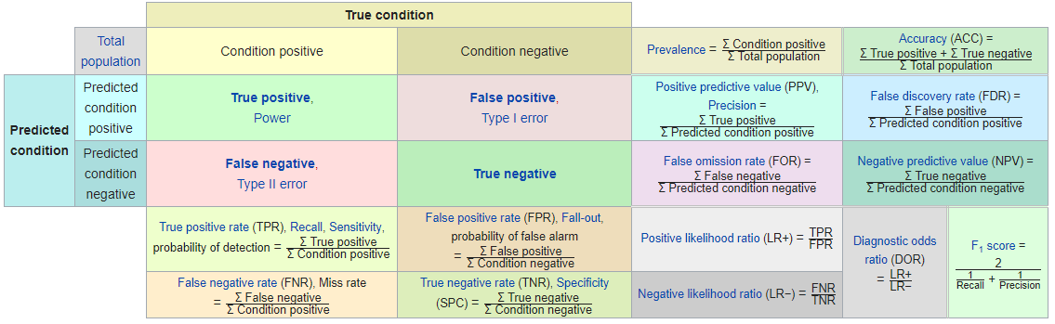

Other accuracy metrics
Sensitivity or Recall = $\frac{TP}{Condition Positive}=\frac{TP}{TP+FN}$
Specificity = $\frac{TN}{Actual Negative}=\frac{TN}{FP+TN}$
Precision = $\frac{TP}{Predicted Positive}=\frac{TP}{TP+FP}$
F1- score = $\frac{2}{\frac{1}{Precision}+\frac{1}{Recall}}$
Wikipedia

Slide 16
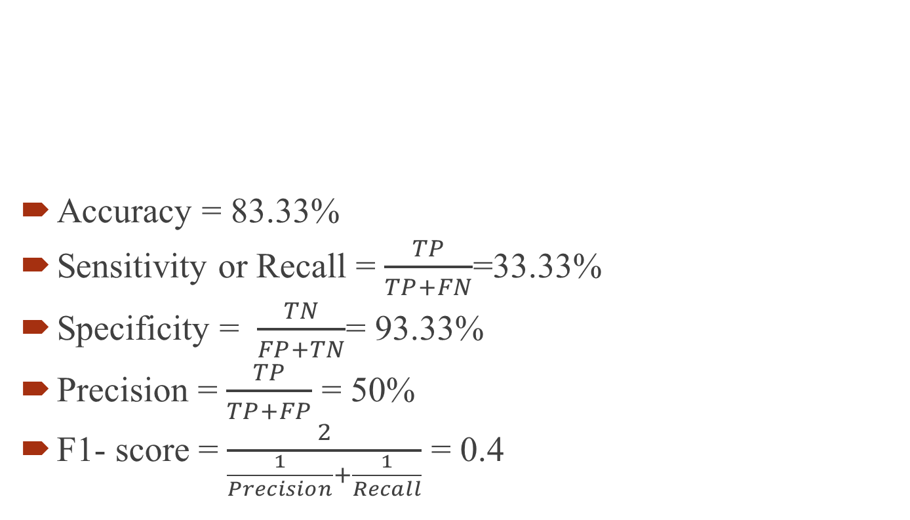
Example
 |  | Actual Target
 |  | Cancer = Yes | Cancer = NO
Predicted Target | Cancer = Yes | TP=5 | FP=5
 | Cancer = NO | FN=10 | TN=70
Accuracy = 83.33%
Sensitivity or Recall = $\frac{TP}{TP+FN}$=33.33%
Specificity = $\frac{TN}{FP+TN}$= 93.33%
Precision = $\frac{TP}{TP+FP}$ = 50%
F1- score = $\frac{2}{\frac{1}{Precision}+\frac{1}{Recall}}$ = 0.4
CS 760 (Machine learning)- University of Wisconsin, D. Page

Slide 17
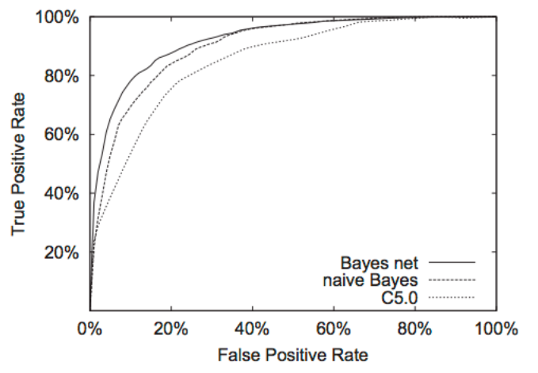
Receive operating characteristics curve
It is commonly called the ROC curve.
It is a plot of the true positive rate (TPR) (sensitivity) against the false positive rate (FPR) (1-specificity) .
The area under the curve is called AUC
AUC=1 is the best AUC=0.5 Gussing AUC>0.5 Good
CS 760 (Machine learning)- University of Wisconsin, D. Page

Slide 18
Example
Check the uploaded file on Canvas
CS 760 (Machine learning)- University of Wisconsin, D. Page

Slide 19
Overfitting
Overfitting occurs when a statistical model or machine learning algorithm captures the noise of the data.
Intuitively, overfitting occurs when the model or the algorithm fits the data too well.
Overfitting is usually called “high variance” in model.
Overfitting is often a result of an excessively complicated model, and it can be prevented by fitting multiple models and using validation or cross-validation to compare their predictive accuracies on test data.
https://chemicalstatistician.wordpress.com

Slide 20
Underfitting
Underfitting occurs when a statistical model or machine learning algorithm cannot capture the underlying trend of the data.
Intuitively, underfitting occurs when the model or the algorithm does not fit the data well enough.
Underfitting is usually called “ high bias” in model.
Underfitting is often a result of an excessively simple model.
https://chemicalstatistician.wordpress.com

Slide 21
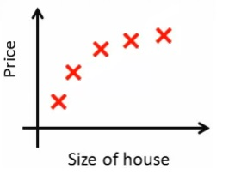
Regression Example
What is the best model for House price based on the size of the house? Assume x=size of houses
ECE485- University of Manitoba, CA

Slide 22
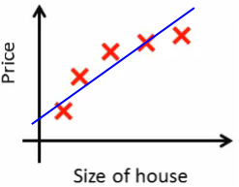
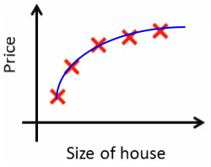
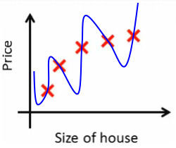
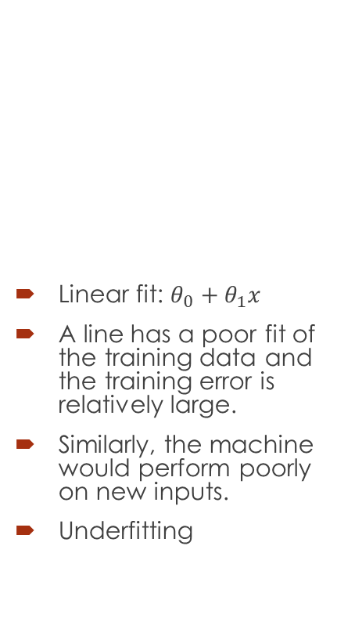
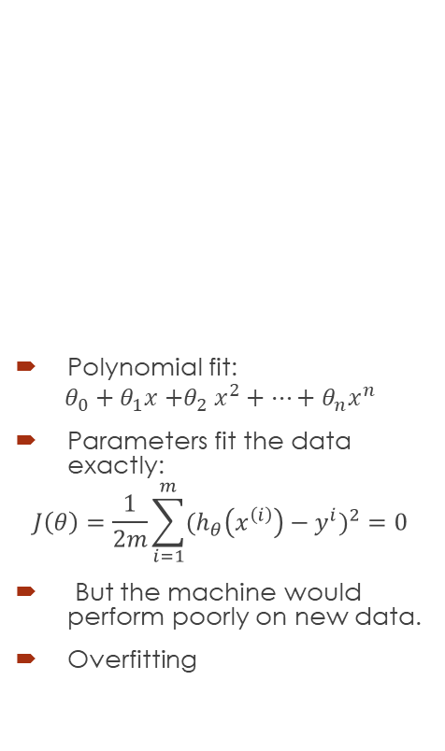
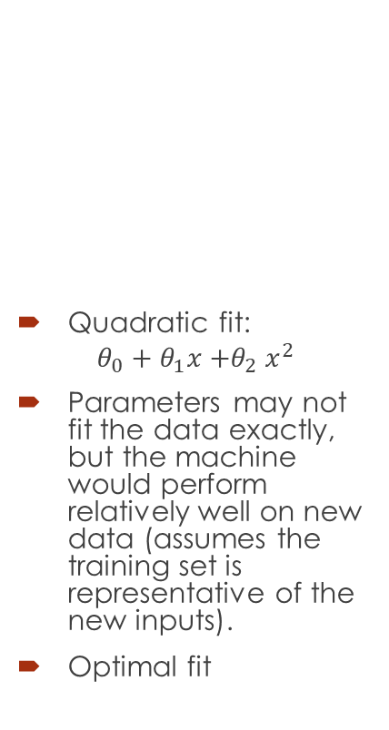
Regression Example
Linear fit: $θ_{0}+θ_{1}x$
A line has a poor fit of the training data and the training error is relatively large.
Similarly, the machine would perform poorly on new inputs.
Underfitting
Quadratic fit:
$$θ_{0}+θ_{1}x{+θ}_{2}x^{2}$$
Parameters may not fit the data exactly, but the machine would perform relatively well on new data (assumes the training set is representative of the new inputs).
Optimal fit
Polynomial fit:
$$θ_{0}+θ_{1}x{+θ}_{2}x^{2}+…+θ_{n}x^{n}$$
Parameters fit the data exactly:
$$J\left(θ\right)=\frac{1}{2m}\sum_{i=1}^{m}{(h_{θ}\left(x^{\left(i\right)}\right)−y^{i})^{2}}=0$$
But the machine would perform poorly on new data.
Overfitting
ECE485- University of Manitoba, CA

Slide 23
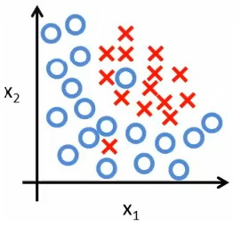

Classification Example
Can you predict the price of the house knowing size of the house and number of the rooms?
Assume $x_{1}$=size of the house, $x_{2}$= Number of rooms
ECE485- University of Manitoba, CA

Slide 24
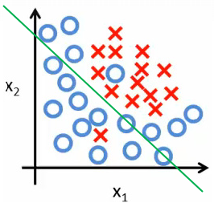
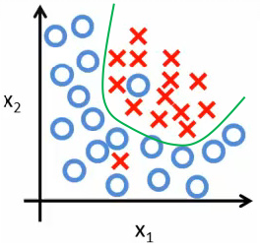
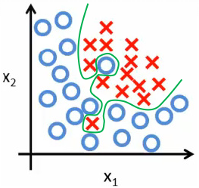

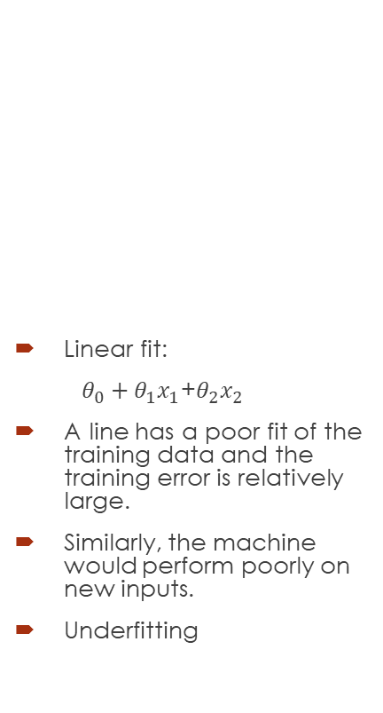
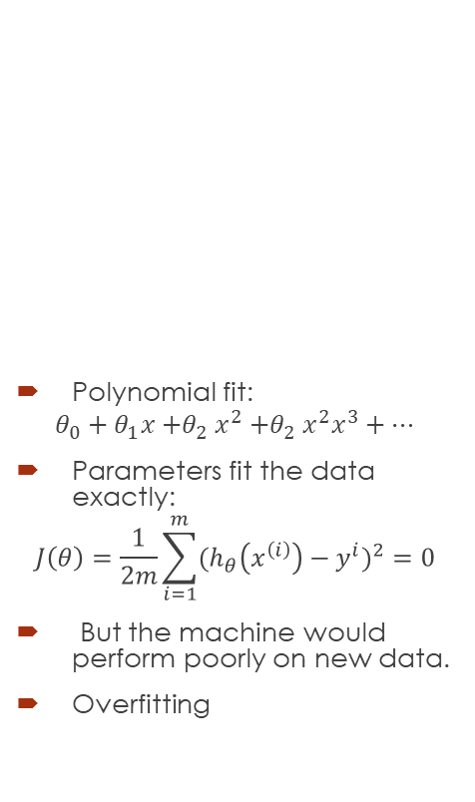
Classification Example
Linear fit:
$θ_{0}+θ_{1}x_{1}$+$θ_{2}x_{2}$
A line has a poor fit of the training data and the training error is relatively large.
Similarly, the machine would perform poorly on new inputs.
Underfitting
Quadratic fit:
$$θ_{0}+θ_{1}x{+θ}_{2}x^{2}$$
Parameters may not fit the data exactly, but the machine would perform relatively well on new data (assumes the training set is representative of the new inputs).
Optimal fit.
Polynomial fit:
$$θ_{0}+θ_{1}x{+θ}_{2}x^{2}{+θ}_{2}x^{2}x^{3}+…$$
Parameters fit the data exactly:
$$J\left(θ\right)=\frac{1}{2m}\sum_{i=1}^{m}{(h_{θ}\left(x^{\left(i\right)}\right)−y^{i})^{2}}=0$$
But the machine would perform poorly on new data.
Overfitting
ECE485- University of Manitoba, CA

Slide 25
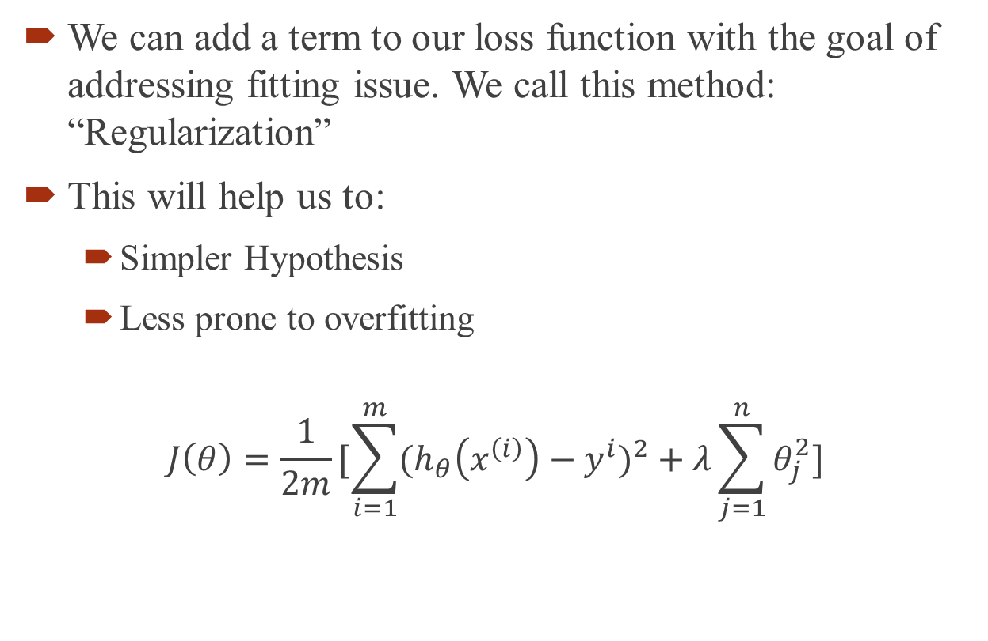
How to resolve the fitting issues?
We can add a term to our loss function with the goal of addressing fitting issue. We call this method: “Regularization”
This will help us to:
Simpler Hypothesis
Less prone to overfitting
$$J\left(θ\right)=\frac{1}{2m}[\sum_{i=1}^{m}{(h_{θ}\left(x^{\left(i\right)}\right)−y^{i})^{2}}+λ\sum_{j=1}^{n}{θ_{j}^{2}}]$$

Slide 26
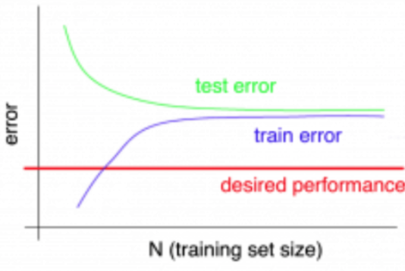
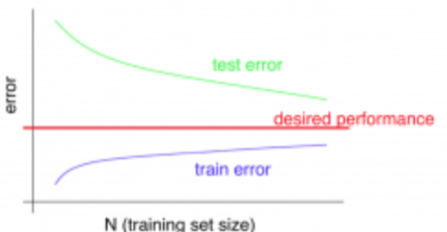
How do they look like?
Underfitting (Bias)
Overfitting (Variance)
https://medium.com/greyatom/what-is-underfitting-and-overfitting-in-machine-learning-and-how-to-deal-with-it-6803a989c76

Slide 27
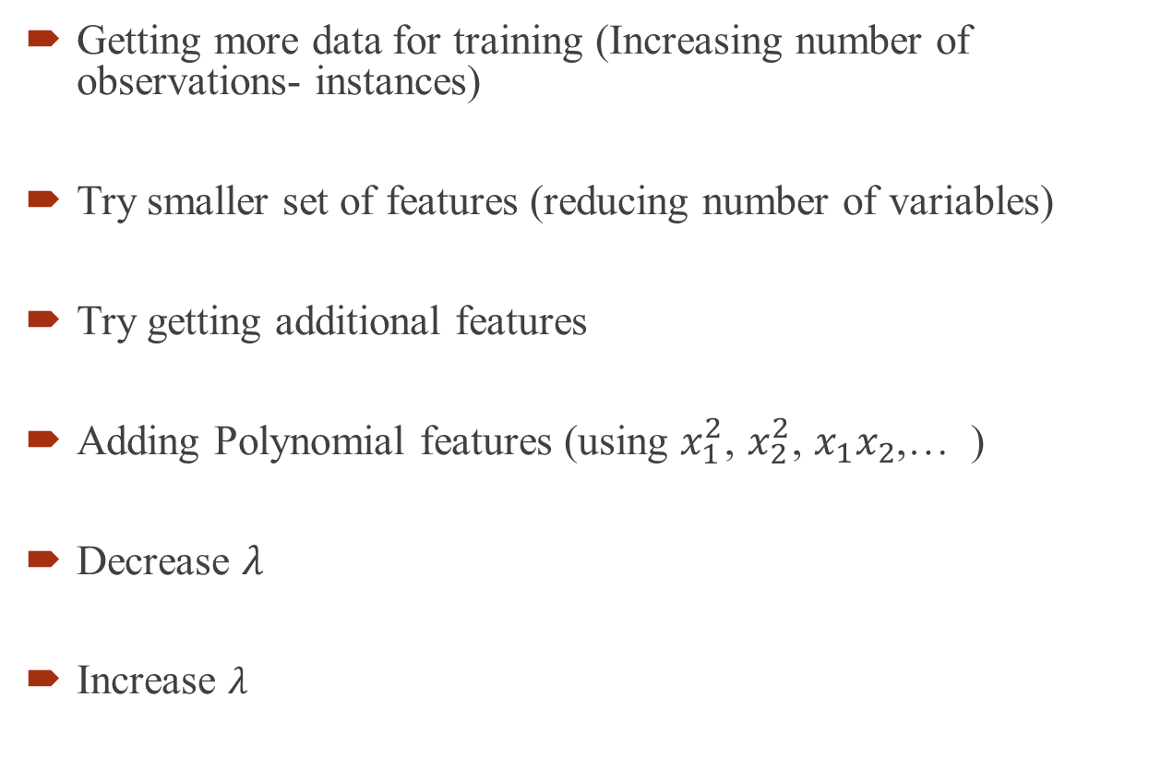
How to resolve the fitting issues?
Getting more data for training (Increasing number of observations- instances)
Try smaller set of features (reducing number of variables)
Try getting additional features
Adding Polynomial features (using $x_{1}^{2}$, $x_{2}^{2}$, $x_{1}x_{2}$,… )
Decrease $λ$
Increase $λ$
Fixes high variance
Fixes high variance
Fixes high Bias
Fixes high Bias
Fixes high Bias
Fixes high Variance
Andrew Ng- Machine learning lectures

