Slide 1
Machine Learning
Lecture 7
Supervised learning Techniques and Algorithms –Bayesian Method

Slide 2
Lesson Outline
Background and Introduction
Bayes Theorem
Examples using Bayes Theorem
Naïve Bayes Classifiers

Slide 3

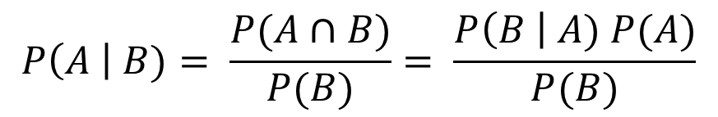



Bayes Theorem
Likelihood
Prior
$$P\left(A \right| B)= \frac{P(A∩B)}{P(B)}= \frac{P\left(B \right| A) P(A)}{P(B)}$$
Posterior
Marginal Likelihood
Task: determine the probability that incoming email was spam
First guess – prior probability –
Additional information
A spam message contains the
word “Urgent” – likelihood given by
Any message contains the word
“Urgent” – marginal likelihood
Now compute the posterior probability
$$P\left(spam\right)or P(A)$$
$$P\left(Urgent \right| spam) or P\left(B \right| A)$$
ham 80%
all email
Urgent 5%
spam 20%
$$P\left(Urgent\right)or P(B)$$
$$P\left(spam \right| Urgent) or P\left(A \right| B)$$

Slide 4
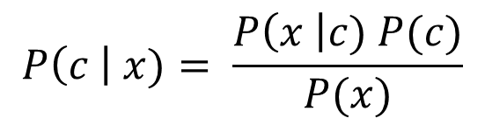
Bayes Theorem
Likelihood
Class- Prior Probability
$$P\left(c \right| x)= \frac{P\left(x \right|c) P(c)}{P(x)}$$
Posterior Probability
Predictor Prior Probability or Normalization constant
Prior Probability: Describes the degree to which we believe the model accurately describes reality based on all of our prior information
Likelihood: Describes how well the model predicts the data
Normalization Constant: Makes the posterior density integrate to one
Posterior Probability: Shows the degree to which we believe a given model accurately describes the situation given the available data and all the prior information

Slide 5

Example Using Bayes Theorem
Day | outlook | Temperature | Humidity | Windy | Play
1 | Sunny | Hot | High | FALSE | No
2 | Sunny | Hot | High | TRUE | No
3 | Overcast | Hot | High | FALSE | Yes
4 | Rainy | Mild | High | FALSE | Yes
5 | Rainy | Cool | Normal | FALSE | Yes
6 | Rainy | Cool | Normal | TRUE | No
7 | Overcast | Cool | Normal | TRUE | Yes
8 | Sunny | Mild | High | FALSE | No
9 | Sunny | Cool | Normal | FALSE | Yes
10 | Rainy | Mild | Normal | FALSE | Yes
11 | Sunny | Mild | Normal | TRUE | Yes
12 | Overcast | Mild | High | TRUE | Yes
13 | Overcast | Hot | Normal | FALSE | Yes
14 | Rainy | Mild | High | TRUE | No

Slide 6

Example Using Bayes Theorem
Outlook |  |  | Temp |  |  | Humidity |  |  | Windy |  |  | Play
 | Yes | No |  | Yes | No |  | Yes | No |  | Yes | No |  | Yes | No
Sunny | 2 | 3 | Hot | 2 | 2 | High | 3 | 4 | False | 6 | 2 |  | 9 | 5
Overcast | 4 | 0 | Mild | 4 | 2 | Normal | 6 | 1 | True | 3 | 3
Rainy | 3 | 2 | Cool | 3 | 1
Sunny | 2/9 | 3/5 | Hot | 2/9 | 2/5 | High | 3/9 | 4/5 | False | 6/9 | 2/5 |  | 9/14 | 5/14
Overcast | 4/9 | 0/5 | Mild | 4/9 | 2/5 | Normal | 6/9 | 1/5 | True | 3/9 | 3/5
Rainy | 3/9 | 2/5 | Cool | 3/9 | 1/5
Example: P(Temperature=cool | Play=Yes)=3/9
Example: P(Outlook=Rainy | Play=No)=2/5
What is the probability of playing knowing in this condition?
So Play or not??!!
Outlook | Temperature | Humidity | Windy | Play
Sunny | Cool | High | True | ?
Let’s call this condition X and the Playing, C

Slide 7
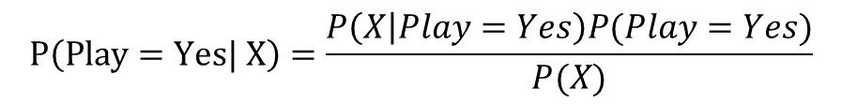
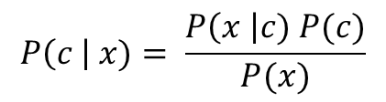
Example
$$P\left(Play=Yes| X\right)=\frac{P\left(X | Play=Yes\right)P(Play=Yes)}{P(X)}$$
$$P\left(X | Play=Yes\right)P(Play=Yes)= \frac{2}{9}∗ \frac{3}{9}∗ \frac{3}{9}∗ \frac{3}{9}∗ \frac{9}{14}=0.0053$$
$$P\left(X | Play=No\right)P(Play=No)= \frac{3}{5}∗ \frac{1}{5}∗ \frac{4}{5}∗ \frac{3}{5}∗ \frac{5}{14}=0.0206$$
If all the weather condition that we considered are independent from each other, then:
𝑃(𝑋)=𝑃(𝑂𝑢𝑡𝑙𝑜𝑜𝑘=𝑠𝑢𝑛𝑛𝑦)∗ 𝑃(𝑇𝑒𝑛𝑝𝑟𝑒𝑟𝑎𝑡𝑢𝑟𝑒=𝐶𝑜𝑜𝑙)∗𝑃(𝐻𝑢𝑚𝑖𝑑𝑖𝑡𝑦=𝐻𝑖𝑔ℎ)∗ 𝑃(𝑊𝑖𝑛𝑑𝑦=𝑇𝑟𝑢𝑒)
$$P\left(X\right)= \frac{5}{14}∗ \frac{4}{14}∗ \frac{7}{14}∗ \frac{6}{14}=0. 02186$$
Remember:
$$P\left(c \right| x)= \frac{P\left(x \right|c) P(c)}{P(x)}$$
$$P\left(Play=Yes| X\right)=\frac{P\left(X | Play=Yes\right)P(Play=Yes)}{P(X)}= \frac{0.0053}{0.02186}=0. 2424$$
$$P\left(Play=No| X\right)= \frac{0.0206}{0.02186}=0. 9421$$

Slide 8

Naïve Bayes Classifiers
A priori probability:
The probability of an event before evidence of that event is seen P(H)
A posteriori probability:
The probability of an event after the evidence of that event is seen P(H|E)
Assume independence- That’s why we call it naïve!
$$P\left(E | H\right)= P\left(E_{1} | H\right)∗ P\left(E_{2} | H\right)∗…∗P\left(E_{n} | H\right)$$
And Bayes Theorem is:
$$P\left(H | E\right)=P\left(E | H\right)∗ \frac{P(H)}{P(E)} = \frac{P\left(E_{1} | H\right)P\left(E_{2} | H\right)…P\left(E_{n} | H\right)P(H)}{P(E)}$$

Slide 9
Was that essential to compute P(X)?
$$P\left(Play=Yes| X\right)=\frac{P\left(X | Play=Yes\right)P(Play=Yes)}{P(X)}= \frac{0.0053}{P(X)}$$
$$P\left(Play=No| X\right)=\frac{P\left(X | Play=No\right)P(Play=No)}{P(X)}= \frac{0.0206}{P(X)}$$
Remember that we don’t actually have to calculate P(X) because it is constant for all classes.

Slide 10
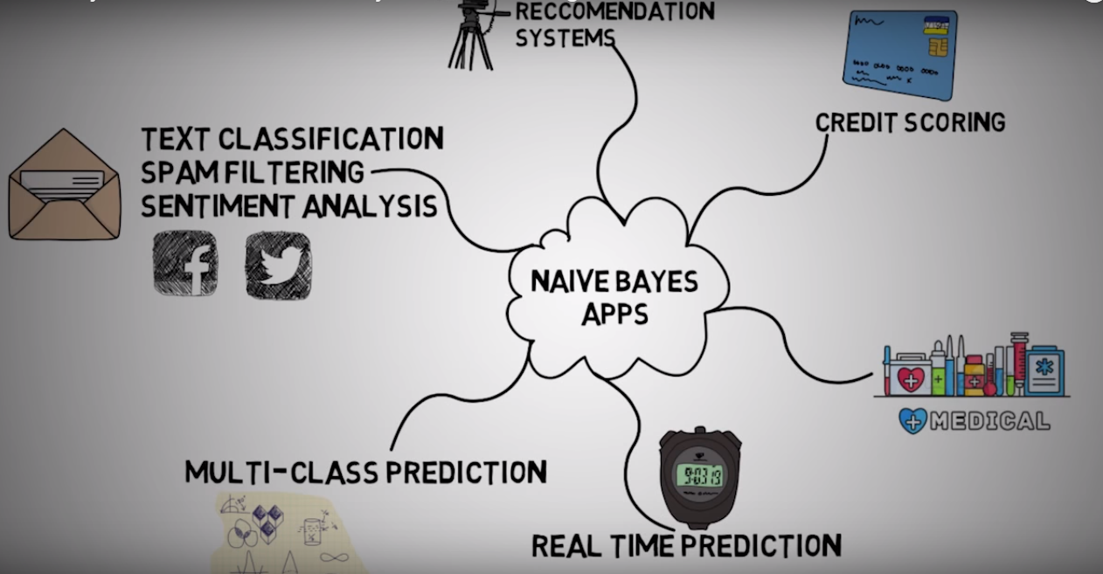
Naïve Bayes Classifier Applications

Slide 11

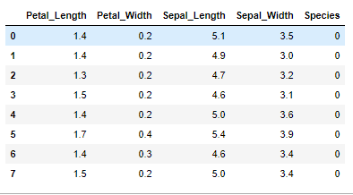
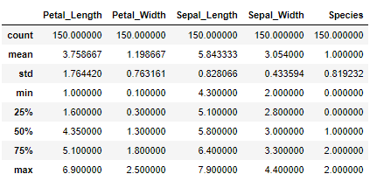
Multiple classes example
For this part, let’s load the Iris dataset
from sklearn import datasets
import numpy as np
iris = datasets.load_iris()
X = iris.data
# Sepal and pedal negth and width
y = iris.target
IRIS = pd.DataFrame({'Sepal_Length':X[:,0], 'Sepal_Width':X[:,1], 'Petal_Length':X[:,2], 'Petal_Width':X[:,3], 'Species':y})

Slide 12
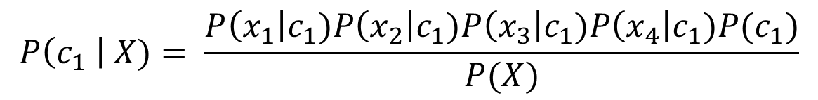
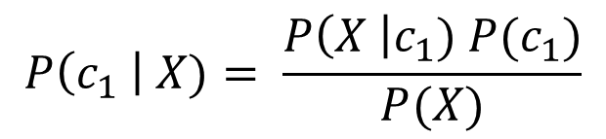
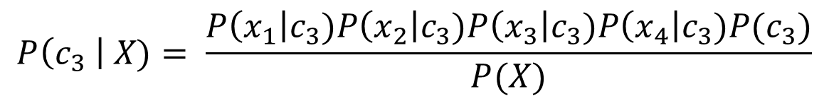
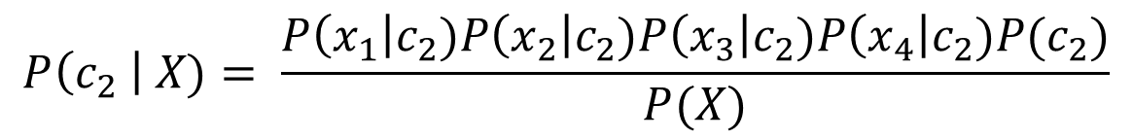
Multiple classes example
Let’s see what is going in our problem
Setosa | length and width information
$$P\left(c_{1} \right| X)= \frac{P\left(X \right|c_{1}) P(c_{1})}{P(X)}$$
sepal width | Setosa
petal width | Setosa
petal length | Setosa
sepal length | Setosa
Setosa
$$P\left(c_{1} \right| X)= \frac{P\left(x_{1}\right|c_{1})P\left(x_{2}\right|c_{1})P\left(x_{3}\right|c_{1})P\left(x_{4}\right|c_{1})P(c_{1})}{P(X)}$$
Virginica | length and width information
$$P\left(c_{2} \right| X)= \frac{P\left(x_{1}\right|c_{2})P\left(x_{2}\right|c_{2})P\left(x_{3}\right|c_{2})P\left(x_{4}\right|c_{2})P(c_{2})}{P(X)}$$
Versicolor | length and width information
$$P\left(c_{3} \right| X)= \frac{P\left(x_{1}\right|c_{3})P\left(x_{2}\right|c_{3})P\left(x_{3}\right|c_{3})P\left(x_{4}\right|c_{3})P(c_{3})}{P(X)}$$

Slide 13
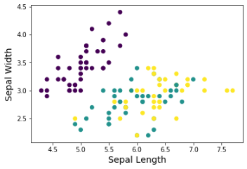
Split data to train and test
Use same methodology as before to split data to train and test
Now we have 70% of data for training and the rest for testing
from sklearn.model_selection import train_test_split
X_train, X_test, y_train, y_test = train_test_split(X, y, test_size=0.30, random_state=52)

Slide 14
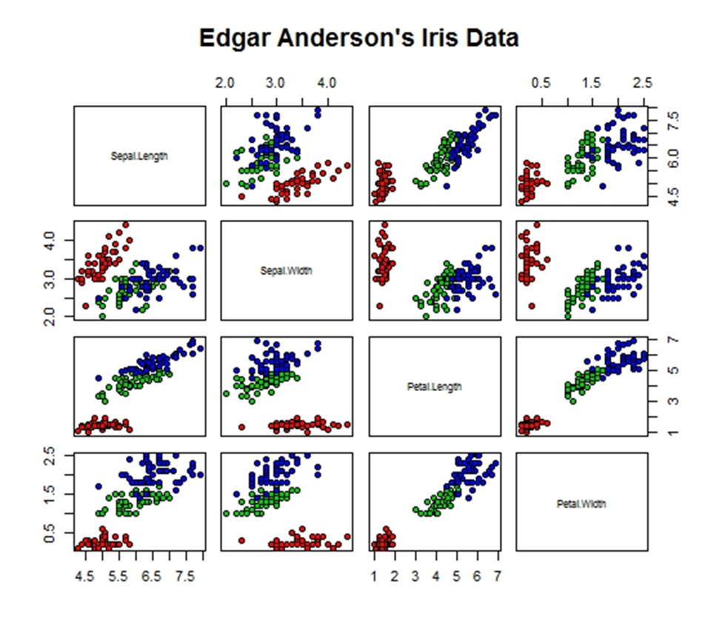

Slide 15
Train and evaluate the model
Now we can train and evaluate the model
One way of improving the accuracy is to change the prior probabilities
For discrete features we use MultinomialNB()
from sklearn.naive_bayes import GaussianNB
from sklearn.metrics import accuracy_score
gnb = GaussianNB()
gnb = gnb.fit(X_train, y_train)
y_predict = gnb.predict(X_test)
accuracy_score(y_test, y_predict)*100
gnb = GaussianNB(priors=[.13,.74,.13])

Slide 16
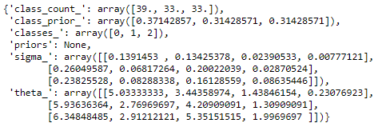
More information
We can get more information about the model
Here we can show likelihood of features
theta_ : mean of each feature per class
sigma_ : variance of each feature per class
gnb.__dict__

Slide 17
R- Iris Dataset
> library(caTools)
> # Make 70% of data for training and the rest for testing
> set.seed(1)
> iris$spl <- sample.split(iris,SplitRatio = 0.7)
> train <- subset(iris, iris$spl==TRUE)
> test <- subset(iris, iris$spl==FALSE)
> # drop the newly added column
> train1 <- train[-6]
> test1 <- test[-6]
> library(naivebayes)

Slide 18
R- Naïve Bayes model
> naive <-naive_bayes(Species ~ ., data=train1)
> (mat<- table(predict(naive, test1[,-5]), test1[,5]))
setosa versicolor virginica
setosa 16 0 0
versicolor 0 16 1
virginica 0 1 16
> (Accuracy <- sum(diag(mat))/sum(mat)*100)
[1] 96

Slide 19
Pros and Cons
Pros
It is easy and fast for classification
If the events are independent, Naïve Bayes usually acts better and we need less training data
It works better on categorical variables compered to numerical ones
Cons
If there is a category which is not seen in training, the probability of zero will be assigned that affects the final result (Zero frequency)
Assumption of independent redactors in real world does not hold

