Slide 1

Impact of Supply chain Analytics on Operational Optimization
A case study on Global Manufacturing Company

Slide 2
Introduction
With globalization and manufacturing spreading all over the world supply chain operations have become complex to manage
Customer buying patterns have changed
Competition has been tough
Optimization is mandatory to keep operational cost down and increase revenue

Slide 3
Literature Review
Supply chain deals with lots of parameters like demand of products, promotion schedules, supply schedule from vendors, logistics, warehouse optimization, cost optimization, Supply & Operations (SNOP) optimization and making sure product lands in the warehouse at the time of fulfillment
Supply chain management then means optimizing the whole process in a way to lower cost and increase operating efficiency while improving customer service and revenue in tandem .

Slide 4
Opportunity
According to @souza2014supply, to address these challenges, companies are widely adopting Enterprise Resource Planning systems(ERP) that manage the workflow of business digitally. As these ERP systems are being implemented, companies are generating lots of data.
Academia and practitioners agree that this flood of data creates new opportunities, therefore many organization tried to develop and enhance their analytics capability to uncover and gain a better understanding from their big data hidden values.(@BOONE2019170)

Slide 5
Use Of Analytics in Literature
Analytics is the way to uncover hidden insights from raw data. According to @russom2011big, analytics includes data mining, statistical analysis, predictive analysis to uncover hidden patterns, trends and corelations. Analytics covers integration of data in such a way that that it can be easily studied and drawn insights from. According to @9314713, digitization of business have become a revolution and machine learning is at the heart of it.
Information flow has become just as important as real flow of goods to get actionable insights and achieve business goals (@TIWARI2018319)

Slide 6
Work done so far
In the research conducted by @CARBONNEAU20081140, the researchers compare the results obtained by implementing machine learning with other traditional methods of supply chain planning.
According to @9314713, Machine learning is most suitable for supply chain function. As this area is being flooded with data, the adoption of machine learning can help make supply chain automated with very minimal human intervention.

Slide 7
Hypothesis
Applying machine learning methods in supply chain can improve forecast accuracy to keep optimal inventory levels. While there were many theoretical analysis on how Analytics can help supply chain management of small size companies there was gap on using data to test the hypothesis, I want to test that through my research.

Slide 8
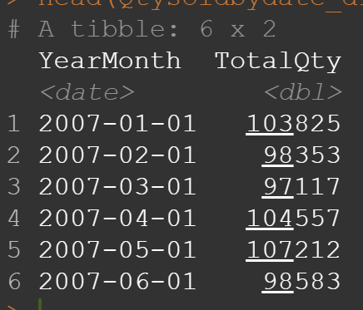
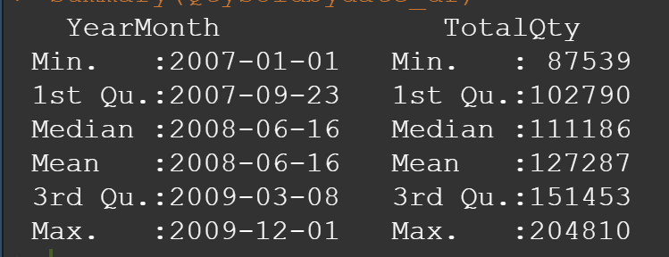
Data
Data was derived from a fictious company called Contoso Limited and data.
Obtained data spanned from 2007 to 2009. The data was fed into R to carry out the research.
Exploratory data analysis was conducted on the data

Slide 9
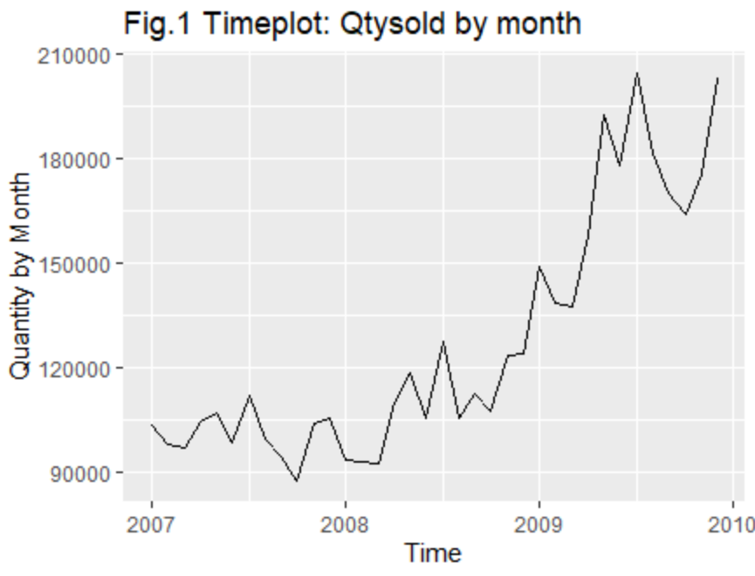
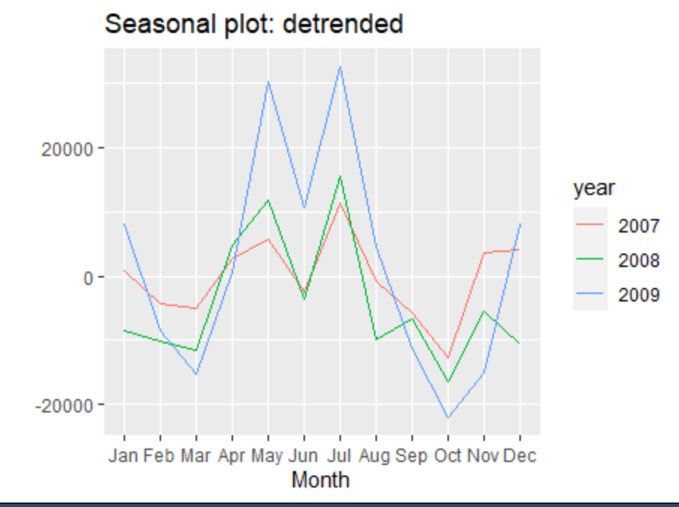
Trend and Seasonality in the data

Slide 10
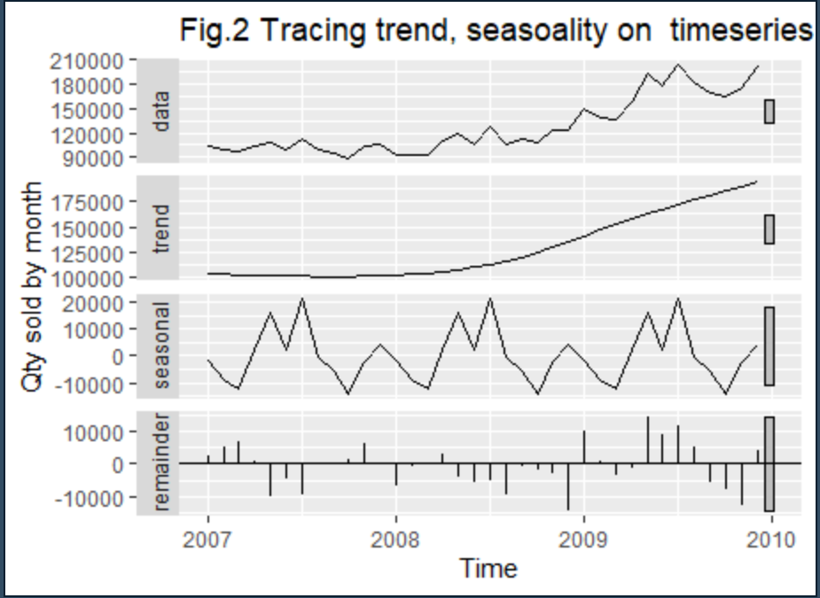
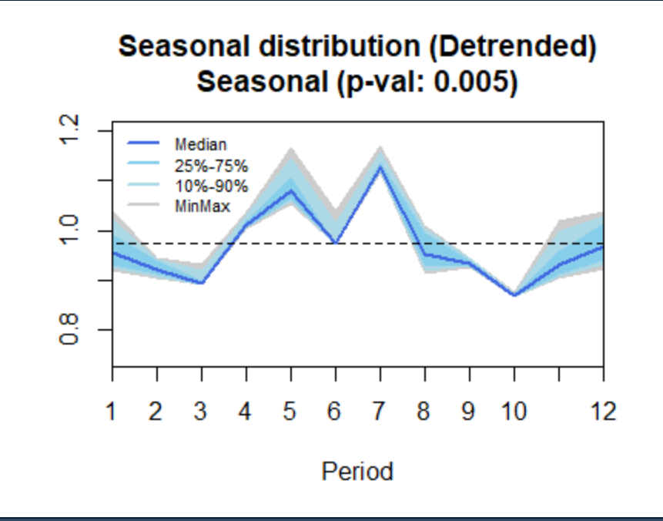
Data Decomposition

Slide 11
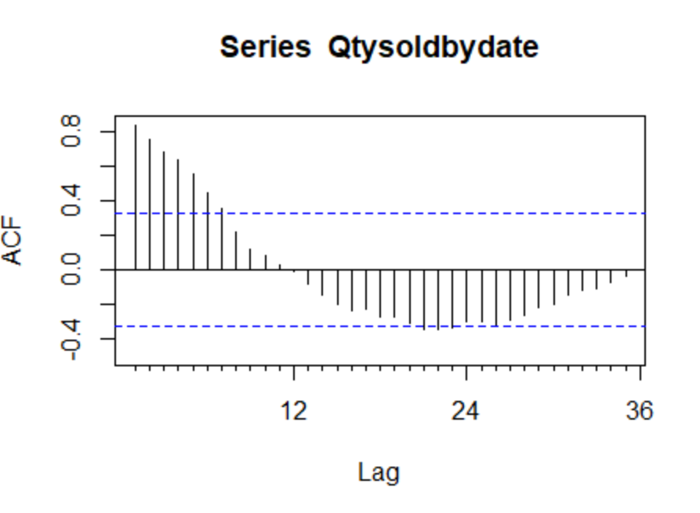
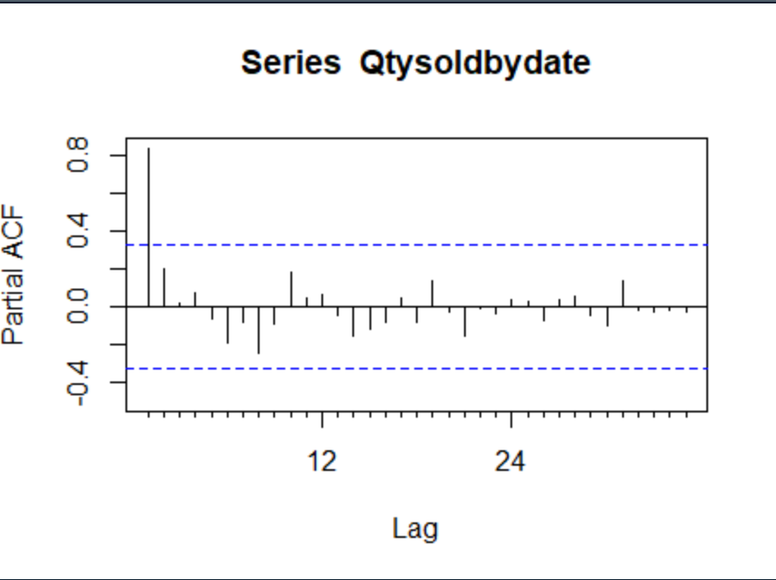
ACF and Pacf Statistics

Slide 12
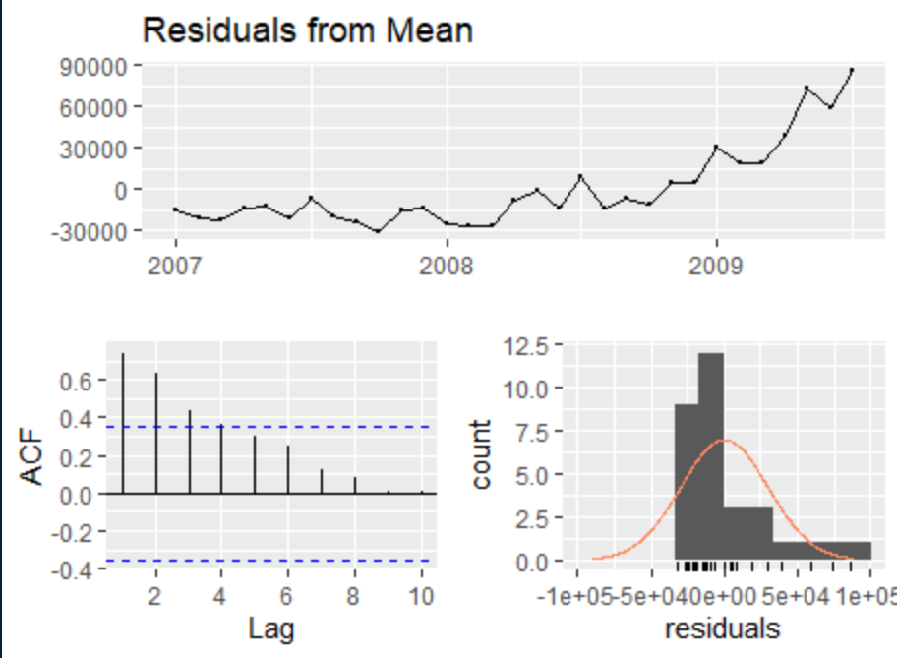
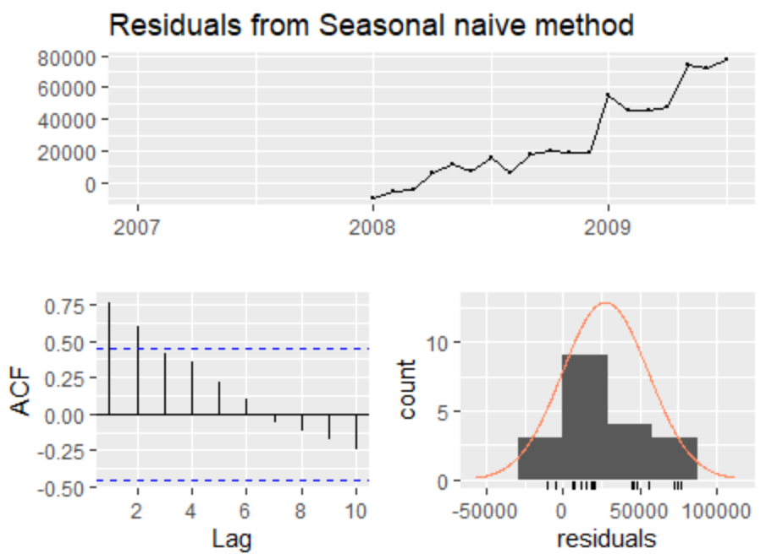
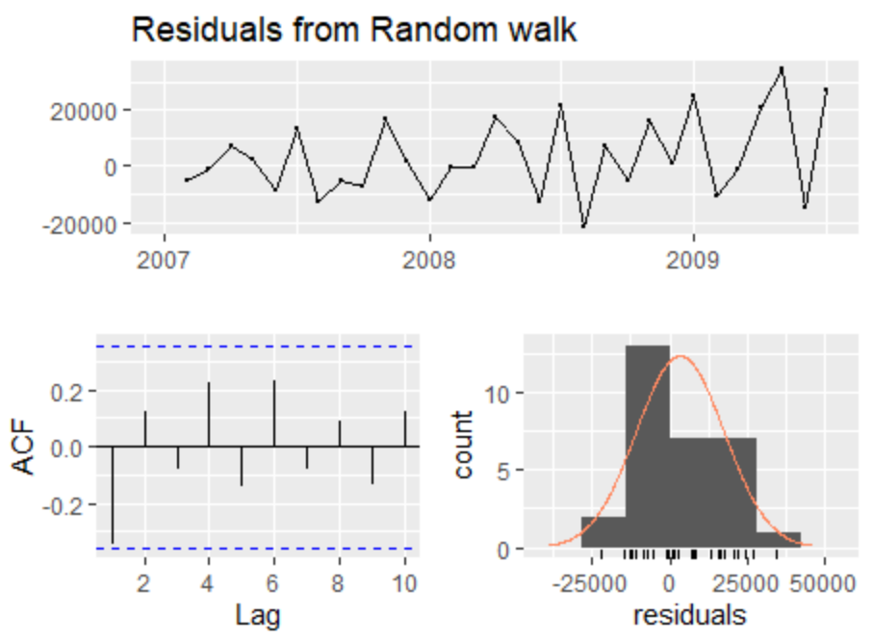
Test data / Train data
Training data- Jan 2007 – July 2009
Test data- Aug 2009 – Dec 2009
Fitted following models
Mean Model
Naïve Model
Seasonal Naïve Model

Slide 13
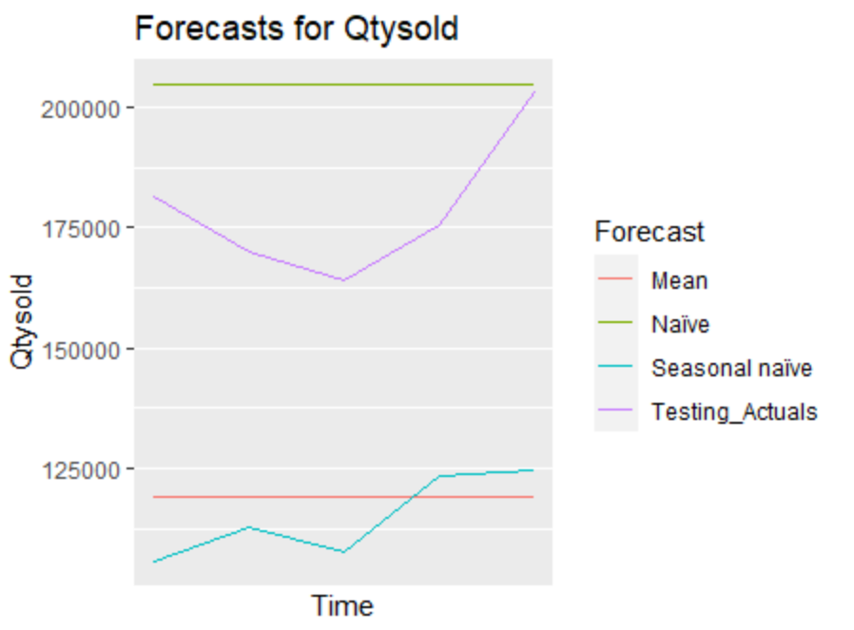
Testing on new data
- Below are the testing statistics of the model on test data.
- The graph on the right-hand side shows forecasts
Model | Training MAE | Training MPE | Seasonal Fit | Testing MAE | Testing MPE | Comments
Mean model | 22264.53 | -4.82% | No | 59928.52 | 33.14% | Training residuals higher than optimal and flat forecast was outputted
Naïve Model | 11307.03 | 1.68% | No | 25917.8 | -15.10% | Training residual not significant and flat forecast was outputted
Seasonal Naive | 29504.37 | 17.58% | Yes | 64096 | 35.66% | Seasonal Pattern detected with 17% error, Auto correlations spotted in ACF;

Slide 14
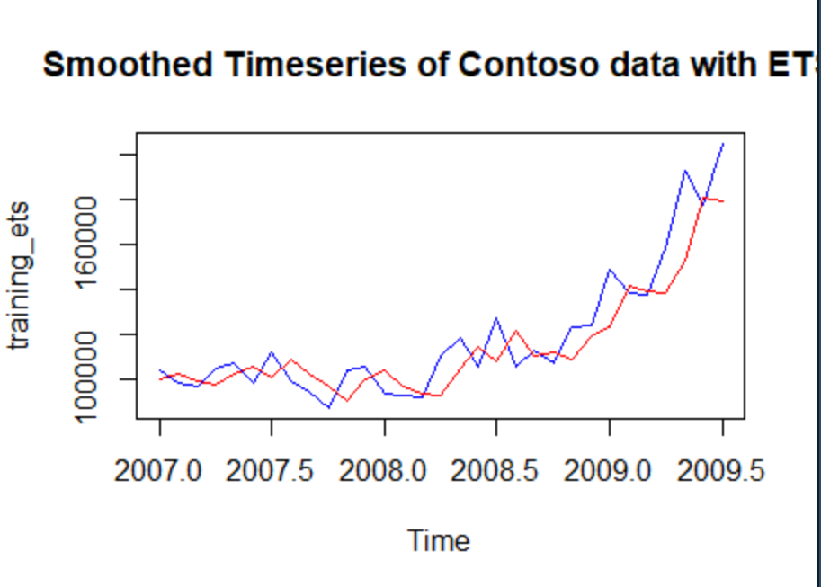
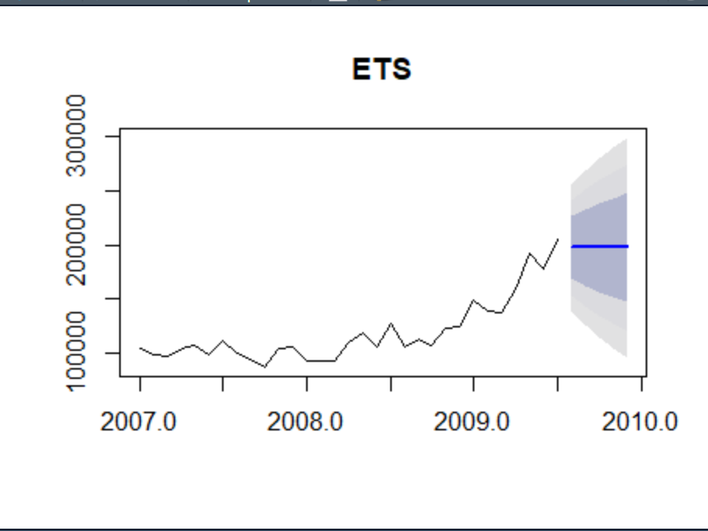
Exponential Smoothing
Model | Training MAE | Training MPE | Seasonal Fit | Testing MAE | Testing MPE | Comments
ETS model | 10448.99 | 2.38% | No | 20770.61 | -10.90% | Training residuals higher than 0.05 and model was rejected because of flat forecast
- Above are the testing statistics of the model on test data.
- The red line graph on the right-hand side shows fit while the blue line graph shows actual data

Slide 15
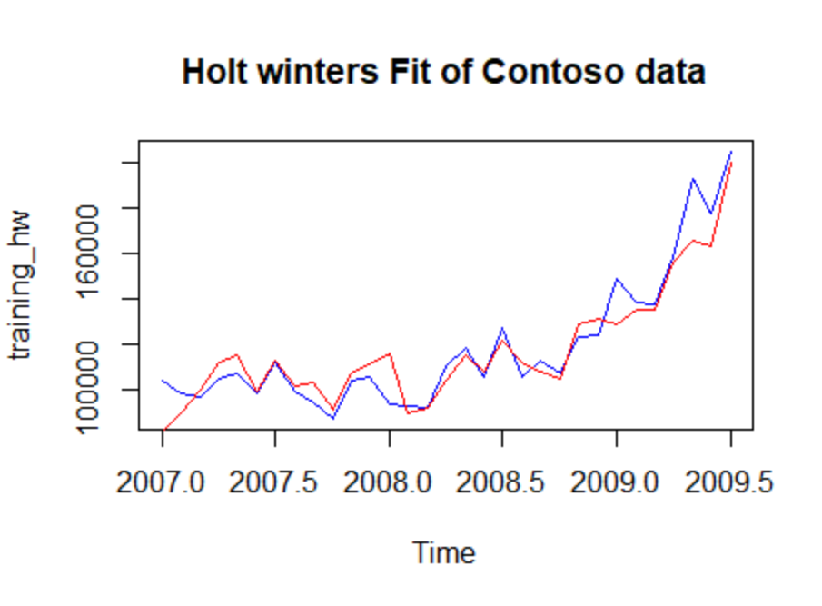
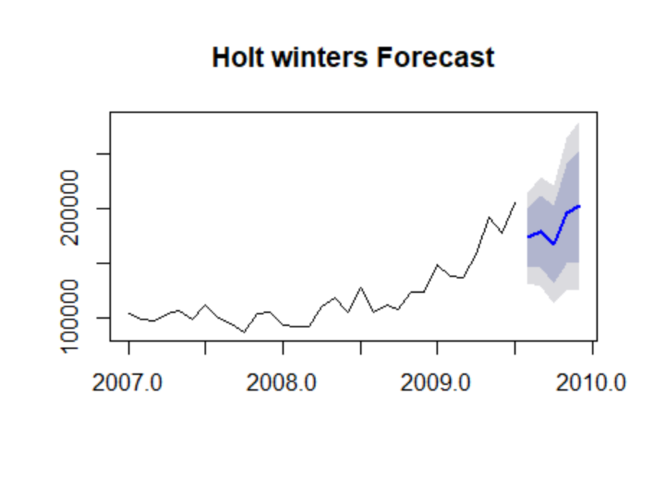
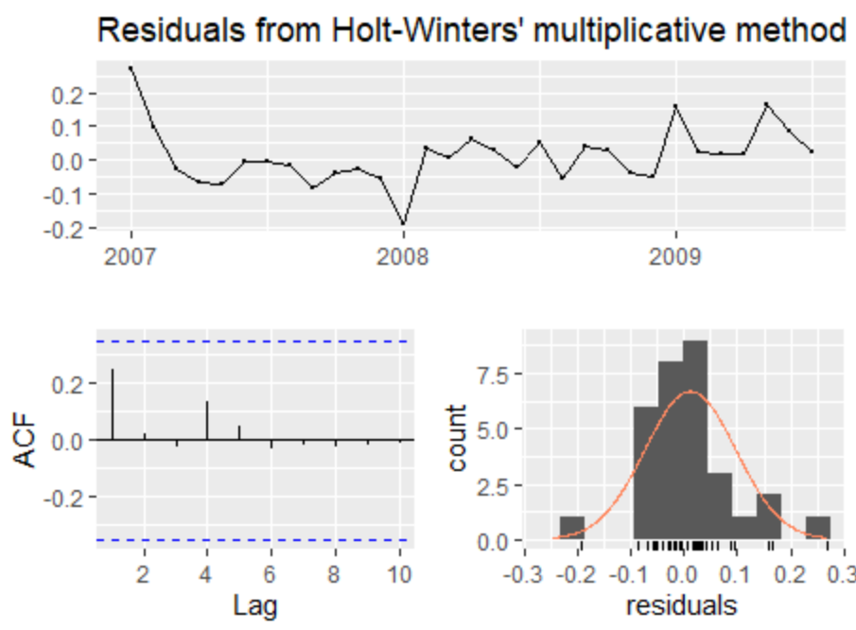
Holt Winters
Model | Training sigma | AIC / BIC | Seasonal Fit | Testing MAE | Testing MPE | Comments
Holt Winters | 0.1219 | 709 /734 | Yes | 8169 | -2.8502% | This model fitted well on the test data with MAE=8169.102 and MPE=-2.852502% the best so far.
- Above are the testing statistics of the model on test data.
- The red- line graph on the right-hand side shows fit while blue shows actuals

Slide 16
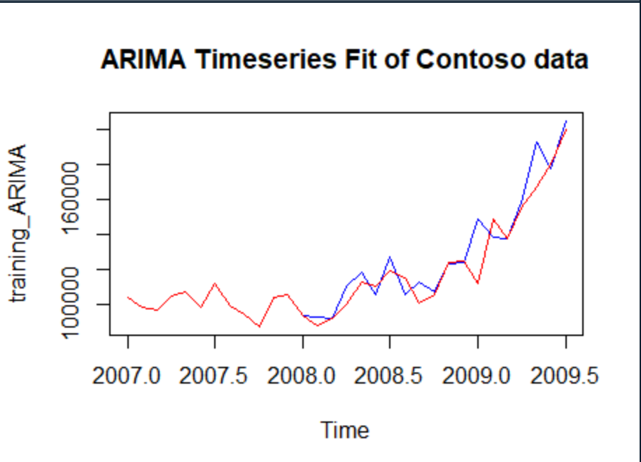
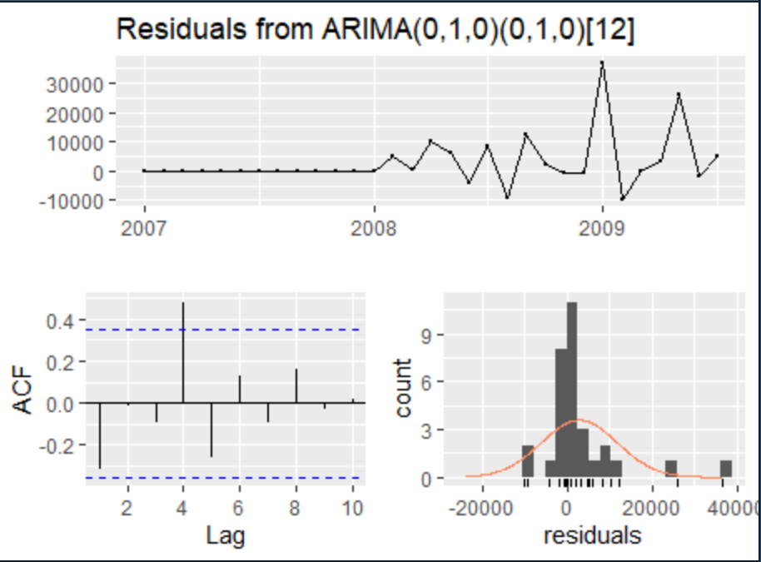
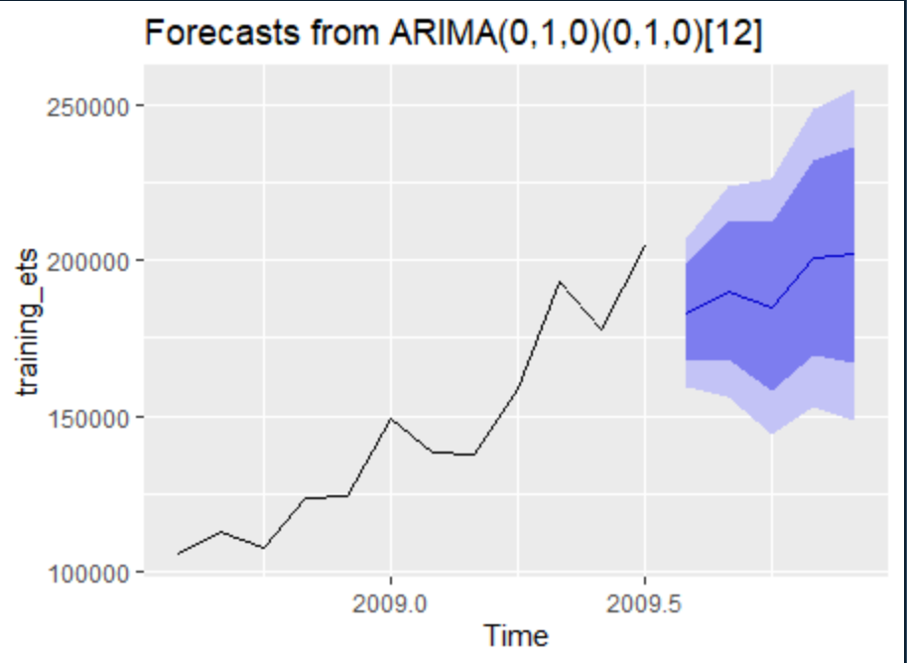
Seasonal Arima ARIMA(0,1,0)(0,1,0)[12]
Model | Training MAE | Training MPE | Seasonal Fit | Testing MAE | Testing MPE | Comments
Sarimax | 4600.965 | 1.90 % | Yes | 13772.4 | -7.783% | This model fitted reasonably well on the test data but it was not as good as Holt winters and Acf shows to have some data left on the residuals
- Above are the testing statistics of the model on test data.
- The red- line graph on the right-hand side shows fit while blue shows actuals

Slide 17
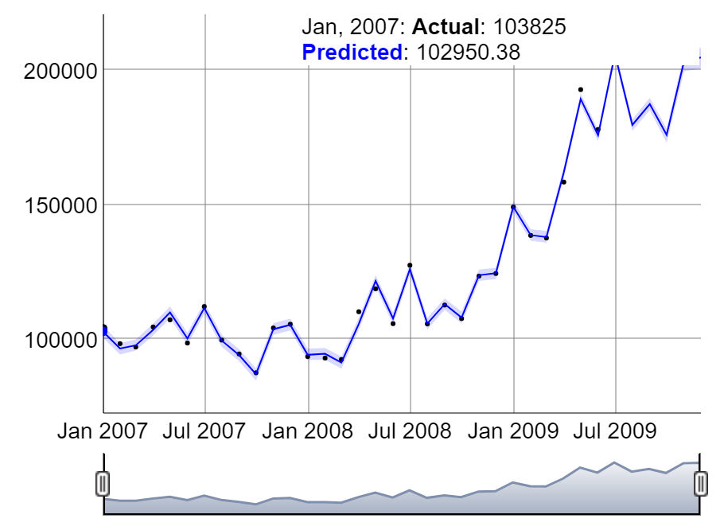
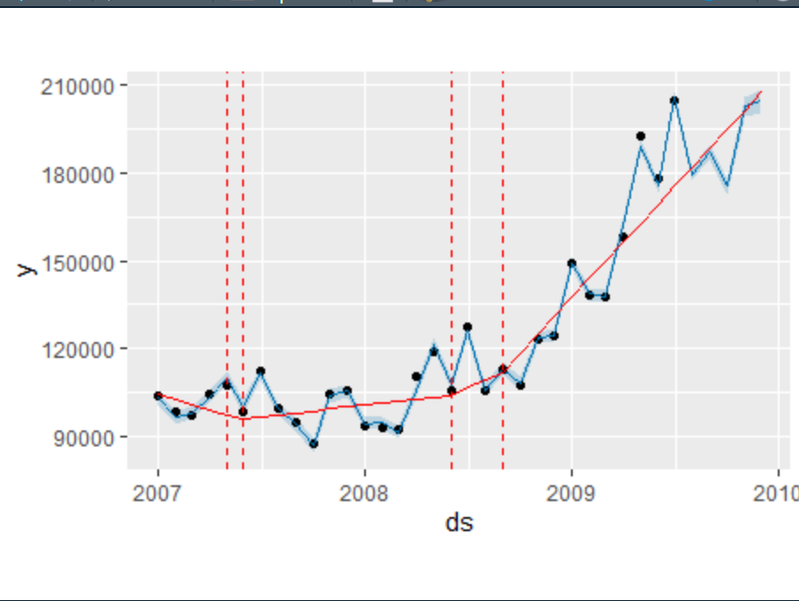
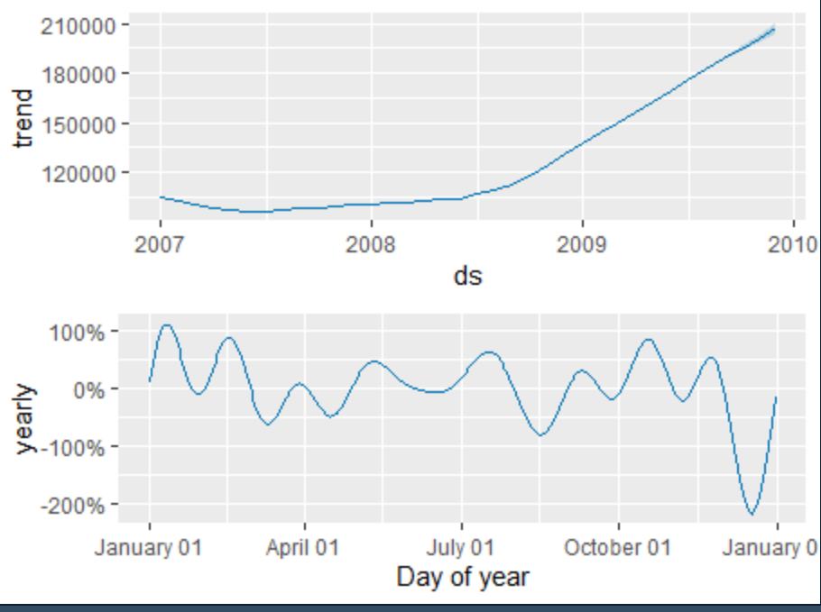
Facebook Prophet
Model | Initial testing MAE | Initial testing MPE | Seasonal Fit | Cross val MAE | Cross val MPE | Comments
Prophet | 12059.73 | -6.58% | Yes | 9399.411 | 2.21% | This model predicted better than by any model so far after cross validation
- Above are the testing statistics of the model on test data.
- The red- line graph on the right-hand side shows trend while blue shows actuals

Slide 18
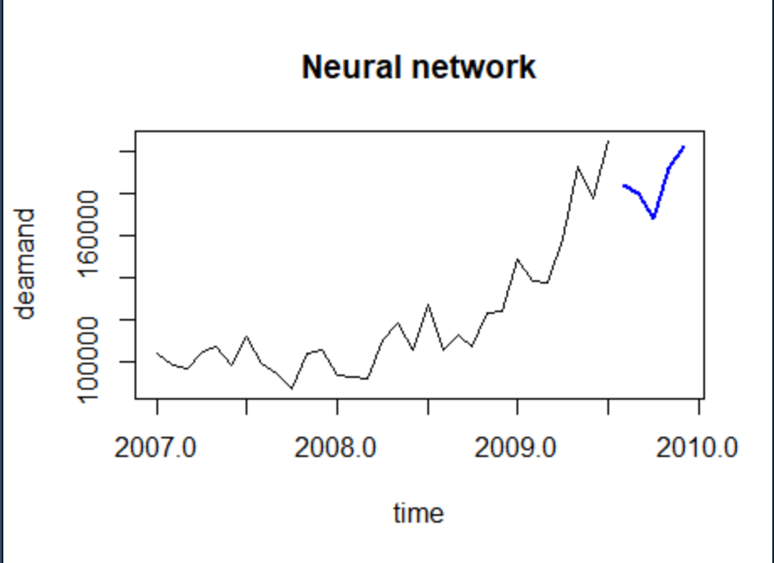
Neural Network
Model | Sigma | Initial testing MPE | Seasonal Fit | TestingMAE | Testing MPE | Comments
NN | 5654.527 | -6.58% | Yes | 6818 | -3.74% | This model is the third best model after Prophet and Holt Winters
- Above are the testing statistics of the model on test data.
- The red- line graph on the right-hand side shows trend while blue shows actuals

Slide 19
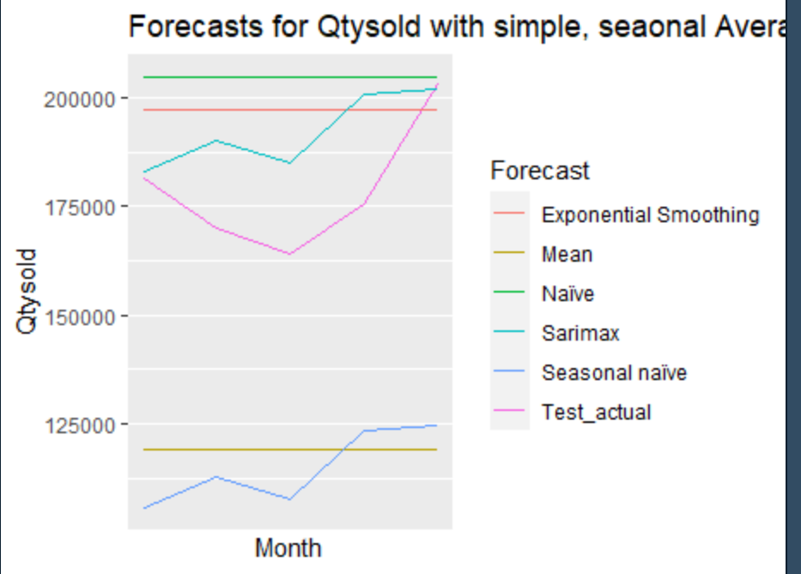
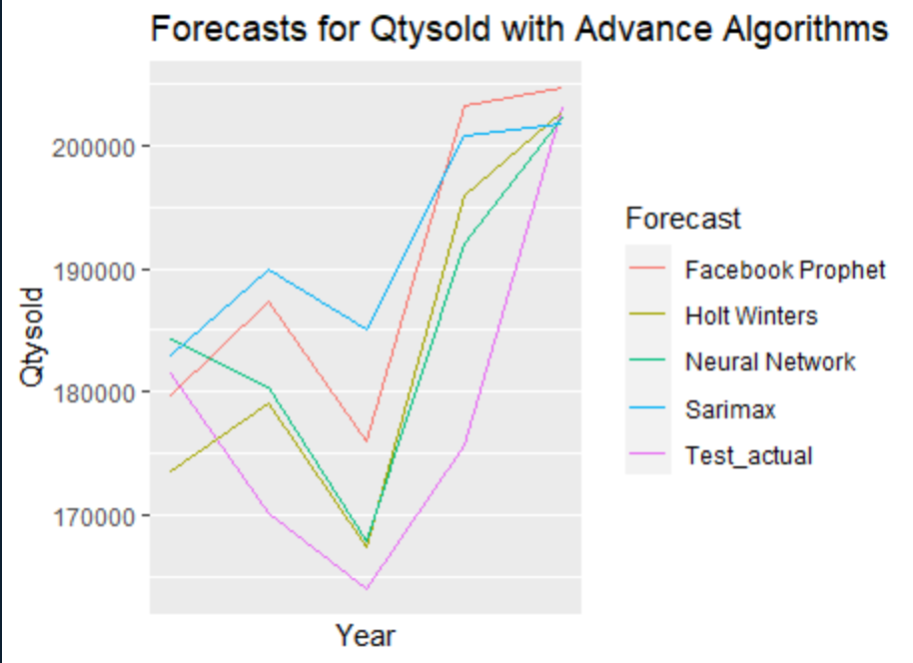
Conclusion
Rank | Algorithm | Seasonal Fit
1 | Prophet | Yes
2 | Holt Winters | Yes
3 | Neural Network | Yes
4 | Sarimax | Yes
5 | Mean | No
6 | Naïve | No
7 | Exponential smoothing | No
8 | Seasonal Naive | Yes
- Seasonal models were needed to fit and predict seasonal data
- Machine Learning Models can predict supply chain demand by close to 97% accuracy

Slide 20

Q & A

