Slide 1


Fostering open science and open data with R
Karthik Ram
Made possible by:
ropensci.github.io/ropensci_intro/

Slide 2
“ Most science is not reproducible or repeatable, even within the same lab group over time.

Slide 3

A reproducibility crisis

Slide 4
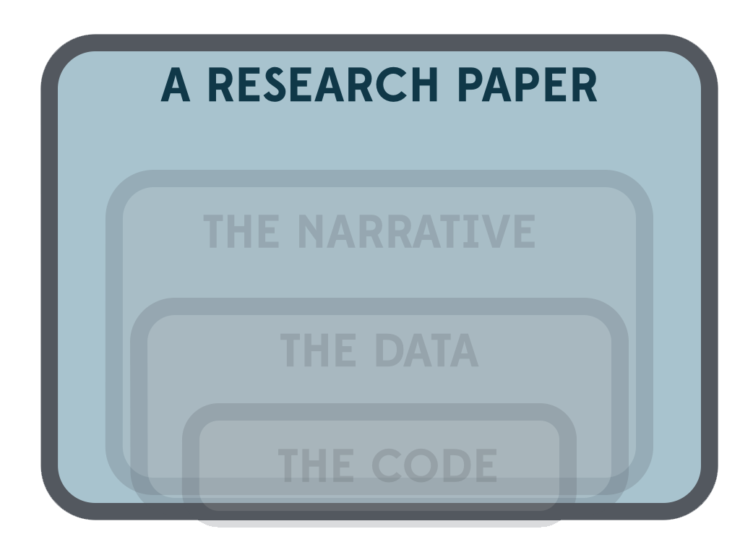
The scientific workflow

Slide 5
“ Instructions for preparation of the Biographical Sketch have been revised to rename the Publications section to "Products” and amend terminology and instructions accordingly. This change makes clear that products may include, but are not limited to, publications, data sets, software, patents, and copyrights.
Issuance of a new NSF Proposal & Award Policies and Procedures Guide (October 4th)

Slide 6
PLOS Data Policy
“the Data Policy states the ‘minimal dataset’ consists “of the dataset used to reach the conclusions drawn in the manuscript with related metadata and methods, and any additional data required to replicate the reported study findings in their entirety. This does not mean that authors must submit all data collected as part of the research, but that they must provide the data that are relevant to the specific analysis presented in the paper.

Slide 7
“Enable access to scientific data repositories, full-text of articles, and science metrics and also facilitate a culture shift in the scientific community.

Slide 8
More info @ ropensci.org/packages
Data
Treebase, Fishbase,
Flybase,
GBIF, Vertnet
Dryad, ITIS
NPN, Taxize
opensnp
Journals
PLOS
Springer
textmine
pensoft
Data publication
figshare
Mendeley
DataONE,
rAltmetric, EML,
rNEXML

Slide 9
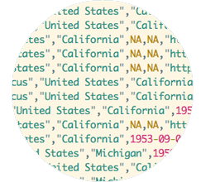
Access all available ecological data
Liberating 400+ million observation records
Full text 100k articles
Data from papers in > 200 journals

Slide 10

Accessing data behind papers –
dryad
library(rdryad)
dryaddat <- download_url(“10.255/dryad.1759”)
# Get a file given the URL
file <- dryad_getfile(dryaddat)
dim(file)
# Get
## [1] 131 30
# Get
Dataset

Slide 11
Biodiversity records from museums
library(ecoengine)
pinus_data <- ee_observations(genus = “Pinus”, georeferenced = TRUE, page = 1:25)
nrow(pinus_data$data)
# Get
## [1] 625
# Get

Slide 12
Get complete and current taxonomic records
classification(c(“Helianthus annuus”), db = “ncbi”)
# Get
## $`Helianthus annuus`
## name rank
## 1 cellular organisms no rank
## 2 Eukaryota superkingdom
## 3 Viridiplantae kingdom
## 4 Streptophyta phylum
## 5 Streptophytina no rank
… cutoff
## attr(,"class")
## [1] "classification"
## attr(,"db")
## [1] "ncbi"

Slide 13
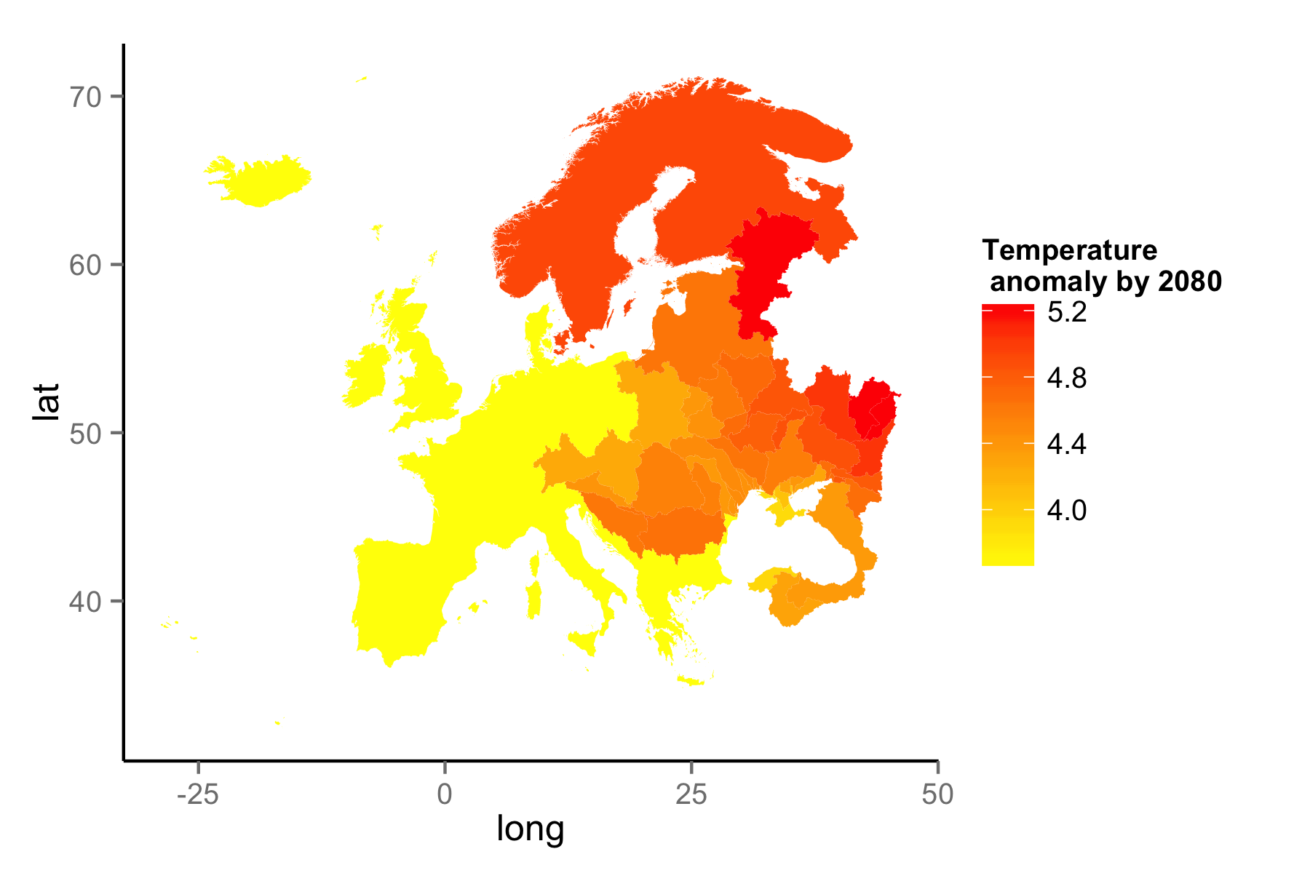
World Bank climate knowledge portal
rWBclimate
library(rWBclimate)
eu_basin <- create_map_df(Eur_basin)
eu_basin_dat <- get_ensemble_temp(Eur_basin, “annualanom”, 2080, 2100)

Slide 14
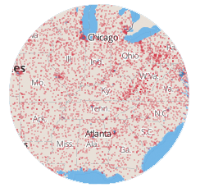
Interactively visualize and analyze data
Explore these data interactively, including any plots you might make

Slide 15
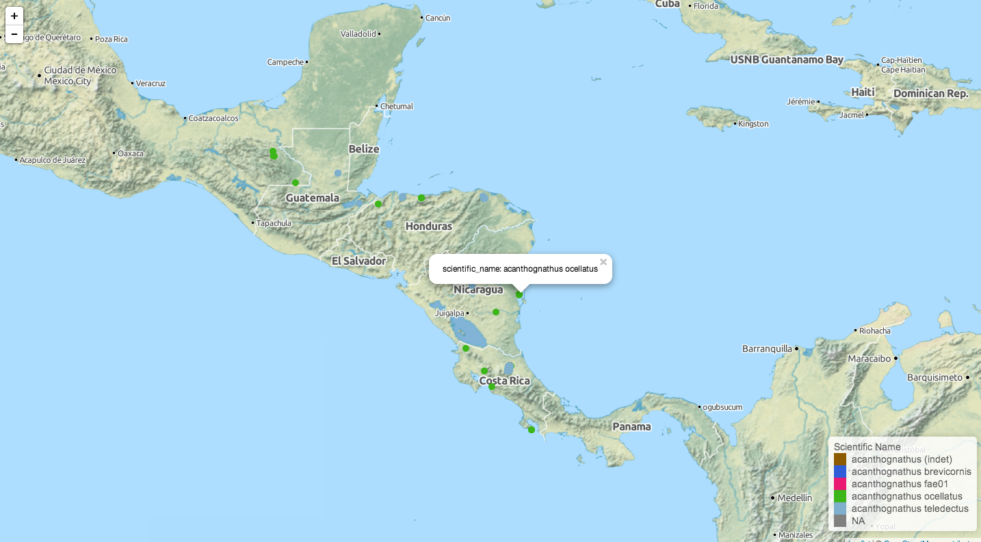
Taxon specific databases - AntWeb
library(AntWeb)
acdd <- aw_data(genus = “acanthognathus”)
aw_map(acd)

Slide 16
Sharing data – (figshare)
Using figshare's API it is possible to share figures,
data and any other object generated in R and
obtain a data citation.
library(rfigshare)
id <- fs_create(“Fisheries dataset”, “A dataset containing catch for 4 important commercial fish species”, “dataset”)
fs_upload(id, “dat.csv”)
# Get

Slide 17
A reproducible workflow (in R)
Load your own data
load all raw untransformed data.
➔
Acquire additional data from the web
e.g., resolve taxonomic names, acquire additional datasets.
➔
Document everything with metadata
The EML package makes it really easy to add valid EML to your data
➔
Submit to a persistent repository
Share your data by submitting to figshare or one at your institution
Generate interactive maps, viewers

Slide 18
The scientific workflow

Slide 19
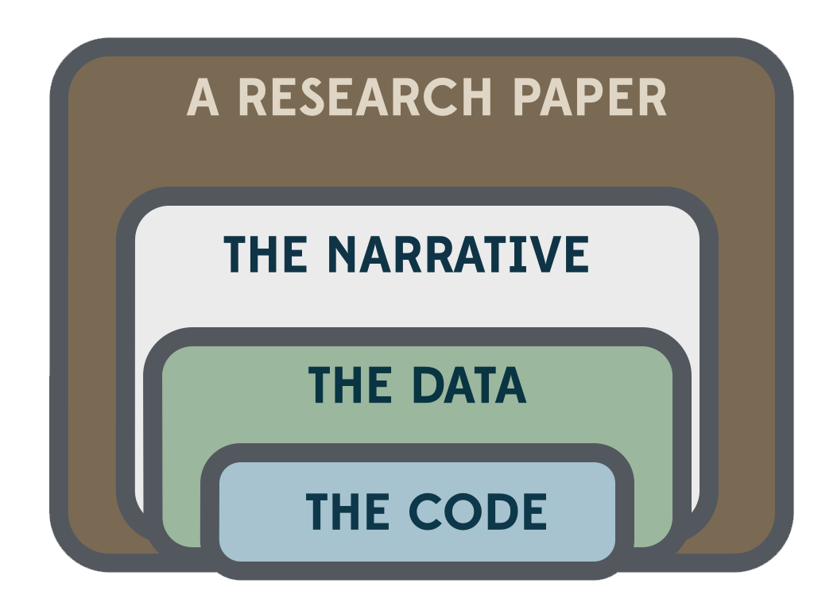
The open scientific workflow

Slide 20
ropensci.org ropensci on GitHub @ropensci on Twitter
Questions or comments to: info@ropensci.org

