Slide 1

GBIF monthly update – October 2013

Slide 2
Latest news
Global Biodiversity Informatics Outlook published
GBIF Secretariat coordinates global partnership on invasive alien species information
Chinese Academy of Sciences joins as Associate Participant
VertNet joins as Associate Participant
Rio Botanic Gardens publishes herbarium data – first Brazilian publisher since Brazil joined GBIF
Last updated: 2013-10-03

Slide 3
GBIF participation information

Slide 4
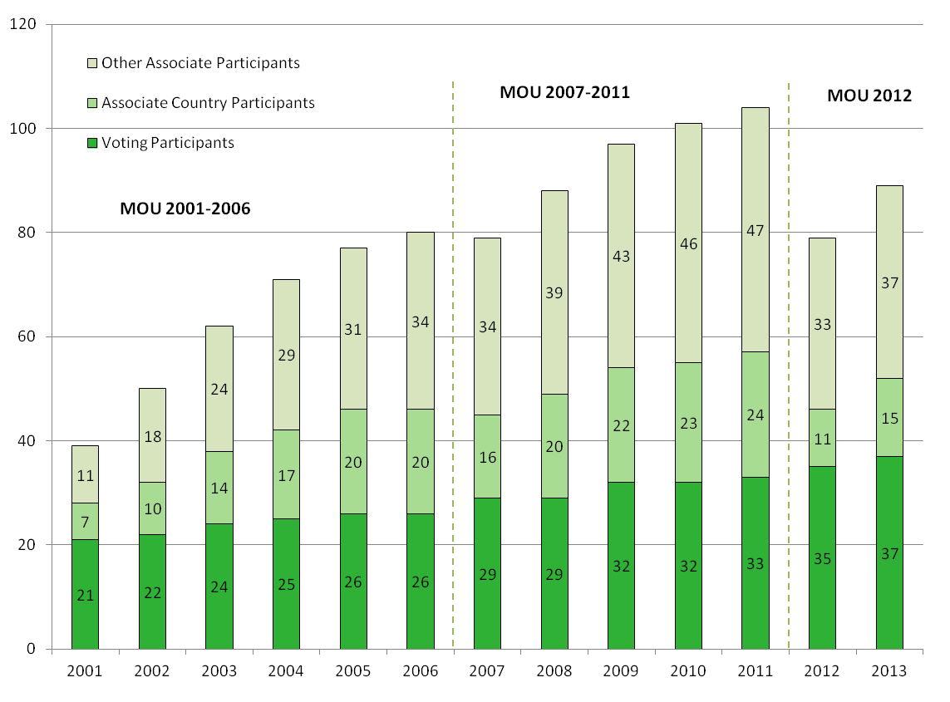
GBIF participation 2001-2013
Last updated: 2013-10-02
Notes:
There are two modes of participation in GBIF. Voting Participants are countries that have decided to make a financial contribution to core funds, as outlined in the MoU and the GBIF Financial Regulations, and have voting rights on the Governing Board. Associate Participants are 1) countries that have not yet decided to make a financial contribution (time-limited to five years) or 2) intergovernmental organizations, international organizations, or other organizations with an international scope, and economies. Associate Participants may attend Governing Board meetings but do not have a vote.

Slide 5
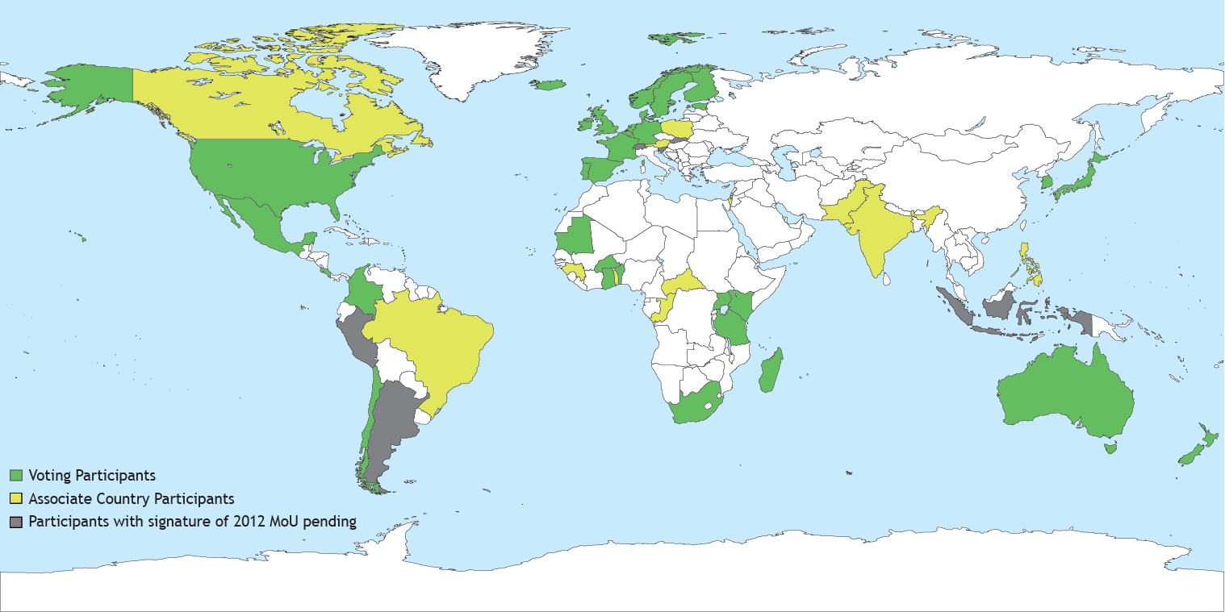
GBIF country participants
Last updated: 2013-06-28
Notes:
There are two modes of participation in GBIF. Voting Participants are countries that have decided to make a financial contribution to core funds, as outlined in the MoU and the GBIF Financial Regulations, and have voting rights on the Governing Board. Associate Participants are 1) countries that have not yet decided to make a financial contribution (time-limited to five years) or 2) intergovernmental organizations, international organizations, or other organizations with an international scope, and economies. Associate Participants may attend Governing Board meetings but do not have a vote.

Slide 6
GBIF participation
Voting Participants
Andorra (moved from ACP)
Argentina *
Australia
Belgium
Benin (moved from ACP)
Burkina Faso (moved from ACP)
Chile
Colombia (moved from ACP)
Costa Rica
Denmark
Estonia
Finland
France
Germany
Ghana (moved from ACP)
Iceland
Ireland
Japan
Kenya
Madagascar (moved from ACP)
Mauritania
Mexico
Netherlands
New Zealand
Norway
Peru *
Portugal
Republic of Korea
Slovakia *
Slovenia *
South Africa
Spain
Sweden
Tanzania
Uganda (moved from ACP)
United Kingdom
United States
Associate Country Participants
Austria
Brazil
Canada (moved from VP)
Central African Republic
Guinea
India
Indonesia *
Israel
Luxembourg
Pakistan
Philippines
Poland
Republic of Congo
Switzerland *
Togo
Other Associate Participants
ASEAN Centre for Biodiversity (ACB)
Albertine Rift Conservation Society (ARCOS)
BioNET-Andionet
BioNET-INTERNATIONAL
Bioversity International
Botanic Gardens Conservation International (BGCI)
Chinese Academy of Sciences
Chinese Taipei
Ciencia y Tecnología para el Desarrollo (CYTED)
Consortium for the Barcode of Life (CBOL)
Consortium of European Taxonomic Facilities (CETAF)
Discover Life
DIVERSITAS
Encyclopedia of Life (EOL)
Endangered Wildlife Trust (EWT)
ETI Bioinformatics
European Environment Agency (EEA)
ICLEI – Local Governments for Sustainability
Integrated Taxonomic Information System (ITIS)
International Barcode of Life Consortium (iBOL)
International Centre for Insect Physiology and Ecology (ICIPE)
International Centre for Integrated Mountain Development (ICIMOD)
International Long-Term Ecological Research Network (ILTER)
Natural Science Collections Alliance (NSCA)
NatureServe
NordGen
Ocean Biogeographic Information System (OBIS) *
Pacific Biodiversity Information Forum (PBIF)
Scientific Committee on Antarctic Research (SCAR)
Society for the Management of Electronic Biodiversity Data (SMEBD)
Society for the Preservation of Natural History Collections (SPNHC)
Species 2000
TDWG
UNEP-WCMC
VertNet
Wildscreen
World Federation for Culture Collections (WFCC)
Last updated: 2013-10-02
* Signature of 2012 MoU pending, previous status shown.
Notes:
There are two modes of participation in GBIF. Voting Participants are countries that have decided to make a financial contribution to core funds, as outlined in the MoU and the GBIF Financial Regulations, and have voting rights on the Governing Board. Associate Participants are 1) countries that have not yet decided to make a financial contribution (time-limited to five years) or 2) intergovernmental organizations, international organizations, or other organizations with an international scope, and economies. Associate Participants may attend Governing Board meetings but do not have a vote.

Slide 7
Data publication and use

Slide 8
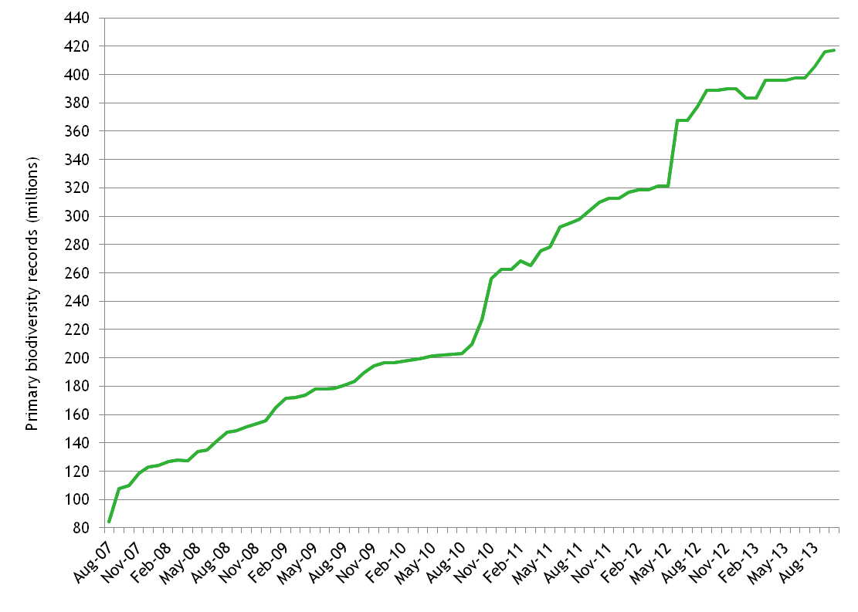
Data published through GBIF
A modest decline in the total number of data records in January 2013 resulted from deletion of duplicates and withdrawn data, identified through software and processing upgrades.
Last updated: 2013-10-02

Slide 9
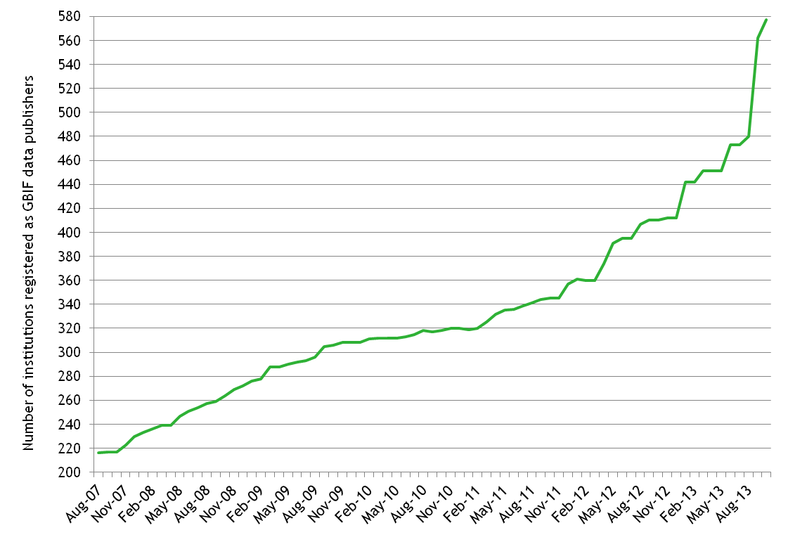
GBIF data publishers
A sharp rise in the number of data publishers in September 2013 results from institutions choosing to register as separate entities rather than sharing datasets through a single publisher at their national node institution. This helps to raise the visibility and branding of the institutions, and provides more accurate attribution, especially in the new GBIF portal coming online shortly.
Last updated: 2013-10-02

Slide 10
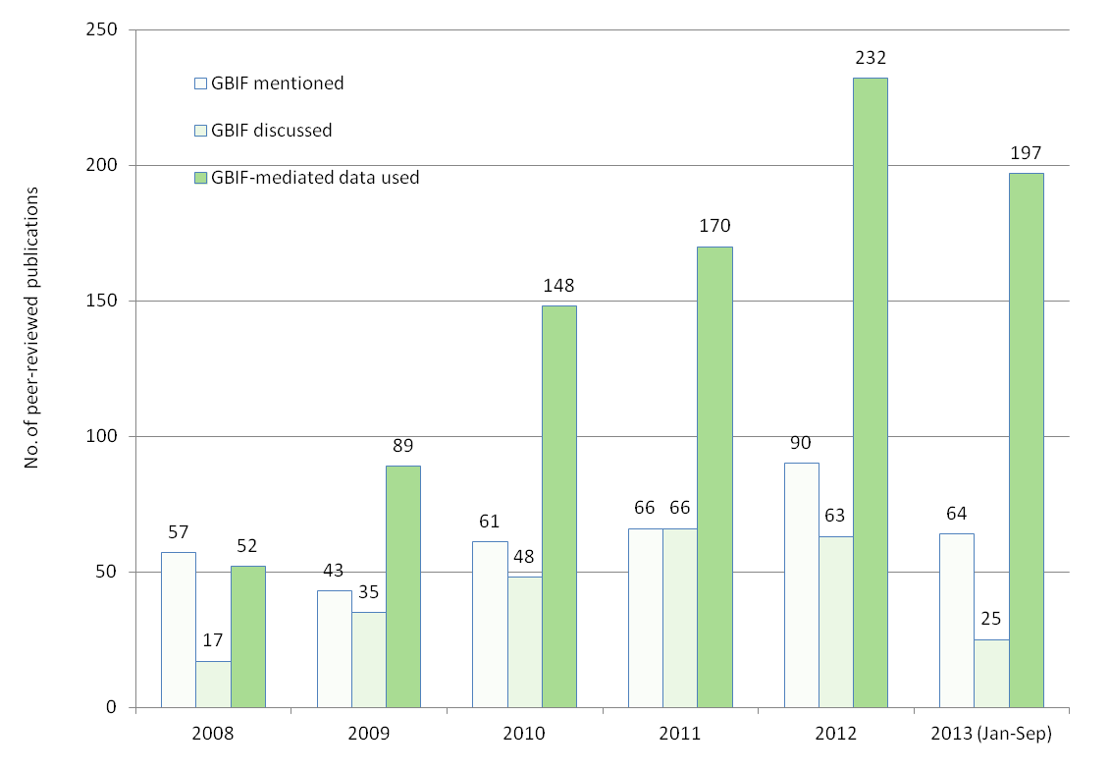
GBIF citation in research
Last updated: 2013-10-2013

Slide 11
GBIF Work Programme

Slide 12
2013 Work Programme progress
Highlights from latest update:
2.2.1 Call for early adopters of Nodes Portal Toolkit Startup
3.3.2 Agreement signed with CBD on GBIFS coordination of invasive species information partnership
3.3.3 Global nodes meeting and training event arrangements finalized
4.2.1 New GBIF portal ready for deployment following extensive testing
5.2.2 Global Biodiversity Informatics Outlook (GBIO) published, on agenda for CBD SBSTTA meeting in October
Last updated: 2013-09-12

Slide 13
WP 2013 – 1: Data publishing framework
Activity | Due | Status | Notes
1.1.1 Strategy & action plans | 4Q2013 | On track | 2 best practice guides near release, task group report released
1.1.2 Connect new data types | 4Q2013 | On track | May workshop on extending Darwin Core for sample data: workshop report completed and in process of being submitted to Standards in Genomic Science; partnerships with environmental impact assessment, local government and invasive alien species communities: roadmap delayed to 4Q 2013
 |  | Delayed
1.2.1 Next generation IPT | 4Q2013 | On track | Release 2.0.5 in 2Q 2013, release 2.1 in 3Q 2013
1.2.2 Other publishing tools | 3Q2013 | Cancelled | Insufficient funds and no existing commitments
1.2.3 Fitness for use tools | 4Q2013 | On track | Merged with 4.2.1 as part of new GBIF Data Portal
1.2.4 Expediting data digitization and mobilization | 2Q2013 | Delayed | Establishment of task group under way
1.3.1 Data papers | 4Q2013 | On track | Three Participant proof-of-concept activities ongoing; staff exploring linkages with key journals adopting data papers; session at TDWG on scholarly data publishing accepted
1.3.2 Citation mechanisms | 4Q2013 | On track | Merged with 4.3.3 as part of new GBIF Data Portal
Deliverables produced
Workshop on Extending Darwin Core held (1.1.2);
IPT 2.0.5 released (1.2.1);
Data paper training workshops held in Spain and India. Two data papers published as an outcome of the Spanish workshop, several in the pipeline (1.3.1).
Report of the Content Needs Assessment Task Group published (1.1.1)
Scope reductions /schedule changes
Owing to 2013 budget reductions, the scope of the following activities has been reduced, as agreed at GB19:
  1.1.1 – Funding for external contracts has been removed
  1.2.2 – Cancelled to save funds since no specific commitments existed in this area
  1.2.3 – Funding for external contracts has been removed
  1.2.4 – Funding for external contracts has been removed
Issues and risks
Reductions in development staff may delay implementation of recommendations from DwC workshop on sample data
Budget: 80,000€ (reduced at GB19 from 160,000€) Expenditure (to end September): 49,867€
Last updated: 2013-10-03

Slide 14
WP 2013 – 2: BIF-building package
Activity | Due | Status | Notes
2.1.1 Updated tools and services inventory | 4Q2013 | Delayed | The Online Resources Centre (www.gbif.org/orc) now displays extra information about tools as a preparatory stage for revision of tools list by Nodes
2.1.2 Updated manuals and guides | 4Q2013 | On track | Secretariat carrying out review of existing and required documentation
2.2.1 NPT initial development | 3Q2012 | On track | Call for early adoption programme distributed to the Nodes Committee. In response to the NPT Startup review results, Secretariat has started further ICT development improving NPT Startup v1.0 Release Candidate 1.
2.2.2 NPT release | 4Q2013 | On track | Merged into 2.2.1
2.2.3 NPT further development | 2Q2013 | On track | Merged into 2.2.1
2.3.1 Welcome box | 2Q2013 | On track | Inadequate funds for new developments. Minor update completed.
2.3.2 BIF start-up kit | 4Q2013 | Cancelled | Inadequate funds
Deliverables produced
First version of the NPT Startup (http://nptstartup.gbif.org/) (2.2.1);
NPT Startup review completed (http://www.gbif.org/orc/?doc_id=5312 & http://www.gbif.org/orc/?doc_id=5311) (2.2.1)
Welcome Box version 2013 (http://www.gbif.org/orc/?doc_id=3096) (2.3.1
Scope reductions /schedule changes
Owing to 2013 budget reductions, the scope of the following activities has been reduced, as agreed at GB19:
  2.1.1 – Process and targeted product simplified
  2.3.1 – New developments cancelled owing to inadequate funds
  2.3.2 – Cancelled owing to inadequate funds
Issues and risks
NPT development tied to a positive response and concrete development proposals by Nodes
Budget: 116,000€ (reduced at GB19 from 130,000€) Expenditure (to end September): 2.015€
Last updated: 2013-10-03

Slide 15
WP 2013 – 3: Global collaboration platform
Activity | Due | Status | Notes
3.1.1 Training programme | 3Q2013 | On track | Inadequate funds for regional training support call; remaining funds reserved to support training in key areas
3.1.2 Mentoring programme | 4Q2013 | On track | 3 mentoring projects approved and funded; communication sent out to Nodes Committee; several mentoring projects from previous years in closing stages.
3.1.3 CEPDEC programme | 3Q2013 | On track | Sud Expert Plantes développement durable (SEPDD) proposal sent out, awaiting funding approval
3.2.1 Network assessment | 4Q2013 | On track | Feedback collected from Nodes on country page drafts, data quality experiences
3.2.2 Communications platforms | 4Q2013 | On track | Communication content ready for new portal, new posters with key messages
3.2.3 Distributed helpdesk | 3Q2012 | Cancelled | Funding for hiring support staff removed
3.3.1 PR & outreach strategy | 4Q2013 | On track | Chinese Academy of Sciences, VertNet join as Associate Participants
3.3.2 Strategic partnerships | 3Q2013 | On track | GBIFS coordinating Global Invasive Alien Species Information Partnership; in-principle agreement to lead project for Abu Dhabi Global Environmental Data Initiative (external funding); continuing engagement in GEO BON, CreativeB
3.3.3 Nodes committee | 3Q2013 | On track | Organization of Global Nodes Meeting and training for GB20 on track, including registration for specific activities; regional highlight reports completed
3.3.4 Internationalisation | 4Q2013 | Cancelled | Translations produced as in-kind contributions by Participants.
Deliverables produced
New set of posters with key GBIF messages, significant new communication content for new portal
GBits newsletter translated into traditional Chinese by TaiBIF and Japanese by GBIF Japan.
Three mentoring projects approved and funded.
Interest group on biodiversity informatics training created (http://community.gbif.org/pg/groups/30748)
Scope reductions/schedule changes
Owing to 2013 budget reductions, the scope of the following activities has been reduced, as agreed at GB19:
  3.1.1 – No call for training projects in 2013
  3.2.1, 3.2.2, 3.2.3 - Funding for external contracts has been removed
  3.3.4 – Funding for external contracts has been removed
Issues and risks
Regional collaboration around training may lose momentum without work programme funding
Engagement by non-English speakers may be impacted if key resources not available in other languages
Secretariat Participation team on reduced capacity due to parental leave
Budget: 168,000€ (reduced at GB19 from 200,000€) Expenditure (to end September): 53,091€
Last updated: 2013-10-03

Slide 16
WP 2013 – 4: Global data infrastructure
Activity | Due | Status | Notes
4.1.1 System architecture overview | 2Q2013 | Delayed | Documentation under development for Registry and web services API. Other documents delayed through staff reductions. Report on GBIF informatics architecture prepared for EU BON partners
4.1.2 Exchange standard and protocol guidelines | 1Q2013 | Delivered | Mostly complete. Documentation for use of persistent identifiers delayed to ensure coordination with 4.3.5
 |  | Delayed
4.2.1 Increased discovery and access | 4Q2013 | On track | Significant progress dealing with feedback from testing environment for the new GBIF portal ahead of October launch, more than 700 issues resolved.
4.2.2 Improved performance | 4Q2013 | On track | Included as part of new GBIF Data Portal
4.2.3 Global registry | 4Q2013 | On track | Included as part of new GBIF Data Portal
4.3.1 Annotation service | 4Q2013 | Delayed | Evaluating options. Implementation delayed
4.3.2 Analytics service | 2Q2013 | Delayed | Implementation delayed
4.3.3 Citation service | 4Q2013 | On track | Included as part of new GBIF Data Portal
4.3.4 Vocabulary services | 4Q2013 | Delivered | Prototype systems in place for vocabulary management
4.3.5 Identifier services | 4Q2013 | On track | Included as part of new GBIF Data Portal; consultation note Stable Identifiers for GBIF-mediated data circulated to Participants for feedback
Deliverables produced
Reports on Knowledge Organization Systems for biodiversity (4.1.2)
Prototype vocabulary and schema management systems (4.3.4)
Scope reductions /schedule changes
Owing to 2013 budget reductions, departing staff have not been replaced, resulting in delayed schedules:
  4.1.1 – Reductions in staffing will delay work on system architecture documentation until 4Q2013 and beyond
  4.3.1 – Delayed until after launch of new Data Portal owing to reductions in staffing.
  4.3.2 – Delayed until after launch of new Data Portal owing to reductions in staffing (but see 5.1.3).
  4.3.3 – Will continue as progressive enhancements beyond 2013
Issues and risks
Departing staff (equivalent to 2.5 full-time staff) have not been replaced. This has placed severe pressure on development schedules and introduced the risk of further slippage in delivery of function.
Budget: 110,000€ (reduced at GB19 from 360,000€) Expenditure (to end September): 50,016€
Last updated: 2013-10-03

Slide 17
WP 2013 – 5: Assess biodiversity information
Activity | Due | Status | Notes
5.1.1 Comprehensive baselines and targets | 3Q2013 | On track | Developing taxonomic, temporal and geospatial indicators for mobilised content. Baselines already developed for data usage. First comprehensive assessment of GBIF mediated data published in Biodiversity Informatics special issue.
5.1.2 Monitoring mechanism toward targets | 4Q2013 | On track | Developing scripts to monitor taxonomic, temporal and geospatial indicators. Progress metrics under development for inclusion in WP 2014-2016.
5.1.3 Assessment of GBIF impacts | 4Q2013 | On track | Quarterly assessments will be implemented using indicators from 5.1.1 and scripts from 5.1.2. Levels and examples of data use in published research reported in Gbits Science Supplement and annual Science Review accompanying 2012 Annual Report; reports on specific thematic usage areas are under development.
5.1.4 Evaluation of WP 2012-13 | 4Q2013 | On track | Full evaluation of WP progress reported to mid-term committee meetings (Apr/May 2013). Annual Report for 2012 published in June 2013. Draft WP 2014-16 circulated to Governing Board for approval at GB20
5.2.1 Review of progress in biodiversity information | 4Q2013 | On track | Reports on the availability, quality, fitness and impact of mobilised content will be developed by the end of 2013.
5.2.2 Global Biodiversity Information Conference/Outlook | 4Q2013 | On track | GBIO published and promoted with communication tools. GBIO incorporated into CBD SBSTTA agenda and being actively promoted by CBD.
Deliverables produced
Monitoring and reporting well established for peer-reviewed papers using GBIF-mediated data. First annual Science Review published alongside 2012 Annual Report (5.1.3, 5.1.4).
Internal data mining infrastructure established to enable indicator assessment (5.1.2).
Scope reductions
Owing to 2013 budget reductions, the scope of the following interconnected activities is reduced, as agreed at GB19:
  5.1.1 – Baselines/targets will not be developed at this time for the GBIF publishing and discovery frameworks
  5.1.3 – Impact assessment will not be carried out at this time for the GBIF publishing and discovery frameworks
  5.2.1 – Report will not be produced at this time on publishing and discovery mechanisms
Issues and risks
Additional budget cuts may affect capacity to monitor peer-reviewed literature as well as some data-mining activities.
Budget: 30,000€ (reduced at GB19 from 90,000€) Expenditure (to end September): 16,711€
Last updated: 2013-10-03

Slide 18
GBIF funding and affiliations

Slide 19
GBIF funding
Contributing agencies:
Externally received grants:
Argentina CONICET - Museo Argentino de Ciencias Naturales
Australia CSIRO Entomology
Benin Laboratoire des Sciences Forestières
Burkina Faso Conseil National pour la Gestion de l’Environnement (SP/CONAGESE)
Chile Comisión Nacional del Medio Ambiente (CONAMA)
Colombia Instituto de Investigación de Recursos Biólogicos
Costa Rica Asociación Instituto Nacional de Biodiversidad (INBio)
Denmark Danish Natural Research Council
Estonia Ministry of Environment
Finland Finnish Museum of Natural History
France Direction Générale pour la Recherche et l’Innovation (DGRI)
Germany Deutsche Forschungsgemeinschaft (DFG) German Aerospace Center, BMBF
Ghana Council for Scientific and Industrial Research (CSIR)
Iceland Ministry for the Environment
Ireland National Parks & Wildlife Service
Japan Japan Science and Technology Agency
Madagascar Centre National de Recherches sur l’Environnement (CNRE)
Mauritania Ecole Normale Supérieure de Nouakchott
Mexico Consejo Nacional de Ciencia y Tecnología (CONACYT)
Netherlands Ministry of Education, Culture and Science
New Zealand Ministry of Research, Science and Technology
Norway The Research Council of Norway
Portugal Foundation for Science and Technology
Republic of Korea Ministry of Education, Science and Technology
Slovak Republic Ministry of the Environment
Slovenia Ministry of Higher Education, Science and Technology
South Africa Department of Science and Technology
Sweden Swedish Research Council
Tanzania Tanzania Commission for Science and Technology (COSTECH)
Uganda* Uganda National Council for Science and Technology
United Kingdom Department for Environment, Food and Rural Affairs (DEFRA) Natural Environment Research Council (NERC) Royal Botanic Gardens, Kew Natural History Museum, London Joint Nature Conservation Committee
USA National Science Foundation Smithsonian Institution U.S. Department of State U.S. Department of Agriculture
University of Copenhagen (IT equipment)
University of Copenhagen (salary subsidy)
i4Life
ViBRANT
OpenUp!
CReATIVE-B (GBIC/GBIO)
Aage V Jensen Charity Foundation (GBIC/GBIO)
JRS Biodiversity Foundation (GBIC/GBIO)
EU BON
EMODNET 2
CBD Secretariat (GIASIP coordination)
Last updated: 2013-10-03
Notes:
.

Slide 20
GBIF current affiliations
Biodiversity Indicators Partnership (BIP) – partner
Encyclopedia of Life (EOL) - council
Eye on Earth Biodiversity Special Initiative - partner
Global Invasive Alien Species Information Partnership (GIASIP) - partner
Global Partnership for Plant Conservation (GPPC) – partner
Group on Earth Observations (GEO) - participant
Group on Earth Observations Biodiversity Observation Network (GEO-BON) – steering committee member
European Biodiversity Observation Network (EU BON) - participant
LifeWatch Policy & Science Board – member
Convention on Biological Diversity (CBD) – observer
Intergovernmental Platform on Biodiversity and Ecosystem Services (IPBES) – observer
Biodiversity Knowledge Network for the European Union (KNEU), member of dialogue group.
Convention on Migratory Species Strategic Plan Working Group - observer
Last updated: 2013-07-15

