Slide 1
Getting started on making your computational work reproducible

Slide 2
My Time

Slide 3
My Time

Slide 4
Reproducibility

Slide 5
Reproducibility = Recording & Organization

Slide 6
There are many levels to reproducibility

Slide 7

Tools/Practices
Or it won’t work!
Vital
It will work,
results may be
wrong.
Current Standard
Reproducible
difficult
Trend
Um, well yeah, it helps
me keep organized.
Useless
I mean, it doesn’t hurt….

Slide 8
Vital
Project Management
git
Markdown
Trend

Slide 9
Everything makes sense fast once you start using it.

Slide 10
Project Management

Slide 11
Read: A Quick Guide to Organizing
Computational Biology Projects
William Noble, 2009
Time: 15 minute read

Slide 12
Project
README.md
doc
data
R
results
notebook.md
paper
scripts.R
2014-06-18
2014-05-12
2014-05-13
README.md
README.md
data1.csv
data2.csv

Slide 13
Data Management and Organization Tips
Keep each project in separate directories
Keep each analysis in separate directories.
Data is separate and never edit.
View similar projects for structure on Github
Be generous with your README files.
Be overly descriptive.
Use dates instead of numbers for chronology.
Don’t use spaces.

Slide 14
Markdown – the small component to many tools.
Time: 20 minutes to learn

Slide 15
Markdown Resources
Markdown editor and viewer:
Mou (Mac)
Write Monkey (PC)
Markible.in (browser)
Guide: Markdown Cheat Sheet

Slide 16
Markdown

Slide 17
Markdown Starter Projects
Taking notes, especially on programming
Explaining your code
Start curating a list of commands you find useful
- Writing tutorials
R project reports
Notes:
Like today.

Slide 18
Learn git, become fearless.
Notes:
There are a billion reasons to learn git, I am going to tell you my all time favorite: It sets up an environment for you to try anything without fear of breaking your work. It’s ironic that people are scared to learn git because they don’t want to mess up their files, when this is the very tool that nearly erases that fear from your thoughts. It gives you the freedom to try anything.

Slide 19
How to git started – Use for Saving.
Prerequisite Knowledge:
Beginner Unix (Navigating Directories)

Slide 20
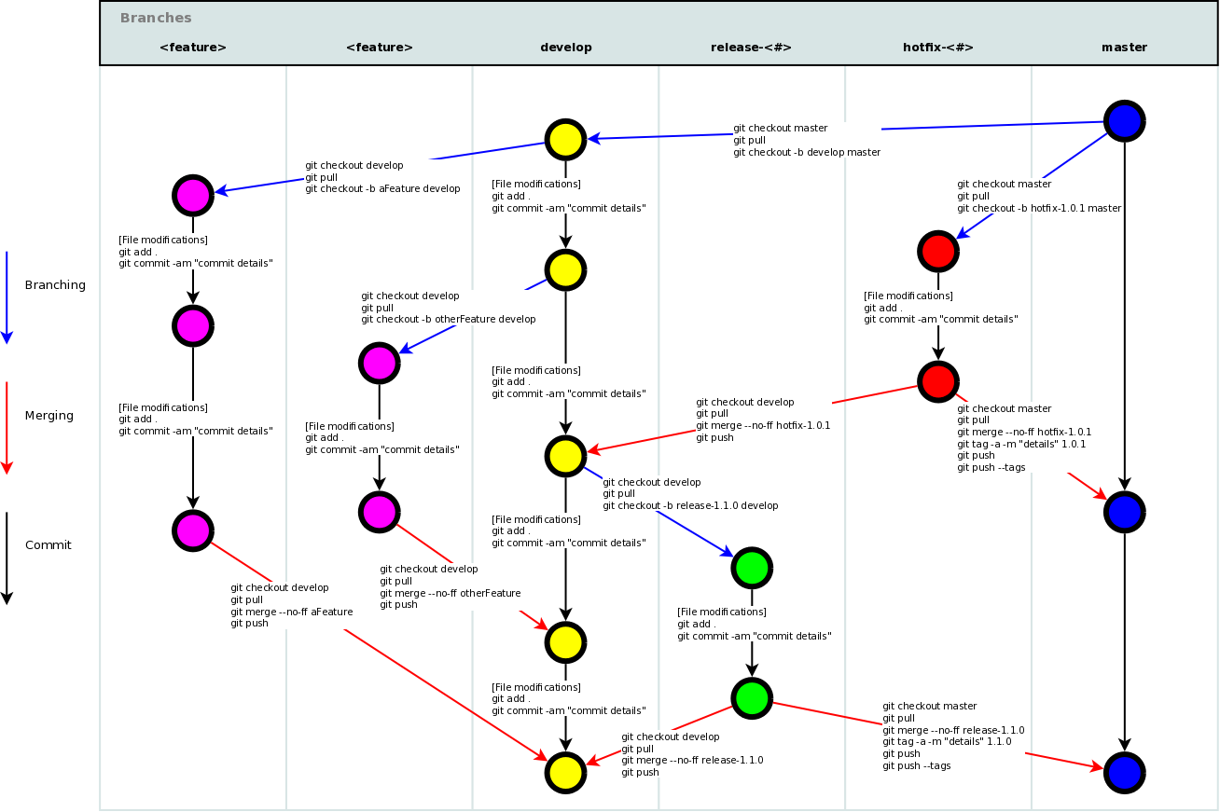

Slide 21
Dive In to Peace of Mind: 5 git commands to get started
Notes:
I am a firm believer in just starting to use

Slide 22
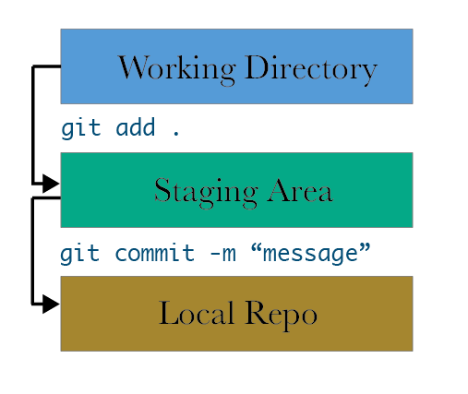
1
git init
2
3

Slide 23
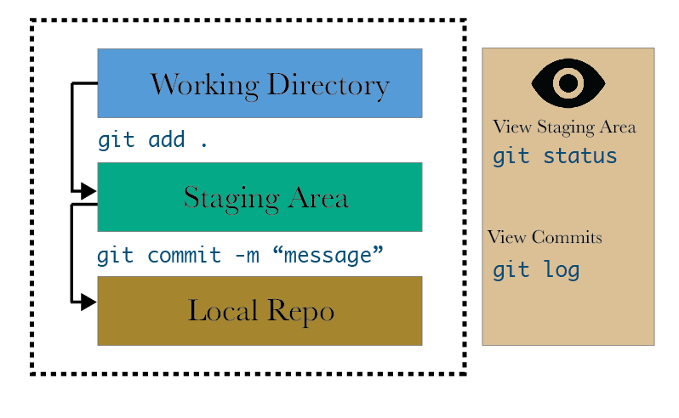
1
git init
2
4
3
5

Slide 24
git

Slide 25
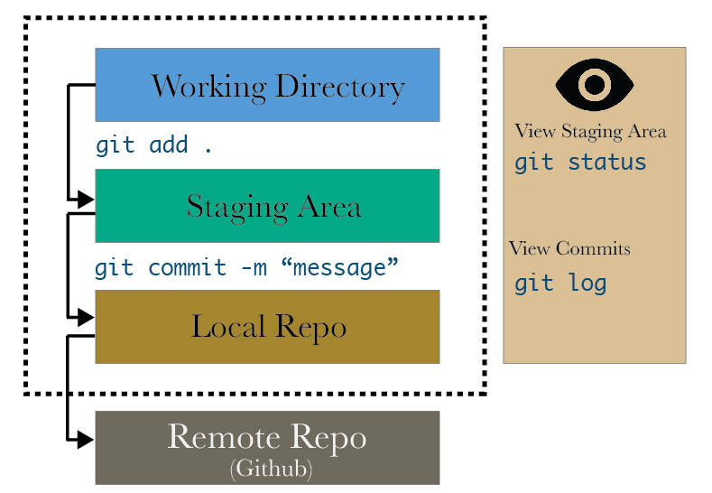

Slide 26
How I have been using git and Github:
Alone
Start on small projects, get used to basic commands.
Collaboration (Github) – find a partner
Collaborating on protocols.
Working on websites together.
Collaborating on lesson plans.

Slide 27
Reproducibility is a mindset: keep reinforcing the thought of sharing.

Slide 28
Literate Programming
Write programs that make sense in ordinary human language.
Start:
If in R, take advantage of the tools available to make reports.
Make a lot of comments in code.
3. Prepare your code for sharing, always.
4. Ask for feedback, from beginners and advanced.

Slide 29
Modify Programmatically
Strive to never manually do change anything.
Avoid steps that make it hard to explain to others what you did.
i.e. taking data out of R and putting in excel to copy/paste/re-arrange.
Start small.
If you never solve the problem, start a list of what you couldn’t do. Learn when you have more time.

Slide 30
Program Together
Helps reinforce your learning
Allows you to see holes in your analysis
Start a group. Once a week, no planned projects.
All skill levels. 2-3 hours. Get an experienced person to have this time be their “office hours”. Work on fun projects, not just research.

Slide 31
Standards for Computational Science
Discussion is needed from computational
biologists & interdisciplinary scientists.
What concepts are difficult?
What are the standards for your field?
What are publishing standards?
What tools work and don’t work?

Slide 32
