Slide 1
Generalizing Cluster Randomized Control Trial Results to a Target Population Rophence Ojiambo, ScM D43 PI: Joseph W. Hogan, ScD Advisor: Jon A. Steingrimsson, PhD Degree program: Master of Science in Biostatistics

Slide 2
Background
Results from randomized controlled trials may not accurately represent outcomes in a target population because of differences in population characteristics.
Concerns about external validity can limit the generalizability of research results.
This project: Conduct statistical analysis to generalize results from a recent RCT to a general clinical population.
Trial: Bridging Income Generation with Group Integrated Care (BIGPIC) study of group medical visits (GMVs) and/or microfinance (MF) for CVD risk reduction.
Target population: Patients with and without HIV enrolled at a primary care program in western Kenya (AMPATH).

Slide 3
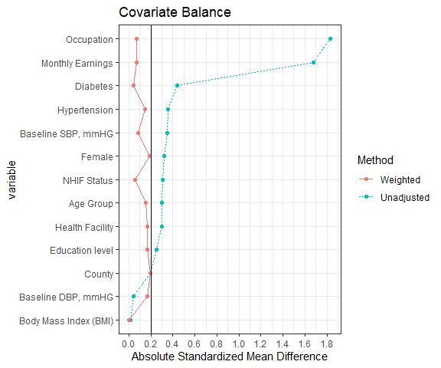
Objective
To generalize the population average treatment effects from BIGPIC study to a sample target population obtained from the Primary Health Integrated Care Project for Chronic Conditions (PIC4C) project.
Methods
The distribution of covariates was compared using standardized mean differences. A mixed effects model with a random effect of cluster, weighted by the inverse-odds of trial participation was used.
Results
Major differences in covariate distribution between the BIGPIC study and the target population. Substantial decrease in estimates of the treatment effect in the target population at 3 months.
BIGPIC participants were on average slightly younger, less likely to have health insurance, were less likely to be formally employed, and with lower monthly earning indices.

Slide 4
Discussion and Conclusion
The mean reduction in systolic blood pressure (SBP), both for GMV-MF, GMV and MF relative to UC arms was substantially decreased in the target population compared to the BIGPIC trial at 3 months.
The estimates of the treatment effect were attenuated at 12 months in the target population.
Caution needed in interpreting results due to baseline differences, model specification, and unmeasured factors.
Future research: collect comprehensive population-level data, use advanced statistical methods to improve transportability assessments, and enhance representativeness with targeted recruitment or broader inclusion criteria (including participants with HIV).
Future plans: Manuscript & publication

Slide 5
Acknowledgements
Moi-Brown Partnership for HIV Biostatistics Training NIH/Fogarty Grant
# D43 TW010050.
Joseph W. Hogan, ScD, Jon A. Steingrimsson, PhD and Ann W. Mwangi, PhD.
BIGPIC team, including Rajesh Vedanthan, MD; Jemima H. Kamano, MMED; Richard Mugo, ScM, & Allison K. Delong, MS.

