Slide 1
Project1-team-pay-to-play
Group members:
Dino Molina
Robert Oppan
Kevin Williamson

Slide 2
Motivation & Summary
Core Message:
Based on player statistics and salary is it worth paying NBA players top dollars.
Initial Questions:
How do we measure player efficiency rate?
What’s
Does the salaries of top players influence team wins?
We wanted to know the relationship between team wins vs salary and the effect on player efficiency rate.
*

Slide 3
Questions & Data
)
Elaborate on the questions you asked, describing what kinds of data you needed to answer them, and where you found it
Data Source:
2017-18 NBA Player Stats: Per Game | Basketball-Reference.com
https://www.kaggle.com/mharvnek/nba-team-stats-00-to-18
Describe whether you were able to answer these questions to your satisfaction, and briefly summarize your findings
Given the same amount of time played (36mins) by each player, we were able to calculate the efficiency rate of players. Using

Slide 4
Data Cleanup & exploration
Describe the exploration and cleanup process
* Discuss insights you had while exploring the data that you didn't anticipate
* Discuss any problems that arose after exploring the data, and how you resolved them
We found out that ESPN had discontinued sharing their public API’s since (August 26, 2014). We found 2017-2018 NBA Player Stats: Per Game. Initially we were struggling with a loop using the dataset provided.
* Present and discuss interesting figures developed during exploration, ideally with the help of Jupyter Notebook

Slide 5
Data analysis
Discuss the steps you took to analyze the data and answer each question you asked in your proposal
* Present and discuss interesting figures developed during analysis, ideally with the help of Jupyter Notebook
With the help of Jupyter Notebook we were able to calculate (using outliners) Average game played by top paid players, the mean of player efficiency rate, the average salary of top players. Using bins, we were able to groupby games which returned the number of games played by each player

Slide 6
Discussion
Discuss your findings. Did you find what you expected to find? If not, why not? What inferences or general conclusions can you draw from your analysis?

Slide 7
Post Mortem
Discuss any difficulties that arose, and how you dealt with them
* Discuss any additional questions that came up, but which you didn't have time to answer: What would you research next, if you had two more weeks?

Slide 8
Questions?
* Open-floor Q&A with the audience

Slide 9
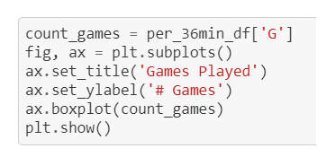
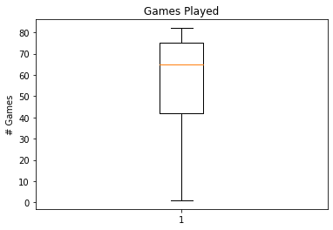

Slide 10
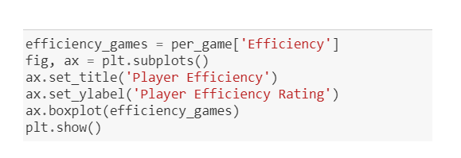
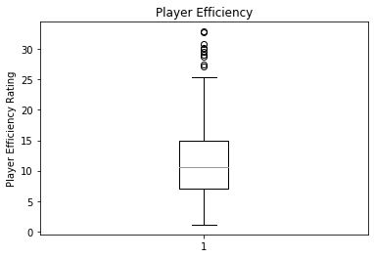
']

Slide 11
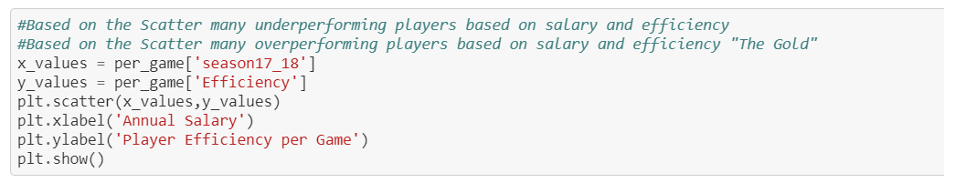
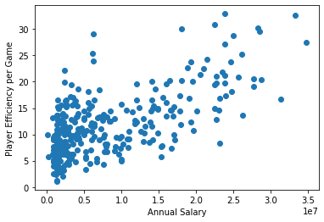

Slide 12
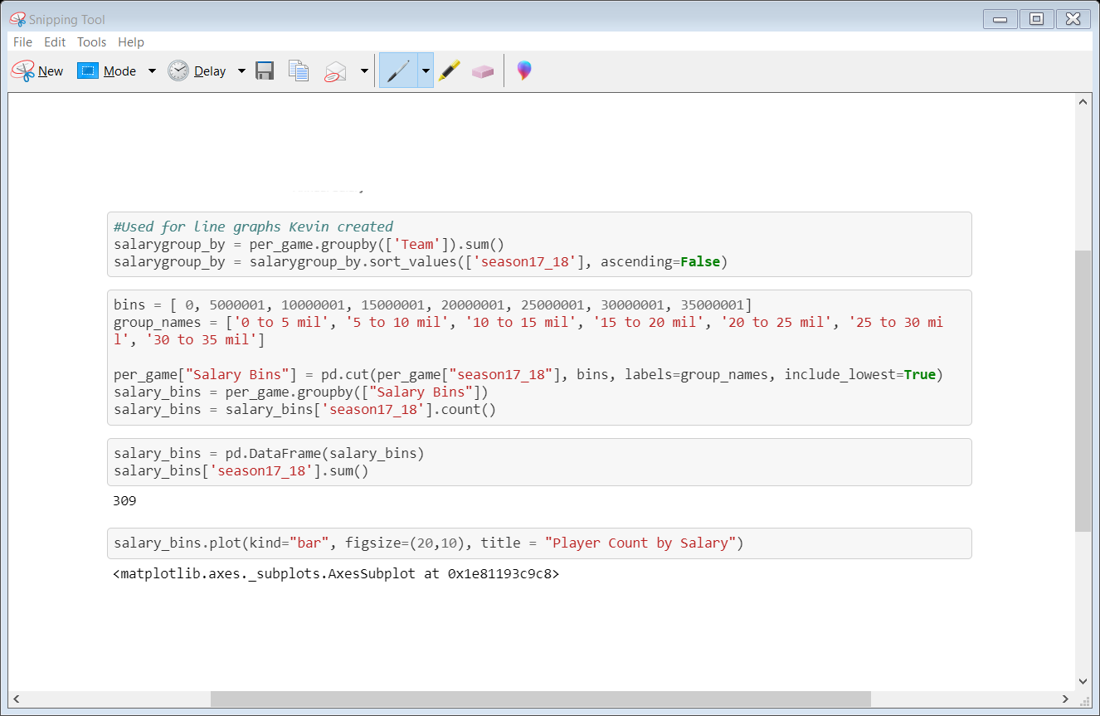
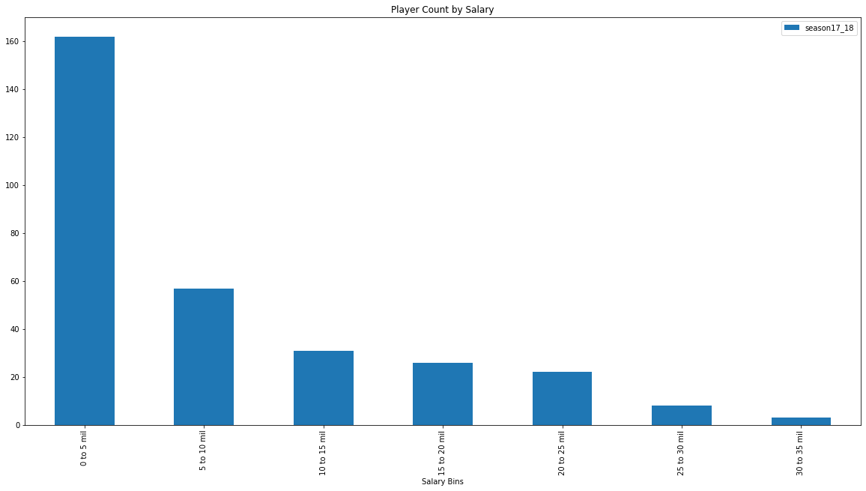

Slide 13
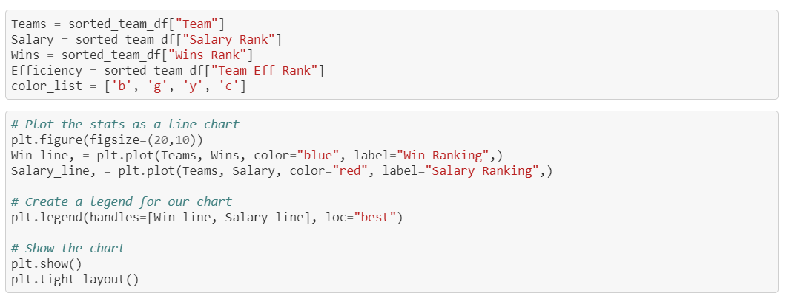
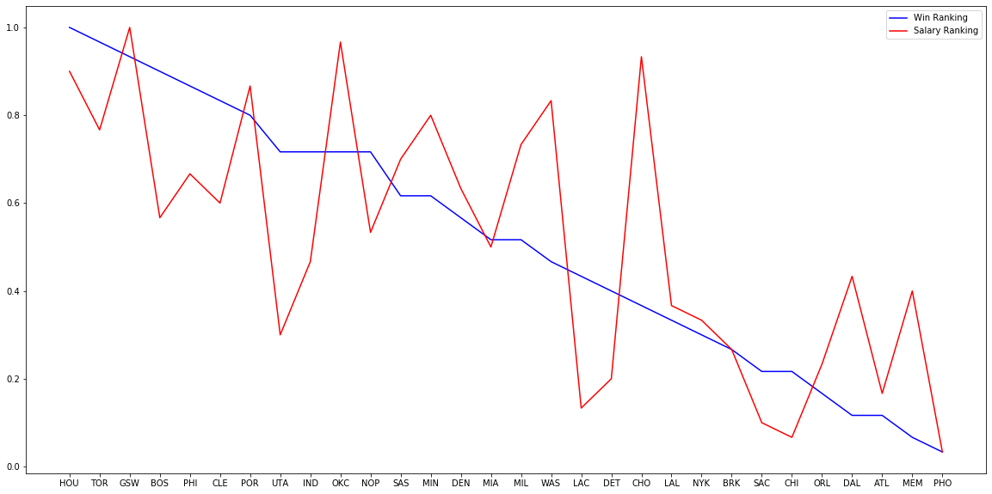

Slide 14
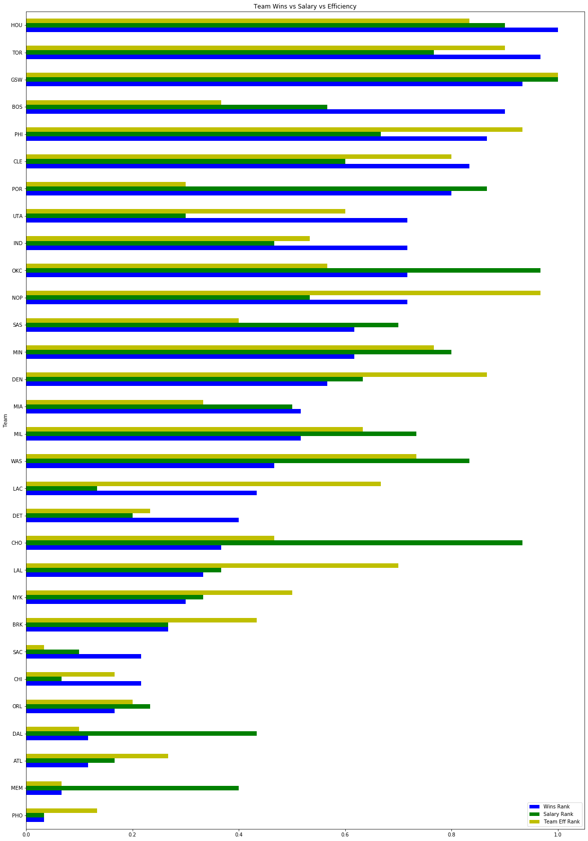
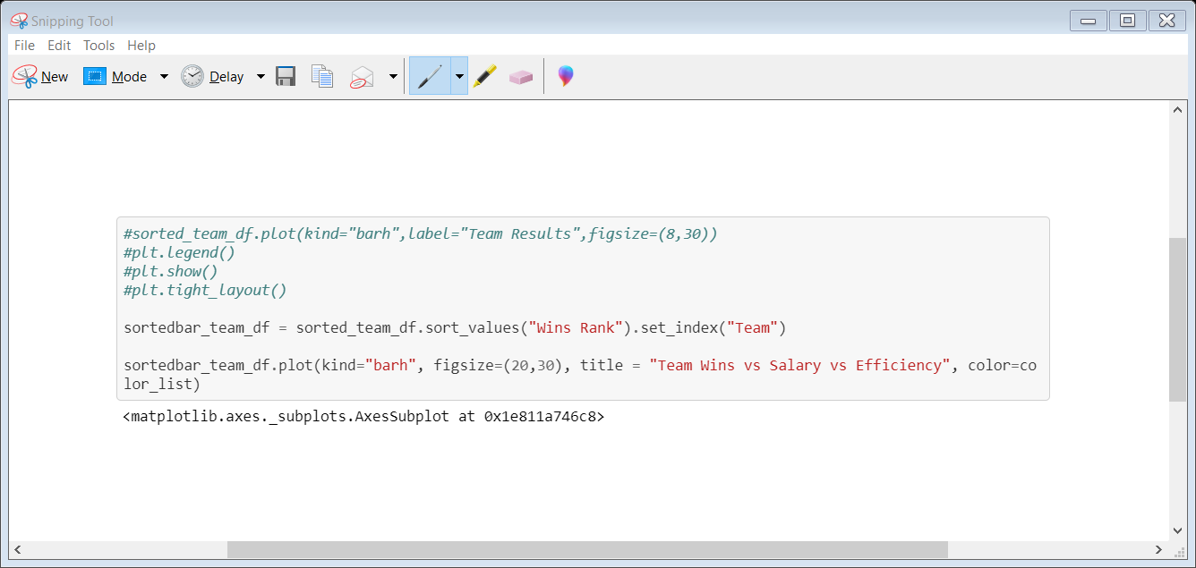

Slide 15
