Slide 1
A Web Application for E-Textiles Design
Roope Lehikoinen
Ohjaaja: Yu Xiao
Department of Communications and Networking
Kandidaattiseminaari 10 op
Kalvo 1
Sivumäärä 9
Electrical Engineering
17.11.2019
Notes:
My name is Roope Lehikoinen and
I’m an engineering student majoring in Information Technology
This talk is about by bachelors thesis on A Web Application for E-Textiles design

Slide 2
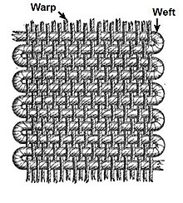
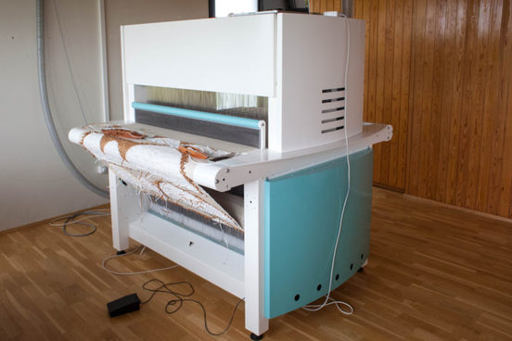
Weaving
Interlacing perpendicular yarns
Warps and wefts (suom. loimi- ja kudelanka)
Looms (suom. kangaspuut)
Jacquard
TC2 power loom
(1)
(2)
2 / 9
Notes:
What is weaving?
Interlacing warps vertically with wefts horizontally
Old wooden looms were improved by Jacquard
Aalto uses tc2 loom

Slide 3
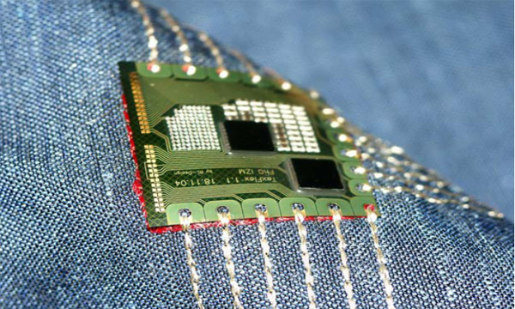
E-textiles
Conducting materials woven into fabrics
Components
Threads
Sensors
Lights
(3)
3 / 9
Notes:
e- textiles have conductive materials in them
From threads to components
Would be great to be able to hide the conductors

Slide 4
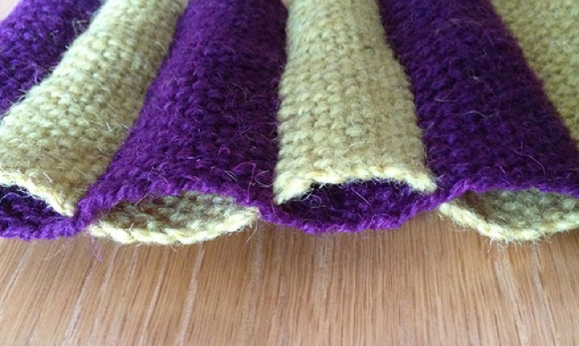
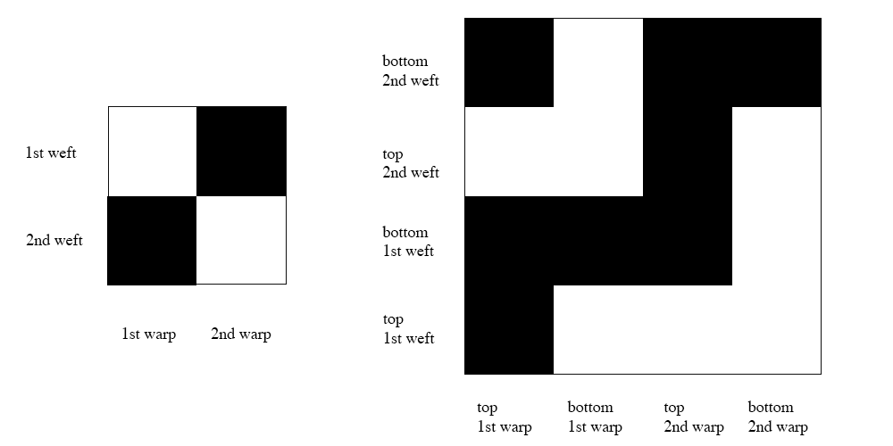
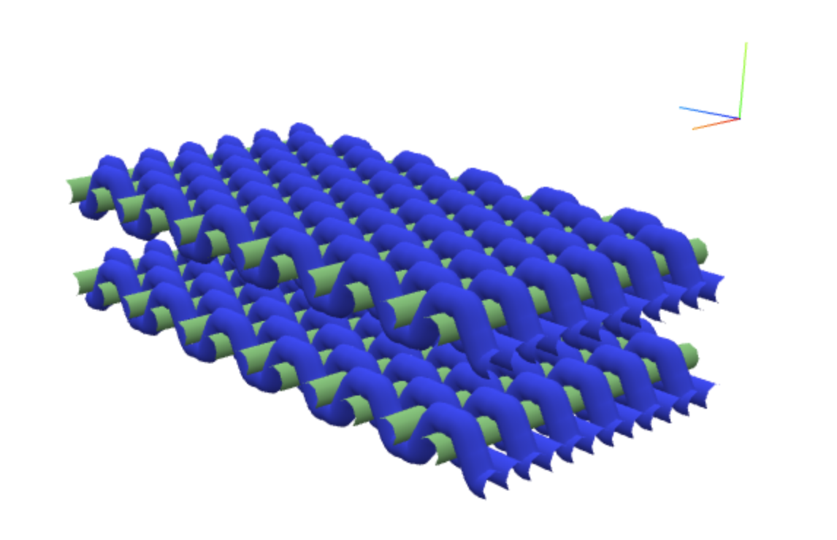
Multilayered weaving
Hiding conductors inside
Conversion to multilayered weaving
(4)
4 / 9
Notes:
Use multilayered weaving to hide conductors
We convert a plain weave to double layers
Double the warps and wefts
When doing bottom weft raise warps
When doing top wefts leave warps down

Slide 5
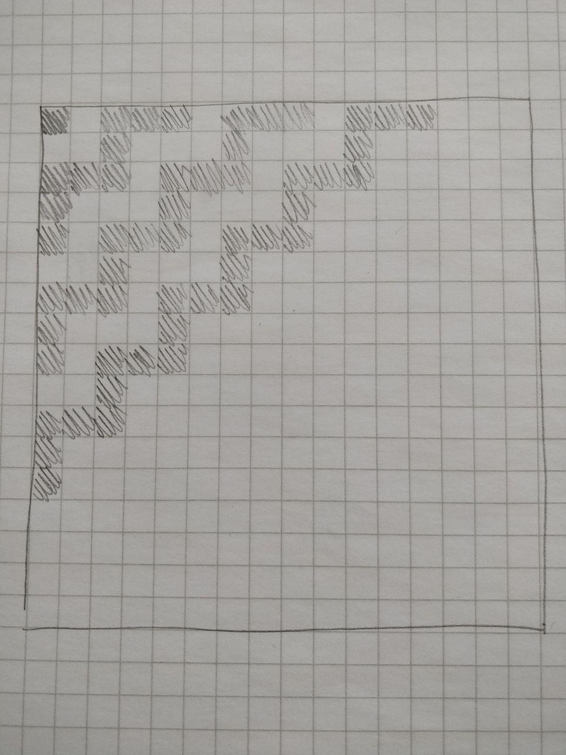

Problem
Designing
Pen and paper
Photoshop
Complications
Complex
Prone to error
(5)
5 / 9
Notes:
Complex designing with pen and paper
Convert to photoshop
Difficult editing and prone to error

Slide 6
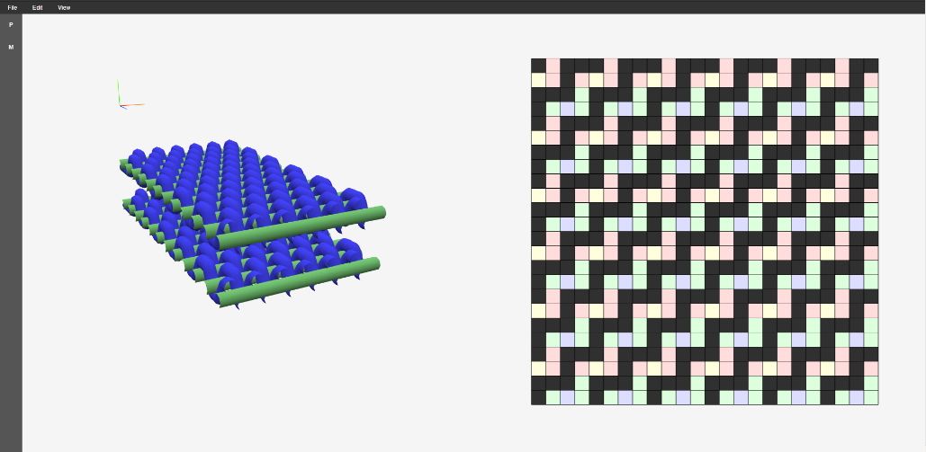
The application
Features
Simple editing
3D viewing of the result
Web application
Accessible by browser
Similar functionality to standalone application
WebGL
Removes heavy calculation from serverside
Supported by most modern browsers
6 / 9
Notes:
Application for designing textiles
Especially 3D viewing is useful
Why web application and not standalone app
It is accessible by nearly any computer
It has similar functionality as standalone
WebGL removes burden from the server
Graphics calculated on the computer instead of server

Slide 7
Conclusion
Textile design methods have stagnated
A need for more powerful tools
Solution
Application that is better suited for e-textiles design
7 / 9
Notes:
In conclusion
Methods for textile design have stagnated
There is a need for powerful tools
Thesis seeks to fill this gap

Slide 8
Sources
A. M. Collier, A Handbook of Textiles, 3rd ed. Oxford, England: Wheaton,1980, ISBN: 9780080249742.
W. H. Dooley, Textiles. Boston, USA: D.C. Heath and Co, 2007. [Online]. Available: www.gutenberg.org/files/24077/24077-h/24077-h.htm
“TC2 Digital Jacquard Loom.” [Online]. Available: https://www.digitalweaving.no/tc2-loom/
8 / 9

Slide 9
Image sources
https://upload.wikimedia.org/wikipedia/en/e/ea/Warp_and_weft.jpg
https://www.textilmidstod.is/static/files/Myndir/Facilities/TC2
http://www.adetexs.com/images/2nd.png
https://cmsassets.mybluprint.com/dims4/default/2684703/2147483647/strip/true/crop/576x344+12+0/resize/1440x860!/quality/90/?url=https%3A%2F%2Fcmsassets.mybluprint.com%2Fdc%2F00%2F0a7c6c08f4d6803be8188e2c4306%2Fcally-booker-double-weave-pockets.jpg
https://upload.wikimedia.org/wikipedia/commons/a/af/Adobe_Photoshop_CC_icon.svg
9 / 9

