Slide 1
Adaptive Hybrid Intelligent Systems for the Competitive Advantage of Enterprises
Dietrich Rordorf
Olten, 19 May 2023
Emerging Topics in Information Systems, SS 2023

Slide 2
Research Question
How can AI systems learn from and adapt to humans and their environment for the competitive advantage of enterprises?

Slide 3
Timeline
AI and competitive advantage
Groups present
From AI to hybrid intelligence
Groups elaborate solution
Adaptive AI
Recap
Scenarios
t
ChatGPT
ChatPDF

Slide 4
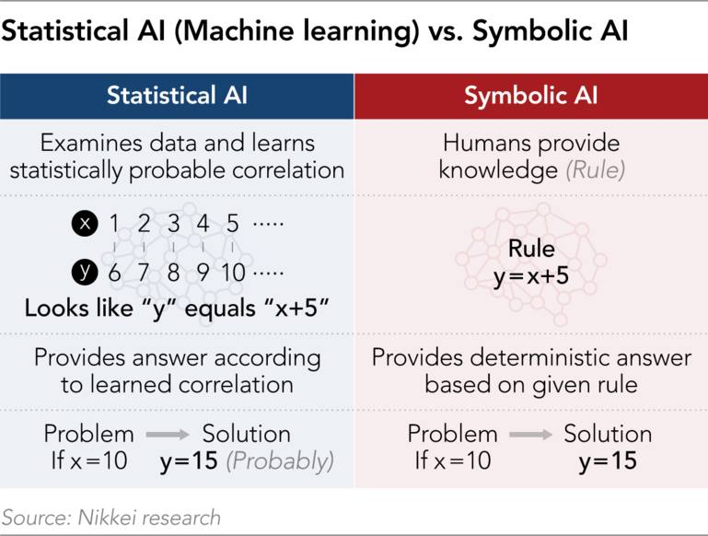
From AI to Hybrid Intelligence

Slide 5
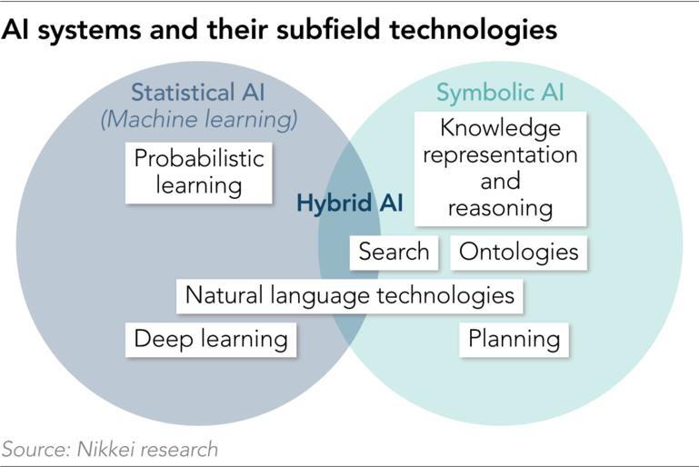


From AI to Hybrid Intelligence
Also: Connectionist or Sub-symbolic AI
Also: Neuro-symbolic AI, MAKE

Slide 6
From AI to Hybrid Intelligence
Hybrid AI refers to systems combining symbolic and sub-symbolic approaches
Anywhere from loosely coupled to tightly integrated (d’Avila Garcez & Lamb, 2023)
Loosely coupled typically involves a human → human-in-the-loop (HITL)

Slide 7
From AI to Hybrid Intelligence
Hybrid intelligent systems: humans and AI work together towards common goals, augmenting the human intellect and overcoming human limitations and cognitive biases (Akata et al., 2020).
Korteling et al. (2021):
cognitive abilities of human intelligence are limited by the biological substrate and biological and evolutionary origin of intelligence
improve outcomes of AI system by developing human-aware AI systems that support human decision-making rather than pursuing Artificial General Intelligence

Slide 8
Adaptable AI
…

Slide 9
References
d’Avila Garcez, A., & Lamb, L. C. (2023). Neurosymbolic AI: The 3rd wave. Artificial Intelligence Review. doi: 10.1007/s10462-023-10448-w

