Slide 1



Adaptive Hybrid Intelligent Systems for the Competitive Advantage of Enterprises
Dietrich Rordorf
Olten, 19 May 2023
Emerging Topics in Information Systems, SS 2023

Slide 2
Recap
From AI to Hybrid Intelligence

Slide 3
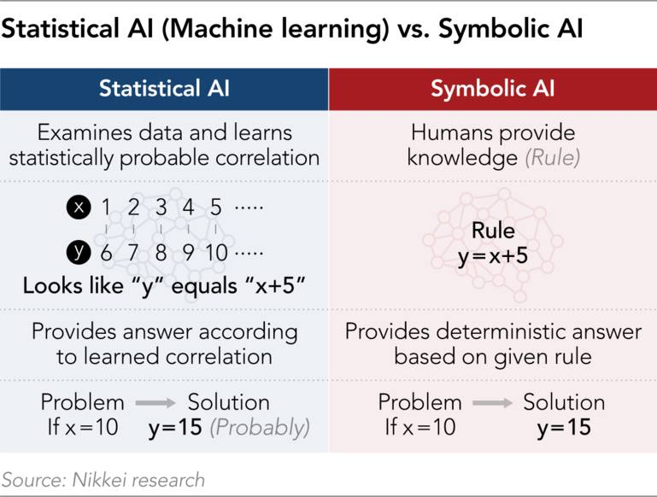
From AI to Hybrid Intelligence

Slide 4
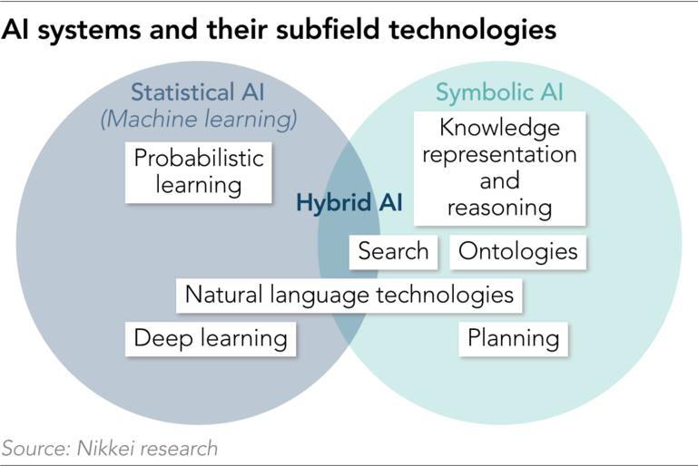


From AI to Hybrid Intelligence
Also: Connectionist or Sub-symbolic AI
Also: Neuro-symbolic AI, MAKE

Slide 5
From AI to Hybrid Intelligence
Hybrid AI refers to systems combining symbolic and sub-symbolic approaches
Anywhere from loosely coupled to tightly integrated (d’Avila Garcez & Lamb, 2023)
Loosely coupled typically involves a human → human-in-the-loop (HITL)
Tightly integrated: neuro-symbolic AI

Slide 6
From AI to Hybrid Intelligence
Hybrid intelligent systems: humans and AI work together towards common goals, augmenting the human intellect and overcoming human limitations and cognitive biases (Akata et al., 2020).
Korteling et al. (2021):
cognitive abilities of human intelligence are limited by the biological substrate and biological and evolutionary origin of intelligence
improve outcomes of AI system by developing human-aware AI systems that support human decision-making rather than pursuing Artificial General Intelligence

Slide 7
Adaptive Hybrid AI

Slide 8
Adaptive AI Systems
Human-aware AI systems should adapt to (based on non-exhaustive literature review):
Different user’s needs
Various user tasks
Joint task completion
Interactions with agents
Changing environment

Slide 9
Adaptive AI – 1) Different User Needs
Recommender systems, think of Netflix recommendations
Netflix should learn my preferences
Cold-start problem: no data about new user
Data sparsity problem: a lot of data in aggregate, but very few data points for each individual user
Promising hybrid AI approach: graph-learning recommender systems (GLRS) (Zhang et al., 2023)

Slide 10
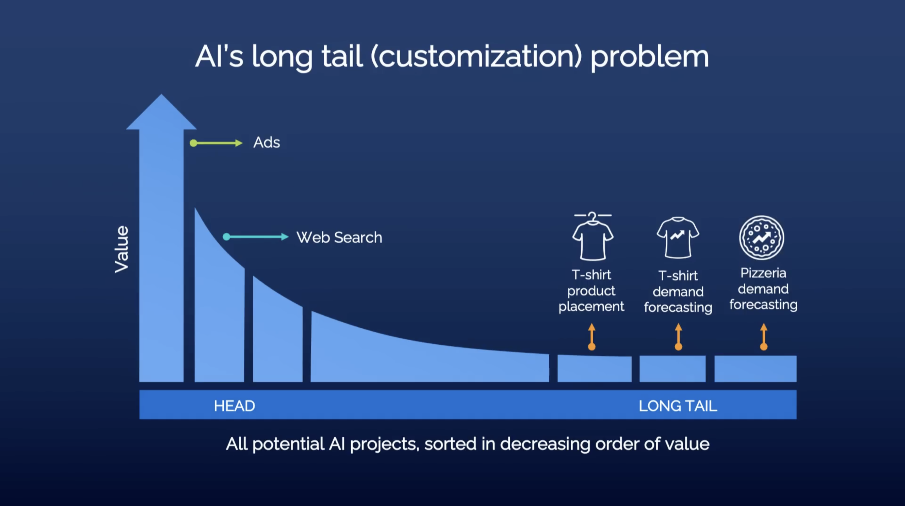
Adaptive AI – 2) Various User Tasks
Andrew Ng TED Talk, 2022 (predates ChatGPT)
Not many working in these areas, but in aggregate represents enormous value.

Slide 11
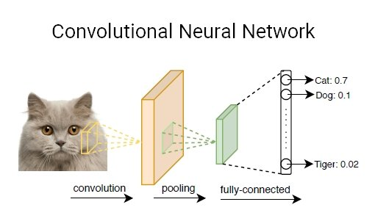
The Long Tail: Narrow AI?
“Narrow AI” refers to machine learning models that are trained for one (narrowly defined) use case
Example:
classify animal in image as cat, dog, …, tiger
If model has never seen a giraffe in training data, it will classify it as any other animal
Thus not very adaptable: each use case requires plenty of training examples. Each new class type needs retraining of model.

Slide 12


Narrow vs. Broad AI
Narrow AI
Specific use cases, high accuracy
Requires many specific data examples
In aggregate very expensive to build as we ned specific data and train a new model for each specific use case
Does not easily adapt to other tasks (but: transfer learning)
Does not easily adapt to another user
If data changes: needs to be retrained
Broad AI
E.g. LLMs, Foundation Models
Generic, huge models (dozens to hundreds billions of parameters)
Emergent capabilities (Wei et al., 2022)
In-context learning / “few shots learners” (Brown et al., 2020)
train-then-fine-tune or prompt-based learning

Slide 13
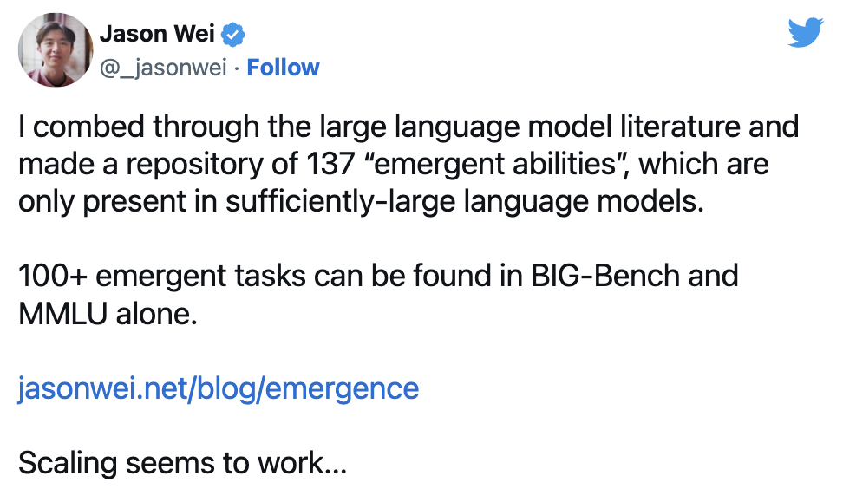
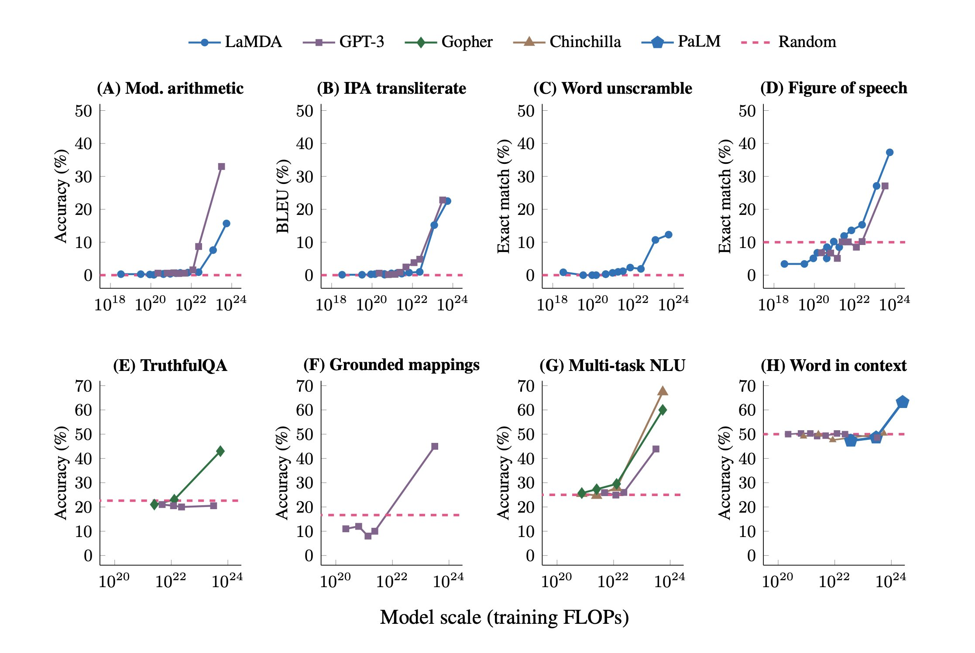
Emergent Abilities
Wei et al. (2022)
Performance of models on many NLP and NLU tasks is only marginally better than random until a certain model size is reached.

Slide 14
The Promise of Broad AI
Train-then-fine-tune
Pre-train large base model (base model for text, base model for image recognition, base model for video sequence analysis, etc.)
Fine-tune model to specific use cases with few examples only
Fine-tune model to specific user with few examples only
Prompt-based learning (see, e.g., Zhou et al., 2023)
user gives an example or two (context)
AI adapts based on example in context
(context in GPT3: 2K tokens, ChatGPT: 4K tokens, GPT4: 8k tokens, GPT4-32K: 32K tokens)

Slide 15
Tokens & Context
Given a text string (e.g., "tiktoken is great!") and an encoding (e.g., "cl100k_base"), a tokenizer can split the text string into a list of tokens: ["t", "ik", "token", " is", " great", "!"]
Source: https://github.com/openai/openai-cookbook/blob/main/examples/How_to_count_tokens_with_tiktoken.ipynb
What to put into the context?
New emerging discipline of “Prompt Engineering”
Users may need to learn completely new strategies such as chain of thought prompting (Wei et al., 2023) and least-to-most prompting (Zhou et al., 2023)

Slide 16

Adaptive AI: GitHub Copilot
Launched October 2021
AI-powered code completion tool by GitHub & OpenAI
Trained on public code repos on GitHub.com, GitLab.com, etc.
Provides suggestions for line completion and entire function blocks
Learns and adapts to user’s coding style
Aims to increase developer productivity
Provides boilerplate code, avoids errors (bugs), avoids looking up documentation

Slide 17
Adaptive AI – 3) Joint Task Completion
AI agents need to adapt as part of human-AI teams (Zhao et al., 2022):
to goals and intentions of the human teammates;
to cognitive features of the human;
to physical factors of the human in robot-human interactions (e.g., fatigue of the human); and
adaptation of learned human models to transfer a learned model to interaction with another human.

Slide 18
Adaptive AI – 4) Others Agents
AI may adapt to other agents:
changing team composition (new human members, other AI agents)
AI should account for effects of its own actions on other agents
Multiagent reinforcement learning (MARL):
AI agent is trained based on the effect of its actions on the environment while consider potential (re)actions of the other agents (Canese et al., 2021).
MARLtrained AI agent show high adaptability to other agents.

Slide 19
Adaptive AI – 5) Changing Environment
Societal trends, political or legal changes, etc.
concept drift: changes to objectives that AI models were designed for
data drift: changes in the data distribution (Lu et al., 2020)
Requires re-training of AI model to adapt:
Online training: continuous training and redeploy of AI model
Model drift: performance of continuously retrained model degrades over time

Slide 20
Competitive Advantage of AI

Slide 21
Competitive Advantage of AI
Davenport (2018):
AI primarily used by large enterprises, technology companies, AI start-ups
AI capabilities:
robotics and robotic process automation (RPA)
gaining insights from data through machine learning
AI-based engagement with employees, customers through chatbots or intelligent agents
AI can fuel new business models (Iansiti & Lakhani, 2020)

Slide 22
Competitive Advantage of AI
Types of benefits of AI for enterprises (Ho et al., 2022):
reduced costs
improved performance
better decision-making
higher customer satisfaction
better customer segmentation
improved customer experience
Better products & services
business innovation

Slide 23
Hands-on / Discussion

Slide 24
Instructions
We build 4 groups, ca. 6-7 persons each
Go to Teams channel for Emerging Topics > Files > Workshop_Didi
Read the _Group_Assignments.pdf
A Powerpoint file is prepared for each group to record your results
Each group is confronted with a scenario (see your group’s powerpoint!)
Discuss and reason about the adaptive, hybrid AI use case in the group, and to what type of competitive advantage this could lead.
Record your results in the powerpoint

Slide 25
References (1/2)
Akata, Z. et al. (2020). A Research Agenda for Hybrid Intelligence: Augmenting Human Intellect With Collaborative, Adaptive, Responsible, and Explainable Artificial Intelligence. Computer. doi: 10.1109/MC.2020.2996587
Brown, T., et al. (2020). Language Models are Few-Shot Learners. arXiv:2005.14165
Canese, L., et al. (2021). Multi-Agent Reinforcement Learning: A Review of Challenges and Applications. Applied Sciences. doi: 10.3390/app11114948
Davenport, T. (2018). The AI Advantage: How to Put the Artificial Intelligence Revolution to Work. MIT Press. doi: 10.7551/mitpress/11781.001.0001
d’Avila Garcez, A., & Lamb, L. (2023). Neurosymbolic AI: The 3rd wave. Artificial Intelligence Review. doi: 10.1007/s10462-023-10448-w
Ho, L. T., Gan, C., Jin, S., & Le, B. (2022). Artificial Intelligence and Firm Performance: Does Machine Intelligence Shield Firms from Risks? Journal of Risk and Financial Management. doi: 10.3390/jrfm15070302
Iansiti, M., & Lakhani, K. R. (2020). Competing in the Age of AI. Harvard Business Review. https://hbr.org/2020/01/competing-in-the-age-of-ai

Slide 26
References (2/2)
Korteling, J. et al. (2021). Human- versus Artificial Intelligence. Frontiers in Artificial Intelligence. doi: 10.3389/frai.2021.622364
Lu, J., et al. (2020). Data-driven decision support under concept drift in streamed big data. Complex & Intelligent Systems. doi: 10.1007/s40747-019-00124-4
Wei, J., et al. (2022). Emergent Abilities of Large Language Models. arXiv:2206.07682
Wei, J., et al. (2023). Chain-of-Thought Prompting Elicits Reasoning in Large Language Models. arXiv:2201.11903
Zhang, L., et al. (2023). Recommending on graphs: A comprehensive review from a data perspective. User Modeling and User-Adapted Interaction. doi: 10.1007/s11257-023-09359-w
Zhao, M., et al. (2022). The Role of Adaptation in Collective Human–AI Teaming. Topics in Cognitive Science. doi: 10.1111/tops.12633
Zhou, Y., et al. (2023). Revisiting Automated Prompting: Are We Actually Doing Better? arXiv:2304.03609

