Slide 1
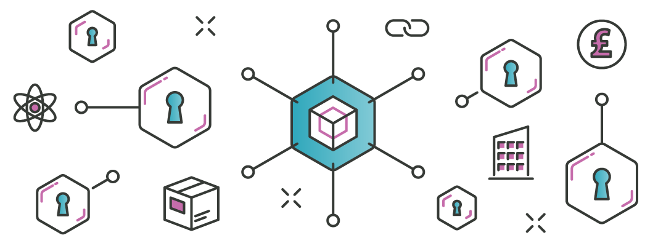
Blockchain Technology
An introduction to decentralised blockchain technology and NFTs

Slide 2
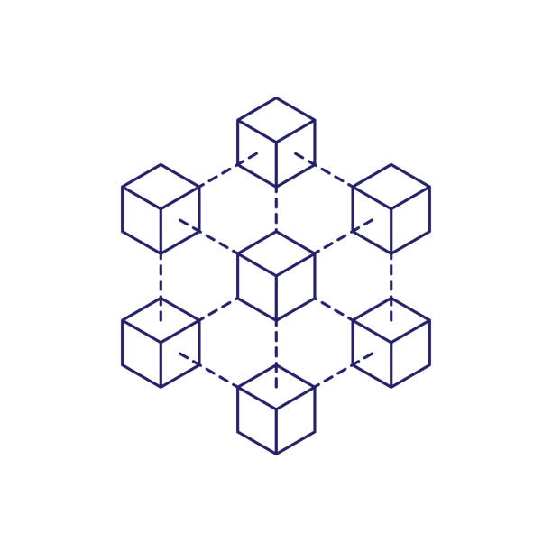
Overview
What is a blockchain?
Hash chains
Distributed consensus
Block mining
Decentralised networks
Centralised architecture
Decentralised architecture
Smart contracts and dApps
Cryptocurrencies
NFTs

Slide 3
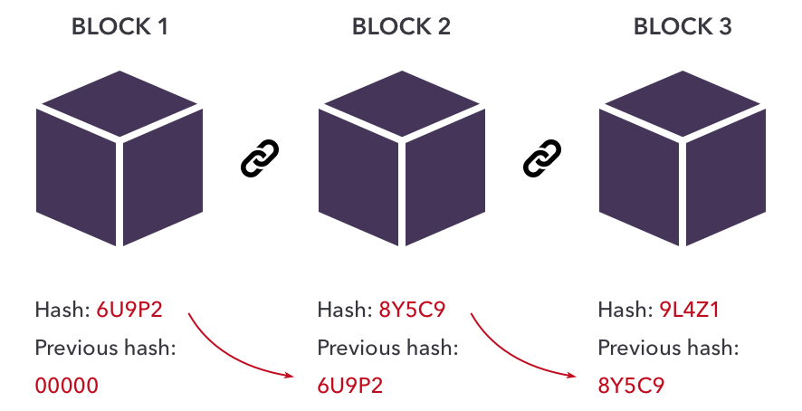
What is a blockchain? : Hash Chains
Data is stored in ‘blocks’ which are encrypted (SHA-256 hashed)
Each successive block contains the previous block hash
Any changes to a block in the chain will break the hashes of the proceeding blocks – tampering is therefore evident.

Slide 4
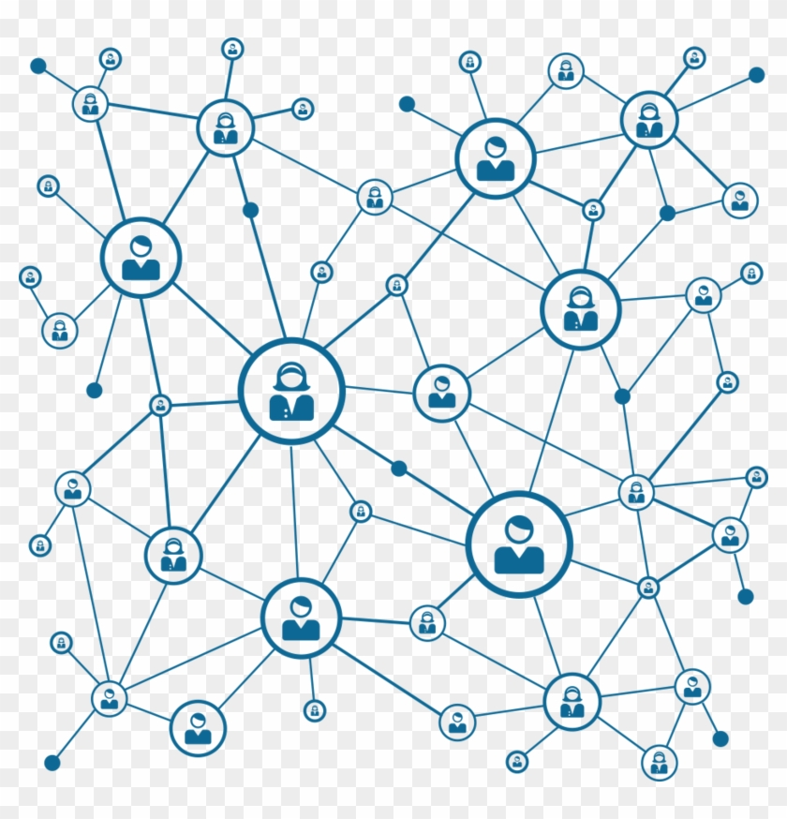
What is a blockchain? : Distributed consensus
The blockchain is distributed across multiple nodes
Each new block added to the chain is verified (hashed) by all nodes
If any node makes changes to earlier blocks, this will be evident from disagreement with the remaining nodes
The contents of the blockchain are therefore immutable and tamper resistant

Slide 5
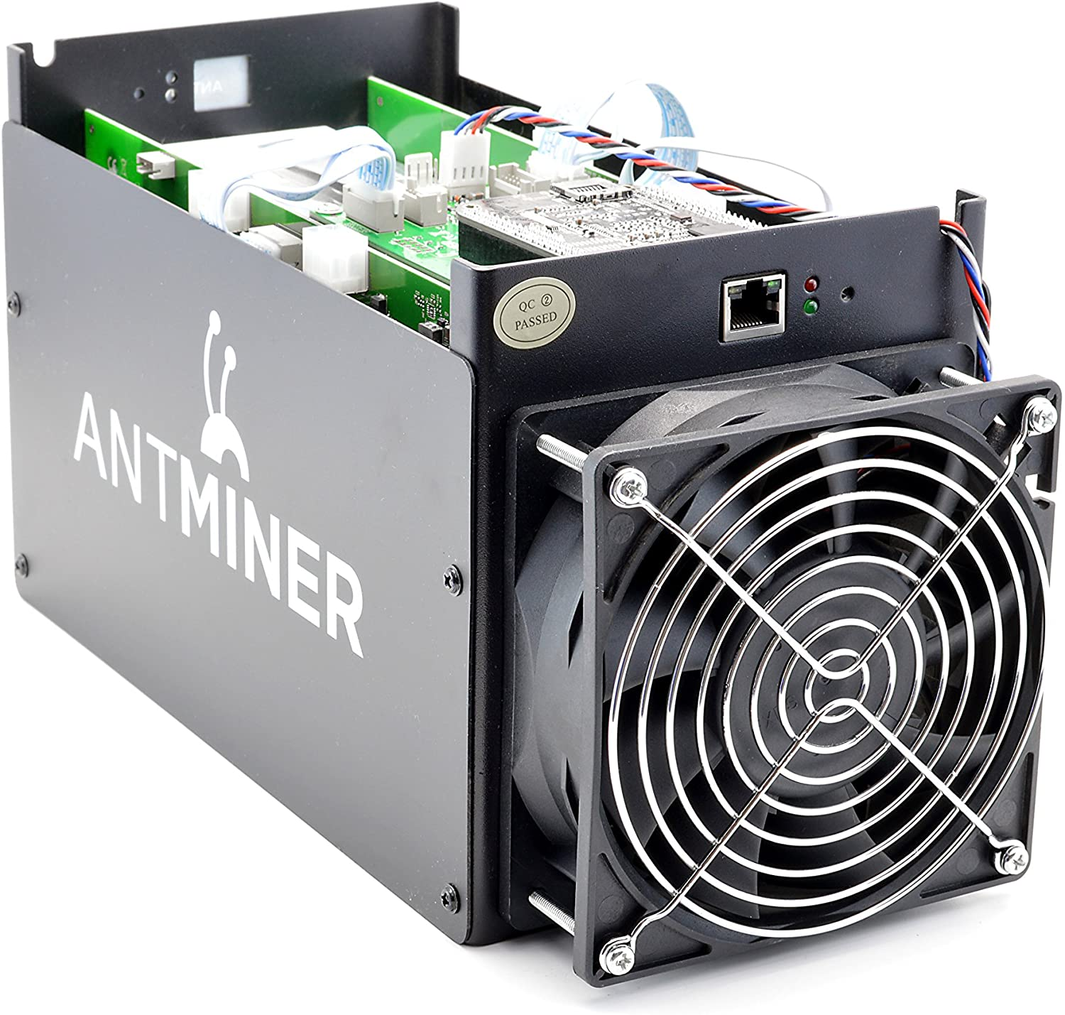
What is a blockchain? : Block Mining
Blocks are verified through a process called ‘mining’.
Each block contains a variable (the ‘nonce’) that is adjusted during the hashing process.
Each miner in the network competes to find a nonce value such that the hash begins with a specified number of zeros.
The number of zeros is adjusted based on the available hashing power of the entire network (mining difficulty).
Once a correct value has been found this block is ‘signed’ and added to the blockchain.
All miners will then hash that block with the signed nonce value and verify the hash is consistent.

Slide 6

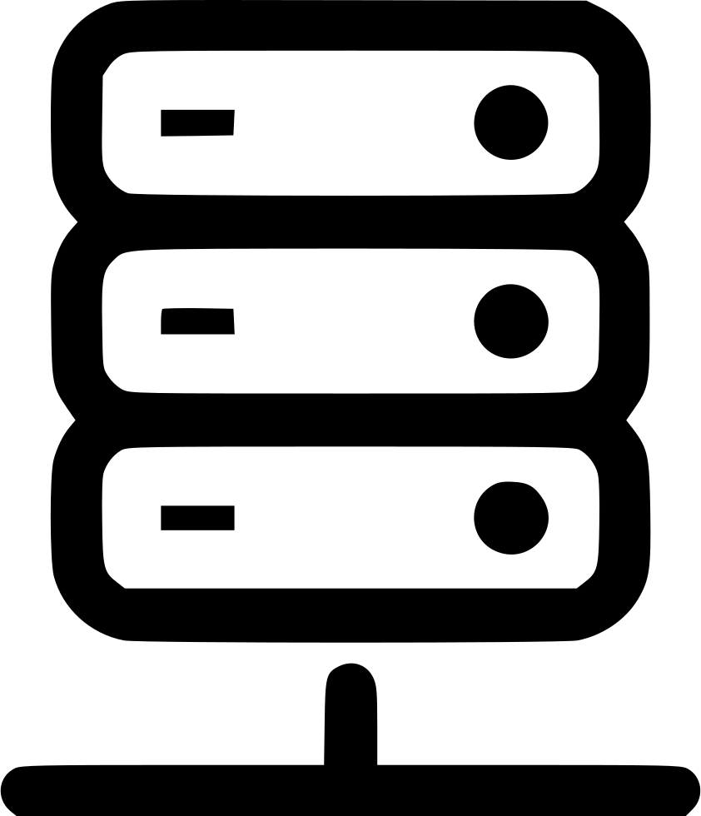
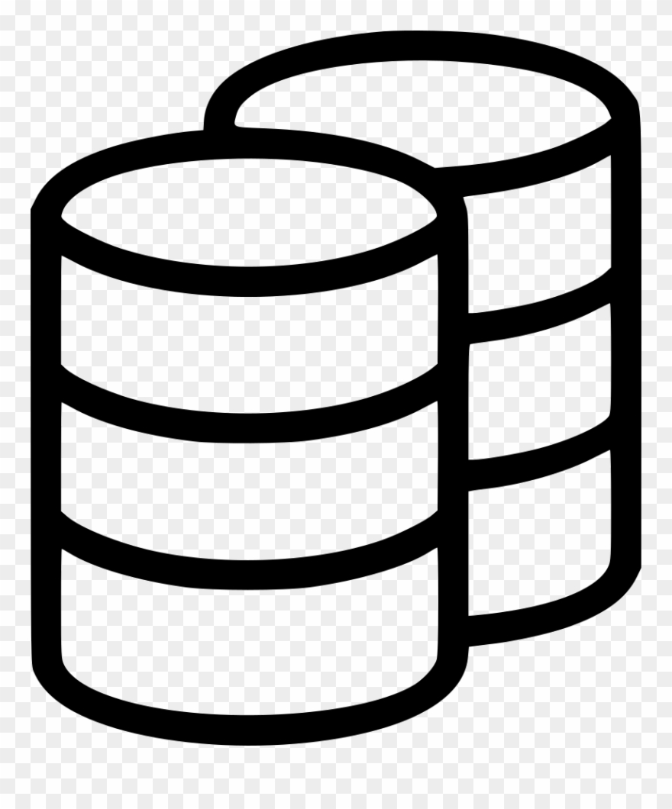
Centralised Architecture
Traditional webserver architecture:
HTTP request
‘Transaction’
HTTP response
Client side browser
Server + Database
Database is single source of truth – possibility of server-side tampering
No way to publicly verify legitimacy of transaction history

Slide 7
Decentralised Architecture
Block
Decentralised network of nodes that independently verify new blocks
The network achieves consensus once the majority have verified each new block hash
The blockchain contains the immutable history of all previous transactions on the chain
‘Transaction’
Block verified
Client
Blockchain
No single source of truth – truth is achieved by consensus
Data in the blockchain is immutable once verified
Vulnerable to ‘51% attacks’ – if majority decide to verify tampered blocks

Slide 8
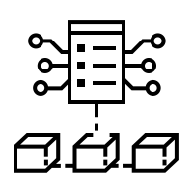
Smart Contracts and dApps
‘Smart contracts’ are code that is stored in the blockchain
Written in the solidity language (similar to JavaScript)
Code is immutable and its legitimacy publicly verifiable
Any changes made to the code would be evident from the blockchain
Updates are possible – majority of blockchain must verify update
dApps are client applications that interact with smart contracts
Smart contracts replace server side code for dApps
Blocks act as the database records for dApps

Slide 9
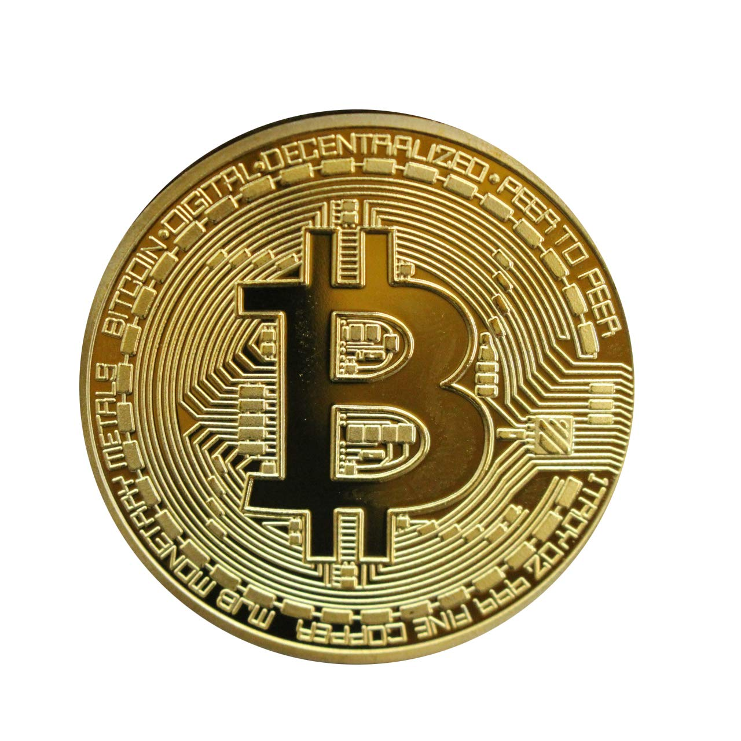
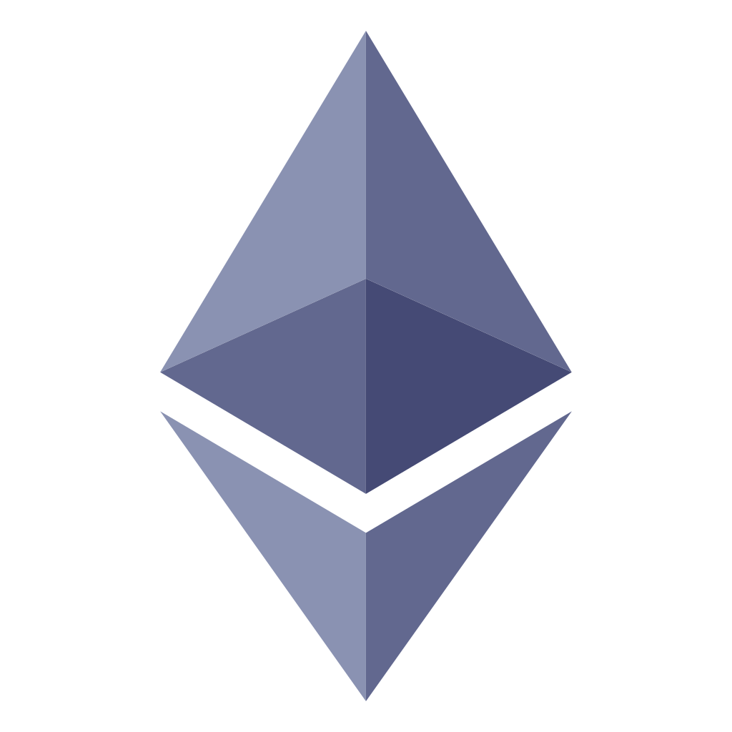
Cryptocurrencies
Cryptocurrency tokens are transferred between public
addresses via the blockchain
The blockchain holds the transfer records for the currency
Address token balances are tracked from the transaction histories
All transfers are publicly verifiable and immutable
Transfers are signed by private keys to ensure only the key holder can send their own tokens
Token transfers are facilitated via smart contracts, that define how tokens can be transferred e.g :
£36,000 can be swapped for 1 BTC
BTC can be transferred between addresses – with a % mining fee
X ETH can be swapped for the Y NFT

Slide 10
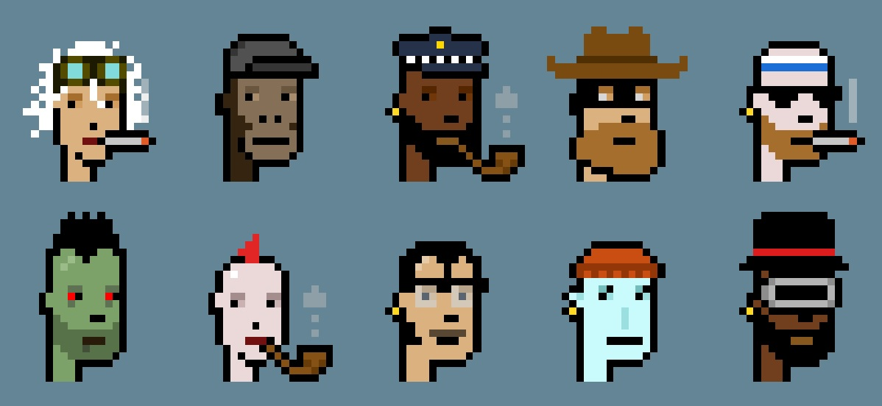
NFTs (Non-Fungible Tokens)
NFTs are associated with digital artworks, that can be bought/sold with cryptocurrency
NFTs can be swapped just like any other token (e.g they are bought with ETH)
The ownership of a particular NFT is permanently recorded within the blockchain
The analogy : Owning a signed and verified unique copy of a particular artwork
Specifically: A publicly verifiable record that you own that particular NFT
Crypto Punks NFT:
Average trading price this week is approximately 100 ETH = £300,000
Nothing inherently valuable about the raw image
Value is derived from the ownership of the unique copy in the blockchain

