Slide 1
Predicting on-time flights
Rowan Rollman

Slide 2
Dataset
Data comes from the U.S. Department of Transportation - Bureau of Transportation Statistics
The website provided allows you to create your own table
537,902 records
11 columns
https://www.transtats.bts.gov/DL_SelectFields.aspx?gnoyr_VQ=FGJ&QO_fu146_anzr=b0-gvzr
Notes:
You can select years going back to 1987 and specify which month you are looking at. It also allows you to add more values like day of the month, day of the week, amount of time delayed, and more.
The specific dataset I’m using comes from January 2022

Slide 3
Exploratory Data Analysis

Slide 4
Variables
Variable | Description
OP_UNIQUE_CARRIER | Unique carrier code, specific to a certain airline
ORIGIN | Code of the origin airport, where the flight departed from
DEST | Code of the destination airport
CRS_DEP_TIME | CRS Departure Time (local time: hhmm)
DEP_TIME | Actual Departure Time (local time: hhmm)
DEP_DELAY_NEW | Difference in minutes between scheduled and actual departure time. Early departures set to 0.
CANCELLED | Cancelled Flight Indicator (1=Yes)
DAY_OF_THE_MONTH | Numerical representation of the day of the month
DAY_OF_THE_WEEK | Numerical representation of the day of the week
Notes:
There are some variables that I create

Slide 5
Data
17 unique airlines
Create indicator for on-time, delayed, or cancelled
Replace empty cells with 0
Double check for unexplained missing values

Slide 6
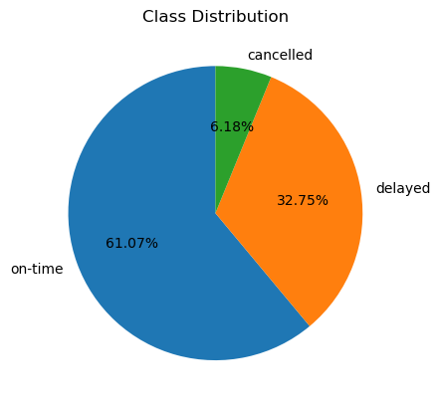
Beginning distribution of classes is showed in the pie-chart
328470 on-time
176176 delayed
33256 cancelled

Slide 7
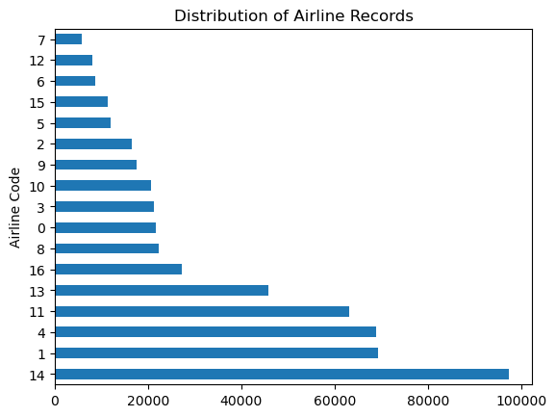

Slide 8
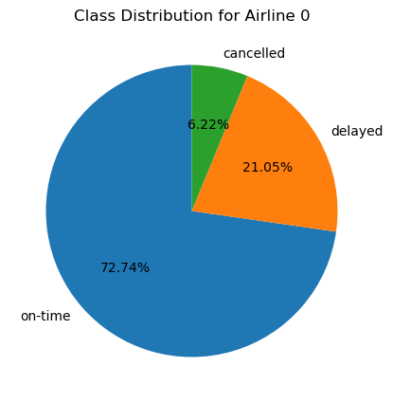
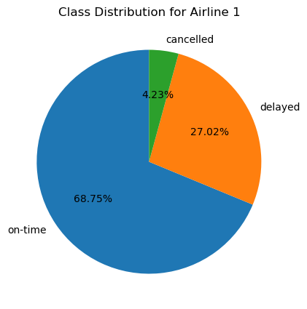
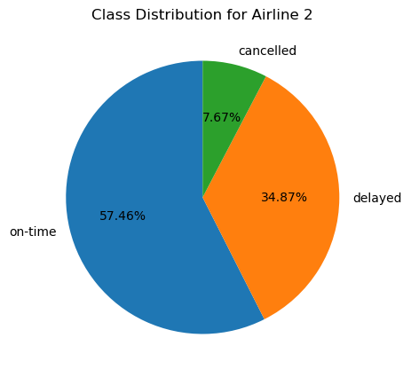
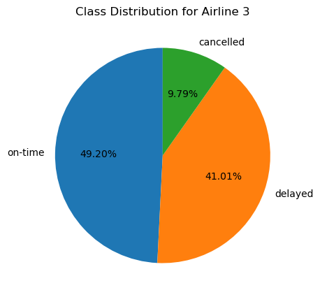
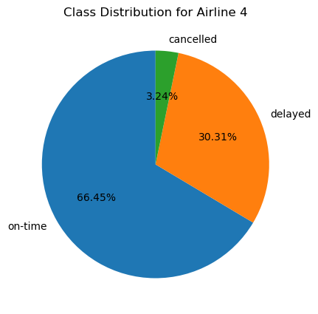
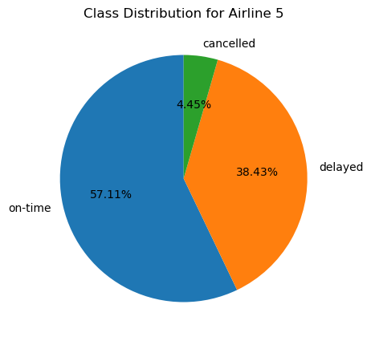
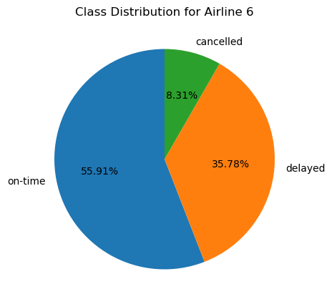
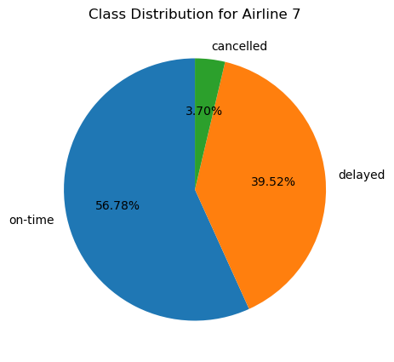
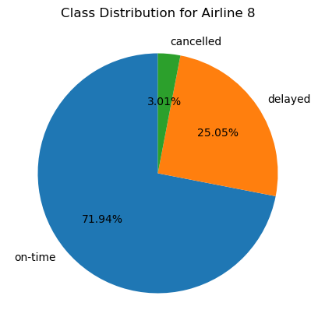
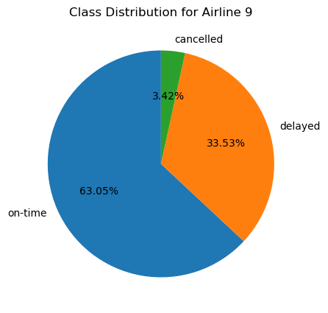
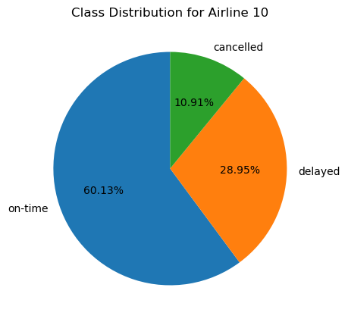
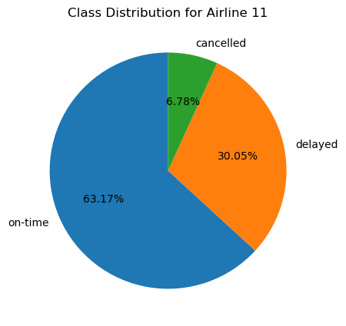
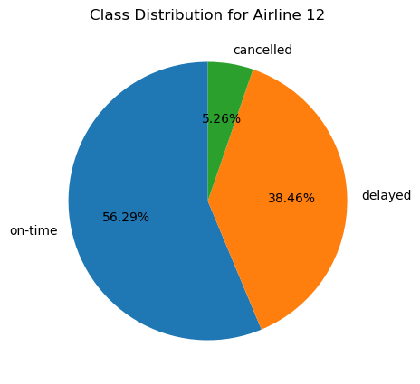
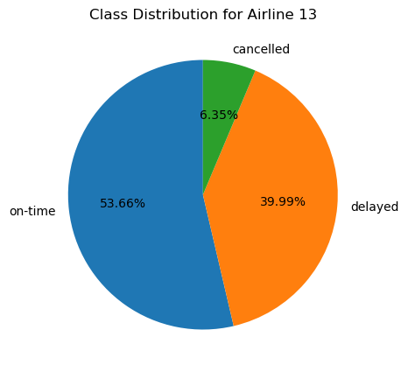
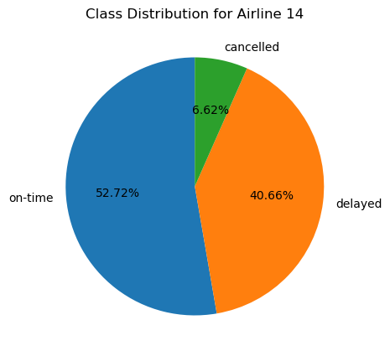
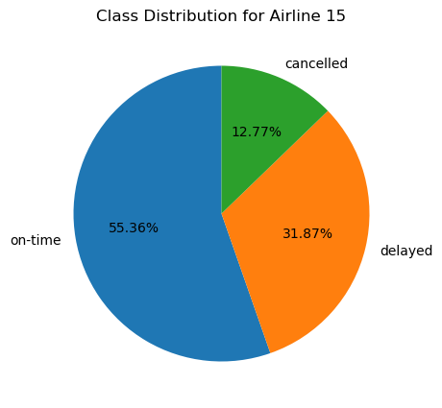
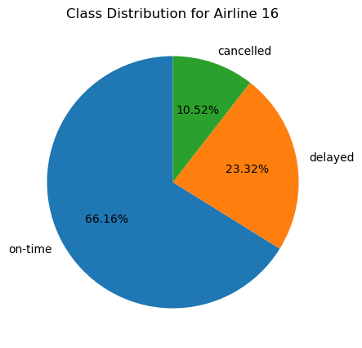

Slide 9
Logistic Regression

Slide 10
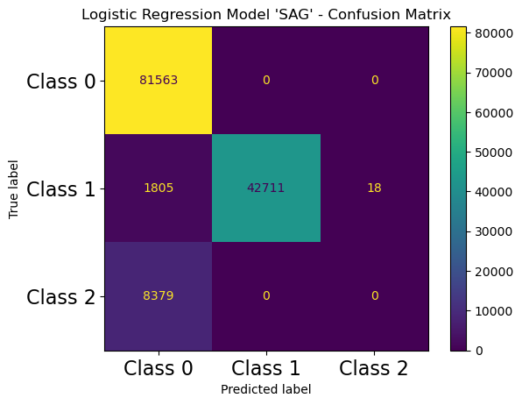

Model score: 92.413%
Cross validation scores:
[0.92064299 0.9212617 0.92081552 0.92079073 0.92007188]
Mean of cross validation scores: 0.920716564
Model score: 92.237%
Cross validation scores:
[0.92020921 0.92090227 0.920233 0.92029497 0.91974964]
Mean of cross validation scores: 0.920277816
Notes:
Used solver “sag” and “saga” because those are best with large datasets. Since my dataset is 500,000+ samples, this solver would speed up the process

Slide 11
KNN Classifier

Slide 12
KNN Scores from 1-29
K-Value | Train Score | Test Score
1 | 0.977529956 | 0.863529552
2 | 0.913952001 | 0.861826646
3 | 0.914001576 | 0.858093637
4 | 0.888095958 | 0.849846813
5 | 0.887706791 | 0.851081234
6 | 0.871966606 | 0.843563164
: | : | :
: | : | :
Best Test Score: 0.8635295517415748
From K Value 1

Slide 13
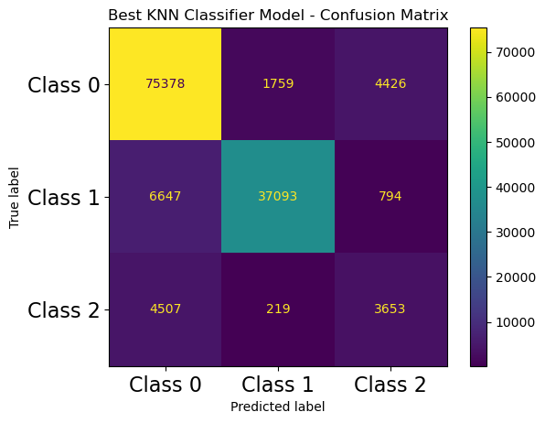
Best K Value Model
Using the best K value from the previous slide, I created another KNN Model, with a score of 86.35%

Slide 14
Cross Validation on KNN
[0.8564594217462498, 0.8560603395076043, 0.8529147836781534, 0.845498301159704, 0.8465542596698821, 0.8389320428721128, 0.8402978445699109, 0.8342223797424044, 0.835134566693872, 0.8299465022918342, 0.8306380800376992, 0.8262209123230466, 0.8268777868434677, 0.8229538948051658, 0.8235388851437371, 0.8200810015448632, 0.8206387235098248, 0.8175700076006391, 0.8179195137458823, 0.8154333076793925, 0.8153787742500693, 0.8133858450273384, 0.8133833648693967, 0.8113309453729615, 0.8112045269937571, 0.8093479300847621, 0.8092785244326273, 0.8075880034227968, 0.8072979866603409]
The array of scores is as shown
Max Score:.85.646%

Slide 15
XGBClassifier
Used multiple learning rates to find the optimal one,
learning_rates = [0.05, 0.1, 0.25, 0.5, 0.75, 1]
xgb.XGBClassifier(max_depth=10, n_estimators=100, learning_rate=lr)
Learning Rate | Model Score
0.05 | 0.9474999256372885
0.1 | 0.9483179154644695
0.25 | 0.9496638805437402
0.5 | 0.9521773401945328
0.75 | 0.9523483744311253
1.0 | 0.9521029774829709
Best learning rate is 0.75 with a score of 0.9523483744311253

Slide 16
Light GBM
lgbm.LGBMClassifier(num_leaves=100,n_estimators=100,max_depth=10,learning_rate=lr, bagging_fraction=.8, bagging_freq=5)
Learning Rate | Model Score
0.05 | 0.9518798893482852
0.1 | 0.9533373984948987
0.25 | 0.9535233052738035
0.5 | 0.882767185222642
0.75 | 0.5450414943930515
1.0 | 0.8444629524970999
Best learning rate is 0.25 with a score of 0.9535233052738035
Notes:
The reason for choosing this model is because it has a faster training speed and has better accuracy than other boosting algorithms, but MAINLY because it is able to handle large datasets with relative ease.

Slide 17
HistGradientBoostingClassifier
HistGradientBoostingClassifier(learning_rate=lr)
Learning Rate | Model Score
0.05 | 0.9496936256283649
0.1 | 0.9515006395193194
0.25 | 0.5756640590142479
0.5 | 0.9450905737826825
0.75 | 0.9329248341711532
1.0 | 0.8978553793985544
Best learning rate is 0.1 with a score of 0.9515006395193194
Notes:
The reason for choosing this model is because it has a faster training speed and has better accuracy than other boosting algorithms, but MAINLY because it is able to handle large datasets with relative ease.

Slide 18
Last two models
SGDClassifier
Running on all processors
Using log_loss
Score 0.8893259763824028
ADABoostClassifier
N_estimators 100
Random_state = 42
Score 0.937341979237931

