Slide 1

Time-Complexity of Key-Insertion in Python Dicts
Rob Orsini

Slide 2
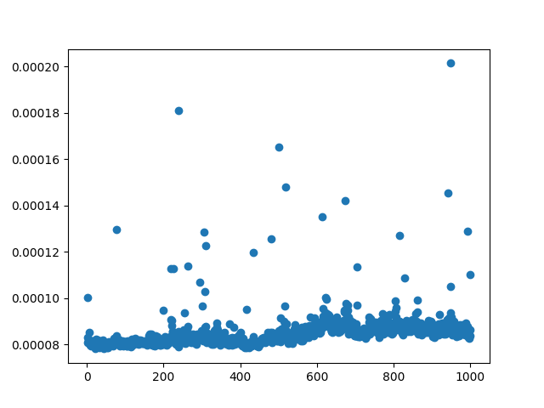

Slide 3
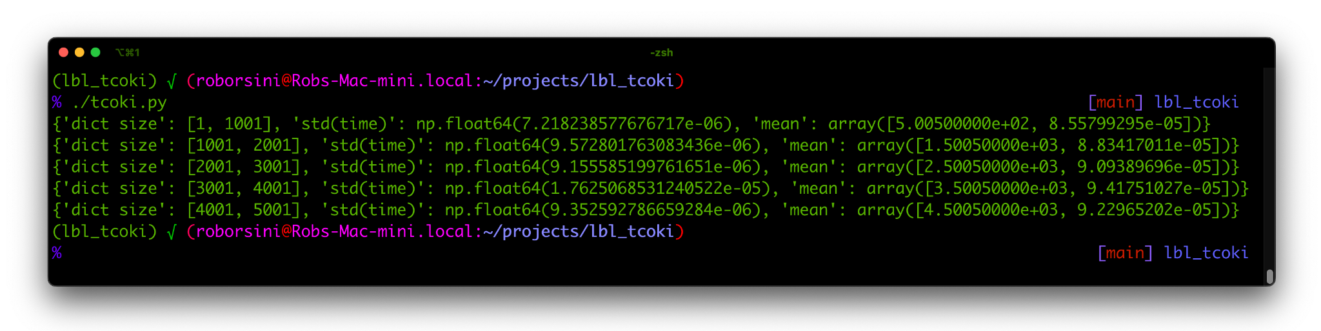
Data summary from five runs (1k more per)

Slide 4
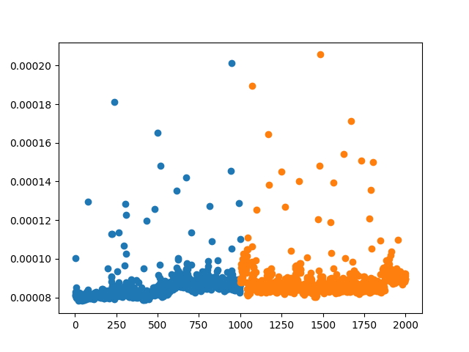

Slide 5
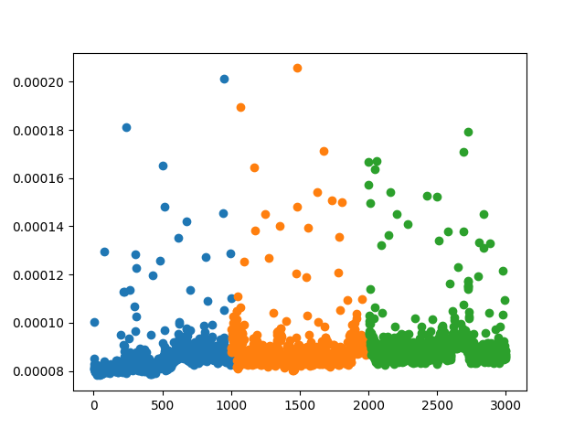
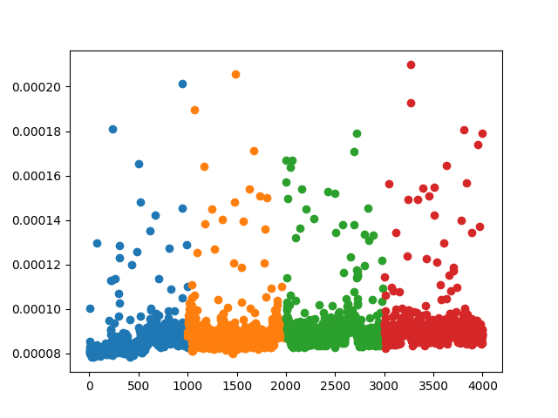
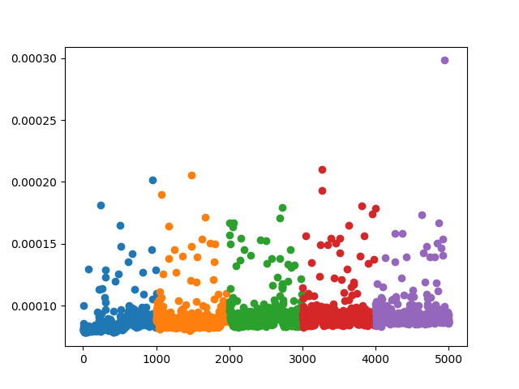

Slide 6
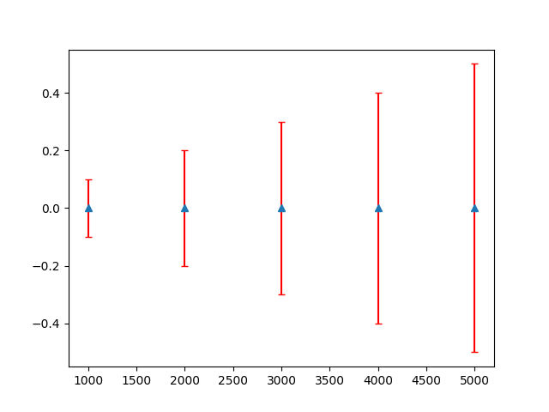
A plot of mean and standard deviation per bucket

Slide 7
The time-complexity of key-insertion in Python dictionaries is constant time, or..
O(1)

