Slide 1
Computer vision surgical skill assessment using operative video
Rory Holmes

Slide 2
Context
Notes:
Who:
- Individually conducted, supervised by James Atlas, partnered with The department of surgery and Critical Care
What?
Assess skill within colorectal surgery
Right hemicolectomy and anterior resection, remove part of colon and rectum
Good for automation due to:
VPDT correlates with competency assessment tools.
Why?
Operative reviews valuable tool in competency based surgical training.
Not often done, time consuming
Surgeons have limited time that could be better spent on patient care and other clinical responsibilities
Introduction of automated techniques provides an assessment of association with adverse outcomes in patients.

Slide 3
01
02
Objectives
03
What is the accuracy of automatically calculated VPDT?
How accurately can relevant surgical information be
automatically classified?
Given automatically calculated VPDT, how closely can a CAT score be approximated?
Notes:
- Given this, the objectives are as follows:

Slide 4
Solution
1
2
Fine-tuning
Feature Extractor
Pre-trained CNN
Feature Maps
3
R
Outputs
Phase predictions
3D-CNN
Notes:
In order to fulfill these objectives.
Pre-trained cnn will be finetuned to be used as a feature extractor on the laparoscopic videos, this will output feature maps
Which will then be stacked linearly and passed to 3d-cnn
Outputs phase predictions

Slide 5
Pre-trained CNN
01
How accurately can relevant surgical information be automatically classified?
Notes:
Addresses the first objective, define what features need to be classified?
Due to previous research, the relevant information being focused on is a classification of what surgical tools are within each frame

Slide 6
Problem
Notes:
Colorectal dataset does not come with any tool annotations to train feature extractor, additionally no other colorectal dataset with tool annotations could be found.
To solve this a surgical dataset on cholecystectomies was found, which as opposed to the colorectal surgery involves removing the gallbladder.
Unfortunately, while there is overlap, the type of tools dosen’t completely line up between surgeries, nor the materials they are made of.

Slide 7
Accuracy
60%
73%
62%
InceptionResnetV2
ResNet50
VGG16
Notes:
Continuing on, three pre-trained models were tested as a feature extractor in classifying tool presence within the cholecystectomy dataset
ResNet50 performs the best when looking at accuracy
Accuracy is not the best evaluation metric

Slide 8
F1 score
66%
52%
43%
InceptionResnetV2
ResNet50
VGG16
Notes:
F1 score may be a better evaluation metric.
F1 score is the balance between precision (the proportion of correct positive predictions) and recall (the proportion of actual positives correctly identified)
Under this metric, InceptionResnetV2 performed the best, and although it underperformed on accuracy, it still makes it the more reliable choice for feature extraction

Slide 9
Fine Tuning
70%
77%
F1 Score
Accuracy
InceptionResnetV2
Notes:
To improve inceptionresnetv2’s performance, further fine tuning was conducted
Initially, all base layers to the model were frozen, only the final classification layer which outputted what tools were present in frame was trained.
Additionally, a custom callback was implemented to unfreeze part of the network after the validation loss stopped decreasing during training.
After doing so the overall F1 score is 70% and accuracy 77%
Freezing the initial layers ensures that they retain the ability to extract general features learned from the original dataset, such as lines and edges, preventing them from being negatively impacted by the fine tuning.
Incrementally unfreezing only the final layers of the model to be trained, the model was able to learn more specific features relevant to the surgical dataset such as tool outlines.

Slide 10
3D-CNN
02
What is the accuracy of automatically calculated VPDT?
Notes:
Address second objective, of automatically calculating VPDT
The key to this is detecting when each phase of the vascular pedicle dissection begin and end, this problem is considered a surgical phase detection problem.
The colorectal surgery is thus split into four phases: time retraction start, time dissection start, time vessel ligated, and completing dissection
Need phase detector, determine transition point between phases, 3d-cnn

Slide 11
Architecture
Feature Maps
Convolutions
Frame stacking
Notes:
A 3D-CNN works similarly to a regular CNN, it uses filters to detect patterns like edges and general shapes.
However, it differs by sliding filters over a stack of images rather than a single image, allowing it to learn not only what is in each image, but also how things are changing over time.
Thus, the resulting architecture is the use of InceptionResnetV2 to extract feature maps of individual frames, stack a sequence of them, and then apply standard convolutions to predict phases.

Slide 12
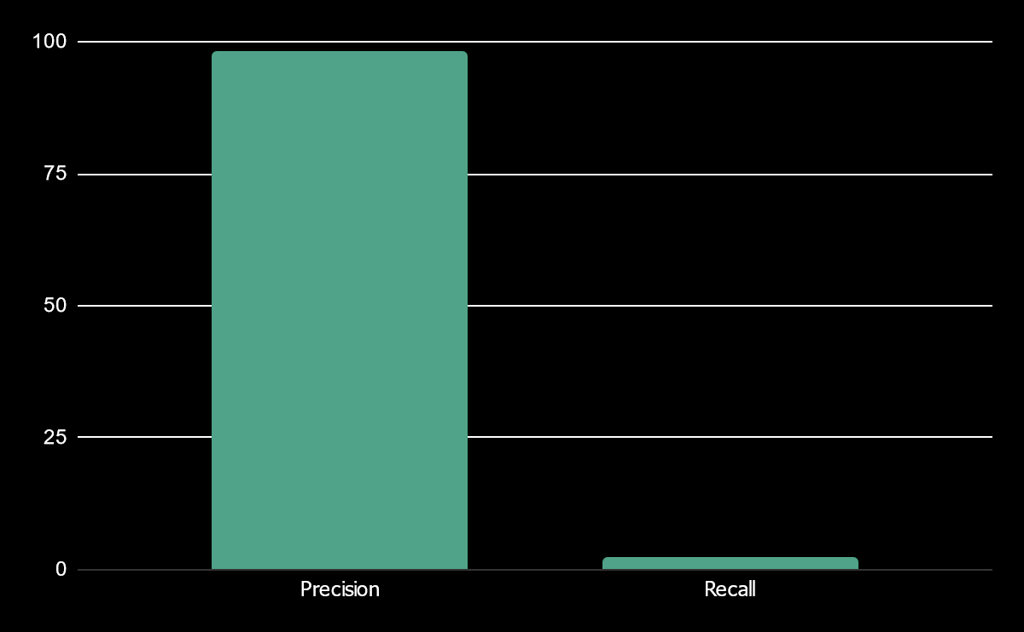
Phase results
4%
F1 Score
Notes:
The results of the 3D-CNN is a precision of 98%, but a recall of 2%
Overall F1 score of 4%
Why is this happening?
Most notably there is a poor class imbalance within colorectal data, some phases being heavily underrepresented.
Smaller phases being around 0.05 seconds, and others being around 20 seconds. With the time before and after key phases being much longer
This imbalance makes it difficult for the model to learn meaningful features for the underrepresented phases, leading to skewed or inaccurate predictions.

Slide 13
In the future
Notes:
To address this, data augmentation could be employed to balance the dataset.
Either through cropping surgical videos to better fit the phase annotations provided,
Or using augmentation techniques such as rotation, scaling, and flipping to create synthetic data of the less represented classes.
- Additionally, feature extraction performance is not as high as it could be.
Ideally classification would be above 90% in both accuracy and F1 score.
This could be done by obtaining more annotations for the colorectal data, allowing for further finetuning, or testing on the colorectal dataset.
Unfortunately, due to time constraints I was not able to address any of these improvements

Slide 14
CNN
03
Given automatically calculated VPDT, how closely can a CAT score be approximated?
Notes:
Nor was I able to address the third objective, however, an additional CNN could be used to fit the VPDT to manually assessed CAT

Slide 15
Thanks!
Any questions?

