Slide 1



RFM analysis: inferences from transactional datasets
Rory Owen Bennett, Ruiqi Sheng, Saket Vishwas Mokashi and Zhou Zhou

Slide 2
The final picture
Our initial approach and ideas for the first dataset.
How we progressed with the project beyond our first presentation, refining our ideas and producing our report utilising both datasets.

Slide 3
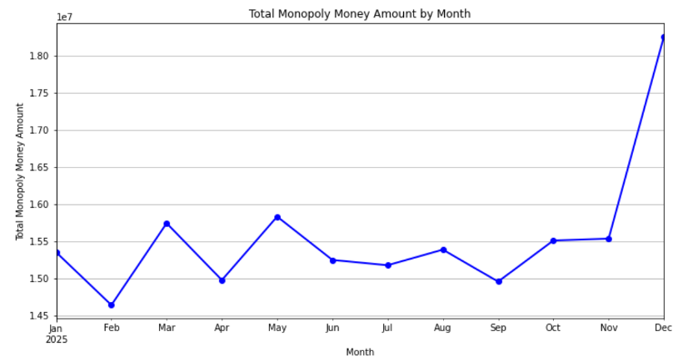
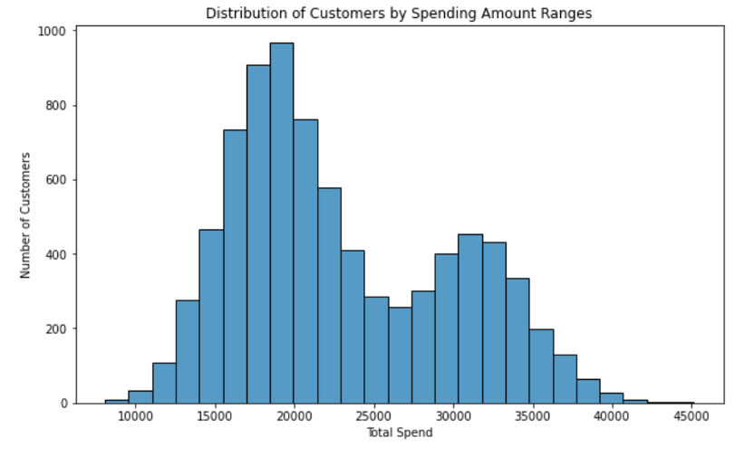
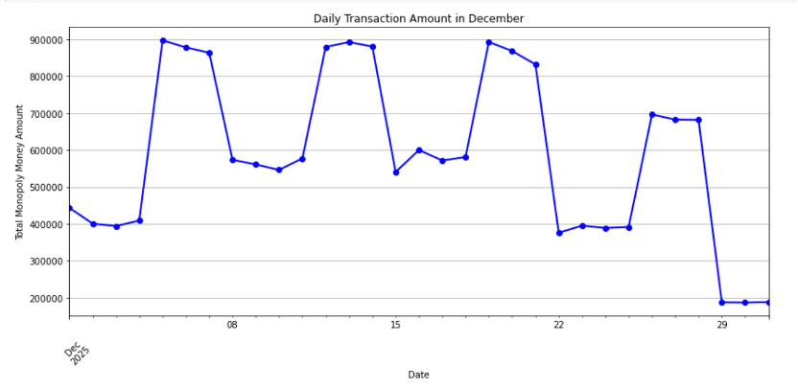
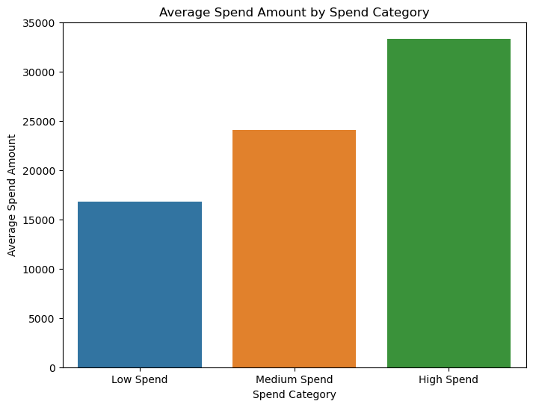
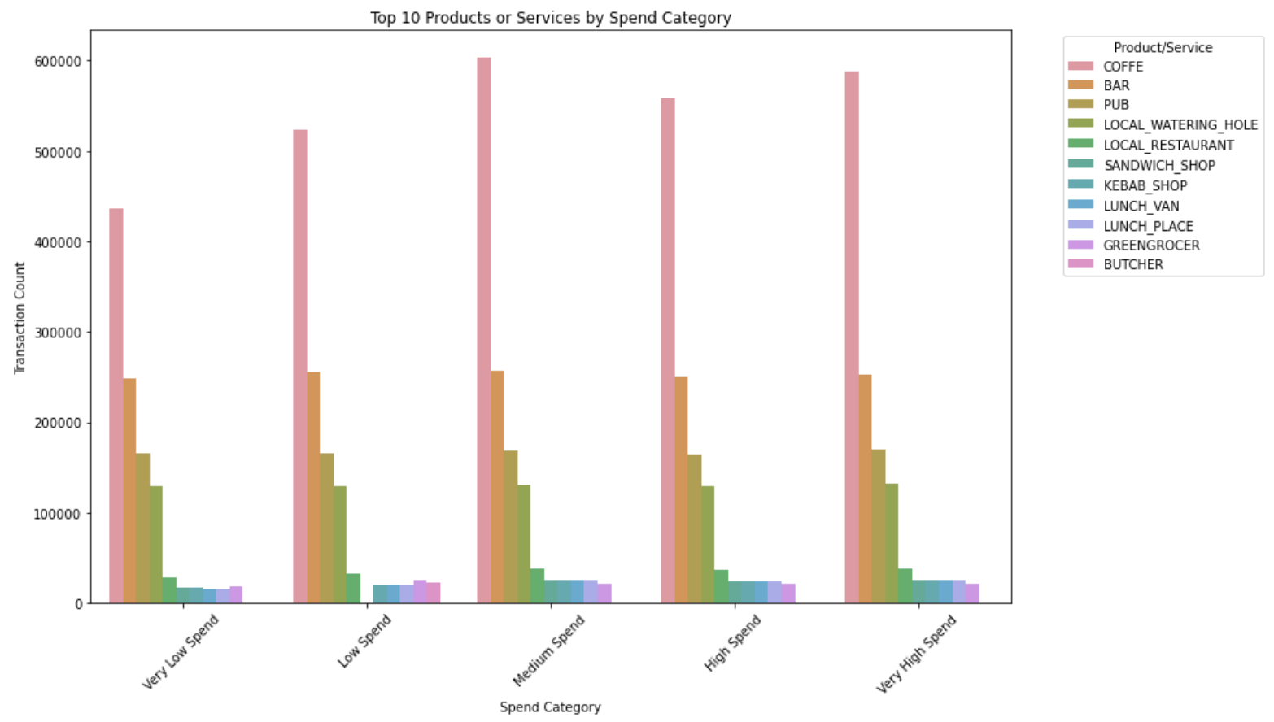
Exploring the data – Dataset 1

Slide 4
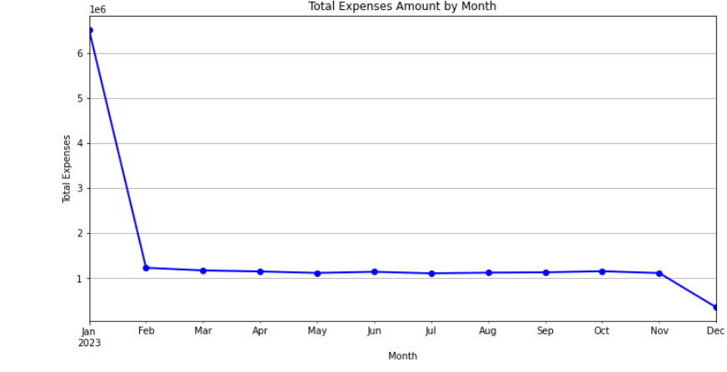
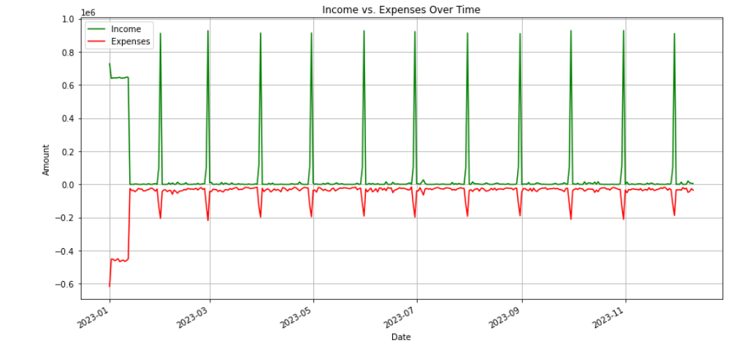
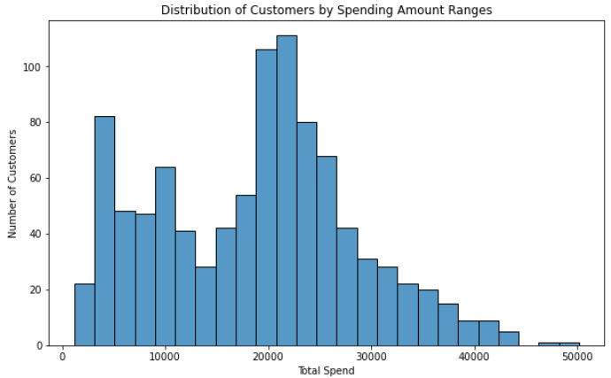
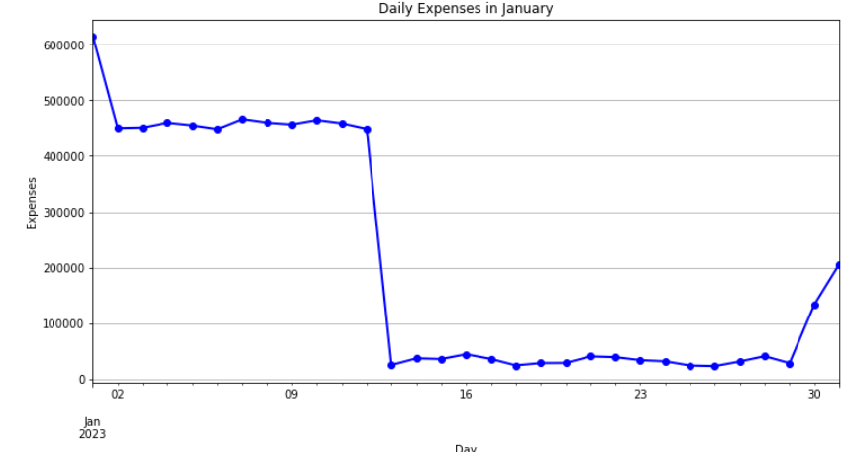
Exploring the data - Dataset 2

Slide 5
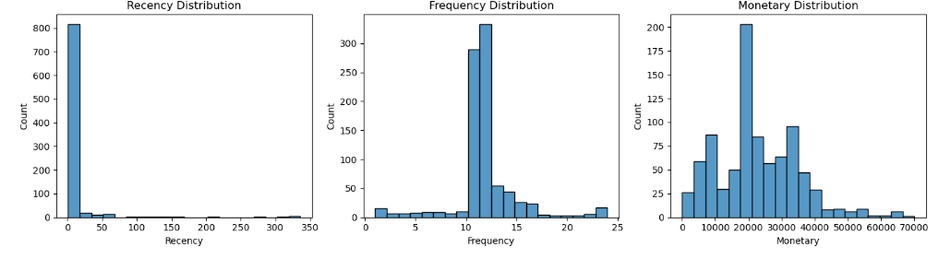
RFM Modelling – what and why?

Slide 6
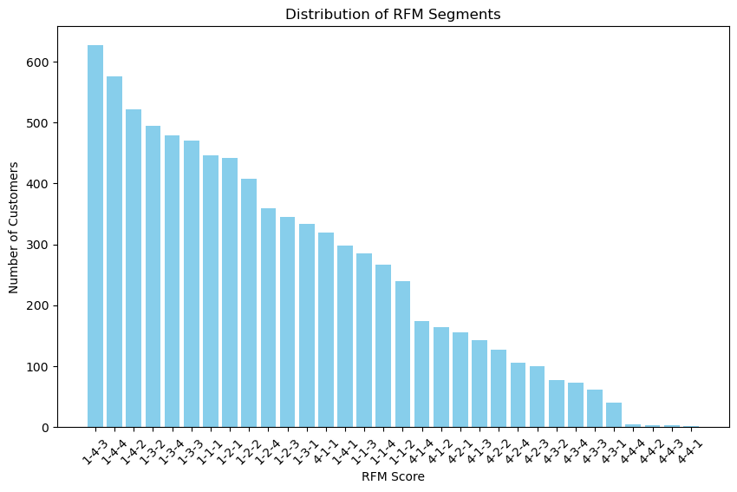
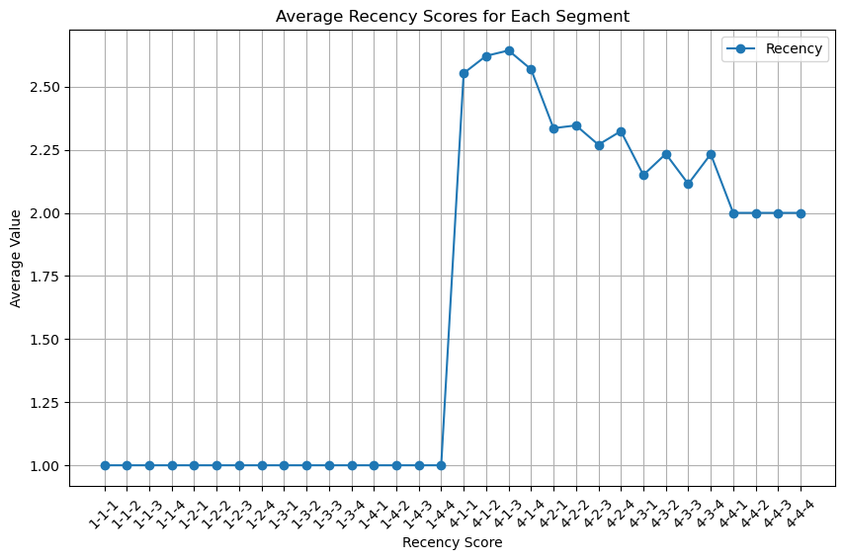
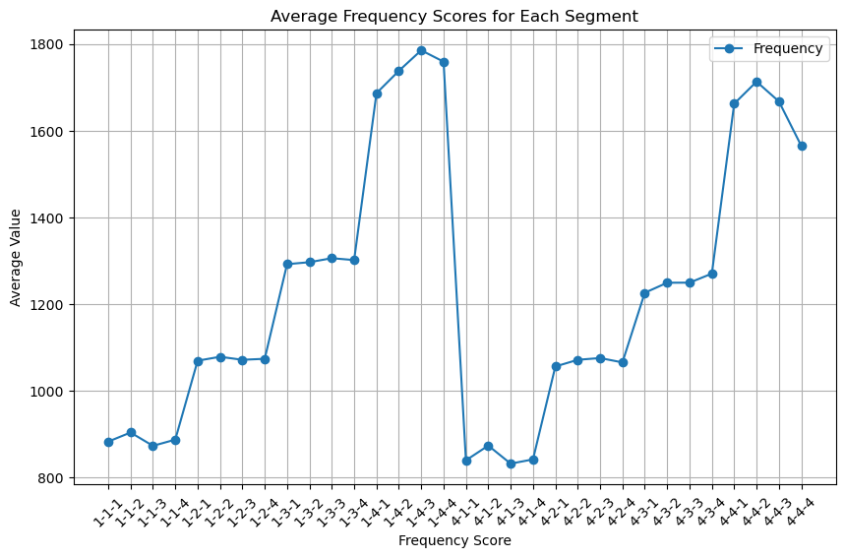
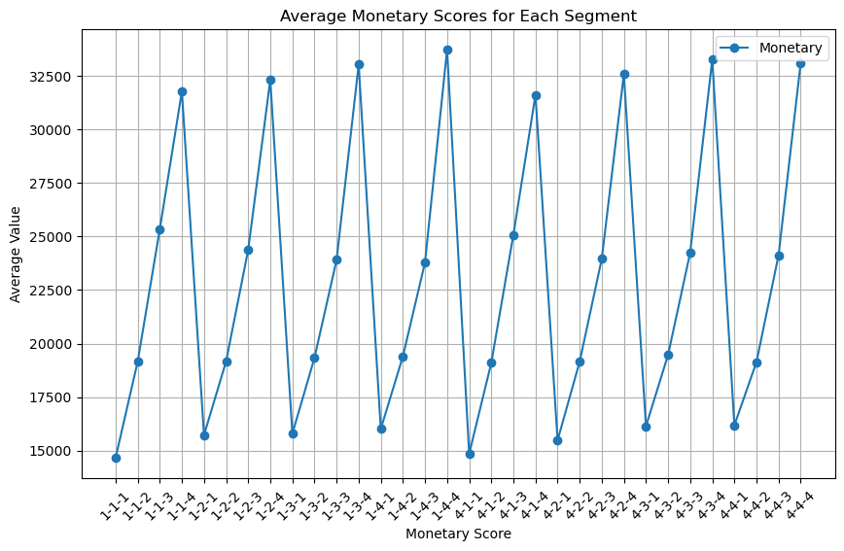
RFM Modelling – Dataset 1
RFM Score | Customer Count | Mean Recency | Mean Frequency | Mean Monetary
1-1-1 | 446 | 1 | 883 | 14665
4-4-4 | 4 | 2 | 1565 | 33090

Slide 7
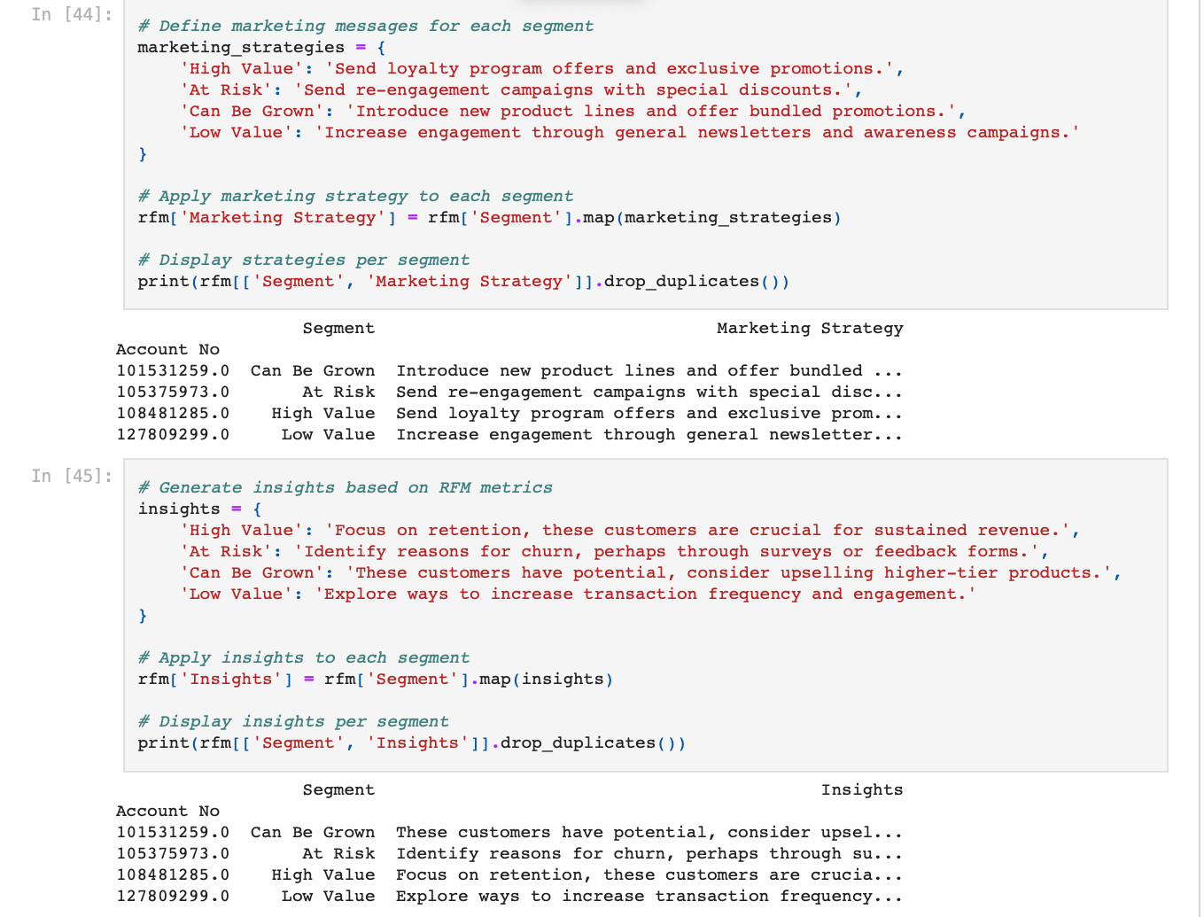
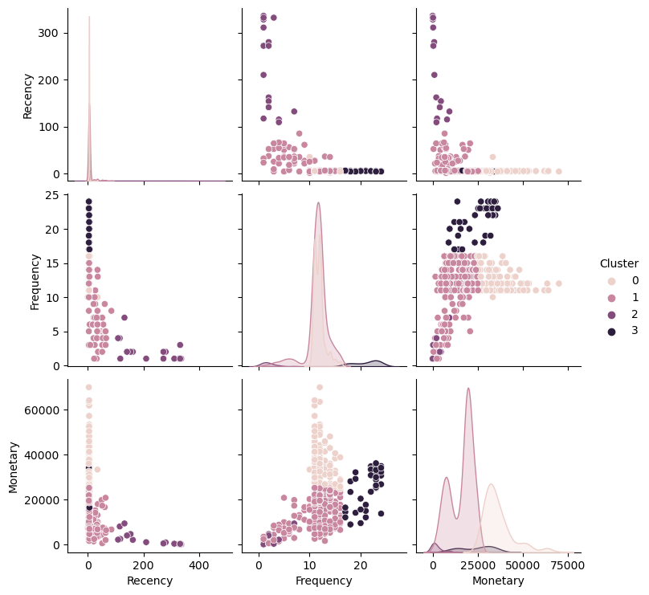
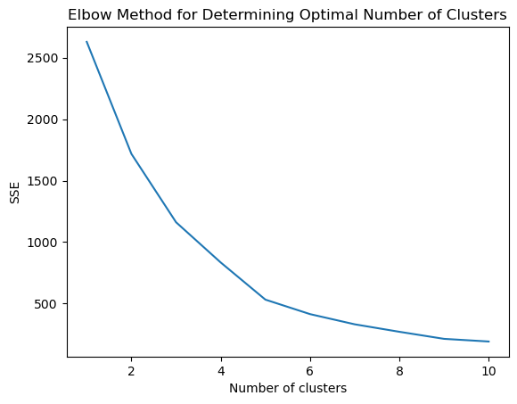
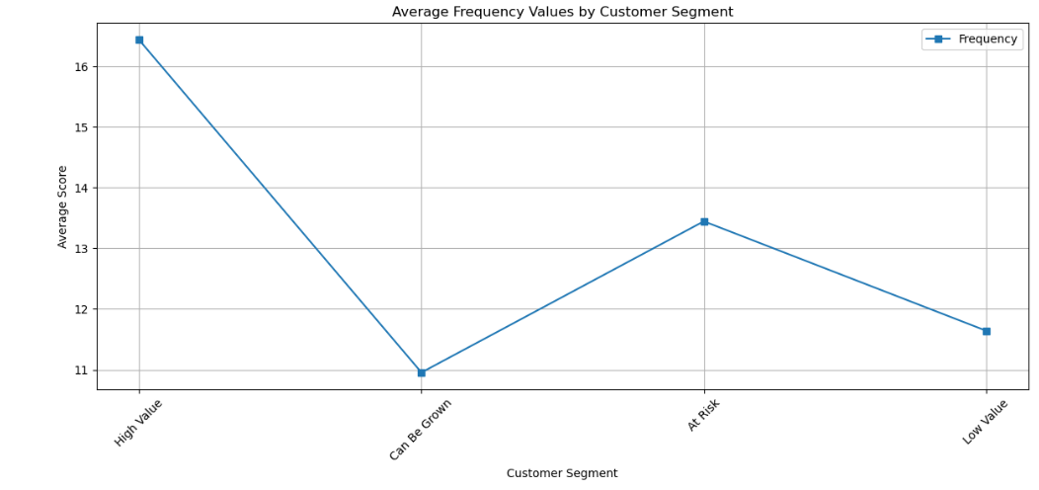
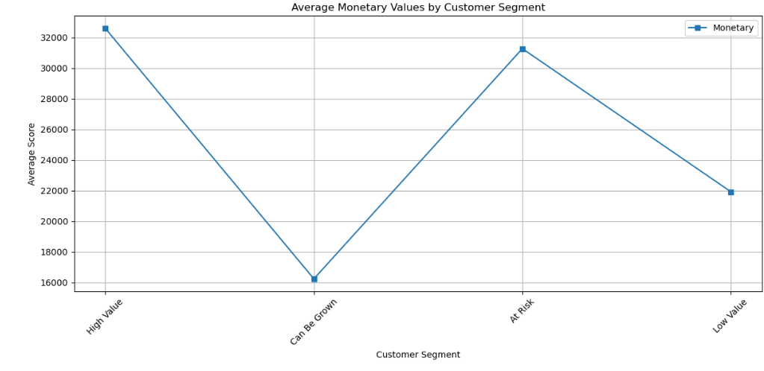
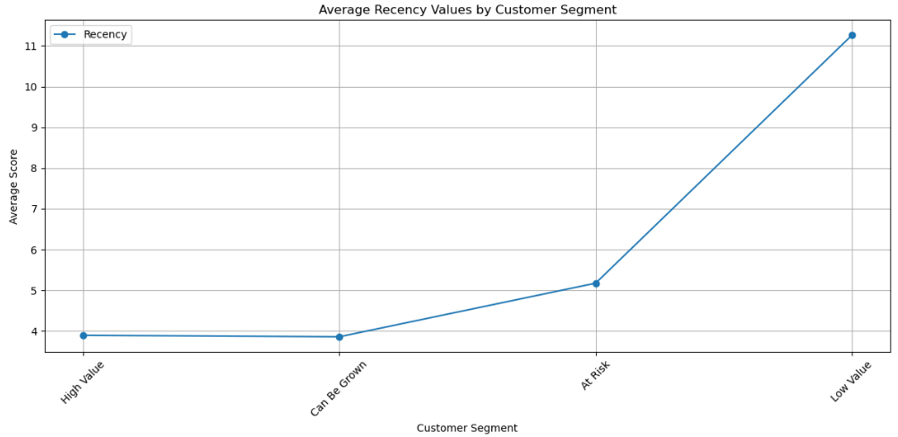
RFM Modelling – Dataset 2

Slide 8
Improvements, further work and conclusions
What would we do differently next time?
What should future literature hope to address?
What have we concluded on this topic from our research?

