Slide 1
CSC4006 Research Project
Rory Flynn 40259039
Using approximate matching and machine learning to uncover malicious activity in logs.

Slide 2
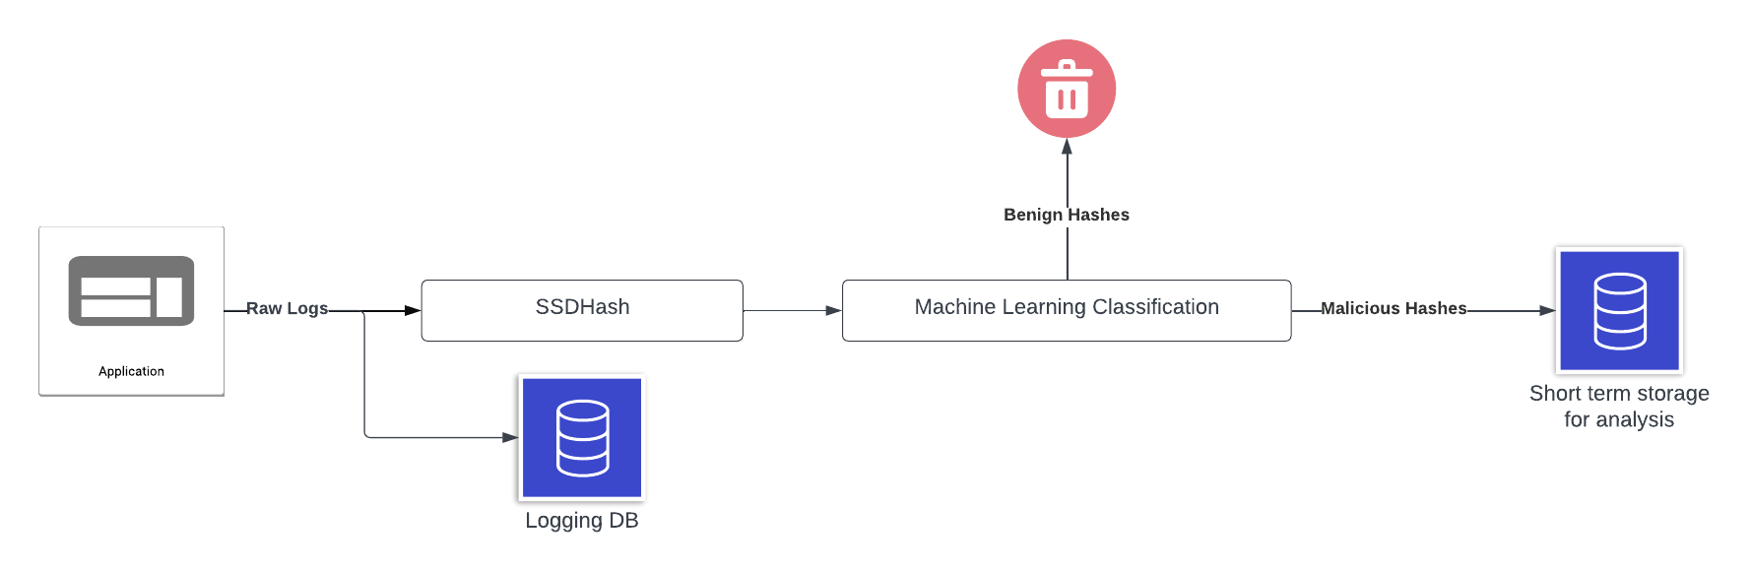
Overview of research
Using Approximate matching and machine learning to uncover malicious activity in logs
The research consisted of two main parts:
Developing a novel fuzzy hashing algorithm SSDHash tailored for semi-structured data.
Utilising this algorithm as the input component of a ML log classification engine HashAnalyser to identify malicious records.

Slide 3
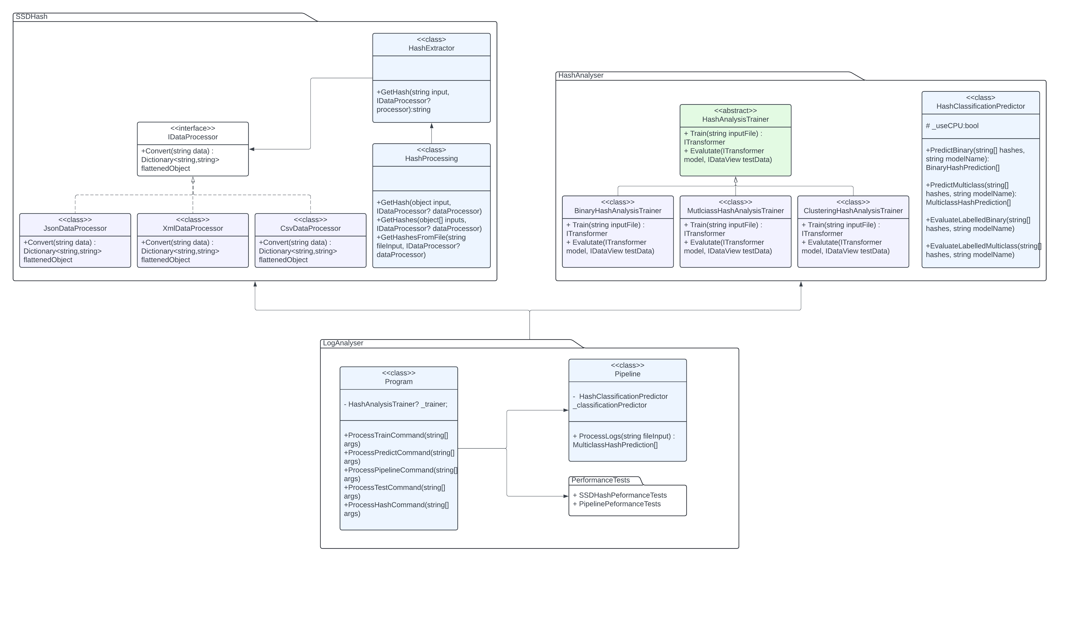
Architecture overview

Slide 4
SSDHash
Locality-Sensitive Fuzzy Hashing Algorithm

Slide 5
Why is there a need for SSDHash?
During the research it was demonstrated that existing industry standard approximate matching algorithms including ssdeep, sdhash and TLSH struggle with semi-structured data.
These algorithms were designed to operate on files or binary data, for tasks such as fragment detection.
These algorithms struggle on semi-structured data for two main reasons:
Size – in comparison to their designed inputs, semi-structured objects are typically quite small.
Format – semi-structured data contains a lot of syntactical and structural information that is necessary to define the structure and relationships within an object.

Slide 6

SSDHash Overview
SSDHash is a locality-sensitive approximate matching algorithm developed as a part of the conducted research.
The algorithm inspired by JSONHash, was designed to provide a universal representation of the content of semi-structured data objects.
The core operation of the algorithm is mapping similar objects into buckets to generate a digest.
SSDHash

Slide 7
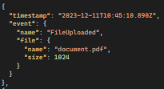



How Does SSDHash Work?
Artifact processing:
Object deserialization & flattening – Transform a semi-structured object as a series of key-value pairs, prepending parent objects’ names to the field name to preserve the relative structure.
Removeable datatypes – Data types such as IDs and timestamps are removed.
Tokenizing values – Separates values on common separator characters to produce an array of tokens.
Prepending keys to tokens – Each fields key is then prepended to the beginning of the value, producing the final representation of the data before digest generation.

Slide 8
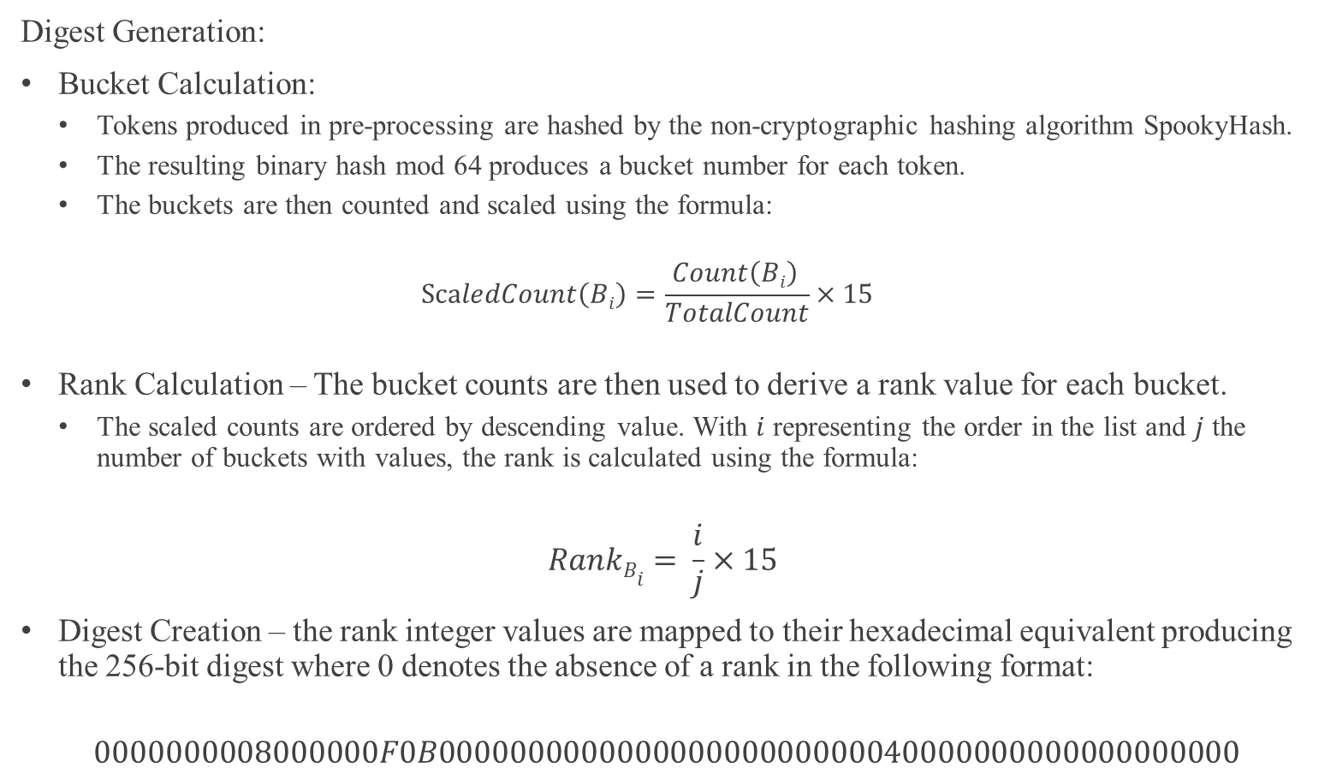
How Does SSDHash Work?
Digest Generation:
Bucket Calculation:
Tokens produced in pre-processing are hashed by the non-cryptographic hashing algorithm SpookyHash.
The resulting binary hash mod 64 produces a bucket number for each token.
The buckets are then counted and scaled using the formula:
$$ScaledCount\left(Bi\right)=\frac{Count\left(Bi\right) }{TotalCount}×15$$
Rank Calculation – The bucket counts are then used to derive a rank value for each bucket.
The scaled counts are ordered by descending value. With $i$ representing the order in the list and $j$ the number of buckets with values, the rank is calculated using the formula:
$$RankBi= \frac{i}{j}×15$$
Digest Creation – the rank integer values are mapped to their hexadecimal equivalent producing the 256-bit digest where 0 denotes the absence of a rank in the following format:
$$0000000008000000F0B000000000000000000000000040000000000000000000$$

Slide 9
SSDHash Demo

Slide 10
HashAnalyser
Machine Learning Classification Engine

Slide 11
ML assisted approximate matching overview
Conventional approximate matching algorithms use similarity scores to measure “distance” between hashes to gauge similarity. This process typically entails counting common fragments, with measures such as Jaccard Index used frequently.
With the advancements in machine-learning in recent years, several research papers have focused on incorporating these technologies with the goal of improving the digest comparison stage.
This approach leverages the superior pattern matching capabilities of machine-learning when compared to conventional similarity scores to classify objects based on their fuzzy hashes.
Here we introduce the second aspect of the research which focuses on utilising the fuzzy hashes of network logs produced by SSDHash to classify logs based on their behaviour.

Slide 12
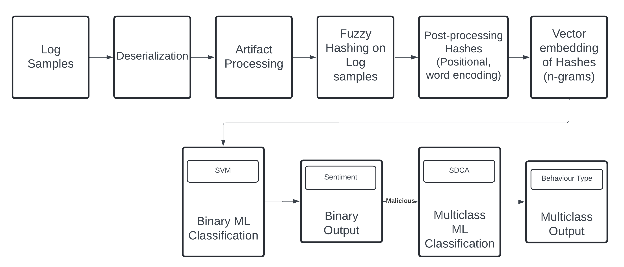
Hash analyser overview
The developed framework was developed completely in C#, utilising ML.NET and TorchSharp (C# wrapper of PyTorch) to create classifiers.
The framework consists of two classifiers to perform multi-stage classification on the fuzzy hashes of log inputs.
The first classifier (SVM) essentially operates as a filter and was trained to distinguish normal use from potentially malicious activity, with the records deemed malicious passed to the second classifier.
These malicious records are then classified by a multi-class model (SDCA) to categorise their behaviour into one of three types: Denial of Service, Command and Control or Port-Scan.

Slide 13
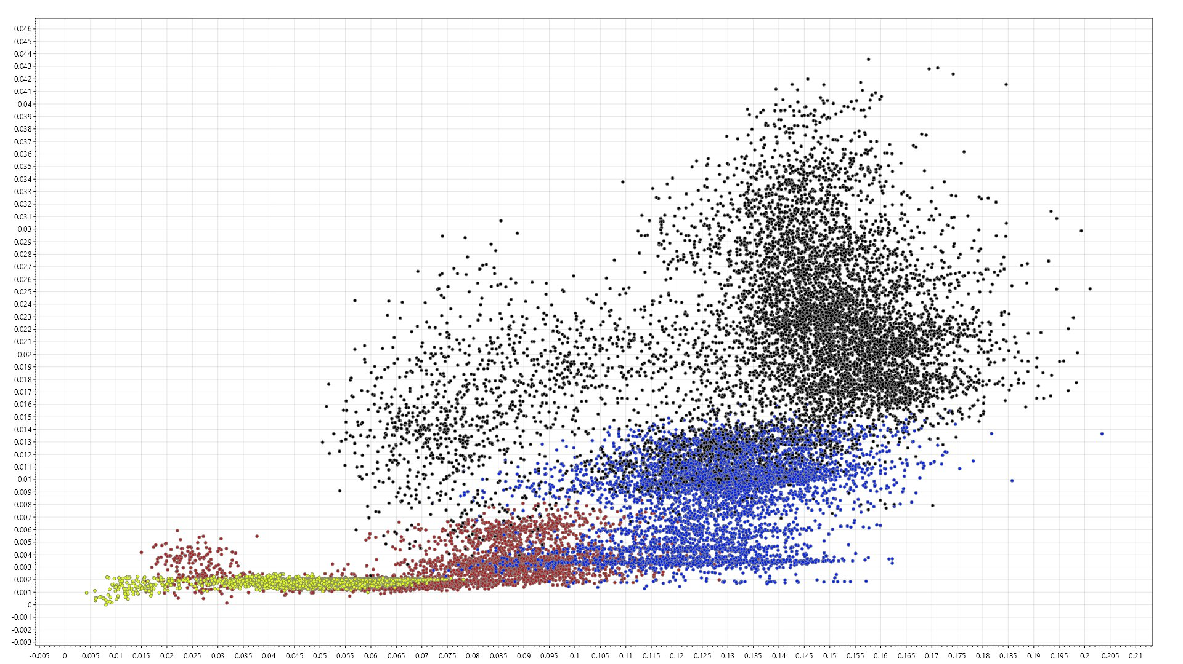
Data overview
The dataset utilised was a 104,693-record dataset of network logs of IoT devices that are contributing to a botnet.

Slide 14
Encoding
During the conducted research one-hot encoding and a custom word encoding were tested to assess the effect these have on a classifier. The results suggest that utilising some encoding that captures position is a necessity when working with fuzzy hashes as without it we lose valuable information held within each hash.
There lies one primary difference between the utilisation of these two encodings in that one-hot encoding only captures positional information. This means it necessitates the use of an additional feature input to capture the contextual information within the hash.
Word Encoding - Incorporates position and value of each character in the hash by mapping each to a unique word.
One-Hot encoding - each character within the fuzzy hash vector is represented as a binary vector, where only one element is hot (set to 1) and all others are cold (set to 0).
Hash | C00000B0
Word Encoding | This Thousand Toward Two Violence Weight Woman World
One-Hot Encoding | [1,0,0], [0,1,0], [0,1,0], [0,1,0], [0,1,0], [0,1,0], [0,0,1], [0,1,0]

Slide 15
Vector embedding of fuzzy hashes
In the case of the final version of the framework it was decided to utilise the forementioned positional word encoding method. However, both encoding methods utilise n-grams (3) in their feature columns, with this being the only input for the case of the word encoding method. To effectively use one-hot encoding the one-hot vectors are concatenated with the n-grams of the hashes before they are vectorised producing the feature input.
Encoded Hash | 3-Grams
“This Thousand Toward Two Violence Weight Woman World” | “This Thousand Toward”, “Thousand Toward Two”, “Toward Two Violence”, “Two Violence Weight”, “Violence Weight Woman”, “Weight Woman World”

Slide 16
Classification Results – Binary model
Results on test set for the Binary classifier using word encoding:
Metric | Result
Accuracy | 0.97
Recall | 0.97
Precision | 0.99
F1 | 0.98
AUC | 0.99

Slide 17
Classification Results – Multi-class model
Results on test set for the multi-class classifier using word encoding:
Accuracy | Log-Loss | Class | Recall | Precision | F1
0.99 | 0.008 | Port-Scan | 1.00 | 0.99 | 0.99
 |  | C&C | 0.99 | 1.00 | 0.99
 |  | DoS | 1.00 | 1.00 | 1.00
 |  | Average | 0.997 | 0.997 | 0.993

Slide 18
K-means Clustering Diagram

Slide 19
Log Analysis Demo

Slide 20
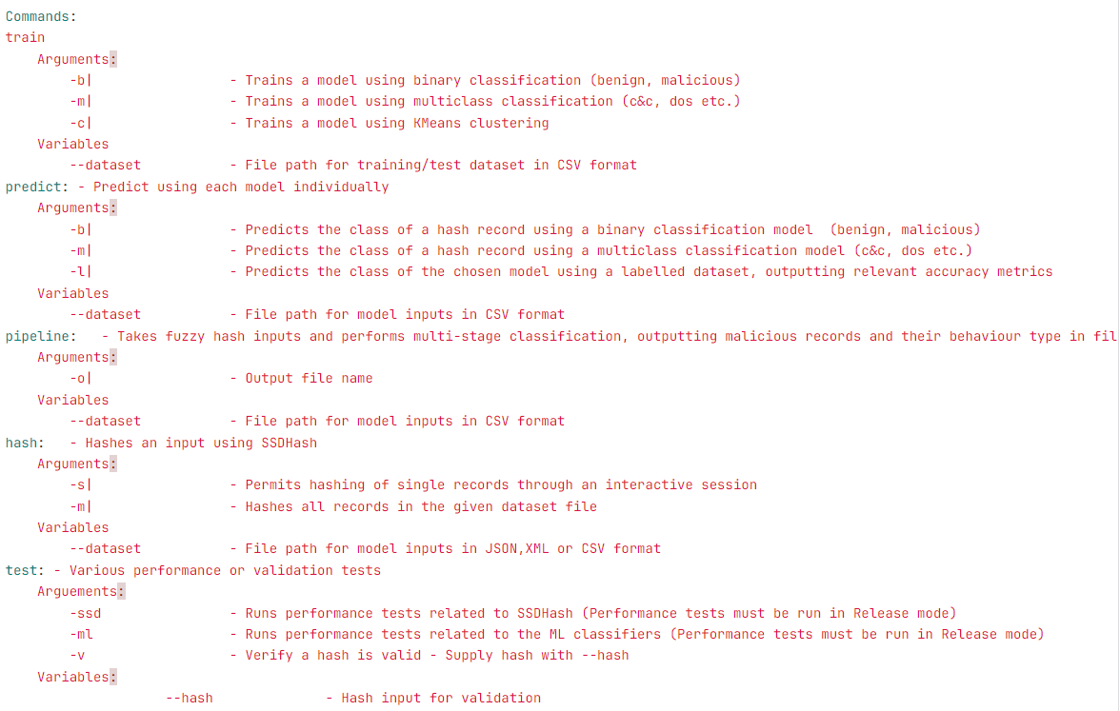
System usage

