Slide 1

How reliable and stable are species-level viral diversity estimates?
Rory Gibb, Greg Albery, Nardus Mollentze, Colin Carlson

Slide 2
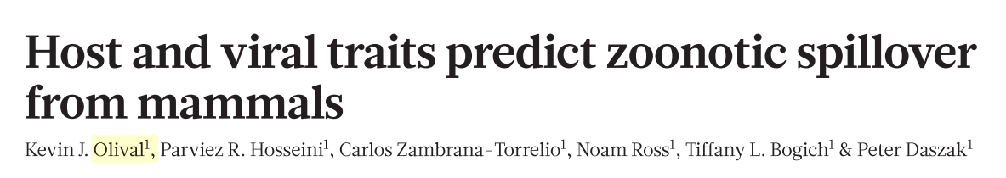
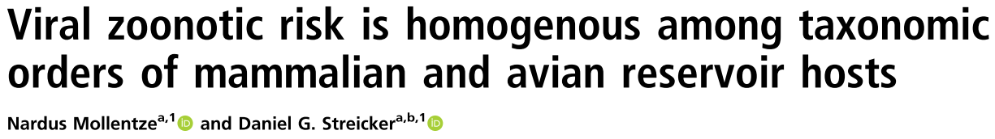
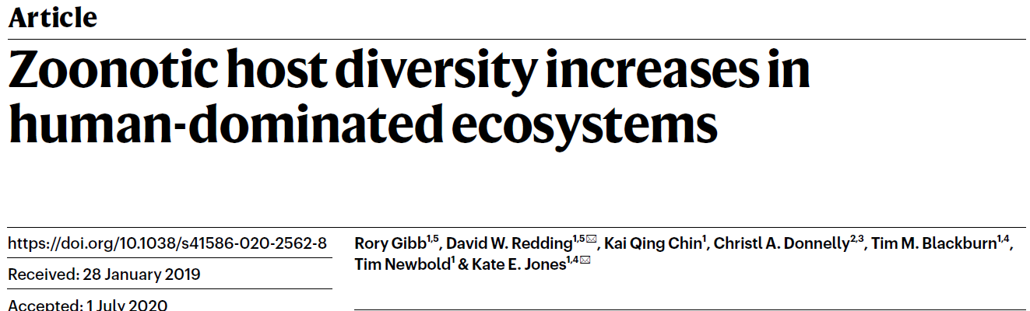
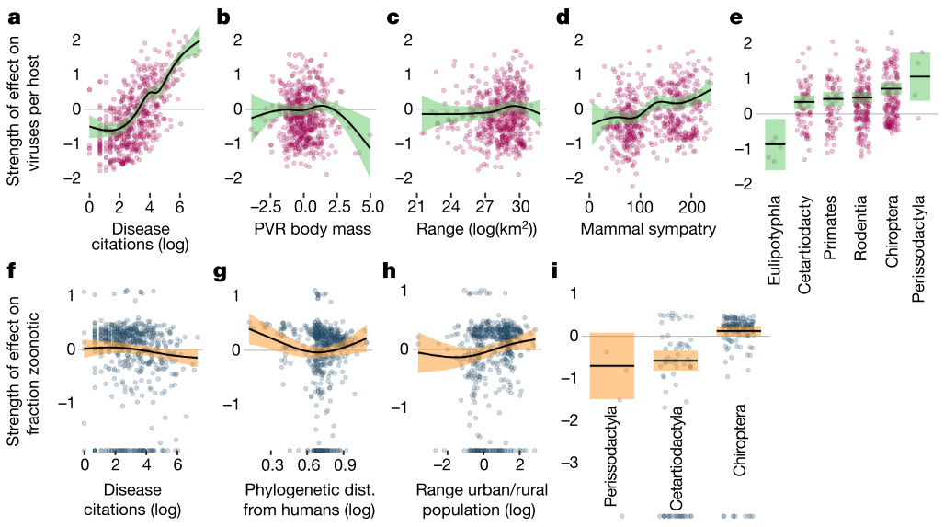
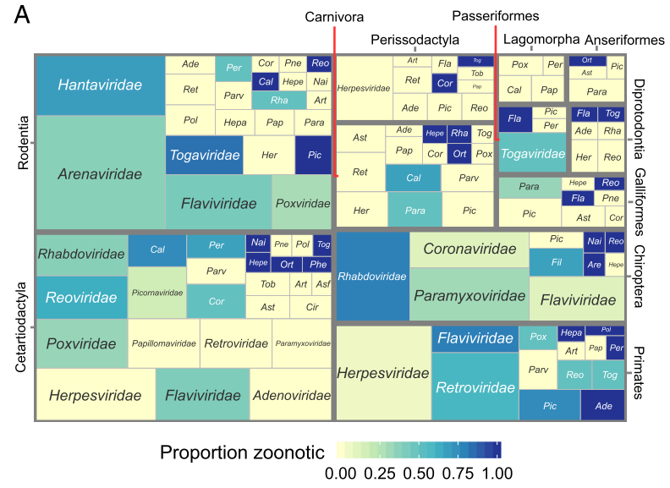
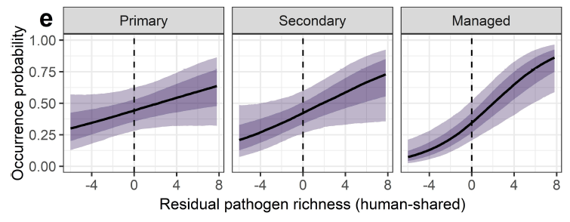
Species-level estimates of viral diversity underpin research in viral macroecology and zoonotic risk prediction
Gibb et al. 2020
Olival et al. 2017
Mollentze et al. 2020
Zoonotic pathogen richness is predicted by overall pathogen richness, which is itself predicted by a bunch of other things (citations, neutral, environmental, biogeographical, traits) that may be significant from a health and disease risk perspective
Notes:
Bolded citations here as it points to something we haven’t properly grappled with – we all accept citations are a terribly coarse proxy for detection processes but we haven’t dug into how severe this issue is

Slide 3
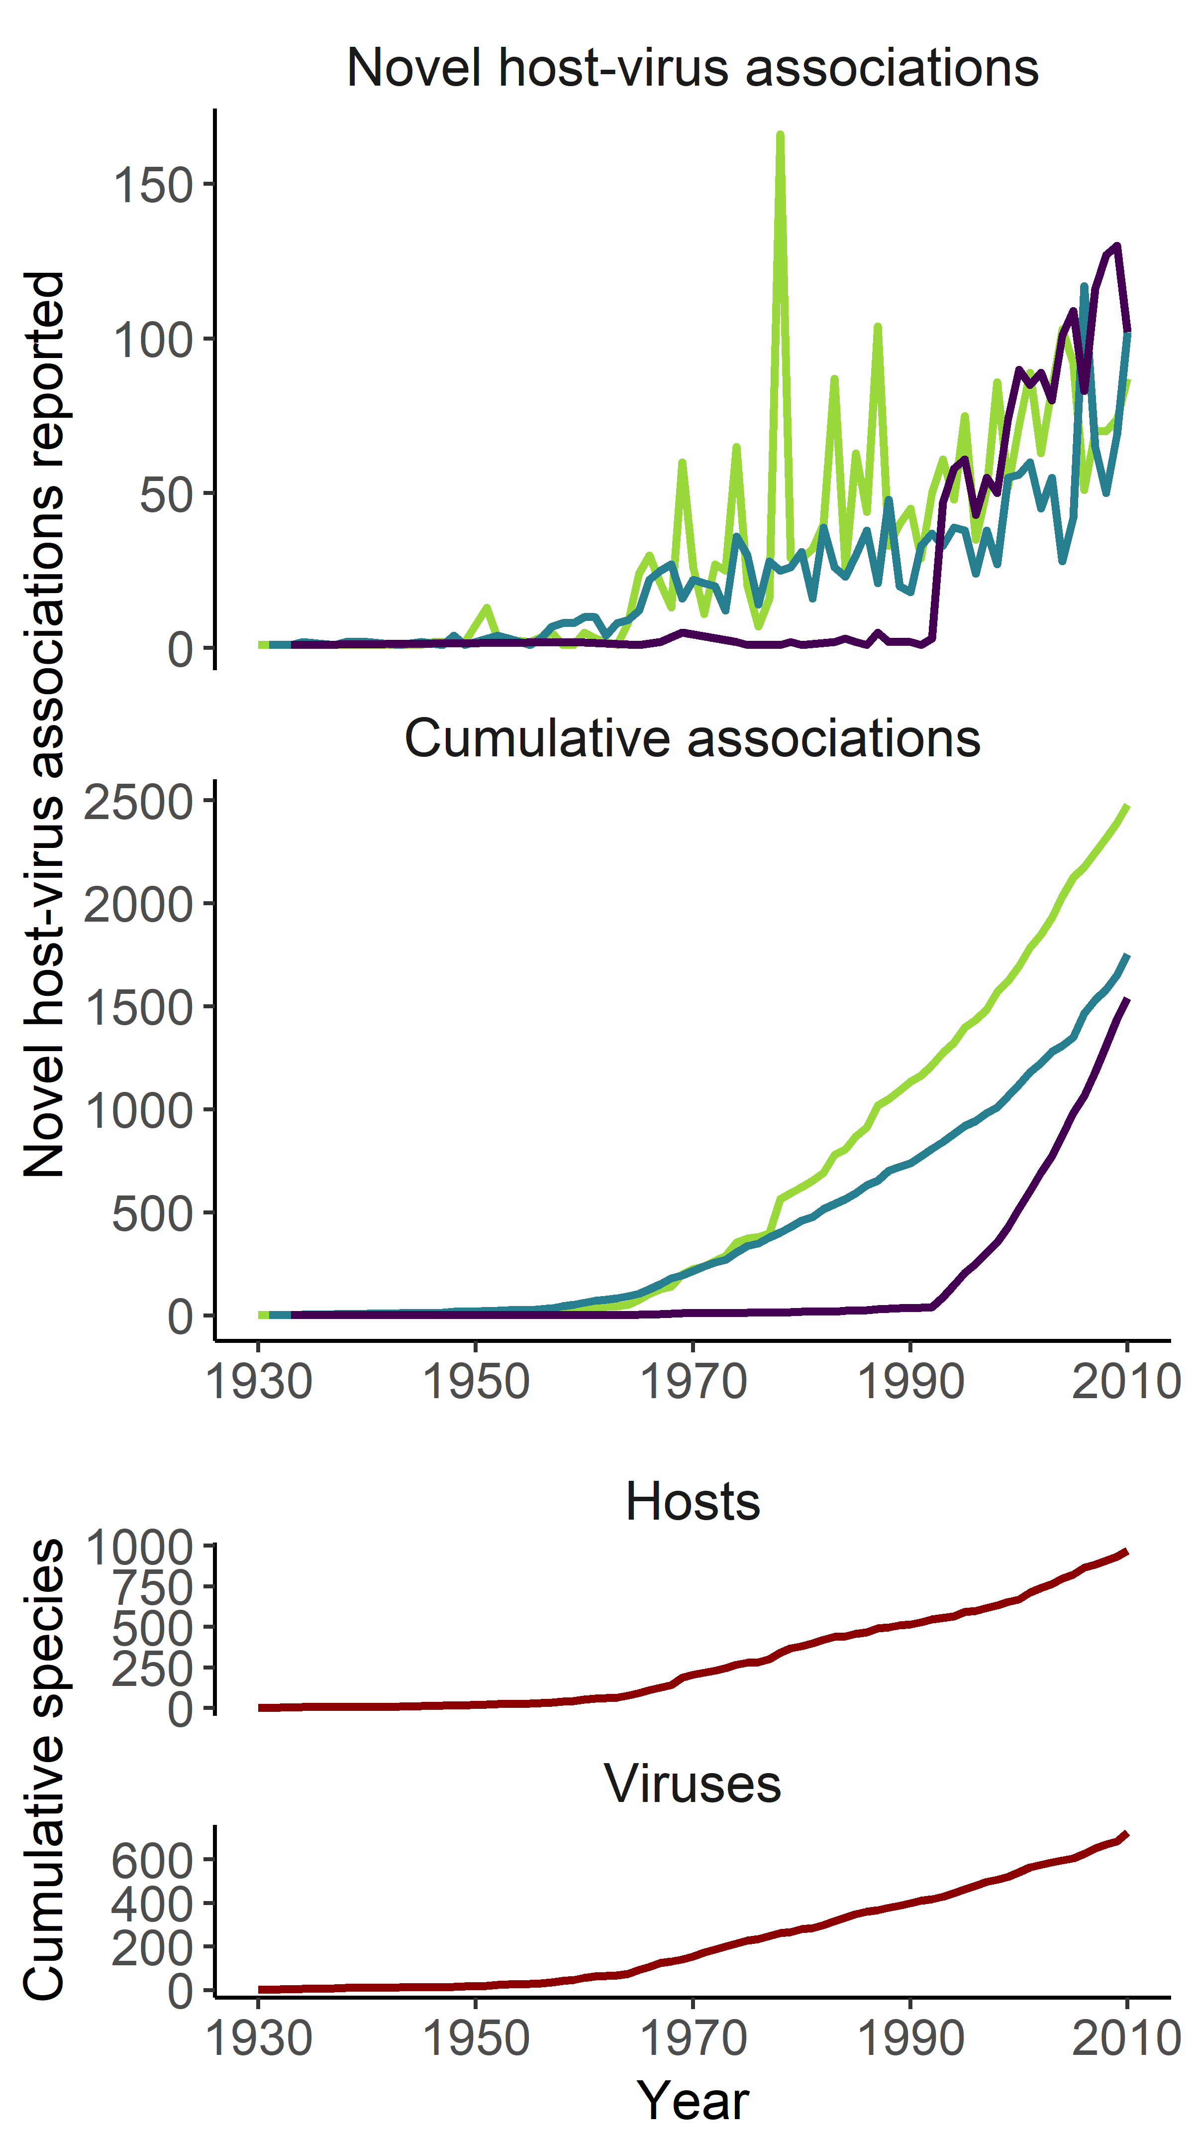
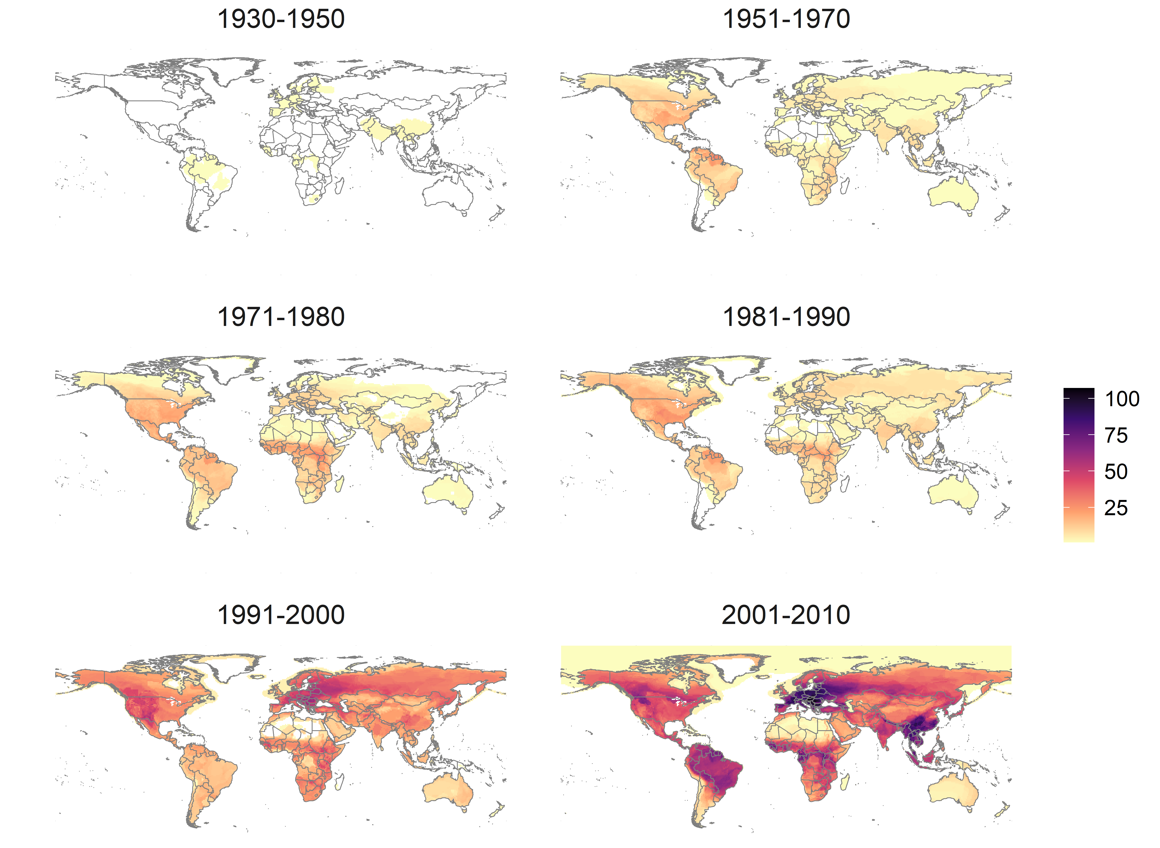
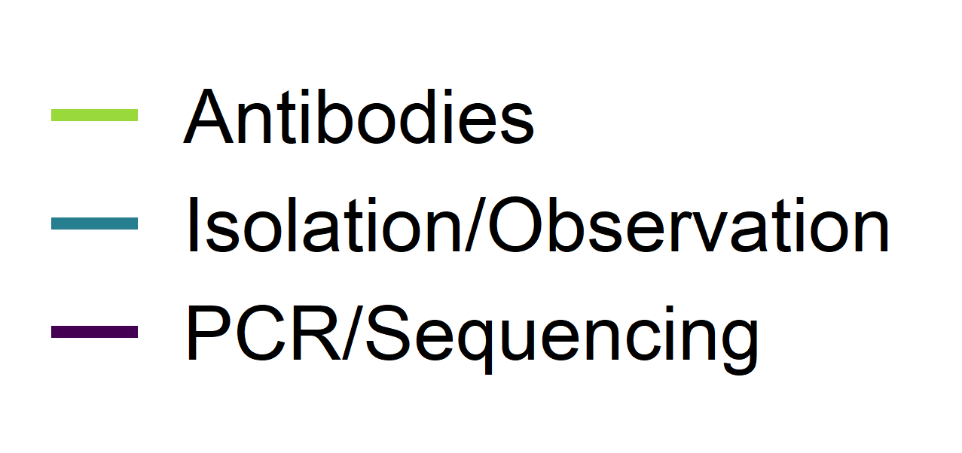

Mammal virus discovery is still in an accelerating and expanding phase
Novel host-virus associations by isolation/observation or PCR/sequencing
Notes:
Now we’ve compiled CLOVER we can look at this in some detail
Virus discovery is very much in an accelerating phase at the moment overall, and we can see how spatial biases have evolved and shifted over time
Note that most of this is also pre-PREDICT so we expect this to have really exploded post 2010

Slide 4
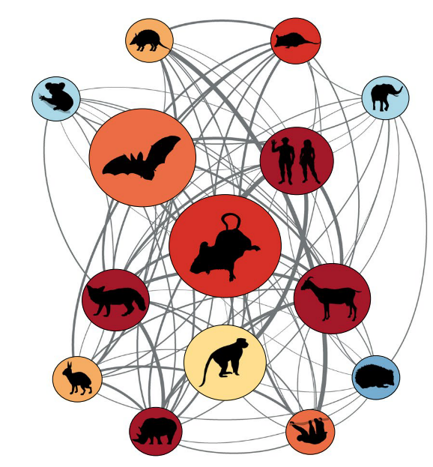
What does this mean for the reliability and stability of current mammal virus richness estimates?
or,
How historically contingent is our current understanding of viral diversity at species (and other taxonomic) levels?
Carlson et al. 2018
Notes:
So what? How can we get a handle on this? How complete are our estimates?

Slide 5
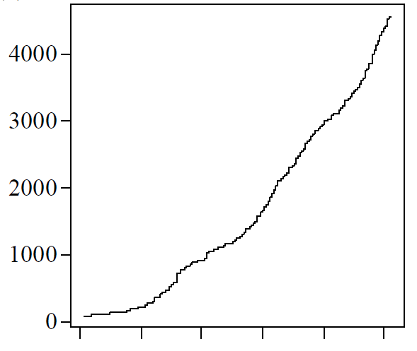
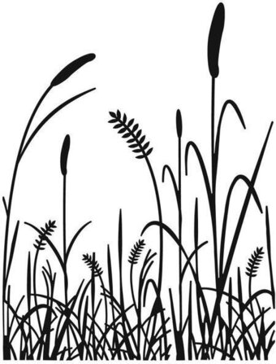
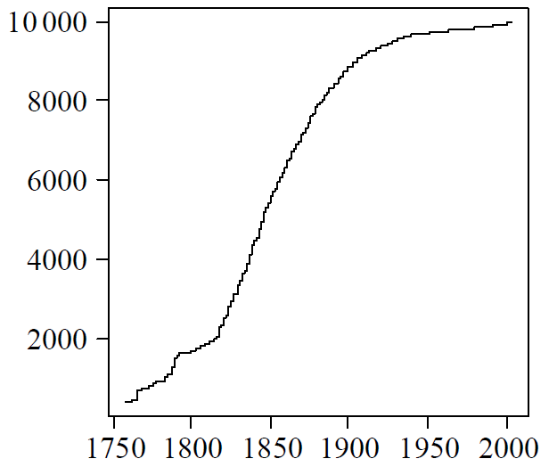

Counting species using temporal discovery curves
Cumulative species described
Year
Bebber et al., 2007
Notes:
From an ecological sampling perspective one way to get a handle on how complete/reliable we think current estimates are is by looking at discovery curves, i.e. rarefaction
Is the curve starting to asymptote? Couple of examples – new world grasses, birds of the world

Slide 6
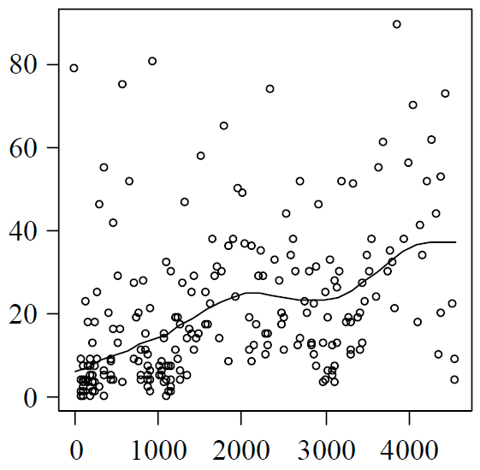
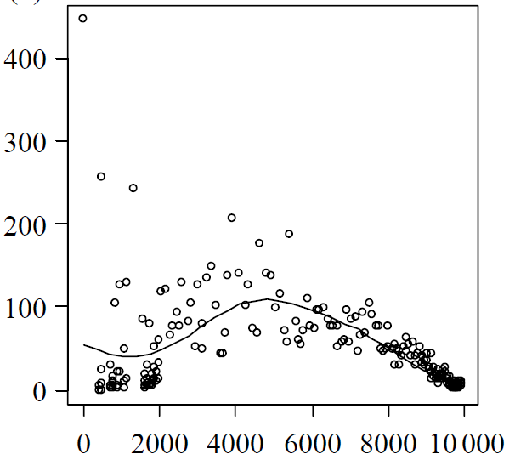
Counting species using temporal discovery curves
Cumulative species described
Species discovered in year t
Year
Cumulative species described
in year t-1
Bebber et al., 2007
Notes:
We can then look at discoveries per year – are they declining over time? Here, plot of yearly discoveries against the cumulative number of species discovered by the previous year
See discovery rates are still constant or increasing for grasses, but clear evidence of asymptote for birds – nearing completion
Generally you might use this to then estimate how many species there are when you reach the asymptote

Slide 7


Counting species using temporal discovery curves
Cumulative species described
Species discovered in year t
Year
Cumulative species described
in year t-1
Bebber et al., 2007
Notes:
We can then look at discoveries per year – are they declining over time? Here, plot of yearly discoveries against the cumulative number of species discovered by the previous year
See discovery rates are still constant or increasing for grasses, but clear evidence of asymptote for birds – nearing completion
Generally you might use this to then estimate how many species there are when you reach the asymptote

Slide 8
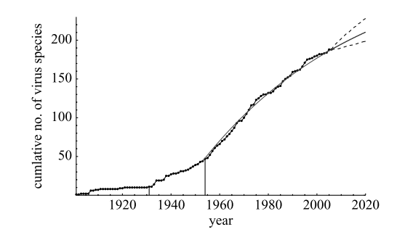
Counting species using temporal discovery curves
Human virus discovery curve to 2005
Cumulative species described
Species discovered in year t
“we [estimate] 10—40 new species to be discovered by 2020”
Woolhouse et al., 2008
Year
Cumulative species described
in year t-1
Bebber et al., 2007
Notes:
For example, Mark Woolhouse’s group have done a couple of papers like this for human viruses
This one is from 2008 where they were extrapolating to expected species to be discovered overall

Slide 9
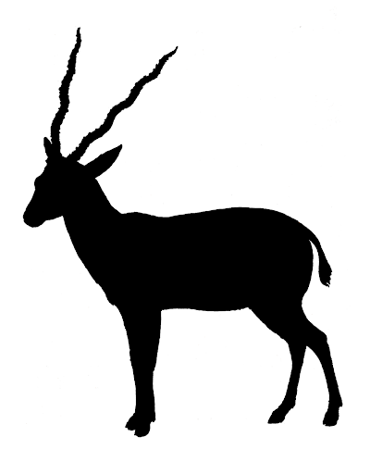
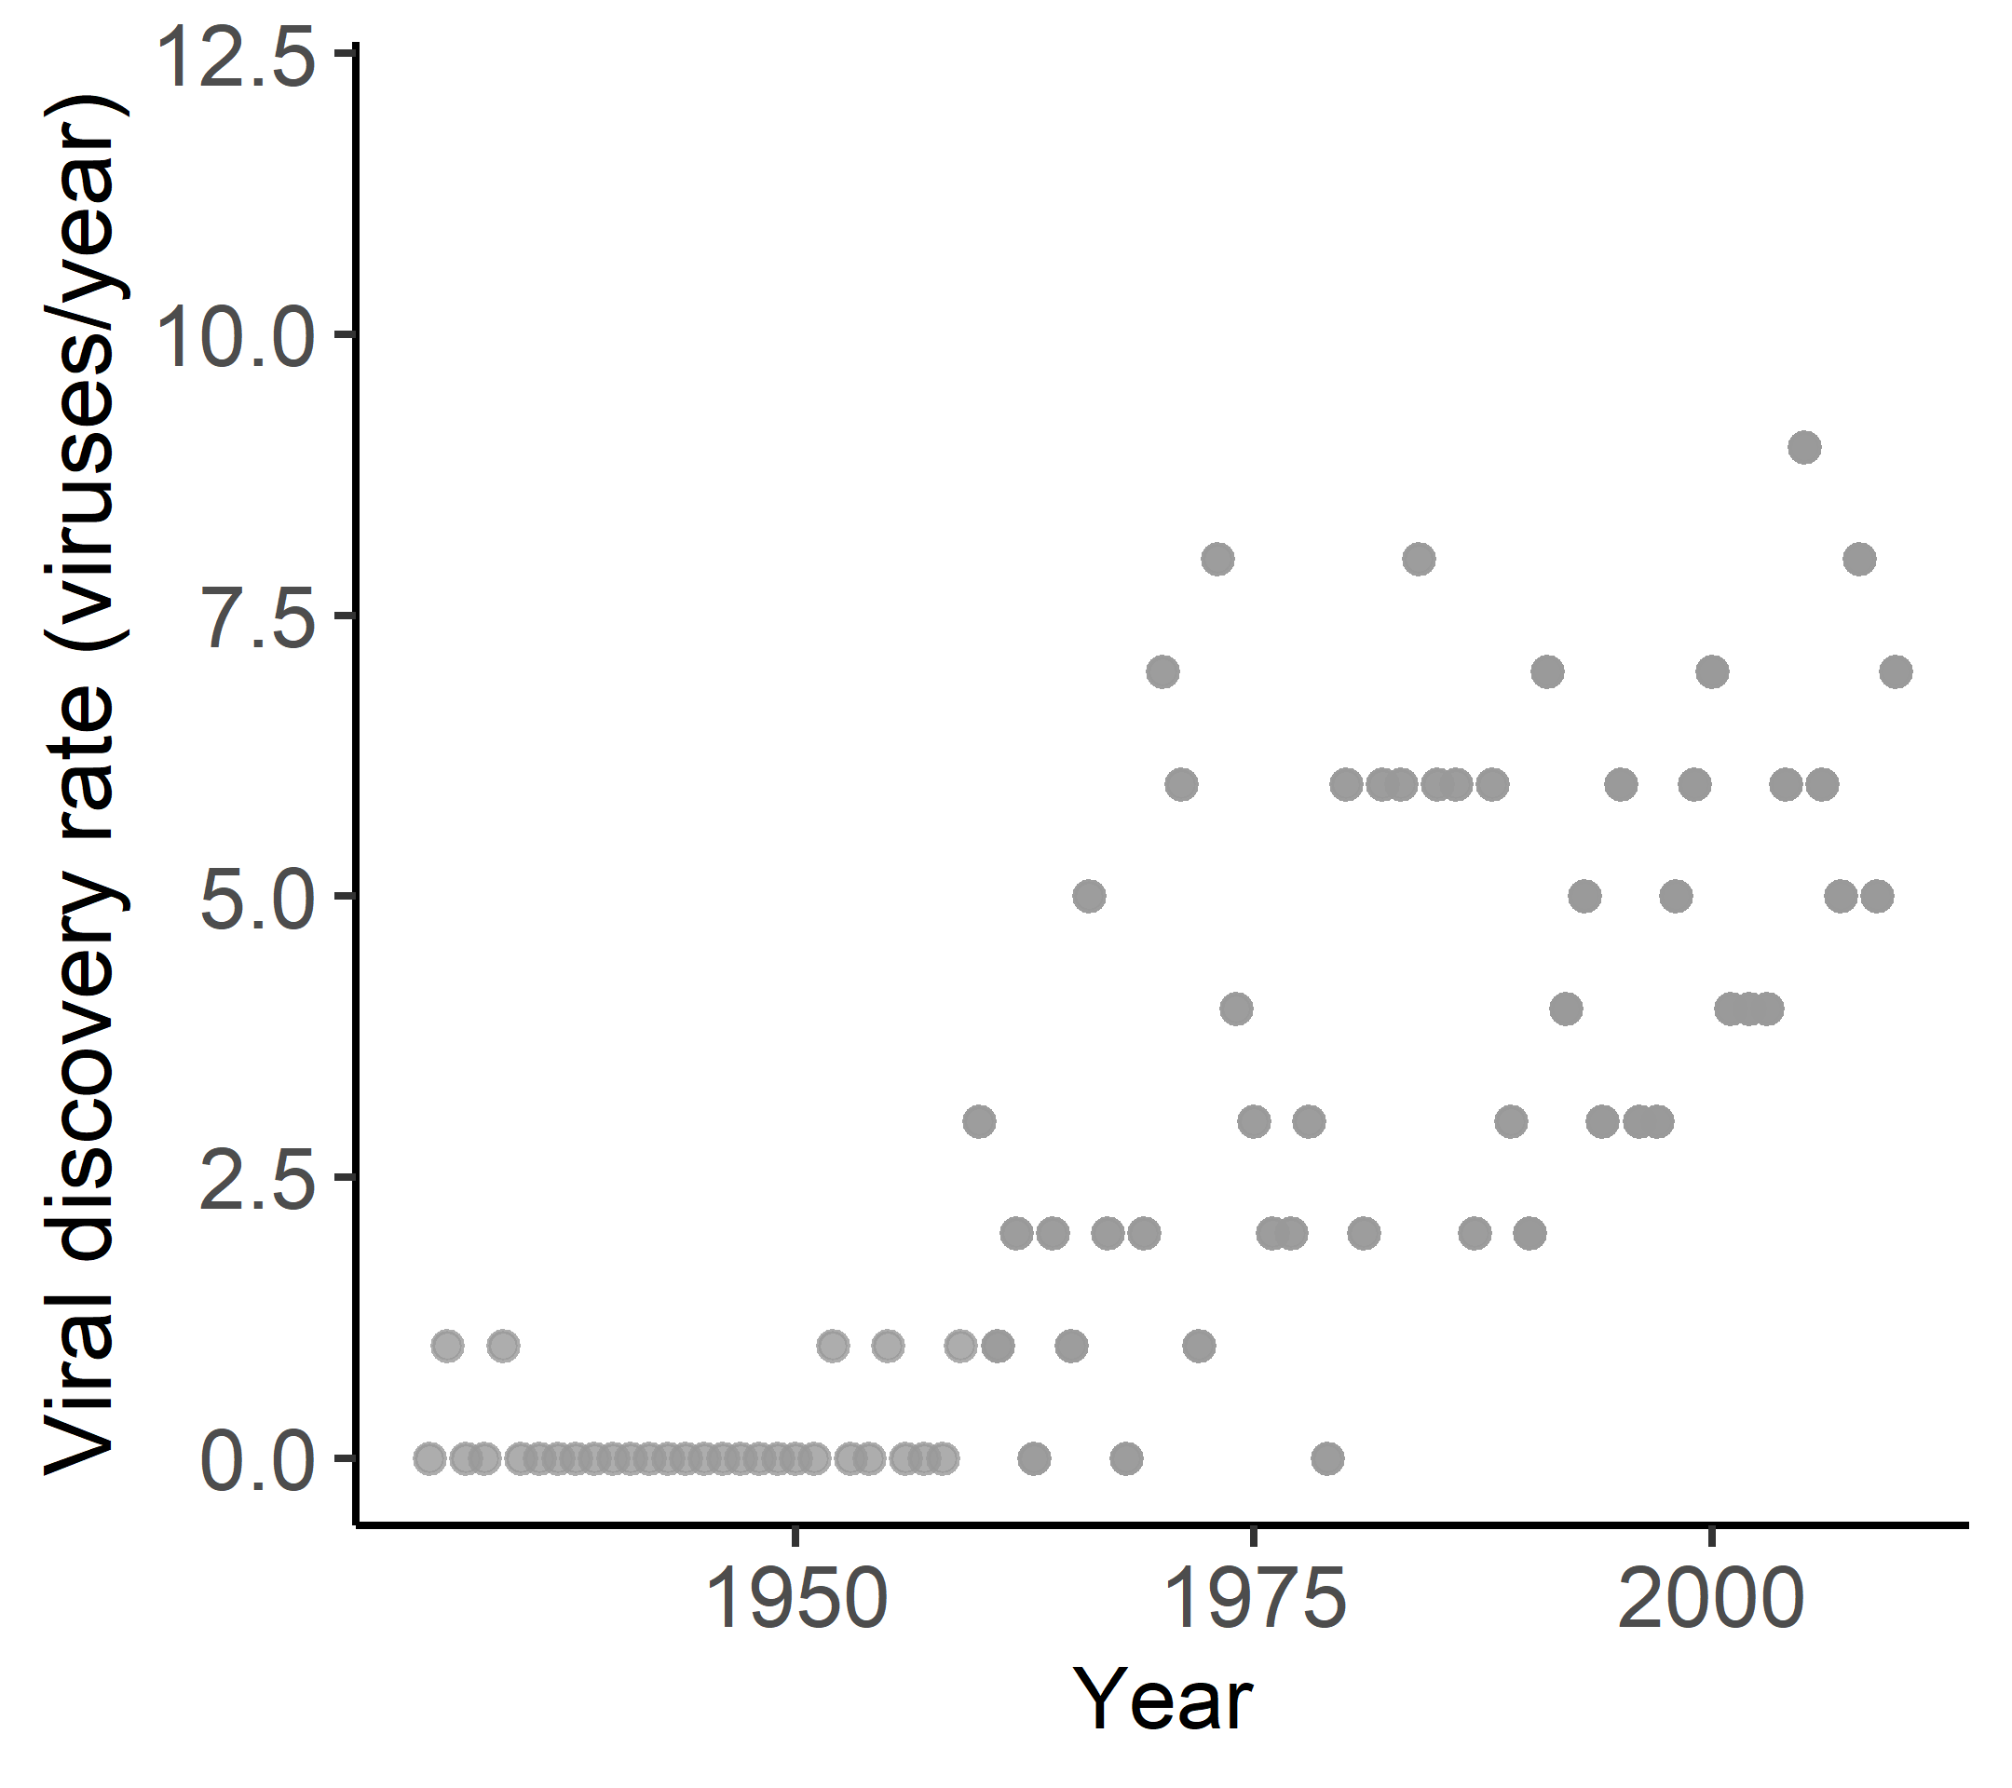
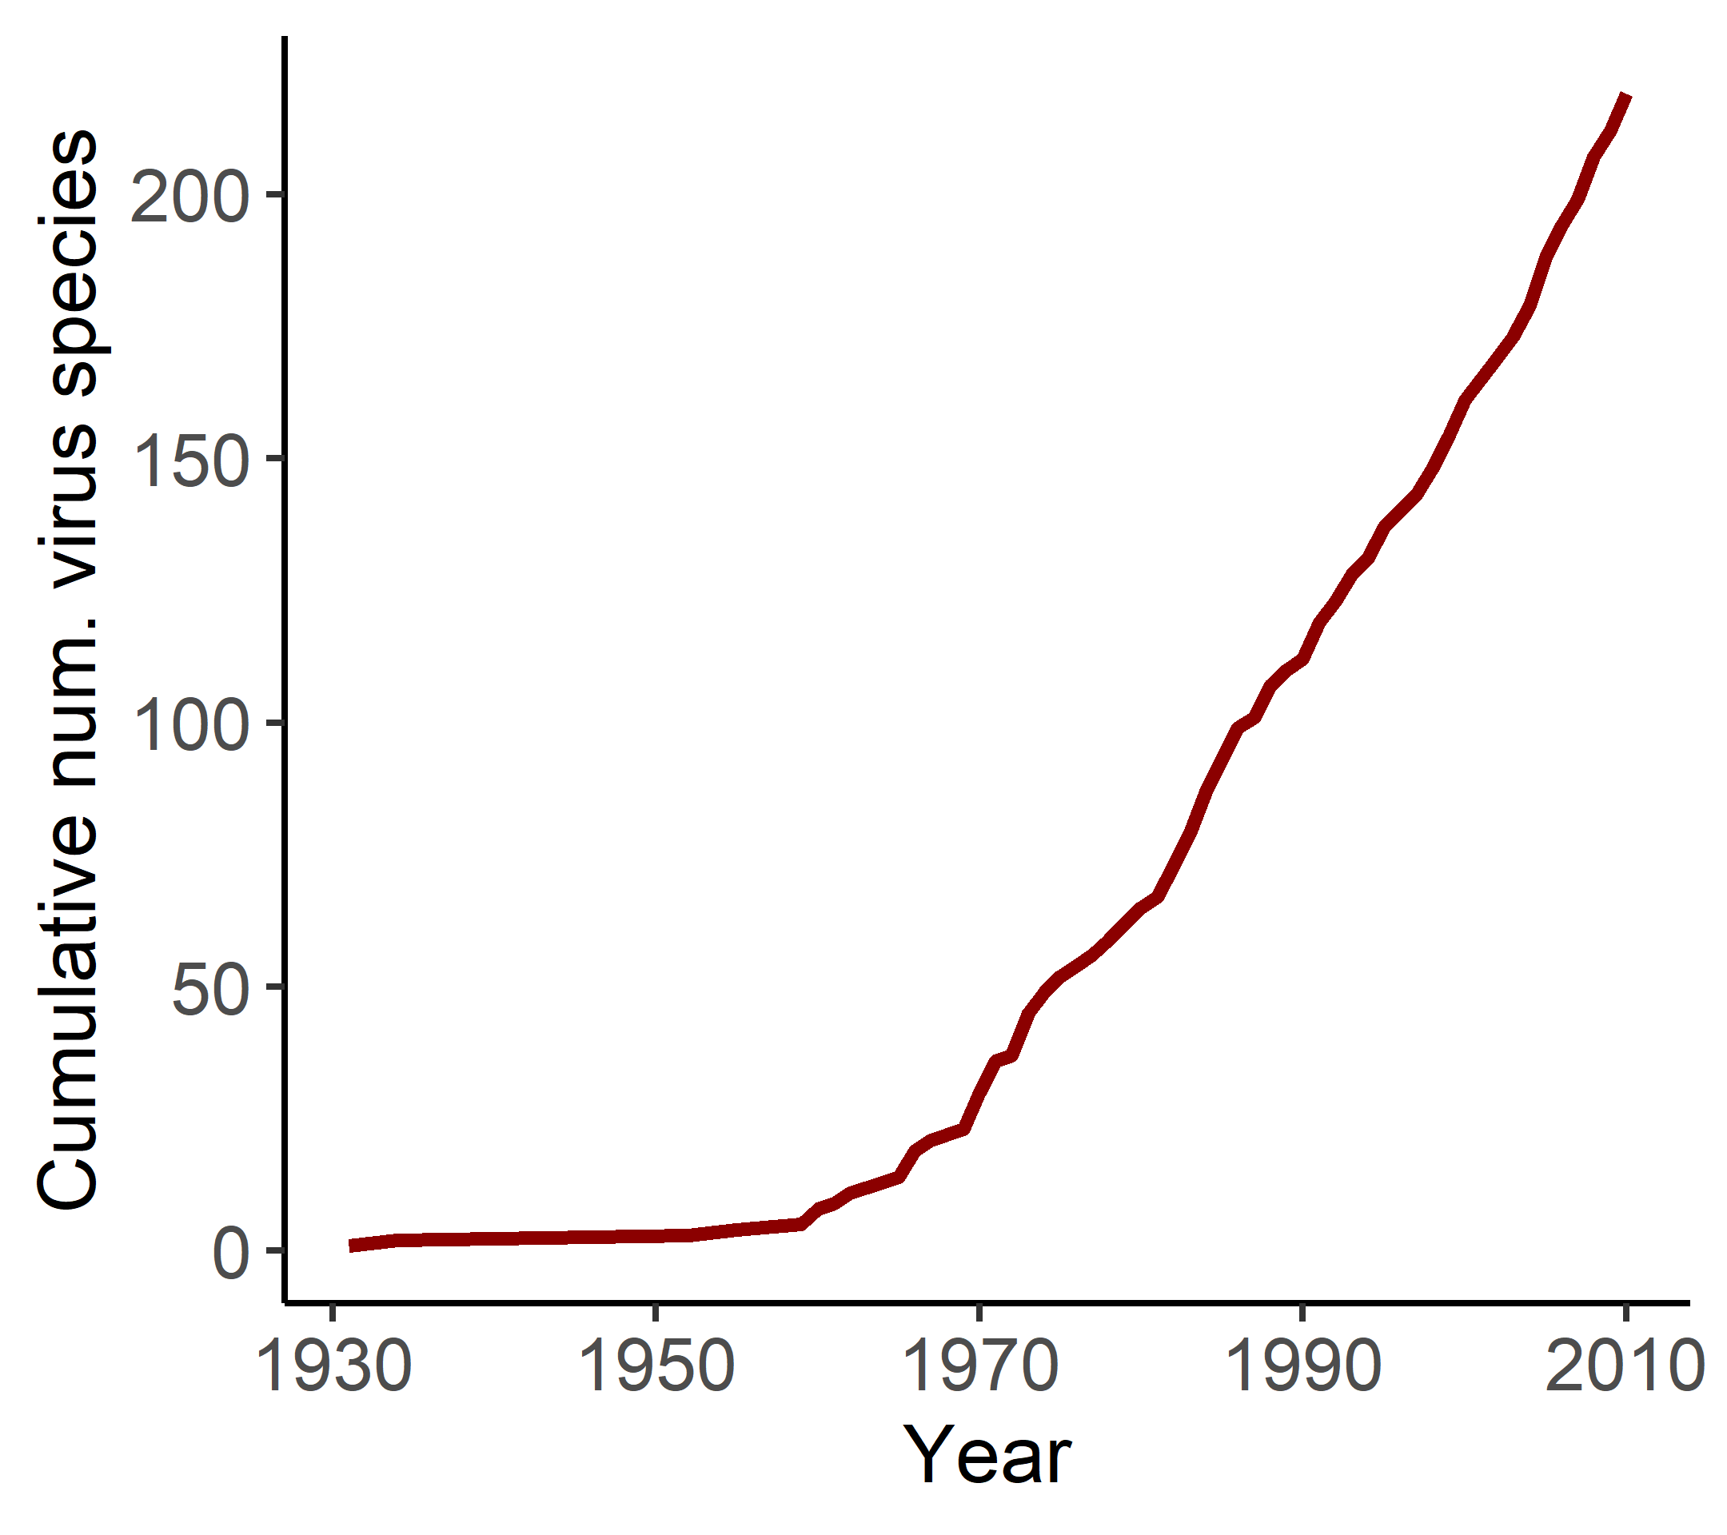
Are virus discovery rates declining in well-sampled mammal orders?
(i.e., is there any evidence they’re starting to asymptote?)
Notes:
Order cetartiodactyla

Slide 10
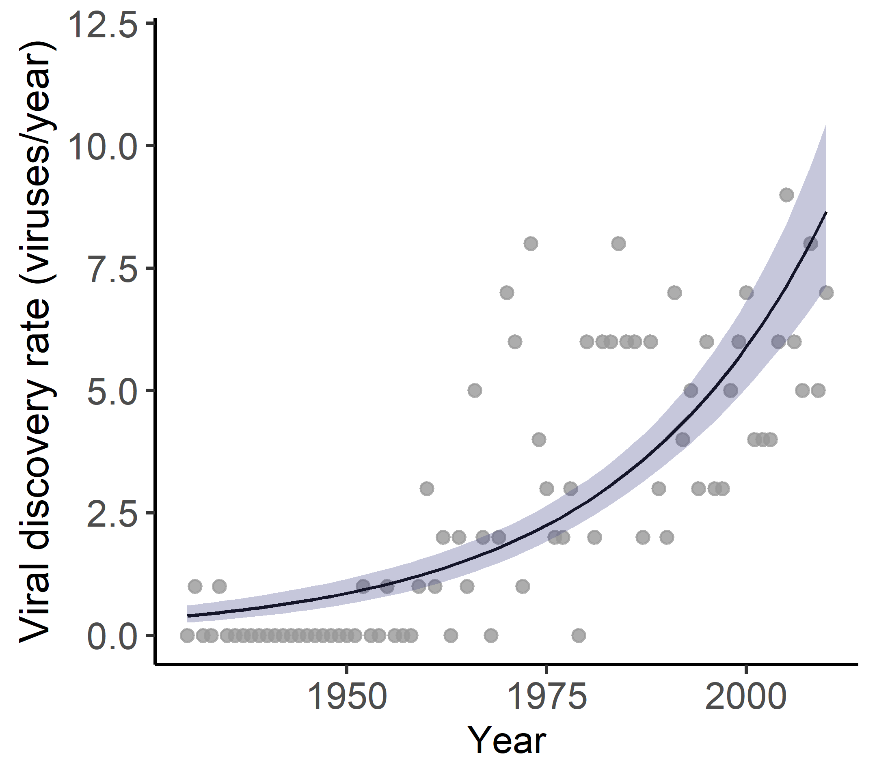
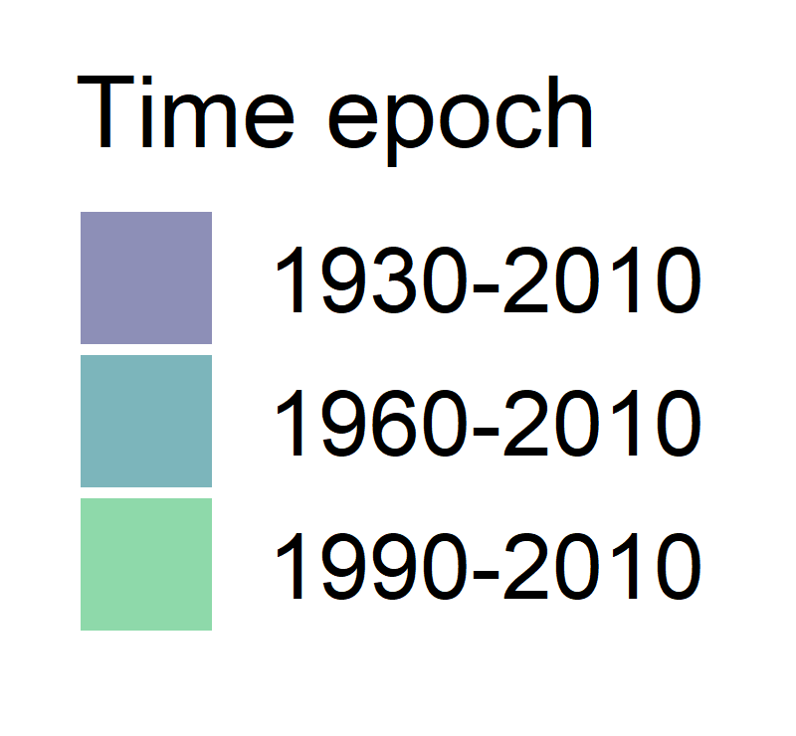


Are virus discovery rates declining in well-sampled mammal orders?
(i.e., is there any evidence they’re starting to asymptote?)
$$y_{i} \sim Pois(λ_{i})$$
$${log⁡(λ}_{i})= α+ β{Year}_{i}$$
Notes:
There are definitely cleverer ways to model this, but this was a simple concept that scaled

Slide 11
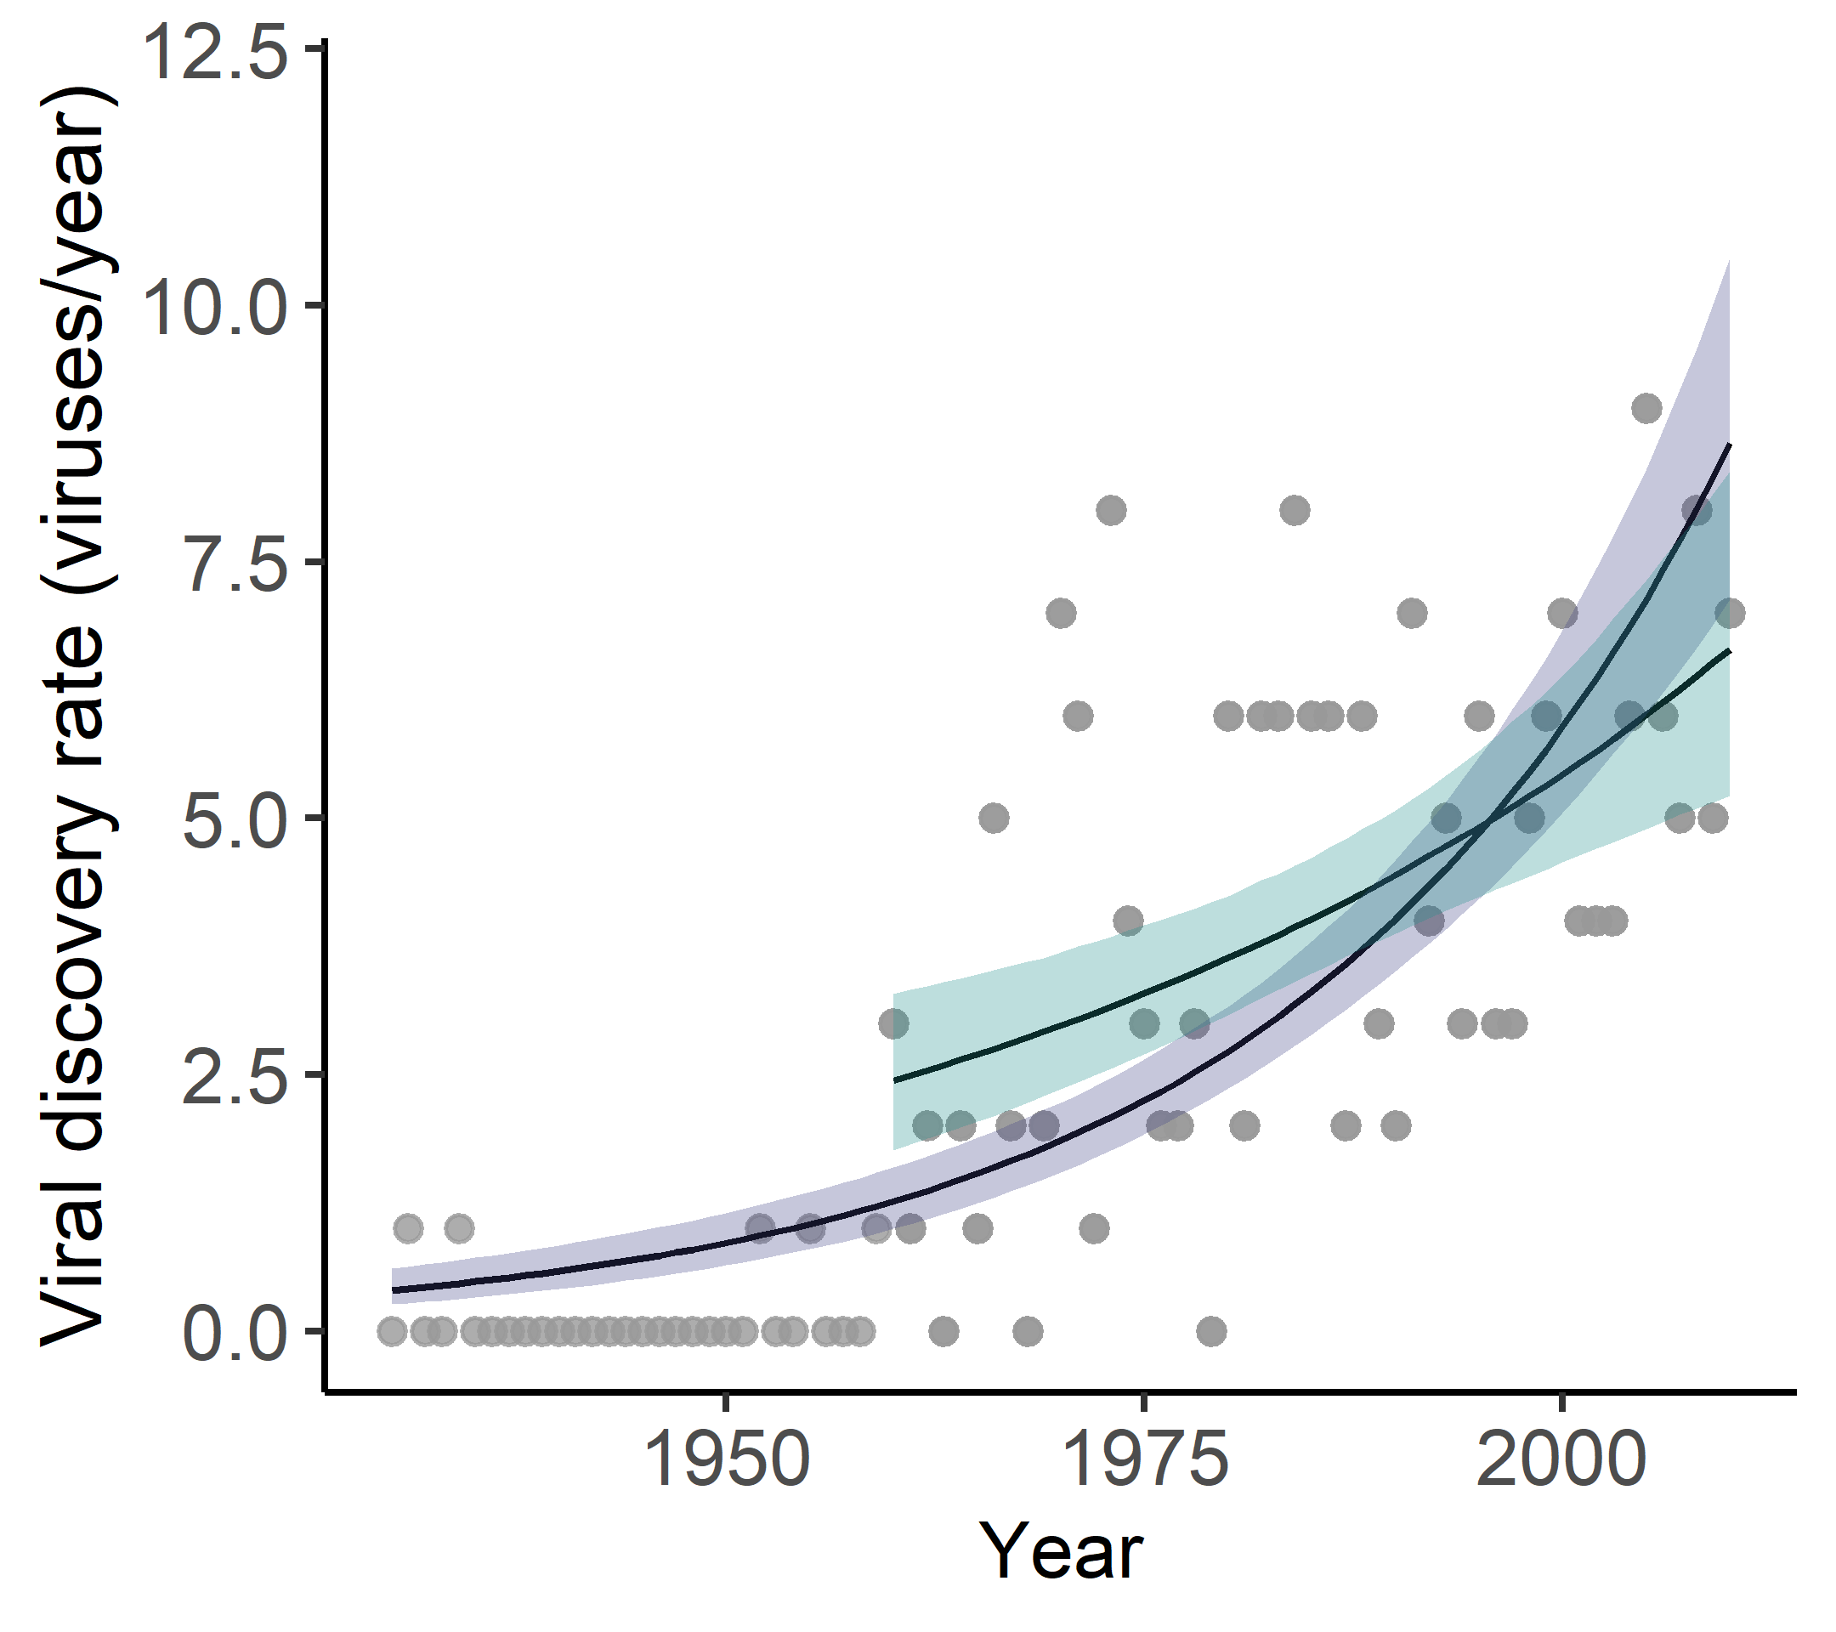
Are virus discovery rates declining in well-sampled mammal orders?
(i.e., is there any evidence they’re starting to asymptote?)
$$y_{i} \sim Pois(λ_{i})$$
$${log⁡(λ}_{i})= α+ β{Year}_{i}$$
Notes:
If we think about this as a sampling/rarefaction problem, we’d hope that if our current estimates of virus diversity at species level are
How close are we to asymptoting in our rarefaction curves?
Woolhouse 2007
Laos 2020 paper

Slide 12
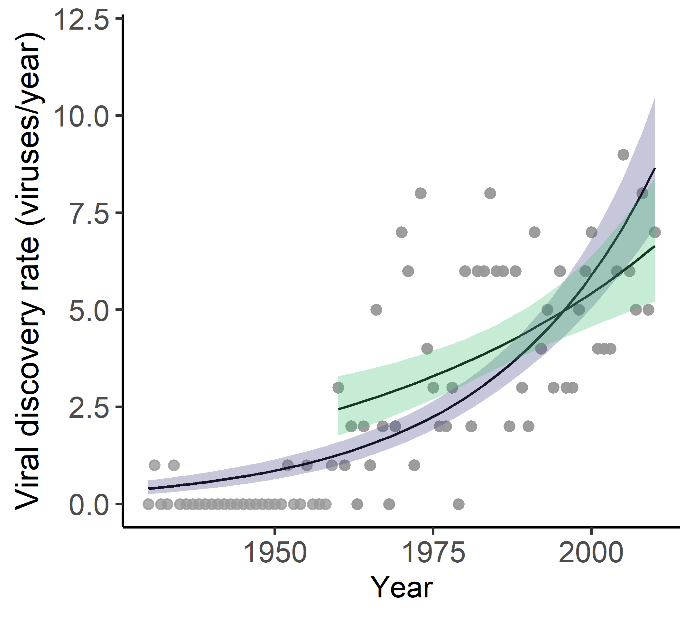
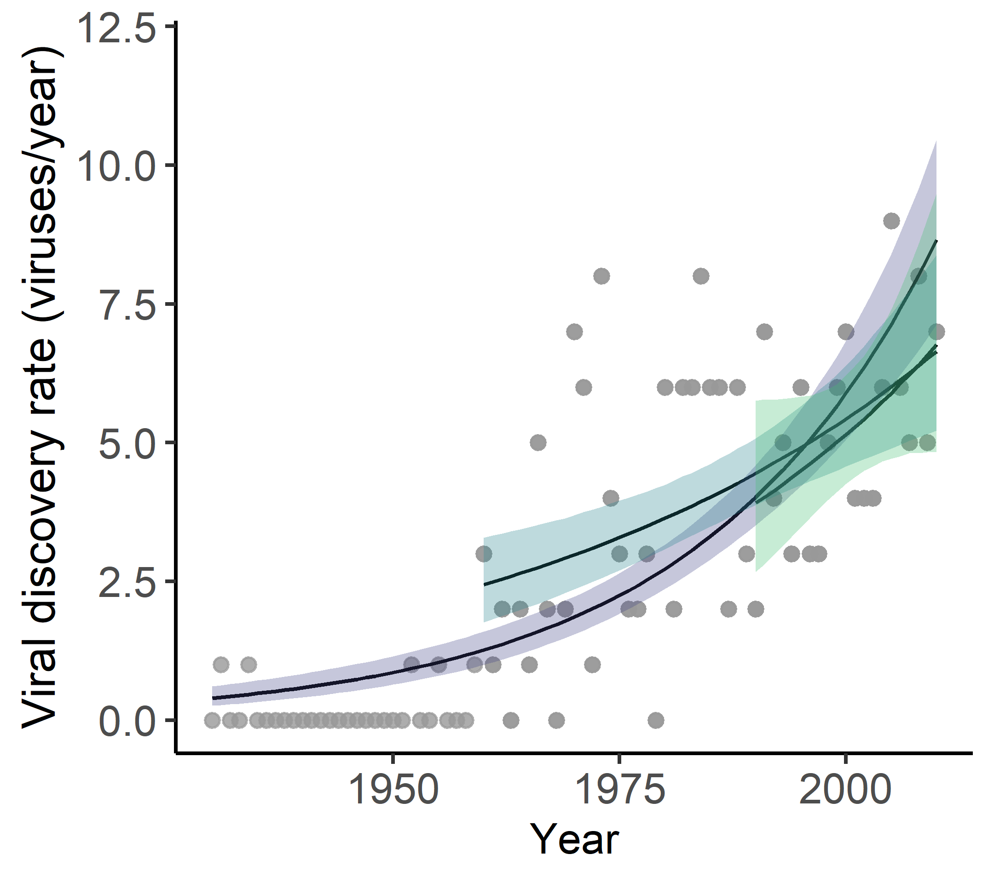
Are virus discovery rates declining in well-sampled mammal orders?
(i.e., is there any evidence they’re starting to asymptote?)
$$y_{i} \sim Pois(λ_{i})$$
$${log⁡(λ}_{i})= α+ β{Year}_{i}$$
Not for the order Cetartiodactyla…
Notes:
If we think about this as a sampling/rarefaction problem, we’d hope that if our current estimates of virus diversity at species level are
How close are we to asymptoting in our rarefaction curves?
Woolhouse 2007
Laos 2020 paper

Slide 13
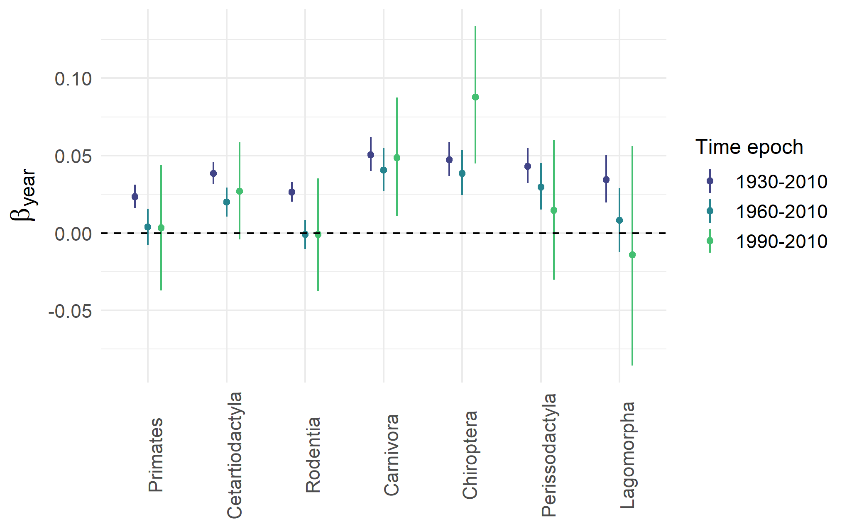
Virus discovery rates are still either constant or accelerating for all the best-sampled mammalian orders
Notes:
This also plays out at the species level; only around 5% of species with viral richness of > 8 are showing declining trends (and these could well be by chance)
Take note of bats – this will be important later
But maybe this doesn’t matter if discovery is progressing at a similar rate for most species – maybe we’re just filling in the gaps and our relative understanding is fairly

Slide 14
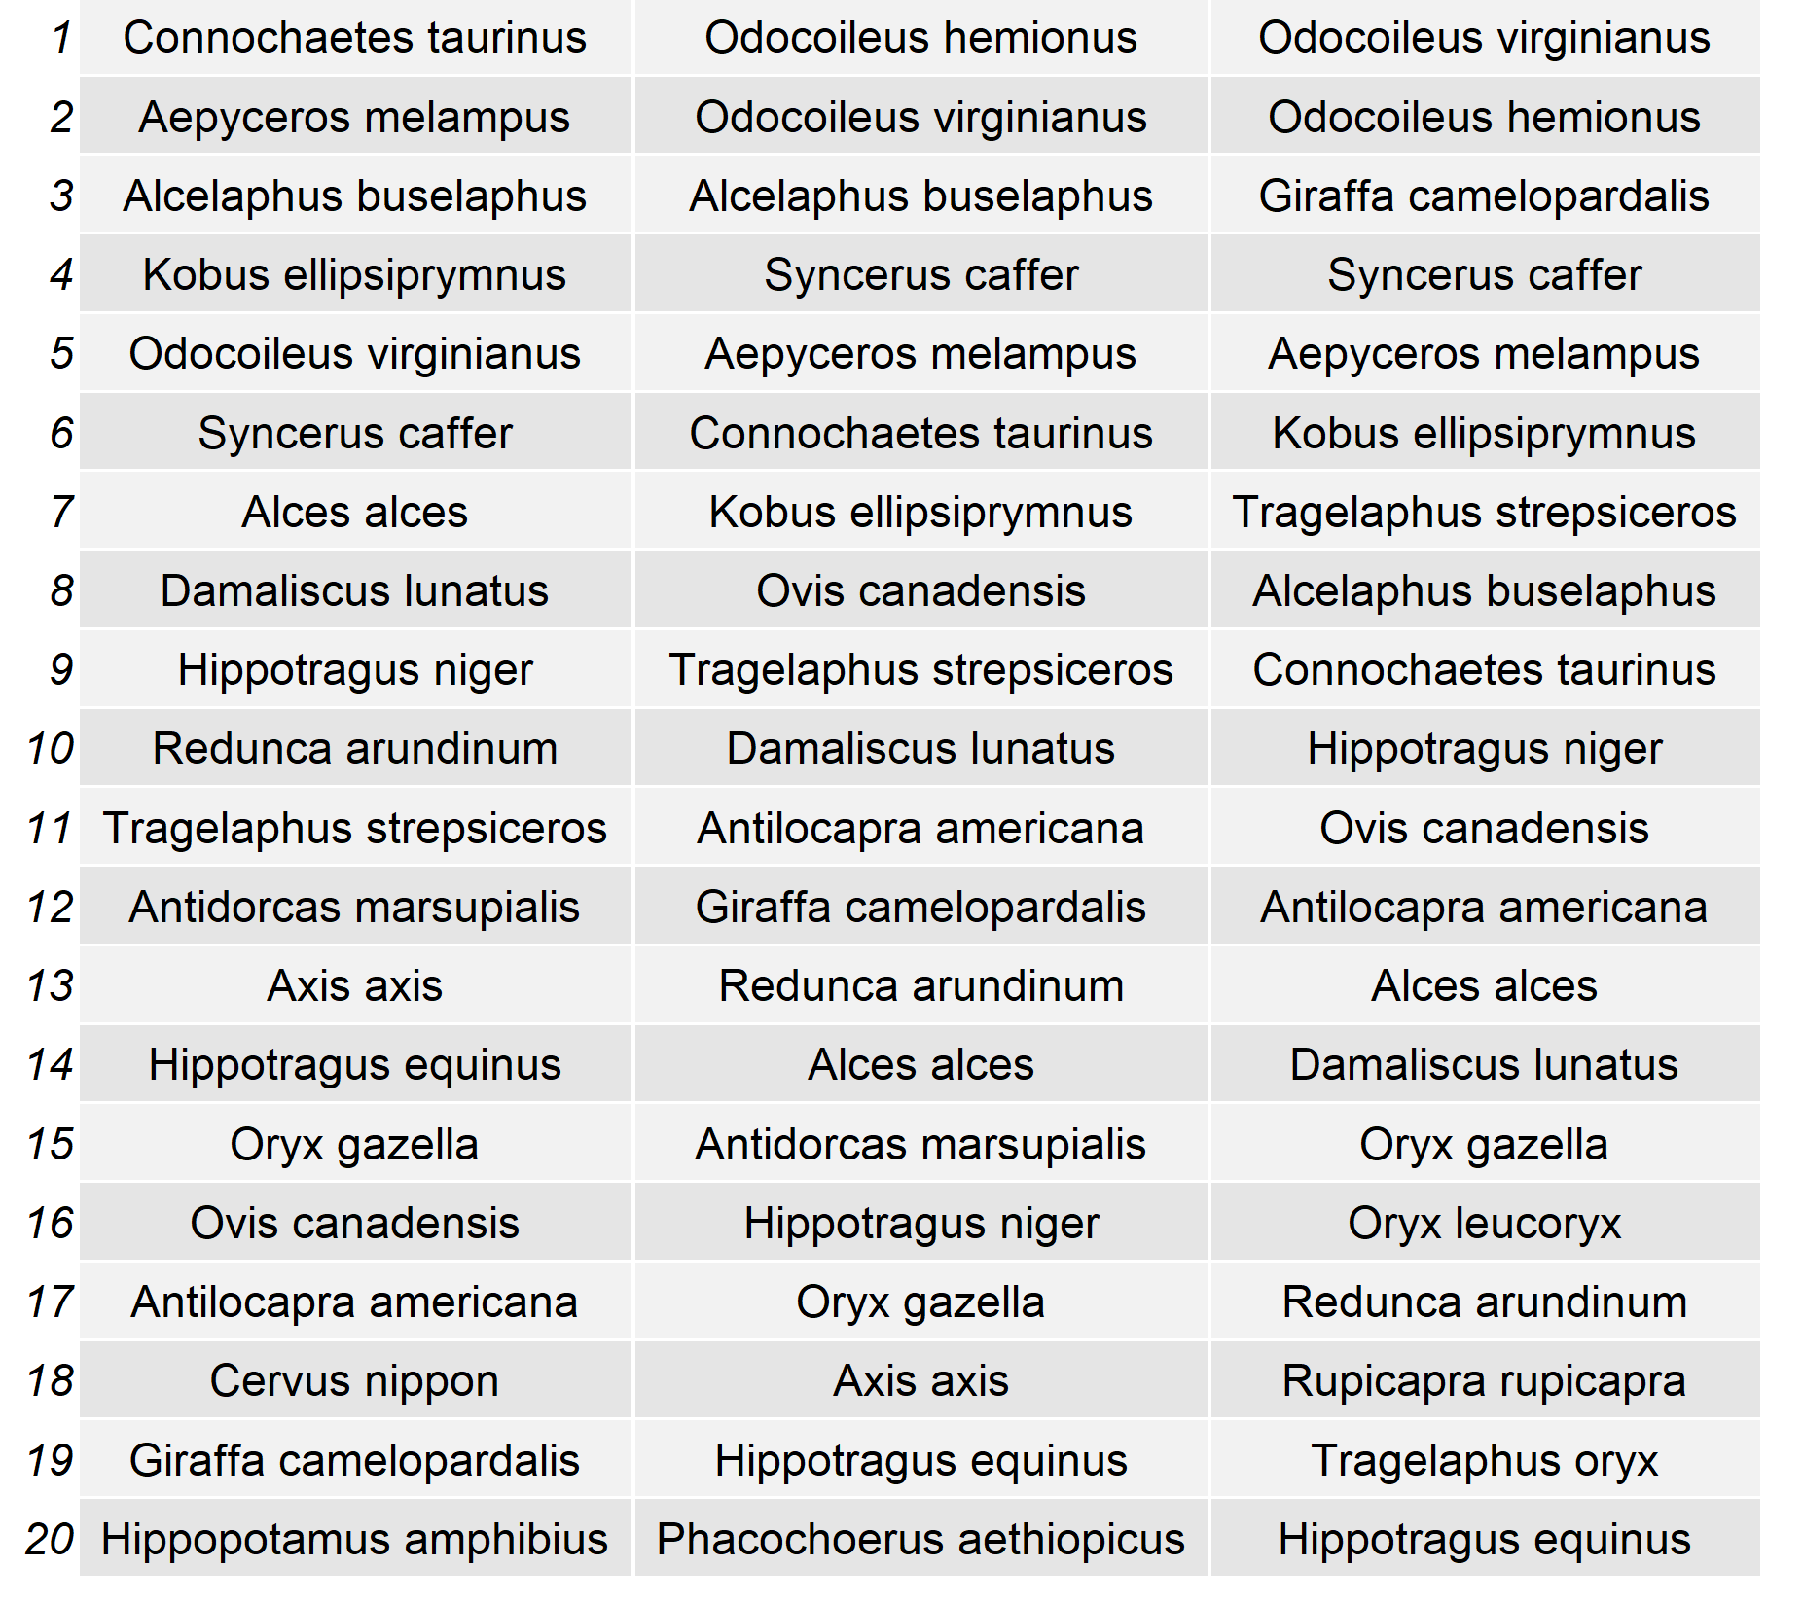
How stable are relative viral richness estimates across species?
1980
1995
2010
Ranking of wild species by viral richness

Slide 15
How stable are relative viral richness estimates across species?
1980
1995
2010
How correlated are species’ present day viral richness ranking to their historical ranking?
1
Ranking of wild species by viral richness
Spearman’s
rho
0
1980
1995
2010

Slide 16
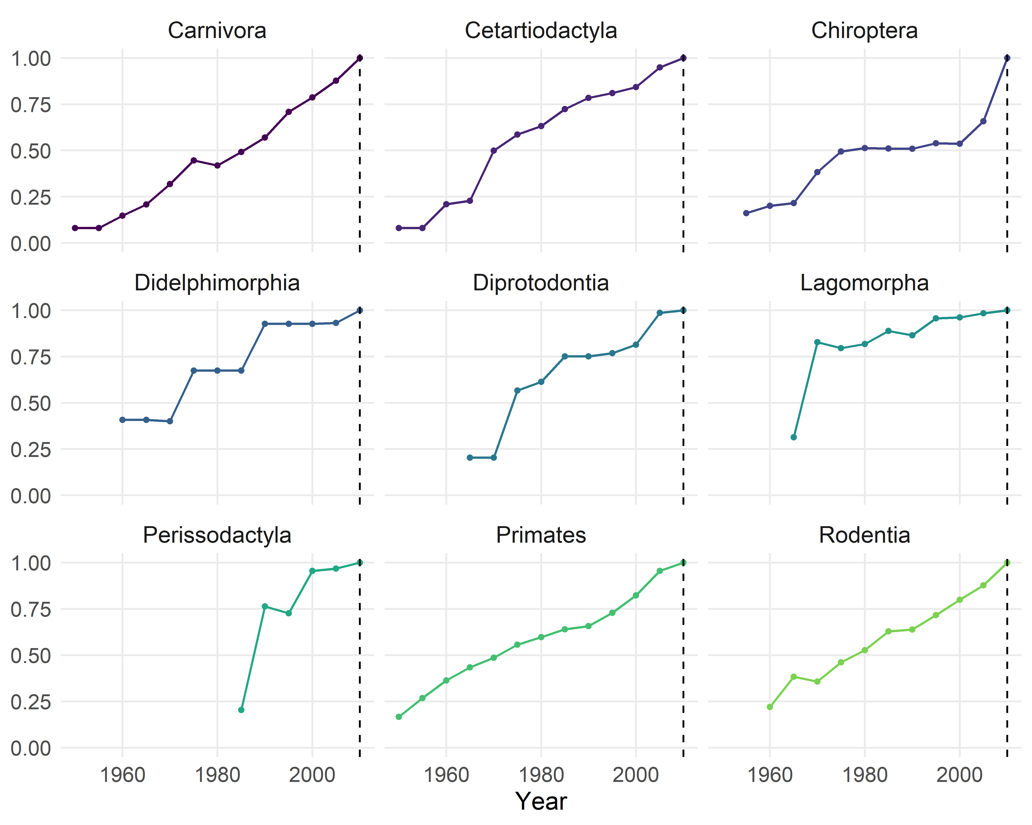
Relative viral richness estimates across species are unstable over time
Spearman’s
Rho of species virus richness ranks
Notes:
Species, families, orders are shuffling around as viral discovery effort progresses, and this can have some quite striking effects
Bats post-SARS and post GVP/PREDICT suddenly undergo a massive shift post-2000
Viral diversity estimates are historically contingent

Slide 17
Reordering of species-level viral richness estimates can happen very rapidly
Spearman’s
Rho of species virus richness ranks
Notes:
Species, families, orders are shuffling around as viral discovery effort progresses, and this can have some quite striking effects
Bats post-SARS and post GVP/PREDICT suddenly undergo a massive shift post-2000
Viral diversity estimates are historically contingent

Slide 18
What does this mean for our understanding of viral macroecology?
Our current understanding of viral diversity in mammals is historically contingent, and can change rapidly depending on sampling priorities.
It is unclear how effective citation counts are at controlling for these issues in disease macroecology studies - caution is advised.
How sensitive are the inferred drivers of viral richness, pathogen sharing and zoonotic risk (e.g. fast life histories), to stratifying analyses by time?
Carlson et al. 2018
Notes:
No reason to assume that our current snapshot is any more complete in relative terms than the snapshot in e.g. 2005 – suggests the need for care when conducting comparative/macro analyses
Olival through time, paper on the history of mammal virus discovery, are these trends in Nardus’ paper consistent through time, timeline, what about important correlates of zoonotic risk? Time series approach potentially gives us a view of the virome over time

Slide 19
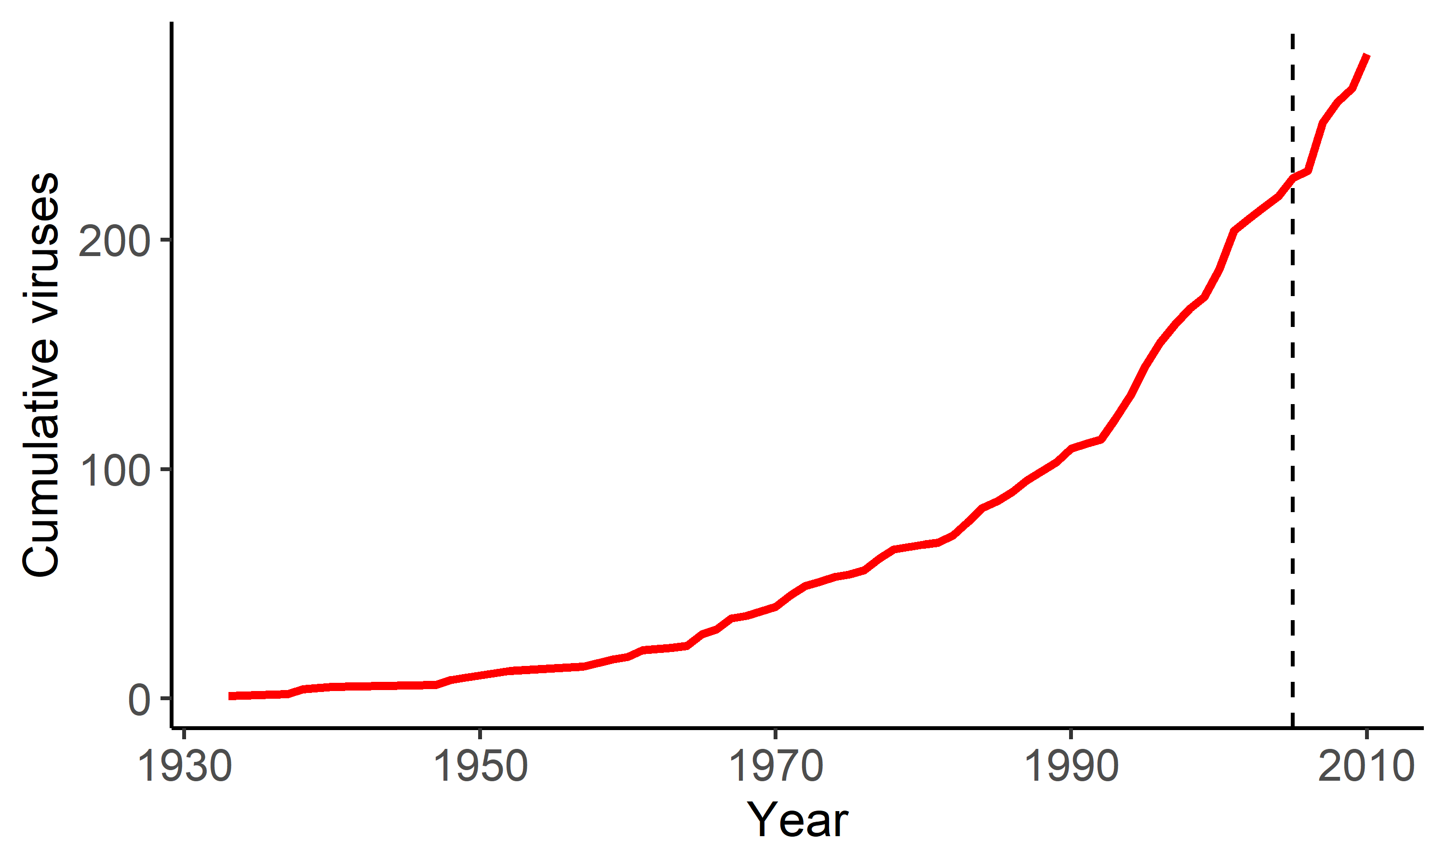
Counting species using temporal discovery curves
Human virus discovery curve from CLOVER (to 2010, PCR/sequencing/isolation)
Human virus discovery curve to 2005
54 new viruses from 2005 to 2010
“we [estimate] 10—40 new species to be discovered by 2020”
Woolhouse et al., 2008
Notes:
As an interesting aside, the shape of the curve when we use CLOVER is rather different – another clear inflection point post-1990s and pretty much constant/accelerating discovery since then

