Slide 1

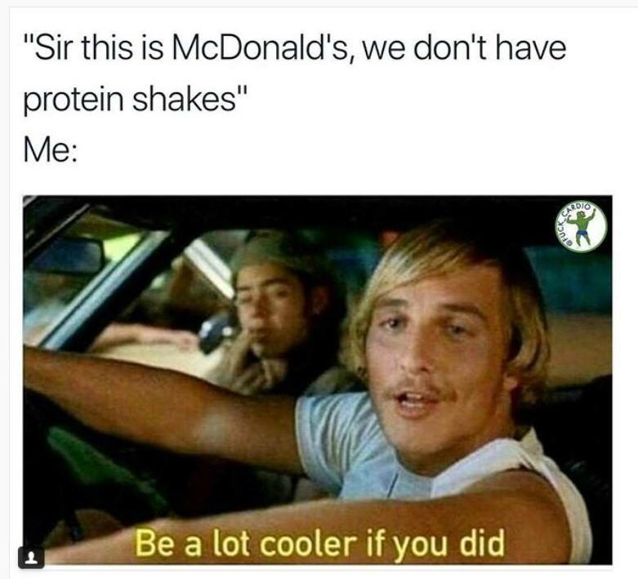
Bros Know
Leroy Jenkins Edition (Bodybuilding App)
#BrosWhoCode(gains);

Slide 2
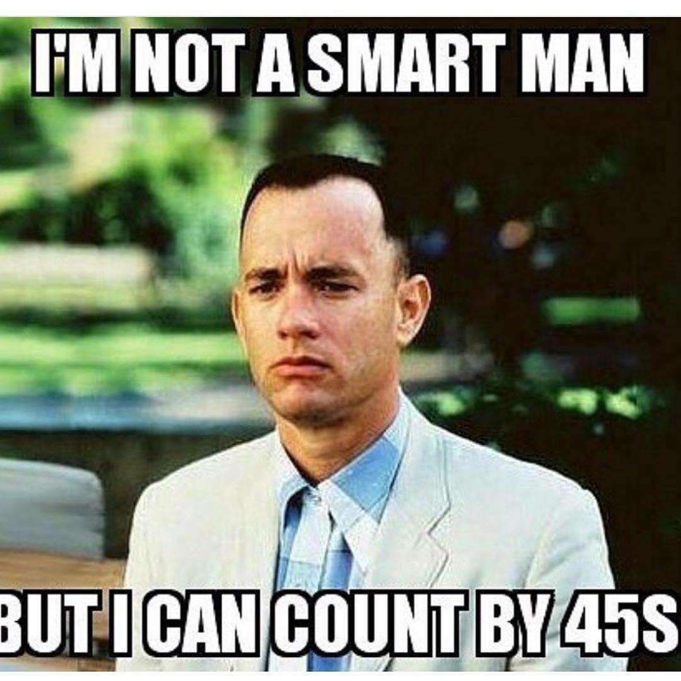
Bros Know App Intro
Over the years in and out of so many gyms all over the country and the world for that matter, there is always the common talk around the gym we will call "Bro Talk" usually about personal goals, opinionated gossip, on the heard this and that we will call "Bro Science".
I am choosing as my class project to come up with an application that can be a quick reference for Bro's in the gym, during these Bro Talk sessions, and to also give the user a great overall body composition picture not only to track your progress, see some results to your hard work, see where you could make some improvements, but to also be able to brag a little to your Bro's.

Slide 3
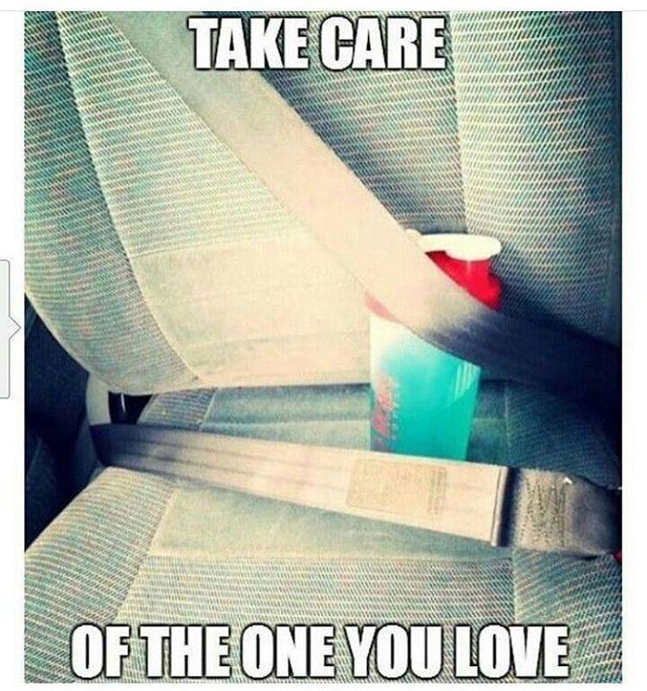
Overview
Humble Salad
(Body Fat %)
Swolemeter
(Muscle Measurements)
Reality Check
(Personal Records)

Slide 4
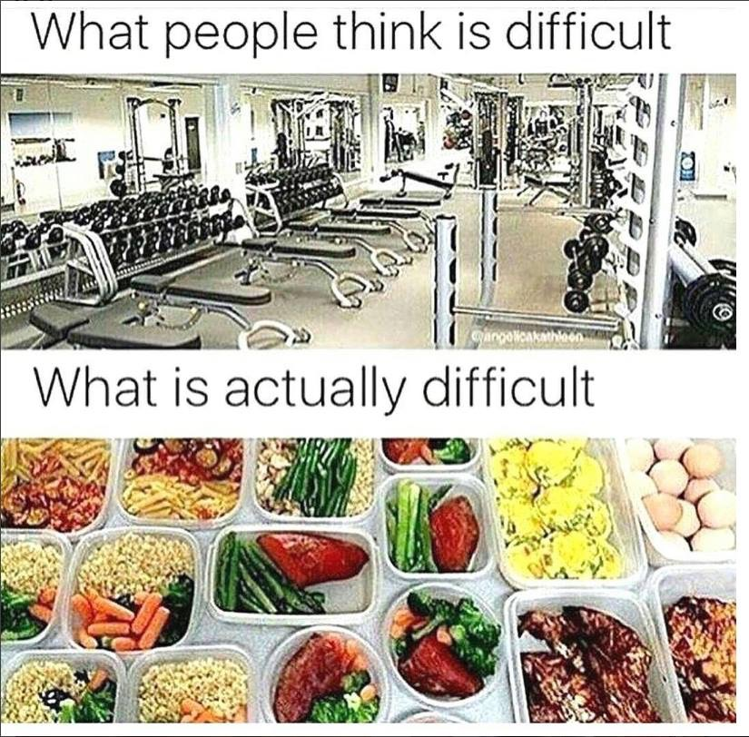
Humble Salad Body Fat % calculations
This section will calculate body fat percentages using the Jackson-Pollock 7 site method.
This area will allow the user to input each measurement into for each site measured.
There are 7 area’s that will be measured, and this is done two times, in the same locations each time.
If there is a difference exceeding more than two millimeters, then a third is required.

Slide 5
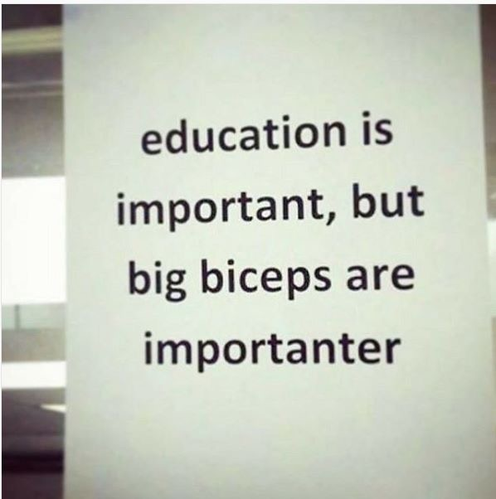
Swolemeter Muscle Measurements
The second section will contain text blocks that tracks measurements of the major muscle groups i.e. arms, chest, back, thighs along with weight, to give the user and idea of muscle gains made based on weight and the body fat calculation from the first section.

Slide 6
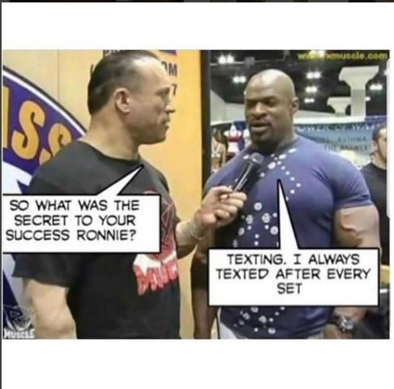

Reality Check Personal Record
The last section will track your PR’s (Personal Record) of amount of weight lifted for their personal best in multiple types of lifts.
Once PR’s are established you can adjust percentages to use throughout your sets.
So, if you are doing five sets, and want to do the first set at 70% of your max weight, this allows for a quick computation.
As this application evolves, more sections may be added, deleted, or modified to give the user a one stop shot at his or her overall progress.

Slide 7
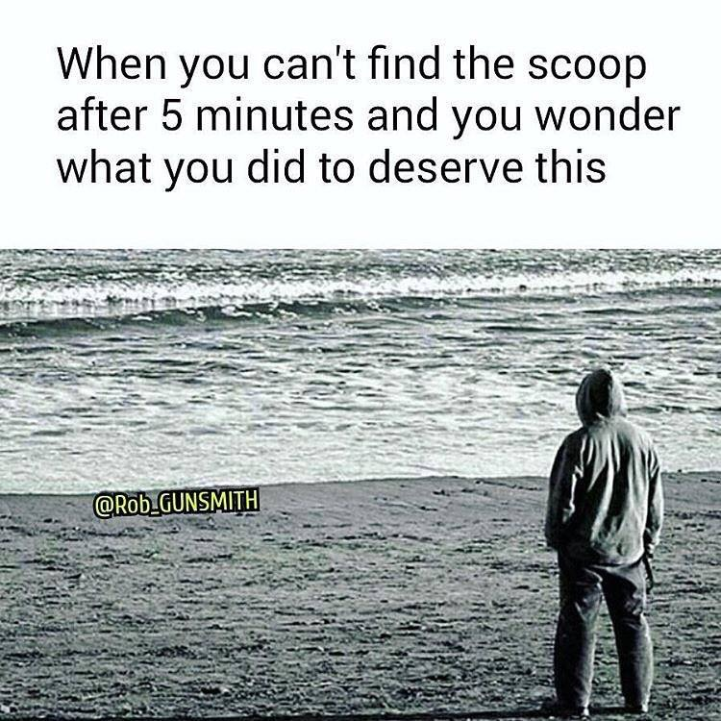
Conclusion
As I hope I've demonstrated that this app with be a great edition to your routine and #BroLifeOrNoLife Lifestyle. Happy Blasting

