Slide 1
IMAGE · F-IMG-06 · coming
Usuku 2 · Amanzi
Storm on a slope
A dark summer storm cloud over a rural homestead on a slope; rain curtains; brown water running along a path.
Yenza imvula ihambe, ingagijimi
F-D2-01
Grow Food, Grow Strong
Notes:
Opening circle: garden-map share in groups. Rotate roles.

Slide 2
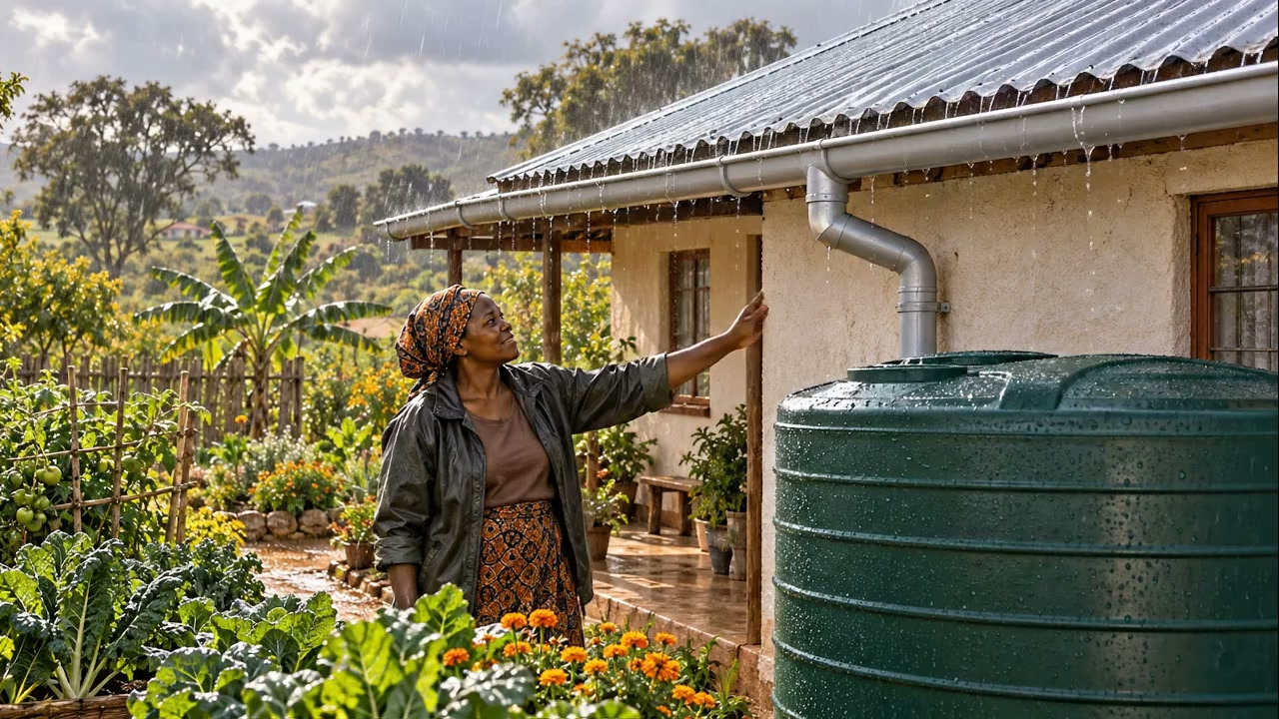
Isiphepho saya kuphi?
• Iziphepho zasehlobo ziyabaleka
• Zithatha inhlabathi yethu
▶ Clip F-ANI-07 · play from the tablet: flow-roof-rain.mp4
F-D2-02 · Poster F-P07
Grow Food, Grow Strong
Notes:
F-D2-S1. Ask where last summer's storm water went, and where it was in September.
Poster: F-P07
Clip F-ANI-07: public/course-animations/water-harvesting/flow-roof-rain.mp4

Slide 3
SEBENZANI
Amanzi ashesha, amanzi ahamba kancane
• Thelani enhlabathini engembozwe
• Fakani amatshe notshani
• Thelani futhi
IMAGE · F-IMG-07 · coming
Tray demo
Two shallow trays of soil tilted on bricks: one bare with water running off carrying soil into a basin; one with a line of stones and grass where water spreads and soaks. Hands pouring from 2 L bottles.
F-D2-03
Grow Food, Grow Strong
Notes:
Tray demo; every group's Materials person pours.

Slide 4
Nciphisa · Sabalalisa · Cwilisa · Gcina
• Yinciphise ijubane · yisabalalise
• Yicwilise · yigcine
POSTER ART · F-P07-ART · coming
Artwork for F-P07 · Slow · Spread · Sink · Store
A homestead cross-section on a slope, left (top of slope) to right (bottom). Rain falls on a corrugated-iron roof → gutter → a first-flush pipe → a round covered tank with a tap and an overflow pipe → the overflow leads into a swale with a mound planted with small trees → below it mulched vegetable beds with a buried 2 ℓ bottle beside a plant → a washing…
F-D2-04 · Poster F-P07
Grow Food, Grow Strong
Notes:
Walk the homestead from roof to soil. Ask: what is the biggest tank on your land? (the soil)
Poster: F-P07
Also: F-ANI-08
Clip F-ANI-08: public/course-animations/water-harvesting/watch-04-swale-infiltration.mp4

Slide 5
SEBENZANI
Izindawo ezimbili zokubamba amanzi ebalazweni
• Imicibisholo eluhlaza: lapho amanzi evela khona
• Izindawo ezimbili zokuwabamba
IMAGE · F-IMG-04 · coming
My garden map
A hand-drawn map on paper seen from above: a house square, a north arrow, a tap, blue arrows of water, a sun symbol on the north side, a circle marking zone 1. Pencil and crayon style.
F-D2-05
Grow Food, Grow Strong
Notes:
Groups help every person mark two water catches on their garden map.

Slide 6
Ukuphepha kuqala
• Amathuluzi abheke phansi
• Akekho ngemuva kwepiki elishaywayo
• Shintshanani imisebenzi njalo emizuzwini engu-10 · phuzani amanzi
IMAGE · F-IMG-08 · coming
Tool safety
A person carrying a spade and a pick with the points down; another person standing well to the side of someone swinging a mattock; a water bottle in the shade.
F-D2-06
Grow Food, Grow Strong
Notes:
F-D2-S2. Say it before any tool is picked up.

Slide 7
I-swale emugqeni olinganayo
• Umsele emugqeni olinganayo
• Inhlabathi ngezansi ibe isidunduma
• Indlela ephephile yokuchichima ekugcineni
POSTER ART · F-P09-ART · coming
Artwork for F-P09 · A swale on the level line
A large cross-section of a slope (uphill on the left). A trench on the level line (about 40 cm wide, 30 cm deep) with water standing in it and blue arrows soaking down and sideways under the mound; the dug soil forms a mound on the DOWNHILL side, mulched with grass and planted with a small tree and bushes whose roots reach towards the wet zone. Rain…
F-D2-07 · Poster F-P09
Grow Food, Grow Strong
Notes:
Point to the five callouts. Not on steep slopes: use stone lines or grass strips there.
Poster: F-P09
Also: F-ANI-09
Clip F-ANI-09: public/course-animations/water-harvesting/watch-07-swale-overflow-pond.mp4

Slide 8

SEBENZANI
Makani i-contour
• Unyawo olulodwa esikhonkwaneni
• Jikisani kuze intambo ifike phakathi
• Isikhonkwane · qhubekani · phindani
▶ Clip F-ANI-06 · play from the tablet: flow-a-frame.mp4
F-D2-08 · Poster F-P06
Grow Food, Grow Strong
Notes:
Everyone in the group places the frame at least once. Smooth zig-zags; join sections.
Poster: F-P06
Clip F-ANI-06: public/course-animations/reading-landscape/flow-a-frame.mp4

Slide 9
SEBENZANI
Mbani
• Umsele ngenhla kwezikhonkwane
• Inhlabathi iye ngezansi
• Phansi komsele kube yisicaba
IMAGE · F-IMG-09 · coming
Digging the swale
Five learners on a contour line of pegs: two digging the ditch uphill of the pegs, one raking soil into a mound downhill, one measuring depth with a marked stick, one bringing water.
F-D2-09 · Poster F-P09
Grow Food, Grow Strong
Notes:
Roles: 2 dig, 1 rakes berm, 1 checks depth (30 cm), 1 fetches water and times swaps.
Poster: F-P09

Slide 10
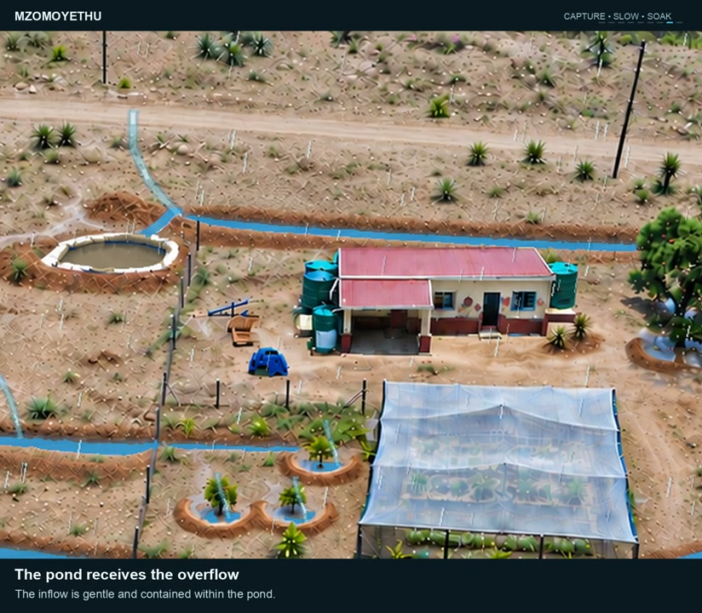
SEBENZANI
Kuhloleni
• Amabhodlela amabili amanzi engxenyeni yenu
• Ayasabalala noma ayagijima?
▶ Clip F-ANI-09 · play from the tablet: watch-07-swale-overflow-pond.mp4
F-D2-10
Grow Food, Grow Strong
Notes:
If it runs to one end, take soil off the floor at the high end. Mulch the mound.
Clip F-ANI-09: public/course-animations/water-harvesting/watch-07-swale-overflow-pond.mp4

Slide 11
Umthetho womlingo
• 1 mm wemvula ku-1 m² = 1 litha
POSTER ART · F-P08-ART · coming
Artwork for F-P08 · How much rain from your roof?
Top: a single square metre of ground marked with four pegs and string, a rain cloud over it, and one 1-litre bottle beside it. Middle: a simple house with a corrugated roof, a measuring tape along the length and width at ground level, rain falling, and a row of identical 20 ℓ buckets lined up beside a tank. Bottom: a tank close-up — gutter with a gentle…
F-D2-11 · Poster F-P08
Grow Food, Grow Strong
Notes:
F-D2-S3. Hold up the 1 litre bottle. A 20 mm storm on 1 m² = one 20 litre bucket.
Poster: F-P08

Slide 12
SEBENZANI
Linganisani uphahla
• Ubude × ububanzi phansi emhlabathini
• Ningaze nikhwele ophahleni
IMAGE · F-IMG-11 · coming
Measuring the roof
Two learners stretching a knotted string along the ground under the edge of a corrugated-iron roof of a hall; a third counting knots.
F-D2-12
Grow Food, Grow Strong
Notes:
Knotted string (knot every metre) or a tape.

Slide 13
Mangaki amabhakede?
• 10 m × 6 m = 60 m²
• 60 × 20 mm × 0.8 = 960 amalitha
• ≈ 48 amabhakede esiphephweni esisodwa
IMAGE · F-IMG-12 · coming
Buckets from one storm
A small house roof with rain and, beside it, a long neat line of identical 20 L buckets receding into the distance — many buckets.
F-D2-13 · Poster F-P08
Grow Food, Grow Strong
Notes:
Worked example, then the venue roof. Counters method: one bottle top = 1 m² = 1 bucket. Yearly: × your area's yearly rain (check locally).
Poster: F-P08

Slide 14
Igatha, i-first-flush, ithange
• Imvula yokuqala igeza uphahla — yiyeke ihambe
• Vala isivalo · ithephu ngaphezu kwebhakede
• Okuchichimayo kuye engadini
ANIMATION · F-ANI-10 · coming
First-flush tank
Rain on a corrugated-iron roof. The first dirty water (leaves, dust) fills a vertical side pipe until it is full; then clean water flows past it into a covered round tank; the tank fills and the overflow pipe sends water to a planted swale. (Replaces the withdrawn clip `water-harvesting/watch-16-first-flush-tank.mp4`.)
F-D2-14 · Poster F-P08
Grow Food, Grow Strong
Notes:
Each learner estimates their own roof and writes the storm number on their map.
Poster: F-P08
Clip F-ANI-10: public/course-media/farmer-5day/F-ANI-10.mp4

Slide 15
POSTER ART · F-P07-ART · coming
Lonke iconsi kabili
Artwork for F-P07 · Slow · Spread · Sink · Store
A homestead cross-section on a slope, left (top of slope) to right (bottom). Rain falls on a corrugated-iron roof → gutter → a first-flush pipe → a round covered tank with a tap and an overflow pipe → the overflow leads into a swale with a mound planted with small trees → below it mulched vegetable beds with a buried 2 ℓ bottle beside a plant → a washing…
Iziteshi ezine · imizuzu engu-10 ngayinye
F-D2-15
Grow Food, Grow Strong
Notes:
F-D2-S4 carousel: bottles, mulch, greywater, banana circle.

Slide 16
SEBENZANI
Ibhodlela lokunisela ngamaconsi
• Izimbobo ezimbili ezincane ngezansi
• Lingcwabeni kuze kube sentanyeni eduze kwesitshalo
• Isipikili esishisayo: ngopliya kuphela
IMAGE · F-IMG-13 · coming
Bottle drip-waterer
Cut-away of soil with a 2 L bottle buried to its neck beside a young plant; tiny droplets leaving two small holes near the base towards the roots.
F-D2-16
Grow Food, Grow Strong
Notes:
Station A.

Slide 17
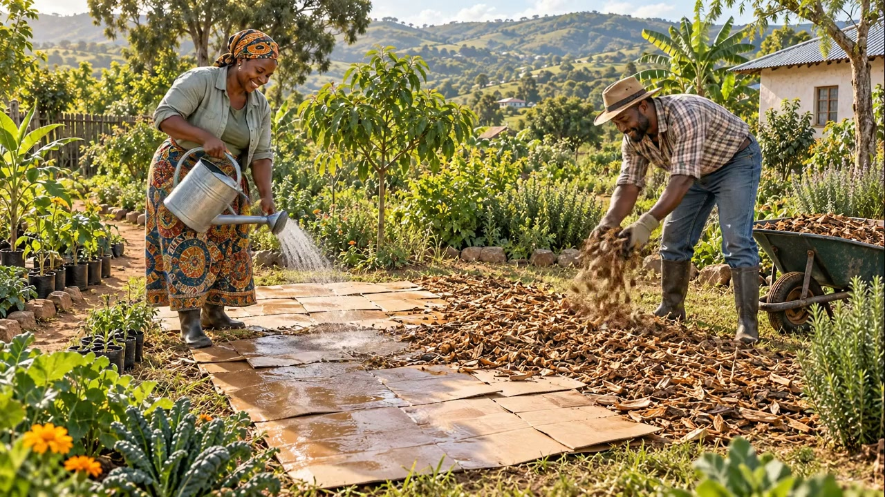
I-mulch efanele
• Ukujula okulingana nobubanzi besandla
• Isikhala esilingana nesibhakela eduze kweziqu
• Ukunisela kwehla ngohhafu
▶ Clip F-ANI-12 · play from the tablet: flow-sheet-mulching.mp4
F-D2-17
Grow Food, Grow Strong
Notes:
Station B. Dig and compare moisture under mulch and bare soil.
Clip F-ANI-12: public/course-animations/food-forest/flow-sheet-mulching.mp4

Slide 18
Amanzi okugeza nesiyingi sikabhanana
• Amanzi okugeza emithini, hhayi emaqabungeni adliwa eluhlaza
• Ungalokothi usebenzise amanzi asendlini yangasese, awenabukeni, anejiki noma anamafutha
• Shintsha lapho uthela khona
ANIMATION · F-ANI-11 · coming
Greywater to mulch
A person carries a basin of used washing water and pours it slowly onto a thick mulch ring around a broad-leaved banana-like plant and a fruit tree (never onto leafy vegetables); in cut-away the water soaks through the mulch down to the roots. (Replaces the withdrawn clip `water-harvesting/watch-21-greywater-mulch.mp4`.)
F-D2-18 · Poster F-P07
Grow Food, Grow Strong
Notes:
Stations C and D. Mark a banana circle 1.5–2 m across; centre bowl filled with grass and prunings.
Poster: F-P07
Clip F-ANI-11: public/course-media/farmer-5day/F-ANI-11.mp4

Slide 19
Kusihlwa
• Ibhakede elilodwa lamanzi okugeza esitshalweni
• Lethani utshani, amaqabunga, imifino, umquba kusasa
IMAGE · F-IMG-05 · coming
Closing circle
Late-afternoon warm light; a circle of standing people, one holding up a hand to speak; tools laid neatly on a tarp in the centre.
F-D2-19
Grow Food, Grow Strong
Notes:
Closing circle.

