Slide 1
IMAGE · F-IMG-01 · coming
Lima Ukudla, Uqine
Course cover
A community garden at mid-morning: dark mulched beds, a small tank on a corrugated roof, a young woman and a gogo in a headscarf laughing as they carry a basket of leafy greens; hills behind. Sun in the north (upper left or right of frame, shadows toward the viewer's bottom).
Usuku 1 kwezi-5 — Kungani silima ngale ndlela
F-D1-01
Grow Food, Grow Strong
Notes:
Title slide. Leave it up while learners register (F-D1-S0).

Slide 2
Siyanamukela
• Izinsuku 5 · 09:00–16:00
• Amaqembu aba-5 · izandla enhlabathini
• Nizohamba nezithombo, imbewu, nohlelo
IMAGE · F-IMG-02 · coming
Welcome circle
About 25 adults of mixed ages in a circle of plastic chairs under a lapa, one standing facilitator mid-gesture, everyone facing each other.
F-D1-02 · Poster F-P01
Grow Food, Grow Strong
Notes:
Introduce both facilitators. Teach the call and response. Round of names: name, where you live, one thing you grow.
Poster: F-P01

Slide 3
SEBENZANI
Umbuzo wezithombe
• Hambani niye empendulweni: A · B · C
• Akekho ongaphenduli kahle namuhla
IMAGE · F-IMG-70 · coming
Picture quiz card 1
Question (said aloud, not printed in the art): 'Where is the sun at midday in winter?' Art: three panels A/B/C: sun to the north of a house (shadow south) · sun to the south · sun straight overhead. Three equal panels with a large A, B and C typeset below each panel in the layout (not in the art).
F-D1-03
Grow Food, Grow Strong
Notes:
Show quiz cards F-IMG-70 to 77 one at a time (forms.md §5). Co-facilitator counts each corner.

Slide 4
SEBENZANI
Dwebani ithemba lenu
• Ingadi yakho ekupheleni konyaka
• Yidwebeni — akudingeki ukubhala
• Khombisani iqembu: umzuzu 1 ngamunye
IMAGE · F-IMG-03 · coming
Drawing a hope
Close-up of hands of different ages drawing with wax crayons on A4 sheets: a house, a garden, a tank.
F-D1-04
Grow Food, Grow Strong
Notes:
F-D1-S1. 5 min drawing, 5 min in groups. Stick all drawings under "Our hopes".

Slide 5
Indlela esifunda ngayo ndawonye
• Yini esiyidinga komunye nomunye?
POSTER ART · F-P01-ART · coming
Artwork for F-P01 · Our class agreement
A circle of 10 seated people seen from slightly above — mixed ages, a gogo in a headscarf, a young man in a cap, a woman with a baby on her back — each with an open hand towards the middle, where a single seedling grows from a small mound. Keep the art in the top 35% so the lower part is a **blank ruled area** (12 lines) for the class to write on.
F-D1-05 · Poster F-P01
Grow Food, Grow Strong
Notes:
Write the class's words on the poster, not yours. Check the eight points on the F-P01 card are there. Everyone signs.
Poster: F-P01

Slide 6
Izindlela ezintathu zokunakekela
• Nakekela umhlaba
• Nakekela abantu
• Yabelana ngokulingene
POSTER ART · F-P02-ART · coming
Artwork for F-P02 · Earth care · People care · Fair share
Three equal overlapping circles (a Venn). Circle ① (top-left, Leaf green): two cupped hands holding dark soil with a sprouting seedling and an earthworm. Circle ② (top-right, Ochre): a family of four — gogo, mother, two children — eating from one pot. Circle ③ (bottom, Water blue outline only, Paper fill): one hand passing a basket of vegetables and a…
F-D1-06 · Poster F-P02
Grow Food, Grow Strong
Notes:
Tell the Gogo Thandi story first. Then the three circles. Groups draw one thing they already do for each (8 min).
Poster: F-P02
Also: F-ANI-01
Clip F-ANI-01: public/course-animations/intro-permaculture/watch-07-three-ethics.mp4

Slide 7
Yiyiphi ingadi ezophila ngesomiso?
• Bhekani imizuzu emi-3
• Yini ehlukile?
POSTER ART · F-P03-ART · coming
Artwork for F-P03 · Two gardens
Split vertically. **Left:** a bare, cracked, pale plot on a slight slope; one crop in straight rows; a fertiliser bag and a spray can with a skull-free generic warning shape; rainwater running off in brown channels taking soil down the slope; a hot sun in the north (upper edge) and a wilting plant. **Right:** the same slope with dark mulched beds, many…
F-D1-07 · Poster F-P03
Grow Food, Grow Strong
Notes:
F-D1-S2. Cover the right half on the poster; on screen show the full picture after groups have discussed the left.
Poster: F-P03

Slide 8
SEBENZANI
Inhlabathi engembozwe noma embozwe?
• Thelani inkomishi eyodwa kokubili
• Amanzi aye kuphi?
ANIMATION · F-ANI-03 · coming
Two gardens through a dry season
Split screen, same gentle slope, same fixed camera. LEFT: bare pale soil, one crop in rows. RIGHT: mulched beds, mixed plants, a small tree, a swale. Sequence: (0–5 s) a summer storm — left: brown water runs off in channels carrying soil; right: water soaks in, swale fills and empties downward into the soil. (5–12 s) days pass (sun arcs across the NORTH…
F-D1-08
Grow Food, Grow Strong
Notes:
Water-pour demo outside, every group pours. Optional clip F-ANI-03 shows the two gardens through a dry season.
Clip F-ANI-03: public/course-media/farmer-5day/F-ANI-03.mp4

Slide 9
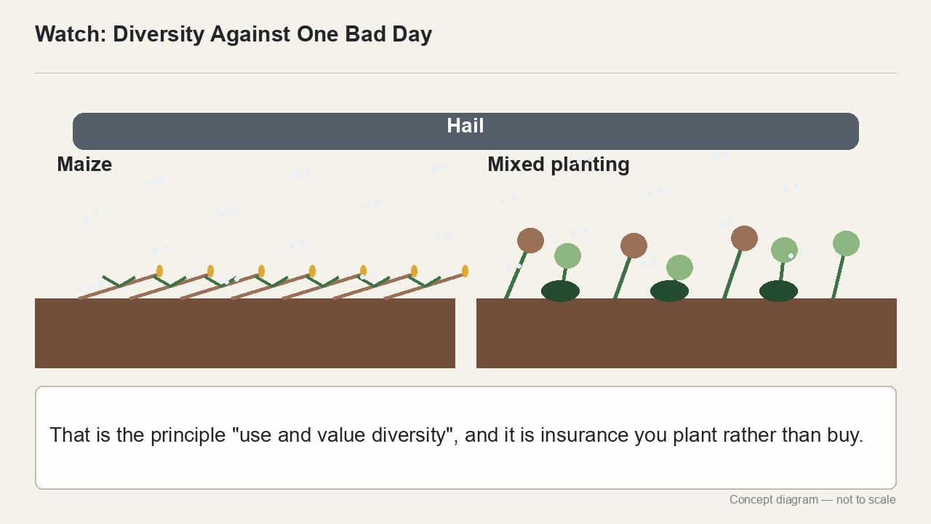
Ukulima nemvelo
• Inhlabathi ihlale imbozwe
• Izitshalo eziningi ndawonye
• Amanzi ahamba kancane · akukho okumoshwayo
▶ Clip F-ANI-02 · play from the tablet: watch-13-diversity.mp4
F-D1-09 · Poster F-P03
Grow Food, Grow Strong
Notes:
Agroecology = farming with nature. Permaculture = designing with nature. Ask what grandmothers did.
Poster: F-P03
Clip F-ANI-02: public/course-animations/intro-permaculture/watch-13-diversity.mp4

Slide 10
Izindlela eziyisithupha zokulima nemvelo
• Qala ngokubuka · Bamba ugcine · Abasizi abaningi
• Akukho okungumfucuza · Qala kancane · Sebenzisa imiphetho
POSTER ART · F-P04-ART · coming
Artwork for F-P04 · Six garden principles
A 2 × 3 grid of six square icons with a bold simple scene each: ① a person squatting, watching rain run across a yard (an eye motif); ② a roof gutter pouring into a tank, and a hand holding seeds; ③ a maize stalk, a bean vine climbing it, and a pumpkin at its foot; ④ vegetable peels going into a compost heap, a small arrow round to a green plant; ⑤ one…
F-D1-10 · Poster F-P04
Grow Food, Grow Strong
Notes:
Two minutes per principle: point, say it, ask for a local example.
Poster: F-P04

Slide 11
SEBENZANI
Ukuzingela izithombe
• Fanisani isithombe ngasinye nendlela
• Wonke umuntu abeke izithombe ezimbili
• Imizuzu engu-20, bese nizungeza nibuka
IMAGE · F-IMG-80 · coming
Principle picture — Watch first
Photo-like illustration of a person squatting and watching rain run across a yard. Must look like a magazine picture (a scene, not a diagram) so the hunt still works. No text.
F-D1-11
Grow Food, Grow Strong
Notes:
Envelopes of 10 pictures per group. No magazines? Use printed picture cards F-IMG-80 to 91.

Slide 12
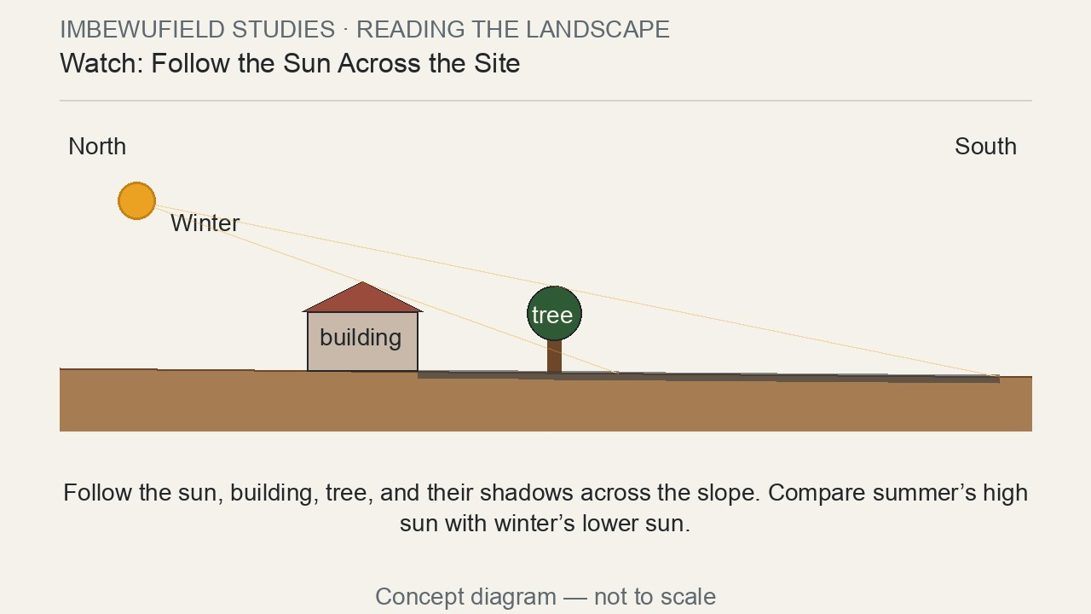
Lingaphi ilanga?
• ENingizimu Afrika ilanga lisenyakatho
• Imithunzi iwela eningizimu
• Tshala enyakatho yendlu
▶ Clip F-ANI-04 · play from the tablet: watch-09-sun-shadows.mp4
F-D1-12 · Poster F-P05
Grow Food, Grow Strong
Notes:
F-D1-S3. Cardboard house in the real sun, or a torch. Lower the torch for winter: longer shadows.
Poster: F-P05
Clip F-ANI-04: public/course-animations/reading-landscape/watch-09-sun-shadows.mp4

Slide 13
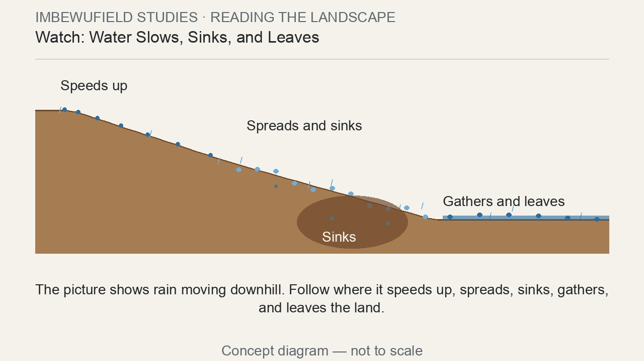
SEBENZANI
Fundani umhlaba
• Ophuzi = ilanga usuku lonke
• Obomvu = amakhaza noma umoya onamandla
• Oluhlaza okwesibhakabhaka = amanzi ayagobhoza noma ayama
▶ Clip F-ANI-05 · play from the tablet: watch-05-water-movement.mp4
F-D1-13 · Poster F-P05
Grow Food, Grow Strong
Notes:
20-minute site walk with ribbons and pegs. Clues: channels, silt, wet patches, bent trees.
Poster: F-P05
Clip F-ANI-05: public/course-animations/reading-landscape/watch-05-water-movement.mp4

Slide 14
Ama-zone: eduze nomnyango
• 0 indlu · 1 amakhambi nemifino yansuku zonke
• 2 imibhede, izithelo, izinkukhu · 3 amasimu
• 4 amadlelo nezinkuni · 5 endle
POSTER ART · F-P05-ART · coming
Artwork for F-P05 · Read your land
A bird's-eye illustrated homestead on a gentle slope. A compass rose with the N arrow pointing to the TOP of the poster. The sun drawn at the top (north) with its arc from east (right) to west (left); the house casts its shadow to the SOUTH (bottom). Blue arrows show water running from the road and roof down the slope. A cold wind drawn as grey curved…
F-D1-14 · Poster F-P05
Grow Food, Grow Strong
Notes:
Ask why spinach is by the kitchen and maize further away. Groups draw the venue from above (15 min).
Poster: F-P05

Slide 15
Thola umugqa olinganayo
• Imilenze emibili · induku ephambanayo · intambo netshe
POSTER ART · F-P06-ART · coming
Artwork for F-P06 · Build an A-frame
Large side view of an A-frame made of two wooden droppers tied at the top (crossed, tips sticking out), a horizontal crossbar halfway, and a string with a stone hanging from the apex past the crossbar. Below it, a small 3-step strip: (a) frame on two pegs, a mark where the string crosses; (b) the frame turned round, feet swapped, a second mark; (c) a big…
F-D1-15 · Poster F-P06
Grow Food, Grow Strong
Notes:
F-D1-S4. One A-frame per group. Everybody has a job while building.
Poster: F-P06

Slide 16

SEBENZANI
Lungisani i-A-frame
• Makani · phendulani · makani
• Phakathi kulinganile
▶ Clip F-ANI-06 · play from the tablet: flow-a-frame.mp4
F-D1-16 · Poster F-P06
Grow Food, Grow Strong
Notes:
Show once, then every group calibrates its own frame. Check each level mark before frames are stored.
Poster: F-P06
Clip F-ANI-06: public/course-animations/reading-landscape/flow-a-frame.mp4

Slide 17
Kusihlwa: dweba igceke lakho
• Indlu · umcibisholo wasenyakatho · ithephu
• Lapho amanzi agobhoza khona · lapho ilanga lishisa khona
• Lapho i-Zone 1 izoba khona
IMAGE · F-IMG-04 · coming
My garden map
A hand-drawn map on paper seen from above: a house square, a north arrow, a tap, blue arrows of water, a sun symbol on the north side, a circle marking zone 1. Pencil and crayon style.
F-D1-17
Grow Food, Grow Strong
Notes:
Hand out A4 and pencils. Any drawing is good. Bring it tomorrow.

Slide 18
Igama elilodwa
• Igama elilodwa ngalolu suku
• Into ozoyenza ekhaya
• Amathuluzi abuyiswe abalwe
IMAGE · F-IMG-05 · coming
Closing circle
Late-afternoon warm light; a circle of standing people, one holding up a hand to speak; tools laid neatly on a tarp in the centre.
F-D1-18
Grow Food, Grow Strong
Notes:
Closing circle (toolkit §3). Register PM signatures.

