Slide 1
IMAGE · F-IMG-06 · coming
Day 2 · Water
Storm on a slope
A dark summer storm cloud over a rural homestead on a slope; rain curtains; brown water running along a path.
Make the rain walk, not run
F-D2-01
Grow Food, Grow Strong
Notes:
Opening circle: garden-map share in groups. Rotate roles.

Slide 2
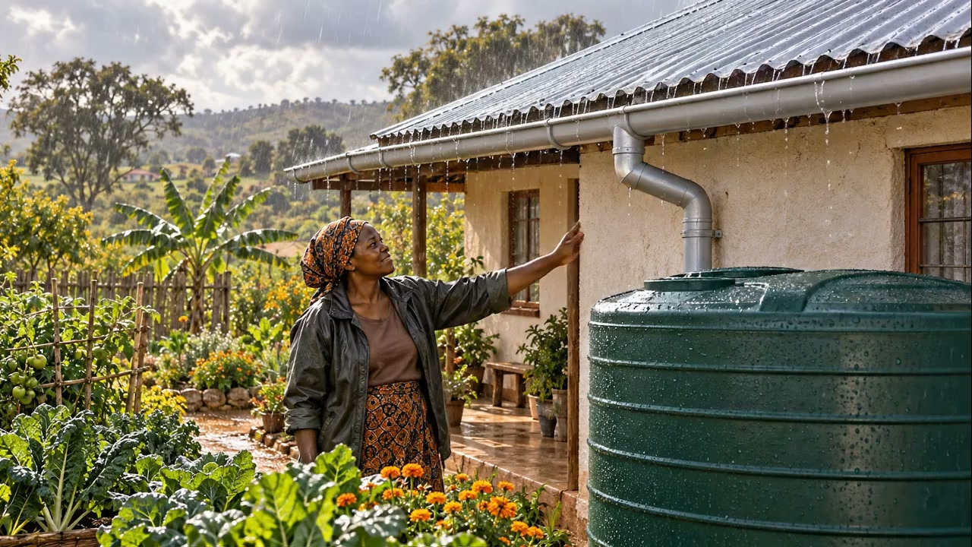
Where did the storm go?
• Summer storms run away
• They take our soil with them
▶ Clip F-ANI-07 · play from the tablet: flow-roof-rain.mp4
F-D2-02 · Poster F-P07
Grow Food, Grow Strong
Notes:
F-D2-S1. Ask where last summer's storm water went, and where it was in September.
Poster: F-P07
Clip F-ANI-07: public/course-animations/water-harvesting/flow-roof-rain.mp4

Slide 3
YOUR TURN
Fast water, slow water
• Pour on bare soil
• Add stones and grass
• Pour again
IMAGE · F-IMG-07 · coming
Tray demo
Two shallow trays of soil tilted on bricks: one bare with water running off carrying soil into a basin; one with a line of stones and grass where water spreads and soaks. Hands pouring from 2 L bottles.
F-D2-03
Grow Food, Grow Strong
Notes:
Tray demo; every group's Materials person pours.

Slide 4
Slow · Spread · Sink · Store
• Slow it · spread it
• Sink it · store it
POSTER ART · F-P07-ART · coming
Artwork for F-P07 · Slow · Spread · Sink · Store
A homestead cross-section on a slope, left (top of slope) to right (bottom). Rain falls on a corrugated-iron roof → gutter → a first-flush pipe → a round covered tank with a tap and an overflow pipe → the overflow leads into a swale with a mound planted with small trees → below it mulched vegetable beds with a buried 2 ℓ bottle beside a plant → a washing…
F-D2-04 · Poster F-P07
Grow Food, Grow Strong
Notes:
Walk the homestead from roof to soil. Ask: what is the biggest tank on your land? (the soil)
Poster: F-P07
Also: F-ANI-08
Clip F-ANI-08: public/course-animations/water-harvesting/watch-04-swale-infiltration.mp4

Slide 5
YOUR TURN
Two catches on your map
• Blue arrows: where water comes from
• Two places to catch it
IMAGE · F-IMG-04 · coming
My garden map
A hand-drawn map on paper seen from above: a house square, a north arrow, a tap, blue arrows of water, a sun symbol on the north side, a circle marking zone 1. Pencil and crayon style.
F-D2-05
Grow Food, Grow Strong
Notes:
Groups help every person mark two water catches on their garden map.

Slide 6
Safety first
• Tools point down
• Nobody behind a swinging pick
• Swap jobs every 10 minutes · drink water
IMAGE · F-IMG-08 · coming
Tool safety
A person carrying a spade and a pick with the points down; another person standing well to the side of someone swinging a mattock; a water bottle in the shade.
F-D2-06
Grow Food, Grow Strong
Notes:
F-D2-S2. Say it before any tool is picked up.

Slide 7
A swale on the level line
• Ditch on the level line
• Soil below as a mound
• Safe spillway at the end
POSTER ART · F-P09-ART · coming
Artwork for F-P09 · A swale on the level line
A large cross-section of a slope (uphill on the left). A trench on the level line (about 40 cm wide, 30 cm deep) with water standing in it and blue arrows soaking down and sideways under the mound; the dug soil forms a mound on the DOWNHILL side, mulched with grass and planted with a small tree and bushes whose roots reach towards the wet zone. Rain…
F-D2-07 · Poster F-P09
Grow Food, Grow Strong
Notes:
Point to the five callouts. Not on steep slopes: use stone lines or grass strips there.
Poster: F-P09
Also: F-ANI-09
Clip F-ANI-09: public/course-animations/water-harvesting/watch-07-swale-overflow-pond.mp4

Slide 8

YOUR TURN
Mark the contour
• One foot on the peg
• Swing until the string hits the middle
• Peg · move · repeat
▶ Clip F-ANI-06 · play from the tablet: flow-a-frame.mp4
F-D2-08 · Poster F-P06
Grow Food, Grow Strong
Notes:
Everyone in the group places the frame at least once. Smooth zig-zags; join sections.
Poster: F-P06
Clip F-ANI-06: public/course-animations/reading-landscape/flow-a-frame.mp4

Slide 9
YOUR TURN
Dig
• Ditch above the pegs
• Soil downhill
• Keep the bottom flat
IMAGE · F-IMG-09 · coming
Digging the swale
Five learners on a contour line of pegs: two digging the ditch uphill of the pegs, one raking soil into a mound downhill, one measuring depth with a marked stick, one bringing water.
F-D2-09 · Poster F-P09
Grow Food, Grow Strong
Notes:
Roles: 2 dig, 1 rakes berm, 1 checks depth (30 cm), 1 fetches water and times swaps.
Poster: F-P09

Slide 10
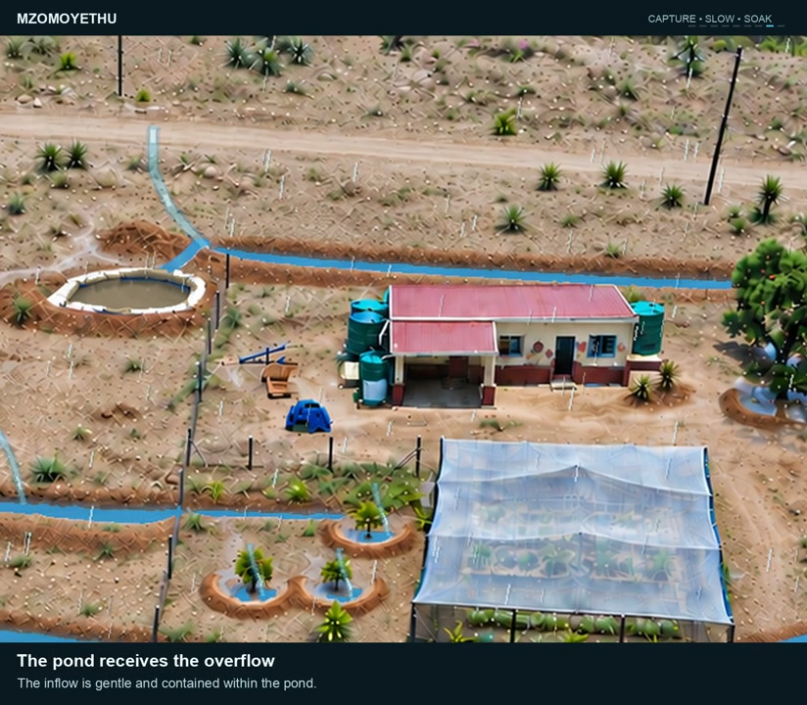
YOUR TURN
Test it
• Two bottles of water in your section
• Does it spread or run?
▶ Clip F-ANI-09 · play from the tablet: watch-07-swale-overflow-pond.mp4
F-D2-10
Grow Food, Grow Strong
Notes:
If it runs to one end, take soil off the floor at the high end. Mulch the mound.
Clip F-ANI-09: public/course-animations/water-harvesting/watch-07-swale-overflow-pond.mp4

Slide 11
The magic rule
• 1 mm of rain on 1 m² = 1 litre
POSTER ART · F-P08-ART · coming
Artwork for F-P08 · How much rain from your roof?
Top: a single square metre of ground marked with four pegs and string, a rain cloud over it, and one 1-litre bottle beside it. Middle: a simple house with a corrugated roof, a measuring tape along the length and width at ground level, rain falling, and a row of identical 20 ℓ buckets lined up beside a tank. Bottom: a tank close-up — gutter with a gentle…
F-D2-11 · Poster F-P08
Grow Food, Grow Strong
Notes:
F-D2-S3. Hold up the 1 litre bottle. A 20 mm storm on 1 m² = one 20 litre bucket.
Poster: F-P08

Slide 12
YOUR TURN
Measure the roof
• Length × width on the ground
• Never climb the roof
IMAGE · F-IMG-11 · coming
Measuring the roof
Two learners stretching a knotted string along the ground under the edge of a corrugated-iron roof of a hall; a third counting knots.
F-D2-12
Grow Food, Grow Strong
Notes:
Knotted string (knot every metre) or a tape.

Slide 13
How many buckets?
• 10 m × 6 m = 60 m²
• 60 × 20 mm × 0.8 = 960 litres
• ≈ 48 buckets from one storm
IMAGE · F-IMG-12 · coming
Buckets from one storm
A small house roof with rain and, beside it, a long neat line of identical 20 L buckets receding into the distance — many buckets.
F-D2-13 · Poster F-P08
Grow Food, Grow Strong
Notes:
Worked example, then the venue roof. Counters method: one bottle top = 1 m² = 1 bucket. Yearly: × your area's yearly rain (check locally).
Poster: F-P08

Slide 14
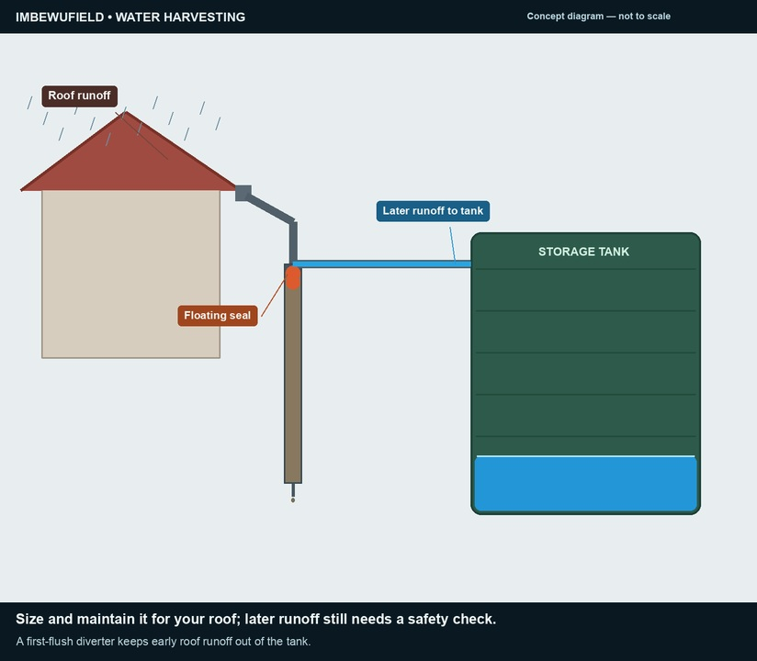
Gutter, first-flush, tank
• First rain washes the roof — let it go
• Lid on · tap above a bucket
• Overflow to the garden
▶ Clip F-ANI-10 · play from the tablet: watch-16-first-flush-tank.mp4
F-D2-14 · Poster F-P08
Grow Food, Grow Strong
Notes:
Each learner estimates their own roof and writes the storm number on their map.
Poster: F-P08
Clip F-ANI-10: public/course-animations/water-harvesting/watch-16-first-flush-tank.mp4

Slide 15
POSTER ART · F-P07-ART · coming
Every drop twice
Artwork for F-P07 · Slow · Spread · Sink · Store
A homestead cross-section on a slope, left (top of slope) to right (bottom). Rain falls on a corrugated-iron roof → gutter → a first-flush pipe → a round covered tank with a tap and an overflow pipe → the overflow leads into a swale with a mound planted with small trees → below it mulched vegetable beds with a buried 2 ℓ bottle beside a plant → a washing…
Four stations · 10 minutes each
F-D2-15
Grow Food, Grow Strong
Notes:
F-D2-S4 carousel: bottles, mulch, greywater, banana circle.

Slide 16
YOUR TURN
Bottle drip-waterer
• Two small holes near the bottom
• Bury to the neck beside the plant
• Hot nail: pliers only
IMAGE · F-IMG-13 · coming
Bottle drip-waterer
Cut-away of soil with a 2 L bottle buried to its neck beside a young plant; tiny droplets leaving two small holes near the base towards the roots.
F-D2-16
Grow Food, Grow Strong
Notes:
Station A.

Slide 17
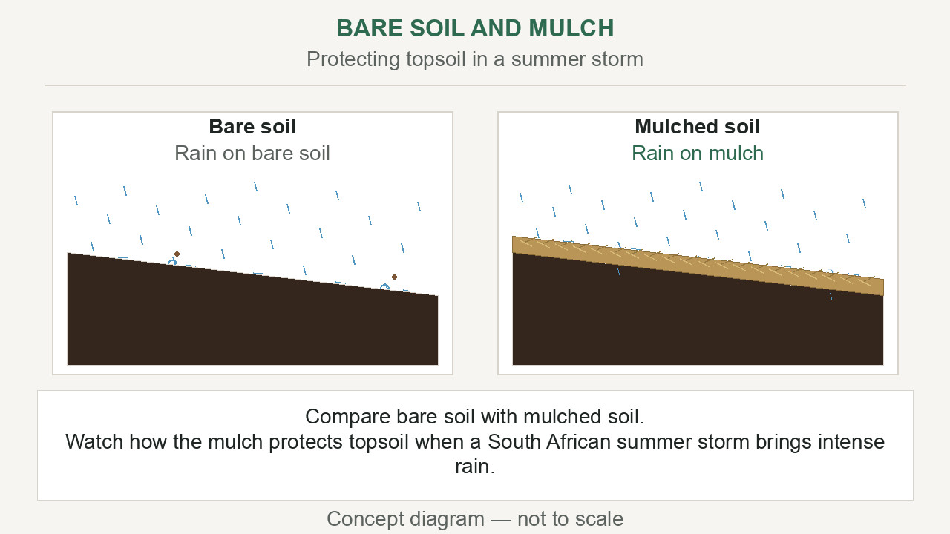
Mulch right
• A hand's width deep
• A fist's gap around stems
• Halves the watering
▶ Clip F-ANI-12 · play from the tablet: watch-14-mulch-protection.mp4
F-D2-17
Grow Food, Grow Strong
Notes:
Station B. Dig and compare moisture under mulch and bare soil.
Clip F-ANI-12: public/course-animations/soil-health/watch-14-mulch-protection.mp4

Slide 18
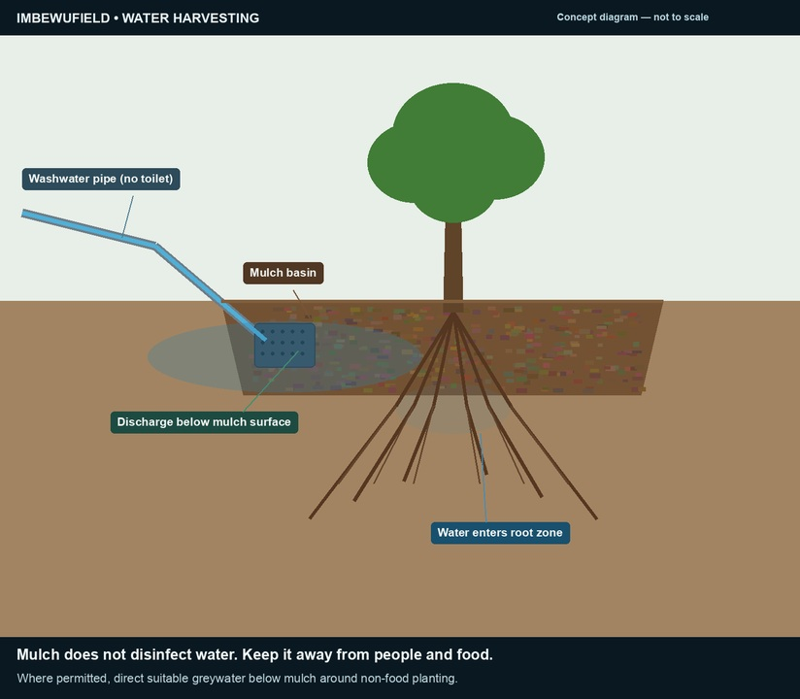
Greywater and the banana circle
• Washing water to trees, not leaves you eat raw
• Never toilet, nappy, bleach or oil water
• Change where you pour
▶ Clip F-ANI-11 · play from the tablet: watch-21-greywater-mulch.mp4
F-D2-18 · Poster F-P07
Grow Food, Grow Strong
Notes:
Stations C and D. Mark a banana circle 1.5–2 m across; centre bowl filled with grass and prunings.
Poster: F-P07
Clip F-ANI-11: public/course-animations/water-harvesting/watch-21-greywater-mulch.mp4

Slide 19
Tonight
• One bucket of washing water on a plant
• Bring grass, leaves, greens, manure tomorrow
IMAGE · F-IMG-05 · coming
Closing circle
Late-afternoon warm light; a circle of standing people, one holding up a hand to speak; tools laid neatly on a tarp in the centre.
F-D2-19
Grow Food, Grow Strong
Notes:
Closing circle.

