Slide 1
IMAGE · F-IMG-14 · coming
Usuku 3 · Inhlabathi ephilayo
Dark crumbly soil
Two cupped hands holding very dark, crumbly soil with an earthworm and fine roots.
Ondla inhlabathi, inhlabathi yondla isitshalo
F-D3-01
Grow Food, Grow Strong
Notes:
Opening circle. Pile the learners' materials: browns, greens, manure.

Slide 2
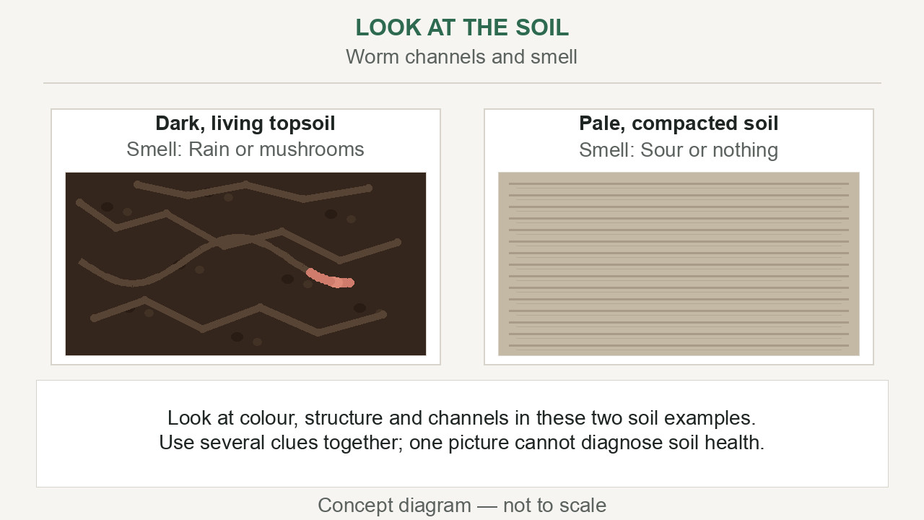
Iyaphila noma ifile?
• Iphunga · umbala · izigaxana · izimpande · imisundu
▶ Clip F-ANI-13 · play from the tablet: watch-05-living-soil.mp4
F-D3-02 · Poster F-P10
Grow Food, Grow Strong
Notes:
F-D3-S1. Two handfuls: under old mulch vs from a path.
Poster: F-P10
Clip F-ANI-13: public/course-animations/soil-health/watch-05-living-soil.mp4

Slide 3
Okuhlala enhlabathini
• Imisundu, amabhungane, isikhunta, amagciwane
• Kuguqula izitshalo ezifile kube ukudla kwezitshalo
POSTER ART · F-P10-ART · coming
Artwork for F-P10 · Soil is alive
Top 55%: a cut-away of soil under a mulched vegetable, magnified: earthworms, a beetle, white fungus threads wrapped around roots, dark crumbs with air gaps, water droplets held in the crumbs, tiny dots for microbes. Bottom 45%: four small panels for the hand tests — (a) a hand squeezing a ball of soil, three results: falls apart / ball that crumbles /…
F-D3-03 · Poster F-P10
Grow Food, Grow Strong
Notes:
One handful of healthy soil holds more life than there are people in South Africa.
Poster: F-P10

Slide 4
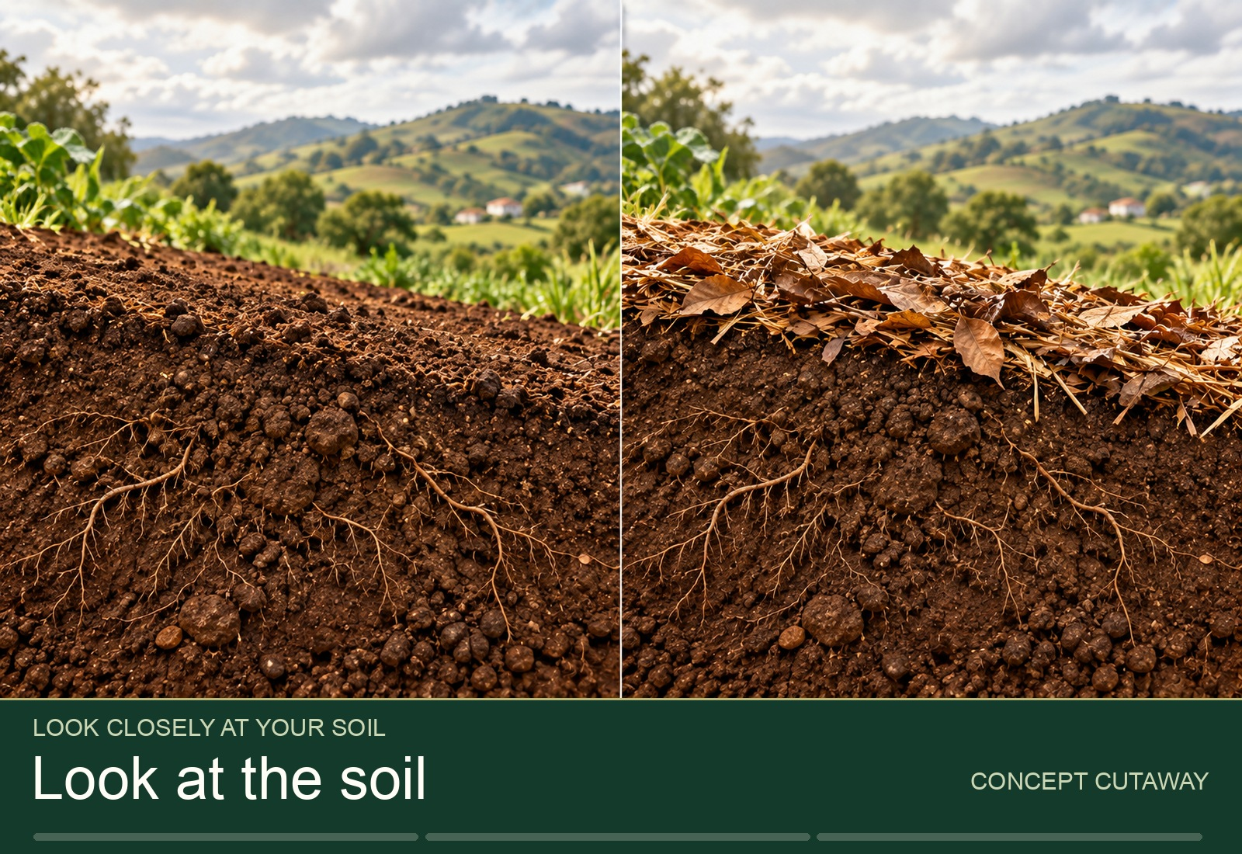
SEBENZANI
Izivivinyo ezine
• Cindezelani · Ingilazi · Hogelani nibuke · Imisundu
• Imizuzu engu-7 ngasinye
▶ Clip F-ANI-14 · play from the tablet: tour-soil-observation.mp4
F-D3-04 · Poster F-P10
Grow Food, Grow Strong
Notes:
Timekeeper calls the rotation. Also the tin soak test with the worm count.
Poster: F-P10
Clip F-ANI-14: public/course-animations/soil-health/tour-soil-observation.mp4

Slide 5
Inhlabathi yethu idingani?
• Isihlabathi noma ubumba — impendulo iyafana
• Izinto ezibolile (organic matter)
IMAGE · F-IMG-15 · coming
Organic matter answer
Split: sandy soil (loose pale grains) and clay soil (cracked plates) each receiving the same handful of dark compost from above.
F-D3-05
Grow Food, Grow Strong
Notes:
Each Reporter: our soil is ___, it needs ___.

Slide 6
Mba kanye, yondla iminyaka
• 1 m ububanzi — unganyatheli
• 50–60 cm ukujula
• Izingqimba njenge-sandwich
POSTER ART · F-P13-ART · coming
Artwork for F-P13 · Beds that hold water
Top 60%: a cut-away trench bed 1 m wide in the ground with a gogo reaching to the middle from one side and a young man from the other (arms showing the reach). Layers visible like a sandwich: sticks and cardboard at the bottom, manure, green, dry grass, soil — repeated — topsoil with young plants on top, mulch, and a small lip at the edges holding water.…
F-D3-06 · Poster F-P13
Grow Food, Grow Strong
Notes:
F-D3-S2. Show the keyhole bed too: good by the kitchen and for older people.
Poster: F-P13

Slide 7
SEBENZANI
Mbani
• Shayani izikhonkwane 1 m × 2 m
• Inhlabathi engaphezulu ohlangothini olulodwa, engaphansi kolunye
• Shintshanani njalo emizuzwini engu-10
IMAGE · F-IMG-16 · coming
Digging a trench bed
A 1 m × 2 m pegged rectangle being dug by two people; pale subsoil on one side, dark topsoil on the other; others waiting with a wheelbarrow of dry grass.
F-D3-07
Grow Food, Grow Strong
Notes:
Break up the bottom with the fork.

Slide 8
SEBENZANI
Yendlaleni ngezingqimba
• Okumahhadla → umquba → okuluhlaza → okomile → inhlabathi
• Niselani ungqimba ngalunye · phindani
• Inhlabathi engaphansi iye phakathi, ingabi phezulu
IMAGE · F-IMG-17 · coming
Trench bed layers
Cut-away of the trench showing sandwich layers: sticks and cardboard, manure, green leaves, dry grass, soil, repeated; a watering can over it.
F-D3-08 · Poster F-P13
Grow Food, Grow Strong
Notes:
Top 15 cm: topsoil plus compost. Lip at the edges, mulch, two buckets of water.
Poster: F-P13

Slide 9
Umhlabathi oqinile?
• Yakha uye phezulu, ungambi
• Ikhadibhodi elimanzi, bese kuba izingqimba ezifanayo
IMAGE · F-IMG-18 · coming
No-dig raised bed
Wet flattened cardboard on hard ground inside a border of logs and sand-filled bottles; layers piling up above ground.
F-D3-09
Grow Food, Grow Strong
Notes:
No-dig raised bed alternative. Bed walk: what would you do differently at home?

Slide 10
Imfucuza ibe ukudla
• Okuluhlaza · Okunsundu · Amanzi · Umoya
POSTER ART · F-P11-ART · coming
Artwork for F-P11 · Build a compost heap
A tall cut-away of a 1 m compost heap with visible layers from the bottom: sticks/stalks (with air gaps), thick yellow-brown dry grass, a thin green layer of fresh cuttings and peels, a dark thin manure layer, a sprinkle of soil, a watering can pouring — repeated three times, topped with a dry-grass blanket and a long stick pushed into the middle. Beside…
F-D3-10 · Poster F-P11
Grow Food, Grow Strong
Notes:
F-D3-S3. Start with the Compost Heap energiser.
Poster: F-P11
Also: F-ANI-15
Clip F-ANI-15: public/course-animations/soil-health/flow-compost-materials.mp4

Slide 11
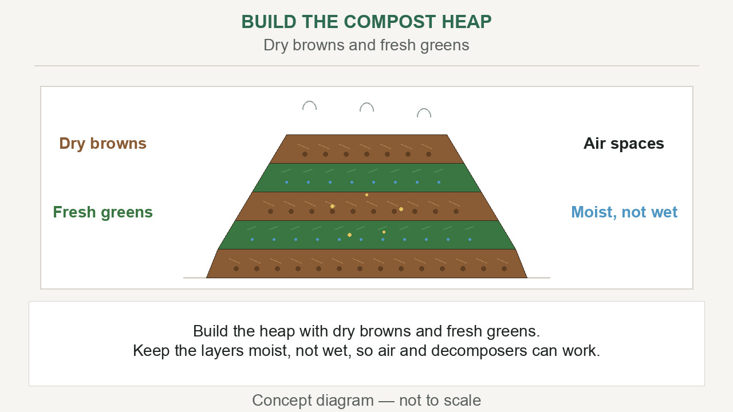
Ingxube
• Amabhakede 2–3 okunsundu : 1 okuluhlaza
• Kumanzana njengendwangu ekhanyiwe
• 1 m × 1 m × 1 m
▶ Clip F-ANI-16 · play from the tablet: watch-10-compost-heap.mp4
F-D3-11 · Poster F-P11
Grow Food, Grow Strong
Notes:
Size matters: big enough to get hot.
Poster: F-P11
Clip F-ANI-16: public/course-animations/soil-health/watch-10-compost-heap.mp4

Slide 12
SEBENZANI
Yakhani inqwaba yenu ye-compost
• Izinti ngaphansi
• Okunsundu · okuluhlaza · umquba · inhlabathi · amanzi
• Induku phakathi, bese nimboza
IMAGE · F-IMG-19 · coming
Building the heap
A group of five building a 1 m compost heap in layers; a long stick standing in the middle; piles of browns and greens beside.
F-D3-12
Grow Food, Grow Strong
Notes:
30 minutes. Squeeze test each group. Pull the stick in 3 days: warm means working.

Slide 13
Akufakwa enqwabeni
• Inyama, amathambo, amafutha, ubisi
• Ipulasitiki, ingilazi, amathini
• Indle yezilwane noma yabantu · izitshalo ezigulayo
IMAGE · F-IMG-20 · coming
Never in the heap
A row of items each with a clear red circle-and-slash overlay: a bone, a bottle, a tin, a cooking-oil bottle, a plastic bag, a dog.
F-D3-13
Grow Food, Grow Strong
Notes:
Weeds with seeds only if the heap gets hot.

Slide 14
SEBENZANI
Umquba oketshezi
• Umquba esakeni, emgqonyeni wamanzi
• Govuzani njalo ezinsukwini ezi-2–3 amasonto ama-2
• Inkomishi 1 ezinkomishini 10 zamanzi, enhlabathini
ANIMATION · F-ANI-17 · coming
Liquid manure drum
Side cut-away of a 20 L plastic drum. (0–3 s) a hand lowers a hessian sack of dark manure on a string tied to a stick laid across the drum mouth. (3–6 s) water pours in to near the brim, a few green leaves added, lid placed. (6–10 s) a day-counter shown as sun/moon icons cycling 14 times while a stick stirs every few cycles; the water darkens to…
F-D3-14 · Poster F-P12
Grow Food, Grow Strong
Notes:
Each group does one step. Agree who stirs.
Poster: F-P12
Clip F-ANI-17: public/course-media/farmer-5day/F-ANI-17.mp4

Slide 15
SEBENZANI
Indlu yemisundu (i-worm farm)
• Imisundu ebomvu ye-compost, hhayi imisundu yasengadini
• Umbhede wephepha elimanzi · amakhasi · umthunzi
• Hhayi amawolintshi, u-anyanisi, inyama, amafutha
ANIMATION · F-ANI-18 · coming
Worm farm layers
Two stacked containers in shade, front cut-away. Top: holes in the base, damp shredded paper bedding, a handful of red worms placed on it, vegetable peels added to one side, a damp sack laid over. Time passes (sun/moon icons): peels shrink, dark crumbly castings build up, a few drops of dark liquid drip through the holes into the bottom container, which…
F-D3-15 · Poster F-P12
Grow Food, Grow Strong
Notes:
F-D3-S4. Each group does one step. Worm tea 1:10.
Poster: F-P12
Clip F-ANI-18: public/course-media/farmer-5day/F-ANI-18.mp4

Slide 16
Izitshalo ezondla inhlabathi
• Ehlobo: ubhontshisi, imbumba (cowpeas), i-lablab
• Ebusika: i-oats, uphizi
• Zisike ngaphambi kokuqhakaza, uzendlale njenge-mulch
IMAGE · F-IMG-21 · coming
Green manure
A bed of dense bushy legume plants being cut at flowering and laid on the soil as mulch.
F-D3-16
Grow Food, Grow Strong
Notes:
Green manure. Never leave soil bare.

Slide 17
SEBENZANI
Uhlelo lwami lwenhlabathi
• Lapho i-compost yami izoba khona
• Lapho umbhede wami wokuqala uzoba khona
• Lapho i-mulch yami izovela khona
IMAGE · F-IMG-04 · coming
My garden map
A hand-drawn map on paper seen from above: a house square, a north arrow, a tap, blue arrows of water, a sun symbol on the north side, a circle marking zone 1. Pencil and crayon style.
F-D3-17
Grow Food, Grow Strong
Notes:
On each learner's garden map. Group checks each map.

Slide 18
Kusihlwa
• Qalani inqwaba ye-compost ekhaya
• Lethani izitsha zezithombo kusasa
IMAGE · F-IMG-05 · coming
Closing circle
Late-afternoon warm light; a circle of standing people, one holding up a hand to speak; tools laid neatly on a tarp in the centre.
F-D3-18
Grow Food, Grow Strong
Notes:
Closing circle. Remind: seed to share on Day 5.

