Slide 1
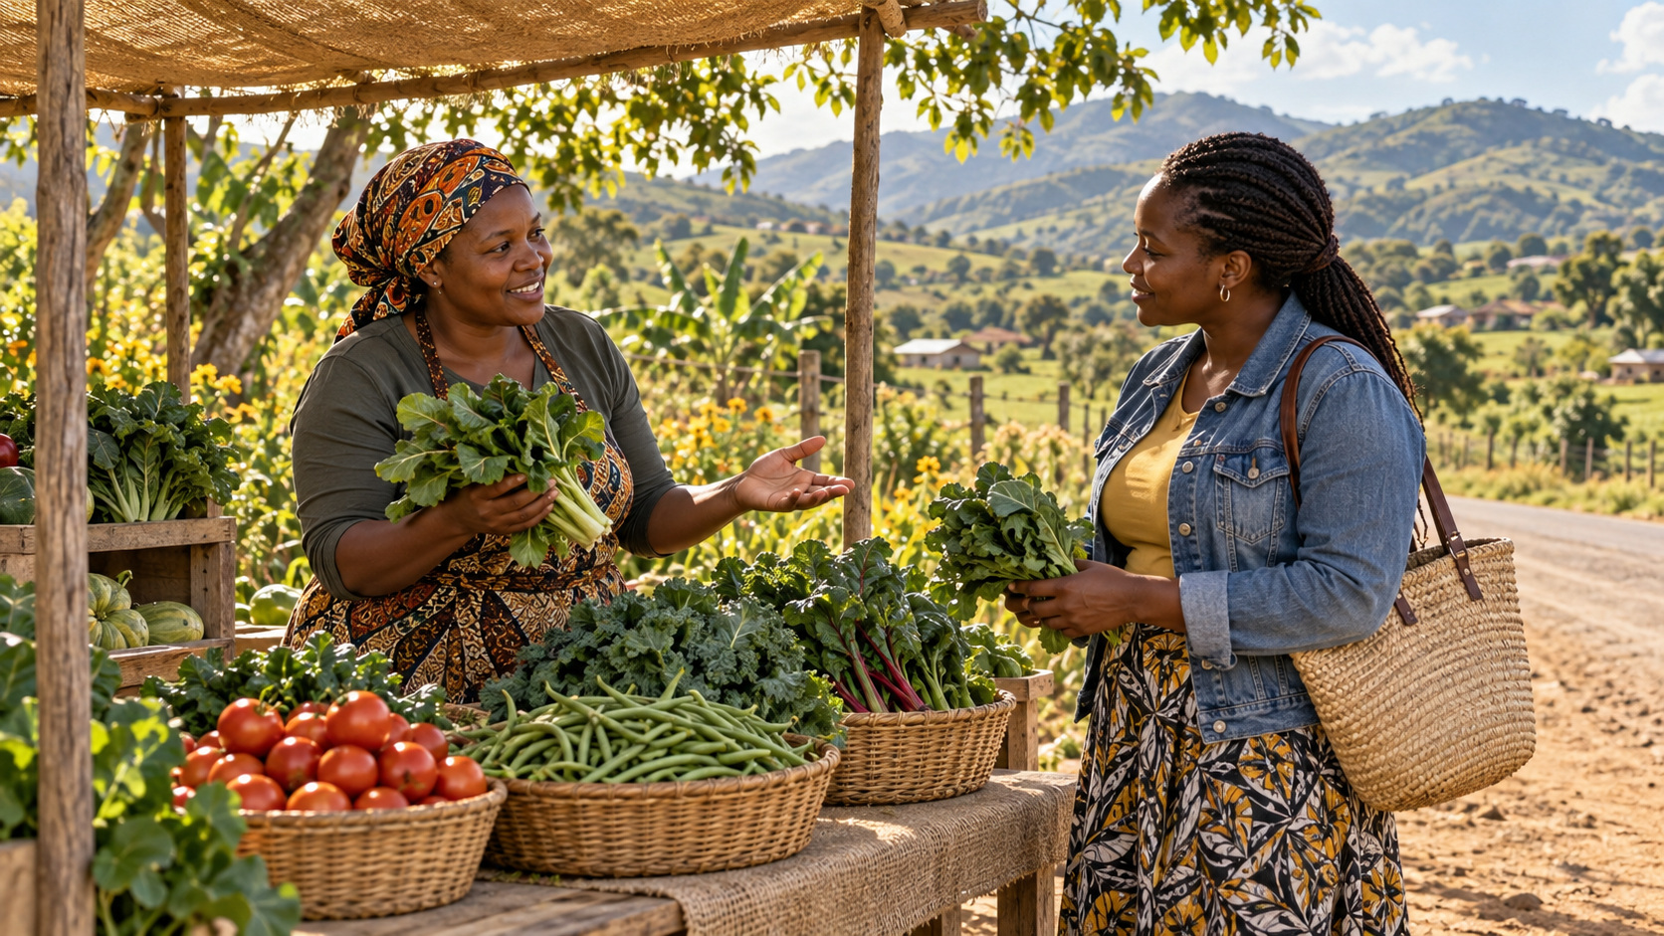
Day 2 · Farm money
Farmer Money · Day 2 of 3
Write it · count it · price it
R-D2-01
Farmer Money
Notes:
R-D2-S0. Register, energiser In · Out · Owed, "what did you sleep on?" — do not ask who made a bean map at home. Rotate roles.

Slide 2
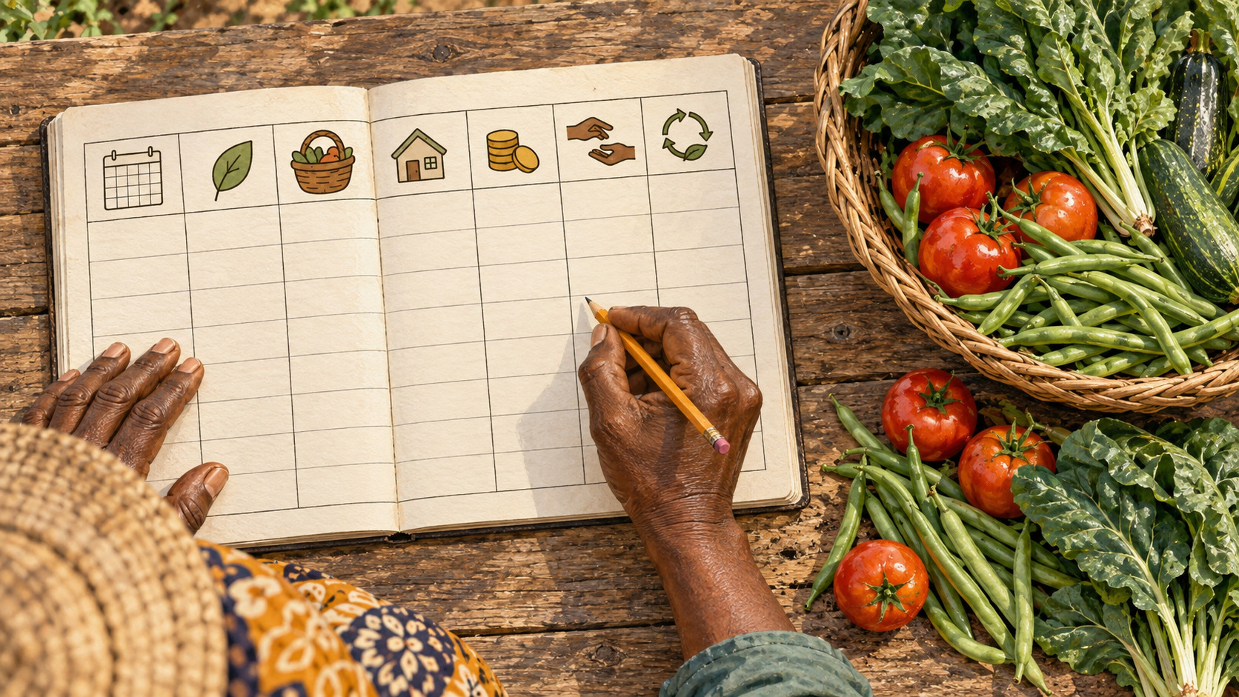
Did Lerato make money?
• Her farm tin has R315
• Did the garden make money?
• The tin can't tell. The book can.
R-D2-02 · Poster R-P08
Farmer Money
Notes:
R-D2-S1. Hold up a tin. Let them say "we can't tell". Then the book.
Poster: R-P08

Slide 3
Write every rand
• Date · what · in · out
• Balance = what's in the tin
• Owed to me: a separate page
POSTER ART · R-P08-ART · coming
Artwork for R-P08 · The money book
A large open exercise book, seen from above, on a wooden table. The left page has a grid of five columns; the column heads are **icons only**: ① a small calendar ② a leaf and a taxi (what happened) ③ a coin with an arrow going in ④ a coin with an arrow going out ⑤ a tin. Rows have scribble marks, not numbers. ⑥ The right page is a separate list with a…
R-D2-03 · Poster R-P08
Farmer Money
Notes:
R-D2-S1. Point to columns 1–5 and the Owed page. F-P20 from Course 1 is the same book. One line for every rand, the same day.
Poster: R-P08
Also: R-ANI-07
Clip R-ANI-07: public/course-animations/market-community/watch-04-farm-record.mp4

Slide 4
YOUR TURN
Lerato's week
• Opening balance R150
• 10 cards: move money, write a line
• Cards 3, 9: money moves? (20 min)
IMAGE · R-IMG-03 · coming
Play money artwork
Artwork for printed **play money** notes and coins. Notes 120 × 60 mm (clearly smaller than real notes, which must not be copied), coins 30 mm circles. Each note: Paper background, a big plain oval on the left with a simple **crop** drawing (R10 = a bean pod, R20 = a spinach leaf, R50 = a cabbage, R100 = a maize cob), a thick colour band down the right…
R-D2-04
Farmer Money
Notes:
R-D2-S1. Materials moves play money; Recorder writes. Card 3 = Owed page (spaza R200). Card 7 = taken home R50. Card 9 = harvest record only. Closing balance R315.

Slide 5
Reconcile
• Count the tin
• Does it match the book?
• No? Find the line.
POSTER ART · R-P08-ART · coming
Artwork for R-P08 · The money book
A large open exercise book, seen from above, on a wooden table. The left page has a grid of five columns; the column heads are **icons only**: ① a small calendar ② a leaf and a taxi (what happened) ③ a coin with an arrow going in ④ a coin with an arrow going out ⑤ a tin. Rows have scribble marks, not numbers. ⑥ The right page is a separate list with a…
R-D2-05 · Poster R-P08
Farmer Money
Notes:
R-D2-S1. Usual mistakes: card 7 missed; card 3 entered as cash. Mistakes are good — this is what reconciling is for.
Poster: R-P08

Slide 6
A sale is not cash
• Sold R590 this week
• Cash in: R390
• Spaza owes R200
R-D2-06 · Poster R-P08
Farmer Money
Notes:
R-D2-S1. When the spaza pays at month-end: R200 in, tick off the Owed page. Never write the sale twice. Profit needs a full season — this afternoon.
Poster: R-P08

Slide 7
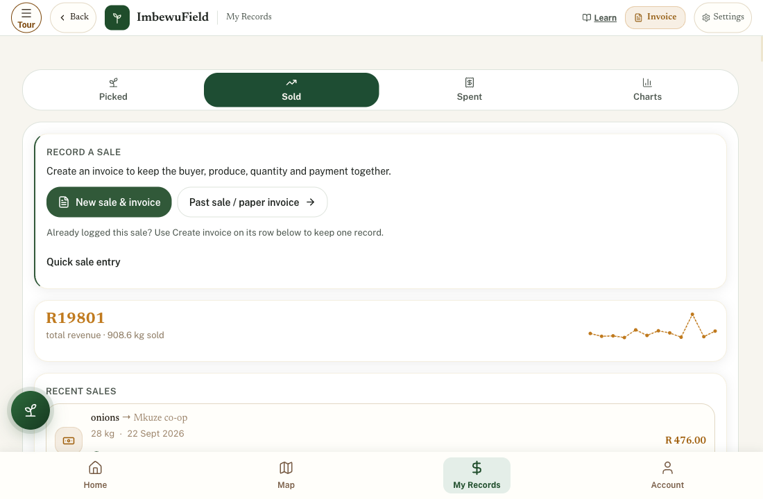
APP
My Records: Sold and Spent
• Picked · Sold · Spent · Charts
• Sold → Quick sale entry
• Spent → New entry
R-D2-07
Farmer Money
Notes:
R-D2-S1 [APP]. Enter cards 1, 2, 3 of Lerato's week. Card 3: New sale & invoice → Not yet — payment outstanding. Keep the paper book too. App works offline.
Also: R-IMG-32

Slide 8
My own money book
• Write your name on the cover
• Practise: Sizanani's Monday
• From tonight: your own garden
PHOTO · R-PHO-01 · coming
A real money book page and tin
Real photograph, taken by the programme on Day 0: the course money book (P1) open on a wooden table, filled in by hand with **Lerato's week** (made-up data — never a learner's real book), a pencil, and a tin with its lid off showing play money. Daylight, from above, no faces. 1920 × 1080.
R-D2-08
Farmer Money
Notes:
R-D2-S1 [PAPER]. Opening R80 + R144 sale − R35 seed − R20 taxi = R169. Pictures are fine. Nobody reads your book.

Slide 9
ANIMATION · R-ANI-06 · coming
Where did the harvest go?
Where the harvest goes
A full basket of greens (0–2 s). Bunches lift out and travel along four paths: to a family pot on a fire (4 bunches), over a fence to a neighbour (1), to a buyer at a gate who hands back coins (4), and one wilts and falls to a goat (1) (2–10 s). Beside the family pot, a coin stays in a purse (money saved) (10–12 s). Poster frame: the four paths.
Eaten · shared · sold · lost
R-D2-09 · Poster R-P09
Farmer Money
Notes:
R-D2-S2. Full basket in the middle. Ask where it goes. All four came from your work and costs.
Poster: R-P09
Also: R-P09-ART
Clip R-ANI-06: public/course-media/farmer-money/R-ANI-06.mp4

Slide 10
YOUR TURN
Harvest, bunch, record
• Harvest 5 bunches — outer leaves
• Weigh one bunch
• Fill the harvest record (25 min)
IMAGE · R-IMG-07 · coming
Bunches weighed and counted
At the edge of a garden bed, a group of five (mixed ages) around a crate: one cuts outer leaves of leafy greens (leaving the heart), one ties even bunches with rubber bands, one hangs a bunch on a simple kitchen hanging scale, one sits on a bucket writing in a harvest record (lines only), one carries a basket. Morning light from the north. No text.
R-D2-10
Farmer Money
Notes:
R-D2-S2. Outside at the bed. Family harvest weeks: Dlamini 30 = 8/2/18/2; Mokoena 50 = 5/5/35/5; Sizanani 40 = 4/0/34/2. The four must add up. App users may log the harvest in Picked (optional).
Also: R-IMG-37

Slide 11
Food eaten is money saved
• 8 bunches × R12 = R96
• R96 stayed in Gogo's purse
• A season: R480 not spent
POSTER ART · R-P09-ART · coming
Artwork for R-P09 · Where did the harvest go?
A big woven basket of leafy greens in the centre. Four arrows lead to: ① a family (gogo, mother, two children) eating from a pot of greens and pap at a table ② a woman handing a bunch over a fence to a neighbour ③ a buyer at the garden gate handing coins for a bunch ④ wilted leaves on the ground, a goat's head reaching through a broken fence, a snail on…
R-D2-11 · Poster R-P09
Farmer Money
Notes:
R-D2-S2. Count it with play money. Write "value of food eaten" at the bottom of the harvest record.
Poster: R-P09

Slide 12
Count every cost
• Seed · compost · water · transport
• Bands, bags, tools
• Your time
POSTER ART · R-P10-ART · coming
Artwork for R-P10 · Count every cost
A healthy leafy bed in the centre (generic greens). Six items around it, each linked by a dotted line: ① a blank seed packet with a seed shape ② a bag of compost and a wheelbarrow of kraal manure ③ a JoJo-style tank with a tap and a watering can ④ a minibus taxi ⑤ rubber bands, a spade, a watering can ⑥ a clock beside a woman bent over the bed working.…
R-D2-12 · Poster R-P10
Farmer Money
Notes:
R-D2-S2. Solid lines = cash costs. Dashed = free but not free (manure, rainwater, own time).
Poster: R-P10

Slide 13
YOUR TURN
Lerato's spinach bed
• 12 cost cards, two piles
• Add the cash costs
• Play money first, calculator last (20 min)
IMAGE · R-IMG-09 · coming
Cost cards (12)
A4 sheet, 12 cards (3 × 4), each one object, no text (amounts are printed on the card backs — printables P17): 1 seed packet (blank) · 2 compost bag · 3 wheelbarrow of kraal manure (dashed outline — "free but not free") · 4 tap with a watering can (municipal water) · 5 JoJo-style tank with rain (dashed outline) · 6 rubber bands · 7 minibus taxi · 8…
R-D2-13
Farmer Money
Notes:
R-D2-S2. Answer R510: seed 35, compost 220, water 60, bands 30, transport 120, spray 15, watering-can share 30. Free but not free: manure, rainwater, seedlings, 44 hours.

Slide 14
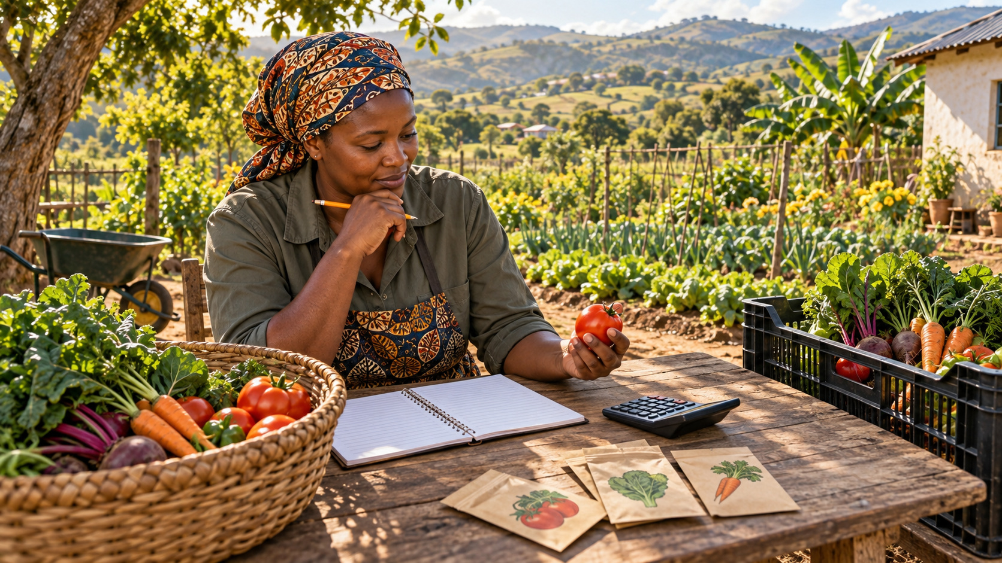
The season's cost
• Cash costs: R510
• Plus 44 hours of her time
• 150 bunches picked
R-D2-14 · Poster R-P10
Farmer Money
Notes:
R-D2-S2. Leave R510 on the flipchart for after lunch. Why R30 for a R90 can? It lasts three seasons.
Poster: R-P10

Slide 15
Keep every slip
• Circle the total
• Glue it in, or envelope
• No slip? Write one
PHOTO · R-PHO-02 · coming
A till slip glued into the book
Real photograph: a till slip from an agri/hardware shop (seed and compost) glued onto the slip page (P2), the total circled in pen and the money-book line number written beside it. Blur or crop any shop name, card digits or personal details. 1920 × 1080.
R-D2-15
Farmer Money
Notes:
R-D2-S2 [PAPER]. Slip page (P2): line number beside each slip. Home-made slip for taxi and hawker costs: date, what, how much, who, sign.

Slide 16
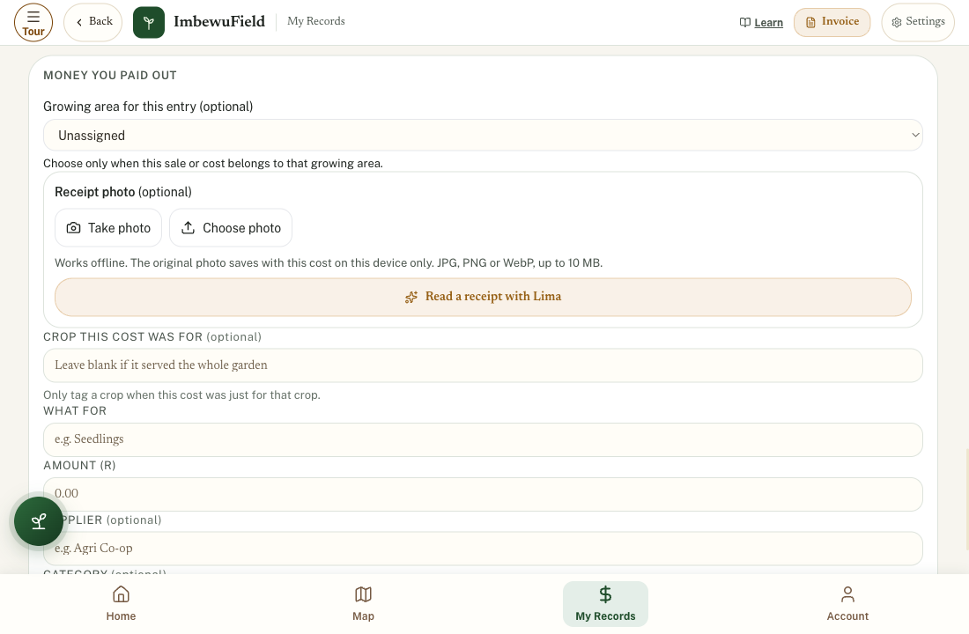
APP
Scan a till slip
• Spent → New entry
• Take photo → Read with Lima
• Check it, then save
R-D2-16
Farmer Money
Notes:
R-D2-S2 [APP]. Receipt photo → Take photo → Read a receipt with Lima. Check amount, date, what for. Crop this cost was for: only if just for that crop. Reading needs data; the photo saves offline. Keep the paper slip too.
Also: R-IMG-32

Slide 17
POSTER ART · R-P11-ART · coming
One bunch
Artwork for R-P11 · One bunch: cost, price, profit
Top half: ① a pile of generic notes and coins on the left ② a row of many spinach bunches on the right ③ a curved arrow that shares the money onto one single bunch, which now sits on a tiny coin stack. Bottom half: three steps like a staircase: ④ the bottom step — a bunch resting on a small coin stack (the floor) ⑤ the middle step — a market stall with…
Cost · price · profit
R-D2-17 · Poster R-P11
Farmer Money
Notes:
R-D2-S3. Energiser "Price Is Right" first (5 min) using the Day 0 price sheet.
Poster: R-P11

Slide 18
Cost of one bunch
• All costs ÷ all bunches
• R510 ÷ 150 = R3.40
• Never sell below it
POSTER ART · R-P11-ART · coming
Artwork for R-P11 · One bunch: cost, price, profit
Top half: ① a pile of generic notes and coins on the left ② a row of many spinach bunches on the right ③ a curved arrow that shares the money onto one single bunch, which now sits on a tiny coin stack. Bottom half: three steps like a staircase: ④ the bottom step — a bunch resting on a small coin stack (the floor) ⑤ the middle step — a market stall with…
R-D2-18 · Poster R-P11
Farmer Money
Notes:
R-D2-S3. Start with R40 shared onto 10 bunch tokens (R4 each). Then Lerato's sum on the calculator. All 150 bunches count — eaten ones cost the same to grow.
Poster: R-P11

Slide 19
A fair price, an honest profit
• Floor · market · buyer
• R1 080 − R510 = R570
• Plus R480 of food
POSTER ART · R-P11-ART · coming
Artwork for R-P11 · One bunch: cost, price, profit
Top half: ① a pile of generic notes and coins on the left ② a row of many spinach bunches on the right ③ a curved arrow that shares the money onto one single bunch, which now sits on a tiny coin stack. Bottom half: three steps like a staircase: ④ the bottom step — a bunch resting on a small coin stack (the floor) ⑤ the middle step — a market stall with…
R-D2-19 · Poster R-P11
Farmer Money
Notes:
R-D2-S3. Then her time: 44 h × about R30 (check the national minimum wage) = R1 320. Selling from one bed does not pay a wage — say it honestly. Only Lerato can decide if it's worth it. Ask how her time could earn more.
Poster: R-P11

Slide 20
Fill the cup first
• Season costs: R600 = 60 beans
• Each bunch leaves R10 = 1 bean
• 60 bunches = break-even
POSTER ART · R-P12-ART · coming
Artwork for R-P12 · Break-even with beans
A big clay cup or tin in the centre, labelled only by a small icon of a fence, a watering can and a taxi on its side (the season's costs). ① The cup is almost full of beans. ② A line of spinach bunches walks towards the cup (drawn as a row); from each bunch drops **one bean** into the cup. ③ The cup is exactly full, with a small star at the rim. ④ Beyond…
R-D2-20 · Poster R-P12
Farmer Money
Notes:
R-D2-S3. Sizanani: price R12, own cost R2 per bunch. Fence R200 + cans R100 + transport R300 = R600.
Poster: R-P12

Slide 21
YOUR TURN
Break-even with beans
• Drop one bean per bunch
• Count until the cup is full
• Try: price falls to R10 (15 min)
R-D2-21
Farmer Money
Notes:
R-D2-S3. At R10 each bunch leaves R8: 600 ÷ 8 = 75 bunches. Use piles of R8 in play money. Expected sales 200 — safe either way.

Slide 22
Money through the season
• Money out first
• Money in later
• Find the pinch month
ANIMATION · R-ANI-05 · coming
The season tin
One tin in the foreground, a garden in the background that changes through 12 months (2 s per month), starting in spring (September): sowing → seedlings → growth → full harvest → autumn planting → winter greens with frost cloth → dry late winter. The sun moves lower in the **northern** sky in winter. The coin level in the tin: falls in September (coins…
R-D2-22 · Poster R-P13
Farmer Money
Notes:
R-D2-S4. Stick local month names on R-P13, September on the left. Ask which month is hardest here (often January or September).
Poster: R-P13
Also: R-P13-ART
Clip R-ANI-05: public/course-media/farmer-money/R-ANI-05.mp4

Slide 23
YOUR TURN
The Dlamini farm tin
• Start: R200 on 1 September
• Month by month, with play money
• Red when below zero (25 min)
R-D2-23
Farmer Money
Notes:
R-D2-S4. Month-ends: Sep −R50, Oct R0, Nov R250, Dec R450, Jan R100, Feb R350. Plans: save from winter sales, buy seed in steps, own compost, save in December for January.

Slide 24
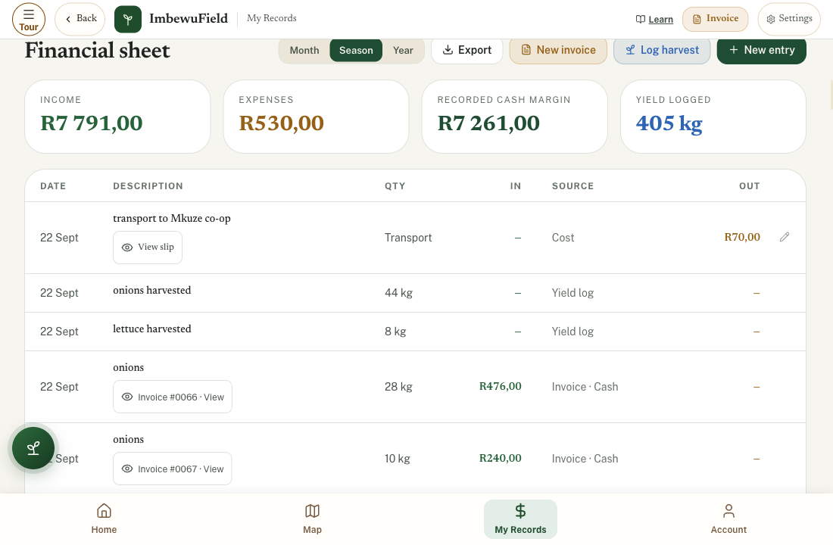
APP
Financial sheet
• My Records → Financial sheet
• Month: Income · Expenses
• Recorded cash margin ≠ season profit
R-D2-24
Farmer Money
Notes:
R-D2-S4 [APP]. Find Lerato's three entries. Optional: Export this month (CSV) to send to a mentor. The sheet is only as good as what was typed in.

Slide 25
Month-end check
• In · out · balance · tin count
• Owed to me · I owe
• Taken home
PHOTO · R-PHO-01 · coming
A real money book page and tin
Real photograph, taken by the programme on Day 0: the course money book (P1) open on a wooden table, filled in by hand with **Lerato's week** (made-up data — never a learner's real book), a pencil, and a tin with its lid off showing play money. Daylight, from above, no faces. 1920 × 1080.
R-D2-25
Farmer Money
Notes:
R-D2-S4 [PAPER]. Summary page (P3) for Lerato's week: in R390, out R225, balance R315, tin R315, owed R200, taken home R50. Ten minutes, last day of every month.

Slide 26
Take home
• Write every farm rand for 7 days
• Price check: one bunch, one other
• Money back: count it all
POSTER ART · R-P08-ART · coming
Artwork for R-P08 · The money book
A large open exercise book, seen from above, on a wooden table. The left page has a grid of five columns; the column heads are **icons only**: ① a small calendar ② a leaf and a taxi (what happened) ③ a coin with an arrow going in ④ a coin with an arrow going out ⑤ a tin. Rows have scribble marks, not numbers. ⑥ The right page is a separate list with a…
R-D2-26 · Poster R-P08
Farmer Money
Notes:
R-D2-SC. Price-check homework: no buying needed; remember or photograph. Question Tree, money back, register PM.
Poster: R-P08

