Slide 1
IMAGE · R-IMG-05 · coming
Usuku 3 · Ukuthengisa nokukhula
Market day
A busy but friendly informal market scene at a taxi rank on a sunny morning (sun in the north). In the foreground a young woman grower hands a crate of even, clean bunches of greens to a creche cook in an apron, who counts them; the grower holds a small duplicate book and pen. Middle ground: a hawker's wheelbarrow stall with greens and tomatoes; a spaza…
Farmer Money · Usuku 3 kwezi-3
Thengisa kahle · boleka ngokuhlakanipha · hlela
R-D3-01
Farmer Money
Notes:
R-D3-S0. Register; energiser Market Shout; "what did you sleep on?"; rotate roles.

Slide 2
Ubani othengayo?
• Umakhelwane · isipaza · umthengisi wasemgwaqweni
• Ikhishi lekhilishi · itafula lasemakethe
• Ukuthengisa ndawonye
POSTER ART · R-P14-ART · coming
Artwork for R-P14 · Who buys? What do they want?
A garden gate in the centre with a woman holding a crate of even, clean bunches. Six paths lead out to: ① a neighbour at the gate with a small bag ② a spaza shop (small building with a serving hatch, crates of vegetables, no signage) ③ a hawker at a taxi rank with a wheelbarrow stall ④ a creche kitchen door with a cook and a delivery crate ⑤ a market…
R-D3-02 · Poster R-P14
Farmer Money
Notes:
R-D3-S1. Start with the price board from the homework. Why are prices different? Who you sell to changes your price.
Poster: R-P14
Also: R-ANI-08
Clip R-ANI-08: public/course-animations/market-community/watch-09-surplus-routes.mp4

Slide 3
SEBENZANI
Umthengi ongcono emndenini wethu
• Amakhadi abathengi ayisithupha
• Wabekeni ngokulandelana, ongcono phezulu
• Yishoni ukuthi kungani (15 min)
IMAGE · R-IMG-10 · coming
Buyer cards (6)
A4 sheet, 6 cards (2 × 3), each one buyer, no text (facts on the backs — printables P16): 1 a neighbour at a garden gate with a shopping bag · 2 a spaza shop hatch with a shopkeeper and crates (no signage) · 3 a hawker with a wheelbarrow stall at a taxi rank · 4 a creche cook at a kitchen door with a delivery crate · 5 a market stall under an awning with…
R-D3-03
Farmer Money
Notes:
R-D3-S1. Why = amount, price, when paid, quality, distance. Reporters: top buyer + one reason, 30 seconds.

Slide 4
Ikhwalithi iyintengo
• Kuvunwe ekuseni · kupholile · kuhlanzekile
• Ubukhulu obufanayo · kufana njalo ngesonto
• Ngesikhathi
IMAGE · R-IMG-08 · coming
Good bunch, bad bunch
Two bunches of leafy greens side by side on a plank. **Left (good):** fresh, upright, clean, deep green, even leaf size, neatly tied with a band, in the shade of a crate. **Right (bad):** wilted, soil on the stems, yellow and holed leaves, mixed sizes, loosely tied, lying in the sun. A small tick-shaped leaf above the left and a drooping leaf above the…
R-D3-04 · Poster R-P14
Farmer Money
Notes:
R-D3-S1. Hold up the good and bad bunch. Which would you buy?
Poster: R-P14

Slide 5
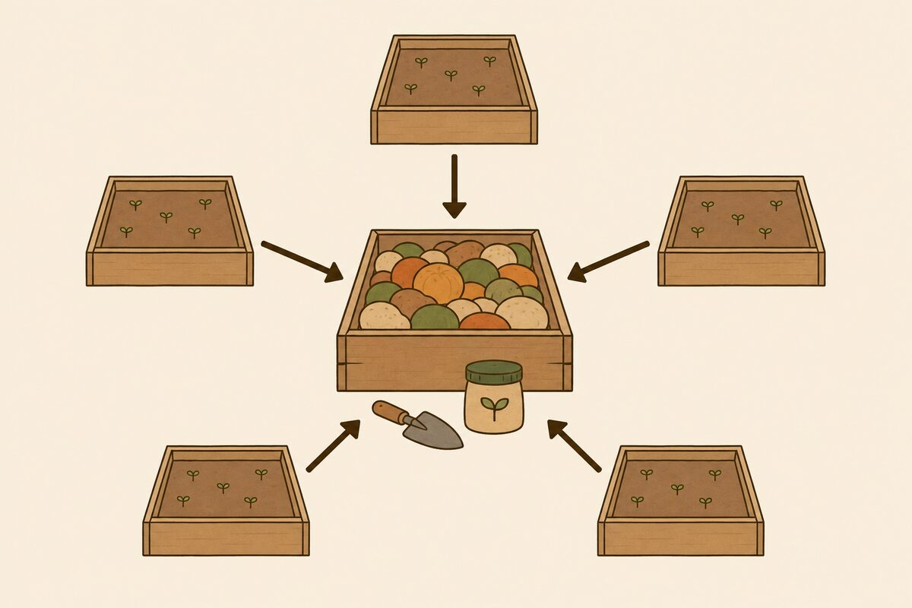
Ukuthengisa ndawonye
• Abalimi abahlanu, i-oda elilodwa elikhulu
• Itekisi elilodwa, izindleko ziyabiwa
• Amarekhodi acacile elungu ngalinye
R-D3-05 · Poster R-P14
Farmer Money
Notes:
R-D3-S1. Five neighbours × 20 bunches = the creche's 100. Taxi R60 together, not R150. Groups: what must they agree? (quality, delivery, one book, receipts per member, how to share money).
Poster: R-P14
Also: R-ANI-09
Clip R-ANI-09: public/course-animations/market-community/watch-14-community-network.mp4

Slide 6
IMAGE · R-IMG-05 · coming
Usuku lwemakethe
Market day
A busy but friendly informal market scene at a taxi rank on a sunny morning (sun in the north). In the foreground a young woman grower hands a crate of even, clean bunches of greens to a creche cook in an apron, who counts them; the grower holds a small duplicate book and pen. Middle ground: a hawker's wheelbarrow stall with greens and tomatoes; a spaza…
Kusuka ku-oda kuya kurisidi
R-D3-06 · Poster R-P15
Farmer Money
Notes:
R-D3-S2. Ask: the creche says "only 20 bunches". What can Lerato show?
Poster: R-P15

Slide 7
Izinyathelo ezinhlanu, ubufakazi obuhlanu
• I-oda → ukuletha → i-invoyisi
• Kukhokhiwe → irisidi
• Iphepha ngalinye lifakazela isinyathelo esisodwa
ANIMATION · R-ANI-03 · coming
From order to receipt
Five beats, 5 s each, same two characters (a young woman grower, a creche cook). 1 Phone order: two phones, a speech bubble with a bunch icon and a crate icon. 2 Delivery: the grower hands a crate; the cook counts bunches one by one (a tally appears as dots) and signs a paper. 3 Invoice: the grower tears the top copy from a book and hands it over; the…
R-D3-07 · Poster R-P15
Farmer Money
Notes:
R-D3-S2. Invoice = you owe me. Receipt = you paid me. Your copy stays in your book. Then a 3-minute demo — then stop and hand over.
Poster: R-P15
Also: R-P15-ART
Clip R-ANI-03: public/course-media/farmer-money/R-ANI-03.mp4

Slide 8
SEBENZANI
Umdlalo wosuku lwemakethe
• Umzuliswano 1: abathengisi aba-3, abathengi aba-3
• Landelani ikhadi lenu lendima
• Shintshanani emzuliswaneni 2 (20 + 20 min)
IMAGE · R-IMG-05 · coming
Market day
A busy but friendly informal market scene at a taxi rank on a sunny morning (sun in the north). In the foreground a young woman grower hands a crate of even, clean bunches of greens to a creche cook in an apron, who counts them; the grower holds a small duplicate book and pen. Middle ground: a hawker's wheelbarrow stall with greens and tomatoes; a spaza…
R-D3-08
Farmer Money
Notes:
R-D3-S2. Buyer tables: SPAZA (half now, half Friday), CRECHE (month-end, needs invoice), HAWKER (cash, no paper). Twist cards at 11:15: wilted bunches returned; treasurer away; no receipt given.

Slide 9
Imali ekweletwayo
• Ekweletwayo ayikho ethinini
• Vumelanani ngosuku lokukhokha, nikubhale phansi
• Asikho isikweletu esisha ize ikhokhwe
R-D3-09 · Poster R-P15
Farmer Money
Notes:
R-D3-S2. At 12:05: each seller group reads its Owed page. Practise a polite reminder in the local language.
Poster: R-P15

Slide 10
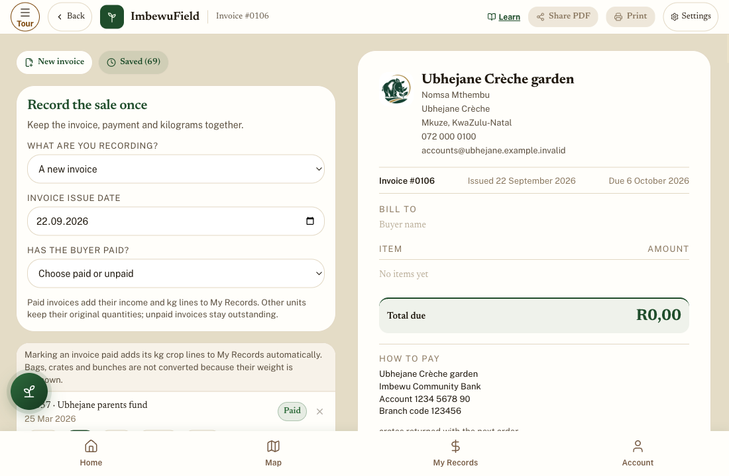
APP
Invoice builder (Isakhi se-invoyisi)
• I-invoyisi entsha
• Izinto, intengo, isamba okufanele sikhokhwe
• Umthengi usekhokhile? Akakakhokhi
R-D3-10
Farmer Money
Notes:
R-D3-S2 [APP]. Creche, 30 bunches × R12 = R360, due month-end. Save invoice. Share PDF to see — do not send to a real person today.

Slide 11
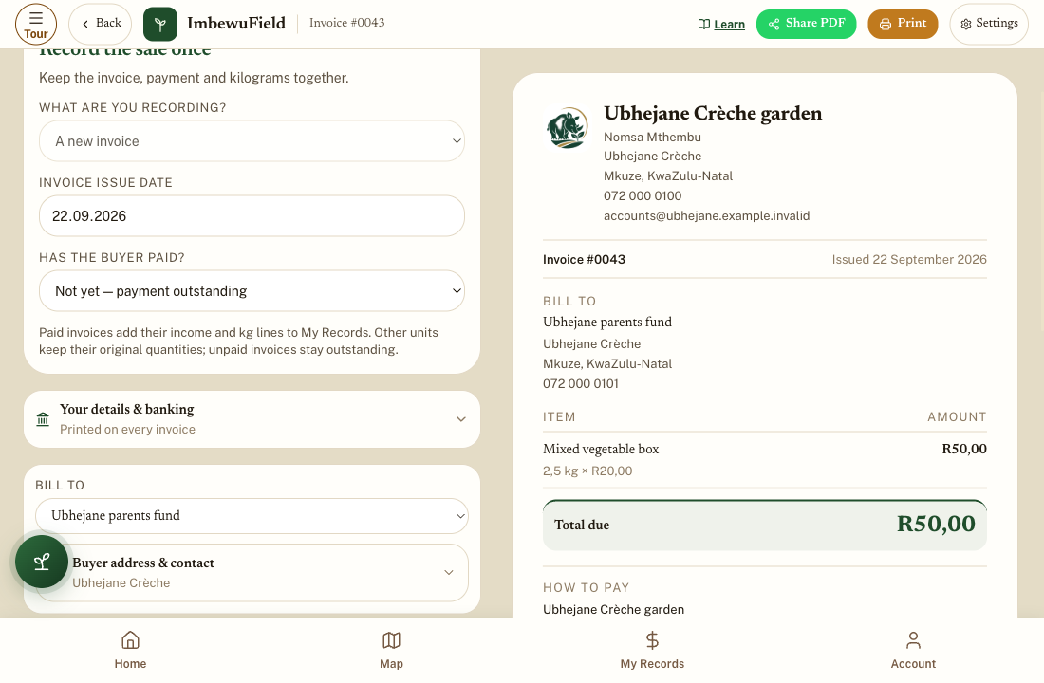
APP
Yibhale ukuthi ikhokhiwe — kanye
• Vula i-invoyisi egciniwe
• Yebo — ikhokhwe yonke + usuku
• Ungabe usayifaka naku-Sold
R-D3-11
Farmer Money
Notes:
R-D3-S2 [APP]. Unpaid invoices stay outstanding — the app's Owed page. Marking paid records the sale once. Past sale / paper invoice is for invoices already written on paper.
Also: R-IMG-36

Slide 12
Izincwadi zama-invoyisi namarisidi
• I-invoyisi: cindezela kakhulu, gcina ikhophi
• Ikhasi lemali engiyikweletwayo: R360
• Kukhokhiwe? Irisidi, thikha, imali ingene
PHOTO · R-PHO-01 · coming
A real money book page and tin
Real photograph, taken by the programme on Day 0: the course money book (P1) open on a wooden table, filled in by hand with **Lerato's week** (made-up data — never a learner's real book), a pencil, and a tin with its lid off showing play money. Daylight, from above, no faces. 1920 × 1080.
R-D3-12
Farmer Money
Notes:
R-D3-S2 [PAPER]. Invoice (P6) and receipt (P7) for the creche order. Amount in words is optional; the buyer's signature matters.

Slide 13
POSTER ART · R-P16-ART · coming
Boleka ngokuhlakanipha
Artwork for R-P16 · Borrow wisely
A young man (mid-20s, cap, overalls) stands at a crossroads, a thought bubble above him showing a small water pump. Four paths lead to: ① a street corner where only a pair of hands is shown, holding a thick stack of bank cards and ID books (the danger — no face, no ethnicity) ② a plain office desk with forms, a stamp, and a person explaining a paper ③ a…
UBongani ufuna iphampu ye-R3 000
Angayithola kuphi?
R-D3-13 · Poster R-P16
Farmer Money
Notes:
R-D3-S3. Energiser Pass the Clap first (5 min). Take all answers.
Poster: R-P16

Slide 14
Imibuzo emihlanu ngaphambi kokuboleka
• Ngiboleka ukwenzani? Izindleko zonke?
• Ngingakhokha? Ubhalisiwe?
• Kuthiwani uma...?
POSTER ART · R-P16-ART · coming
Artwork for R-P16 · Borrow wisely
A young man (mid-20s, cap, overalls) stands at a crossroads, a thought bubble above him showing a small water pump. Four paths lead to: ① a street corner where only a pair of hands is shown, holding a thick stack of bank cards and ID books (the danger — no face, no ethnicity) ② a plain office desk with forms, a stamp, and a person explaining a paper ③ a…
R-D3-14 · Poster R-P16
Farmer Money
Notes:
R-D3-S3. Cost of a loan = pay back − borrowed. Registered lenders show an NCR number and give a written quote.
Poster: R-P16
Also: R-ANI-04
Clip R-ANI-04: public/course-media/farmer-money/R-ANI-04.mp4

Slide 15
SEBENZANI
Izindlela ezine zokuthola u-R3 000
• Balani i-offer ngayinye ngemali yokudlala
• Uthola · ubuyisela · izindleko
• Ingadi ingakhokha? (20 min)
R-D3-15
Farmer Money
Notes:
R-D3-S3. Costs: A R1 500 (and keeps the card — illegal), B R840 (R640 a month — garden has R400), C R450 (R1 150 a month for 3 months — too big; borrow less), D R0 (save R500 a month; hire a pump meanwhile).

Slide 16
Umbolekisi ongekho emthethweni · imali egciniwe
• Ugcina ikhadi lakho? Hamba
• Ayikho inombolo ye-NCR? Hamba
• Imali egciniwe: R20 ngesonto
POSTER ART · R-P16-ART · coming
Artwork for R-P16 · Borrow wisely
A young man (mid-20s, cap, overalls) stands at a crossroads, a thought bubble above him showing a small water pump. Four paths lead to: ① a street corner where only a pair of hands is shown, holding a thick stack of bank cards and ID books (the danger — no face, no ethnicity) ② a plain office desk with forms, a stamp, and a person explaining a paper ③ a…
R-D3-16 · Poster R-P16
Farmer Money
Notes:
R-D3-S3. NCR 0860 627 627. Never borrow with interest for food, parties or another loan. Reserve: R20 × 25 weeks = R500, kept in SAVE, for real emergencies.
Poster: R-P16

Slide 17
Uhlelo lwami lwemali
• Umgomo · amathini amathathu · usuku lwencwadi
• Inyanga enzima nemali egciniwe
• Isinyathelo esisodwa ngenyanga ezayo
POSTER ART · R-P17-ART · coming
Artwork for R-P17 · My money plan
A woman in her 30s and a young man sit at a table outdoors, each drawing on a large sheet. Around them, floating like a mind-map, five small pictures: ① a goal (a school uniform, a water tank, a small shelter for a stall) ② three tins ③ an open money book with a pencil and a sun/moon symbol (when I write) ④ a calendar with one month circled and a small…
R-D3-17 · Poster R-P17
Farmer Money
Notes:
R-D3-S4. Plans are private. Pictures and ticks are fine. No real amounts needed.
Poster: R-P17

Slide 18
SEBENZANI
Yenzani uhlelo lwenu nixoxe ngalo
• 15 min: uhlelo lwami
• 2 min ngamunye: umgomo nesinyathelo esisodwa
• Inkanyezi eyodwa evela eqenjini
R-D3-18
Farmer Money
Notes:
R-D3-S4. Readers help only if asked. Amounts stay private.

Slide 19
SEBENZANI
Imibuzo ngezithombe — futhi
• Amakhadi afanayo, amakhona afanayo
• Yini eshintshile?
IMAGE · R-IMG-20 · coming
Picture quiz cards (8 × 3)
Eight A4 landscape cards, one per quiz question (README table). Each card: a small question picture on the top third, and three answer panels below marked by a **big letter A, B, C typeset by the layout** (the art itself has no letters). 1 · top: coins from a spinach sale; A: coins into a purse with other things; B: coins into a tin beside an open book;…
R-D3-19
Farmer Money
Notes:
R-D3-S4. Write totals next to Day 1's. Now give the answers and celebrate the change.

Slide 20
IMAGE · R-IMG-01 · coming
Izitifiketi
The three families
Three side-by-side scenes, equal width, one per family, same style, a thin Hairline divider between them. **Left — the Dlamini household (rural KZN):** a rondavel and a small block house on a green hillside; a 2 500 ℓ plastic water tank beside the house; trench beds with leafy greens, cabbages and a row of maize. A grandmother (70s, headscarf, cardigan)…
Farmer Money
Halala, nenze kahle
R-D3-20
Farmer Money
Notes:
R-D3-SC. Evaluation (forms.md §6 Q1–6, stickers on the 17 poster topics). Certificates: say each name, hand over, shake hands. Photos only with consent. Money back — the last count.

