Slide 1
IMAGE · M-IMG-10 · coming
Walking With Farmers online
A mentor on the WhatsApp classroom
The mentor sits on a low wall at the edge of a garden in the late afternoon, holding a phone to her mouth to record a voice note, a printed A5 card and notebook on her lap. Blank screen. 16:9. --- **Still images (REUSE)**
Six weeks · WhatsApp classroom
A field task every week
M-ON-01
Walking With Farmers
Notes:
online-programme.md, week 1 opening. Only show this if the group is on a call with screen sharing; otherwise send the image in the WhatsApp group.
Also: M-IMG-01

Slide 2
How we learn online
• Voice notes ≤ 2 minutes
• Consent before names or faces
• Printed cards in your hand
IMAGE · M-IMG-10 · coming
A mentor on the WhatsApp classroom
The mentor sits on a low wall at the edge of a garden in the late afternoon, holding a phone to her mouth to record a voice note, a printed A5 card and notebook on her lap. Blank screen. 16:9. --- **Still images (REUSE)**
M-ON-02
Walking With Farmers
Notes:
Group rules from online-programme.md "Before week 1". Audio only; cameras off to save data.

Slide 3
Week 1: walk beside and listen
• Beside, not in front
• Ears · eyes · heart
• Field task: listen for 20 minutes
POSTER ART · M-P01-ART · coming
Artwork for M-P01 · Walk beside
Three small scenes stacked on a dirt path between vegetable beds. Top: a person with a clipboard striding ahead, farmer trailing behind, head down (in front). Middle: the same person behind the farmer, pointing and pushing (behind). Bottom, largest and in full colour: mentor and farmer walking side by side, the farmer pointing at a healthy bed, the…
M-ON-03 · Poster M-P03
Walking With Farmers
Notes:
Week 1. Triads by phone, 3 rounds × 8 minutes, with the observer strip from the pack.
Poster: M-P03

Slide 4
Week 2: climb the ladder
• Closed → open → deeper → their plan
• Start with what's working
POSTER ART · M-P04-ART · coming
Artwork for M-P04 · The question ladder
A wooden ladder leaning against a fruit tree. On the bottom rung the farmer stands with arms folded; on each higher rung the farmer climbs higher, looking more engaged; at the top the farmer is reaching for a ripe fruit with a smile. The mentor steadies the ladder at the bottom. Four rungs highlighted with Ochre numbers.
M-ON-04 · Poster M-P04
Walking With Farmers
Notes:
Week 2 practice: pairs climb 3 closed questions each and post the ladder.
Poster: M-P04

Slide 5
Week 2: coach a skill
• I do · We do · You do
• Field task: photo of the farmer's hands
POSTER ART · M-P05-ART · coming
Artwork for M-P05 · I do · We do · You do
Three panels left to right on one strip of garden, the same pair each time, laying a knotted spacing string along a bed and planting seedlings. Panel 1: mentor plants, farmer watches. Panel 2: both kneeling, the farmer's hands on the seedling, the mentor's hand guiding. Panel 3: the farmer planting alone; the mentor standing back with hands in pockets,…
M-ON-05 · Poster M-P05
Walking With Farmers
Notes:
Week 2. Coaching by phone is hard — that is the lesson. Field task 2 evidence: the photo (with consent) and the result.
Poster: M-P05

Slide 6
Week 3: the action agreement
• What · Who · By when
• How will we know?
POSTER ART · M-P06-ART · coming
Artwork for M-P06 · The action agreement
The mentor and farmer shaking hands over a garden bed at the end of a visit. Around them, four corner vignettes: a bundle of dry grass mulch on a bed (what); the farmer's grandson carrying grass (who); a wall calendar with one square circled (by when — no numbers); the same bed later, covered in mulch, with the mentor looking and the farmer pointing (how…
M-ON-06 · Poster M-P06
Walking With Farmers
Notes:
Week 3. Fix 3 weak agreements in voice notes.
Poster: M-P06

Slide 7
Week 3: the Visit Hand
• Five fingers, five steps
• Field task: a full visit, buddy observes
POSTER ART · M-P07-ART · coming
Artwork for M-P07 · The Visit Hand
A large open hand (brown skin tone, palm towards viewer, fingers spread). In each fingertip a small round scene: thumb — mentor and farmer looking at a mulched bed together (look back); pointing finger — the pair walking between beds, farmer pointing; middle finger (tallest) — the pair sitting in shade talking; ring finger — both kneeling, farmer's hands…
M-ON-07 · Poster M-P07
Walking With Farmers
Notes:
Week 3. Field task 3 is the big one. Evidence: observer checklist photo and the visit form (name covered) or a screenshot.
Poster: M-P07

Slide 8
Week 4: record the visit
• App: Record visit, offline draft
• Paper: five boxes, read it back
• Field task: go back, close the action
POSTER ART · M-P14-ART · coming
Artwork for M-P14 · Two tracks, same records
A path that splits around a tree into two lanes and joins again. Left lane: the youth holds a smartphone (screen blank), showing it to the gogo farmer. Right lane: the gogo writes in an exercise book with a pencil; an envelope of slips and a carbon invoice book beside her. Both lanes pass the same four objects: a hanging scale with a bunch of spinach, a…
M-ON-08 · Poster M-P14
Walking With Farmers
Notes:
Week 4 [APP] and [PAPER] run at the same time, 45 minutes each, in separate calls or threads.
Poster: M-P14

Slide 9
Week 5: traffic light
• Red · Amber · Green
• Do your own sum
POSTER ART · M-P09-ART · coming
Artwork for M-P09 · Traffic light: who needs me most?
A tall traffic light made from three stacked round shapes, each with a small scene beside it. Top (Red, with a triangle pattern for B&W): a bare, dry garden and a worried farmer — the mentor walking towards them. Middle (Amber/Ochre, with dots): a half-planted garden, farmer working. Bottom (Green/Leaf, with stripes): a lush garden and a farmer showing…
M-ON-09 · Poster M-P09
Walking With Farmers
Notes:
Week 5. Mentors post totals only (numbers, not names). Back-to-back phone check-in role-play.
Poster: M-P09

Slide 10
Week 5: the season
• Cluster visits · field days · phone
• Field task: plan a cluster visit
POSTER ART · M-P13-ART · coming
Artwork for M-P13 · The season journey
A winding path across the poster through six "stops", each a small garden scene matching M-P08's stages, from bare ground (left) to harvest and seed jars (right). Along the path, small symbols show contact types: a single pair walking (individual visit), a circle of people under a tree (cluster visit), a phone (check-in), and at stops 4 and 6 a big…
M-ON-10 · Poster M-P13
Walking With Farmers
Notes:
Week 5. Field task 5: caseload totals, week plan, cluster-visit plan.
Poster: M-P13

Slide 11
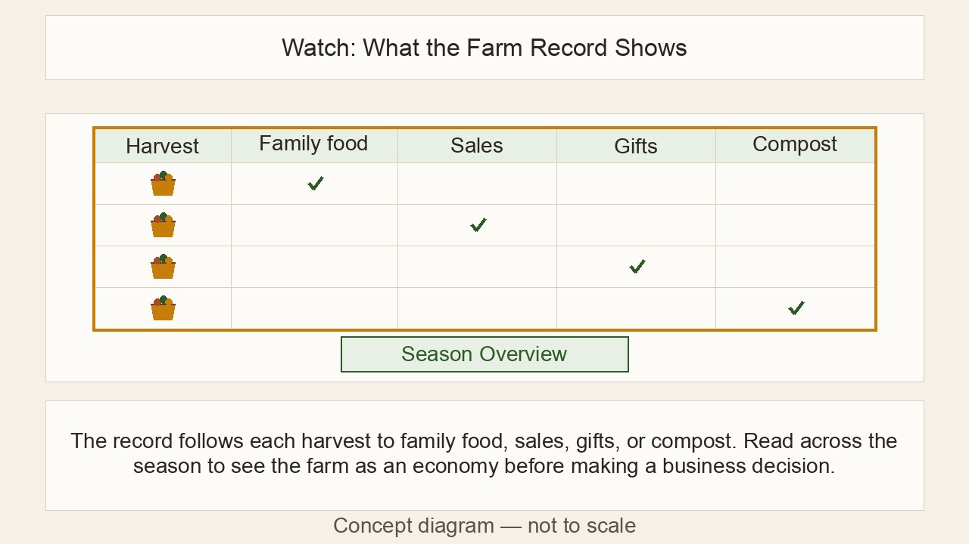
Week 6: records and money
• Harvest · money · slip · invoice
• App or paper, same checks
▶ Clip M-ANI-05 · play from the tablet: watch-04-farm-record.mp4
M-ON-11 · Poster M-P14
Walking With Farmers
Notes:
Week 6 [APP]/[PAPER], 40 minutes each. Send the clip link before the session; don't stream it live.
Poster: M-P14
Clip M-ANI-05: public/course-animations/market-community/watch-04-farm-record.mp4

Slide 12
Week 6: hard moments and your plan
• Stay calm · Listen · Their options · Help
• Send your season plan
POSTER ART · M-P15-ART · coming
Artwork for M-P15 · When it gets hard
A dry garden with wilting plants and an empty drum. The farmer sits on the ground, head in hands. Four steps shown as footprints leading to him: the mentor breathing calmly; the mentor sitting beside him listening; the farmer standing, pointing at one small bed he can save; a small group of neighbours arriving with a wheelbarrow of grass mulch. No clinic…
M-ON-12 · Poster M-P15
Walking With Farmers
Notes:
Week 6. Pairs voice-note the four steps for one card. Close: one word each, evaluation poll, certificates.
Poster: M-P15

