Slide 1
IMAGE · F-IMG-31 · coming
Usuku 5 · Imbewu, ukudla, imali
Seed table
A table covered with small labelled heaps of different seeds (beans of many colours, maize, pumpkin seed) and paper envelopes; hands reaching in.
Sivala isiyingi
F-D5-01
Grow Food, Grow Strong
Notes:
Opening circle; seed on the seed table.

Slide 2
Imbewu yakho ivelaphi?
• Yendabuko (open-pollinated): yigcine njalo
• I-hybrid (F1): ungayigcini
• Imbewu elashiwe (treated) inoshevu
POSTER ART · F-P18-ART · coming
Artwork for F-P18 · Save your seed
Top: two seed packets. Left packet leads to three generations of similar healthy plants (open-pollinated); right packet (marked with a small generic "F1" style badge shape — no letters, use a distinct symbol like a double circle) leads to one good plant then mixed, uneven small plants. Middle left: dry bean pods rattling on the plant, hands shelling, a…
F-D5-02 · Poster F-P18
Grow Food, Grow Strong
Notes:
F-D5-S1. Read the packet: F1 or hybrid means don't save.
Poster: F-P18

Slide 3
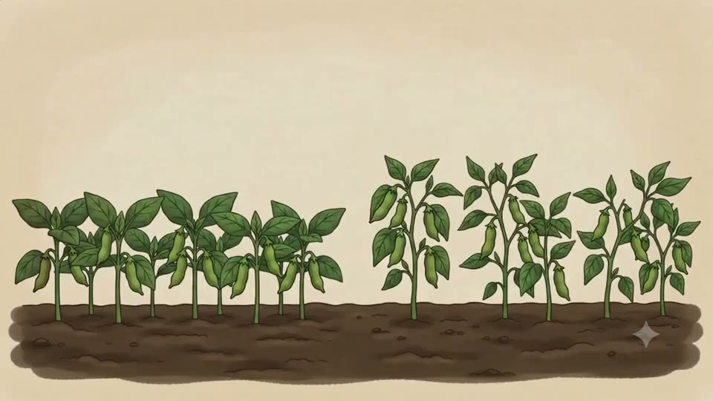
Khetha abazali
• Izitshalo ezinhle kakhulu · izitshalo eziningi
• Ungalokothi uthathe ezihlumela imbewu kuqala
▶ Clip F-ANI-24 · play from the tablet: seed-selecting-parents.mp4
F-D5-03 · Poster F-P18
Grow Food, Grow Strong
Notes:
Mark chosen plants with a ribbon.
Poster: F-P18
Clip F-ANI-24: public/course-animations/seeds-sovereignty/seed-selecting-parents.mp4

Slide 4
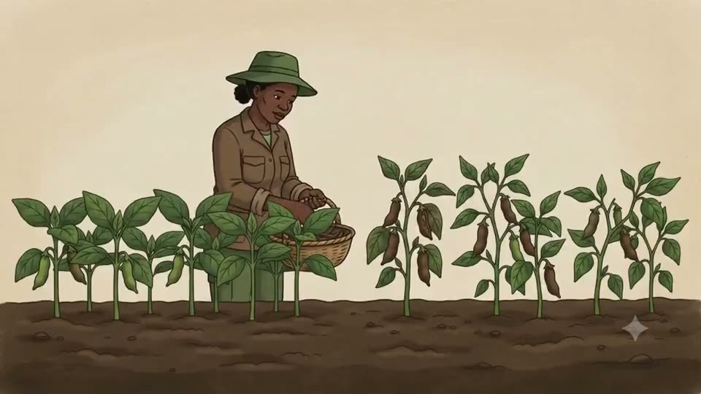
SEBENZANI
Indlela eyomile
• Yiyekeni yome esitshalweni ize ikhenkethe
• Yomile uma iphuka
▶ Clip F-ANI-25 · play from the tablet: seed-dry-processing.mp4
F-D5-04 · Poster F-P18
Grow Food, Grow Strong
Notes:
Groups shell beans or maize.
Poster: F-P18
Clip F-ANI-25: public/course-animations/seeds-sovereignty/seed-dry-processing.mp4

Slide 5
SEBENZANI
Indlela emanzi
• Imbewu katamatisi engilazini, izinsuku 2–3
• Hlanzani · yomiseni isakazekile emthunzini
ANIMATION · F-ANI-27 · coming
Tomato seed ferment
A ripe tomato cut in half; seeds and jelly scooped with a spoon into a small glass jar; a little water added; cloth tied over the top. Sun/moon icons cycle 3 times; a thin white skin forms on the surface. The skin and floating seeds are poured off; the heavy seeds at the bottom are tipped into a sieve and rinsed under a stream from a jug; then spread…
F-D5-05 · Poster F-P18
Grow Food, Grow Strong
Notes:
Show the class ferment started 2 days ago.
Poster: F-P18
Clip F-ANI-27: public/course-media/farmer-5day/F-ANI-27.mp4

Slide 6
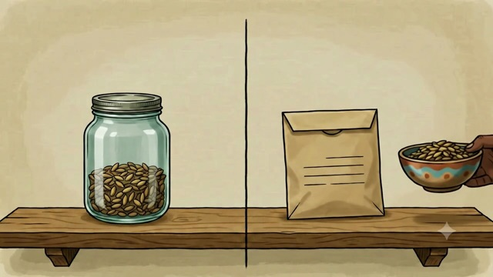
Gcina uhlole
• Kupholile · kumnyama · komile · kunelebula
• Imbewu engu-10 endwangwini emanzi
• Ezingu-8 ziyamila = imbewu enhle
▶ Clip F-ANI-26 · play from the tablet: new_seed-storage-jar-vs-bag.mp4
F-D5-06 · Poster F-P18
Grow Food, Grow Strong
Notes:
Then the seed swap: take up to 5 packets; bring back double next season.
Poster: F-P18
Clip F-ANI-26: public/course-animations/seeds-sovereignty/new_seed-storage-jar-vs-bag.mp4

Slide 7
Ipuleti lomndeni
• Uhhafu imifino nezithelo
• Ikota isitashi · ikota ubhontshisi, amaqanda, inyama
POSTER ART · F-P19-ART · coming
Artwork for F-P19 · Eat the rainbow
A large round enamel plate from above, divided: half filled with vegetables and fruit of many colours (dark green leaves, orange pumpkin slices, red tomato, purple beetroot), a quarter with pap, a quarter with beans and an egg. Around the plate, a family: a gogo, a mother, a toddler on a lap, a school child — eating together. Along the bottom, four small…
F-D5-07 · Poster F-P19
Grow Food, Grow Strong
Notes:
F-D5-S2. Colours: dark green (iron), orange (vitamin A), beans (growing).
Poster: F-P19

Slide 8
SEBENZANI
Umdlalo wamapuleti
• Amapuleti ama-3 omndeni onengane encane
• Okungenani imibala emi-4 ngosuku
IMAGE · F-IMG-50 · coming
Food card — dark green leaves bundle (spinach/morogo)
Dark green leaves bundle (spinach/morogo) as it looks in a South African kitchen, on a plain Paper background, no text. Sized to be cut out and placed on a paper plate.
F-D5-08
Grow Food, Grow Strong
Notes:
16 food cards per group (F-IMG-50 to 65).

Slide 9
SEBENZANI
Unyaka wemibala
• Izitshalo zasehlobo · izitshalo zasebusika
• Okuthile ongakukha njalo ngenyanga
IMAGE · F-IMG-32 · coming
A year of colour
A circular calendar ring divided into 12 segments, the top half (summer) full of warm-season vegetable shapes, the bottom half (winter) of cool-season leaf and root shapes.
F-D5-09
Grow Food, Grow Strong
Notes:
Check the local planting calendar; frost areas differ.

Slide 10
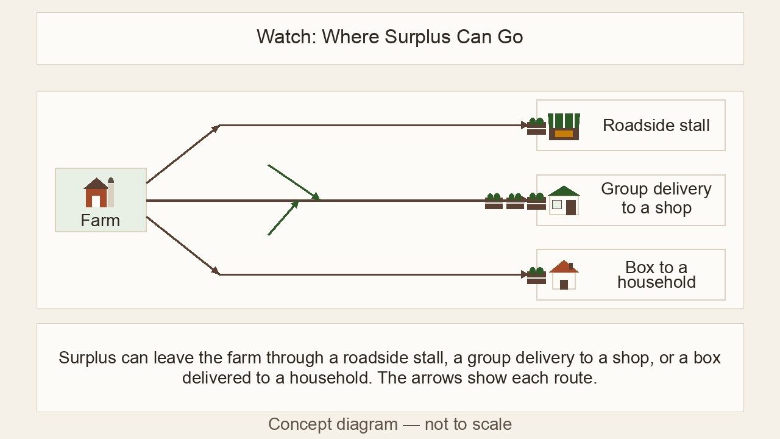
SEBENZANI
Kalani nibhale
• Okudliwe · okwabelwe · okuthengisiwe
• Kubhaleni ekhasini lesivuno
▶ Clip F-ANI-28 · play from the tablet: watch-09-surplus-routes.mp4
F-D5-10
Grow Food, Grow Strong
Notes:
[APP] twin: log the harvest in Records → Picked. Then the garden handover roster.
Clip F-ANI-28: public/course-animations/market-community/watch-09-surplus-routes.mp4

Slide 11
Izikhwama ezimbili
• Imali yendlu · imali yengadi · imali elondoloziwe
POSTER ART · F-P20-ART · coming
Artwork for F-P20 · Money in, money out
Top: three tins on a table with picture icons (a house, a seedling, a small safe/piggy-bank-like clay pot). Arrows: vegetables being handed to a buyer and notes coming back into the seedling tin; notes going out of the seedling tin to a seed packet, a manure bag and a taxi. Middle: an open exercise book with two ruled columns — one with a green arrow…
F-D5-11 · Poster F-P20
Grow Food, Grow Strong
Notes:
F-D5-S3. If it all goes in one pocket, you never know if the garden helps.
Poster: F-P20

Slide 12
SEBENZANI
Usuku lwemakethe
• R200 ethinini lengadi
• Lingisani ikhadi lenu
• Hambisani imali phakathi kwamathini
IMAGE · F-IMG-33 · coming
Market day
A small roadside table of bunches of greens and tomatoes; a buyer handing over notes; three tins on the table with house, seedling and savings-pot icons.
F-D5-12
Grow Food, Grow Strong
Notes:
Five scenario cards in day-5.md S3.

Slide 13
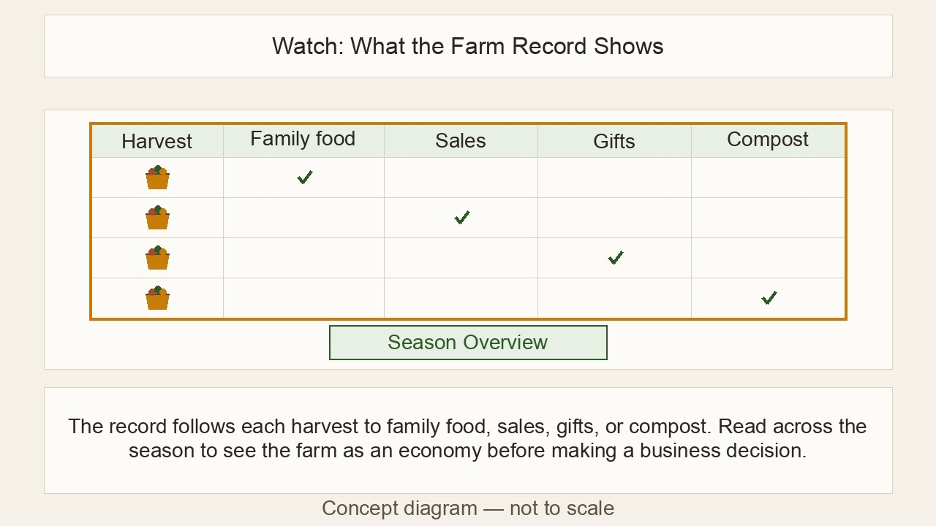
Imali engenayo, imali ephumayo
• Usuku · yini · engenayo · ephumayo
• Yibhale ngalo lolo suku
▶ Clip F-ANI-29 · play from the tablet: watch-04-farm-record.mp4
F-D5-13 · Poster F-P20
Grow Food, Grow Strong
Notes:
Everyone writes their card's lines. [APP] twin: Records → Sold and Spent; scan a till slip in a Spent entry.
Poster: F-P20
Clip F-ANI-29: public/course-animations/market-community/watch-04-farm-record.mp4

Slide 14
Izindleko ngesixha
• R100 esetshenzisiwe ÷ 40 izixha = R2.50
• Intengo yasesitolo? Buza lapha eduze
• Beka intengo efanele phakathi
IMAGE · F-IMG-34 · coming
Cost per bunch
Visual sum: a seed packet + a manure bag + a water drop + a taxi → one bed → a row of 40 small bunches.
F-D5-14 · Poster F-P20
Grow Food, Grow Strong
Notes:
Your own time is worth something too — Farmer Money course goes deeper.
Poster: F-P20

Slide 15
Izinsuku zami ezingu-90 ezizayo
• Amasonto 2 okuqala · ngamasonto 6 · ngezinsuku ezingu-90
POSTER ART · F-P21-ART · coming
Artwork for F-P21 · My 90-day garden plan
A path drawn from bottom-left to top-right through three stepping stones. Stone 1: a person mulching and starting a small compost pile beside a tap. Stone 2: the same person digging one bed north of the house and planting seedlings with a spacing stick. Stone 3: the same person harvesting leafy greens into a basket, a jar of seed on the windowsill and a…
F-D5-15 · Poster F-P21
Grow Food, Grow Strong
Notes:
F-D5-S4. Read the example plan.
Poster: F-P21

Slide 16
SEBENZANI
Khombisani uhlelo lwenu
• Imizuzu emi-2 ngamunye eqenjini
• Izinkanyezi ezimbili nesifiso esisodwa
• Khethani umngane wenu (buddy)
IMAGE · F-IMG-35 · coming
Buddies
Two learners from the same group shaking hands; one holding a paper plan, the other a basic phone.
F-D5-16
Grow Food, Grow Strong
Notes:
Write the buddy's name on the plan.

Slide 17
SEBENZANI
Senze kanjani?
• Umbuzo wezithombe futhi
• Iminwe 1 kuye ku-5
• Engikuqonde kakhulu · engifuna ukukufunda kabanzi
IMAGE · F-IMG-70 · coming
Picture quiz card 1
Question (said aloud, not printed in the art): 'Where is the sun at midday in winter?' Art: three panels A/B/C: sun to the north of a house (shadow south) · sun to the south · sun straight overhead. Three equal panels with a large A, B and C typeset below each panel in the layout (not in the art).
F-D5-17
Grow Food, Grow Strong
Notes:
F-D5-S5. forms.md §5 and §6. Return to the "Our hopes" drawings.

Slide 18
IMAGE · F-IMG-36 · coming
Izitifiketi
Certificate
A facilitator handing a certificate to a smiling older woman in her Sunday best; group applauding behind.
Siyanihalalisela
F-D5-18
Grow Food, Grow Strong
Notes:
Call each name clearly; hand personally; photo only with consent.

Slide 19
Hambani kahle
• UMentor wenu uzonivakashela kungakapheli amasonto 2
• Umngane wenu (buddy) uzonishayela
• Nakekelani ingadi yethu
IMAGE · F-IMG-37 · coming
Go well
The course garden at dusk: planted beds, compost heaps, the young fruit tree, the swale mound — a few people walking home along the path with seedling trays.
F-D5-19
Grow Food, Grow Strong
Notes:
Closing circle, final register, tools back.

