Slide 1
IMAGE · M-IMG-01 · coming
Day 2: the farm visit
Mentor and farmer at the gate
Cover image for all decks. Early morning; the mentor greets the farmer at a wire-and- dropper garden gate, both smiling, a vegetable garden behind with mulched beds and a JoJo-style tank beside a corrugated-iron roof. Sun low in the north-east, long shadows falling south-west. 16:9, 1920 × 1080, space on the left third for the slide title.
Walking With Farmers
Day 2 of 3: the farm visit
M-D2-01
Walking With Farmers
Notes:
M-D2-S0. Short circle: register, 3 voices, Pass the Clap, today's route sheet and any host changes.

Slide 2
The Visit Hand
• Look back · Walk & look
• Listen & ask · Try it together
• Agree & record
POSTER ART · M-P07-ART · coming
Artwork for M-P07 · The Visit Hand
A large open hand (brown skin tone, palm towards viewer, fingers spread). In each fingertip a small round scene: thumb — mentor and farmer looking at a mulched bed together (look back); pointing finger — the pair walking between beds, farmer pointing; middle finger (tallest) — the pair sitting in shade talking; ring finger — both kneeling, farmer's hands…
M-D2-02 · Poster M-P07
Walking With Farmers
Notes:
M-D2-S1 steps 1–2. "Hold up your hand — what are the five steps?" The thumb goes first: it shows respect for what the farmer planned.
Poster: M-P07

Slide 3
Sixty minutes, five fingers
• 10 · 15 · 10 · 15 · 10 minutes
• Never cut ring or little finger
M-D2-03 · Poster M-P07
Walking With Farmers
Notes:
M-D2-S1 step 2 table. Opening words for each finger are on the A5 card. 45-minute version: 5 · 10 · 5 · 15 · 10.
Poster: M-P07

Slide 4
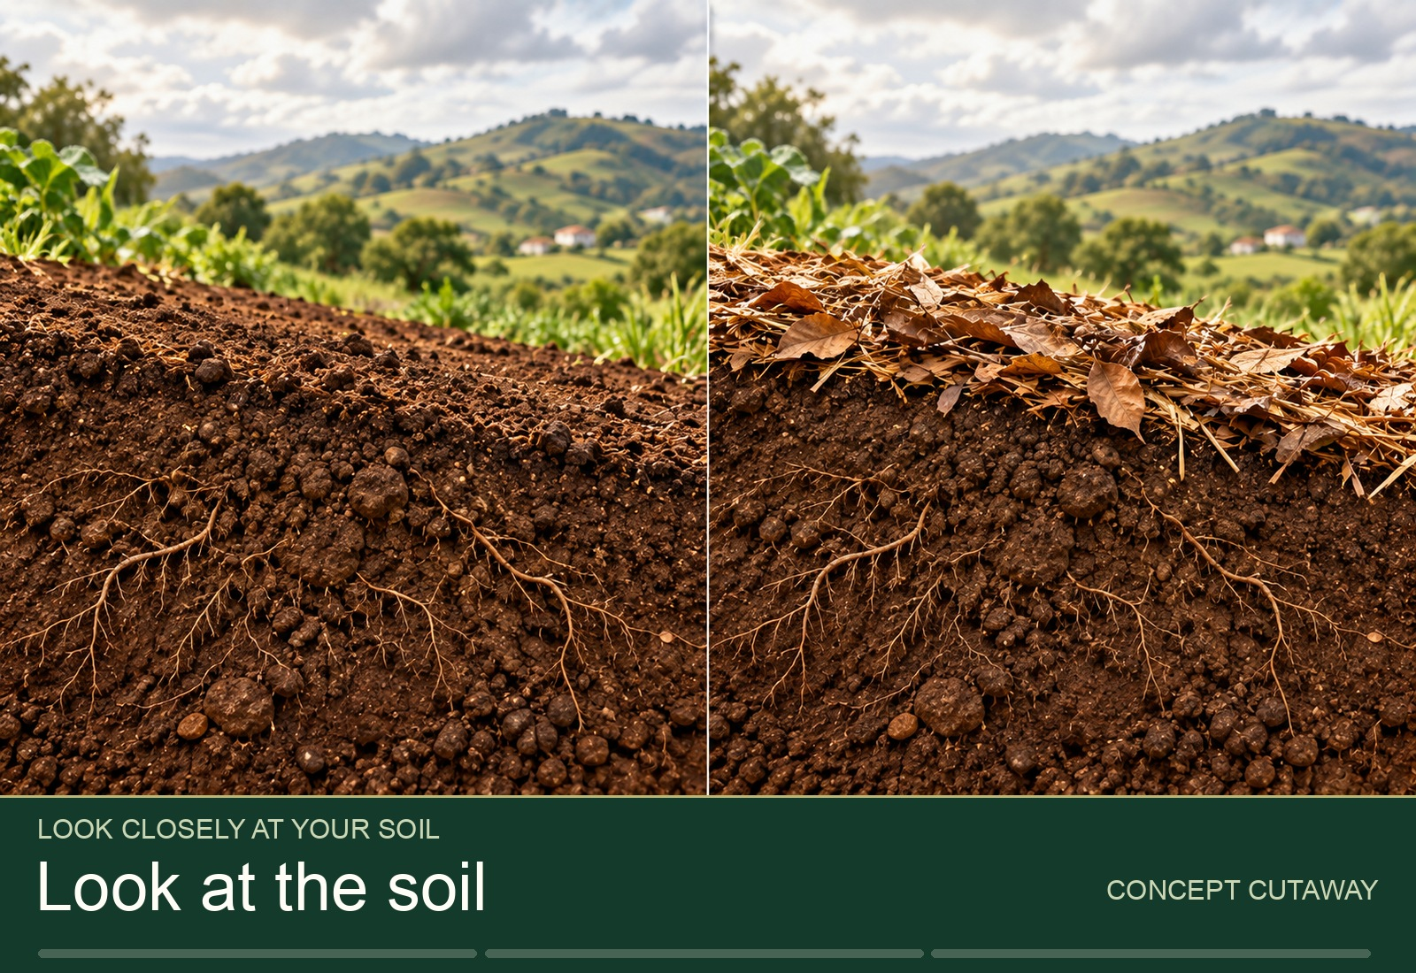
YOUR TURN
Speed rehearsal
• Pairs · 10 minutes
• 2 minutes per finger
▶ Clip M-ANI-07 · play from the tablet: tour-soil-observation.mp4
M-D2-04 · Poster M-P07
Walking With Farmers
Notes:
M-D2-S1 step 3. Timekeeper calls each finger. The "farmer" uses a real memory of a garden.
Poster: M-P07
Clip M-ANI-07: public/course-animations/soil-health/tour-soil-observation.mp4

Slide 5
What to look at, stage by stage
• Baseline · planting · growth
• Harvest · selling · review
• Pick 3–5 checks
POSTER ART · M-P08-ART · coming
Artwork for M-P08 · What to look at, stage by stage
One garden drawn six times in a row, left to right, as it changes over a season: (1) boundary pegged, beds marked, drum at the roof; (2) beds planted with a spacing string laid along one row, seedlings in a tray, mulch; (3) plants growing, a person checking under leaves, a bucket of liquid manure; (4) harvest basket on a hanging scale, a family plate;…
M-D2-05 · Poster M-P08
Walking With Farmers
Notes:
M-D2-S1 step 4. Point to the spacing check (F-P15) and the Course 1 skills (★). Full list: visit-playbook.md §5.
Poster: M-P08
Also: M-IMG-14, M-IMG-12, M-IMG-15, M-ANI-06, M-ANI-08
Clip M-ANI-06: public/course-animations/market-community/watch-09-surplus-routes.mp4
Clip M-ANI-08: public/course-animations/seeds-sovereignty/seed-selecting-parents.mp4

Slide 6
APP
[APP] Record visit
• Mentor workspace → People & gardens
• Record visit → five fingers, five fields
• Save offline · it syncs later
POSTER ART · M-P14-ART · coming
Artwork for M-P14 · Two tracks, same records
A path that splits around a tree into two lanes and joins again. Left lane: the youth holds a smartphone (screen blank), showing it to the gogo farmer. Right lane: the gogo writes in an exercise book with a pencil; an envelope of slips and a carbon invoice book beside her. Both lanes pass the same four objects: a hanging scale with a bunch of spinach, a…
M-D2-06 · Poster M-P14
Walking With Farmers
Notes:
M-D2-S1 [APP] block, 25 min. Thumb → Completed on + Completion evidence. Pointing → Observations and issues, photos, site location. Middle → Support requested + support area. Ring → Skill observed + Observation result. Little → Agreed action, Responsible person, Follow-up date. Practice records only.
Poster: M-P14

Slide 7
[PAPER] The visit form
• Five boxes = five fingers
• Fill it at the farm
• Read it back · leave the card
POSTER ART · M-P14-ART · coming
Artwork for M-P14 · Two tracks, same records
A path that splits around a tree into two lanes and joins again. Left lane: the youth holds a smartphone (screen blank), showing it to the gogo farmer. Right lane: the gogo writes in an exercise book with a pencil; an envelope of slips and a carbon invoice book beside her. Both lanes pass the same four objects: a hanging scale with a bunch of spinach, a…
M-D2-07 · Poster M-P14
Walking With Farmers
Notes:
M-D2-S1 [PAPER] block, 25 min, same time as the app block. Pairs fill the form from the rehearsal; copy the bottom box onto the farmer's card; swap forms — could a stranger understand it?
Poster: M-P14

Slide 8
Your trio
• Mentor leads · Recorder writes and times
• Observer watches, says nothing
• No promises · no gifts · consent
IMAGE · M-IMG-04 · coming
A trio arrives at a farm
Three mentors-in-training (a young woman, an older man, a young man) waiting politely at a farmer's gate; one waves; the farmer walks towards them from the garden; a dog sits calmly by the gate. 16:9.
M-D2-08 · Poster M-P07
Walking With Farmers
Notes:
M-D2-S1 step 6, the trio briefing card. Arrive 10:35–10:40, leave by 11:40, huddle away from the house, pick-up 11:45. Anything worrying: leave politely and phone the lead.
Poster: M-P07
Also: M-IMG-05

Slide 9
YOUR TURN
The farm visit
• 60 minutes with a real farmer
• 5 minutes huddle: two stars, a wish
• Pick-up 11:45
IMAGE · M-IMG-04 · coming
A trio arrives at a farm
Three mentors-in-training (a young woman, an older man, a young man) waiting politely at a farmer's gate; one waves; the farmer walks towards them from the garden; a dog sits calmly by the gate. 16:9.
M-D2-09 · Poster M-P07
Walking With Farmers
Notes:
M-D2-S2. Facilitators visit 3–4 trios each, stand back, tick their own checklist, hand over the programme's thank-you pack. Host cancels: spare host → join another trio → role-play garden.
Poster: M-P07
Also: M-PHO-01

Slide 10
The cluster visit
• Welcome · Host's tour · Try it
• Share circle · Everyone agrees one action
POSTER ART · M-P11-ART · coming
Artwork for M-P11 · The cluster visit
A host farmer's garden with 10 farmers of mixed ages and genders. In one corner the host gogo leads a tour, pointing at a mulched bed; in the middle, three small groups of 3–4 kneeling at different stations (spacing string, seedling tray, a bucket); at the front, everyone sitting in a circle in the shade of a tree; the mentor sits in the circle, not…
M-D2-10 · Poster M-P11
Walking With Farmers
Notes:
M-D2-S3. Trainee teams: 1 welcome & register, 2–4 stations, 5 the share circle. The host teaches first — positive deviance: same soil, same rain, doing well. Find out how.
Poster: M-P11
Also: M-ANI-04
Clip M-ANI-04: public/course-animations/market-community/watch-14-community-network.mp4

Slide 11
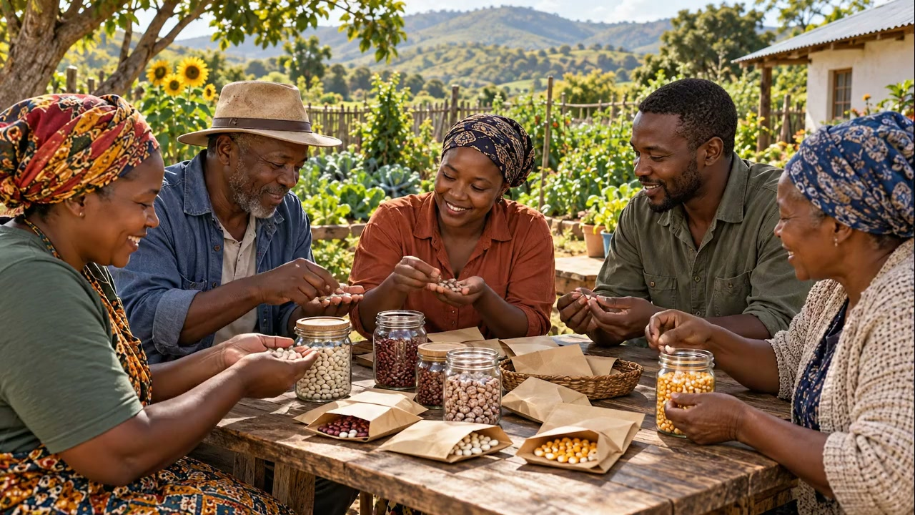
YOUR TURN
Stations and share circle
• 3 stations · 8 minutes each
• Farmers answer farmers first
▶ Clip M-ANI-09 · play from the tablet: flow-seed-sharing.mp4
M-D2-11 · Poster M-P11
Walking With Farmers
Notes:
M-D2-S3 steps 4–6. Farmers rotate in 3s–4s. In the circle, ask "Who has tried something for that?" before you answer. Each farmer says one action aloud; agree the next host.
Poster: M-P11
Also: M-PHO-02
Clip M-ANI-09: public/course-animations/market-community/flow-seed-sharing.mp4

Slide 12
Farmers learn from farmers
• Same soil, same rain
• Seeing is believing
• Rotate the host
M-D2-12 · Poster M-P11
Walking With Farmers
Notes:
M-D2-S3 debrief at the site, 3 minutes, trainees only.
Poster: M-P11

Slide 13
YOUR TURN
Visit debrief
• Mentor first · then Observer · then Recorder
• Two stars and a wish
IMAGE · M-IMG-05 · coming
The observer stands back
In a garden: the mentor and the gogo kneel planting seedlings together (the gogo's hands on the plant); a recorder writes in a notebook nearby; an observer stands 3 m back with a clipboard, watching the gogo's face. 16:9.
M-D2-13 · Poster M-P07
Walking With Farmers
Notes:
M-D2-S4 step 1. Rain Storm energiser first. Talk privately about any visit that went badly; nothing distressing is discussed in the room.
Poster: M-P07

Slide 14
YOUR TURN
The hand map
• Green dot: our best finger
• Ochre dot: our hardest finger
M-D2-14 · Poster M-P07
Walking With Farmers
Notes:
M-D2-S4 steps 2–3. Usually the ring finger (coaching) and the middle (advice too soon) get ochre dots. "I don't know — let's find out together" is a strong answer.
Poster: M-P07

Slide 15
Who talked more?
• The farmer talks more than half
• Ask a buddy to observe you monthly
M-D2-15 · Poster M-P06
Walking With Farmers
Notes:
M-D2-S4 steps 4–5 and key messages. Review 3 action agreements. Then the closing circle: bring your farmer list and a rough map tomorrow.
Poster: M-P06

