Slide 1
IMAGE · T-IMG-04 · coming
Day 3
A tablet for a group of five
Five learners crowd round a tablet held by a young man (the Recorder) at a garden table outdoors in shade. The tablet screen shows a simple animation frame of water soaking into soil (Water blue, soil Ochre). An older woman points at the screen; a young woman beside her already has her hands in a tray of soil, doing what they just watched. A facilitator…
Hands on, every time
Day 3 of 5
T-D3-01 · Poster T-P04
Teach the Teachers
Notes:
T-D3-S0. Register by a trainee; energiser; "you said, we did"; each trainee names one way to lower
their talk % today.
Poster: T-P04

Slide 2
The 2022 story
• One person digging
• Twenty-five watching
• Kit for four groups in the car
ANIMATION · T-ANI-02 · coming
From one demo to five groups
Top view of a practical site. 0–4 s: one facilitator digging, 25 small figures standing around her in a crowd, still. 4–8 s: the crowd splits into five groups of five that walk to five stations 3 m apart, each with its own small pile of tools. 8–12 s: every figure is moving — digging, carrying, mixing; the facilitator walks between stations with hands…
T-D3-02 · Poster T-P07
Teach the Teachers
Notes:
T-D3-S1 step 1. Three minutes max. Then groups: why does it happen? Sort into can fix / can't fix.
Poster: T-P07
Clip T-ANI-02: public/course-media/teach-the-teachers/T-ANI-02.mp4

Slide 3
Hands on, not a demo
• Kit per group · Demo 3 minutes
• Groups of 5 · Stations apart
• Hands behind your back
POSTER ART · T-P07-ART · coming
Artwork for T-P07 · A practical, not a demo
Two panels. Small top-left panel (one third width), drawn in faded greys: one facilitator digging while a crowd of about twenty stands watching, arms folded; a thick Ochre diagonal bar crosses the panel (a "no" sign made of a shape, not a letter). Large main panel: four groups of five at four stations spaced apart on open ground, every person working —…
T-D3-03 · Poster T-P07
Teach the Teachers
Notes:
T-D3-S1 step 3. Six moves. "If you take the spade, the practical is over."
Poster: T-P07

Slide 4
YOUR TURN
Rescue the practical
• One card per group
• Plan the rescue, 12 minutes
• 2 minutes to present
POSTER ART · T-P07-ART · coming
Artwork for T-P07 · A practical, not a demo
Two panels. Small top-left panel (one third width), drawn in faded greys: one facilitator digging while a crowd of about twenty stands watching, arms folded; a thick Ochre diagonal bar crosses the panel (a "no" sign made of a shape, not a letter). Large main panel: four groups of five at four stations spaced apart on open ground, every person working —…
T-D3-04 · Poster T-P07
Teach the Teachers
Notes:
T-D3-S1 step 4. Cards: one spade; rain; a learner takes over; elders won't get hands dirty.
Poster: T-P07

Slide 5

YOUR TURN
One kit? Carousel
• One A-frame, 25 learners
• Five stations, 8 minutes each
• Nobody watches over 10 minutes
▶ Clip T-ANI-10 · play from the tablet: flow-a-frame.mp4
T-D3-05 · Poster T-P07
Teach the Teachers
Notes:
T-D3-S1 step 5. Model answer in the day file.
Poster: T-P07
Clip T-ANI-10: public/course-animations/reading-landscape/flow-a-frame.mp4

Slide 6
YOUR TURN
Spot the hazard
• Find 8 hazards in 4 minutes
• Tools points down
• First aid kit open
IMAGE · T-IMG-16 · coming
Spot the hazard
A busy practical site with eight hazards for learners to find: a spade lying point-up on a path; a garden fork leaning at head height; an open spray bottle next to a plate of food; a hosepipe across a walkway; a group working in full midday sun with no hats; a first aid box inside a closed car; someone swinging a pick with a person standing just behind;…
T-D3-06 · Poster T-P16
Teach the Teachers
Notes:
T-D3-S1 steps 6–8. Safety rules; count a crate in and out; journal rule.
Poster: T-P16

Slide 7
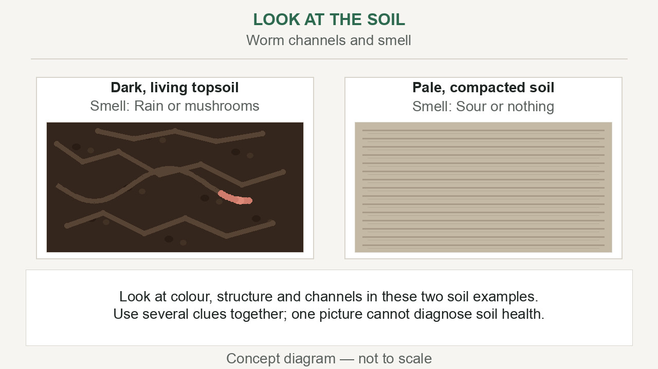
Model practical: living soil
You are farmers now
Recorders: practical-check card
▶ Clip T-ANI-17 · play from the tablet: watch-05-living-soil.mp4
T-D3-07 · Poster F-P10
Teach the Teachers
Notes:
T-D3-S2. Co-trainer teaches. Observer ticks each person every 5 minutes their hands are in the task.
Poster: F-P10
Clip T-ANI-17: public/course-animations/soil-health/watch-05-living-soil.mp4

Slide 8
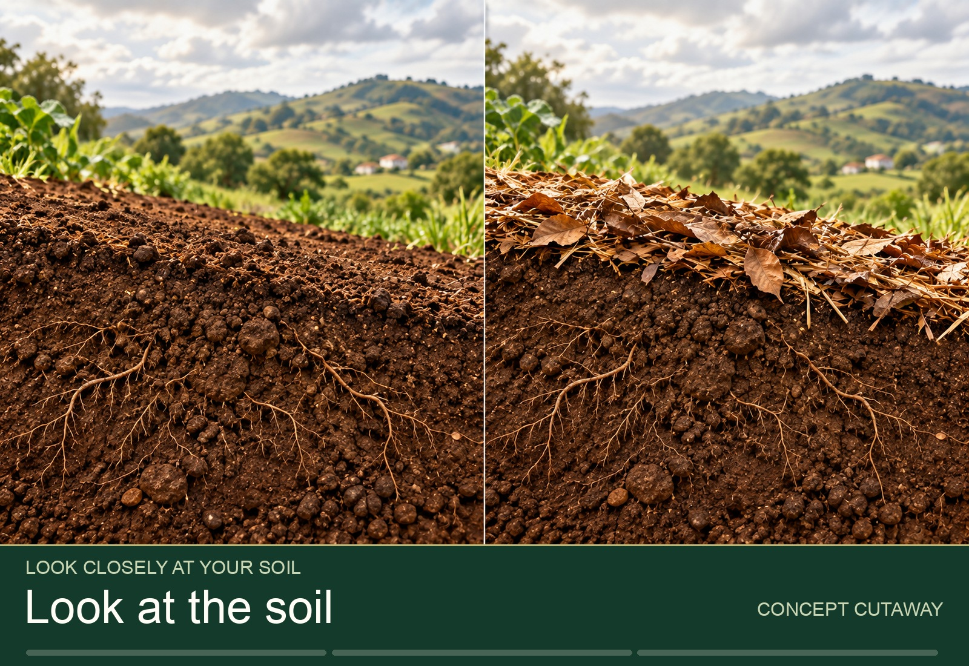
YOUR TURN
Four soil tests
• Squeeze · Jar · Worms · Infiltration
• Every person does each
• 27 minutes
▶ Clip T-ANI-19 · play from the tablet: tour-soil-observation.mp4
T-D3-08 · Poster F-P10
Teach the Teachers
Notes:
T-D3-S2 step 2. Demo 3 minutes max, then hands behind your back. Read the settled Day 0 jar.
Poster: F-P10
Clip T-ANI-19: public/course-animations/soil-health/tour-soil-observation.mp4

Slide 9
YOUR TURN
Test it side by side
• Two pots, one change
• Sow, label, water the same
• Predict, then look on Day 5
POSTER ART · T-P21-ART · coming
Artwork for T-P21 · Test it side by side
Two small plots side by side, divided by a string line. Left plot: bare soil, small pale plants. Right plot: mulched soil with compost, taller dark-green plants. A group of five farmers crouches between them: one measures a plant against a marked stick, one draws on a clipboard, one holds a handful of soil from each side, two discuss, pointing. Along the…
T-D3-09 · Poster T-P21
Teach the Teachers
Notes:
T-D3-S2 step 4. Compost vs no compost. This is how farmer field schools learn.
Poster: T-P21

Slide 10
Step out: unpack
• Who had fewer than 4 ticks?
• What kept every hand busy?
IMAGE · T-IMG-04 · coming
A tablet for a group of five
Five learners crowd round a tablet held by a young man (the Recorder) at a garden table outdoors in shade. The tablet screen shows a simple animation frame of water soaking into soil (Water blue, soil Ochre). An older woman points at the screen; a young woman beside her already has her hands in a tray of soil, doing what they just watched. A facilitator…
T-D3-10 · Poster T-P07
Teach the Teachers
Notes:
T-D3-S2 steps 6–8. Then soil and compost questions from the content notes.
Poster: T-P07

Slide 11
IMAGE · T-IMG-03 · coming
Mode 2: slides
Projector in daylight
Split image. Left: a bright church hall with open windows; a projector on a table throws a pale, washed-out rectangle onto a white wall — nothing on it can be seen; learners at the back squint and shade their eyes. Right: the same group in a shaded corner of the hall, gathered close around a large TV on a table; the TV shows a clear picture of a green…
Can you read it from the back?
T-D3-11 · Poster T-P13
Teach the Teachers
Notes:
T-D3-S3 step 1. Energiser first. Show this slide on the projector with curtains open; trainees
at the back wall.
Poster: T-P13

Slide 12
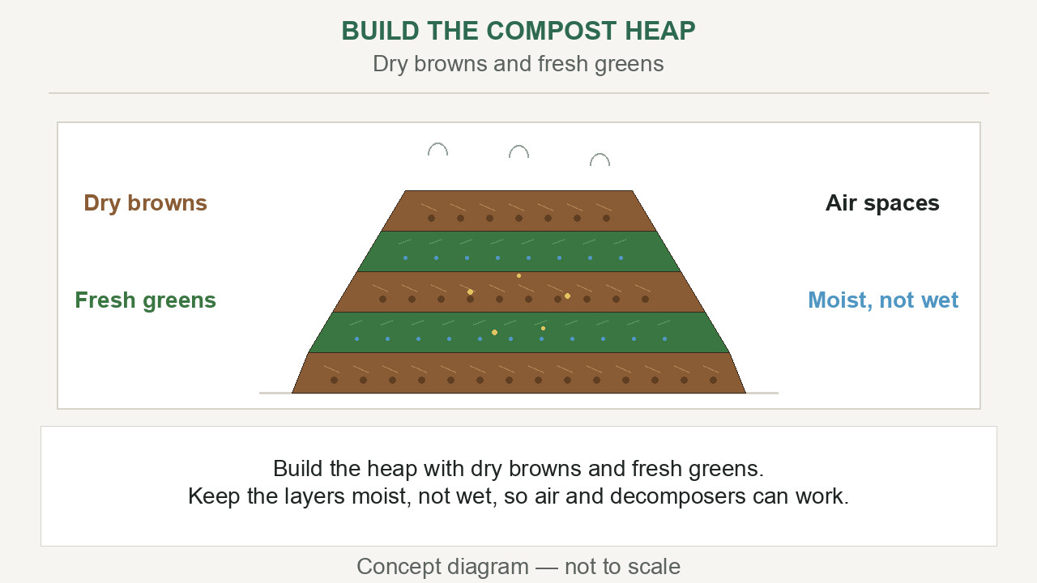
When slides help
• Things that move or grow
• Pests out of season
• Big group in a dark room
▶ Clip T-ANI-18 · play from the tablet: watch-10-compost-heap.mp4
T-D3-12 · Poster T-P13
Teach the Teachers
Notes:
T-D3-S3 step 2. Ask first; let them answer.
Poster: T-P13
Clip T-ANI-18: public/course-animations/soil-health/watch-10-compost-heap.mp4

Slide 13
Set up to be seen
• Test from the back, in daylight
• TV beats projector; press B
• Tablet per group of 5
IMAGE · T-IMG-04 · coming
A tablet for a group of five
Five learners crowd round a tablet held by a young man (the Recorder) at a garden table outdoors in shade. The tablet screen shows a simple animation frame of water soaking into soil (Water blue, soil Ochre). An older woman points at the screen; a young woman beside her already has her hands in a tray of soil, doing what they just watched. A facilitator…
T-D3-13 · Poster T-P13
Teach the Teachers
Notes:
T-D3-S3 step 2. Presenter view; carry the deck three ways (laptop, flash drive, PDF on phone).
Poster: T-P13

Slide 14
YOUR TURN
Three stations
• A: big screen, 2 slides
• B: tablet clip, teach it
• C: paper flip-book
IMAGE · T-IMG-14 · coming
The paper flip-book
A group of five seated round a small table outdoors. One person holds a ring-bound A4 book of big pictures (a slide printed on each page — simple garden drawings, no text), turning a page toward the group; another points at the picture. No devices anywhere.
T-D3-14 · Poster T-P13
Teach the Teachers
Notes:
T-D3-S3 step 3. 8 minutes each. Flip-book: show, ask, then turn. No devices? All flip-books.
Poster: T-P13

Slide 15
Hand over, don't take over
• Plan who leads each step
• Say the handover out loud
• Touch your ear to offer
POSTER ART · T-P14-ART · coming
Artwork for T-P14 · Hand over, don't take over
In front of a seated group, one facilitator hands a seedling tray to a second facilitator, like passing a relay baton; both smile. Behind them, a third small scene of the same second facilitator quietly carrying a crate of materials and making marks on a clipboard while the first one teaches. In a small inset, a facilitator touches her ear with one…
T-D3-15 · Poster T-P14
Teach the Teachers
Notes:
T-D3-S3 steps 4–5. Then pair studio: finish plans, handovers, signal and posters.
Poster: T-P14

Slide 16
YOUR TURN
Micro-teaching Round 3
• 15 minutes, pairs, half-class
• A practical in two groups of 4
• 7 minutes feedback
IMAGE · T-IMG-11 · coming
Two facilitators, one lesson
In front of a seated group, a young woman facilitator hands a seedling tray to a young man facilitator, both smiling, like passing a relay baton. Behind them a crate of tools and a clipboard with tally marks on a chair. Learners watch, one already reaching toward the tray.
T-D3-16 · Poster T-P14
Teach the Teachers
Notes:
T-D3-S4. Stream A with the lead, Stream B with the co-trainer. Set up during the previous feedback.
Poster: T-P14

Slide 17
Feedback for pairs
• Partners star each other
• Observer 1: talk and questions
• Observer 2: hands and handovers
POSTER ART · T-P10-ART · coming
Artwork for T-P10 · Two stars and a wish
A small group of four seated in a circle after a lesson. A young woman (the teacher) speaks first, hand open. Opposite her, an older man with a clipboard (the observer) speaks kindly; above him float two big Ochre star shapes and one Leaf-green sprouting seedling shape. The teacher, now with hand on heart, listens and nods. A third person smiles and…
T-D3-17 · Poster T-P10
Teach the Teachers
Notes:
T-D3-S4 step 1. Trainer gives one star only. Never interrupt a teach unless there is a safety risk.
Poster: T-P10

Slide 18
Course craft: the kit
• Count per group, plus one spare
• Kit in, kit out, every day
• Certificates: registered + 10%
POSTER ART · T-P16-ART · coming
Artwork for T-P16 · Ready by Day 0 — the course kit
A flat-lay seen from above on a green tarp: four crates, each with a different plant symbol drawn on it (bean, pumpkin, maize cob, marula fruit), holding spades, string, jars and tins; a poster tube; an open flip folder with forms (lines, not letters); a first aid kit with a cross symbol, open; a clipboard with a register grid; a stack of blank…
T-D3-18 · Poster T-P16
Teach the Teachers
Notes:
T-D3-SC. Groups write a kit list for one Course 1 practical. Round 4 (choose your mode) and Round 5
pool C cards handed out now.
Poster: T-P16

