Slide 1
IMAGE · F-IMG-22 · coming
Usuku 4 · Izitshalo
Beds come alive
Morning light on five freshly layered, mulched beds with a group standing ready with seedling trays.
Namuhla imibhede iyaphila
F-D4-01
Grow Food, Grow Strong
Notes:
Opening circle: feel the compost sticks. Warm? Hot? Cold?

Slide 2
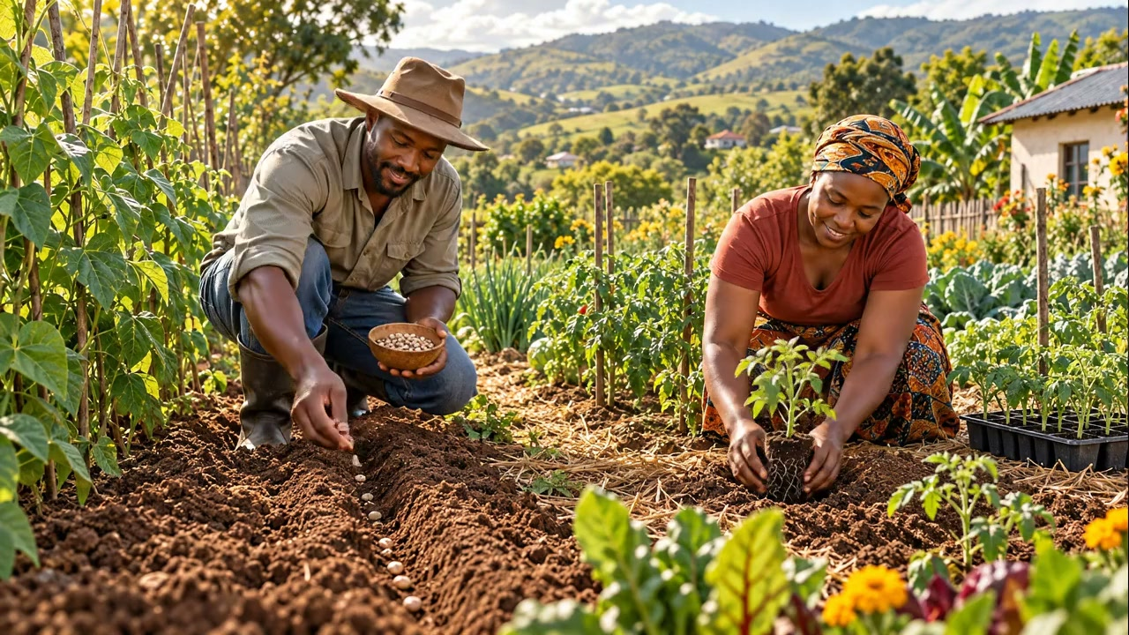
Imbewu noma isithombo?
• Tshala ngqo: ubhontshisi, ummbila, ithanga, izaqathe
• Izithombo kuqala: iklabishi, isipinashi, utamatisi, u-anyanisi
▶ Clip F-ANI-19 · play from the tablet: flow-seed-or-seedling.mp4
F-D4-02 · Poster F-P14
Grow Food, Grow Strong
Notes:
F-D4-S1. Sort together.
Poster: F-P14
Clip F-ANI-19: public/course-animations/vegetables-staples/flow-seed-or-seedling.mp4

Slide 3
SEBENZANI
Inhlabathi yezithombo
• 1 i-compost : 1 isihlabathi : 1 inhlabathi
• Kuhlungiwe · kumanzana, kungabi manzi kakhulu
POSTER ART · F-P14-ART · coming
Artwork for F-P14 · Grow strong seedlings
Left column: two groups of generic seeds — large seeds going straight into a bed; small seeds going into a tray. Centre: three buckets (compost, sand, soil) pouring into a basin through a sieve; a tray of recycled containers (yoghurt tubs, egg box, toilet rolls) with holes; a finger making a hole twice as deep as a seed is wide (show the seed beside the…
F-D4-03 · Poster F-P14
Grow Food, Grow Strong
Notes:
Add worm castings if the class worm farm has any.
Poster: F-P14

Slide 4
SEBENZANI
Tshalani ithreyi lenu
• Jula kabili kunembewu
• Imbewu ezimbili emgodini
• Ilebula · nisela · umthunzi omncane
IMAGE · F-IMG-23 · coming
Sowing a tray
A finger making a small hole in seedling mix in a yoghurt-tub tray; two small seeds beside it for scale; a label cut from a milk bottle.
F-D4-04 · Poster F-P14
Grow Food, Grow Strong
Notes:
Every learner fills and sows their own tray to take home on Day 5.
Poster: F-P14

Slide 5
Kusuka ethreyini kuya embhedeni
• Nisela njalo ekuseni, kancane
• Qinisa izithombo isonto elilodwa
• Tshala uma inamaqabunga angu-4–6, ntambama
IMAGE · F-IMG-24 · coming
Hardening off
A seedling tray shown in three positions over a week, moving from shade into full sun (three small sun icons growing).
F-D4-05 · Poster F-P14
Grow Food, Grow Strong
Notes:
Water the tray first, lift with the soil ball, same depth, firm, water, mulch.
Poster: F-P14

Slide 6
Kusondelene kakhulu? Kukude kakhulu?
• Ibanga elifanele = isivuno esikhulu kunazo zonke
ANIMATION · F-ANI-20 · coming
The spacing stick
Top-down view of a bare 1 m × 2 m bed. A 1 m stick with notches every 10 cm lies along the edge; three notches are colour-marked (Leaf, Ochre, Forest). (0–5 s) the stick is laid across the bed and pegs are placed at the Forest (45 cm) notches — two large plant shapes appear down the middle in a triangle pattern. (5–10 s) stick moves; pegs at the Ochre…
F-D4-06 · Poster F-P15
Grow Food, Grow Strong
Notes:
F-D4-S2. Ask what happens when cabbages are too close.
Poster: F-P15
Clip F-ANI-20: public/course-media/farmer-5day/F-ANI-20.mp4

Slide 7
SEBENZANI
Yenzani induku yokulinganisa
• Induku ye-1 m
• Nqunyani uphawu njalo ku-10 cm
• Makani u-15 · 30 · 45
IMAGE · F-IMG-25 · coming
Making a spacing stick
A 1 m stick with notches being cut with a knife every 10 cm; three notches painted in different colours.
F-D4-07
Grow Food, Grow Strong
Notes:
Three colours for 15, 30, 45 if you have them.

Slide 8
Kube kude kangakanani?
• 10 cm u-anyanisi, ubhitrudi · 15 cm ubhontshisi
• 30 cm isipinashi, ulethisi
• 45–50 cm iklabishi, utamatisi
POSTER ART · F-P15-ART · coming
Artwork for F-P15 · Planting plan: spacing & rotation
Top 55%: a 1 m × 2 m bed from above with plants placed in a triangle pattern — a middle line of large round cabbage-like heads, rows of leafy plants on either side, a dense row of thin onion-like shoots at one end, small flowers at the corners; a 1 m spacing stick lying along the edge with notches. Bottom 40%: a four-part wheel (like a clock with four…
F-D4-08 · Poster F-P15
Grow Food, Grow Strong
Notes:
Triangle pattern. Pumpkin 1–1.5 m, on the swale mound.
Poster: F-P15

Slide 9
SEBENZANI
Hlelani ephepheni kuqala
• Dwebani umbhede wenu we-1 m × 2 m
• Okungenani izitshalo ezi-3
• Ezinkulu phakathi, u-anyanisi emaphethelweni
IMAGE · F-IMG-26 · coming
Bed plan on paper
A hand-drawn rectangle on paper with circles of different sizes in a triangle pattern, big ones in the middle, small ones at the ends, flowers at the corners.
F-D4-09
Grow Food, Grow Strong
Notes:
Facilitators check every plan before planting.

Slide 10
SEBENZANI
Tshalani
• Makani ngenduku
• Wonke umuntu atshale okungenani ezi-3
• Niselani kancane · i-mulch phakathi kwezitshalo
IMAGE · F-IMG-27 · coming
Planting out
Learners on both sides of a bed transplanting seedlings with a spacing stick laid across; watering can and mulch.
F-D4-10
Grow Food, Grow Strong
Notes:
Recorder ticks names. Bed walk at 12:20.

Slide 11
SEBENZANI
Isitha noma umngane?
• Tholani esisodwa sohlobo ngalunye
• Bhekani ngaphansi kwamaqabunga
IMAGE · F-IMG-40 · coming
Pest & friend card — Aphids on a stem
Aphids on a stem — a pest. Clear, large, accurate enough to recognise in the garden; plain Paper background; no text. A small Leaf-green border for friends and an Ochre border for pests.
F-D4-11
Grow Food, Grow Strong
Notes:
F-D4-S3. 15-minute bug hunt. No bugs? Use cards F-IMG-40 to 45.

Slide 12
Khuphuka kusukela phansi
• Inhlabathi ephilile · izitshalo eziningi · buka njalo
• Izandla nemigoqo · mema abangane
• Isifutho sasekhaya · ushevu ekugcineni
POSTER ART · F-P16-ART · coming
Artwork for F-P16 · Healthy garden, fewer pests
A tall wooden ladder with seven rungs, filling the height of the poster. Beside each rung, a small scene (bottom to top): 1 dark soil with worms and a strong plant; 2 a mixed bed with flowers; 3 a person looking under a leaf; 4 hands picking a caterpillar, a toilet-roll collar round a seedling, a net over a bed; 5 a ladybird, a bird, a frog, a spider on…
F-D4-12 · Poster F-P16
Grow Food, Grow Strong
Notes:
Ask where most people start (the top). We start at the bottom.
Poster: F-P16
Also: F-ANI-21
Clip F-ANI-21: public/course-animations/plant-guilds/Imbewu-Guilds-04-Helpful-insects.mp4

Slide 13
SEBENZANI
Isifutho sikagalikhi nopelepele
• Ugalikhi + upelepele + u-anyanisi + amanzi, ubusuku bonke
• Hluzani · faka insipho encane engenalutho
• Inkomishi 1 ezinkomishini 4 zamanzi · hlolani kuqala
IMAGE · F-IMG-28 · coming
Garlic-chilli spray
On a board: a garlic bulb, red chillies, an onion, a 2 L bottle of water, a cloth strainer, a bar of plain soap, a spray bottle, and gloves.
F-D4-13 · Poster F-P16
Grow Food, Grow Strong
Notes:
Gloves if possible, never touch your eyes, wash hands. Label the bottle. Spray late afternoon under leaves.
Poster: F-P16

Slide 14
SEBENZANI
Amakhola nezicupho
• Ikhola lephepha lasendlini yangasese ezungeze isithombo
• Ipulangwe lemiminzane ubusuku bonke
IMAGE · F-IMG-29 · coming
Collar and trap
A cardboard toilet-roll tube pushed into soil around a young stem; beside it a board lifted to show slugs underneath.
F-D4-14
Grow Food, Grow Strong
Notes:
Each group protects one seedling in its bed.

Slide 15
Shintshanisa izitshalo isizini ngayinye
• Ubhontshisi → Amaqabunga → Izithelo → Izimpande
ANIMATION · F-ANI-22 · coming
Rotation wheel
Four beds arranged as quarters of a circle seen from above, each with one crop group: bean pods; leafy heads; round fruits (tomato/pumpkin shapes); roots (carrot/beetroot shown in cut-away). Every 3 s the crops rotate one quarter clockwise while the soil colour under the bean quarter darkens slightly as it passes (showing the soil being fed). A season…
F-D4-15 · Poster F-P15
Grow Food, Grow Strong
Notes:
F-D4-S4. Four learners with cards walk the wheel.
Poster: F-P15
Clip F-ANI-22: public/course-media/farmer-5day/F-ANI-22.mp4

Slide 16
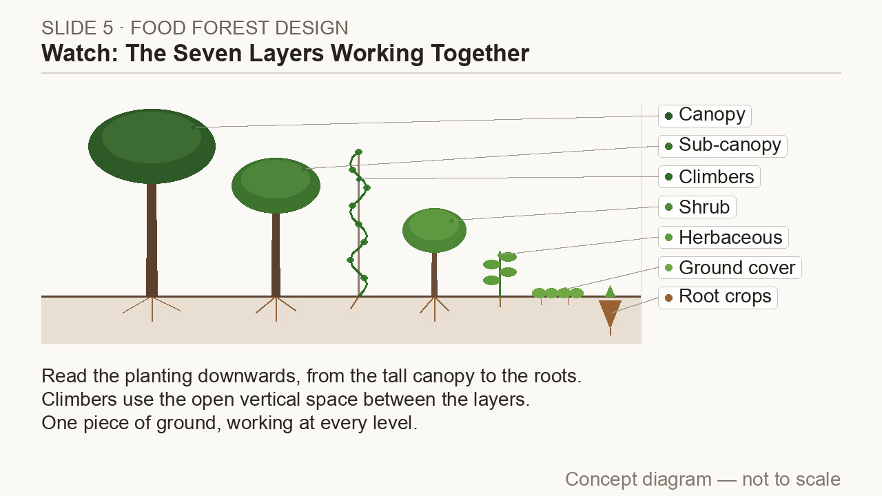
Tshala njengehlathi
• Umuthi omude · umuthi omncane · isihlahlana · amakhambi
• Okumbozayo · izimpande · okukhwelayo
▶ Clip F-ANI-23 · play from the tablet: watch-05-seven-layers.mp4
F-D4-16 · Poster F-P17
Grow Food, Grow Strong
Notes:
Ask: who waters and fertilises the forest?
Poster: F-P17
Clip F-ANI-23: public/course-animations/food-forest/watch-05-seven-layers.mp4

Slide 17
SEBENZANI
Tshalani umuthi wezithelo
• 60 × 60 × 60 cm · ukujula okufana nesikhwama
• Umgodi · induku · i-mulch eshiya isikhala
• Amalitha angu-20 amanzi
POSTER ART · F-P17-ART · coming
Artwork for F-P17 · Food-forest layers & planting a fruit tree
Top 55%: a side view of a small home food forest with seven layers, generic shapes only: a tall canopy tree, a small fruit tree, a bush, herbs, a spreading ground cover, a root crop shown in cut-away below the soil, and a climber twining up the small tree. Fallen leaves on the ground. Bottom 40%: six small steps of planting a fruit tree — a pit with…
F-D4-17 · Poster F-P17
Grow Food, Grow Strong
Notes:
Each group does one step. Best at the start of the rains.
Poster: F-P17

Slide 18
SEBENZANI
Uhlelo lwami lokutshala
• Imiphi imibhede · iziphi izitshalo kuqala
• Lapho umuthi wezithelo ungaba khona
IMAGE · F-IMG-04 · coming
My garden map
A hand-drawn map on paper seen from above: a house square, a north arrow, a tap, blue arrows of water, a sun symbol on the north side, a circle marking zone 1. Pencil and crayon style.
F-D4-18
Grow Food, Grow Strong
Notes:
On each learner's garden map.

Slide 19
Kusasa
• Lethani imbewu yokwabelana
• Izitifiketi ngo-15:15 — imindeni yamukelekile
IMAGE · F-IMG-05 · coming
Closing circle
Late-afternoon warm light; a circle of standing people, one holding up a hand to speak; tools laid neatly on a tarp in the centre.
F-D4-19
Grow Food, Grow Strong
Notes:
Closing circle.

