Slide 1
IMAGE · T-IMG-08 · coming
Day 2
Tree talk
A teaching circle under a big shade tree: a poster tied to the trunk at seated eye level; about twelve learners in a horseshoe on chairs and a log, faces in shade, the sun behind them in the upper part of the scene (north). The facilitator stands to one side of the poster. On the ground in the middle: two cut-open 2 ℓ bottles and a cardboard house. A…
Say less, ask more
Day 2 of 5
T-D2-01 · Poster T-P01
Teach the Teachers
Notes:
T-D2-S0. A trainee runs the register. Energiser by a volunteer. "You said, we did" — answer
yesterday's wishes in two sentences.
Poster: T-P01

Slide 2
What did you sleep on?
• One thing you remember
• One question you woke with
IMAGE · T-IMG-01 · coming
A learning circle under a tree
Twenty adults sit in a wide circle on plastic chairs and a wooden bench under a big shade tree beside a rural community hall. Mixed ages: young graduates in trainers and T-shirts, two extension officers in work shirts, gogos in headscarves, an older lead farmer in a hat. One young woman stands, mid-sentence, hands open; others lean in, some laughing.…
T-D2-02 · Poster T-P11
Teach the Teachers
Notes:
T-D2-S0 steps 4–6. Questions to the Question Tree. Roles rotate; say today's promise.
Poster: T-P11

Slide 3
Which outcome can you see?
• A: understand compost
• B: build a 1 m layered heap
POSTER ART · T-P05-ART · coming
Artwork for T-P05 · Outcomes start with a doing word
A young farmer stands proudly beside a finished, neatly layered compost heap about waist high, pointing to its layers. A facilitator beside her holds a clipboard and draws a tick shape. In the background, a clock shape on a wall shows the hands near twelve (midday). Three big ochre callout circles sit on: the farmer's pointing hand (①), the heap (②), and…
T-D2-03 · Poster T-P05
Teach the Teachers
Notes:
T-D2-S1 step 1. Ask: at 12:30, how would you know? Only B can be seen.
Poster: T-P05

Slide 4
Start with a doing word
• A doing word · What · How well
• Make, show, find, measure, explain
• Could you see it by lunch?
POSTER ART · T-P05-ART · coming
Artwork for T-P05 · Outcomes start with a doing word
A young farmer stands proudly beside a finished, neatly layered compost heap about waist high, pointing to its layers. A facilitator beside her holds a clipboard and draws a tick shape. In the background, a clock shape on a wall shows the hands near twelve (midday). Three big ochre callout circles sit on: the farmer's pointing hand (①), the heap (②), and…
T-D2-04 · Poster T-P05
Teach the Teachers
Notes:
T-D2-S1 steps 2–4. Foggy words: understand, know, learn about, appreciate. Groups fix six foggy
cards; then pairs fix their own Round 2 outcome. Ten minutes = one small outcome.
Poster: T-P05

Slide 5
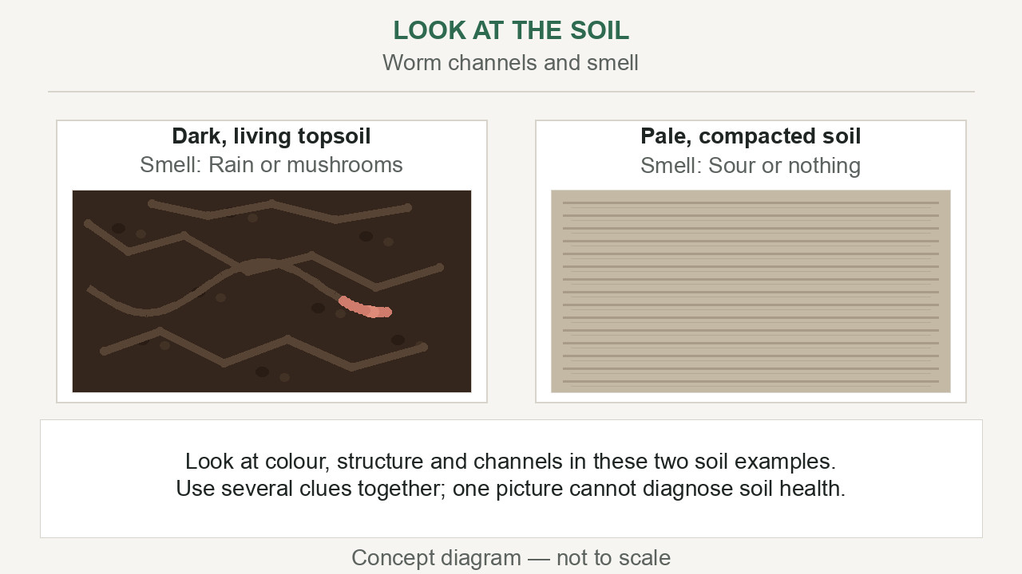
Three questions
• Is soil alive?
• What lives in soil?
• How could you find out?
▶ Clip T-ANI-17 · play from the tablet: watch-05-living-soil.mp4
T-D2-05 · Poster T-P08
Teach the Teachers
Notes:
T-D2-S1 step 5. Ask each, wait after each. Which got the best thinking?
Poster: T-P08
Clip T-ANI-17: public/course-animations/soil-health/watch-05-living-soil.mp4

Slide 6
Climb the question ladder
• Closed · Open · Deeper
• Wait 5 seconds
• Bounce it back
POSTER ART · T-P08-ART · coming
Artwork for T-P08 · The question ladder
A tall wooden ladder with three rungs leans against a tree. On the bottom rung, a small figure beside one short speech-bubble shape (empty). On the middle rung, two figures with several branching bubble shapes. On the top rung, a figure looks out over a whole garden, hand on chin, with a bubble shaped like a sprouting seed. At the ladder's foot: an open…
T-D2-06 · Poster T-P08
Teach the Teachers
Notes:
T-D2-S1 steps 6–7. Not "Any questions?" but "What questions do you have?" Pairs write a ladder
for a Course 1 poster.
Poster: T-P08

Slide 7
YOUR TURN
Wait and bounce
• Count five fingers silently
• Don't answer — bounce it back
• 12 minutes
POSTER ART · T-P08-ART · coming
Artwork for T-P08 · The question ladder
A tall wooden ladder with three rungs leans against a tree. On the bottom rung, a small figure beside one short speech-bubble shape (empty). On the middle rung, two figures with several branching bubble shapes. On the top rung, a figure looks out over a whole garden, hand on chin, with a bubble shaped like a sprouting seed. At the ladder's foot: an open…
T-D2-07 · Poster T-P08
Teach the Teachers
Notes:
T-D2-S1 step 8. Four farmer questions; then give the short content answers from the day file.
Take home: three ladder questions into the Round 2 plan.
Poster: T-P08

Slide 8
IMAGE · T-IMG-08 · coming
Model lesson under a tree
Tree talk
A teaching circle under a big shade tree: a poster tied to the trunk at seated eye level; about twelve learners in a horseshoe on chairs and a log, faces in shade, the sun behind them in the upper part of the scene (north). The facilitator stands to one side of the poster. On the ground in the middle: two cut-open 2 ℓ bottles and a cardboard house. A…
Read the land and water
Recorders: count question types
T-D2-08 · Poster F-P05
Teach the Teachers
Notes:
T-D2-S2. Ladder tally card to each Recorder. Walk out; F-P05 on the trunk; sun behind learners.
Poster: F-P05

Slide 9
YOUR TURN
Where is the sun?
• Window faces north
• Mark winter shade with sticks
• Which way does the shadow point?
IMAGE · T-IMG-07 · coming
The cardboard house and the sun
Close view on bare ground: a shoebox house with a card triangle roof and small windows on each side, sitting on a patch of soil. A compass arrow drawn on the ground points up-screen (north). Sunlight comes from the north (upper part), low (winter), casting a long shadow of the house down-screen (south). Small sticks mark the edge of the shadow. Two hands…
T-D2-09 · Poster F-P05
Teach the Teachers
Notes:
T-D2-S2 steps 2–3. Cardboard house per group, torch or real sun. Stick shadow points south at noon.
Poster: F-P05
Also: T-ANI-13
Clip T-ANI-13: public/course-animations/reading-landscape/watch-09-sun-shadows.mp4

Slide 10
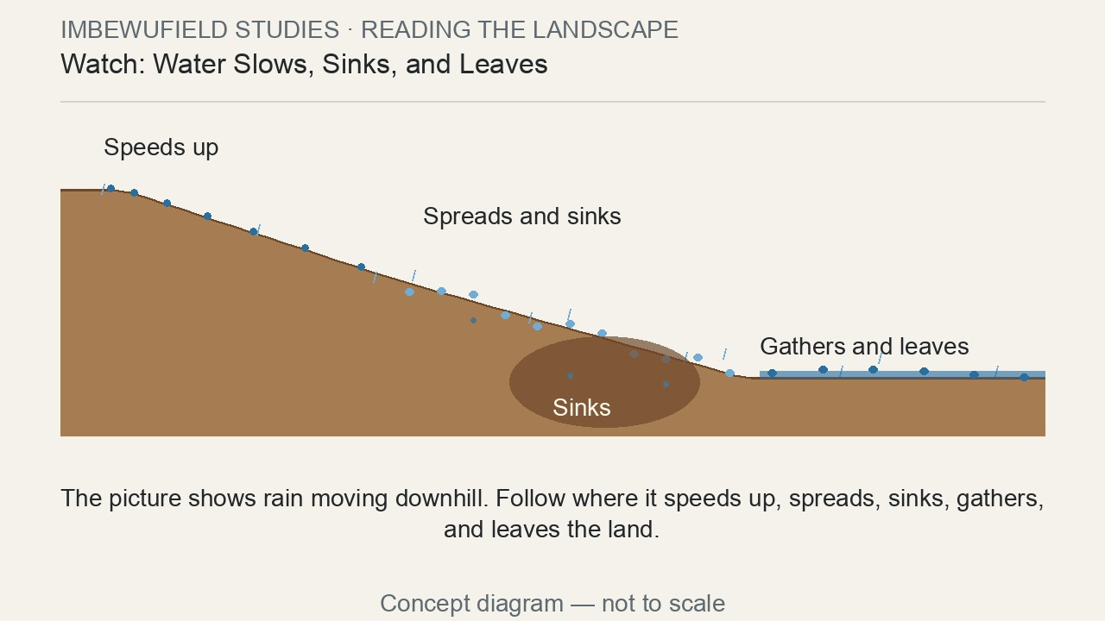
YOUR TURN
Where does the water go?
• Pour 500 ml on each bottle
• Catch and measure the runoff
• Find three water signs
▶ Clip T-ANI-14 · play from the tablet: watch-05-water-movement.mp4
T-D2-10 · Poster F-P07
Teach the Teachers
Notes:
T-D2-S2 steps 4–6. Debrief on F-P07; roof sum on F-P08 (60 m² × 10 mm = 600 ℓ, about 500 caught).
Clip T-ANI-15 for the roof.
Poster: F-P07
Clip T-ANI-14: public/course-animations/reading-landscape/watch-05-water-movement.mp4

Slide 11
Tree talk
• Sun behind learners
• Poster at eye level
• Stop, then talk
POSTER ART · T-P12-ART · coming
Artwork for T-P12 · Teach with what you have (tree talk)
A teaching circle under a large shade tree. A poster is tied to the trunk at the eye level of seated people. Learners sit in a horseshoe facing the trunk, the sun shape behind them in the upper part of the scene (north, marked by a small compass arrow pointing up), so their faces are in shade. The facilitator stands to one side of the poster, wind lines…
T-D2-11 · Poster T-P12
Teach the Teachers
Notes:
T-D2-S2 steps 7–10. Ladder counts; tree-talk rules; improvised-aids brainstorm (8 free things per
group); roof-sum practice. 1 mm on 1 m² = 1 litre.
Poster: T-P12

Slide 12
POSTER ART · T-P13-ART · coming
Mode 1: posters only
Artwork for T-P13 · One lesson, three ways
Three tall columns. Left: a poster on a fence with a group of five standing, one pointing. Middle, top: a laptop connected to a TV on a table in a shaded room with seated learners; middle, bottom: a group of five crowded around a tablet held by one of them. Right: a group of five watching a phone; beneath it, a hand signing on a phone screen with a…
One lesson, three ways
Today: the poster
T-D2-12 · Poster T-P13
Teach the Teachers
Notes:
T-D2-S3. Energiser by a trainee first.
Poster: T-P13

Slide 13
Teach from a poster
• Cover and reveal
• Point and ask
• Learners come to the poster
IMAGE · T-IMG-02 · coming
Notes on the phone, poster on the fence
A young female facilitator stands beside (not in front of) a poster tied to a wire fence with cable ties. She holds a phone low in one hand, glancing at it, and points with an open hand at a numbered circle on the poster. Five learners stand in a horseshoe facing the poster, one stepping forward to touch it. Garden beds behind. Poster content drawn as…
T-D2-13 · Poster T-P13
Teach the Teachers
Notes:
T-D2-S3 steps 2–3. Co-trainer teaches F-P06 badly (90 s) then well (90 s). Stand to the side;
notes on the A5 card or phone.
Poster: T-P13

Slide 14
Everyone learns
• Language time: retell it
• A role for everyone
• Seated jobs, picture labels
POSTER ART · T-P17-ART · coming
Artwork for T-P17 · Everyone learns
A mixed group of five at a raised table outside, mixing seedling soil: a gogo seated, showing seeds in her palm to others; a young man in a wheelchair at the table's end mixing soil with both hands; a young mother with a baby tied on her back; an older man seated close to the facilitator, watching her face as she speaks; two young women talking side by…
T-D2-14 · Poster T-P17
Teach the Teachers
Notes:
T-D2-S3 steps 4–6. Language-time demo with the roof sum; six scenario cards; then studio: improve
the poster and write a 5-prompt Teach it card.
Poster: T-P17

Slide 15
YOUR TURN
Micro-teaching Round 2
• 10 minutes, solo, posters only
• Observer counts talk and questions
• 6 minutes feedback
IMAGE · T-IMG-05 · coming
A micro-teach in a small circle
Five adults in a small circle of chairs in the corner of a hall. One young man (teaching) holds up a cut-open 2 ℓ bottle of soil while three peers lean forward, one pouring water. A fourth person, an older woman, sits slightly back with a clipboard, making tally marks (simple strokes). A second person holds up a small red card (the STOP card, no text). A…
T-D2-15 · Poster T-P04
Teach the Teachers
Notes:
T-D2-S4 steps 1–4. Reverse order. Talk % = marks ÷ 10 × 100. Trainers observe two full teaches each.
Poster: T-P04

Slide 16
The talk scoreboard
• Write your own talk %
• What helped you talk less?
POSTER ART · T-P04-ART · coming
Artwork for T-P04 · The teacher-talk meter
Top half: a big half-circle gauge, like a fuel gauge, split into ten equal wedges — three Ochre wedges on the left, seven Leaf-green wedges on the right (the Leaf wedges also carry small dot pattern so it works in black and white). A thick Ink needle points into the third Ochre wedge. Bottom half: a facilitator stands to one side with an open hand…
T-D2-16 · Poster T-P04
Teach the Teachers
Notes:
T-D2-S4 steps 5–7. No comments on others' numbers. Add tips to "Our teaching tips". Tick Poster.
Poster: T-P04

Slide 17
Course craft: POPIA
• Consent before the camera
• Green dot = no photos
• Share only what was agreed
IMAGE · T-IMG-15 · coming
The register at the door
A small table at a hall doorway in the morning light. A young man signs a register on a clipboard (grid lines, no letters) while an older woman presses her thumb onto an ink pad to mark her name. A facilitator beside them holds name tags; a small sheet of green dot stickers sits on the table. A queue of three learners waits, chatting.
T-D2-17 · Poster T-P17
Teach the Teachers
Notes:
T-D2-SC. Eight "OK or not?" cards. Pairs made inside groups; pool B cards for Round 3 (15 min, with
a practical).
Poster: T-P17

