Slide 1
IMAGE · T-IMG-04 · coming
Usuku 3
A tablet for a group of five
Five learners crowd round a tablet held by a young man (the Recorder) at a garden table outdoors in shade. The tablet screen shows a simple animation frame of water soaking into soil (Water blue, soil Ochre). An older woman points at the screen; a young woman beside her already has her hands in a tray of soil, doing what they just watched. A facilitator…
Izandla emsebenzini, njalo
Usuku 3 kwezi-5
T-D3-01 · Poster T-P04
Teach the Teachers
Notes:
T-D3-S0. Register by a trainee; energiser; "you said, we did"; each trainee names one way to lower
their talk % today.
Poster: T-P04

Slide 2
Indaba ka-2022
• Umuntu oyedwa uyamba
• Abangu-25 bayabuka
• I-kit yamaqembu amane isemotweni
ANIMATION · T-ANI-02 · coming
From one demo to five groups
Top view of a practical site. 0–4 s: one facilitator digging, 25 small figures standing around her in a crowd, still. 4–8 s: the crowd splits into five groups of five that walk to five stations 3 m apart, each with its own small pile of tools. 8–12 s: every figure is moving — digging, carrying, mixing; the facilitator walks between stations with hands…
T-D3-02 · Poster T-P07
Teach the Teachers
Notes:
T-D3-S1 step 1. Three minutes max. Then groups: why does it happen? Sort into can fix / can't fix.
Poster: T-P07
Clip T-ANI-02: public/course-media/teach-the-teachers/T-ANI-02.mp4

Slide 3
Izandla emsebenzini, hhayi i-demo
• I-kit eqenjini ngalinye · I-demo imizuzu 3
• Amaqembu abantu 5 · Iziteshi zihlukene
• Izandla zakho ngemuva
POSTER ART · T-P07-ART · coming
Artwork for T-P07 · A practical, not a demo
Two panels. Small top-left panel (one third width), drawn in faded greys: one facilitator digging while a crowd of about twenty stands watching, arms folded; a thick Ochre diagonal bar crosses the panel (a "no" sign made of a shape, not a letter). Large main panel: four groups of five at four stations spaced apart on open ground, every person working —…
T-D3-03 · Poster T-P07
Teach the Teachers
Notes:
T-D3-S1 step 3. Six moves. "If you take the spade, the practical is over."
Poster: T-P07

Slide 4
SEBENZANI
Sindisani umsebenzi wezandla
• Ikhadi elilodwa eqenjini ngalinye
• Hlelani ukusindisa, imizuzu 12
• Imizuzu 2 yokwethula
POSTER ART · T-P07-ART · coming
Artwork for T-P07 · A practical, not a demo
Two panels. Small top-left panel (one third width), drawn in faded greys: one facilitator digging while a crowd of about twenty stands watching, arms folded; a thick Ochre diagonal bar crosses the panel (a "no" sign made of a shape, not a letter). Large main panel: four groups of five at four stations spaced apart on open ground, every person working —…
T-D3-04 · Poster T-P07
Teach the Teachers
Notes:
T-D3-S1 step 4. Cards: one spade; rain; a learner takes over; elders won't get hands dirty.
Poster: T-P07

Slide 5

SEBENZANI
I-kit eyodwa? Jikelezani
• I-A-frame eyodwa, abafundi abangu-25
• Iziteshi ezinhlanu, imizuzu 8 ngasinye
• Akekho obuka ngaphezu kwemizuzu 10
▶ Clip T-ANI-10 · play from the tablet: flow-a-frame.mp4
T-D3-05 · Poster T-P07
Teach the Teachers
Notes:
T-D3-S1 step 5. Model answer in the day file.
Poster: T-P07
Clip T-ANI-10: public/course-animations/reading-landscape/flow-a-frame.mp4

Slide 6
SEBENZANI
Thola ingozi
• Tholani izingozi ezi-8 ngemizuzu 4
• Amathuluzi akhombe phansi
• Ikhithi yosizo lokuqala ivuliwe
IMAGE · T-IMG-16 · coming
Spot the hazard
A busy practical site with eight hazards for learners to find: a spade lying point-up on a path; a garden fork leaning at head height; an open spray bottle next to a plate of food; a hosepipe across a walkway; a group working in full midday sun with no hats; a first aid box inside a closed car; someone swinging a pick with a person standing just behind;…
T-D3-06 · Poster T-P16
Teach the Teachers
Notes:
T-D3-S1 steps 6–8. Safety rules; count a crate in and out; journal rule.
Poster: T-P16

Slide 7
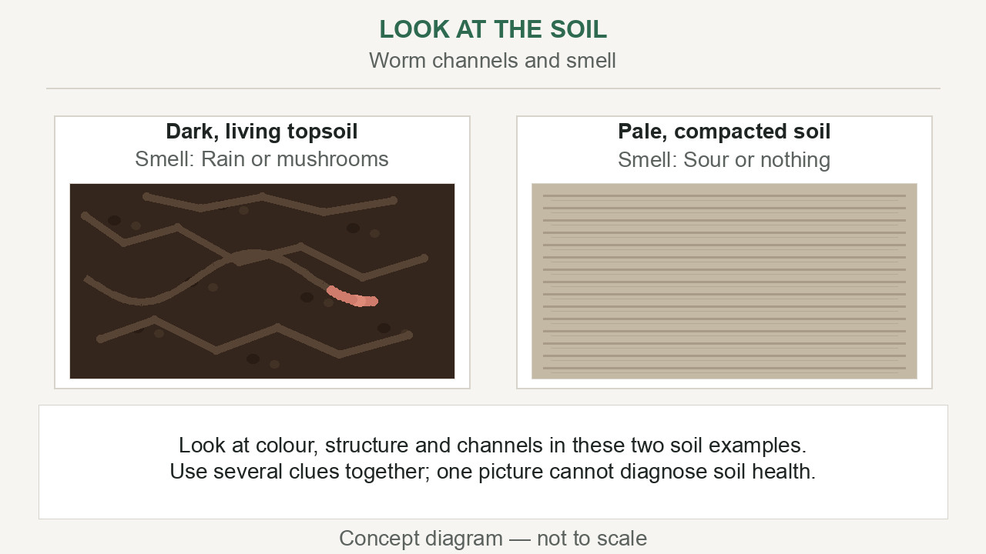
Umsebenzi wezandla oyisibonelo: inhlabathi ephilayo
Manje ningabalimi
Ababhali: ikhadi lokuhlola umsebenzi wezandla
▶ Clip T-ANI-17 · play from the tablet: watch-05-living-soil.mp4
T-D3-07 · Poster F-P10
Teach the Teachers
Notes:
T-D3-S2. Co-trainer teaches. Observer ticks each person every 5 minutes their hands are in the task.
Poster: F-P10
Clip T-ANI-17: public/course-animations/soil-health/watch-05-living-soil.mp4

Slide 8
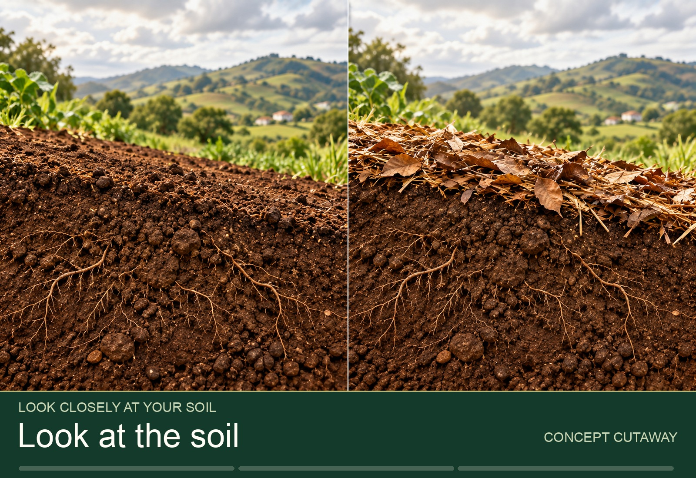
SEBENZANI
Izivivinyo ezine zenhlabathi
• Cindezela · Imbiza · Imisundu · Ukungena kwamanzi
• Wonke umuntu wenza ngasinye
• Imizuzu 27
▶ Clip T-ANI-19 · play from the tablet: tour-soil-observation.mp4
T-D3-08 · Poster F-P10
Teach the Teachers
Notes:
T-D3-S2 step 2. Demo 3 minutes max, then hands behind your back. Read the settled Day 0 jar.
Poster: F-P10
Clip T-ANI-19: public/course-animations/soil-health/tour-soil-observation.mp4

Slide 9
SEBENZANI
Hlolani eceleni ngeceleni
• Amabhodwe amabili, ushintsho olulodwa
• Hlwanyelani, nibhale, ninisele ngokufanayo
• Qagelani, bese nibheka ngoSuku 5
POSTER ART · T-P21-ART · coming
Artwork for T-P21 · Test it side by side
Two small plots side by side, divided by a string line. Left plot: bare soil, small pale plants. Right plot: mulched soil with compost, taller dark-green plants. A group of five farmers crouches between them: one measures a plant against a marked stick, one draws on a clipboard, one holds a handful of soil from each side, two discuss, pointing. Along the…
T-D3-09 · Poster T-P21
Teach the Teachers
Notes:
T-D3-S2 step 4. Compost vs no compost. This is how farmer field schools learn.
Poster: T-P21

Slide 10
Phumani: sihlaziye
• Ubani othole ama-tick angaphansi kuka-4?
• Yini egcine zonke izandla zimatasa?
IMAGE · T-IMG-04 · coming
A tablet for a group of five
Five learners crowd round a tablet held by a young man (the Recorder) at a garden table outdoors in shade. The tablet screen shows a simple animation frame of water soaking into soil (Water blue, soil Ochre). An older woman points at the screen; a young woman beside her already has her hands in a tray of soil, doing what they just watched. A facilitator…
T-D3-10 · Poster T-P07
Teach the Teachers
Notes:
T-D3-S2 steps 6–8. Then soil and compost questions from the content notes.
Poster: T-P07

Slide 11
IMAGE · T-IMG-03 · coming
Indlela 2: ama-slide
Projector in daylight
Split image. Left: a bright church hall with open windows; a projector on a table throws a pale, washed-out rectangle onto a white wall — nothing on it can be seen; learners at the back squint and shade their eyes. Right: the same group in a shaded corner of the hall, gathered close around a large TV on a table; the TV shows a clear picture of a green…
Ungakufunda usemuva?
T-D3-11 · Poster T-P13
Teach the Teachers
Notes:
T-D3-S3 step 1. Energiser first. Show this slide on the projector with curtains open; trainees
at the back wall.
Poster: T-P13

Slide 12
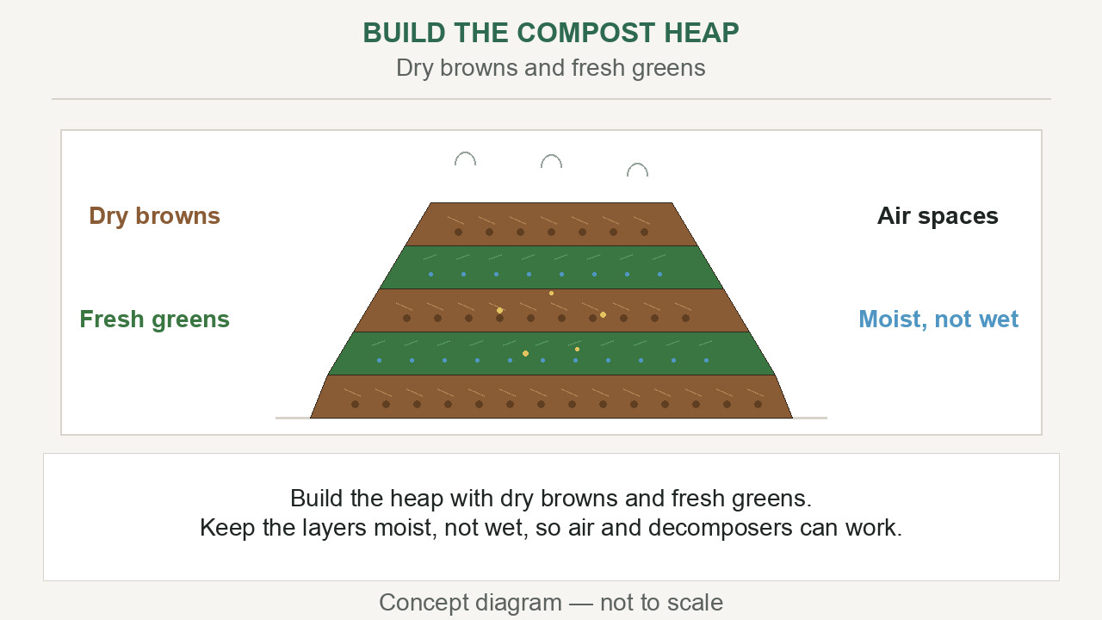
Lapho ama-slide esiza khona
• Izinto ezihambayo noma ezikhulayo
• Izinambuzane ezingekho ngalesi sikhathi
• Iqembu elikhulu egumbini elimnyama
▶ Clip T-ANI-18 · play from the tablet: watch-10-compost-heap.mp4
T-D3-12 · Poster T-P13
Teach the Teachers
Notes:
T-D3-S3 step 2. Ask first; let them answer.
Poster: T-P13
Clip T-ANI-18: public/course-animations/soil-health/watch-10-compost-heap.mp4

Slide 13
Hlela ukuze kubonakale
• Hlola usemuva, emini
• I-TV ingcono kune-projector; cindezela B
• Ithebhulethi eqenjini ngalinye labantu 5
IMAGE · T-IMG-04 · coming
A tablet for a group of five
Five learners crowd round a tablet held by a young man (the Recorder) at a garden table outdoors in shade. The tablet screen shows a simple animation frame of water soaking into soil (Water blue, soil Ochre). An older woman points at the screen; a young woman beside her already has her hands in a tray of soil, doing what they just watched. A facilitator…
T-D3-13 · Poster T-P13
Teach the Teachers
Notes:
T-D3-S3 step 2. Presenter view; carry the deck three ways (laptop, flash drive, PDF on phone).
Poster: T-P13

Slide 14
SEBENZANI
Iziteshi ezintathu
• A: isikrini esikhulu, ama-slide 2
• B: ividiyo kuthebhulethi, yifundiseni
• C: incwajana yezithombe yephepha
IMAGE · T-IMG-14 · coming
The paper flip-book
A group of five seated round a small table outdoors. One person holds a ring-bound A4 book of big pictures (a slide printed on each page — simple garden drawings, no text), turning a page toward the group; another points at the picture. No devices anywhere.
T-D3-14 · Poster T-P13
Teach the Teachers
Notes:
T-D3-S3 step 3. 8 minutes each. Flip-book: show, ask, then turn. No devices? All flip-books.
Poster: T-P13

Slide 15
Dlulisela, ungathathi izintambo
• Hlelani ozohola isinyathelo ngasinye
• Dlulisela ngezwi elizwakalayo
• Thinta indlebe yakho ukuze unikele
POSTER ART · T-P14-ART · coming
Artwork for T-P14 · Hand over, don't take over
In front of a seated group, one facilitator hands a seedling tray to a second facilitator, like passing a relay baton; both smile. Behind them, a third small scene of the same second facilitator quietly carrying a crate of materials and making marks on a clipboard while the first one teaches. In a small inset, a facilitator touches her ear with one…
T-D3-15 · Poster T-P14
Teach the Teachers
Notes:
T-D3-S3 steps 4–5. Then pair studio: finish plans, handovers, signal and posters.
Poster: T-P14

Slide 16
SEBENZANI
Ukufundisa okuncane: Round 3
• Imizuzu 15, ngababili, ingxenye yekilasi
• Umsebenzi wezandla ngamaqembu amabili aba-4
• Imizuzu 7 yempendulo
IMAGE · T-IMG-11 · coming
Two facilitators, one lesson
In front of a seated group, a young woman facilitator hands a seedling tray to a young man facilitator, both smiling, like passing a relay baton. Behind them a crate of tools and a clipboard with tally marks on a chair. Learners watch, one already reaching toward the tray.
T-D3-16 · Poster T-P14
Teach the Teachers
Notes:
T-D3-S4. Stream A with the lead, Stream B with the co-trainer. Set up during the previous feedback.
Poster: T-P14

Slide 17
Impendulo yababili
• Abangane banikana izinkanyezi
• Umbukeli 1: ukukhuluma nemibuzo
• Umbukeli 2: izandla nokudlulisela
POSTER ART · T-P10-ART · coming
Artwork for T-P10 · Two stars and a wish
A small group of four seated in a circle after a lesson. A young woman (the teacher) speaks first, hand open. Opposite her, an older man with a clipboard (the observer) speaks kindly; above him float two big Ochre star shapes and one Leaf-green sprouting seedling shape. The teacher, now with hand on heart, listens and nods. A third person smiles and…
T-D3-17 · Poster T-P10
Teach the Teachers
Notes:
T-D3-S4 step 1. Trainer gives one star only. Never interrupt a teach unless there is a safety risk.
Poster: T-P10

Slide 18
Ubuciko besifundo: i-kit
• Bala ngeqembu, kanye nesisodwa esengeziwe
• I-kit ingena, i-kit iphuma, nsuku zonke
• Izitifiketi: ababhalisile + 10%
POSTER ART · T-P16-ART · coming
Artwork for T-P16 · Ready by Day 0 — the course kit
A flat-lay seen from above on a green tarp: four crates, each with a different plant symbol drawn on it (bean, pumpkin, maize cob, marula fruit), holding spades, string, jars and tins; a poster tube; an open flip folder with forms (lines, not letters); a first aid kit with a cross symbol, open; a clipboard with a register grid; a stack of blank…
T-D3-18 · Poster T-P16
Teach the Teachers
Notes:
T-D3-SC. Groups write a kit list for one Course 1 practical. Round 4 (choose your mode) and Round 5
pool C cards handed out now.
Poster: T-P16

