Slide 1
IMAGE · F-IMG-31 · coming
Day 5 · Seed, food, money
Seed table
A table covered with small labelled heaps of different seeds (beans of many colours, maize, pumpkin seed) and paper envelopes; hands reaching in.
Closing the circle
F-D5-01
Grow Food, Grow Strong
Notes:
Opening circle; seed on the seed table.

Slide 2
Where does your seed come from?
• Open-pollinated: save it for ever
• Hybrid (F1): don't save it
• Treated seed is poison
POSTER ART · F-P18-ART · coming
Artwork for F-P18 · Save your seed
Top: two seed packets. Left packet leads to three generations of similar healthy plants (open-pollinated); right packet (marked with a small generic "F1" style badge shape — no letters, use a distinct symbol like a double circle) leads to one good plant then mixed, uneven small plants. Middle left: dry bean pods rattling on the plant, hands shelling, a…
F-D5-02 · Poster F-P18
Grow Food, Grow Strong
Notes:
F-D5-S1. Read the packet: F1 or hybrid means don't save.
Poster: F-P18

Slide 3
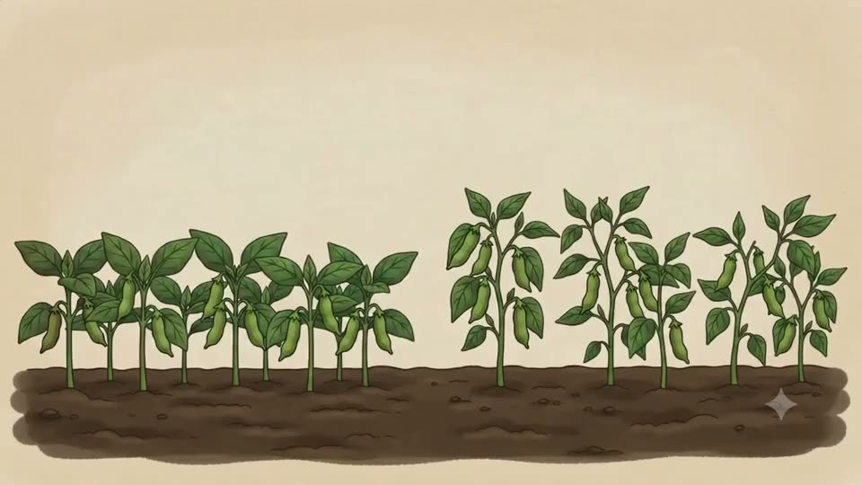
Choose the parents
• The best plants · many plants
• Never the first to bolt
▶ Clip F-ANI-24 · play from the tablet: seed-selecting-parents.mp4
F-D5-03 · Poster F-P18
Grow Food, Grow Strong
Notes:
Mark chosen plants with a ribbon.
Poster: F-P18
Clip F-ANI-24: public/course-animations/seeds-sovereignty/seed-selecting-parents.mp4

Slide 4
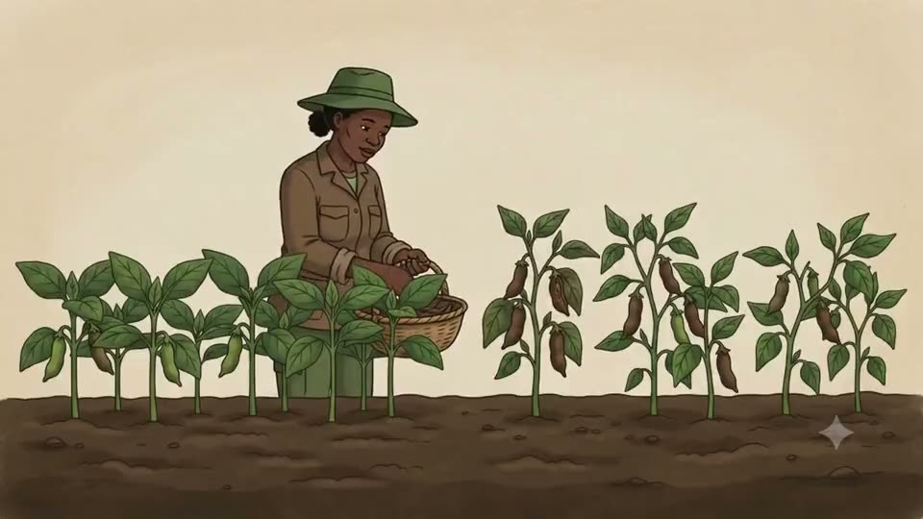
YOUR TURN
Dry method
• Dry on the plant until it rattles
• Dry is when it snaps
▶ Clip F-ANI-25 · play from the tablet: seed-dry-processing.mp4
F-D5-04 · Poster F-P18
Grow Food, Grow Strong
Notes:
Groups shell beans or maize.
Poster: F-P18
Clip F-ANI-25: public/course-animations/seeds-sovereignty/seed-dry-processing.mp4

Slide 5
YOUR TURN
Wet method
• Tomato seed in a jar, 2–3 days
• Rinse · dry thin in the shade
ANIMATION · F-ANI-27 · coming
Tomato seed ferment
A ripe tomato cut in half; seeds and jelly scooped with a spoon into a small glass jar; a little water added; cloth tied over the top. Sun/moon icons cycle 3 times; a thin white skin forms on the surface. The skin and floating seeds are poured off; the heavy seeds at the bottom are tipped into a sieve and rinsed under a stream from a jug; then spread…
F-D5-05 · Poster F-P18
Grow Food, Grow Strong
Notes:
Show the class ferment started 2 days ago.
Poster: F-P18
Clip F-ANI-27: public/course-media/farmer-5day/F-ANI-27.mp4

Slide 6
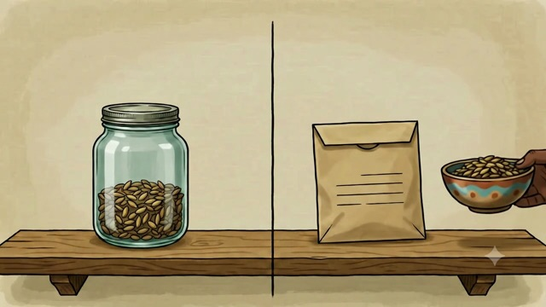
Store and test
• Cool · dark · dry · labelled
• 10 seeds on a damp cloth
• 8 sprout = good seed
▶ Clip F-ANI-26 · play from the tablet: new_seed-storage-jar-vs-bag.mp4
F-D5-06 · Poster F-P18
Grow Food, Grow Strong
Notes:
Then the seed swap: take up to 5 packets; bring back double next season.
Poster: F-P18
Clip F-ANI-26: public/course-animations/seeds-sovereignty/new_seed-storage-jar-vs-bag.mp4

Slide 7
The family plate
• Half vegetables and fruit
• Quarter starch · quarter beans, eggs, meat
POSTER ART · F-P19-ART · coming
Artwork for F-P19 · Eat the rainbow
A large round enamel plate from above, divided: half filled with vegetables and fruit of many colours (dark green leaves, orange pumpkin slices, red tomato, purple beetroot), a quarter with pap, a quarter with beans and an egg. Around the plate, a family: a gogo, a mother, a toddler on a lap, a school child — eating together. Along the bottom, four small…
F-D5-07 · Poster F-P19
Grow Food, Grow Strong
Notes:
F-D5-S2. Colours: dark green (iron), orange (vitamin A), beans (growing).
Poster: F-P19

Slide 8
YOUR TURN
Plate game
• 3 plates for a family with a small child
• At least 4 colours in the day
IMAGE · F-IMG-50 · coming
Food card — dark green leaves bundle (spinach/morogo)
Dark green leaves bundle (spinach/morogo) as it looks in a South African kitchen, on a plain Paper background, no text. Sized to be cut out and placed on a paper plate.
F-D5-08
Grow Food, Grow Strong
Notes:
16 food cards per group (F-IMG-50 to 65).

Slide 9
YOUR TURN
A year of colour
• Summer crops · winter crops
• Something to pick every month
IMAGE · F-IMG-32 · coming
A year of colour
A circular calendar ring divided into 12 segments, the top half (summer) full of warm-season vegetable shapes, the bottom half (winter) of cool-season leaf and root shapes.
F-D5-09
Grow Food, Grow Strong
Notes:
Check the local planting calendar; frost areas differ.

Slide 10
YOUR TURN
Weigh and write
• Eaten · shared · sold
• Write it on the harvest page
ANIMATION · F-ANI-28 · coming
Surplus routes
A basket of harvested vegetables at a homestead; paths lead to three destinations one by one: the family table, a neighbour at the fence, and a small roadside table where a buyer hands over plain generic money (no real currency). (Replaces the withdrawn clip `market-community/watch-09-surplus-routes.mp4`.)
F-D5-10
Grow Food, Grow Strong
Notes:
[APP] twin: log the harvest in Records → Picked. Then the garden handover roster.
Clip F-ANI-28: public/course-media/farmer-5day/F-ANI-28.mp4

Slide 11
Two pockets
• House money · garden money · savings
POSTER ART · F-P20-ART · coming
Artwork for F-P20 · Money in, money out
Top: three tins on a table with picture icons (a house, a seedling, a small safe/piggy-bank-like clay pot). Arrows: vegetables being handed to a buyer and notes coming back into the seedling tin; notes going out of the seedling tin to a seed packet, a manure bag and a taxi. Middle: an open exercise book with two ruled columns — one with a green arrow…
F-D5-11 · Poster F-P20
Grow Food, Grow Strong
Notes:
F-D5-S3. If it all goes in one pocket, you never know if the garden helps.
Poster: F-P20

Slide 12
YOUR TURN
Market day
• R200 in the garden tin
• Act out your card
• Move the money between tins
IMAGE · F-IMG-33 · coming
Market day
A small roadside table of bunches of greens and tomatoes; a buyer handing over notes; three tins on the table with house, seedling and savings-pot icons.
F-D5-12
Grow Food, Grow Strong
Notes:
Five scenario cards in day-5.md S3.

Slide 13
Money in, money out
• Date · what · in · out
• Write it the same day
ANIMATION · F-ANI-29 · coming
Farm record
A hand makes tally marks in two columns of a simple exercise book beside a basket of harvested greens and a hanging scale; bunches move from the basket into three piles (eat, share, sell) as marks appear. Marks are simple strokes, never readable writing. (Replaces the withdrawn clip `market-community/watch-04-farm-record.mp4`.)
F-D5-13 · Poster F-P20
Grow Food, Grow Strong
Notes:
Everyone writes their card's lines. [APP] twin: Records → Sold and Spent; scan a till slip in a Spent entry.
Poster: F-P20
Clip F-ANI-29: public/course-media/farmer-5day/F-ANI-29.mp4

Slide 14
Cost per bunch
• R100 spent ÷ 40 bunches = R2.50
• Shop price? Check locally
• Set a fair price in between
IMAGE · F-IMG-34 · coming
Cost per bunch
Visual sum: a seed packet + a manure bag + a water drop + a taxi → one bed → a row of 40 small bunches.
F-D5-14 · Poster F-P20
Grow Food, Grow Strong
Notes:
Your own time is worth something too — Farmer Money course goes deeper.
Poster: F-P20

Slide 15
My next 90 days
• First 2 weeks · by 6 weeks · by 90 days
POSTER ART · F-P21-ART · coming
Artwork for F-P21 · My 90-day garden plan
A path drawn from bottom-left to top-right through three stepping stones. Stone 1: a person mulching and starting a small compost pile beside a tap. Stone 2: the same person digging one bed north of the house and planting seedlings with a spacing stick. Stone 3: the same person harvesting leafy greens into a basket, a jar of seed on the windowsill and a…
F-D5-15 · Poster F-P21
Grow Food, Grow Strong
Notes:
F-D5-S4. Read the example plan.
Poster: F-P21

Slide 16
YOUR TURN
Show your plan
• 2 minutes each to your group
• Two stars and a wish
• Choose your buddy
IMAGE · F-IMG-35 · coming
Buddies
Two learners from the same group shaking hands; one holding a paper plan, the other a basic phone.
F-D5-16
Grow Food, Grow Strong
Notes:
Write the buddy's name on the plan.

Slide 17
YOUR TURN
How did we do?
• Picture quiz again
• Fingers 1 to 5
• Understand best · want to learn more
IMAGE · F-IMG-70 · coming
Picture quiz card 1
Question (said aloud, not printed in the art): 'Where is the sun at midday in winter?' Art: three panels A/B/C: sun to the north of a house (shadow south) · sun to the south · sun straight overhead. Three equal panels with a large A, B and C typeset below each panel in the layout (not in the art).
F-D5-17
Grow Food, Grow Strong
Notes:
F-D5-S5. forms.md §5 and §6. Return to the "Our hopes" drawings.

Slide 18
IMAGE · F-IMG-36 · coming
Certificates
Certificate
A facilitator handing a certificate to a smiling older woman in her Sunday best; group applauding behind.
Congratulations
F-D5-18
Grow Food, Grow Strong
Notes:
Call each name clearly; hand personally; photo only with consent.

Slide 19
Go well
• Your mentor visits within 2 weeks
• Your buddy will call you
• Look after our garden
IMAGE · F-IMG-37 · coming
Go well
The course garden at dusk: planted beds, compost heaps, the young fruit tree, the swale mound — a few people walking home along the path with seedling trays.
F-D5-19
Grow Food, Grow Strong
Notes:
Closing circle, final register, tools back.

