Slide 1
IMAGE · R-IMG-05 · coming
Day 3 · Selling & growing
Market day
A busy but friendly informal market scene at a taxi rank on a sunny morning (sun in the north). In the foreground a young woman grower hands a crate of even, clean bunches of greens to a creche cook in an apron, who counts them; the grower holds a small duplicate book and pen. Middle ground: a hawker's wheelbarrow stall with greens and tomatoes; a spaza…
Farmer Money · Day 3 of 3
Sell well · borrow wisely · plan
R-D3-01
Farmer Money
Notes:
R-D3-S0. Register; energiser Market Shout; "what did you sleep on?"; rotate roles.

Slide 2
Who buys?
• Neighbour · spaza · hawker
• Creche kitchen · market stall
• Selling together
POSTER ART · R-P14-ART · coming
Artwork for R-P14 · Who buys? What do they want?
A garden gate in the centre with a woman holding a crate of even, clean bunches. Six paths lead out to: ① a neighbour at the gate with a small bag ② a spaza shop (small building with a serving hatch, crates of vegetables, no signage) ③ a hawker at a taxi rank with a wheelbarrow stall ④ a creche kitchen door with a cook and a delivery crate ⑤ a market…
R-D3-02 · Poster R-P14
Farmer Money
Notes:
R-D3-S1. Start with the price board from the homework. Why are prices different? Who you sell to changes your price.
Poster: R-P14
Also: R-ANI-08
Clip R-ANI-08: public/course-media/farmer-money/R-ANI-08.mp4

Slide 3
YOUR TURN
The best buyer for our family
• Six buyer cards
• Put them in order, best on top
• Say why (15 min)
IMAGE · R-IMG-10 · coming
Buyer cards (6)
A4 sheet, 6 cards (2 × 3), each one buyer, no text (facts on the backs — printables P16): 1 a neighbour at a garden gate with a shopping bag · 2 a spaza shop hatch with a shopkeeper and crates (no signage) · 3 a hawker with a wheelbarrow stall at a taxi rank · 4 a creche cook at a kitchen door with a delivery crate · 5 a market stall under an awning with…
R-D3-03
Farmer Money
Notes:
R-D3-S1. Why = amount, price, when paid, quality, distance. Reporters: top buyer + one reason, 30 seconds.

Slide 4
Quality is price
• Picked early · cool · clean
• Same size · same every week
• On time
IMAGE · R-IMG-08 · coming
Good bunch, bad bunch
Two bunches of leafy greens side by side on a plank. **Left (good):** fresh, upright, clean, deep green, even leaf size, neatly tied with a band, in the shade of a crate. **Right (bad):** wilted, soil on the stems, yellow and holed leaves, mixed sizes, loosely tied, lying in the sun. A small tick-shaped leaf above the left and a drooping leaf above the…
R-D3-04 · Poster R-P14
Farmer Money
Notes:
R-D3-S1. Hold up the good and bad bunch. Which would you buy?
Poster: R-P14

Slide 5
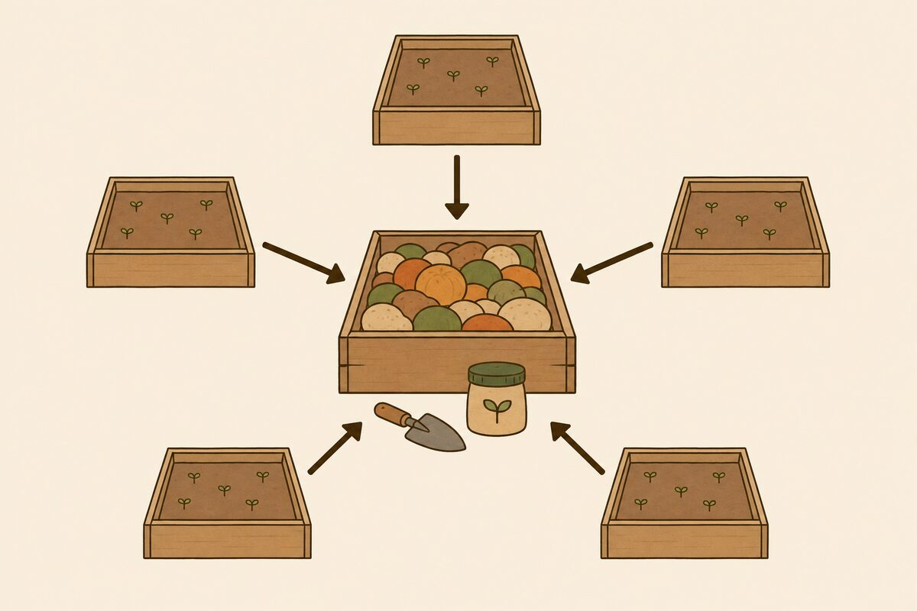
Selling together
• Five growers, one big order
• One taxi, shared cost
• Clear records for every member
R-D3-05 · Poster R-P14
Farmer Money
Notes:
R-D3-S1. Five neighbours × 20 bunches = the creche's 100. Taxi R60 together, not R150. Groups: what must they agree? (quality, delivery, one book, receipts per member, how to share money).
Poster: R-P14
Also: R-ANI-09
Clip R-ANI-09: public/course-media/farmer-money/R-ANI-09.mp4

Slide 6
IMAGE · R-IMG-05 · coming
Market day
Market day
A busy but friendly informal market scene at a taxi rank on a sunny morning (sun in the north). In the foreground a young woman grower hands a crate of even, clean bunches of greens to a creche cook in an apron, who counts them; the grower holds a small duplicate book and pen. Middle ground: a hawker's wheelbarrow stall with greens and tomatoes; a spaza…
From order to receipt
R-D3-06 · Poster R-P15
Farmer Money
Notes:
R-D3-S2. Ask: the creche says "only 20 bunches". What can Lerato show?
Poster: R-P15

Slide 7
Five steps, five proofs
• Order → deliver → invoice
• Paid → receipt
• Each paper proves one step
ANIMATION · R-ANI-03 · coming
From order to receipt
Five beats, 5 s each, same two characters (a young woman grower, a creche cook). 1 Phone order: two phones, a speech bubble with a bunch icon and a crate icon. 2 Delivery: the grower hands a crate; the cook counts bunches one by one (a tally appears as dots) and signs a paper. 3 Invoice: the grower tears the top copy from a book and hands it over; the…
R-D3-07 · Poster R-P15
Farmer Money
Notes:
R-D3-S2. Invoice = you owe me. Receipt = you paid me. Your copy stays in your book. Then a 3-minute demo — then stop and hand over.
Poster: R-P15
Also: R-P15-ART
Clip R-ANI-03: public/course-media/farmer-money/R-ANI-03.mp4

Slide 8
YOUR TURN
Market day role-play
• Round 1: 3 sellers, 3 buyers
• Follow your role card
• Swap for round 2 (20 + 20 min)
IMAGE · R-IMG-05 · coming
Market day
A busy but friendly informal market scene at a taxi rank on a sunny morning (sun in the north). In the foreground a young woman grower hands a crate of even, clean bunches of greens to a creche cook in an apron, who counts them; the grower holds a small duplicate book and pen. Middle ground: a hawker's wheelbarrow stall with greens and tomatoes; a spaza…
R-D3-08
Farmer Money
Notes:
R-D3-S2. Buyer tables: SPAZA (half now, half Friday), CRECHE (month-end, needs invoice), HAWKER (cash, no paper). Twist cards at 11:15: wilted bunches returned; treasurer away; no receipt given.

Slide 9
Money owed
• Owed is not in the tin
• Agree the pay date in writing
• No new credit till it's paid
R-D3-09 · Poster R-P15
Farmer Money
Notes:
R-D3-S2. At 12:05: each seller group reads its Owed page. Practise a polite reminder in the local language.
Poster: R-P15

Slide 10
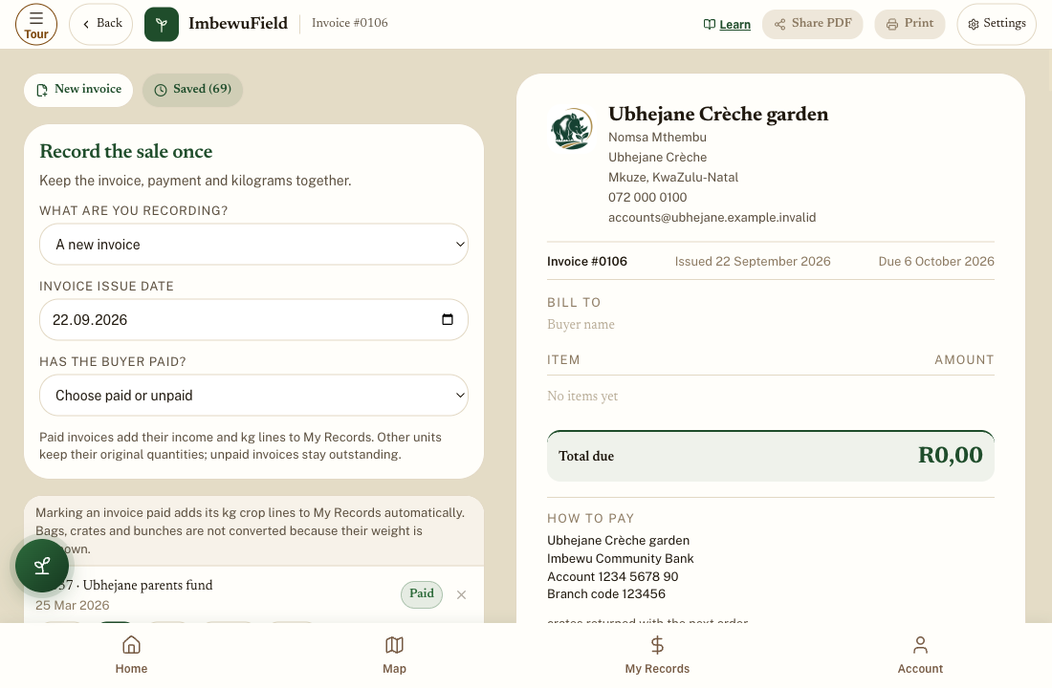
APP
The Invoice builder
• A new invoice
• Items, price, total due
• Has the buyer paid? Not yet
R-D3-10
Farmer Money
Notes:
R-D3-S2 [APP]. Creche, 30 bunches × R12 = R360, due month-end. Save invoice. Share PDF to see — do not send to a real person today.

Slide 11
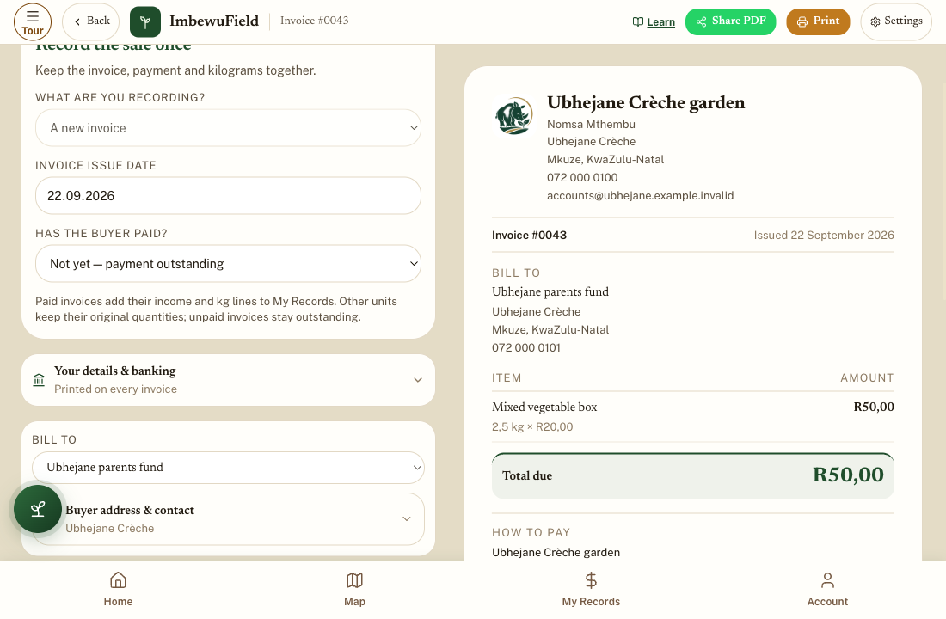
APP
Mark it paid — once
• Open the saved invoice
• Yes — paid in full + date
• Don't also add it in Sold
R-D3-11
Farmer Money
Notes:
R-D3-S2 [APP]. Unpaid invoices stay outstanding — the app's Owed page. Marking paid records the sale once. Past sale / paper invoice is for invoices already written on paper.
Also: R-IMG-36

Slide 12
Invoice and receipt books
• Invoice: press hard, keep the copy
• Owed page: R360
• Paid? Receipt, tick, money in
PHOTO · R-PHO-01 · coming
A real money book page and tin
Real photograph, taken by the programme on Day 0: the course money book (P1) open on a wooden table, filled in by hand with **Lerato's week** (made-up data — never a learner's real book), a pencil, and a tin with its lid off showing play money. Daylight, from above, no faces. 1920 × 1080.
R-D3-12
Farmer Money
Notes:
R-D3-S2 [PAPER]. Invoice (P6) and receipt (P7) for the creche order. Amount in words is optional; the buyer's signature matters.

Slide 13
POSTER ART · R-P16-ART · coming
Borrow wisely
Artwork for R-P16 · Borrow wisely
A young man (mid-20s, cap, overalls) stands at a crossroads, a thought bubble above him showing a small water pump. Four paths lead to: ① a street corner where only a pair of hands is shown, holding a thick stack of bank cards and ID books (the danger — no face, no ethnicity) ② a plain office desk with forms, a stamp, and a person explaining a paper ③ a…
Bongani wants a R3 000 pump
Where can he get it?
R-D3-13 · Poster R-P16
Farmer Money
Notes:
R-D3-S3. Energiser Pass the Clap first (5 min). Take all answers.
Poster: R-P16

Slide 14
Five questions before you borrow
• What for? Total cost?
• Can I pay? Registered?
• What if?
POSTER ART · R-P16-ART · coming
Artwork for R-P16 · Borrow wisely
A young man (mid-20s, cap, overalls) stands at a crossroads, a thought bubble above him showing a small water pump. Four paths lead to: ① a street corner where only a pair of hands is shown, holding a thick stack of bank cards and ID books (the danger — no face, no ethnicity) ② a plain office desk with forms, a stamp, and a person explaining a paper ③ a…
R-D3-14 · Poster R-P16
Farmer Money
Notes:
R-D3-S3. Cost of a loan = pay back − borrowed. Registered lenders show an NCR number and give a written quote.
Poster: R-P16
Also: R-ANI-04
Clip R-ANI-04: public/course-media/farmer-money/R-ANI-04.mp4

Slide 15
YOUR TURN
Four ways to get R3 000
• Count each offer in play money
• Gets · pays back · cost
• Can the garden pay? (20 min)
R-D3-15
Farmer Money
Notes:
R-D3-S3. Costs: A R1 500 (and keeps the card — illegal), B R840 (R640 a month — garden has R400), C R450 (R1 150 a month for 3 months — too big; borrow less), D R0 (save R500 a month; hire a pump meanwhile).

Slide 16
Spot the illegal lender · the reserve
• Keeps your card? Walk away
• No NCR number? Walk away
• Reserve: R20 a week
POSTER ART · R-P16-ART · coming
Artwork for R-P16 · Borrow wisely
A young man (mid-20s, cap, overalls) stands at a crossroads, a thought bubble above him showing a small water pump. Four paths lead to: ① a street corner where only a pair of hands is shown, holding a thick stack of bank cards and ID books (the danger — no face, no ethnicity) ② a plain office desk with forms, a stamp, and a person explaining a paper ③ a…
R-D3-16 · Poster R-P16
Farmer Money
Notes:
R-D3-S3. NCR 0860 627 627. Never borrow with interest for food, parties or another loan. Reserve: R20 × 25 weeks = R500, kept in SAVE, for real emergencies.
Poster: R-P16

Slide 17
My money plan
• Goal · three tins · book day
• Pinch month and reserve
• One step next month
POSTER ART · R-P17-ART · coming
Artwork for R-P17 · My money plan
A woman in her 30s and a young man sit at a table outdoors, each drawing on a large sheet. Around them, floating like a mind-map, five small pictures: ① a goal (a school uniform, a water tank, a small shelter for a stall) ② three tins ③ an open money book with a pencil and a sun/moon symbol (when I write) ④ a calendar with one month circled and a small…
R-D3-17 · Poster R-P17
Farmer Money
Notes:
R-D3-S4. Plans are private. Pictures and ticks are fine. No real amounts needed.
Poster: R-P17

Slide 18
YOUR TURN
Make and share your plan
• 15 min: my own plan
• 2 min each: goal and one step
• One star from the group
R-D3-18
Farmer Money
Notes:
R-D3-S4. Readers help only if asked. Amounts stay private.

Slide 19
YOUR TURN
Picture quiz — again
• Same cards, same corners
• What changed?
IMAGE · R-IMG-20 · coming
Picture quiz cards (8 × 3)
Eight A4 landscape cards, one per quiz question (README table). Each card: a small question picture on the top third, and three answer panels below marked by a **big letter A, B, C typeset by the layout** (the art itself has no letters). 1 · top: coins from a spinach sale; A: coins into a purse with other things; B: coins into a tin beside an open book;…
R-D3-19
Farmer Money
Notes:
R-D3-S4. Write totals next to Day 1's. Now give the answers and celebrate the change.

Slide 20
IMAGE · R-IMG-01 · coming
Certificates
The three families
Three side-by-side scenes, equal width, one per family, same style, a thin Hairline divider between them. **Left — the Dlamini household (rural KZN):** a rondavel and a small block house on a green hillside; a 2 500 ℓ plastic water tank beside the house; trench beds with leafy greens, cabbages and a row of maize. A grandmother (70s, headscarf, cardigan)…
Farmer Money
Well done
R-D3-20
Farmer Money
Notes:
R-D3-SC. Evaluation (forms.md §6 Q1–6, stickers on the 17 poster topics). Certificates: say each name, hand over, shake hands. Photos only with consent. Money back — the last count.

