Slide 1
IMAGE · T-IMG-09 · coming
Usuku 4
A gallery walk
An outdoor space with six stations along a fence and two walls, each with a poster (simple shapes) and a small table of objects: seed trays, string, jars, seed packets, insect picture cards. Four small groups are each busy at a different station — sowing, measuring with string, sorting cards. A facilitator rings a small hand bell near the middle.…
Izindlela eziningi zokungena
Usuku 4 kwezi-5
T-D4-01 · Poster T-P11
Teach the Teachers
Notes:
T-D4-S0. A trainee who has not led yet runs the energiser.
Poster: T-P11

Slide 2
Abafowethu ababili
• Ungacela imbewu komuphi umfowabo?
IMAGE · T-IMG-10 · coming
Role play in threes
Three adults standing on a veranda. An older man plays an annoyed learner, arms crossed, frowning (acted, a little comic). A young woman plays the facilitator: relaxed shoulders, open palms, calm face. A third person watches from the side holding a card and smiling. In the background other trios doing the same. Friendly, safe mood.
T-D4-02 · Poster T-P22
Teach the Teachers
Notes:
T-D4-S1 step 1. Tell the story without the slide if you can; show the picture after.
Poster: T-P22

Slide 3
Isimo sendaba
• Umuntu ofana nathi, nenkinga
• Lokho akuzamile, nokwenzekile
• Umbuzo kulabo abasegumbini
IMAGE · T-IMG-10 · coming
Role play in threes
Three adults standing on a veranda. An older man plays an annoyed learner, arms crossed, frowning (acted, a little comic). A young woman plays the facilitator: relaxed shoulders, open palms, calm face. A third person watches from the side holding a card and smiling. In the background other trios doing the same. Friendly, safe mood.
T-D4-03 · Poster T-P17
Teach the Teachers
Notes:
T-D4-S1 steps 2–3. Groups make and tell a 2-minute story from a pool-A topic.
Poster: T-P17

Slide 4
SEBENZANI
Qambani ingoma
• Iculo wonke umuntu alaziyo
• Umlayezo owodwa obalulekile
• Imizuzu 13
IMAGE · T-IMG-09 · coming
A gallery walk
An outdoor space with six stations along a fence and two walls, each with a poster (simple shapes) and a small table of objects: seed trays, string, jars, seed packets, insect picture cards. Four small groups are each busy at a different station — sowing, measuring with string, sorting cards. A facilitator rings a small hand bell near the middle.…
T-D4-04 · Poster T-P11
Teach the Teachers
Notes:
T-D4-S1 step 4. Songs carry messages home for readers and non-readers.
Poster: T-P11

Slide 5
Ukuzola esikhathini esinzima
• Phefumula · Kusho ngomusa
• Lalela, ubuze · Nikeza indlela eya phambili
• Landelela ngasese
POSTER ART · T-P22-ART · coming
Artwork for T-P22 · Calm in a difficult moment
Main scene: a facilitator stands relaxed with open palms, shoulders down, facing a learner who is standing and gesturing angrily; other learners seated watch. Small inset lower right: the same facilitator and learner seated together on a bench with cups of tea, talking quietly, the learner calmer. No weapons, no aggression beyond gesture.
T-D4-05 · Poster T-P22
Teach the Teachers
Notes:
T-D4-S1 step 5. Safety first: if anyone is at risk, stop and get help.
Poster: T-P22

Slide 6
SEBENZANI
Lingisani ngabathathu
• Umqeqeshi · Umfundi · Umbukeli
• Imizuzu 3 yokulingisa, imizuzu 3 yokukhuluma
• Shintshanani kathathu
IMAGE · T-IMG-10 · coming
Role play in threes
Three adults standing on a veranda. An older man plays an annoyed learner, arms crossed, frowning (acted, a little comic). A young woman plays the facilitator: relaxed shoulders, open palms, calm face. A third person watches from the side holding a card and smiling. In the background other trios doing the same. Friendly, safe mood.
T-D4-06 · Poster T-P22
Teach the Teachers
Notes:
T-D4-S1 steps 6–8. Hand out the help-lines list in the plenary. You're not a counsellor.
Poster: T-P22

Slide 7
IMAGE · T-IMG-09 · coming
Isifundo esiyisibonelo: ukuhamba emibukisweni
A gallery walk
An outdoor space with six stations along a fence and two walls, each with a poster (simple shapes) and a small table of objects: seed trays, string, jars, seed packets, insect picture cards. Four small groups are each busy at a different station — sowing, measuring with string, sorting cards. A facilitator rings a small hand bell near the middle.…
Ubani owenze lezi zimbobo?
T-D4-07 · Poster F-P16
Teach the Teachers
Notes:
T-D4-S2 step 1. Hold up a real leaf; hold the answers until the end.
Poster: F-P16

Slide 8
SEBENZANI
Iziteshi eziyisithupha
• Umsebenzi esiteshini ngasinye
• Imizuzu 6, bese niya phambili njengewashi
• Shiyani uphawu lweqembu lenu
IMAGE · T-IMG-09 · coming
A gallery walk
An outdoor space with six stations along a fence and two walls, each with a poster (simple shapes) and a small table of objects: seed trays, string, jars, seed packets, insect picture cards. Four small groups are each busy at a different station — sowing, measuring with string, sorting cards. A facilitator rings a small hand bell near the middle.…
T-D4-08 · Poster F-P14
Teach the Teachers
Notes:
T-D4-S2 steps 2–3. Groups start at stations 1, 2, 4, 5. Trainer at station 3 (pest or friend).
Poster: F-P14

Slide 9
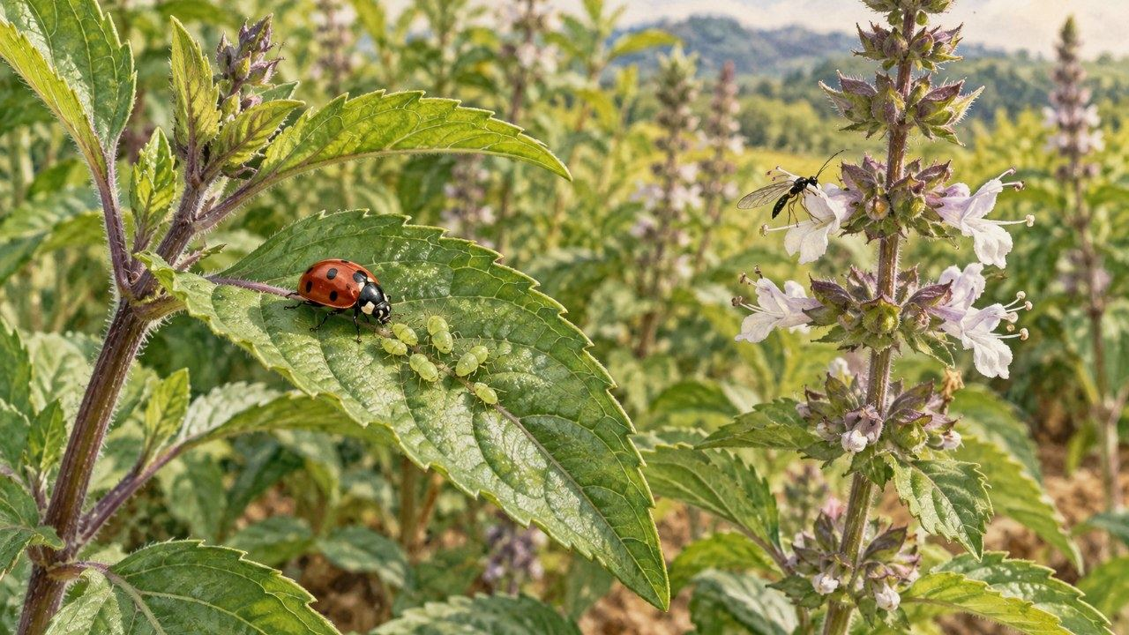
Vimbela kuqala, fafaza ekugcineni
• Inhlabathi ephilile, izitshalo ezixubile
• Bheka njalo, wenze masinyane
• Fafaza ekugcineni
▶ Clip T-ANI-20 · play from the tablet: Imbewu-Guilds-04-Helpful-insects.mp4
T-D4-09 · Poster F-P16
Teach the Teachers
Notes:
T-D4-S2 steps 4–5. Walk the ladder from the bottom; read marks from two stations.
Poster: F-P16
Clip T-ANI-20: public/course-animations/plant-guilds/Imbewu-Guilds-04-Helpful-insects.mp4

Slide 10
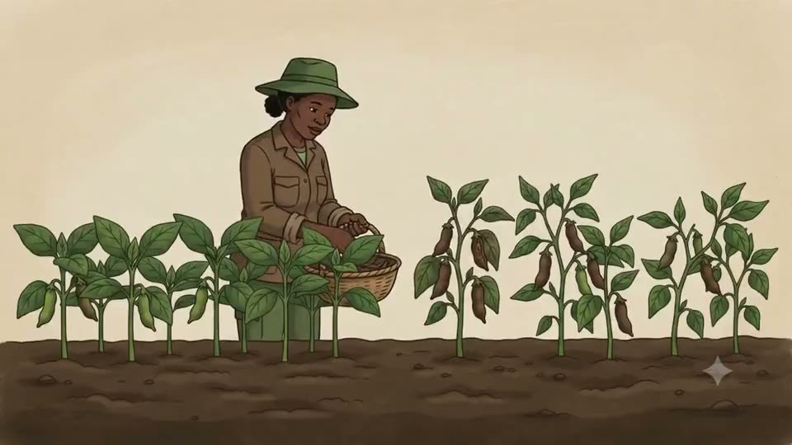
Phumani: sihlaziye
• Yini eyenze ukuhamba kwaphumelela?
• Uzokusebenzisa nini?
▶ Clip T-ANI-21 · play from the tablet: seed-dry-processing.mp4
T-D4-10 · Poster F-P18
Teach the Teachers
Notes:
T-D4-S2 steps 6–7. Then content questions: spacing, seedlings, seed (clip T-ANI-22 for storage).
Poster: F-P18
Clip T-ANI-21: public/course-animations/seeds-sovereignty/seed-dry-processing.mp4

Slide 11
POSTER ART · T-P13-ART · coming
Indlela 3: i-app
Artwork for T-P13 · One lesson, three ways
Three tall columns. Left: a poster on a fence with a group of five standing, one pointing. Middle, top: a laptop connected to a TV on a table in a shaded room with seated learners; middle, bottom: a group of five crowded around a tablet held by one of them. Right: a group of five watching a phone; beneath it, a hand signing on a phone screen with a…
Bonisa · Rekhoda · Buza ubheke
T-D4-11 · Poster T-P13
Teach the Teachers
Notes:
T-D4-S3. Run [APP] or its [PAPER] twin — same time, same outcome.
Poster: T-P13

Slide 12
SEBENZANI
APP
My Studies, ngaphandle kwe-inthanethi
• Vulani i-flight mode
• Bukani ividiyo, bese niyenza
• Ividiyo ingabonisa ini?
IMAGE · T-IMG-17 · coming
Screenshot: My Studies → Study offline
Capture from the live ImbewuField app on a phone (sample account, no personal data): **My Studies** with the **Study offline** panel open and the button "Save available lessons to this phone" visible. Frame it inside a simple drawn phone outline on Paper background, 16:9. Re-capture whenever the screen changes.
T-D4-12 · Poster T-P13
Teach the Teachers
Notes:
T-D4-S3 [APP] station A. Lessons saved via My Studies → Study offline → Save available lessons to
this phone. [PAPER]: picture-sequence cards.
Poster: T-P13

Slide 13
SEBENZANI
APP
Mentor → Training
• Indawo, usuku, ababekhona
• Amasiginesha nesithombe
• Impendulo, igcinwe ngaphandle kwe-inthanethi
IMAGE · T-IMG-18 · coming
Screenshot: Mentor → Training
Capture from the app (sample mode only — invented sample names, no real people): the **Mentor** workspace, **Training** view showing an attendance list, a signature box and the venue/date fields. Blur or replace any real names. Frame in a phone or tablet outline.
T-D4-13 · Poster T-P13
Teach the Teachers
Notes:
T-D4-S3 [APP] station B. Check green dots before the photo. Delete the test event after.
[PAPER]: forms.md §1 and §7.
Poster: T-P13

Slide 14
SEBENZANI
APP
Lima Vision: siyavumelana?
• Thathani isithombe seqabunga
• Fundani umphumela ndawonye
• Singahlola kanjani?
IMAGE · T-IMG-19 · coming
Screenshot: Lima Vision result
Capture from the app (sample account): a **Lima Vision** result for a photo of a leafy crop, showing the crop identification and the yield/weigh screen. Photo subject must be a plant, not a person. Frame in a phone outline.
T-D4-14 · Poster T-P13
Teach the Teachers
Notes:
T-D4-S3 [APP] station C and step 3 rules. A result is a question for the group, not the answer.
[PAPER]: hand lens and picture cards.
Poster: T-P13

Slide 15
SEBENZANI
Ukufundisa okuncane: Round 4
• Imizuzu 20, ngababili
• Ama-slide noma i-app — khethani
• Idivayisi ingahluleka ngamabomu
IMAGE · T-IMG-04 · coming
A tablet for a group of five
Five learners crowd round a tablet held by a young man (the Recorder) at a garden table outdoors in shade. The tablet screen shows a simple animation frame of water soaking into soil (Water blue, soil Ochre). An older woman points at the screen; a young woman beside her already has her hands in a tray of soil, doing what they just watched. A facilitator…
T-D4-15 · Poster T-P13
Teach the Teachers
Notes:
T-D4-S4. Each partner uses a mode new to them (Mode tracker). Every teach still has a hands-on moment.
Poster: T-P13

Slide 16
Uma idivayisi ihluleka
• Shintsha ngemizuzwana 30
• Iphosta noma incwajana yezithombe
• Ungaxolisi, qhubeka
IMAGE · T-IMG-03 · coming
Projector in daylight
Split image. Left: a bright church hall with open windows; a projector on a table throws a pale, washed-out rectangle onto a white wall — nothing on it can be seen; learners at the back squint and shade their eyes. Right: the same group in a shaded corner of the hall, gathered close around a large TV on a table; the TV shows a clear picture of a green…
T-D4-16 · Poster T-P13
Teach the Teachers
Notes:
T-D4-S4 step 3. Device-fail drill once per stream, never on a nervous trainee's first device lesson.
Poster: T-P13

Slide 17
Ubuciko besifundo: umbiko nezitifiketi
• Umbiko wansuku zonke nesithombe serejista
• Ukuba khona, hhayi iziqu
• Kusasa: Round 5, imizuzu 30
IMAGE · T-IMG-13 · coming
The certificate handshake
Inside a hall decorated with posters, an older male trainer shakes hands with a young woman trainee while handing her a certificate (a sheet with a border and a seal shape, no readable text). Colleagues around them clap. Warm, proud mood.
T-D4-17 · Poster T-P15
Teach the Teachers
Notes:
T-D4-SC. Streams change tomorrow. Bring a hand-made A1 poster, lesson plan, kit list, Teach it card.
Poster: T-P15

